Slide 1
Edexcel IGCSE Chemistry
18 - Atmospheric Gases
Proportions, Reactions and the Greenhouse Effect
For more help, please visit www.exampaperspractice.co.uk
© 2025 Exams Papers Practice. All Rights Reserved

Slide 2
The Composition of Air
Specification Point 2.9
Know the approximate percentages by volume of the four most abundant gases in dry air.
The composition of the atmosphere has been relatively stable for the last 200 million years.
The atmosphere is made up of a number of different gases.
Most of the atmosphere (78%) is made up of nitrogen (N₂).
Some of the atmosphere (21%) is made up of oxygen (O₂).
About 1% of the atmosphere is made up of other gases.
0.9% of the atmosphere is made up of the noble gas argon (Ar).
0.04% of the atmosphere is made up of carbon dioxide (CO₂).
For more help, please visit www.exampaperspractice.co.uk
© 2025 Exams Papers Practice. All Rights Reserved

Slide 3
The composition of atmospheric air.
XENON
ARGON - 0.9%
OXYGEN
21%
NEON
HYDROGEN
HELIUM
NITROGEN
78%
KRYPTON
CARBON DIOXIDE - 0.04%
For more help, please visit www.exampaperspractice.co.uk
© 2025 Exams Papers Practice. All Rights Reserved

Slide 4
Reactions with Oxygen in Air
Specification Points 2.10 and 2.14
Understand how to determine the percentage by volume of oxygen in air using experiments involving the reactions of metals and non-metals with air.
Practical: determine the approximate percentage by volume of oxygen in air using a metal or a non-metal.
Oxygen reacts with both metals and non-metals.
These reactions can be used to calculate the proportion of oxygen in atmospheric air.
Oxygen reacts with iron (Fe) to form iron oxide (Fe₂O₃).
This is more commonly referred to as rust.
4Fe _{(s)} + 3O_{2 (g)} → 2Fe₂O_{3 (s)}
When heated, oxygen will react with phosphorus (P) to form phosphorus oxide (P₄O₁₀).
P_{4 (s)} + 5O_{2 (g)} → P₄O_{10 (s)}
For more help, please visit www.exampaperspractice.co.uk
© 2025 Exams Papers Practice. All Rights Reserved

Slide 5
Soak a piece of iron wool in acetic acid.
This will help to speed up the reaction.
Record the initial volume of water in the test tube.
As the iron reacts with the oxygen in the air, the volume of the water in the test tube will rise.
Leave the apparatus until the level of the water remains constant.
This will take several days.
Record the final volume of the water in the test tube.
This will act as the final volume of air.
Percentage of Oxygen = Initial Volume - Final Volume
IRON WOOL SOAKED IN ACETIC ACID
AIR
BEAKER
WATER
Initial Volume
The percentage of oxygen should be around 20%.
For more help, please visit www.exampaperspractice.co.uk
© 2025 Exams Papers Practice. All Rights Reserved

Slide 6
Fill a gas tube full of phosphorus and attach syringes at both ends.
1 of the syringes should be full of air and the other should be empty.
Heat the phosphorus with a bunsen burner.
The phosphorus will oxidise to form phosphorus oxide.
As the oxygen is consumed, its volume in the gas syringe should decrease.
The formula from the previous slide can be used to calculate the percentage of oxygen in the air.
PHOSPHOROUS
GAS SYRINGE
For more help, please visit www.exampaperspractice.co.uk
© 2025 Exams Papers Practice. All Rights Reserved

Slide 7
Combustion
Specification Point 2.11
Describe the combustion of elements in oxygen, including magnesium, hydrogen and sulphur.
Combustion occurs when an element or compound is burnt in oxygen.
Combustion reactions form oxides.
Some oxides are acidic, others are alkaline.
Magnesium (Mg) burns in oxygen to produce a bright white flame.
Magnesium oxide (MgO) is formed during combustion.
Magnesium oxide is a bright white powder.
Magnesium oxide is alkaline when dissolved in water.
2Mg _{(s)} + O_{2 (g)} → 2MgO _{(s)}
For more help, please visit www.exampaperspractice.co.uk
© 2025 Exams Papers Practice. All Rights Reserved

Slide 8
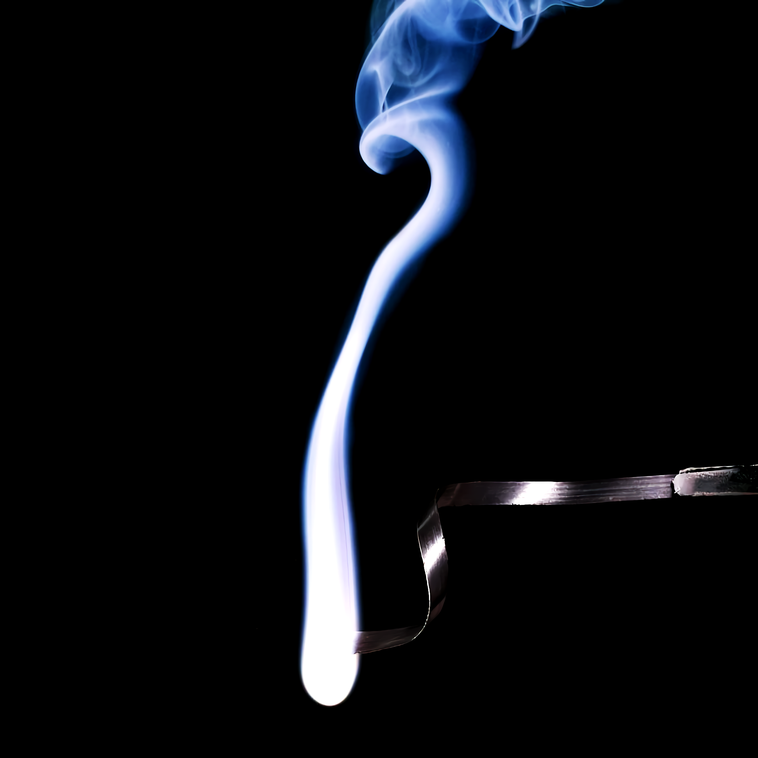
Magnesium burns in oxygen to produce a bright white flame.
For more help, please visit www.exampaperspractice.co.uk
© 2025 Exams Papers Practice. All Rights Reserved

Slide 9
Combustion
Hydrogen (H₂) burns in oxygen to produce an orange/yellow flame.
Hydrogen can explode on ignition with oxygen to produce water vapour.
The test for hydrogen is the squeaky pop test.
2H_{2 (g)} + O_{2 (g)} → 2H₂O _{(l)}
Sulphur (S) burns in oxygen to produce a pale blue flame.
Sulphur dioxide (SO₂) is formed during combustion.
Sulphur dioxide is acidic when dissolved in water.
S _{(s)} + O_{2 (g)} → SO_{2 (g)}
For more help, please visit www.exampaperspractice.co.uk
© 2025 Exams Papers Practice. All Rights Reserved

Slide 10
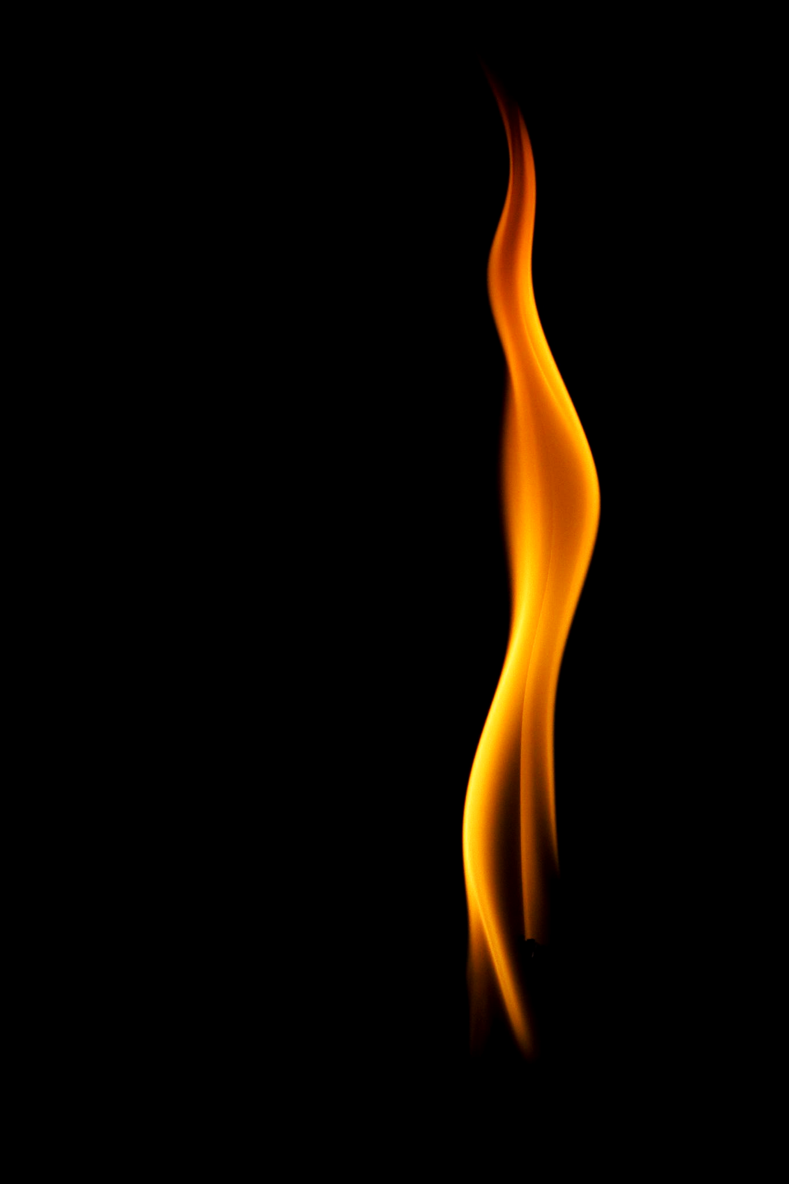
Hydrogen burns in oxygen to produce an orange/yellow flame.
For more help, please visit www.exampaperspractice.co.uk
© 2025 Exams Papers Practice. All Rights Reserved

Slide 11
Sulphur burns in oxygen to produce a pale blue flame.
For more help, please visit www.exampaperspractice.co.uk
© 2025 Exams Papers Practice. All Rights Reserved

Slide 12
Thermal Decomposition
Specification Point 2.12
Describe the formation of carbon dioxide from the thermal decomposition of metal carbonates, including copper (II) carbonate.
Thermal decomposition occurs when a substance breaks down when heated.
A simpler substance is formed as a result.
Thermal decomposition occurs with metal carbonates.
Metal carbonates will decompose into metal oxides and carbon dioxide.
Take the example of copper (II) carbonate (CuCO₃).
Copper (II) carbonate is a green powder than decomposes into black copper (II) oxide (CuO) when heated.
CuCO_{3 (s)} → CuO_{(s)} + CO_{2(g)}
When bubbled through limewater, carbon dioxide will turn the limewater cloudy.
For more help, please visit www.exampaperspractice.co.uk
© 2025 Exams Papers Practice. All Rights Reserved

Slide 13
Copper (II) carbonate is a green powder than decomposes into black copper (II) oxide when heated.
For more help, please visit www.exampaperspractice.co.uk
© 2025 Exams Papers Practice. All Rights Reserved

Slide 14
Carbon Dioxide and the Greenhouse Effect
Specification Point 2.13
Know that carbon dioxide is a greenhouse gas and that increasing amounts in the atmosphere may contribute to climate change.
The Earth is warmed by radiation from the sun.
Most of this radiation is re-emitted back into space.
Some radiation is trapped by greenhouse gases.
These gases help to insulate the Earth and keep the surface temperature constant.
Carbon dioxide, methane (CH₄) and water vapour are all examples of greenhouse gases.
Human activity has led to the enhanced greenhouse effect.
Deforestation and the burning of fossil fuels has led to increasing atmospheric concentrations of carbon dioxide.
Greenhouse effect video.
For more help, please visit www.exampaperspractice.co.uk
© 2025 Exams Papers Practice. All Rights Reserved

Slide 15
Climate Change
There is a strong correlation between increasing carbon dioxide concentrations and climate change.
Over the last century, the average temperature of the Earth has increased by 1°C.
Increasing global temperatures have been linked to a number of disruptive climate patterns:
Drought.
Flooding.
Extreme weather events.
MAUNA LOA 1958 - 2020
420
400
380
CO₂ CONCENTRATION (PPM)
360
340
320
1960
1970
1980
1990
2000
2010
2020
For more help, please visit www.exampaperspractice.co.uk
© 2025 Exams Papers Practice. All Rights Reserved

