Slide 1
Edexcel IGCSE Chemistry
17 - Group 7 Elements
The Halogens and Displacement Reactions
For more help, please visit www.exampaperspractice.co.uk
© 2025 Exams Papers Practice. All Rights Reserved

Slide 2
Group 7 Elements - The Halogens
Specification Point 2.5
Know the colours, physical states (at room temperature) and trends in physical properties of chlorine, bromine and iodine.
Elements in group 7 are called the halogens.
The halogens include fluorine (F), chlorine (Cl), bromine (Br) and iodine (I).
Halogens exist as dimers.
This means that they form molecules that consist of 2 atoms sharing a covalent bond.
Fluorine exists as F₂, chlorine as Cl₂, bromine as Br₂ and iodine as I₂.
The properties of the halogens change as their atomic number increases.
Halogens become darker in colour.
Their boiling points also increase.
For more help, please visit www.exampaperspractice.co.uk
© 2025 Exams Papers Practice. All Rights Reserved

Slide 3
Elements in group 7 are called the halogens. They have similar physical and chemical properties.
GROUP 7
For more help, please visit www.exampaperspractice.co.uk
© 2025 Exams Papers Practice. All Rights Reserved

Slide 4
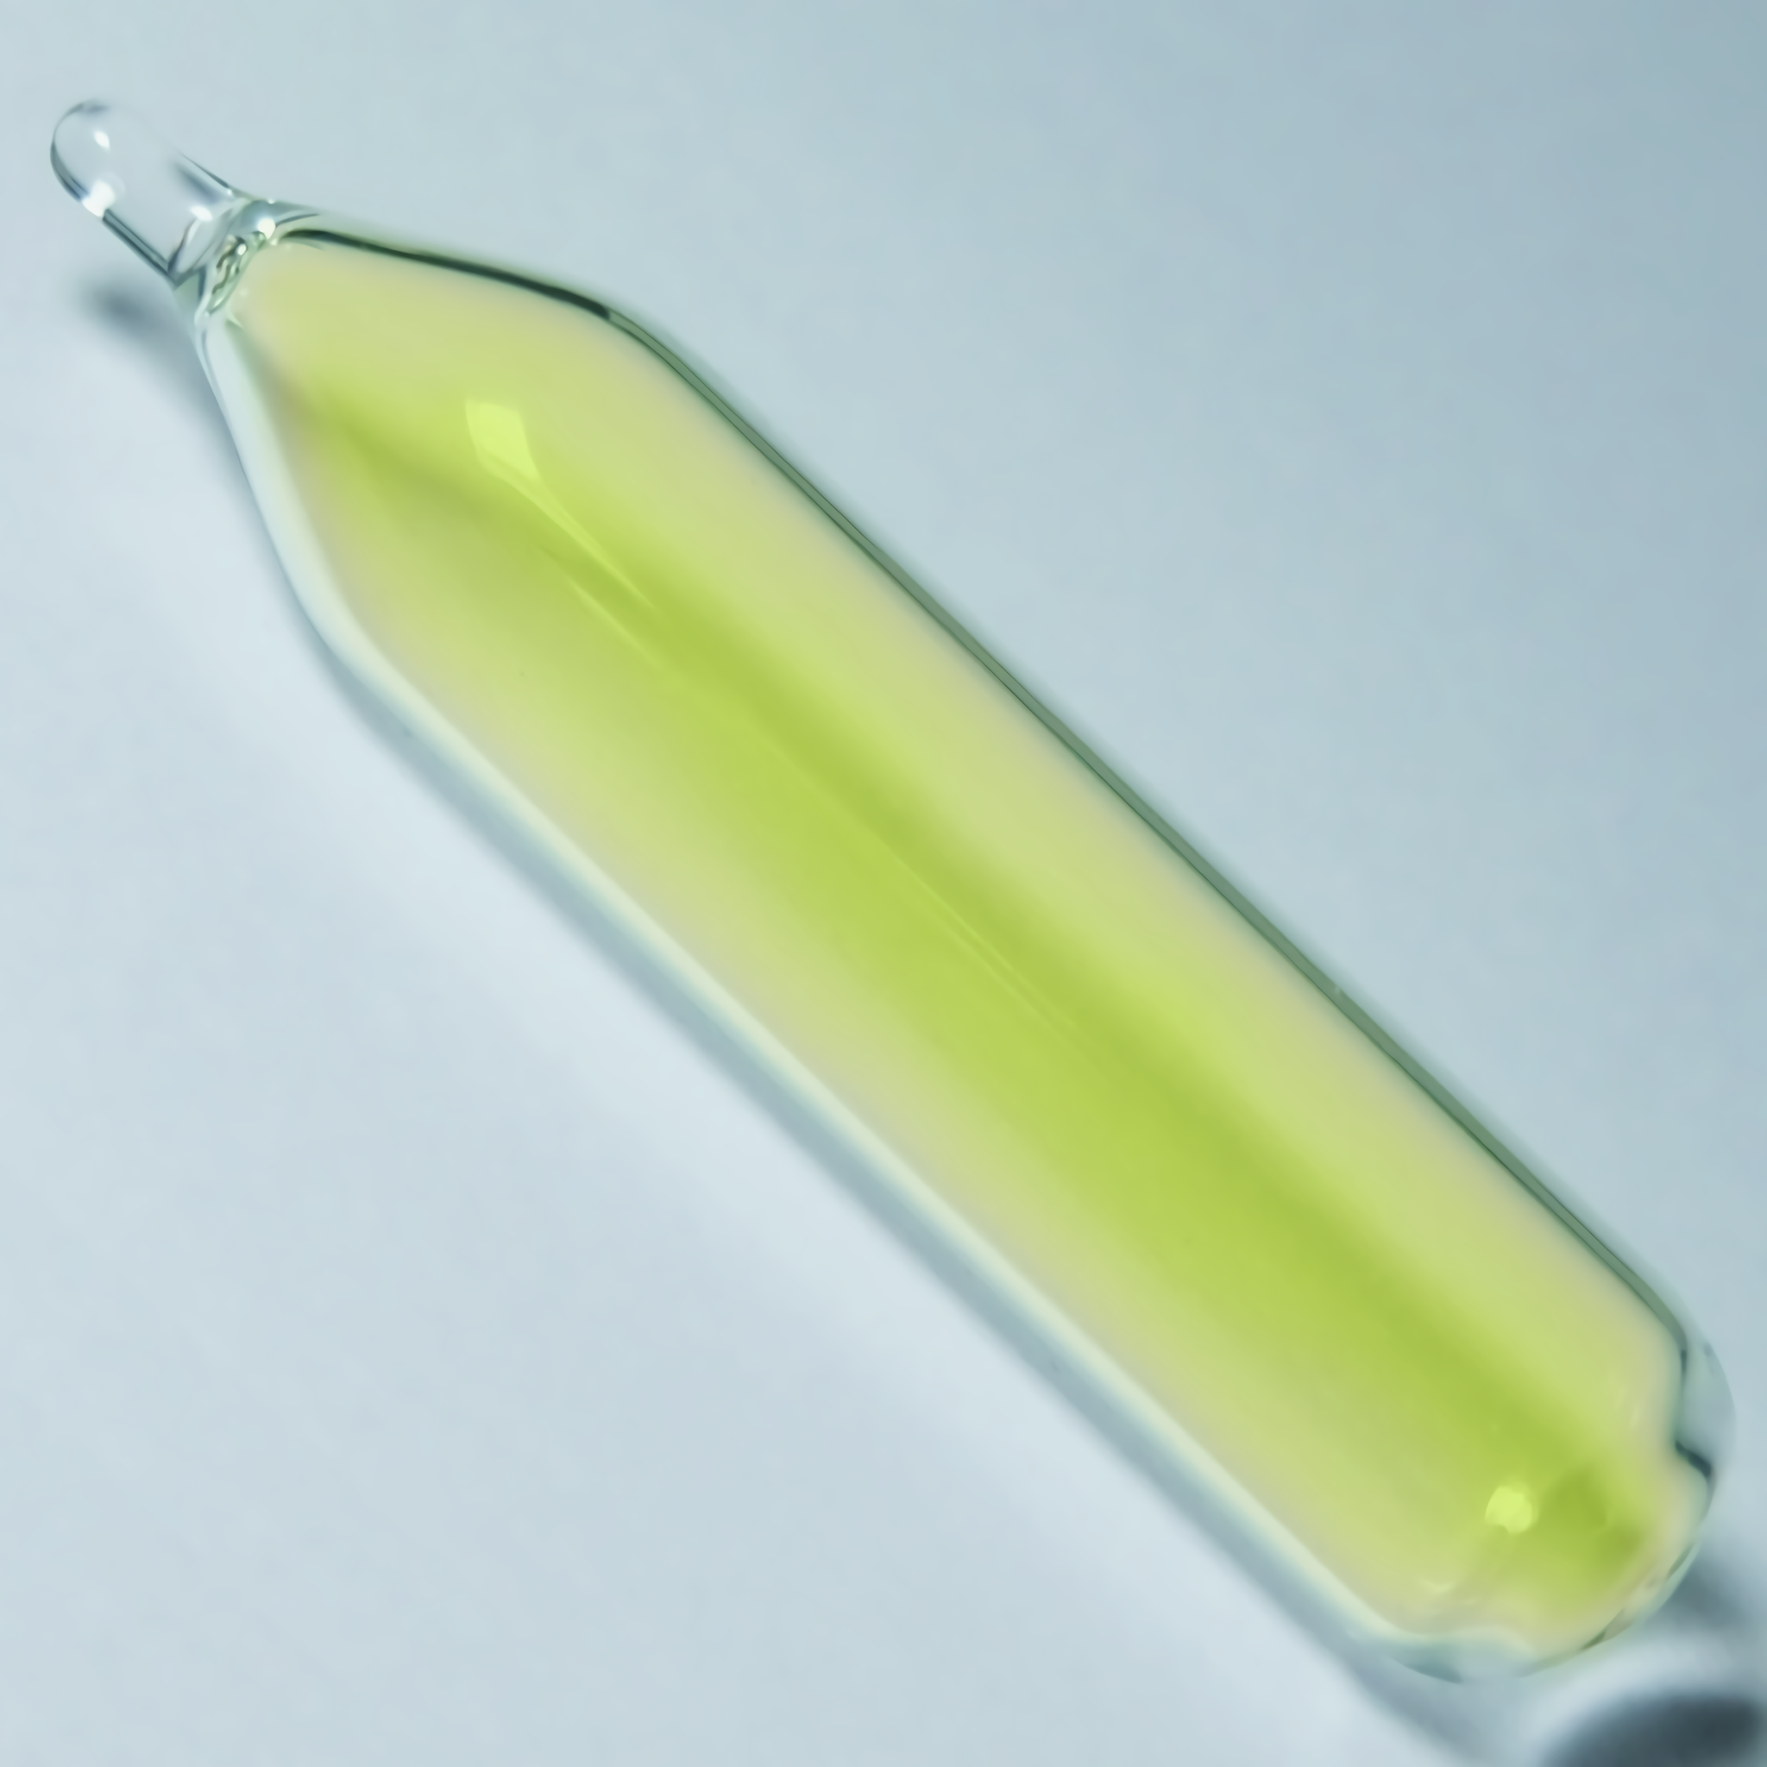
Fluorine (F₂) exists as a very reactive, toxic pale yellow gas.
For more help, please visit www.exampaperspractice.co.uk
© 2025 Exams Papers Practice. All Rights Reserved

Slide 5
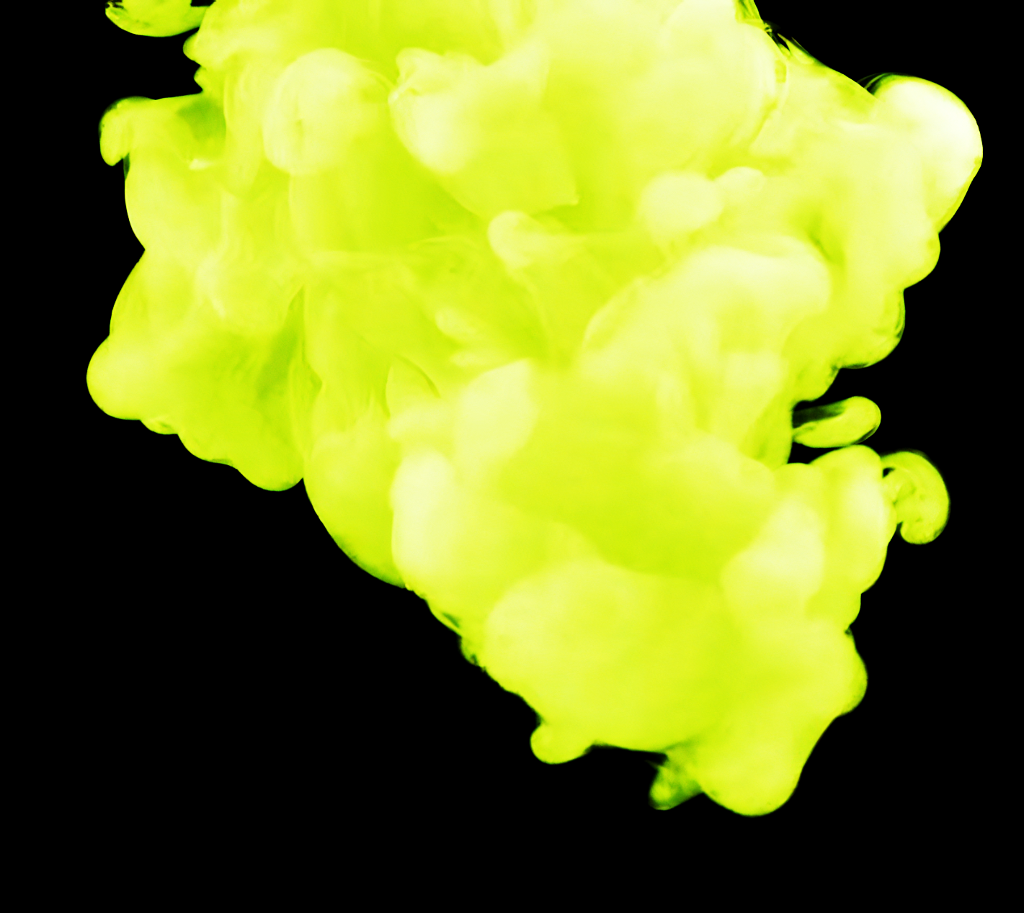
Chlorine (Cl₂) exists as a relatively reactive, dense toxic green gas.
For more help, please visit www.exampaperspractice.co.uk
© 2025 Exams Papers Practice. All Rights Reserved

Slide 6
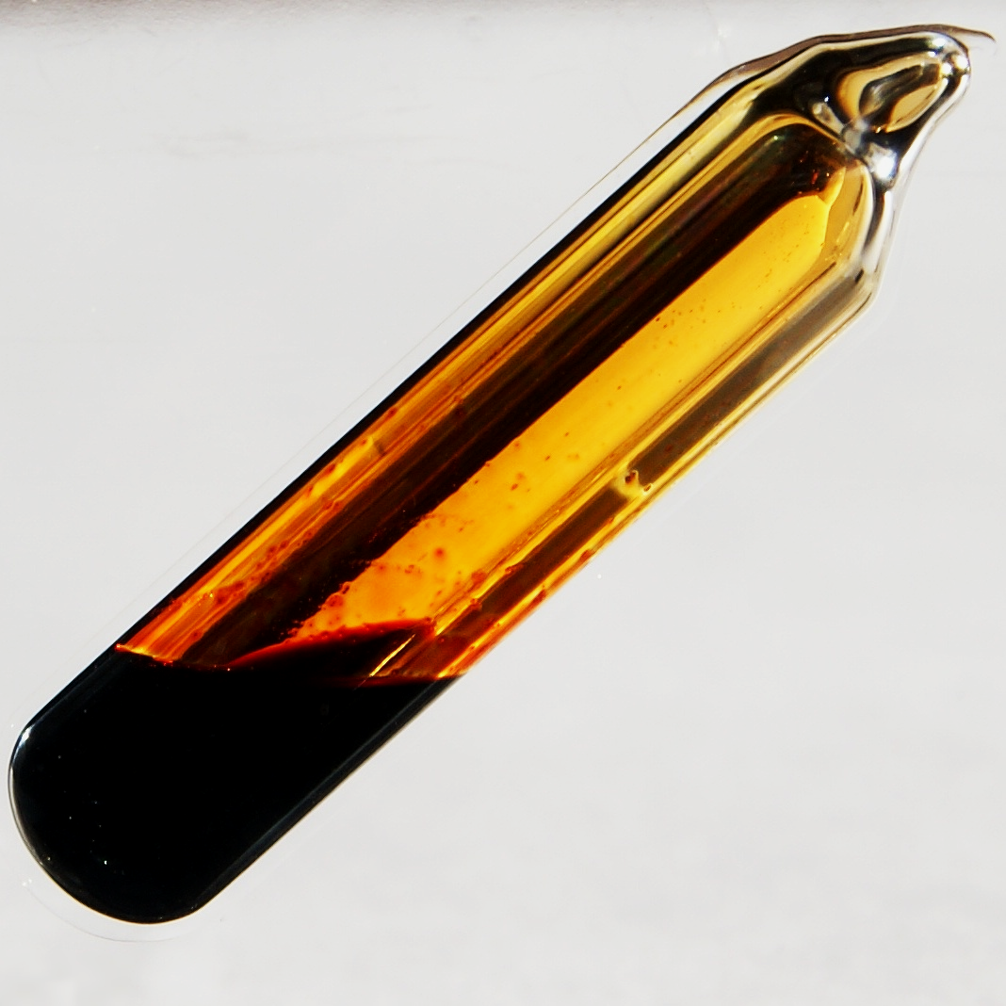
Bromine (Br₂) exists as a toxic red-brown liquid that gives off an orange vapor when at room temperature.
For more help, please visit www.exampaperspractice.co.uk
© 2025 Exams Papers Practice. All Rights Reserved

Slide 7
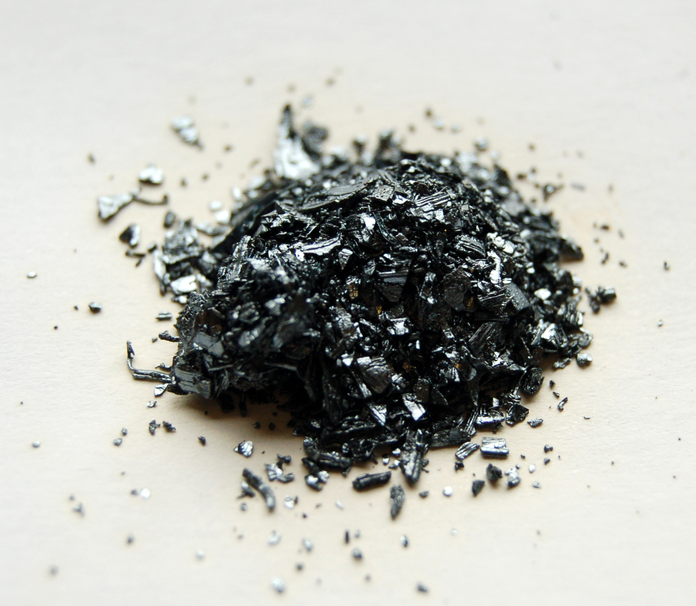
Iodine (I₂) exists as a shimmering black solid that releases a purple vapor when heated.
For more help, please visit www.exampaperspractice.co.uk
© 2025 Exams Papers Practice. All Rights Reserved

Slide 8
Group 7 Elements - The Halogens
The properties of the halogens will change as you go down the group.
At room temperature, the halogens exist in different states and colours.
They also have different characteristics.
Halogen | Atomic Number | Boiling Point | Appearance at Room Temperature | Characteristics
Fluorine (F₂) | 9 | -188°C | Yellow gas | Very reactive, toxic gas
Chlorine (Cl₂) | 17 | -34°C | Green gas | Fairly reactive, dense toxic gas
Bromine (Br₂) | 35 | 59°C | Red-brown liquid | Toxic liquid with high volatility
Iodine (I₂) | 53 | 185°C | Black solid | Crystalline solid that sublimes to give off purple vapour when heated
For more help, please visit www.exampaperspractice.co.uk
© 2025 Exams Papers Practice. All Rights Reserved

Slide 9
Predicting the Properties of Other Halogens
Specification Point 2.6
Use knowledge of trends in group 7 to predict the properties of other halogens.
The halogens decrease in reactivity as you move down the group.
Fluorine, at the top of group 7, is the most reactive of all the halogens.
The halogens get darker as you move down the group.
The boiling point of the halogens increases as you move down the group.
This information can be used to predict the nature of other halogens.
Astatine (At), at the bottom of group 7, is a darkly-coloured solid with a boiling point of 337°C.
Astatine is the least reactive of all the halogens.
For more help, please visit www.exampaperspractice.co.uk
© 2025 Exams Papers Practice. All Rights Reserved

Slide 10
Halogen Reactivity
Specification Point 2.8C
Explain the trend in reactivity in group 7 in terms of electronic configurations.
Halogens react with metals to form halide salts.
Halide salts are ionic compounds.
The most famous halide salt is sodium chloride (NaCl).
During these reactions, a halogen atom will gain an electron.
The halogen atom will become a halide ion.
The halide ion now has a complete outer shell of electrons.
Take the example of chlorine:
Cl + e⁻ → Cl⁻
Smaller halogens are more reactive because they have fewer electron shells.
This means that the positively charged nucleus is closer to the outer shell of electrons.
Smaller halogens have more ability to attract electrons from other elements.
For more help, please visit www.exampaperspractice.co.uk
© 2025 Exams Papers Practice. All Rights Reserved

Slide 11
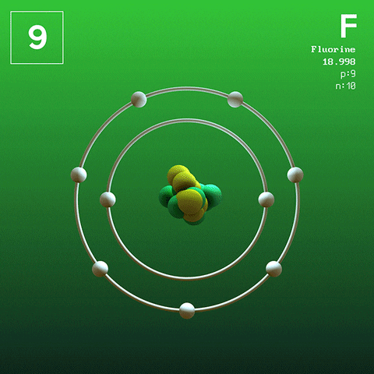
As fluorine has 2 electron shells, its nucleus is very capable at attracting electrons from other atoms. This makes fluorine very reactive.
Iodine has 5 electron shells. Its nucleus is not very capable at attracting electrons from other atoms. This makes iodine relatively unreactive.
For more help, please visit www.exampaperspractice.co.uk
© 2025 Exams Papers Practice. All Rights Reserved

Slide 12
Displacement Reactions
Specification Point 2.7
Understand how displacement reactions involving halogens and halides provide evidence for the trend in reactivity in group 7.
A displacement reaction occurs when a more reactive element takes the place of a less reactive element in a compound.
The halogens participate in displacement reactions.
Take the example of chlorine with potassium bromide:
Cl₂ + 2KBr → 2KCl + Br₂
Chlorine is more reactive than bromine so will displace it to take its place in the compound.
For more help, please visit www.exampaperspractice.co.uk
© 2025 Exams Papers Practice. All Rights Reserved

Slide 13
Displacement Reactions
There are a number of halide salts that can form depending on the reactivity of the participating halogen:
Initial Compound | When Adding Chlorine Water - Cl_{2 (aq)} | When Adding Bromine Water - Br_{2 (aq)} | When Adding Iodine Water - I_{2 (aq)}
Potassium chloride (KCl) | No reaction | No reaction | No reaction
Potassium bromide (KBr) | Chlorine displaces bromide ions - orange bromine solution formed | No reaction | No reaction
Potassium Iodide (KI) | Chlorine displaces iodide ions - brown iodine solution formed | Bromine displaces iodide ions - brown iodine solution formed. | No reaction
For more help, please visit www.exampaperspractice.co.uk
© 2025 Exams Papers Practice. All Rights Reserved

