Slide 1
Edexcel IGCSE Chemistry
12 - Ionic Bonding
Ions, Electron Transfer and Lattices
For more help, please visit www.exampaperspractice.co.uk
© 2025 Exams Papers Practice. All Rights Reserved

Slide 2
Ions
Specification Point 1.37
Understand how ions are formed by electron loss or gain.
An ion is a charged particle.
Ions can consist of single atoms - K⁺ is a potassium ion.
They can also consist of molecules - NO₃⁻ is a nitrate ion.
A positively charged ion is called a cation.
Cations are formed when atoms lose electrons.
Cations have a positive charge because they have more protons than electrons.
A negatively charged ion is called an anion.
Anions are formed when atoms gain electrons.
Anions have a negative charge because they have more electrons than protons.
The number of electrons lost or gained is equivalent to the charge of the ion.
An ion that has lost 2 electrons will have a charge of 2+.
An ion that has lost 2 electrons will have a charge of 2-.
For more help, please visit www.exampaperspractice.co.uk
© 2025 Exams Papers Practice. All Rights Reserved

Slide 3
Na⁺
Positively charged ions such as sodium (Na⁺) are called cations.
Positively charged ions are usually metals.
For more help, please visit www.exampaperspractice.co.uk
© 2025 Exams Papers Practice. All Rights Reserved

Slide 4
Cl⁻
Negatively charged ions such as chloride (Cl⁻) are called anions.
Negatively charged ions are usually non-metals.
For more help, please visit www.exampaperspractice.co.uk
© 2025 Exams Papers Practice. All Rights Reserved

Slide 5
Some ions can be molecular in nature and have several different atoms in their construction.
A phosphate ion has lost an electron from each of 3 oxygen atoms and thus has a charge of 3- (PO₄³⁻).
For more help, please visit www.exampaperspractice.co.uk
© 2025 Exams Papers Practice. All Rights Reserved

Slide 6
Metal and Non-Metal Ions
Specification Point 1.38
Know the charges of the following ions:
Metals in groups 1, 2 and 3.
Non-metals in groups 5, 6 and 7.
Ag⁺, Cu²⁺, Fe²⁺, Fe³⁺, Pb²⁺, Zn²⁺, H⁺, OH–, NH⁴⁺, CO₃^{2–}, NO₃⁻ and SO₄^{2–}.
Elements in the same group have the same number of outer shell electrons.
This means they will form ions with the same charge.
For example, all elements in group 1 have 1 outer shell electron - they will lose this outer shell electron to form 1+ ions.
Metallic elements are found in groups 1, 2 and 3.
These metals lose electrons to form positively charged cations.
Non-metallic elements are found in groups 5, 6 and 7.
These non-metals gain electrons to form negatively charged anions.
For more help, please visit www.exampaperspractice.co.uk
© 2025 Exams Papers Practice. All Rights Reserved

Slide 7
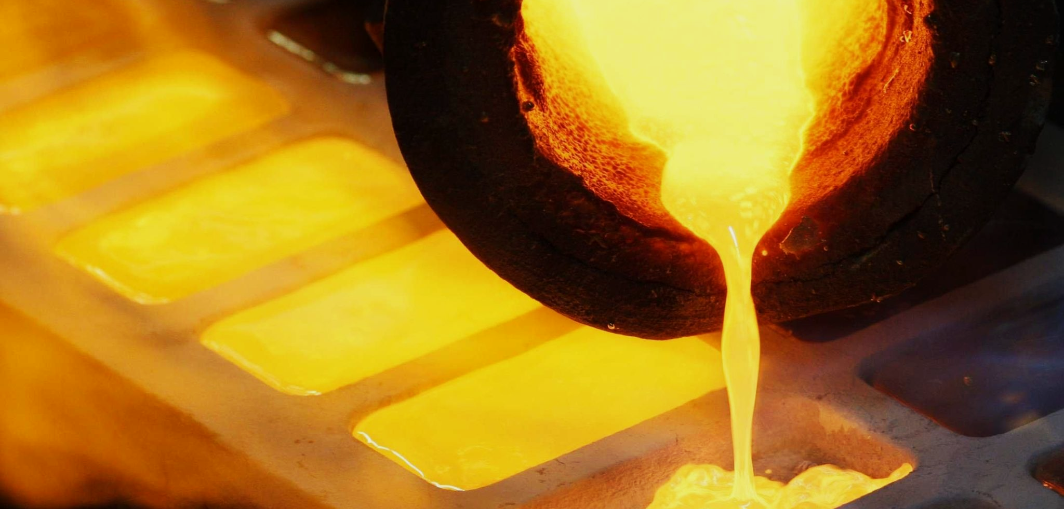
Metals like gold (Au) can lose electrons to form positively charged cations (Au⁺).
For more help, please visit www.exampaperspractice.co.uk
© 2025 Exams Papers Practice. All Rights Reserved

Slide 8
Ion | Charge | Chemical Symbol
Silver | 1+ | Ag⁺
Copper | 2+ | Cu²⁺
Iron (II) | 2+ | Fe²⁺
Iron (III) | 3+ | Fe³⁺
Lead | 2+ | Pb²⁺
Zinc | 2+ | Zn²⁺
Hydrogen | 1+ | H⁺
Specification Point 1.39 - Write formulae for compounds formed between the ions listed in 1.38.
For more help, please visit www.exampaperspractice.co.uk
© 2025 Exams Papers Practice. All Rights Reserved

Slide 9
Ion | Charge | Chemical Formula
Hydroxide | 1- | OH⁻
Ammonium | 1+ | NH₄⁺
Carbonate | 2- | CO₃²⁻
Nitrate | 1- | NO₃⁻
Sulphate | 2- | SO₄²⁻
Specification Point 1.39 - Write formulae for compounds formed between the ions listed in 1.38.
For more help, please visit www.exampaperspractice.co.uk
© 2025 Exams Papers Practice. All Rights Reserved

Slide 10
Ionic Compounds
Specification Points 1.40 and 1.41
Draw dot-and-cross diagrams to show the formation of ionic compounds by electron transfer, limited to combinations of elements from groups 1, 2, 3, 5, 6 and 7.
Understand ionic bonding in terms of electrostatic attractions.
Ionic compounds form when metals react with non-metals.
The metal will lose electrons to form a cation.
The non-metal will gain electrons to form an anion.
Cations and anions are strongly attracted to each other.
This is called electrostatic attraction.
Electrostatic attraction leads to the formation of an ionic bond.
One example of an ionic compound is sodium fluoride (NaF).
For more help, please visit www.exampaperspractice.co.uk
© 2025 Exams Papers Practice. All Rights Reserved

Slide 11
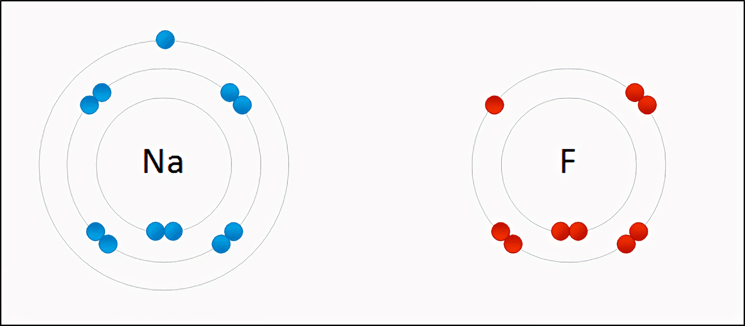
During ionic bonding, an electron is transferred between the metal (Na) and the non-metal (F). The metal loses electrons and becomes a positively charged cation (Na⁺). The non-metal gains electrons and becomes a negatively charged anion (F⁻). The illustration below is referred to as a dot and cross diagram.
For more help, please visit www.exampaperspractice.co.uk
© 2025 Exams Papers Practice. All Rights Reserved

Slide 12
Ionic Formulae
The overall charge of an ionic compound is 0.
This means that the positively and negatively charged parts of the compound must cancel each other out.
The formula of ionic compounds can be calculated by balancing the charges of individual ions:
What is the chemical formula of calcium chloride?
1. List the formulas of the calcium and the chloride ions - Ca²⁺ and Cl⁻.
2. Calculate the ratio of atoms/compounds that is needed to yield a net 0 charge - There are 2 chloride ions needed to balance the charge of the calcium ion. The formula of calcium chloride is therefore CaCl₂.
For more help, please visit www.exampaperspractice.co.uk
© 2025 Exams Papers Practice. All Rights Reserved

Slide 13
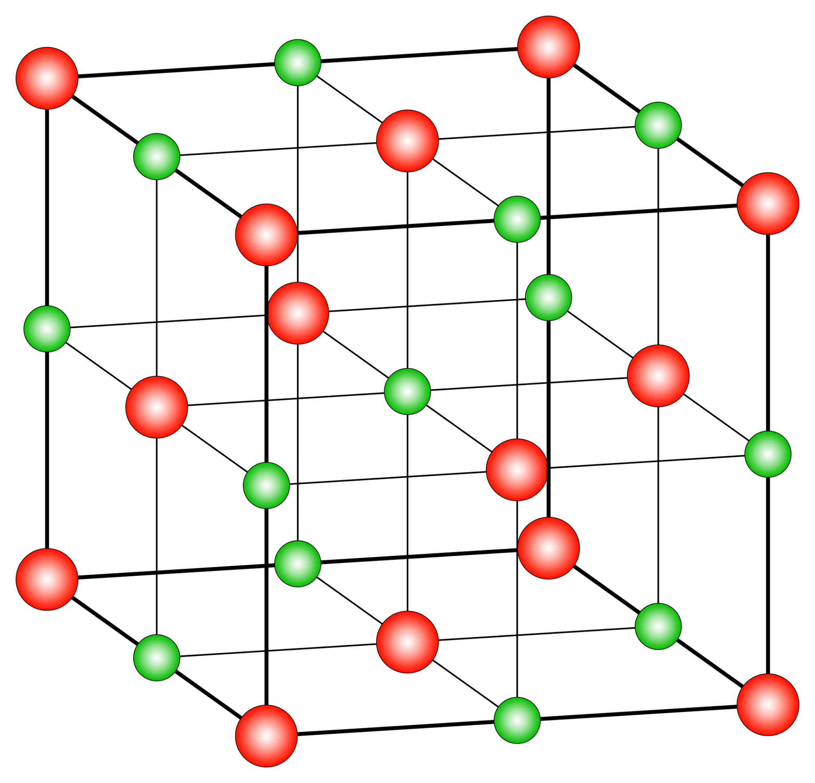
Ionic Lattices
Specification Points 1.42 and 1.43
Understand why compounds with giant ionic lattices have high melting and boiling points.
Know that ionic compounds do not conduct electricity when solid, but do conduct electricity when molten and in aqueous solution.
The ions in an ionic compound form giant lattice structures.
Ions with opposite charges are closely packed together in a 3D arrangement.
The electrostatic attraction between ions is very strong.
Lots of energy is required to overcome this attraction.
As a result, ionic compounds have very high melting and boiling points.
Ionic compounds do not conduct electricity when solid.
They do however conduct electricity when dissolved in water, or when molten.
A giant ionic lattice. The positively charged ions are electrostatically attracted to the negatively charged ions, forming compounds that are very stable.
For more help, please visit www.exampaperspractice.co.uk
© 2025 Exams Papers Practice. All Rights Reserved

