Slide 1
Edexcel IGCSE Chemistry
10 - Formulae and Calculations Part 2
Reacting Masses, Percentage Yield and Empirical Formula
For more help, please visit www.exampaperspractice.co.uk
© 2025 Exams Papers Practice. All Rights Reserved

Slide 2
Reacting Masses
Equations are often used to calculate the mass or moles of reactants or products.
When offered a balanced chemical equation, the ratios between different substances can be calculated.
Reacting masses worksheet.
What mass of magnesium oxide (MgO) can be produced when 6 grams of magnesium (Mg) is burnt in oxygen (O₂)?
2Mg _{(s)} + O_{2 (g)} → 2MgO _{(s)}
1. First calculate the M_{r} of the reactant in question, in this case Mg (24).
2. Calculate the number of moles of Mg. This is calculated by dividing mass by M_{r} (6 ÷ 24 = 0.25 moles).
3. In this equation, 2 moles of Mg react to produce 2 moles of MgO. As a result 0.25 moles of Mg will be needed to make 0.25 moles of MgO.
4. Calculate the mass of 0.25 moles of MgO. Mass is calculated by multiplying the number of moles by the M_{r} (0.25 × 40 = 10 grams).
For more help, please visit www.exampaperspractice.co.uk
© 2025 Exams Papers Practice. All Rights Reserved

Slide 3
Percentage Yield
Specification Point 1.30
Calculate percentage yield.
The mass of a product formed is called the yield of a reaction.
Reacting masses calculations result in theoretical yields.
A theoretical yield is the maximum amount of product that can be formed from a theoretical chemical reaction.
Actual yields are the yields obtained from real reactions.
Actual yields are often significantly smaller than theoretical yields.
This is because the real-life conditions of a reaction are never perfect.
There may incomplete reactions, where reactants don’t react together to form a product.
The percentage yield compares the actual yield of a reaction with the theoretical yield.
Percentage yields vary from 0% (no product formed) to 100% (no product lost).
For more help, please visit www.exampaperspractice.co.uk
© 2025 Exams Papers Practice. All Rights Reserved

Slide 4
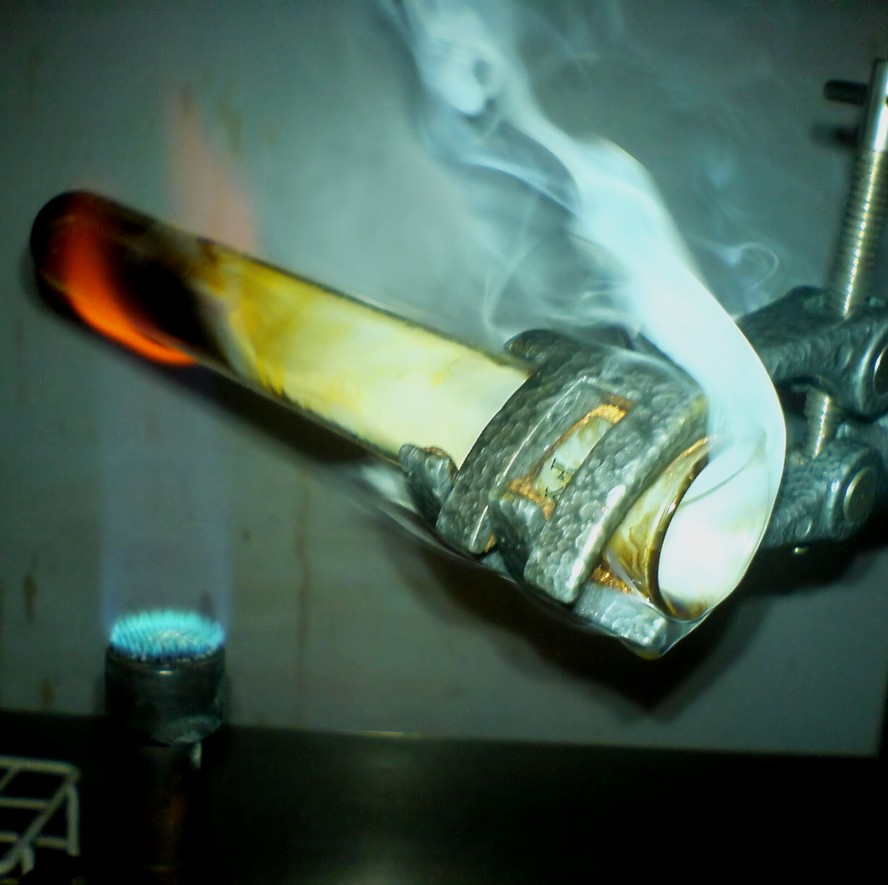
Most chemical reactions do not yield their theoretical potential.
The actual yield of a reaction is usually lower than the theoretical yield.
One reason for this is that some product may escape during the reaction.
For more help, please visit www.exampaperspractice.co.uk
© 2025 Exams Papers Practice. All Rights Reserved

Slide 5
Percentage Yield
Percentage yields are a measure of how successful a chemical process is.
Industry will try to maximise percentage yield to gain as much profit from a reaction as possible.
Companies will compare different reaction pathways and determine which is most profitable for them.
The Haber process (an industrial reaction that creates ammonia) is carried out at very specific conditions to maximise profits and minimize waste.
%Y = percentage yield
A_{Y} = actual yield
T_{Y} = theoretical yield
For more help, please visit www.exampaperspractice.co.uk
© 2025 Exams Papers Practice. All Rights Reserved

Slide 6
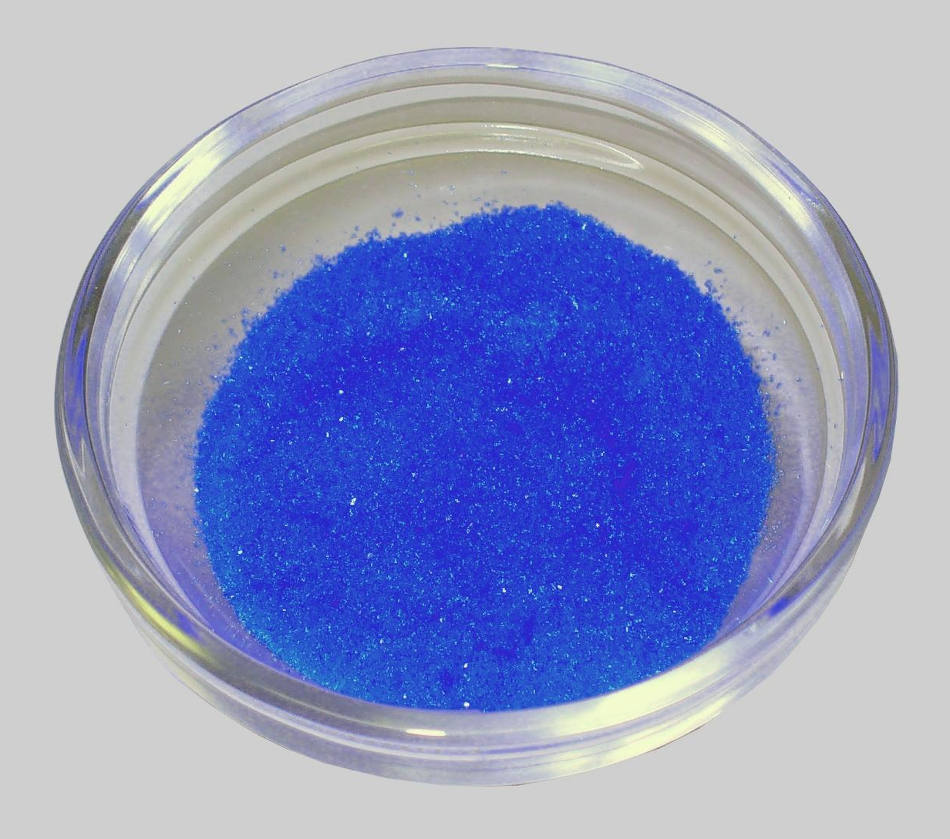
Copper oxide reacts with sulphuric acid to yield copper sulphate and water.
In an experiment, 1.4 grams of copper sulphate crystals are made. If the theoretical yield is 2 grams, what is the percentage yield of copper sulphate?
1.4 ÷ 2 = 0.7
0.7 × 100 = 70%
For more help, please visit www.exampaperspractice.co.uk
© 2025 Exams Papers Practice. All Rights Reserved

Slide 7
Finding Formulae of Compounds
Specification Point 1.31
Understand how the formulae of simple compounds can be obtained experimentally, including metal oxides, water and salts containing water of crystallisation.
Experiments can be used to determine the formulae of a compound.
Combustion can be used to calculate the formula of a metal oxide.
Combustion occurs when a substance reacts with oxygen.
Magnesium (a metal) reacts with oxygen to form magnesium oxide at high temperatures.
Reduction can also be used to calculate the formula of a metal oxide.
Reduction is the loss of oxygen from a substance.
Copper oxide can be reduced into copper metal by heating.
For more help, please visit www.exampaperspractice.co.uk
© 2025 Exams Papers Practice. All Rights Reserved

Slide 8
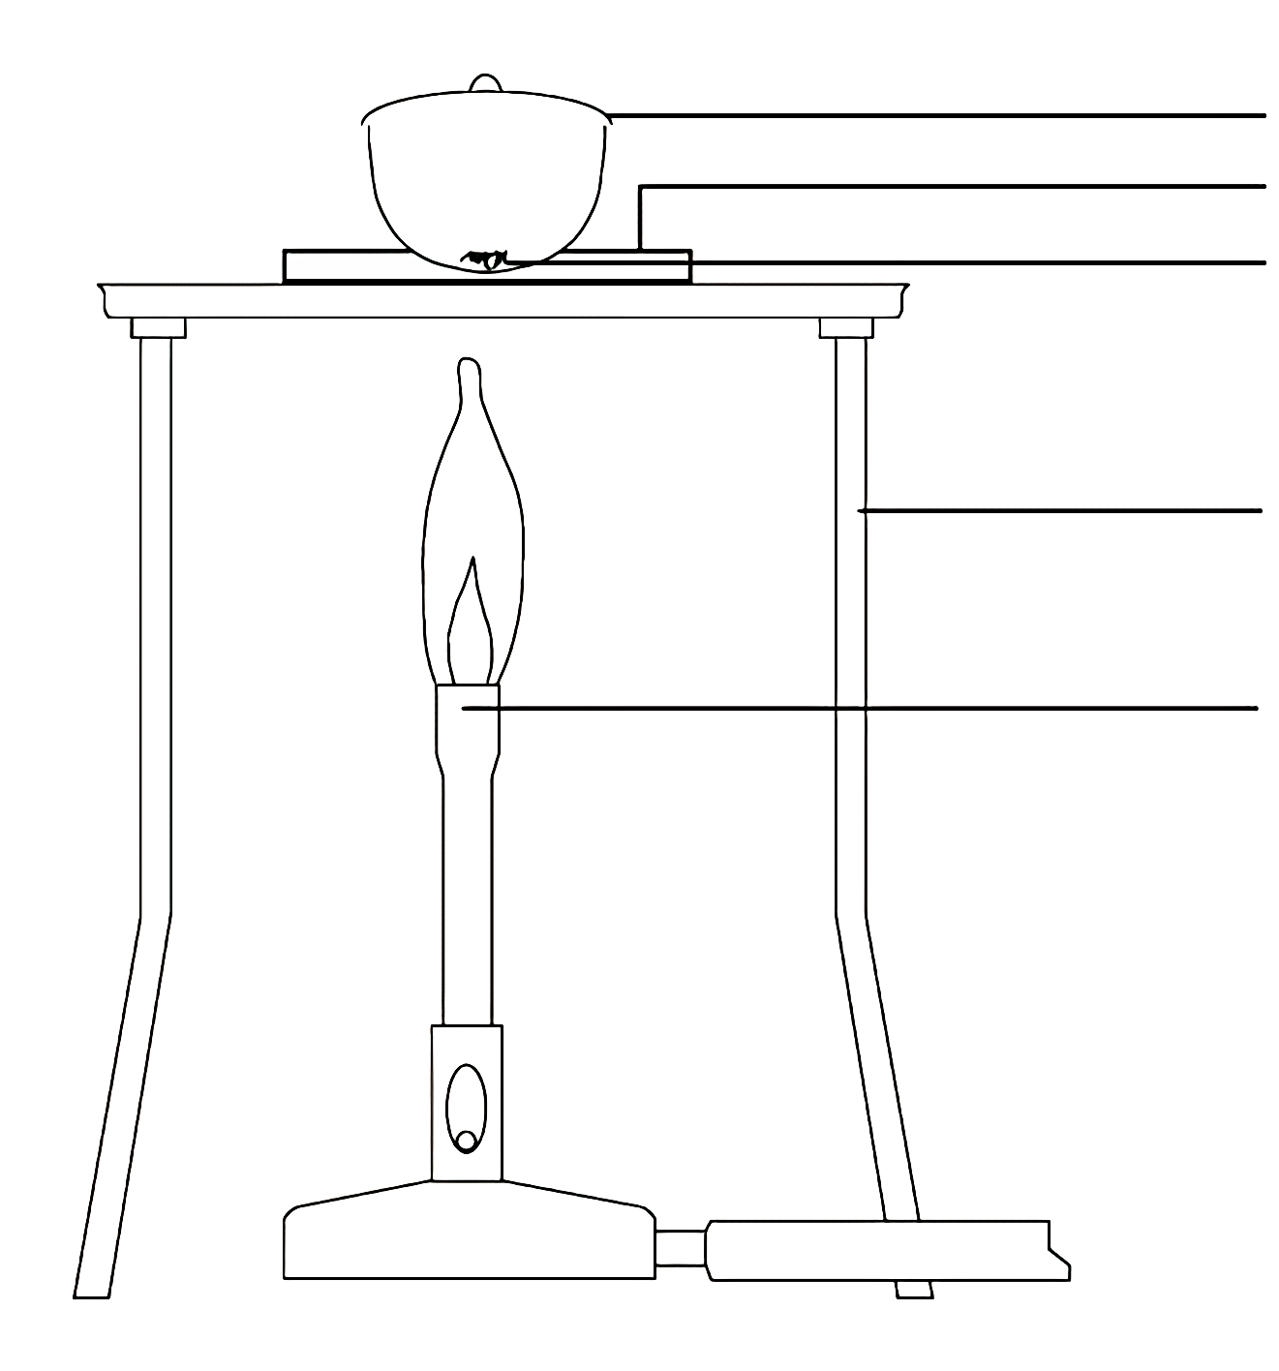
CRUCIBLE
PIPE CLAY TRIANGLE
Specification Point 1.36: Know how to determine the formula of a metal oxide by combustion or by reduction.
1. Measure the mass of a crucible with its lid.
2. Add a sample of magnesium ribbon to the crucible and measure the mass - the mass of magnesium is calculated by subtracting the mass of the crucible from the total.
3. Heat the crucible until it is red hot. Continue heating until the mass of the crucible and its contents are constant.
Magnesium combustion experiment video.
MAGNESIUM RIBBON
TRIPOD
BUNSEN BURNER
Calculating the mass of magnesium oxide formed by combustion.
For more help, please visit www.exampaperspractice.co.uk
© 2025 Exams Papers Practice. All Rights Reserved

Slide 9
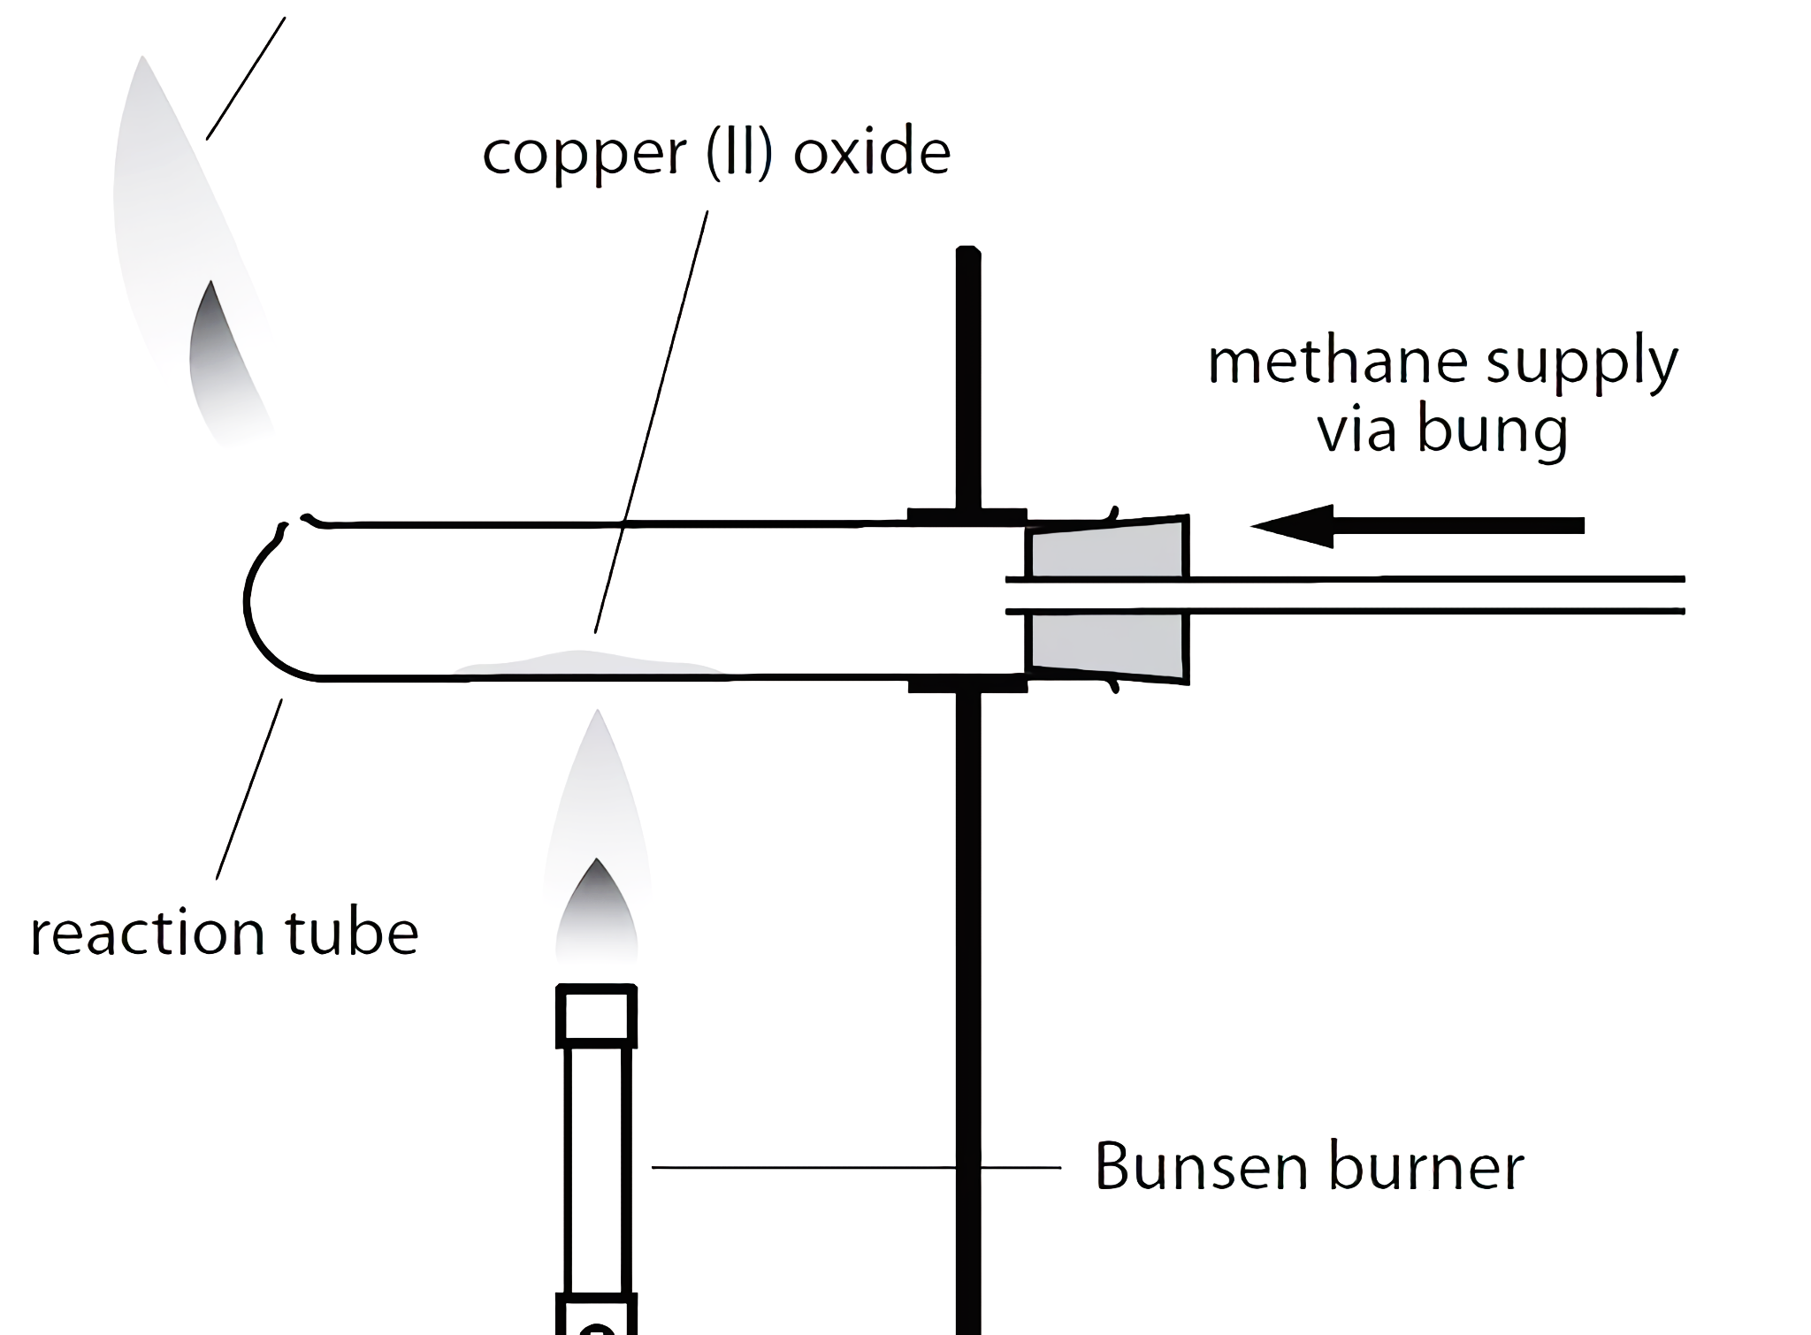
Specification Point 1.36: Know how to determine the formula of a metal oxide by combustion or by reduction.
1. Measure the mass of the empty boiling tube.
2. Add a sample of copper oxide into the boiling tube and remeasure the mass.
3. Add a stream of natural gas (methane) through a bung in the boiling tube.
4. Heat the tube strongly using a bunsen burner. As the copper oxide is reduced, it will change colour. The reaction is complete when all of the copper oxide has changed colour.
5. Once the tube has cooled, reweigh the boiling tube and its contents.
Copper oxide reduction video.
EXCESS GAS
COPPER OXIDE
GAS VIA BUNG
BOILING TUBE
BUNSEN BURNER
Calculating the mass of oxygen lost by reduction.
For more help, please visit www.exampaperspractice.co.uk
© 2025 Exams Papers Practice. All Rights Reserved

Slide 10
Empirical and Molecular Formulae
Specification Points 1.32 and 1.33
Know what is meant by the terms empirical formula and molecular formula.
Calculate empirical and molecular formulae from experimental data.
The molecular formula of a compound displays the number of each atom of an element in the compound.
The molecular formula is the actual formula of a compound.
For example, the molecular formula of glucose is C₆H₁₂O₆.
The empirical formula of a compound is the simplest whole number ratio of atoms of elements in the compound.
It is calculated using experiments and is therefore termed empirical.
The empirical formula of glucose is CH₂O.
Molecular formulae are multiples of empirical formulae.
For more help, please visit www.exampaperspractice.co.uk
© 2025 Exams Papers Practice. All Rights Reserved

Slide 11
The empirical formula of a compound is CH₂ and its M_{r} is 42. Calculate its molecular formula.
1. First calculate the M_{r} of the empirical formula - 12 + (2 × 1) = 14
2. Divide the M_{r} of the molecular formula by the M_{r} of the empirical formula - 42 ÷ 14 = 3
3. Multiply the atoms present in the molecular formula by this factor - CH₂ × 3 = C₃H₆
For more help, please visit www.exampaperspractice.co.uk
© 2025 Exams Papers Practice. All Rights Reserved

Slide 12
x
Calculate the empirical formula of magnesium chloride if 0.96 grams of magnesium combines with 2.84 grams of chlorine?
1. Write down the masses of each element combining.
2. Divide both elements by their respective A_{r}. This will yield a molar ratio.
3. Divide each number by the smallest number present to create a whole number ratio.
4. Use this to calculate the empirical formula.
Element | Mg | Cl
Mass in Grams | 0.96 | 2.84
Molar Ratio | 0.96 ÷ 24 = 0.04 | 2.84 ÷ 35.5 = 0.08
Ratio | 0.04 ÷ 0.04 = 1 | 0.08 ÷ 0.04 = 2
Empirical Formula | MgCl₂
For more help, please visit www.exampaperspractice.co.uk
© 2025 Exams Papers Practice. All Rights Reserved

Slide 13
Water of Crystallisation
Water of crystallisation is a term that explains how water can be chemically bonded to other compounds in a crystal-like structure.
Copper sulphate (CuSO₄) is a salt that is often found chemically bonded to 5 molecules of water (H₂O).
If solid crystals of salt contain water, they are said to be hydrated.
If no water is present, the salt is said to be anhydrous.
Magnesium sulphate occurs as a hydrated salt with 6 water molecules.
Its formula is written as MgSO₄.6H₂O.
For more help, please visit www.exampaperspractice.co.uk
© 2025 Exams Papers Practice. All Rights Reserved

Slide 14
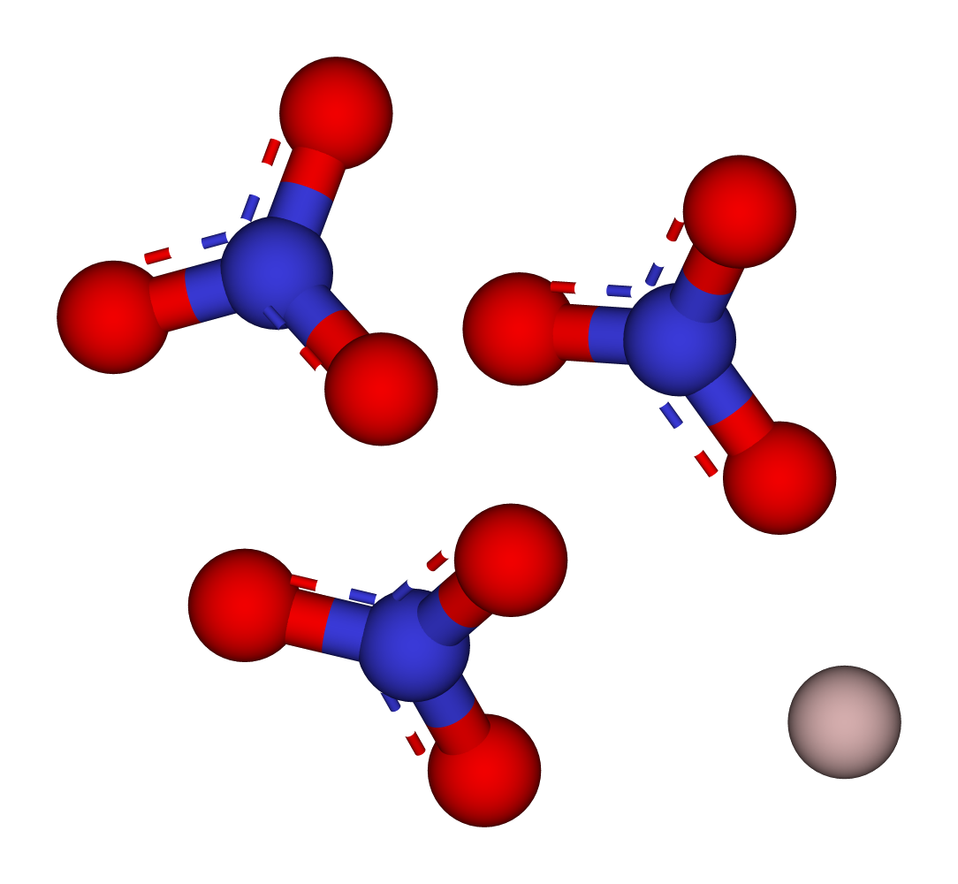
3.75 grams of hydrated aluminum nitrate Al(NO₃)₃.xH₂O is heated until all the water present evaporates.
The mass of the anhydrous aluminium nitrate is 2.13 grams. Calculate how many water molecules were present in the hydrated salt.
1. Write down the masses of both molecules.
2. Calculate the M_{r} values for each molecule.
3. Divide the masses of each molecule by their M_{r} to find the moles.
4. Calculate the empirical ratio.
Compound | Al(NO₃)₃ | H₂O
Mass in Grams | 2.13 | 3.75 - 2.13 = 1.62
M_{r} | 213 | 18
Moles | 2.13 ÷ 213 = 0.01 | 1.62 ÷ 18 = 0.09
Ratio | 0.01 ÷ 0.01 = 1 | 0.09 ÷ 0.01 = 9
Empirical Formula | Al(NO₃)₃.9H₂O
For more help, please visit www.exampaperspractice.co.uk
© 2025 Exams Papers Practice. All Rights Reserved

