Slide 1
Edexcel IGCSE Biology
9 - Movement Across Membranes
Diffusion, Osmosis and Active Transport
For more help, please visit www.exampaperspractice.co.uk
© 2025 Exams Papers Practice. All Rights Reserved

Slide 2
Methods of Transport
Specification Point 2.15
Understand the processes of diffusion, osmosis and active transport by which substances move into and out of cells.
There are three main ways that molecules can pass through a cell membrane.
Most molecules move by diffusion.
Molecules of water move by osmosis.
Some molecules move by active transport.
For more help, please visit www.exampaperspractice.co.uk
© 2025 Exams Papers Practice. All Rights Reserved

Slide 3
Diffusion
Diffusion can be defined as the movement of particles from an area of high concentration to an area of lower concentration.
Diffusion occurs down a concentration gradient.
Diffusion occurs at random.
Diffusion is a passive process.
Passive processes do not require energy.
During diffusion, particles will move from an area of higher concentration to an area of lower concentration, down a concentration gradient.
For more help, please visit www.exampaperspractice.co.uk
© 2025 Exams Papers Practice. All Rights Reserved

Slide 4
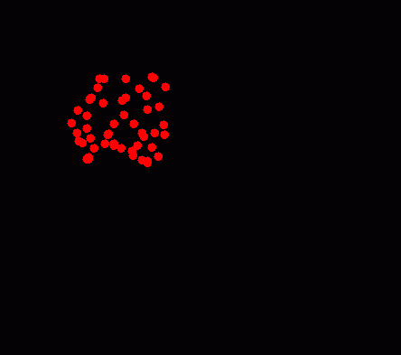
Importance of Diffusion
All living creatures rely on diffusion to some extent.
Diffusion is important for extracting oxygen from blood vessels.
Diffusion is vital for respiration.
Diffusion is also important for removing carbon dioxide from the stomata of plants.
Diffusion is vital for photosynthesis.
The more concentrated a solution is, the more solid is dissolved in it.
Dissolved solids are referred to as solutes.
During diffusion, the solute distributes itself throughout the solvent, creating a solution.
For more help, please visit www.exampaperspractice.co.uk
© 2025 Exams Papers Practice. All Rights Reserved

Slide 5
Osmosis
Osmosis is a particular type of diffusion.
Osmosis is also a passive process.
Osmosis can be defined as the net movement of water from an area of high water potential (Ψ) to an area of lower water potential across a partially permeable membrane.
Solutions with a high water potential contain a high concentration of water.
Solutions with a lower water potential contain a lower concentration of water.
Dilute solutions have a high water potential.
Dilute solutions contain a high concentration of water.
Concentrated solutions have a low water potential.
Concentrated solutions contain a low concentration of water.
For more help, please visit www.exampaperspractice.co.uk
© 2025 Exams Papers Practice. All Rights Reserved

Slide 6
During osmosis, water will move from an area of high water potential (the left-hand side), to an area of lower water potential (the right-hand side), across a partially permeable membrane.
For more help, please visit www.exampaperspractice.co.uk
© 2025 Exams Papers Practice. All Rights Reserved

Slide 7
Importance of Osmosis
Plant cells that have a higher water potential than their surroundings will lose water to the environment.
This is because water moves from high to low concentrations, down a concentration gradient.
If the cell loses too much water, the cell wall can no longer support the cell.
This will lead to the cell becoming flaccid.
Eventually, the cell wall will detach from the cell membrane.
This is called plasmolysis.
Plasmolysis will likely lead to the death of the cell.
If the Ψ of a cell is higher than the Ψ of its surroundings, the cell will lose water. In extreme cases this can lead to plasmolysis.
For more help, please visit www.exampaperspractice.co.uk
© 2025 Exams Papers Practice. All Rights Reserved

Slide 8
Factors Affecting Diffusion
Specification Point 2.16
Understand how factors affect the rate of movement of substances into and out of cells, including the effects of surface area to volume ratio, distance, temperature and concentration gradient.
The rates of diffusion and osmosis are affected by a number of factors:
They are affected by temperature.
Molecules with more kinetic energy will move faster.
As the temperature increases, the rate of both diffusion and osmosis increases.
They are affected by diffusion distance.
A shorter diffusion pathway means there is less distance for molecules to travel.
As the diffusion distance decreases, the rate of both diffusion and osmosis increases.
They are affected by the steepness of the concentration gradient.
The concentration gradient is the difference in the concentrations of a solute in two different locations.
As the steepness of the concentration gradient increases, the rate of both diffusion and osmosis increases.
They are affected by the surface area to volume ratio (SA:V) of the exchange surface.
The SA:V is the amount of surface area compared to the volume of an object.
Objects with a high SA:V have more exchange surface compared to their volume for diffusion and osmosis to take place.
As the SA:V of an object increases, the rate of both diffusion and osmosis increases.
For more help, please visit www.exampaperspractice.co.uk
© 2025 Exams Papers Practice. All Rights Reserved

Slide 9
As the temperature increases, molecules have more kinetic energy. Molecules move more quickly. This causes the rates of diffusion and osmosis to increase.
RATE OF DIFFUSION →
TEMPERATURE (°C) →
For more help, please visit www.exampaperspractice.co.uk
© 2025 Exams Papers Practice. All Rights Reserved

Slide 10
THIN MEMBRANE
THICK MEMBRANE
Thin membranes have short diffusion pathways. This means that molecules can diffuse through them more quickly.
For more help, please visit www.exampaperspractice.co.uk
© 2025 Exams Papers Practice. All Rights Reserved

Slide 11
NUMBER OF CUBES = 1
DIMENSIONS (CM) = 2 × 2
SURFACE AREA (CM²) = (2 × 2 × 6) = 24
VOLUME (CM³) = (2 × 2 × 2) = 8
SA:V = 24 ÷ 8 = 3
NUMBER OF CUBES = 8
DIMENSIONS (CM) = 1 × 1
SURFACE AREA (CM²) = 8 (1 × 1 × 6) = 48
VOLUME (CM³) = 8 (1 × 1 × 1) = 8
SA:V = 48 ÷ 8 = 6
Cubes with larger dimensions will have a lower surface area to volume ratio. This means there is less exchange surface for diffusion to work on so the rate of diffusion slows.
For more help, please visit www.exampaperspractice.co.uk
© 2025 Exams Papers Practice. All Rights Reserved

Slide 12
Active Transport
Active transport can be defined as the movement of particles against the concentration gradient.
Active transport occurs when particles are moved from a region of low concentration to a region of higher concentration.
Active transport requires energy to pump molecules through protein channels.
This energy is derived from respiration.
This energy is in the form of the molecule ATP.
For more help, please visit www.exampaperspractice.co.uk
© 2025 Exams Papers Practice. All Rights Reserved

Slide 13
During active transport, molecules will move from an area of lower concentration, to an area of higher concentration, against the concentration gradient.
For more help, please visit www.exampaperspractice.co.uk
© 2025 Exams Papers Practice. All Rights Reserved

Slide 14
Diffusion and Osmosis Practicals
Specification Point 2.17
Practical: Investigate diffusion and osmosis using living and non-living systems.
Diffusion and osmosis can be investigated through practicals.
Diffusion practical:
A coloured crystal (usually KMnO₄) is added to a solvent (water).
The crystal particles will dissolve and spread out throughout the solvent.
Osmosis practicals:
Semi-permeable (sometimes referred to as visking) tubing is filled with sugar solution and placed into a beaker of water.
Because the concentration of water is higher in the beaker than in the tubing, water molecules will move into the tubing by osmosis.
Potatoes are cut into tubes and submerged into sucrose solutions of various concentrations.
Those that are submerged into the more concentrated solutions will decrease in mass, those in the more dilute solutions will increase in mass.
Osmosis practical video.
For more help, please visit www.exampaperspractice.co.uk
© 2025 Exams Papers Practice. All Rights Reserved

Slide 15
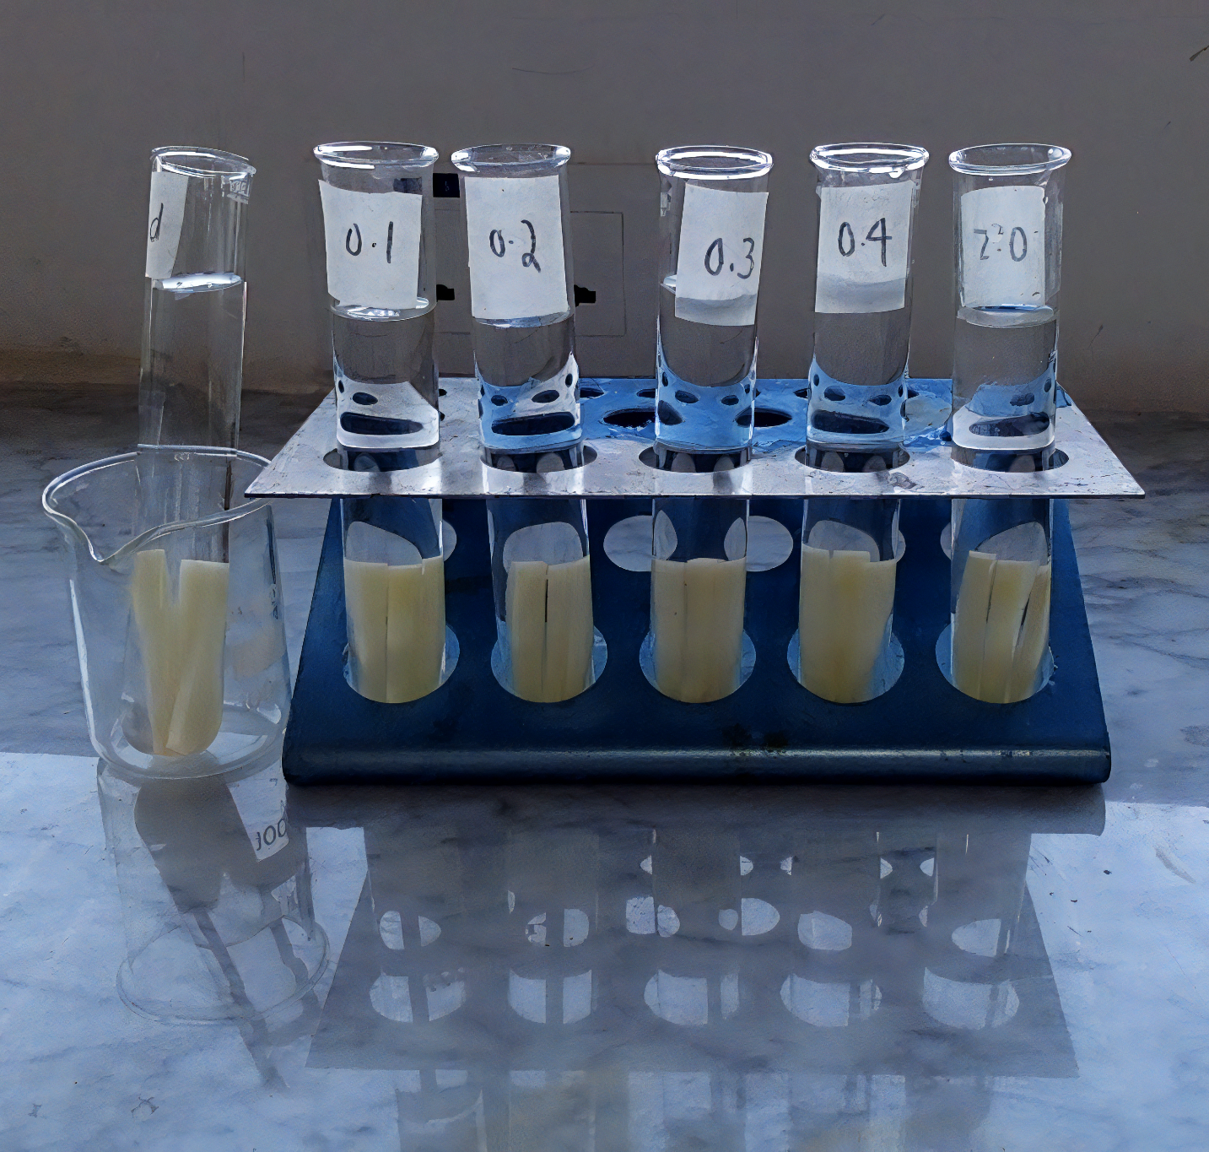
Potato cores are submerged into solutions with different concentrations of sucrose to investigate the process of osmosis.
For more help, please visit www.exampaperspractice.co.uk
© 2025 Exams Papers Practice. All Rights Reserved

Slide 16
Potatoes that are submerged in a low sucrose concentration will gain mass (water will move from the solution to the potatoes).
Potatoes that are submerged in a high sucrose concentration will lose mass (water will move from the potatoes to the solution).
For more help, please visit www.exampaperspractice.co.uk
© 2025 Exams Papers Practice. All Rights Reserved

Slide 17
Calculating Percentage Change
The mass of the potato will either increase or decrease.
The change in mass can be calculated using percentage change.
Percentage change is more useful than the change in mass.
This is because two potato cores may have different starting masses.
Percentage change allows for more accurate comparisons between potato cores.
PC = percentage change
C = change in value
O = original value
For more help, please visit www.exampaperspractice.co.uk
© 2025 Exams Papers Practice. All Rights Reserved

