Slide 1
Edexcel IGCSE Biology
7 - Enzymes
Biological Catalysts
For more help, please visit www.exampaperspractice.co.uk
© 2025 Exams Papers Practice. All Rights Reserved

Slide 2
Enzymes
Specification Point 2.10
Understand the role of enzymes as biological catalysts in metabolic reactions.
Enzymes are often referred to as biological catalysts.
A catalyst is a something that speeds up a chemical reaction without being used up itself.
Enzymes can be used over and over again.
Enzymes can be very effective even in small quantities.
Enzymes are proteins.
Enzymes are synthesised by ribosomes.
All enzymes have the suffix -ase.
Amylase, protease and lipase are all examples of enzymes.
Enzymes are used to speed up chemical reactions in biological systems.
For more help, please visit www.exampaperspractice.co.uk
© 2025 Exams Papers Practice. All Rights Reserved

Slide 3
Enzymes
Enzymes are 3D structures.
All enzymes contain an active site.
Each active site is specific to a particular enzyme.
Enzymes are selective about which reactions they catalyse.
Molecules that bind to the active site are called substrates.
The resulting structure is called an enzyme-substrate complex.
Once the enzyme has catalysed the reaction, one or more products is formed.
Enzyme video.
For more help, please visit www.exampaperspractice.co.uk
© 2025 Exams Papers Practice. All Rights Reserved

Slide 4
PRODUCTS
SUBSTRATE
ACTIVE SITE
SUBSTRATE ENTERS THE ACTIVE SITE OF THE ENZYME
ENZYME-SUBSTRATE COMPLEX IS FORMED
ENZYME-PRODUCT COMPLEX IS FORMED
PRODUCTS LEAVE THE ACTIVE SITE OF ENZYME
For more help, please visit www.exampaperspractice.co.uk
© 2025 Exams Papers Practice. All Rights Reserved

Slide 5
Lock and Key/Induced Fit Models
One theory of how enzymes work is called the lock and key model.
Here the shape of the substrate (the key) fits in the active site (the lock).
These shapes are perfectly complementary to one another.
A more modern theory is called the induced fit model.
The enzyme and the substrate are not perfectly complementary to one another.
The substrate induces a slight change in the shape of the active site to create a fit.
The lock and key model summarizes the basic mechanism of enzyme action.
For more help, please visit www.exampaperspractice.co.uk
© 2025 Exams Papers Practice. All Rights Reserved

Slide 6
Enzymes and Temperature
Specification Point 2.11
Understand how temperature changes can affect enzyme function, including changes to the shape of the active site.
For an enzyme to work correctly, it must collide with the substrate.
When the substrate collides with enough force, an enzyme-substrate complex is formed.
As temperature increases, so does kinetic energy.
This increases the likelihood of a successful collision between enzyme and substrate.
Enzymes work fastest at their optimum temperature.
Enzymes in the human body work fastest at around 37°C.
RATE OF REACTION →
OPTIMUM TEMPERATURE
TEMPERATURE (°C) →
For more help, please visit www.exampaperspractice.co.uk
© 2025 Exams Papers Practice. All Rights Reserved

Slide 7
Denaturation
At higher temperatures, enzymes can denature.
At high temperatures, bonds inside the active site rupture.
When enzymes denature, the rate of reaction decreases significantly.
This is because the active site and the substrate are no longer complementary with each other.
At higher temperatures, enzymes can denature. This has a negative impact on the rate of many chemical reactions. In the human body, enzymes denature around 40°C.
RATE OF REACTION →
TEMPERATURE (°C) →
For more help, please visit www.exampaperspractice.co.uk
© 2025 Exams Papers Practice. All Rights Reserved

Slide 8
Temperature and Enzymes Practical
Specification Point 2.12
Practical: Investigate how enzyme activity can be affected by changes in temperature.
Heat a solution containing starch to a set temperature.
Add iodine solution to the wells of a spotting tile.
Iodine is the test for starch.
A positive result is a colour change from orange to blue-black.
Add some amylase to the wells of the spotting tile.
Amylase is an enzyme that breaks down starch into maltose.
As the starch is broken down, the iodine will return to its orange colour.
The amylase will work at different rates at different temperatures.
The amylase will break down the starch slowly at low temperatures.
The amylase will break down the starch quickly at the optimum temperature.
At high temperatures the amylase will denature and stop working.
Temperature practical video.
For more help, please visit www.exampaperspractice.co.uk
© 2025 Exams Papers Practice. All Rights Reserved

Slide 9
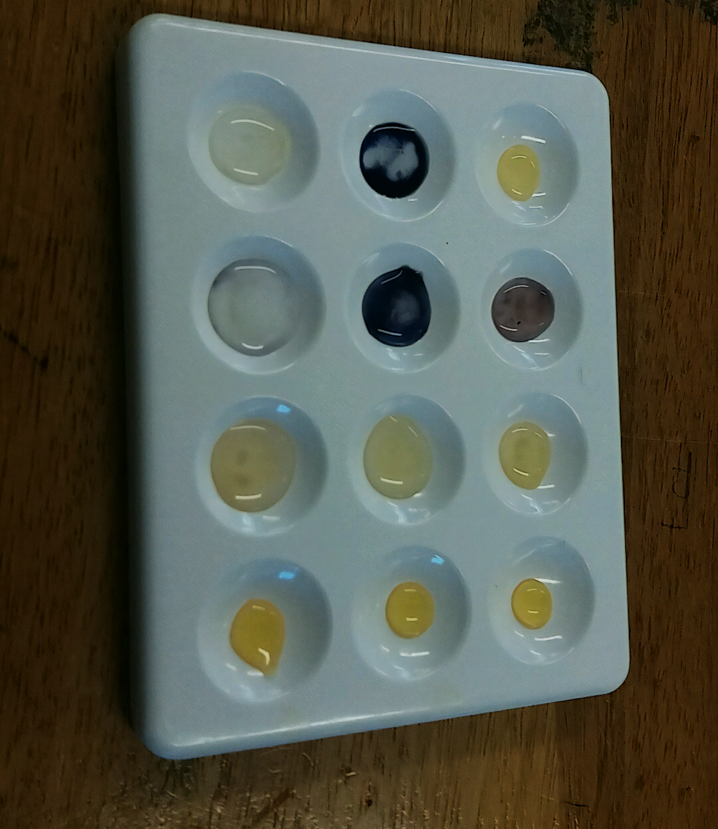
As the amylase enzyme breaks down the starch into maltose, the iodine stain reverts from its blue-black colour to orange.
For more help, please visit www.exampaperspractice.co.uk
© 2025 Exams Papers Practice. All Rights Reserved

Slide 10
Enzymes and pH
Specification Point 2.13
Understand how enzyme function can be affected by changes in pH altering the active site.
pH is a measure of how acidic or alkaline a solution is.
Acidic solutions have a pH of less than 7.
Alkaline solutions have a pH of more than 7.
Neutral solutions have a pH of 7.
Each enzyme has a different optimum pH.
Most enzymes work well at a neutral pH.
Some enzymes work best in acidic or alkaline conditions.
If the pH is too far from optimum, enzymes can denature.
At extreme pH values, bonds inside the active site can rupture.
ACIDIC
ALKALINE
RATE OF REACTION →
OPTIMUM pH
pH →
For more help, please visit www.exampaperspractice.co.uk
© 2025 Exams Papers Practice. All Rights Reserved

