Slide 1
Edexcel IGCSE Biology
6 - Food Tests
Tests for Sugars, Proteins and Lipids
For more help, please visit www.exampaperspractice.co.uk
© 2025 Exams Papers Practice. All Rights Reserved

Slide 2
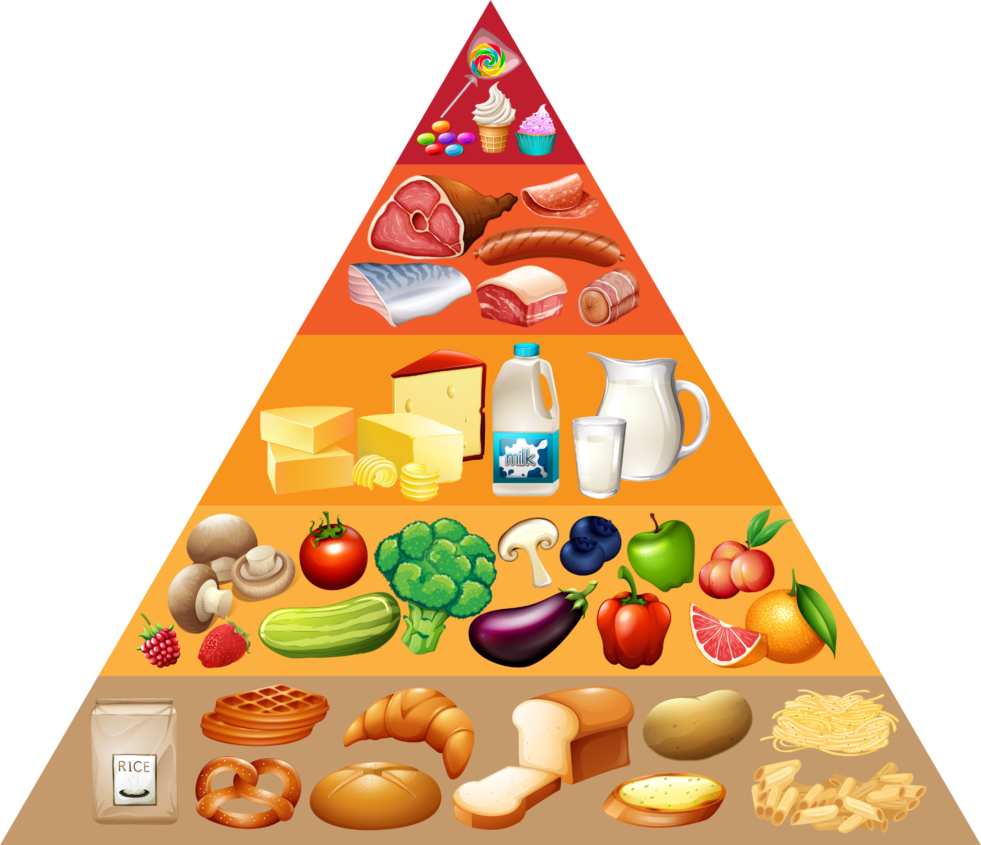
Food Tests
Specification Point 2.9
Practical: Investigate food samples for the presence of glucose, starch, protein and fat.
There are well established biochemical tests for the major food groups:
The test for glucose is called Benedict’s test.
The test for starch is called the iodine test.
The test for proteins is called the Biuret test.
The test for lipids is called the Sudan III test.
There are well established tests for the major food groups.
For more help, please visit www.exampaperspractice.co.uk
© 2025 Exams Papers Practice. All Rights Reserved

Slide 3
Benedict’s Test for Glucose
Add some Benedict’s reagent to a food sample containing glucose.
Benedict’s reagent is a pale blue solution.
Heat the sample in a water bath.
Heat the sample to around 60° C for approximately five minutes.
Benedict’s reagent will change into a brick red precipitate.
The transition from blue to red depends on the concentration of sugar.
PALE BLUE → GREEN → YELLOW → ORANGE → BRICK RED
→ INCREASING CONCENTRATION OF GLUCOSE
A positive test for glucose sees Benedict’s reagent change from a pale blue solution to a brick red precipitate.
For more help, please visit www.exampaperspractice.co.uk
© 2025 Exams Papers Practice. All Rights Reserved

Slide 4
When heated in the presence of glucose, Benedict’s reagent will turn from a pale blue solution into a brick red precipitate.
For more help, please visit www.exampaperspractice.co.uk
© 2025 Exams Papers Practice. All Rights Reserved

Slide 5
The Iodine Test For Starch
Add some iodine to a food sample containing starch.
Iodine is a dark orange liquid.
The iodine will turn a blue-black colour.
Starchy foods like potatoes will cause an instant colour change.
If starch is present in a food sample, iodine will immediately change colour from dark orange to blue-black.
For more help, please visit www.exampaperspractice.co.uk
© 2025 Exams Papers Practice. All Rights Reserved

Slide 6
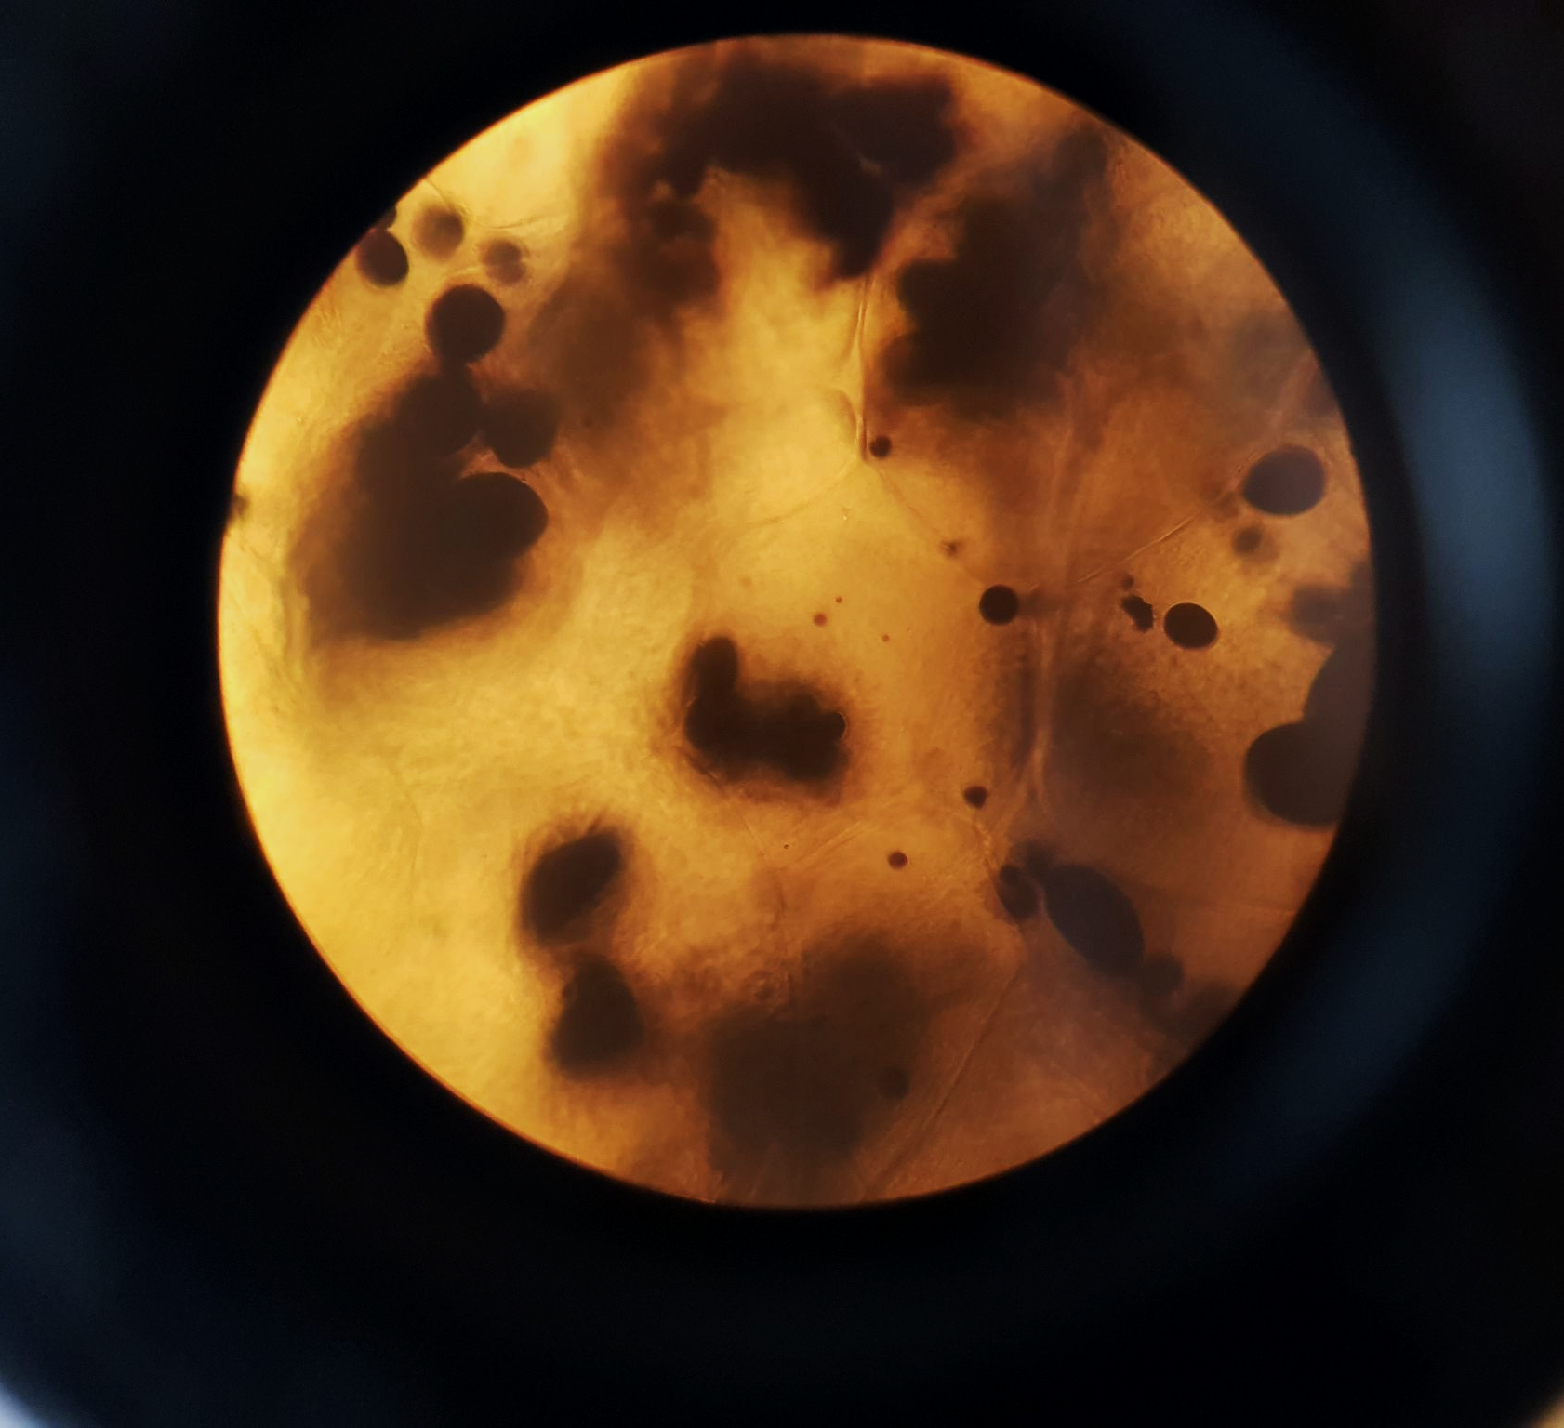
Starchy foods like potatoes cause iodine to change colour instantly.
For more help, please visit www.exampaperspractice.co.uk
© 2025 Exams Papers Practice. All Rights Reserved

Slide 7
The Biuret Test for Proteins
Add some Biuret reagent to a food sample containing proteins.
Biuret reagent is a pale blue solution.
Biuret reagent can detect the peptide bonds found in proteins.
Add some sodium hydroxide to the solution.
Biuret reagent will only work in alkaline conditions.
Biuret reagent will turn a purple colour.
The greater the concentration of protein, the deeper the purple colour.
A positive test for proteins sees Biuret reagent change colour from pale blue to purple.
For more help, please visit www.exampaperspractice.co.uk
© 2025 Exams Papers Practice. All Rights Reserved

Slide 8
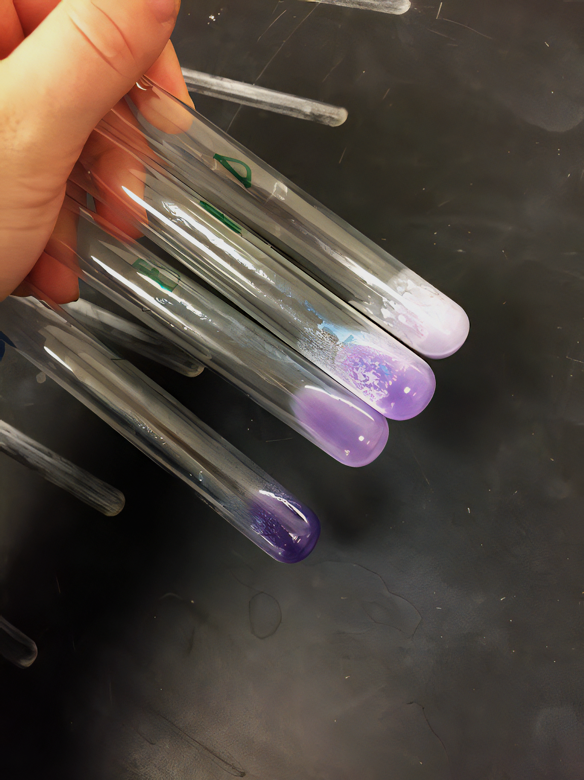
Biuret reagent can be used to estimate the concentration of protein. The higher the concentration, the deeper the purple colour.
For more help, please visit www.exampaperspractice.co.uk
© 2025 Exams Papers Practice. All Rights Reserved

Slide 9
The Sudan III Test for Lipids
Add some Sudan III dye to a food sample containing lipids.
Sudan III is a red/orange dye that binds to triglycerides.
Triglycerides are the basis of most lipids.
A red layer of stained lipid will form at the top of the food sample
The dye will not bind to water-soluble compounds.
Food tests video.
If lipids are present in a food sample, the Sudan III stain will bind to them, creating a layer of stained lipid at the top of the sample.
For more help, please visit www.exampaperspractice.co.uk
© 2025 Exams Papers Practice. All Rights Reserved

Slide 10
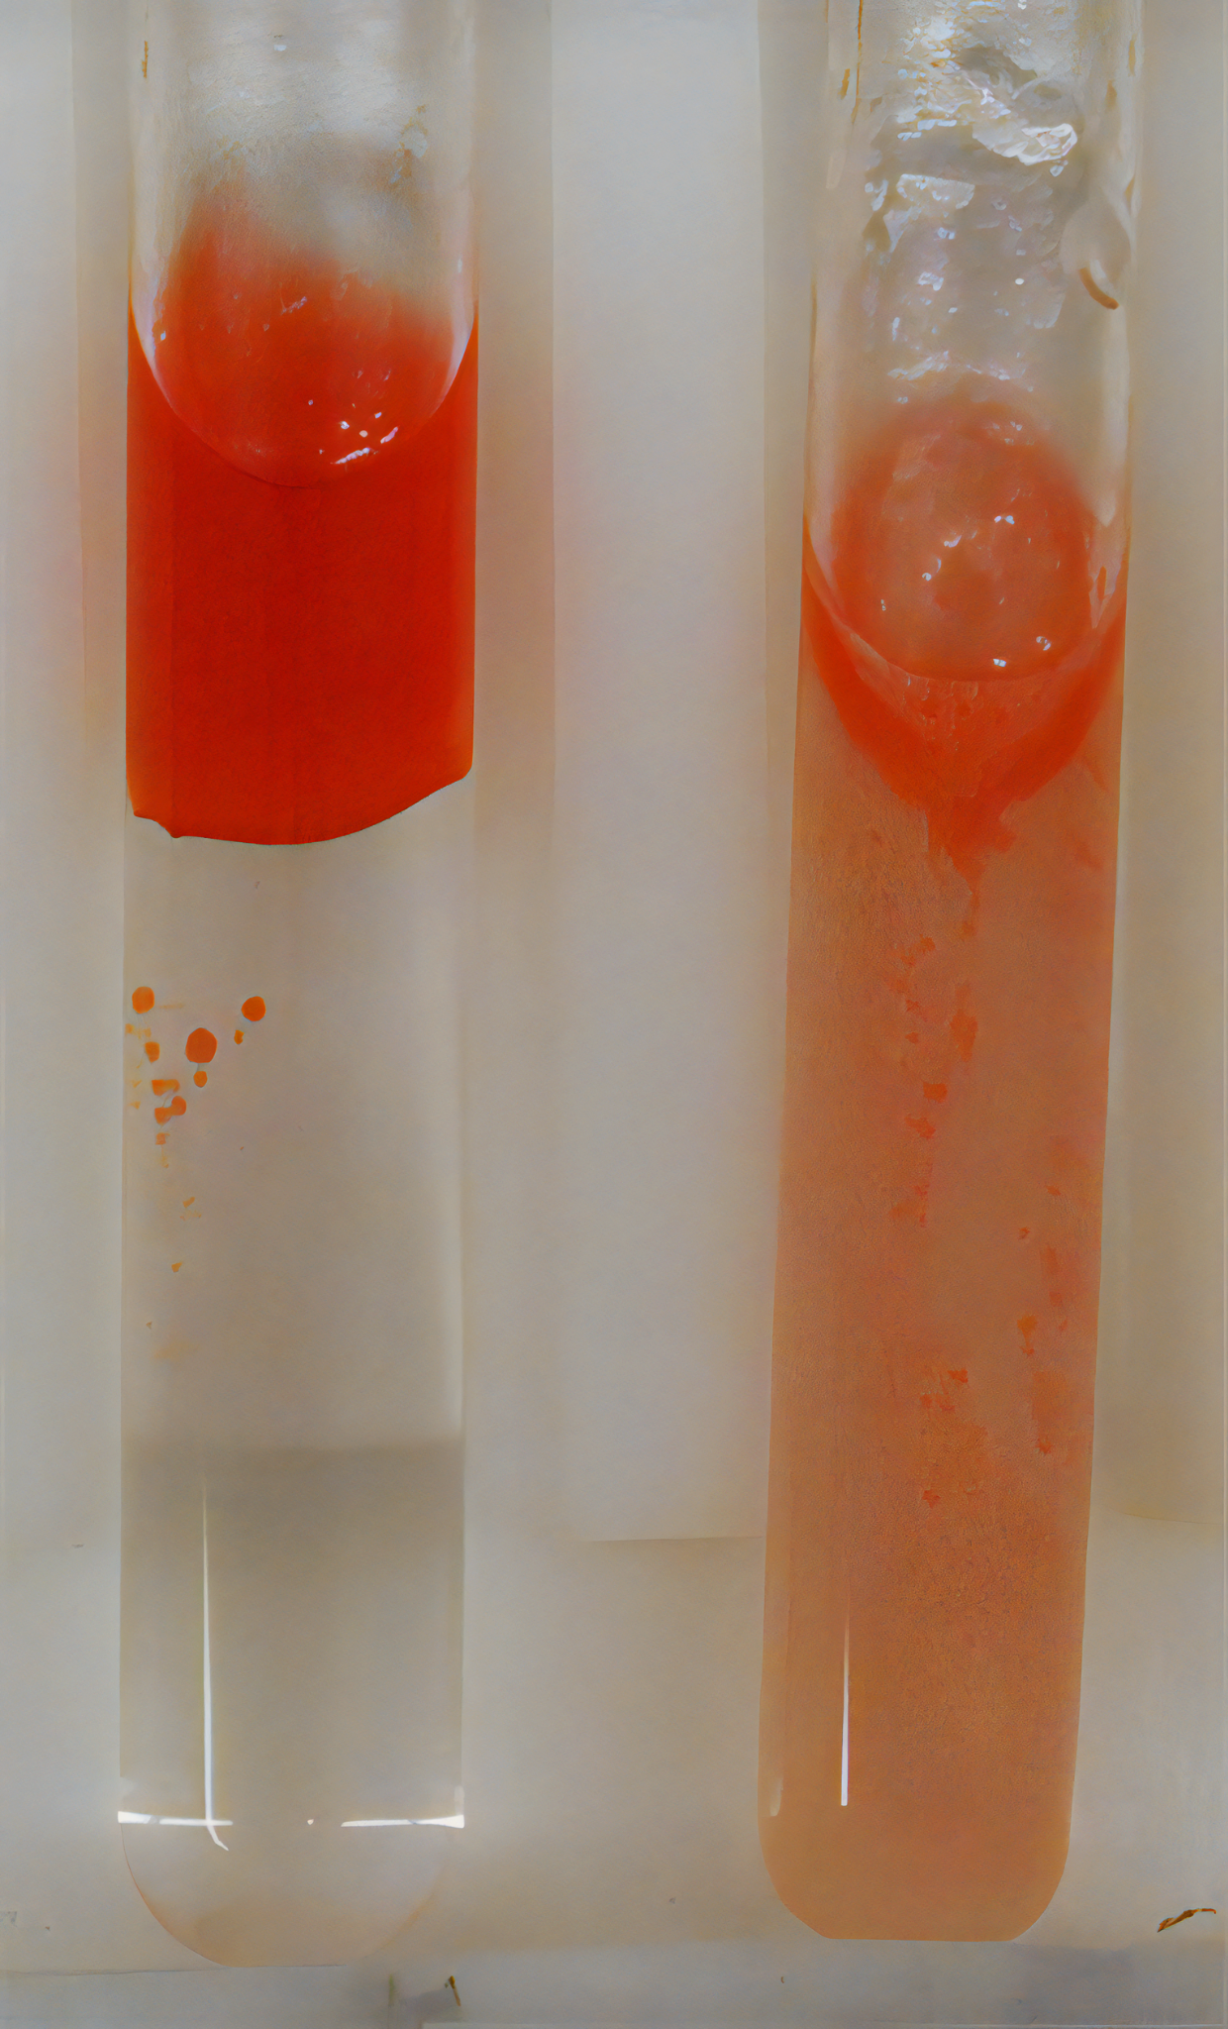
If lipids are present in a food sample, a layer of Sudan III dye will form at the top of the sample. If no lipids are present, the dye will diffuse throughout the sample.
For more help, please visit www.exampaperspractice.co.uk
© 2025 Exams Papers Practice. All Rights Reserved

