Slide 1
Edexcel IGCSE Biology
61 - Genetic Modification
Genetic Engineering and GMOs
For more help, please visit www.exampaperspractice.co.uk
© 2025 Exams Papers Practice. All Rights Reserved

Slide 2
Genetic Engineering
Specification Point 5.12
Understand how restriction enzymes are used to cut DNA at specific sites and ligase enzymes are used to join pieces of DNA together.
Organisms can be altered at the molecular level.
The DNA from one organism can be inserted into the DNA of another organism.
The recipient organism will show characteristics possessed by the donor organism.
This is called genetic engineering.
Organisms that receive genetic material are said to be genetically modified (GM).
The DNA that has been inserted into the GM organism is called recombinant DNA.
For more help, please visit www.exampaperspractice.co.uk
© 2025 Exams Papers Practice. All Rights Reserved

Slide 3
These tobacco plants have been genetically modified to glow in the dark.
To achieve this, DNA from a bioluminescent fungus was inserted into the plant genome.
For more help, please visit www.exampaperspractice.co.uk
© 2025 Exams Papers Practice. All Rights Reserved

Slide 4
Vectors
Specification Point 5.13
Understand how plasmids and viruses can act as vectors, which take up pieces of DNA, and then insert this recombinant DNA into other cells.
A vector is a vehicle used to artificially carry foreign DNA into another cell.
Bacterial plasmids are often used as vectors.
Plasmids are rings of DNA found in bacteria.
When bacteria reproduce, the plasmids are copied.
A recombinant plasmid will express the gene in a genetically modified bacterium.
Viruses are also used as vectors.
Viruses will infect host organisms.
Viruses will force the host to express the recombinant DNA.
Circular rings of bacterial DNA, called plasmids, are often used as vectors. Recombinant plasmids carry genes from foreign organisms.
For more help, please visit www.exampaperspractice.co.uk
© 2025 Exams Papers Practice. All Rights Reserved

Slide 5
Genetic Engineering
There is a standard protocol to creating GM organisms:
The desired gene is located in the original organism.
One example is the gene that codes for human insulin.
Enzymes called restriction endonucleases isolate the gene by cutting at specific sites.
Restriction endonucleases create staggered cuts referred to as sticky ends.
A vector is cut with the same restriction enzyme.
Cutting the vector with the same restriction enzyme will create complementary sticky ends.
The gene and the plasmid are joined together by an enzyme called DNA ligase.
This creates a phosphodiester bond between the DNA of the gene and the vector.
The vector is now referred to as a recombinant vector.
The recombinant vector is inserted into the target organism.
Genetic engineering video.
For more help, please visit www.exampaperspractice.co.uk
© 2025 Exams Papers Practice. All Rights Reserved

Slide 6
2. A RESTRICTION ENDONUCLEASE RECOGNISES A SPECIFIC SITE AND CUTS OUT THE GENE, AS WELL AS CUTTING A SECTION OUT OF A PLASMID
1. A DNA FRAGMENT, CONTAINING THE GENE OF INTEREST, IS TAKEN FROM ITS CELL
RESTRICTION ENDONUCLEASE
GENE
RESTRICTION FRAGMENT
There are several steps to successfully genetically engineer a bacterium.
3. THE STICKY ENDS OF THE RESTRICTION FRAGMENTS ATTACH TO EACH OTHER VIA COMPLEMENTARY BASE PAIRING, FORMING HYDROGEN BONDS. A RECOMBINANT PLASMID HAS BEEN FORMED
DNA LIGASE
4. DNA LIGASE MAKES THE BOND PERMANENT BY ATTACHING NUCLEOTIDES TO EACH OTHER WITH PHOSPHODIESTER BONDS
7. THE PLASMIDS ARE MIXED WITH THE BACTERIA. SOME OF THEM TAKE UP THE RECOMBINANT PLASMID TO BECOME TRANSGENIC
For more help, please visit www.exampaperspractice.co.uk
© 2025 Exams Papers Practice. All Rights Reserved

Slide 7
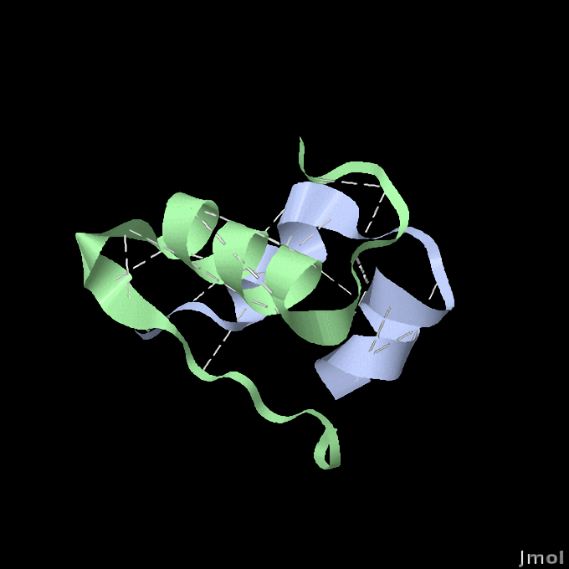
Making Human Insulin
Specification Point 5.14
Understand how large amounts of human insulin can be manufactured from genetically modified bacteria that are grown in a fermenter.
Insulin is a hormone that controls blood sugar.
Individuals with diabetes make insufficient insulin.
Insulin used to be collected from the pancreases of pigs.
Pig insulin often caused allergic reactions when injected into humans.
Insulin is now made using genetically modified bacteria.
The gene for human insulin is inserted into a bacterial plasmid.
Each bacterial cell will make a small amount of insulin.
Genetically modified bacteria are grown in industrial fermenters.
Insulin is a hormone that is vital in regulating blood sugar.
For more help, please visit www.exampaperspractice.co.uk
© 2025 Exams Papers Practice. All Rights Reserved

Slide 8
Insulin was historically extracted from the pancreases of pigs. This caused many to suffer allergic reactions.
Today, human insulin is manufactured using genetically modified organisms.
For more help, please visit www.exampaperspractice.co.uk
© 2025 Exams Papers Practice. All Rights Reserved

Slide 9
GMOs
Specification Point 5.15
Understand how genetically modified plants can be used to improve food production.
Genetically modified plants have foreign DNA inserted into their genomes.
Genetically modified plants are sometimes called GMOs.
Genetic modification is usually used to increased crop yield or crop quality:
Corn has been genetically modified to increase resistance to pests.
Rice has been genetically modified to produce beta carotene.
Plum plants have been genetically modified to make bigger fruit.
For more help, please visit www.exampaperspractice.co.uk
© 2025 Exams Papers Practice. All Rights Reserved

Slide 10
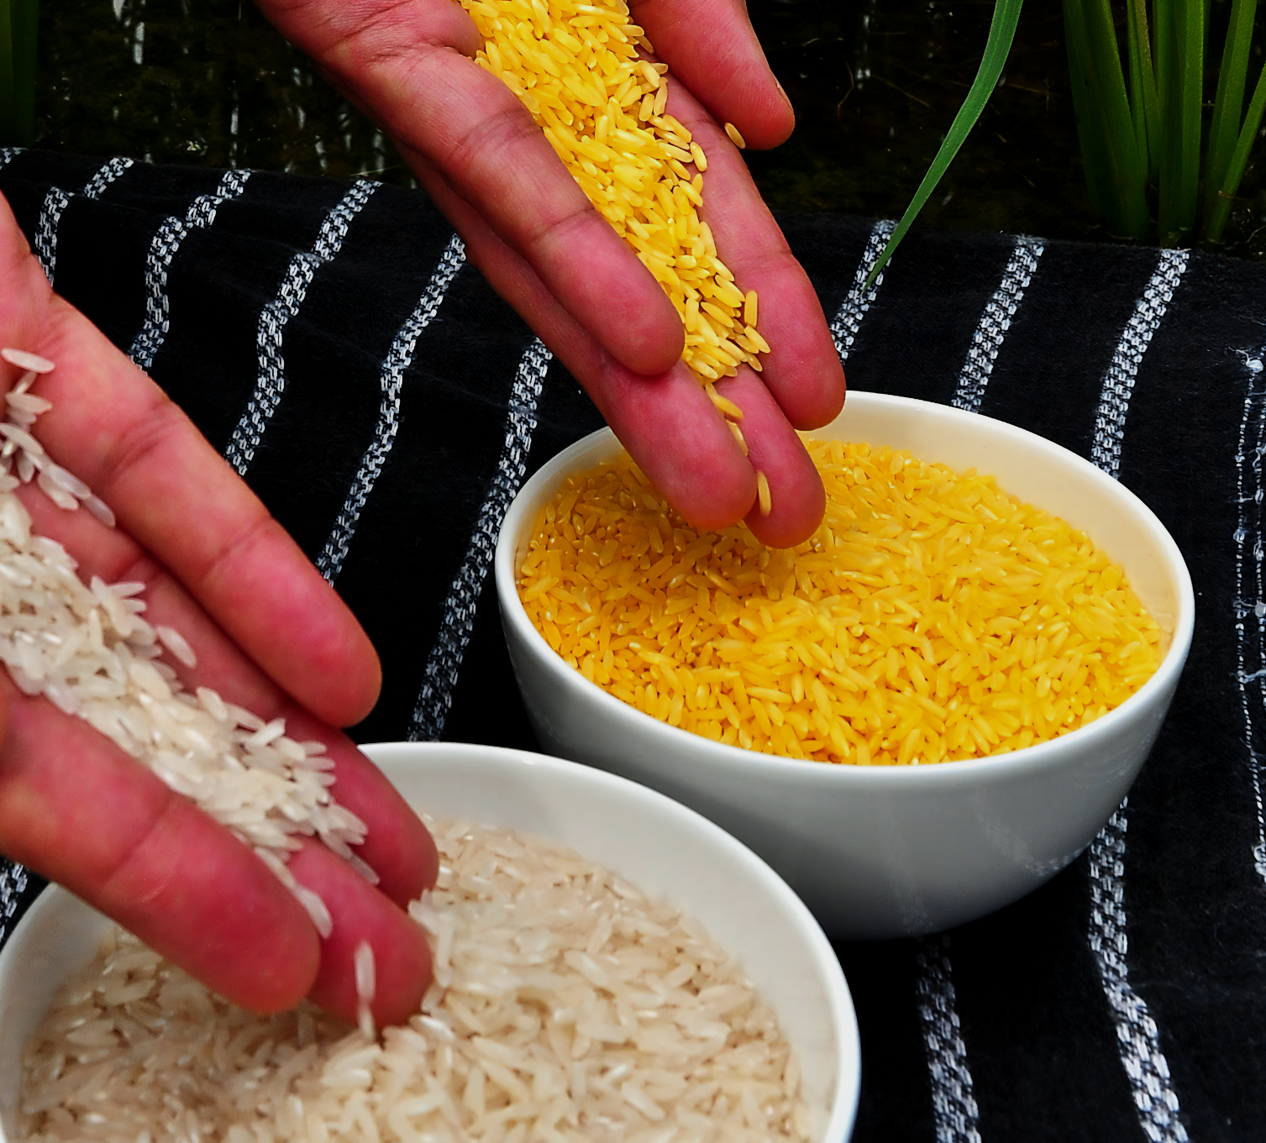
Golden rice has been genetically modified to produce beta carotene. This is converted to vitamin A in the body.
Vitamin A deficiency is a leading cause of blindness in the developing world.
For more help, please visit www.exampaperspractice.co.uk
© 2025 Exams Papers Practice. All Rights Reserved

Slide 11
Advantages of GM Crops
GM crops can help combat nutritional deficiencies.
Golden rice can help to prevent blindness.
GM crops can combat starvation.
Some GM crops have a much greater yield than their natural counterparts.
GM soy plants have been developed with a 36% increase in crop production compared to their non-GM counterparts.
Some GM crops are resistant to pests.
This means more food will be available to eat.
GM crops can be grown in harsher conditions.
This means growing seasons can be extended.
Over 80% of planted soy is GM. This has contributed to the massive increase in global soy production.
SOY PRODUCTION
AREA HARVESTED
1200%
GLOBAL SOY PRODUCTION (%)
600%
0%
1960
2020
For more help, please visit www.exampaperspractice.co.uk
© 2025 Exams Papers Practice. All Rights Reserved

Slide 12
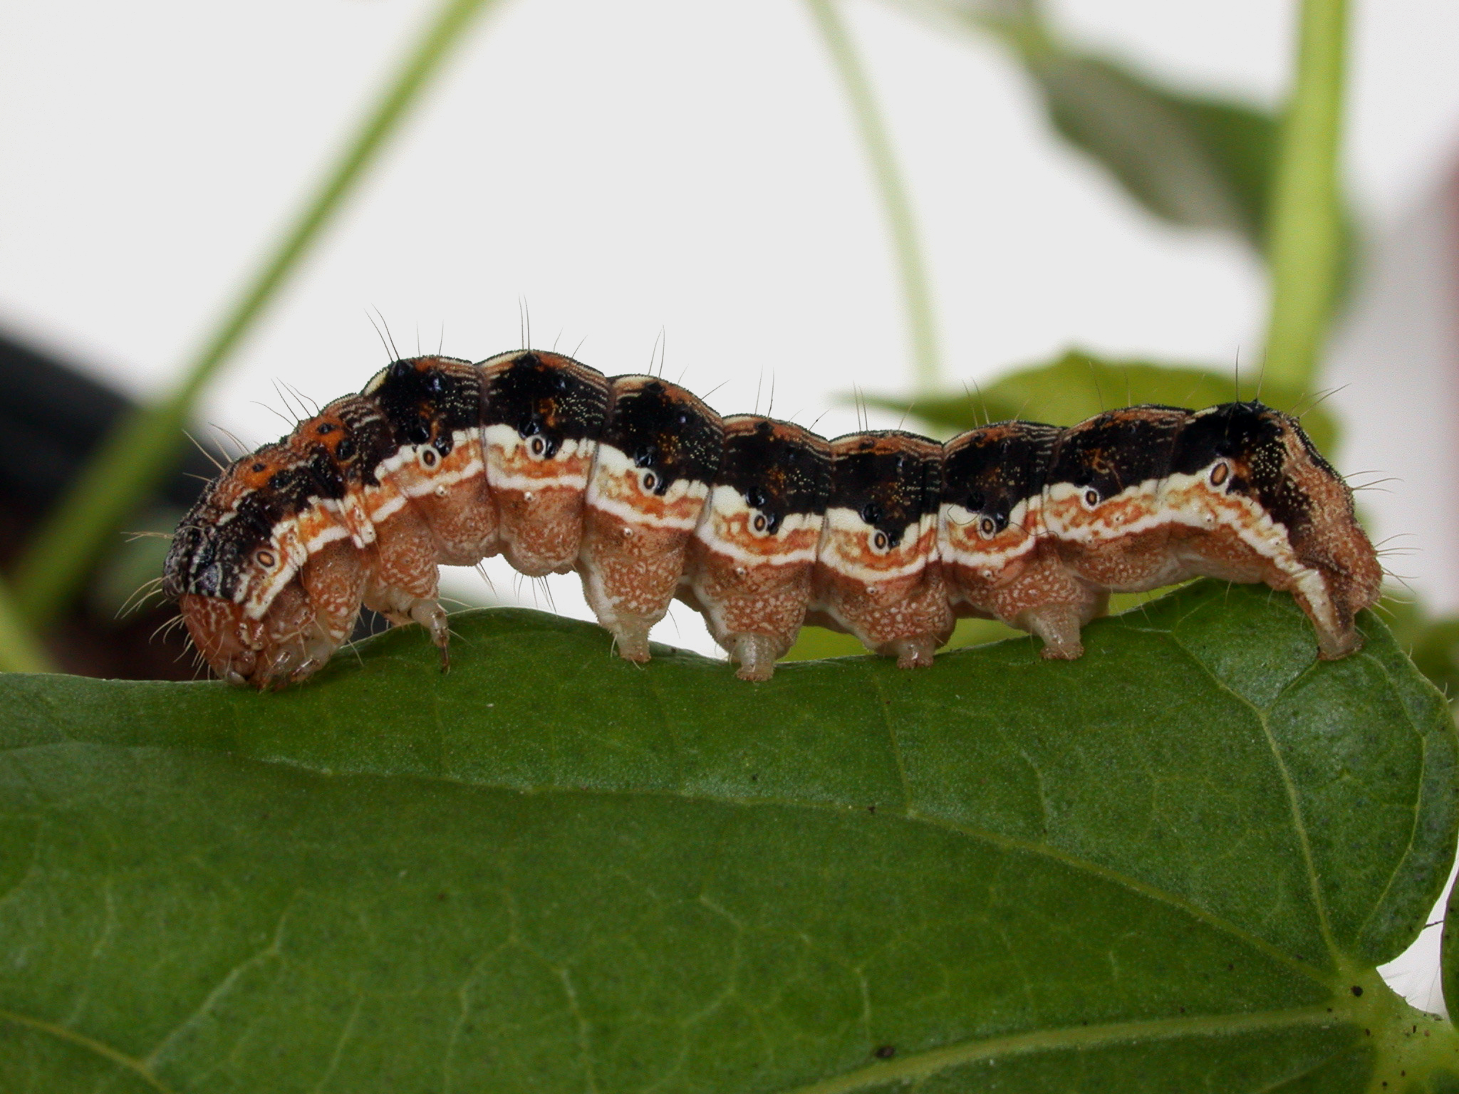
Around 15% of all crops are lost to insect pests.
By genetically modifying plants to become resistant to insect pests, crop yields may be increased.
For more help, please visit www.exampaperspractice.co.uk
© 2025 Exams Papers Practice. All Rights Reserved

Slide 13
Disadvantages of GM Crops
The seeds for GM crops are very expensive.
Large agrochemical companies sell GM seeds at high prices.
This means that many farmers cannot afford to grow GM crops.
GM crops could breed with wild crops.
This might contaminate the wild crop.
The consequences would be unknown.
GM crops could lead to a reduction in biodiversity.
Fewer weeds would survive as they would be outcompeted by the crop.
This would result in fewer habitats and food sources for animals.
For more help, please visit www.exampaperspractice.co.uk
© 2025 Exams Papers Practice. All Rights Reserved

Slide 14
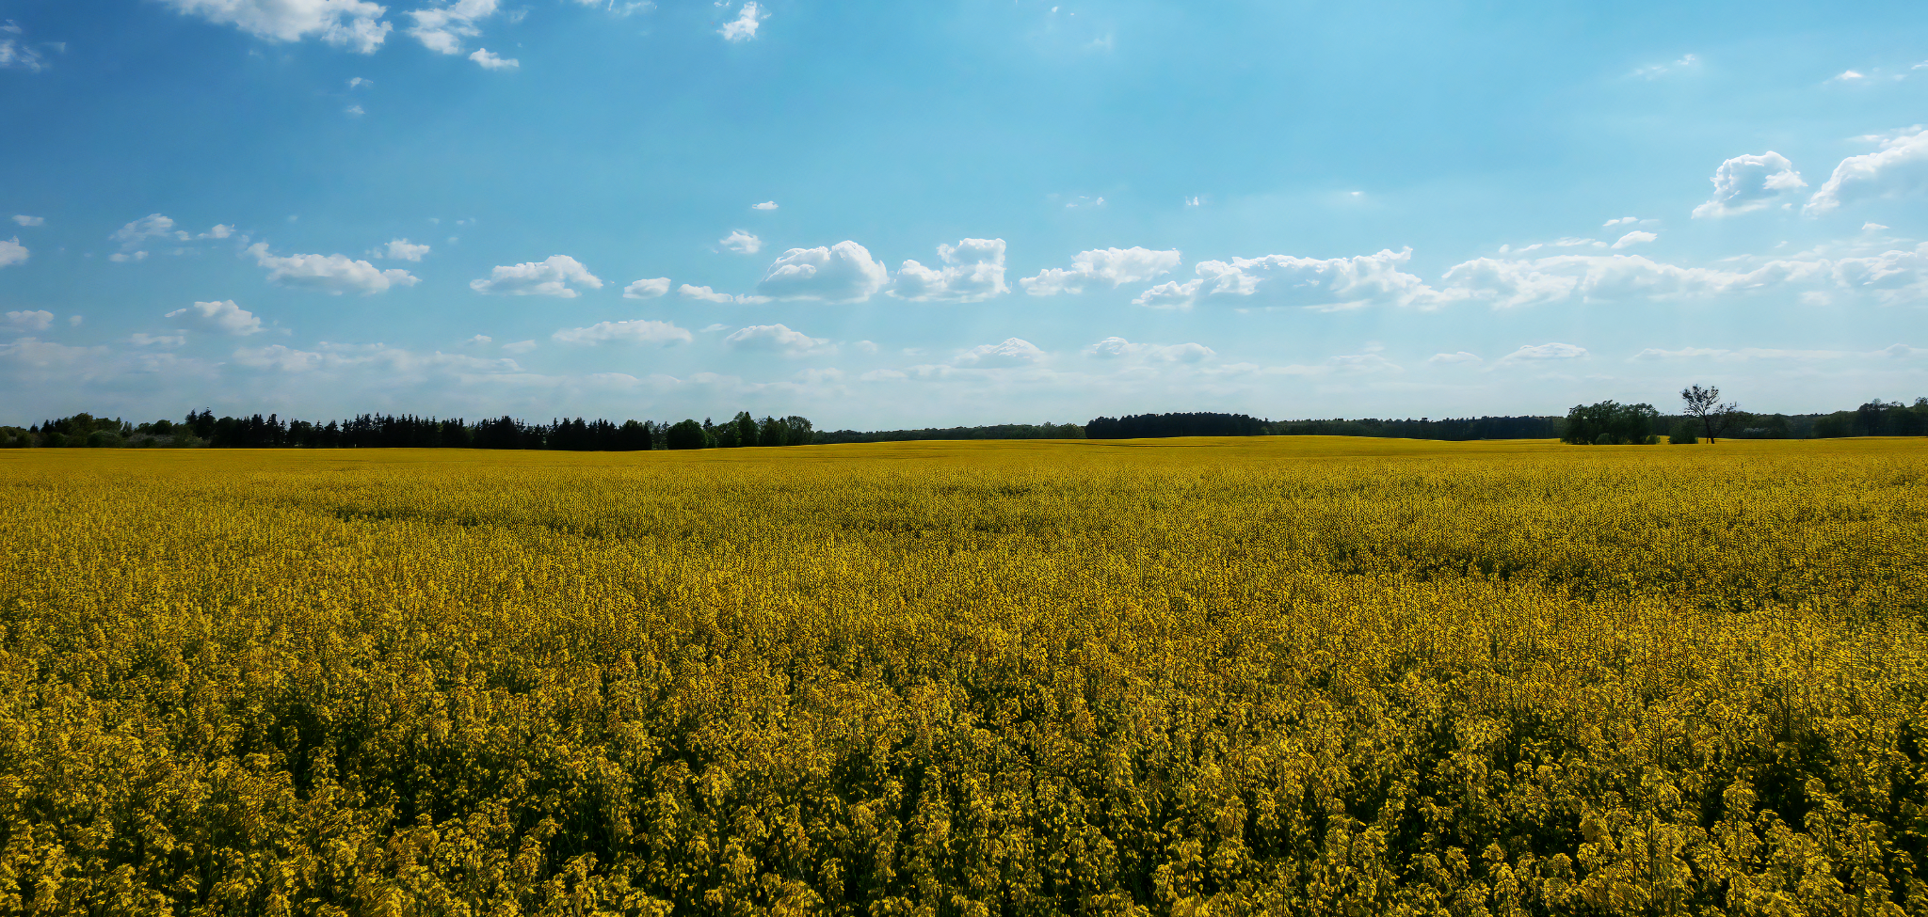
GM crops may outcompete other plants which will reduce biodiversity.
For more help, please visit www.exampaperspractice.co.uk
© 2025 Exams Papers Practice. All Rights Reserved

Slide 15
Transgenic Organisms
Specification Point 5.16
Understand that the term transgenic means the transfer of genetic material from one species to a different species.
Transgenic organisms contain genetic information from a different species.
Genetic information is transferred from one organism to another:
The gene for human insulin is transferred from a human cell into a bacteria called E. coli.
The E. coli bacteria is now said to be transgenic.
GM crops are usually transgenic because they contain genes from other species of plant or animal.
Transgenic E. coli are capable of creating human insulin protein.
For more help, please visit www.exampaperspractice.co.uk
© 2025 Exams Papers Practice. All Rights Reserved

