Slide 1
Edexcel IGCSE Biology
60 - Selective Breeding
In Plants and Animals
For more help, please visit www.exampaperspractice.co.uk
© 2025 Exams Papers Practice. All Rights Reserved

Slide 2
Selective Breeding in Plants
Specification Point 5.10
Understand how selective breeding can develop plants with desired characteristics.
Organisms with desirable characteristics can be mated together.
This ensures their offspring will also have desirable characteristics.
If this is repeated for many generations a new breed will form.
This is called selective breeding.
Plants have been selectively bred by humans for thousands of years.
The wild brassica has been selectively bred to create:
Cabbage.
Cauliflower.
Broccoli.
Kale.
For more help, please visit www.exampaperspractice.co.uk
© 2025 Exams Papers Practice. All Rights Reserved

Slide 3
BROCCOLI
CABBAGE
A variety of crops have been selectively bred from the wild brassica.
Selective breeding allows for desirable characteristics to be magnified over several generations.
CAULIFLOWER
KALE
WILD BRASSICA
For more help, please visit www.exampaperspractice.co.uk
© 2025 Exams Papers Practice. All Rights Reserved

Slide 4
Selective Breeding in Plants
Humans can selectively breed desirable characteristics in plants:
Crops can be bred for high yields.
High crop yields increase the amount of profit for a farmer.
Crops can be bred for taste.
Crops can be bred to tolerate poor weather.
This will reduce the amount of crop lost to wind and frost.
Crops can be bred to resist diseases or pests.
This will also reduce the amount of crop lost.
Selective breeding video.
Wheat has been selectively bred on a global scale for thousands of years.
Wheat has been bred to have high yields and be extremely tolerant to extremes in weather.
For more help, please visit www.exampaperspractice.co.uk
© 2025 Exams Papers Practice. All Rights Reserved

Slide 5
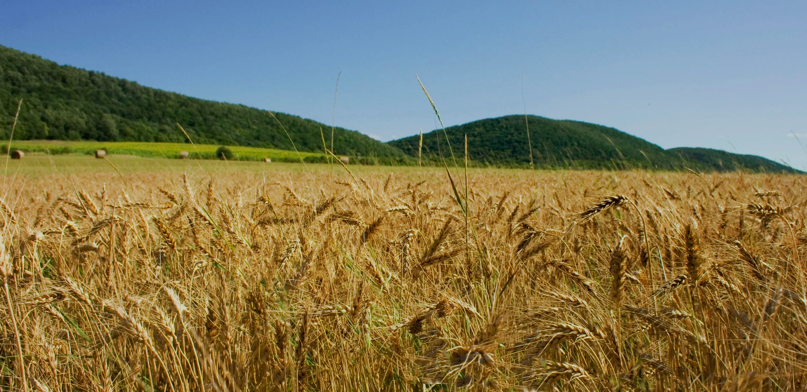
Wheat has been selectively bred on a global scale for thousands of years.
For more help, please visit www.exampaperspractice.co.uk
© 2025 Exams Papers Practice. All Rights Reserved

Slide 6
Selective Breeding in Animals
Specification Point 5.11
Understand how selective breeding can develop animals with desired characteristics.
Selective breeding can also be carried out on animals.
Animals with desired characteristics can be mated together.
This ensures their offspring will also have desired characteristics.
If this is repeated for many generations a new breed will form.
Animals have been selectively bred by humans for thousands of years:
Cows have been selectively bred for high meat and milk yields.
Chickens have been selectively bred to lay large eggs.
Dogs have been bred to be placid.
Cows are a form of livestock that have seen extensive selective breeding.
Some species of cow are bred for milk, others for meat.
For more help, please visit www.exampaperspractice.co.uk
© 2025 Exams Papers Practice. All Rights Reserved

Slide 7
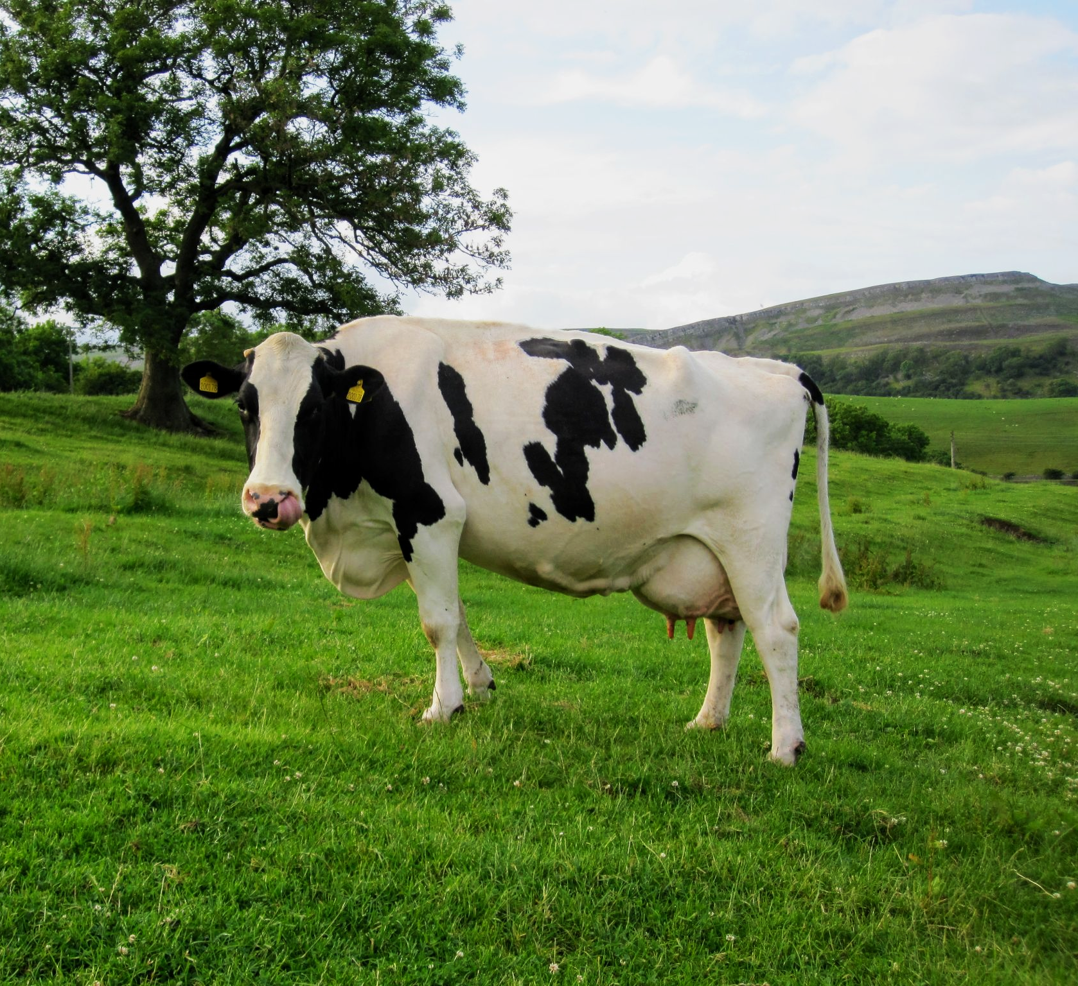
The Friesian cow has been selectively bred to produce lots of milk.
Friesian cows now produce the most milk of any species of cow and dominate the dairy industry.
For more help, please visit www.exampaperspractice.co.uk
© 2025 Exams Papers Practice. All Rights Reserved

Slide 8
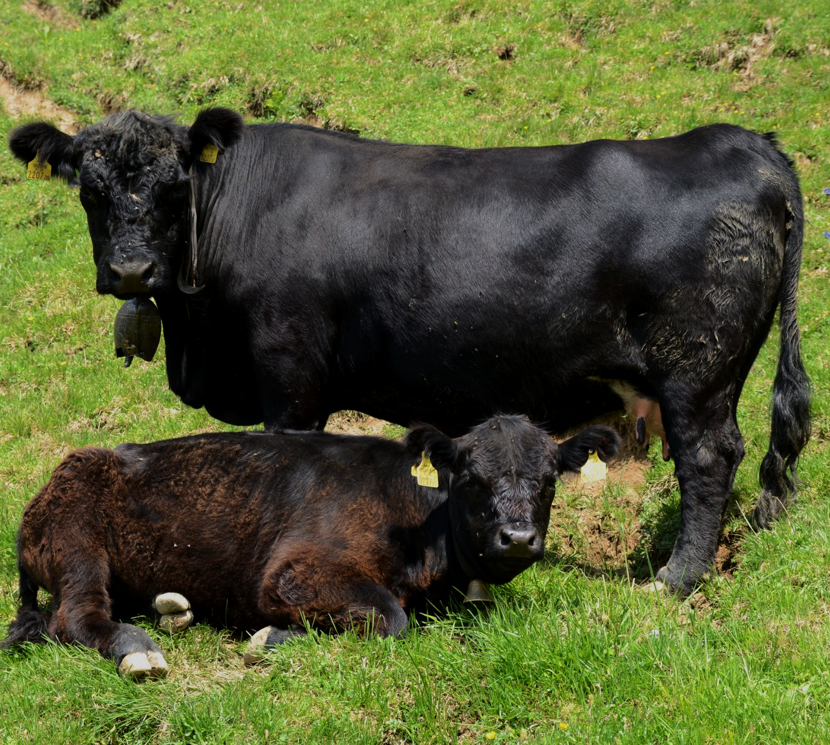
The Aberdeen Angus cow is farmed for its meat.
Aberdeen Angus cows have been selectively bred to be fast-growing and for their desirable meat quality.
For more help, please visit www.exampaperspractice.co.uk
© 2025 Exams Papers Practice. All Rights Reserved

Slide 9
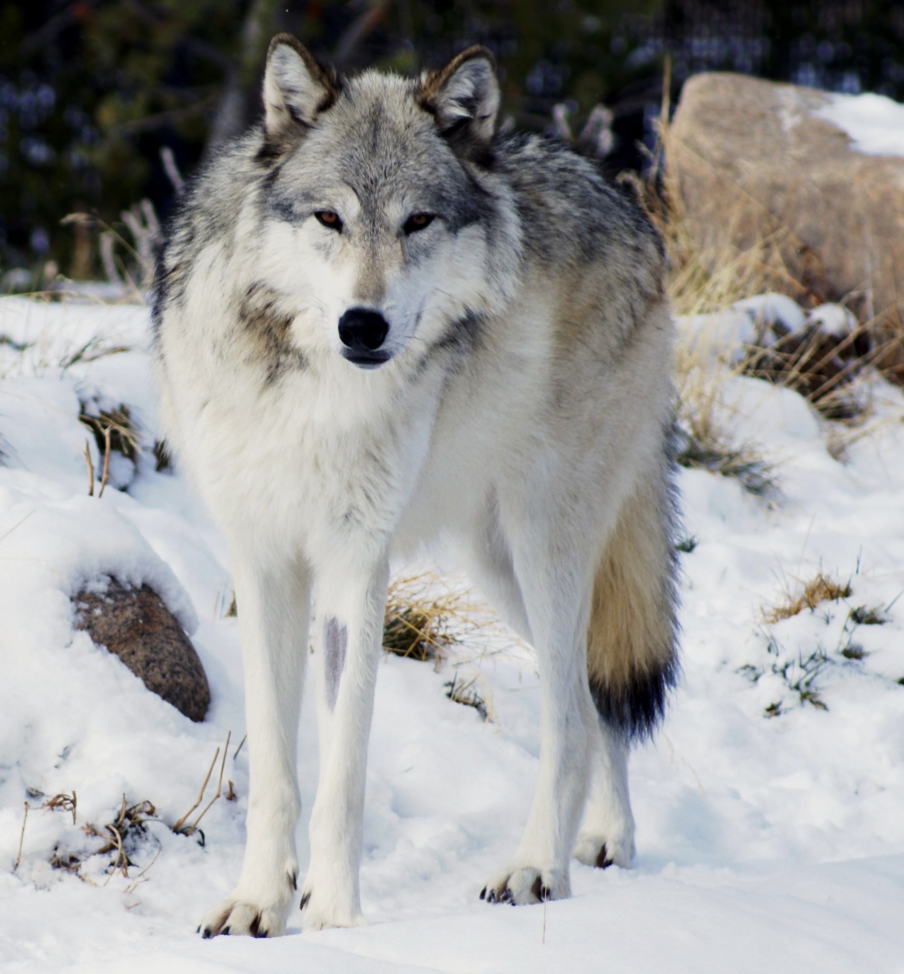
There are a number of theories as to how the domestic dog came to descend from wolves.
One theory involves the selective breeding of wild wolves into dogs around 12,000 BC.
For more help, please visit www.exampaperspractice.co.uk
© 2025 Exams Papers Practice. All Rights Reserved

Slide 10
There are now 339 recognised breeds of dog, many of which have been bred for specific traits.
The over reliance on these pedigree traits has been criticised because of their link to health issues.
13,000 BC
PRESENT DAY
For more help, please visit www.exampaperspractice.co.uk
© 2025 Exams Papers Practice. All Rights Reserved

Slide 11
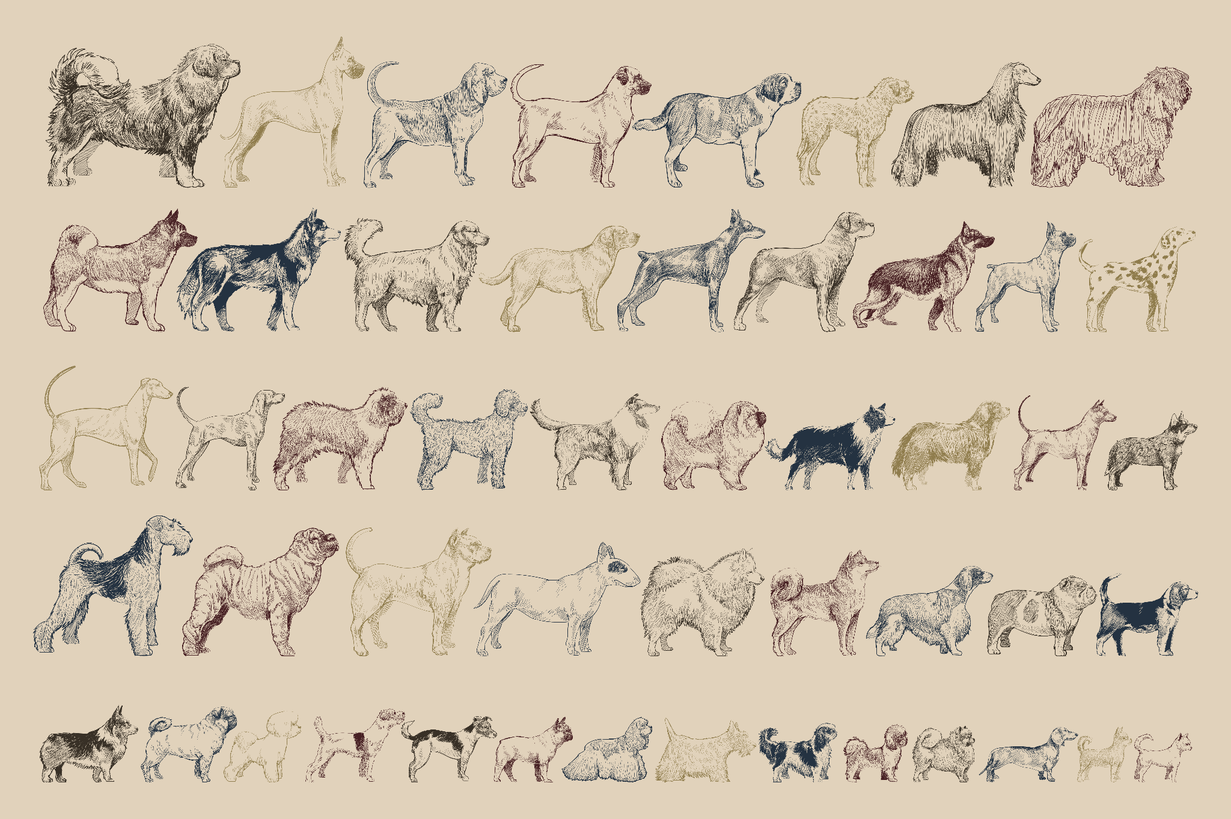
There are now 339 recognised breeds of dog, many of which have been bred for specific traits.
The over reliance on these pedigree traits has been criticised because of their link to health issues.
For more help, please visit www.exampaperspractice.co.uk
© 2025 Exams Papers Practice. All Rights Reserved

