Slide 1
Edexcel IGCSE Biology
5 - Biological Molecules
Carbohydrates, Proteins and Lipids
For more help, please visit www.exampaperspractice.co.uk
© 2025 Exams Papers Practice. All Rights Reserved

Slide 2
Carbohydrates, Proteins and Lipids
Specification Point 2.7
Identify the chemical elements present in carbohydrates, proteins and lipids.
All living things require nutrients.
Nutrition is the act of obtaining food for growth and repair.
There are three main groups of nutrients:
Carbohydrates.
Carbohydrates contain the elements carbon, hydrogen and oxygen.
Proteins.
Proteins contain the elements carbon, hydrogen, oxygen and nitrogen.
Lipids.
Lipids contain the elements carbon, hydrogen and oxygen.
For more help, please visit www.exampaperspractice.co.uk
© 2025 Exams Papers Practice. All Rights Reserved

Slide 3
Carbohydrates
Specification Point 2.8
Describe the structure of carbohydrates, proteins and lipids as large molecules made up from smaller basic units.
The basic units of all carbohydrates are simple sugars.
Glucose is an example of a simple sugar.
Glucose is a monosaccharide.
A monosaccharide is a single unit of sugar that cannot be broken down further.
When two glucose molecules join together, a disaccharide is formed.
When two glucose molecules are joined, a molecule of maltose is formed.
When lots of glucose molecules join together, a polysaccharide is formed.
Starch is one example of a glucose-based polysaccharide.
Breads, grains and pasta are good sources of carbohydrates.
For more help, please visit www.exampaperspractice.co.uk
© 2025 Exams Papers Practice. All Rights Reserved

Slide 4
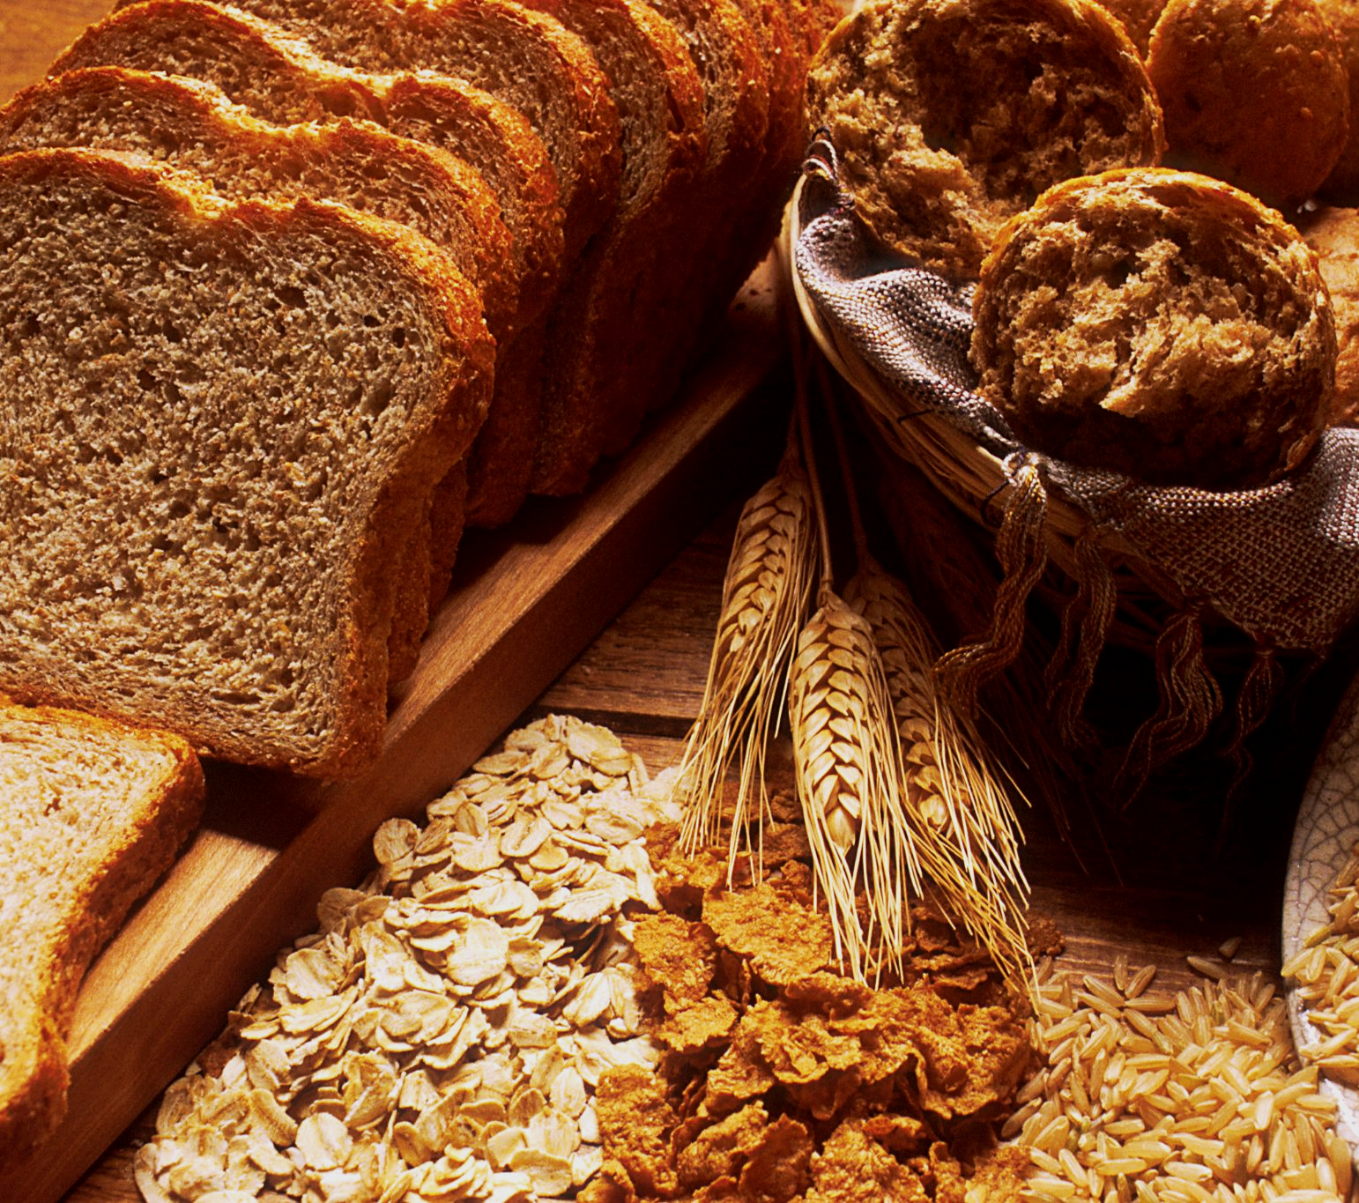
Breads, grains and pasta are good sources of carbohydrates.
For more help, please visit www.exampaperspractice.co.uk
© 2025 Exams Papers Practice. All Rights Reserved

Slide 5
Glucose is a six-carbon (hexose) sugar. As a monosaccharide, glucose cannot be broken down any further.
For more help, please visit www.exampaperspractice.co.uk
© 2025 Exams Papers Practice. All Rights Reserved

Slide 6
Proteins
The basic unit of all protein molecules is an amino acid.
There are 20 different amino acids.
All 20 amino acids contain the same basic structure.
Each amino acid has a different R group.
R groups have a variety of sizes and activities.
When amino acids join together, a protein is formed.
When two amino acids are joined together, a dipeptide is formed.
When many amino acids are joined together, a polypeptide is formed.
Amino acids can be arranged in any order.
Even a small change in the sequence of the amino acids can cause a big change in the shape of the protein being formed.
Fish, meats and eggs are good sources of proteins.
For more help, please visit www.exampaperspractice.co.uk
© 2025 Exams Papers Practice. All Rights Reserved

Slide 7
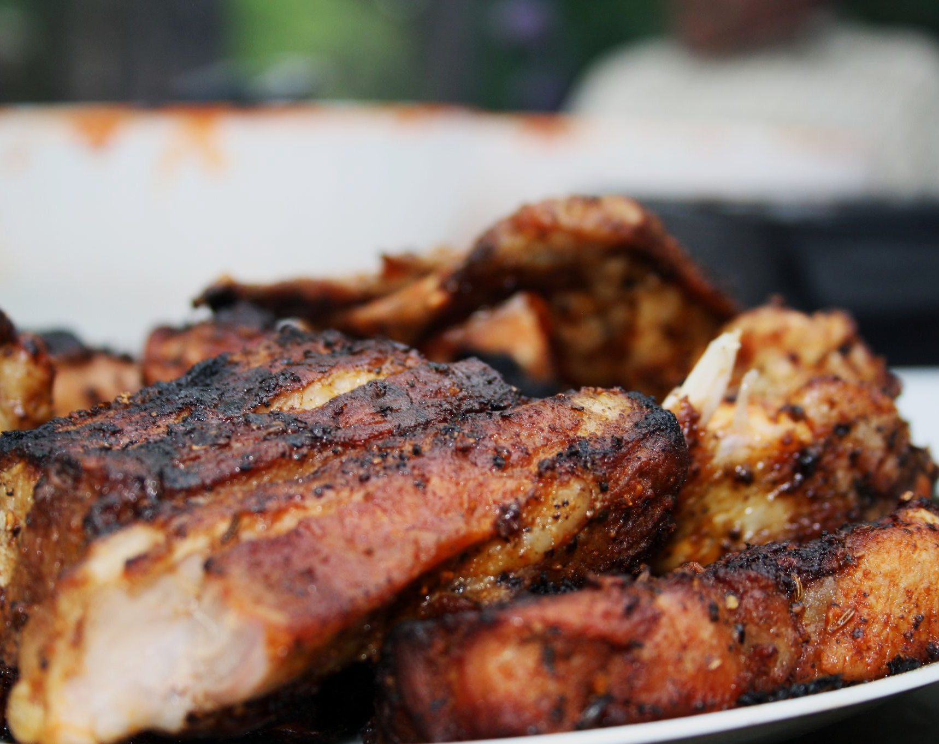
Cooked meats are an excellent source of protein.
For more help, please visit www.exampaperspractice.co.uk
© 2025 Exams Papers Practice. All Rights Reserved

Slide 8
The basic structure of an amino acid. There are 20 different R groups across the 20 amino acids.
For more help, please visit www.exampaperspractice.co.uk
© 2025 Exams Papers Practice. All Rights Reserved

Slide 9
Lipids
Lipids include fats and oils.
Fats are solid at room temperature.
Oils are liquid at room temperature.
The main group of lipids found in foods are triglycerides.
Triglycerides are a combination of glycerol and three fatty acids.
Meats, nuts and certain fruits and vegetables are sources of lipids.
For more help, please visit www.exampaperspractice.co.uk
© 2025 Exams Papers Practice. All Rights Reserved

Slide 10
A triglyceride consists of a glycerol head and three fatty acid tails.
For more help, please visit www.exampaperspractice.co.uk
© 2025 Exams Papers Practice. All Rights Reserved

Slide 11
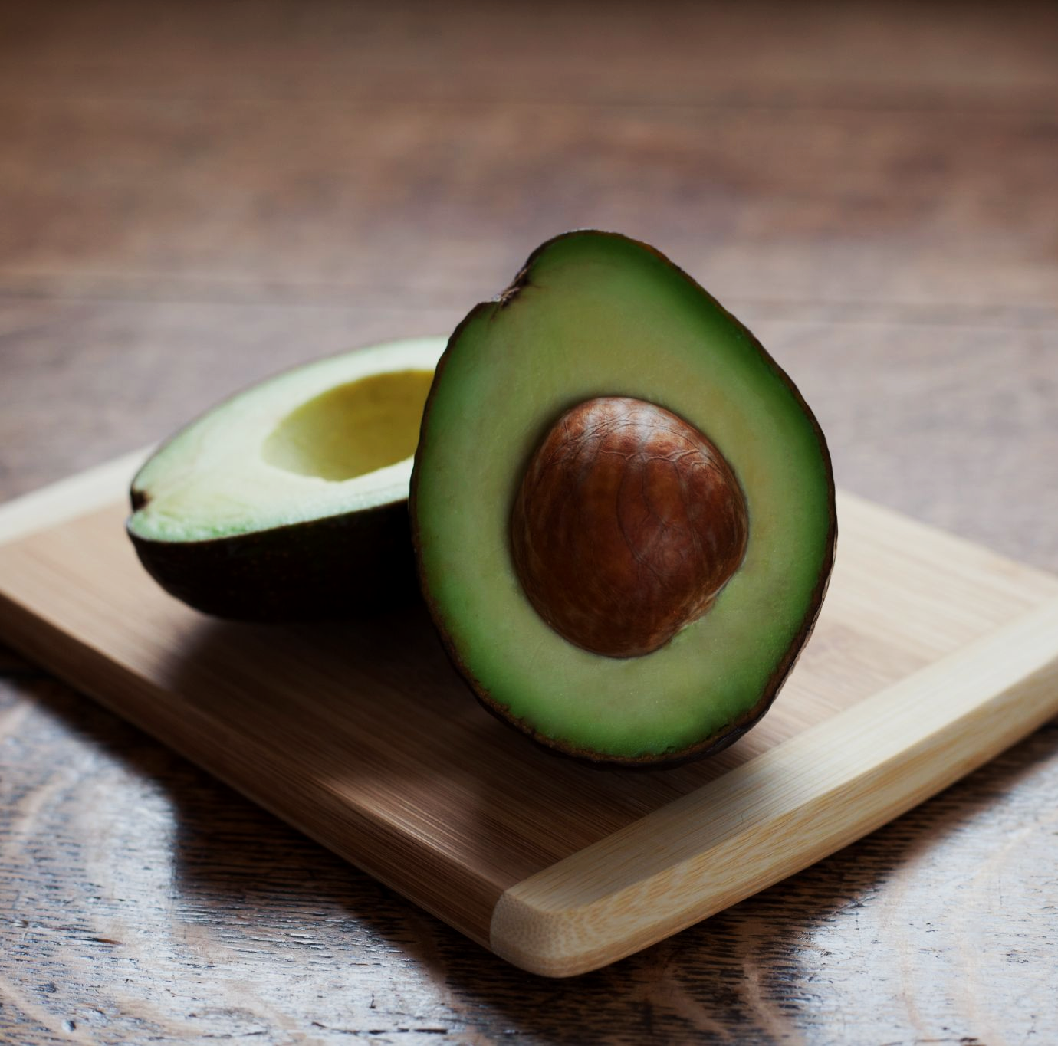
Some fruits like avocados are a good source of healthy lipids.
For more help, please visit www.exampaperspractice.co.uk
© 2025 Exams Papers Practice. All Rights Reserved

