Slide 1
Edexcel IGCSE Biology
58 - Microorganisms for Food
Yeast, Lactobacillus and Industrial Fermentation
For more help, please visit www.exampaperspractice.co.uk
© 2025 Exams Papers Practice. All Rights Reserved

Slide 2
Using Yeast
Specification Point 5.5
Understand the role of yeast in the production of food including bread.
Microorganisms can be used to grow food.
Microorganisms grow quickly and only require basic nutrients to grow.
One example of a microorganism used to produce food is yeast.
Yeast is a microscopic fungus.
Yeast respires anaerobically to create ethanol and carbon dioxide:
GLUCOSE → ETHANOL + CARBON DIOXIDE
C₆H₁₂O₆ → 2C₂H₅OH + 2CO₂
For more help, please visit www.exampaperspractice.co.uk
© 2025 Exams Papers Practice. All Rights Reserved

Slide 3
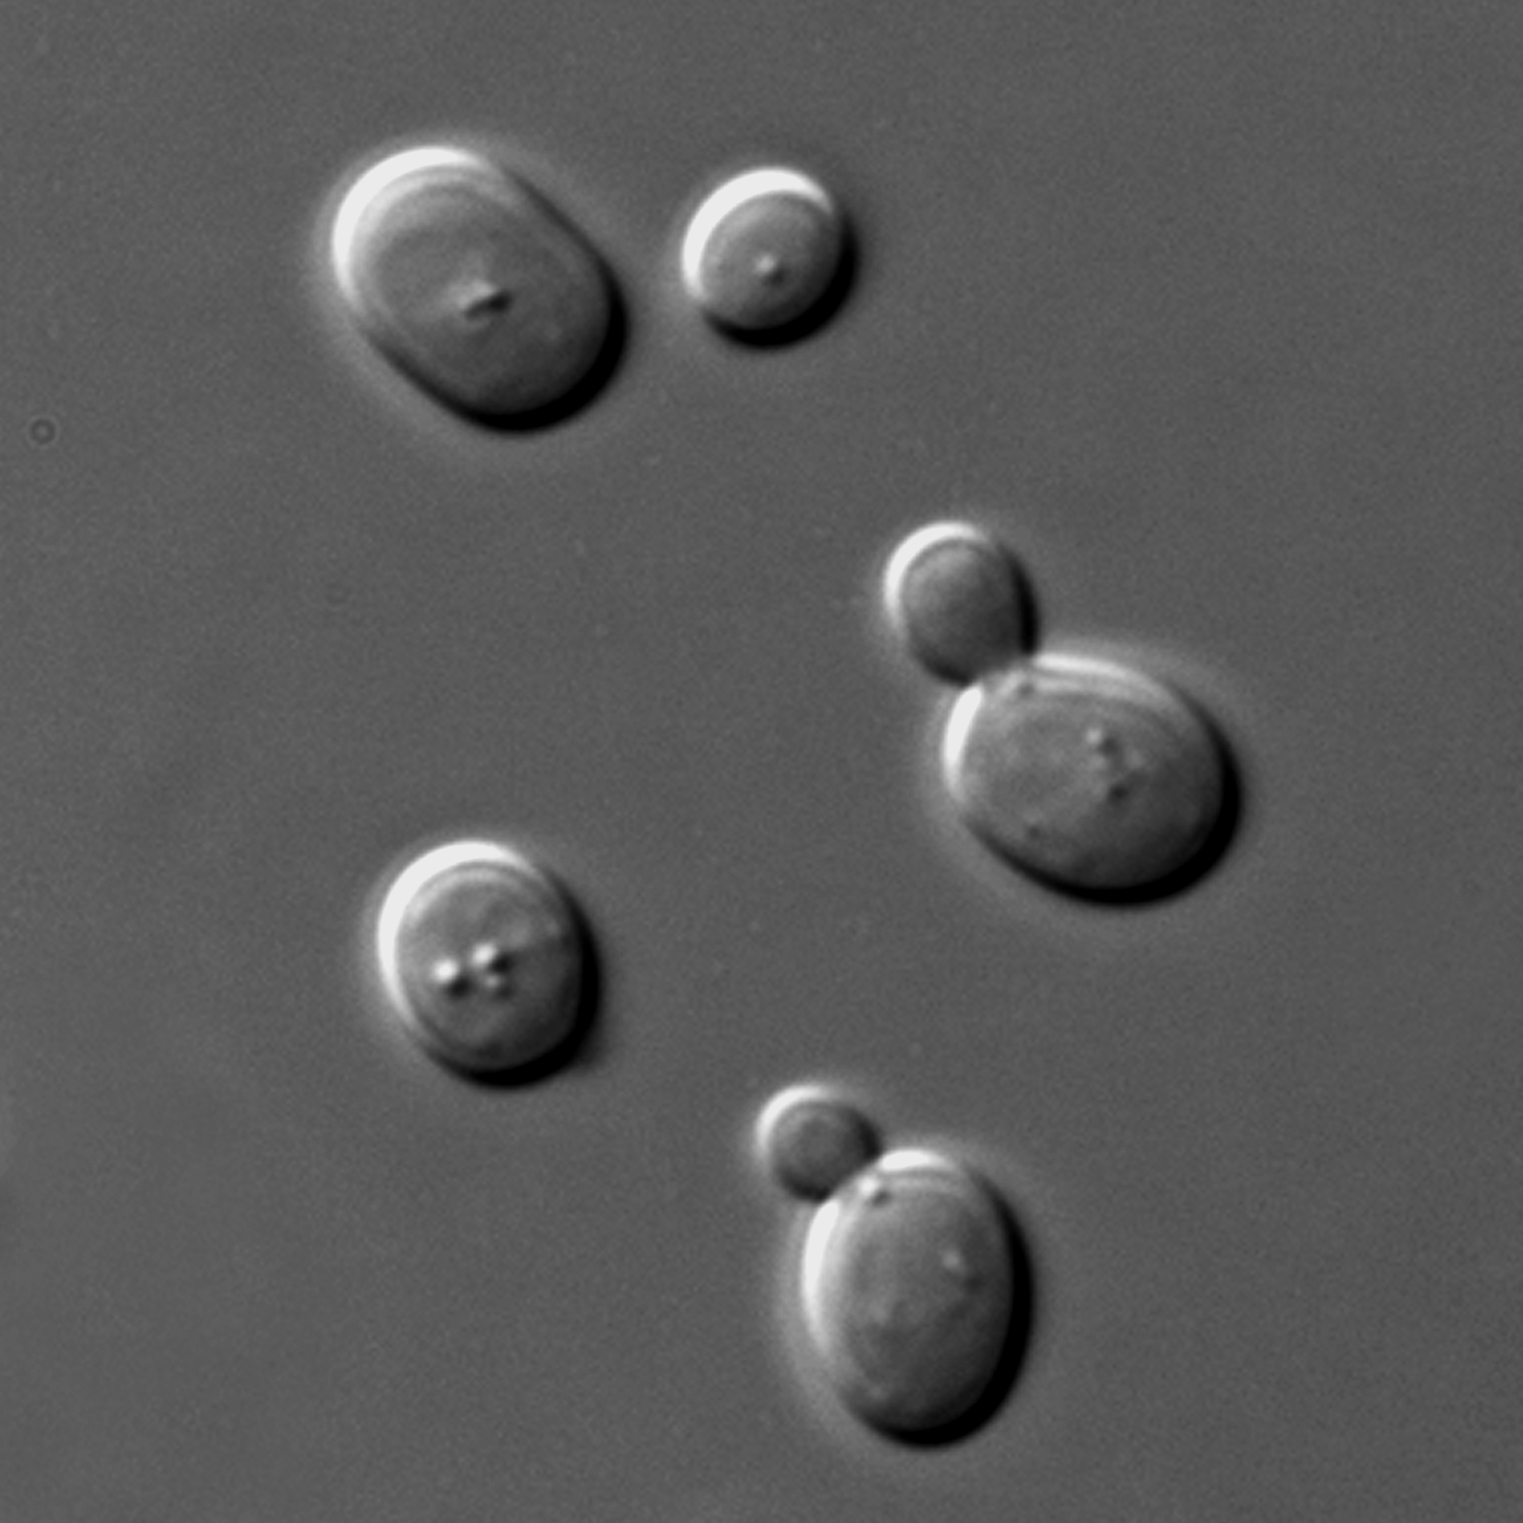
Making Bread and Beer
Ethanol and carbon dioxide from yeast respiration have uses in food production.
Carbon dioxide is used to make bread.
CO₂ forms bubbles of gas in the dough of the bread.
This causes the dough of the bread to rise.
Ethanol is used to make beer.
Glucose is added to a mixture.
Yeast is added and the container is sealed to prevent oxygen entering.
The yeast respires anaerobically and converts the glucose to ethanol - an alcohol.
Beer production video.
Yeast (S. cerevisiae) is used in the production of both bread and beer.
For more help, please visit www.exampaperspractice.co.uk
© 2025 Exams Papers Practice. All Rights Reserved

Slide 4
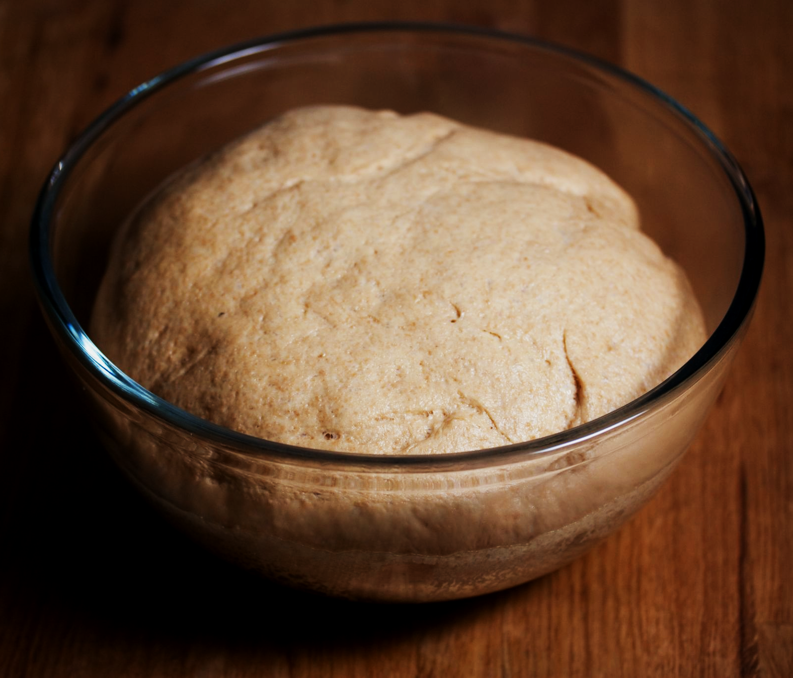
Yeast releases CO₂ when it respires anaerobically.
CO₂ is used in breadmaking to help the dough rise.
For more help, please visit www.exampaperspractice.co.uk
© 2025 Exams Papers Practice. All Rights Reserved

Slide 5
Yeast also releases ethanol during anaerobic respiration.
This is vital for creating alcoholic drinks like beer.
For more help, please visit www.exampaperspractice.co.uk
© 2025 Exams Papers Practice. All Rights Reserved

Slide 6
Investigating Respiration in Yeast
Specification Point 5.6
Practical: investigate the role of anaerobic respiration by yeast in different conditions.
Yeast releases CO₂ during anaerobic respiration.
The rate of CO₂ production can be used to measure the rate of respiration.
Mix yeast and glucose in a test tube and cover with layer of oil.
The oil prevents oxygen from reaching the yeast, ensuring respiration will be anaerobic.
Connect the test tube to another test tube full of limewater.
Use a capillary tube to link the two test tubes.
As the yeast respires, bubbles of CO₂ will be released.
As the temperature increases, more bubbles of CO₂ will be released per minute.
The CO₂ will cause the limewater to turn cloudy.
For more help, please visit www.exampaperspractice.co.uk
© 2025 Exams Papers Practice. All Rights Reserved

Slide 7
CAPILLARY
TUBE
As the yeast respires anaerobically, it will produce CO₂ gas. The gas will travel down the capillary tube to the limewater, which will turn cloudy.
LAYER OF OIL
YEAST AND GLUCOSE MIXTURE
LIMEWATER
For more help, please visit www.exampaperspractice.co.uk
© 2025 Exams Papers Practice. All Rights Reserved

Slide 8
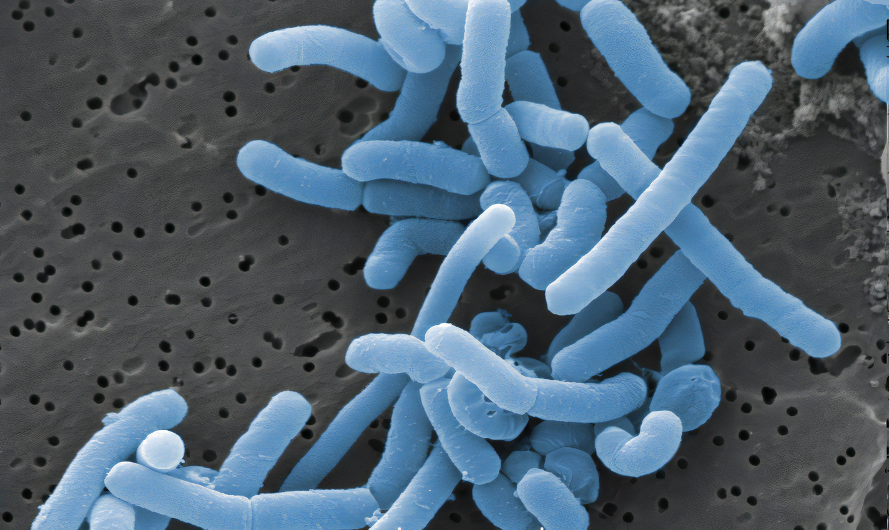
Yoghurt and Lactobacillus
Specification Point 5.7
Understand the role of bacteria (Lactobacillus) in the production of yoghurt.
The production of yoghurt also relies on microorganisms.
Lactobacillus is a bacteria that is used to make yoghurt.
Lactobacillus digests some of the proteins found in milk.
Lactobacillus also converts lactose (a sugar found in milk) into lactic acid.
This sours and thickens the milk to make yoghurt.
Lactobacillus is a rod-shaped bacteria that is used in the production of yoghurt.
For more help, please visit www.exampaperspractice.co.uk
© 2025 Exams Papers Practice. All Rights Reserved

Slide 9
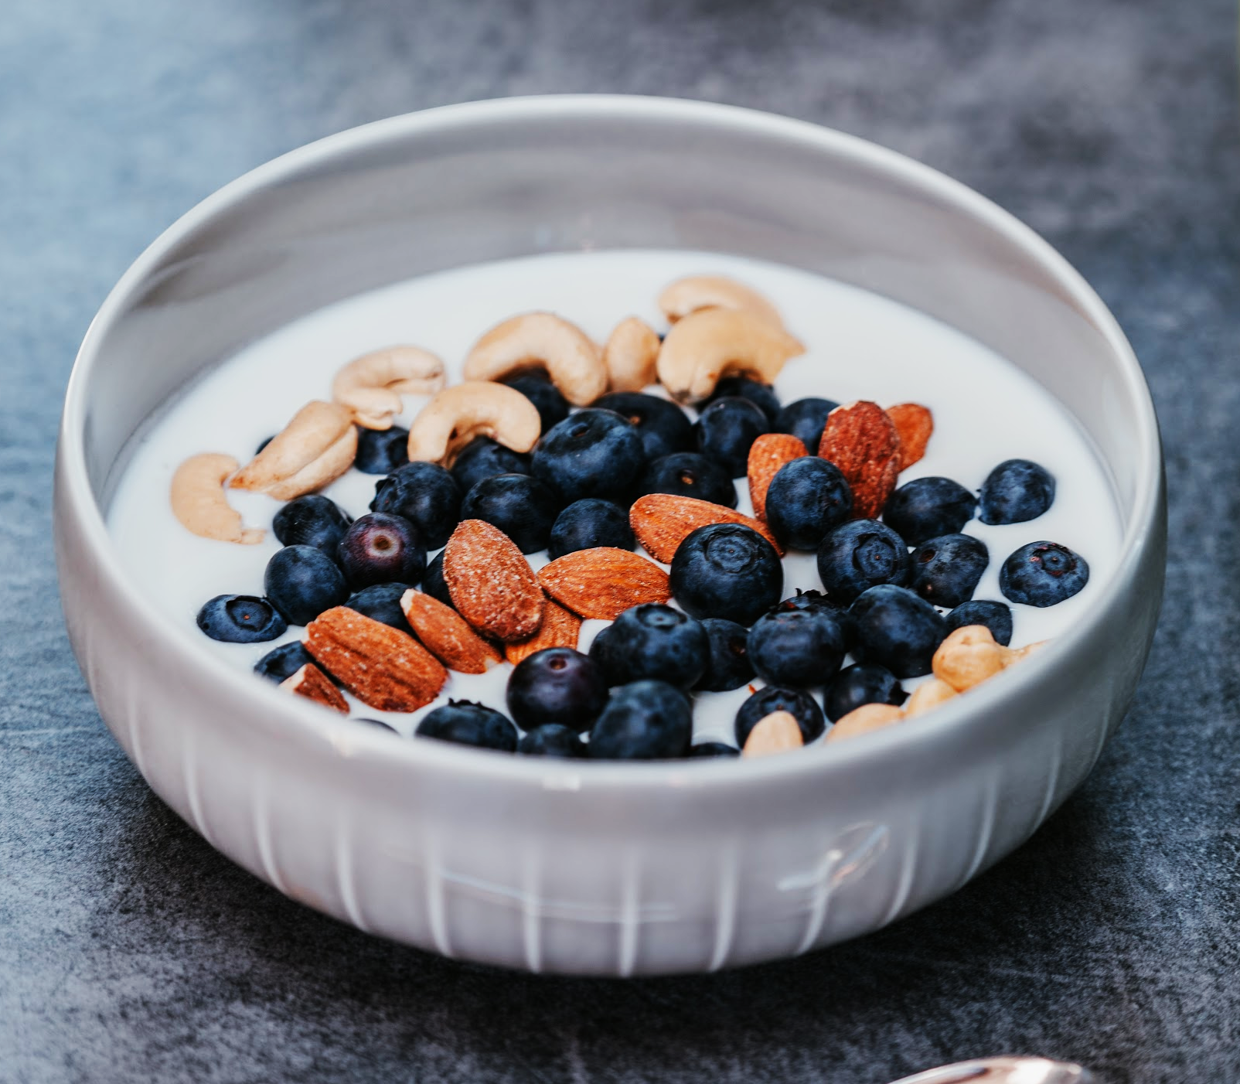
Lactobacillus will convert the lactose sugar found in milk into the sour-tasting lactic acid to form yoghurt.
For more help, please visit www.exampaperspractice.co.uk
© 2025 Exams Papers Practice. All Rights Reserved

Slide 10
Making Yoghurt
There is a standard protocol to making yoghurt using Lactobacillus:
Sterilize equipment to prevent contamination.
Sterilization ensures no other bacteria can grow in the reactant mixture.
Pasteurise the milk by heating it to 95°C.
Pasteurisation kills any microorganisms that may already be in the milk.
This ensures that no other microorganisms can compete with the Lactobacillus.
Cool the milk to between 45°C and 55°C.
Leave the mixture for several hours to incubate.
During this time the Lactobacillus will digest the lactose in the milk.
This will sour and thicken the milk to produce yoghurt.
Cool the yoghurt to 5°C.
This stops the Lactobacillus from breaking down the yoghurt further.
Yoghurt production video.
For more help, please visit www.exampaperspractice.co.uk
© 2025 Exams Papers Practice. All Rights Reserved

Slide 11
Microorganisms in Industry
Specification Point 5.8
Understand the use of an industrial fermenter and explain the need to provide suitable conditions in the fermenter.
Microorganisms are grown on an industrial scale.
This is because microorganisms have a wide range of applications:
Microorganisms are used to make foods like bread, yoghurt and mycoprotein.
Microorganisms are used in brewing to make beer and wine.
Genetically-modified microorganisms are used to make medicines and drugs.
Microorganisms can be grown in an industrial fermenter.
Conditions can be carefully controlled to optimise growth.
For more help, please visit www.exampaperspractice.co.uk
© 2025 Exams Papers Practice. All Rights Reserved

Slide 12
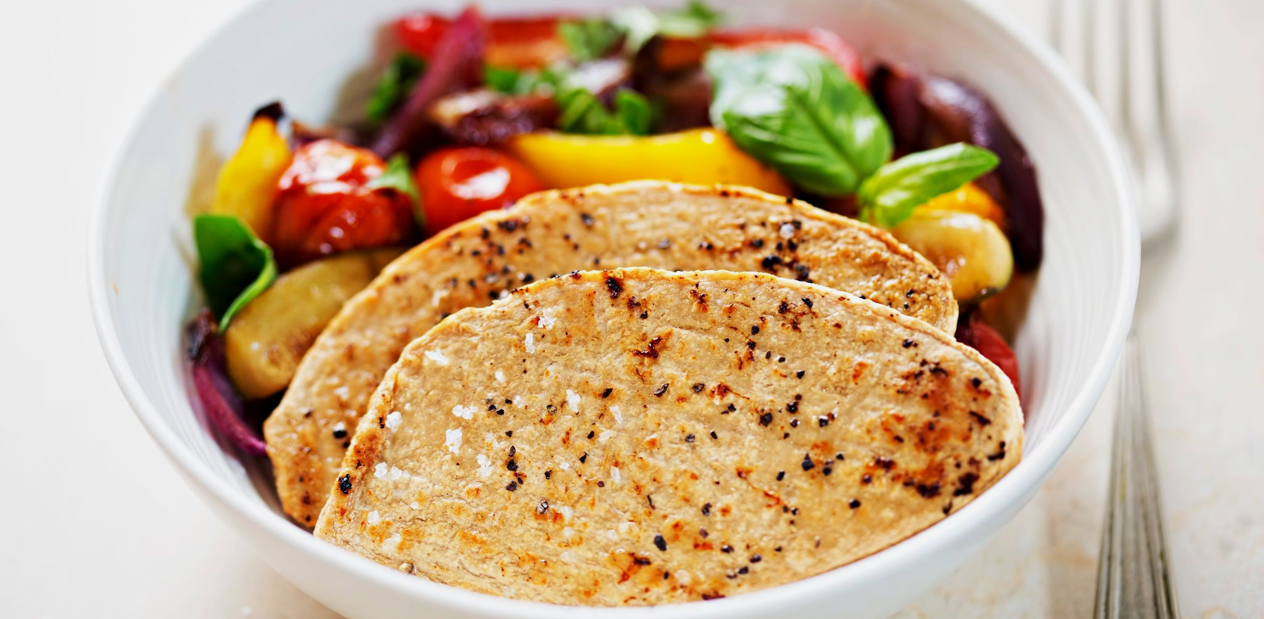
Mycoprotein, most commonly known as Quorn, is a meat-substitute made using microorganisms.
For more help, please visit www.exampaperspractice.co.uk
© 2025 Exams Papers Practice. All Rights Reserved

Slide 13
AGITATOR
NUTRIENTS IN →
Industrial fermenters are used to grow microorganisms on an industrial scale.
In order to maximise the growth rate of microorganisms, the conditions in the fermenter have to be carefully controlled.
AIR IN →
FERMENTER
WATER JACKET
PRODUCT OUT →
For more help, please visit www.exampaperspractice.co.uk
© 2025 Exams Papers Practice. All Rights Reserved

Slide 14
Conditions in the Fermenter
Conditions in the fermenter are carefully controlled.
Aseptic technique is practiced during industrial fermentation.
The fermenter is regularly steam-cleaned to kill any unwanted microorganisms.
This ensures only the desired microorganism will grow.
The fermenter is kept at an optimum temperature and pH.
Temperature and pH probes ensure optimum conditions are being maintained.
If the temperature is too high the enzymes in the microorganisms will denature.
If the temperature is too low there will not be enough kinetic energy for enzymes to work quickly.
The fermenter is continually supplied with oxygen.
This is fed in the form of sterile air, which ensures no contamination.
Oxygen is required for aerobic respiration of the microorganisms.
For more help, please visit www.exampaperspractice.co.uk
© 2025 Exams Papers Practice. All Rights Reserved

Slide 15
Conditions in the Fermenter
Nutrients are constantly added to the fermenter.
Nutrients are needed for the microorganisms to respire.
The energy released from respiration will allow the microorganisms to grow and reproduce.
The fermenter is agitated.
Paddles in the fermenter will continually stir the mixture.
This ensures that the microorganisms and their nutrients are evenly distributed in the fermenter.
It also ensures the fermenter is sufficiently aerated (full of oxygen).
For more help, please visit www.exampaperspractice.co.uk
© 2025 Exams Papers Practice. All Rights Reserved

Slide 16
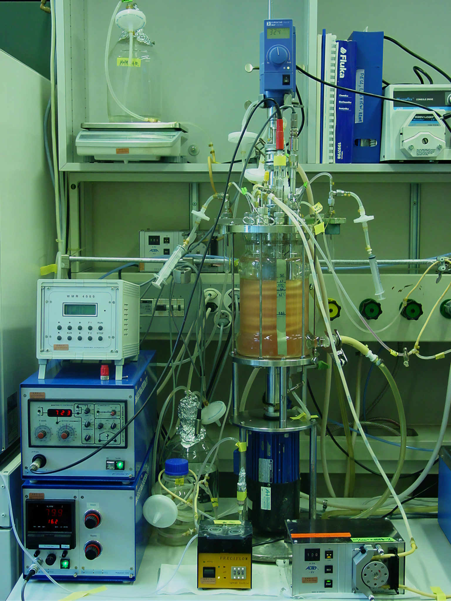
The conditions in fermenters are continually monitored to ensure that the conditions for growth of the microorganisms are optimal.
For more help, please visit www.exampaperspractice.co.uk
© 2025 Exams Papers Practice. All Rights Reserved

