Slide 1
Edexcel IGCSE Biology
57 - Crop Production
Polytunnels, Fertilizers and Pesticides
For more help, please visit www.exampaperspractice.co.uk
© 2025 Exams Papers Practice. All Rights Reserved

Slide 2
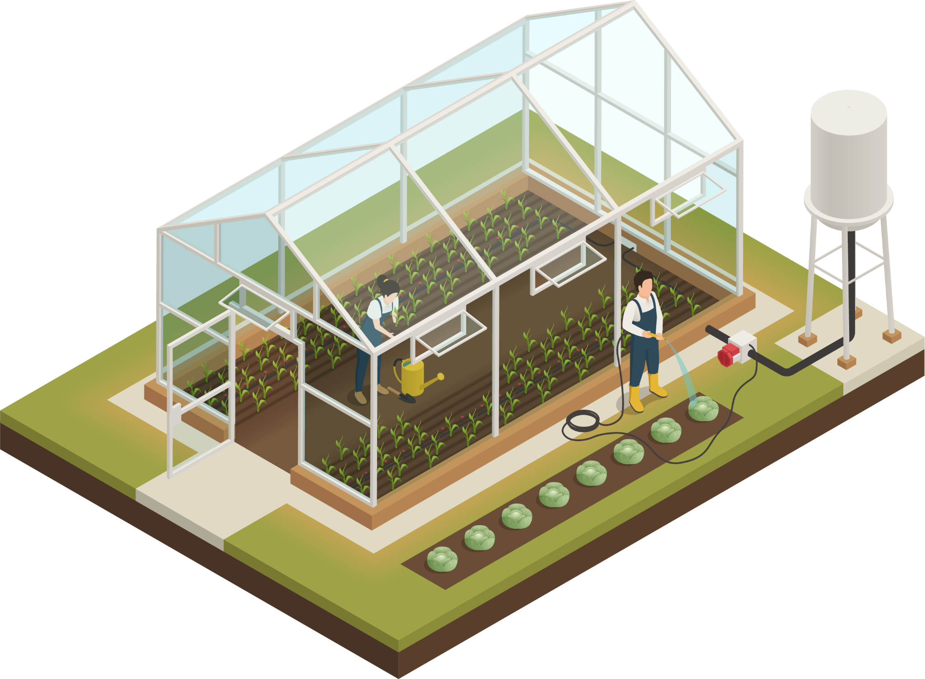
Glasshouses
Specification Point 5.1
Describe how glasshouses and polythene tunnels can be used to increase the yield of certain crops.
The rate of growth of crops for food is dependent on:
Temperature.
Light intensity.
Carbon dioxide (CO₂) levels.
The rate of growth of crops can be increased by using glasshouses:
The increased temperature means that metabolic reactions occur faster due to more kinetic energy.
Additional lighting through artificial lamps can increase the rate of photosynthesis.
Additional CO₂ through the burning of paraffin lamps can be used to increase the rate of photosynthesis.
Additional watering increases the rate of metabolic reactions.
Crops are often grown in glasshouses to increase their yield. Glasshouses provide the optimum conditions for growth.
For more help, please visit www.exampaperspractice.co.uk
© 2025 Exams Papers Practice. All Rights Reserved

Slide 3
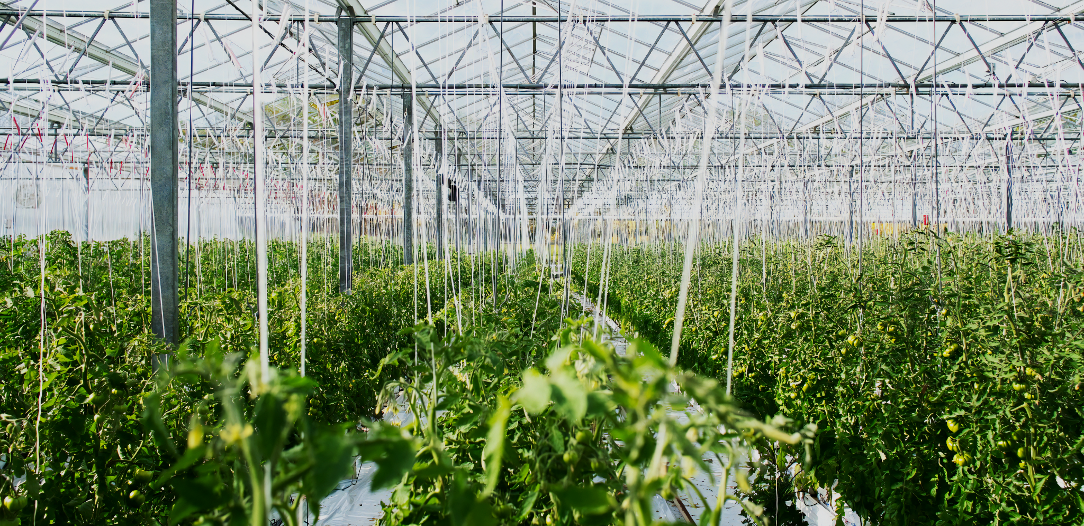
Glasshouses can be used on an industrial scale to grow crops like bananas.
For more help, please visit www.exampaperspractice.co.uk
© 2025 Exams Papers Practice. All Rights Reserved

Slide 4
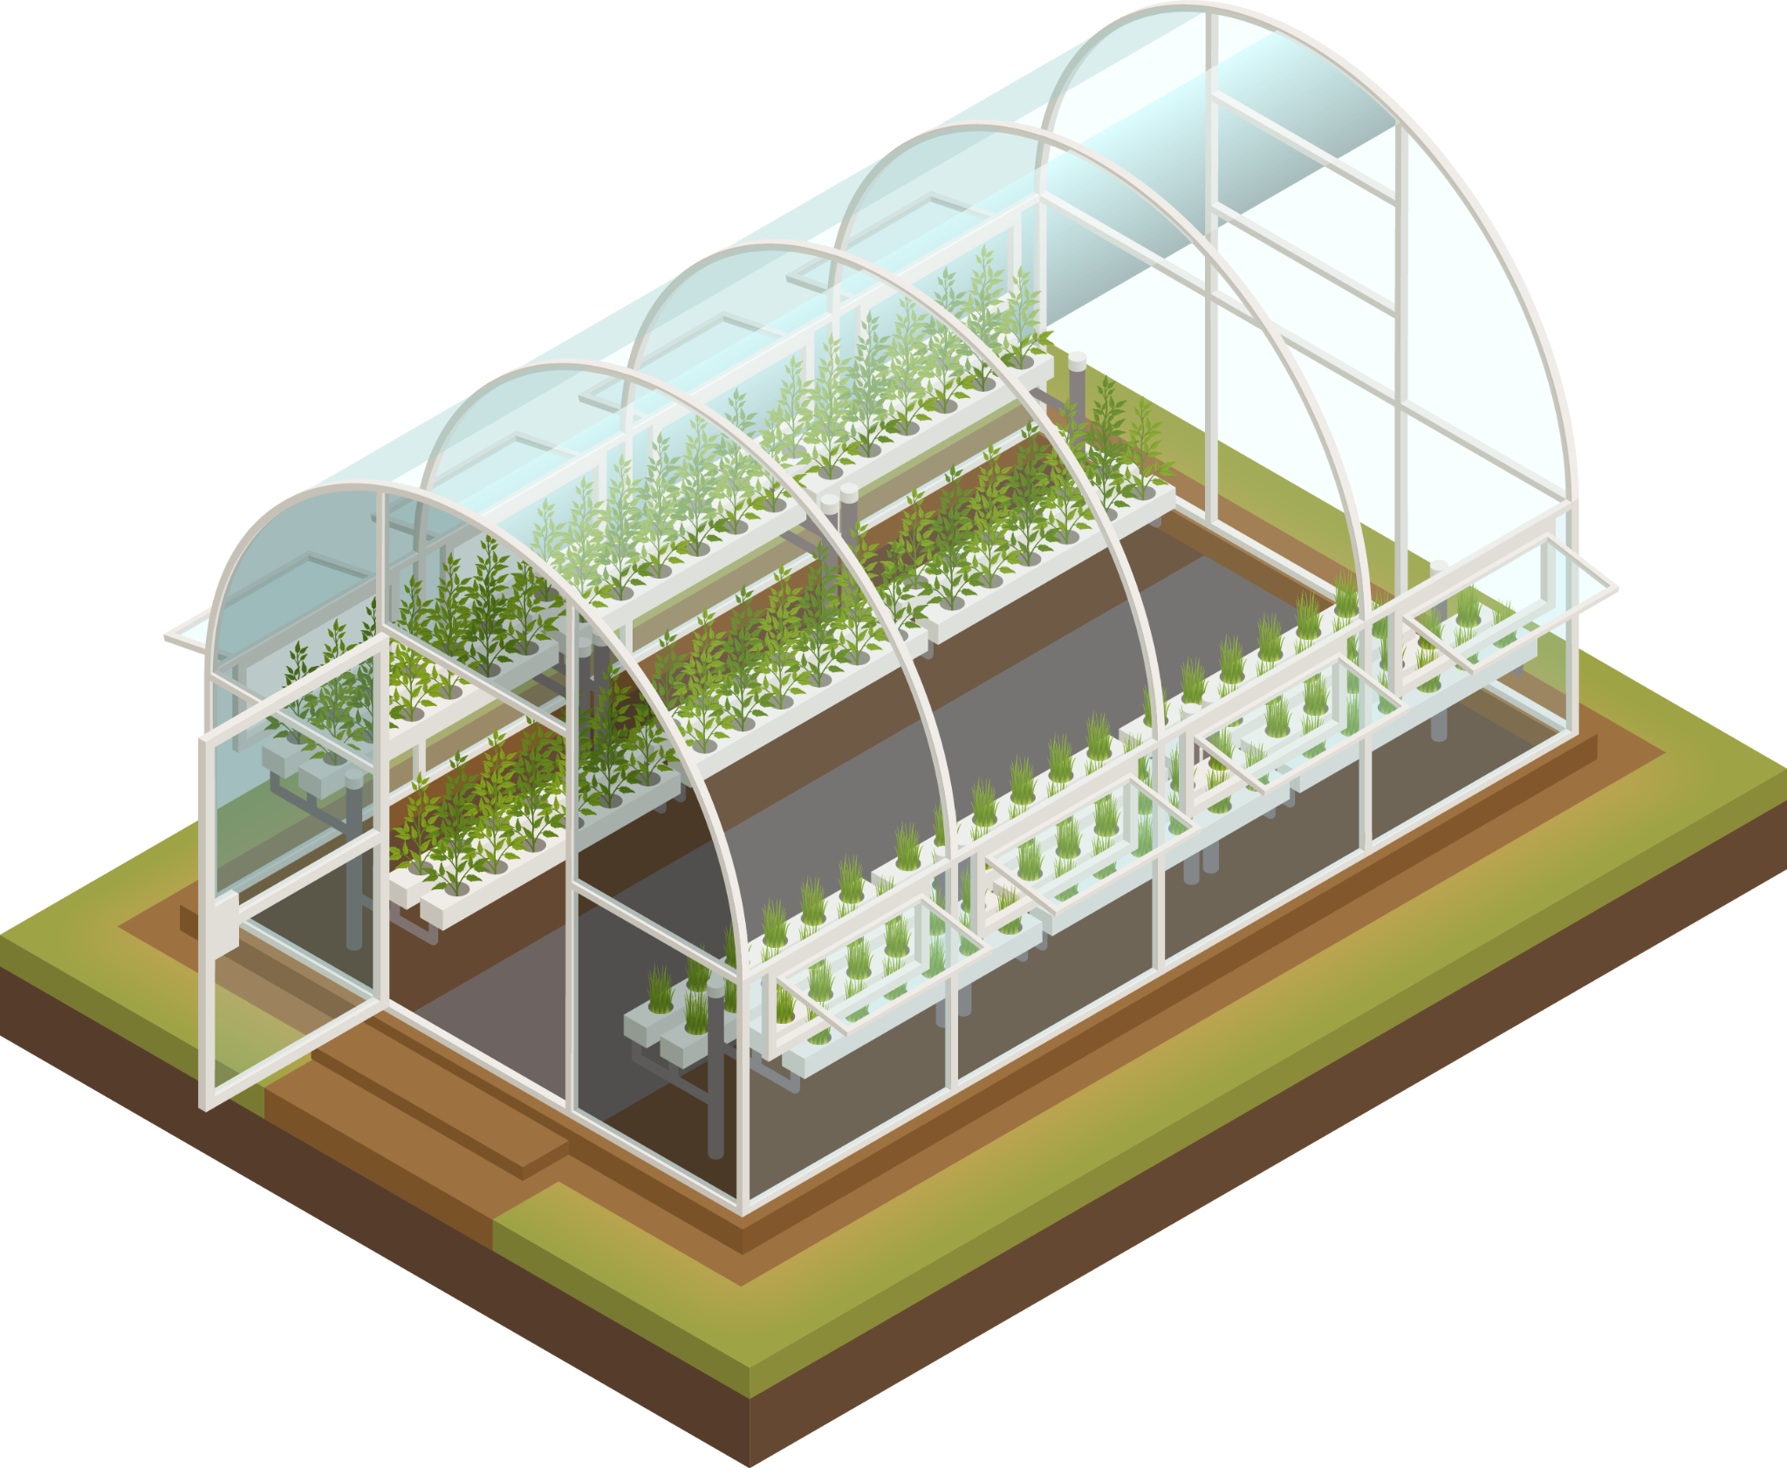
Polytunnels
Crops can also be grown in polytunnels.
Polytunnels are usually semi-circular constructions covered in polythene plastic.
Polytunnels protect against:
Wind.
Rain.
Fluctuations in temperature.
Polytunnels can protect against bird pests.
Polytunnels can also protect against insect pests.
Polythene forms a seal under the ground to protect against insect invasion.
Polytunnels are usually semi-permanent structures designed to protect crops from extreme fluctuations in weather. They also offer some protection against pests.
For more help, please visit www.exampaperspractice.co.uk
© 2025 Exams Papers Practice. All Rights Reserved

Slide 5
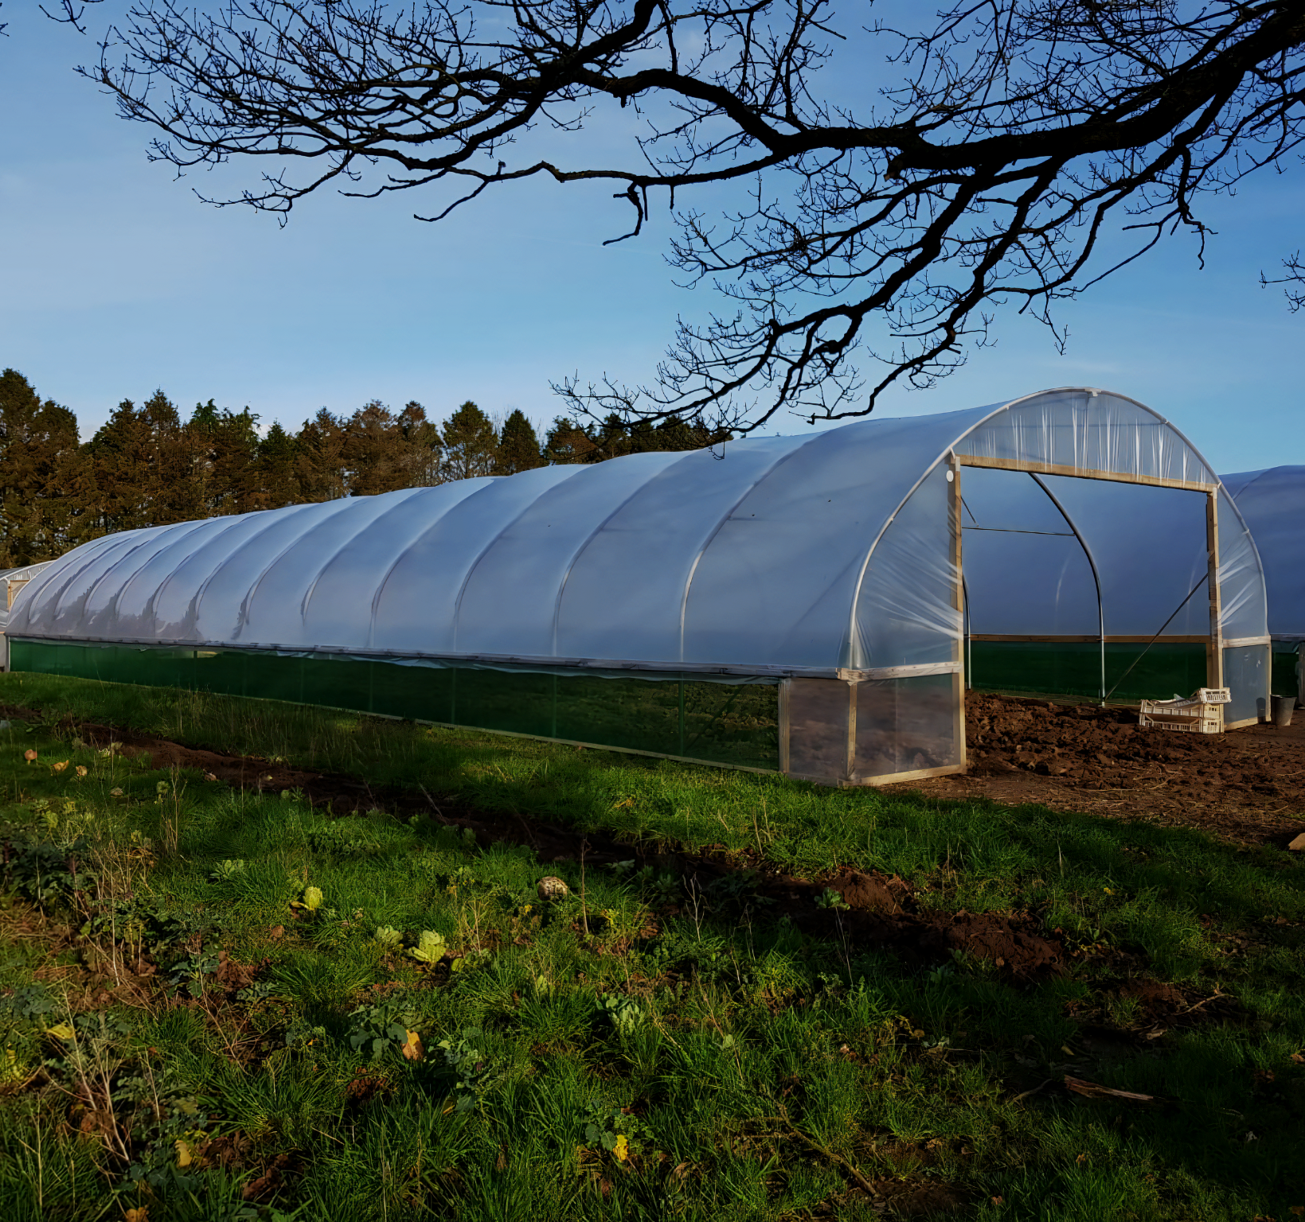
Polytunnels provide protection against extremes of weather as well as attacks from pests.
For more help, please visit www.exampaperspractice.co.uk
© 2025 Exams Papers Practice. All Rights Reserved

Slide 6
CO₂ and Crop Growth
Specification Point 5.2
Understand the effects on crop yield of increased carbon dioxide and increased temperature in glasshouses.
Increasing the CO₂ concentration increases the crop yield:
More CO₂ is available for photosynthesis.
More carbon is incorporated into glucose.
As more glucose is available there is more respiration.
Respiration ensures the plant has more energy.
More energy is available for crop growth.
The concentration of CO₂ is often increased by burning paraffin lamps inside glasshouses.
For more help, please visit www.exampaperspractice.co.uk
© 2025 Exams Papers Practice. All Rights Reserved

Slide 7
Temperature and Crop Growth
Increasing the temperature in a glasshouse increases the crop yield:
More kinetic energy is available for enzymes.
The enzymes that control photosynthesis will work faster.
This will increase the rate of glucose production.
More glucose is available for respiration.
More energy is available for crop growth.
Farmers will try and grow their crops at the optimum temperature, between 35°C and 40°C.
RATE OF PHOTOSYNTHESIS →
OPTIMUM TEMPERATURE - 35°C
TEMPERATURE (°C) →
For more help, please visit www.exampaperspractice.co.uk
© 2025 Exams Papers Practice. All Rights Reserved

Slide 8
Fertilizers
Specification Point 5.3
Understand how the use of fertiliser can increase crop yield.
Many farmers use fertilizers to increase crop yields.
One of the main groups of fertilizers are called NPK fertilizers.
NPK fertilizers contain nitrogen, phosphorus and potassium.
NPK fertilizers are water-soluble and easily absorbed by the roots of plants.
Nitrogen is needed to make amino acids.
Plants with a nitrogen deficiency will have yellow leaves and stunted growth.
Phosphorus is needed to make cell membranes and DNA.
Plants with a phosphorus deficiency will have discoloured leaves and poor root growth.
Potassium is needed to make ATP and drive enzyme reactions.
Plants with a potassium deficiency will have poor fruit growth and brown spots on leaves.
For more help, please visit www.exampaperspractice.co.uk
© 2025 Exams Papers Practice. All Rights Reserved

Slide 9
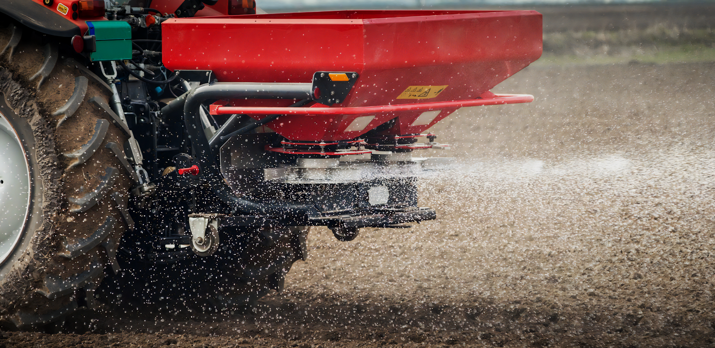
NPK fertilizers are sprayed in vast quantities to increase crop yields.
For more help, please visit www.exampaperspractice.co.uk
© 2025 Exams Papers Practice. All Rights Reserved

Slide 10
GLOBAL FERTILIZER PRODUCTION IN TONNES PER YEAR
200 MILLION
POTASSIUM
FERTILIZER
150 MILLION
PHOSPHATE
FERTILIZER
Due to higher demand from agriculture, there has been a huge increase in the amount of NPK fertilizers produced per year.
100 MILLION
NITROGEN
FERTILIZER
50 MILLION
1960
1985
2010
For more help, please visit www.exampaperspractice.co.uk
© 2025 Exams Papers Practice. All Rights Reserved

Slide 11
Agricultural Pests
Specification Point 5.4
Understand the reasons for pest control and the advantages and disadvantages of using pesticides and biological control with crop plants.
Crop yields can be significantly reduced by pests.
Insects and other small animals can damage crop yields by eating crops.
Crop yields can also be reduced by weeds.
Weeds compete with crops for light and nutrients.
Crops can become diseased by fungi or bacteria.
Aphids are insect pests that can be extremely destructive to crops. Different species of aphids feed on cabbages, apples and potatoes.
For more help, please visit www.exampaperspractice.co.uk
© 2025 Exams Papers Practice. All Rights Reserved

Slide 12
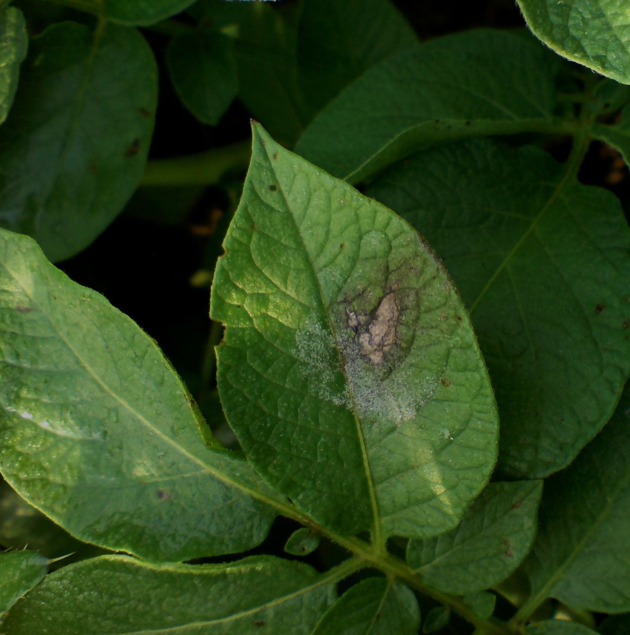
Potato blight is a fungal infection that was responsible for the Great Irish Famine of the 1840s.
Today, potato blight is still responsible for the loss of up to 20% of potato crops.
For more help, please visit www.exampaperspractice.co.uk
© 2025 Exams Papers Practice. All Rights Reserved

Slide 13
Pesticides
Pesticides are used as a chemical control to kill other organisms.
Insects are killed by insecticides.
Insecticides usually target aphids, moths and beetles.
Weeds are killed by herbicides.
Herbicides usually target grasses, ivys and nettles.
Fungi are killed by fungicides.
Fungicides usually target mildews, rusts and rots.
Pesticides are generally quite toxic and must be applied with caution.
For more help, please visit www.exampaperspractice.co.uk
© 2025 Exams Papers Practice. All Rights Reserved

Slide 14
Evaluating Pesticides
There are advantages and disadvantages to the use of pesticides:
Pesticides have an immediate effect on the pest population.
Pesticides are fast-acting and quickly reduce the number of pests.
Pesticides are cheap and readily available.
Pesticides are manufactured on a huge scale.
Pesticides usually eradicate pests.
Pesticides are usually very toxic to pests and often eliminate the population.
Pesticides need to be repeatedly applied in order to be effective.
This can be expensive and time-consuming.
Pesticides kill organisms that are not pests.
Pesticides are non-specific and may harm organisms that are not pests.
Pesticides also persist in the environment and may have unpredictable consequences on food webs.
Over time pests may become resistant to pesticides.
This means the pesticide will become less effective.
For more help, please visit www.exampaperspractice.co.uk
© 2025 Exams Papers Practice. All Rights Reserved

Slide 15
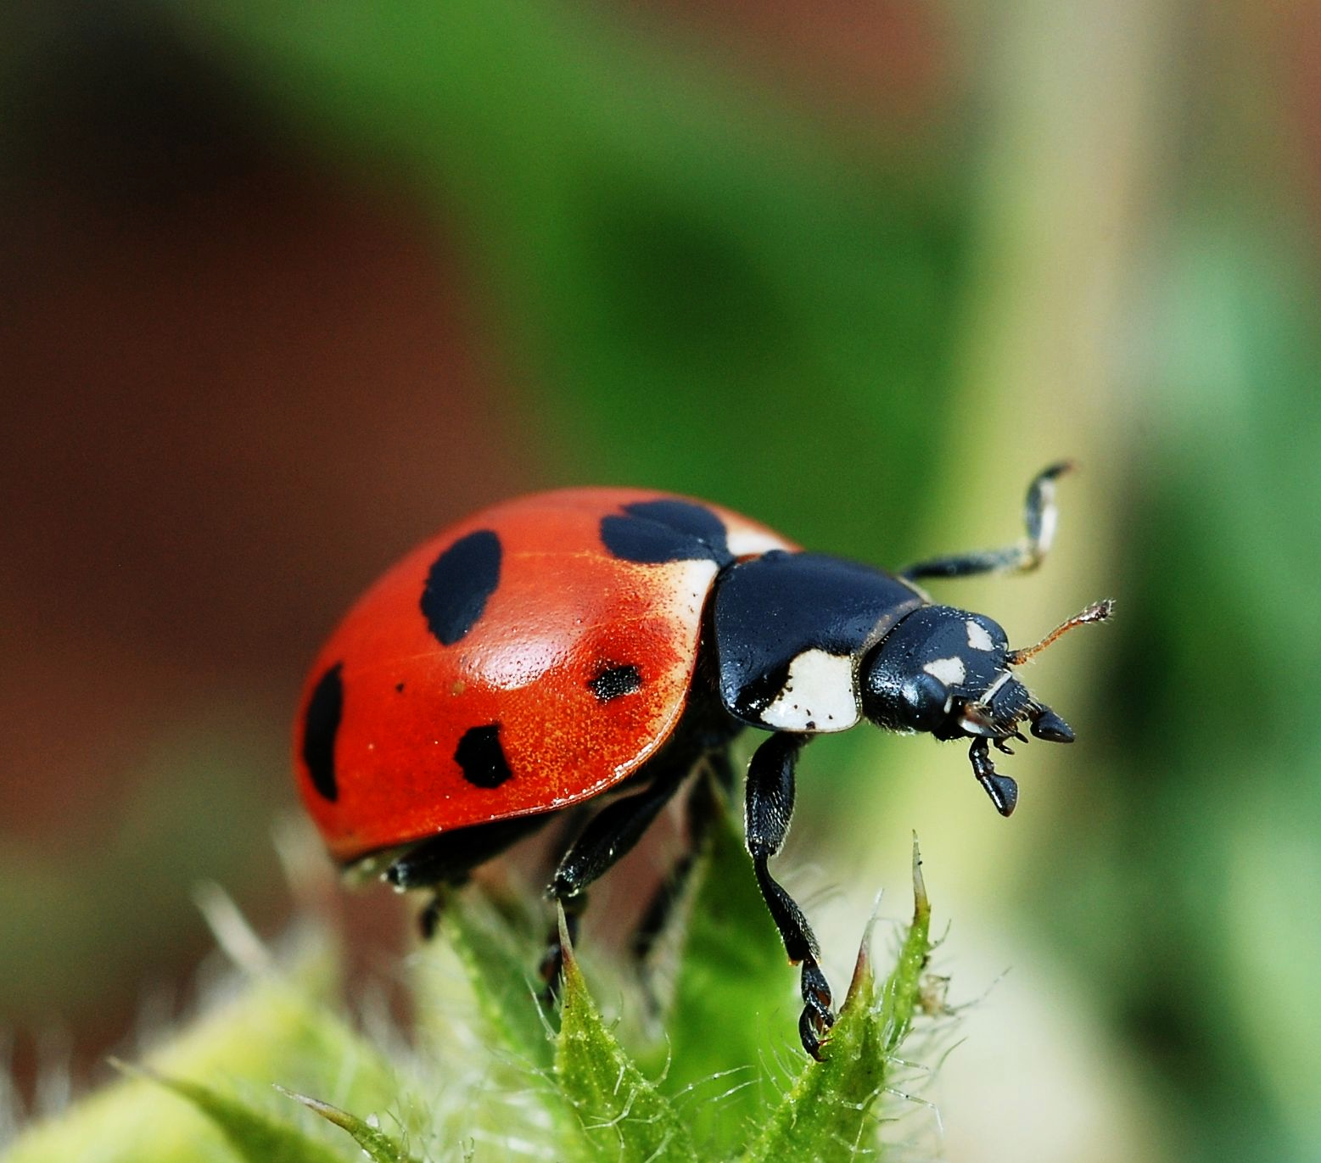
Biological Controls
Pests can also be controlled with biological controls.
A biological control is a living organism that is a natural predator of the pest.
The ladybird beetle is often used to control populations of aphids.
Biological controls are usually introduced into the ecosystem.
Colonies of predators may be introduced and integrated into agricultural settings.
The ladybird is a natural predator of aphids and is often artificially introduced into farms to control their numbers.
For more help, please visit www.exampaperspractice.co.uk
© 2025 Exams Papers Practice. All Rights Reserved

Slide 16
Evaluating Biological Controls
There are also advantages and disadvantages to the use of biological controls:
Biological controls are long-lasting.
Unlike pesticides, biological controls do not need to be regularly reapplied.
Biological controls are non-polluting.
Biological controls can target individual species.
Biological controls are much more specific in their targeting than pesticides.
Biological controls take time to be established.
Populations may take weeks or months to fully integrate themselves into a new environment.
Biological controls might not eat the pest.
There is no guarantee the biological control will target the pest.
The biological control may instead choose to eat a different organism.
Biological controls will not eradicate the pest.
Some pests will remain in the ecosystem and continue to cause harm to crops.
For more help, please visit www.exampaperspractice.co.uk
© 2025 Exams Papers Practice. All Rights Reserved

