Slide 1
Edexcel IGCSE Biology
55 - Pollution and Global Warming
Air and Water Pollution, the Greenhouse Effect
For more help, please visit www.exampaperspractice.co.uk
© 2025 Exams Papers Practice. All Rights Reserved

Slide 2
Air Pollution
Specification Point 4.12
Understand the biological consequences of pollution of air by sulfur dioxide and carbon monoxide.
Pollution is the release of environmentally damaging substances.
Since the industrial revolution, humanity has released large quantities of pollutants from fossil fuels and manufacturing.
Pollution released into the atmosphere is called air pollution.
Polluting gases include carbon monoxide (CO) and sulphur dioxide (SO₂).
EMISSIONS OF SO₂ BY WORLD REGION
140
120
100
S. AMERICA
80
N. AMERICA
EMISSIONS (MEGATONNES)
60
EUROPE
40
ASIA
20
AFRICA
1850
TIME →
2010
For more help, please visit www.exampaperspractice.co.uk
© 2025 Exams Papers Practice. All Rights Reserved

Slide 3
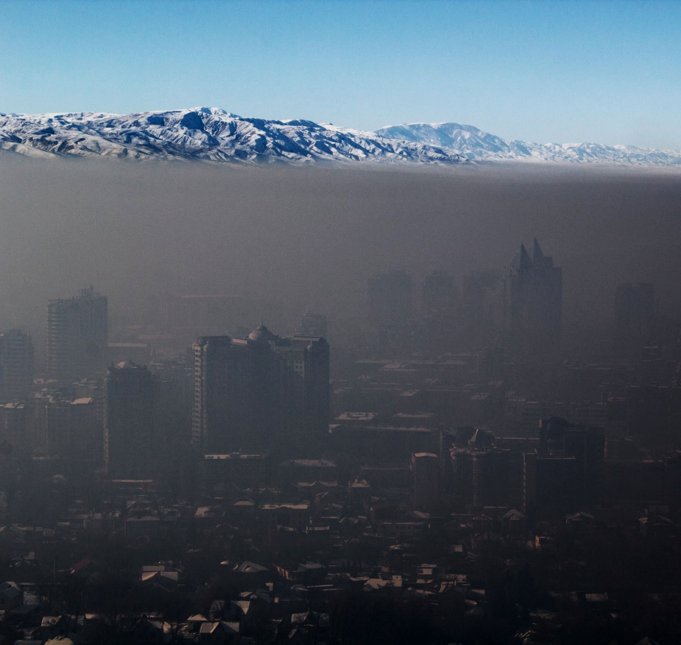
Air pollution is considered to be hazardous to human health.
Air pollution is worst in cities. Several pollutants combine to form a concoction called smog.
For more help, please visit www.exampaperspractice.co.uk
© 2025 Exams Papers Practice. All Rights Reserved

Slide 4
Acid Rain
Fossil fuels contain traces of sulphur.
When fossil fuels are burnt, sulphur dioxide forms in the atmosphere.
Sulphur combines with oxygen to form SO₂.
Sulphur dioxide combines with water droplets in the atmosphere as well as oxygen to form sulphuric acid (H₂SO₄):
2SO₂ + 2H₂O + O₂→ 2H₂SO₄
Sulphuric acid falls as acid rain.
Acid rain has a pH of around 5.
Acid rain damages plants and aquatic life.
Acid rain causes damage to root systems and leaves.
Acid rain makes the pH of lakes and river too low to sustain life.
For more help, please visit www.exampaperspractice.co.uk
© 2025 Exams Papers Practice. All Rights Reserved

Slide 5
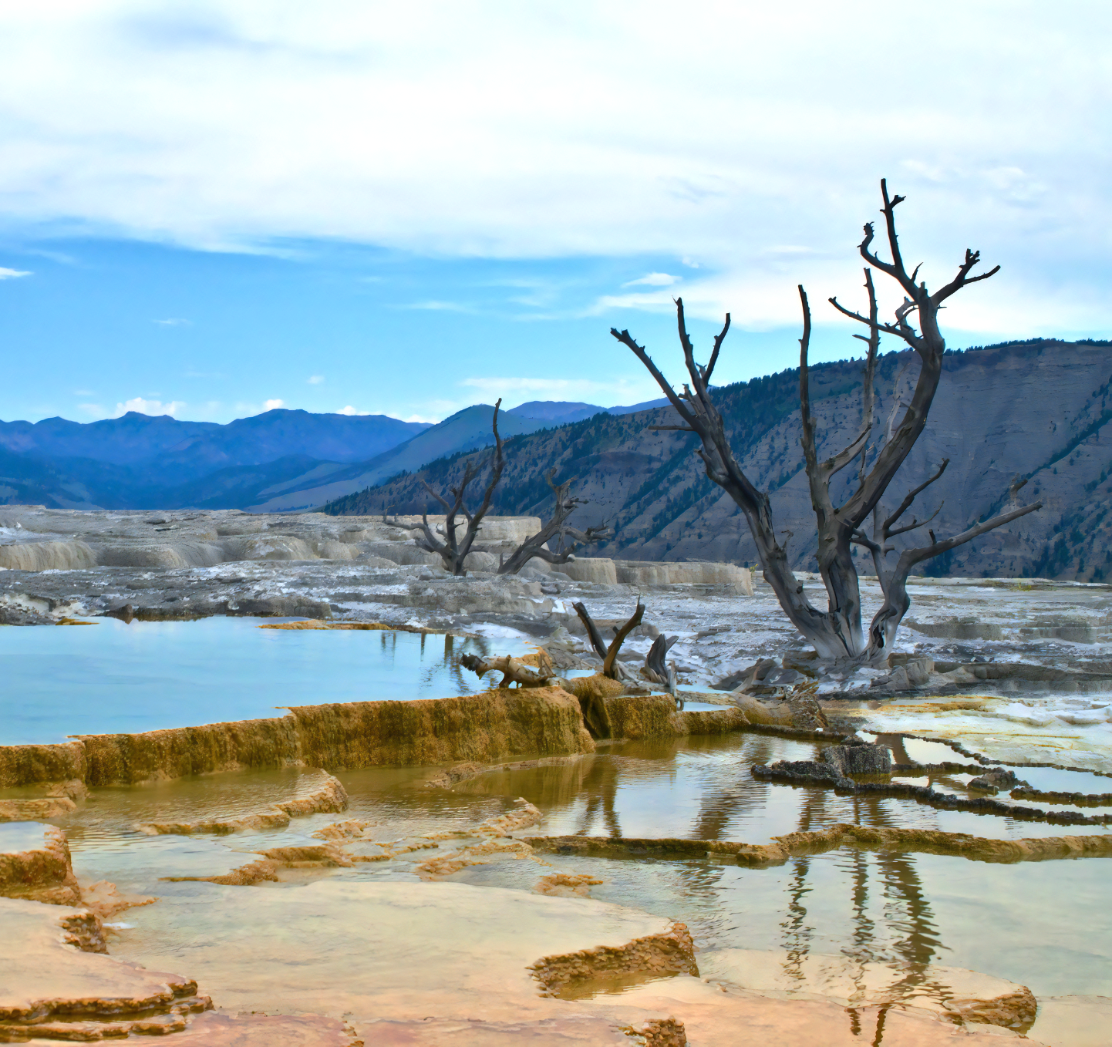
Acid rain strips the leaves off trees and denatures the enzymes of fish and other aquatic life.
For more help, please visit www.exampaperspractice.co.uk
© 2025 Exams Papers Practice. All Rights Reserved

Slide 6
Carbon Monoxide
Carbon monoxide (CO) is formed from the incomplete combustion of fossil fuels.
Incomplete combustion occurs when fossil fuels burn in limited oxygen.
Car engines produce lots of carbon monoxide.
Carbon monoxide binds irreversibly to haemoglobin in red blood cells.
Carbon monoxide combines with haemoglobin instead of oxygen.
The body’s ability to carry oxygen is reduced.
This is referred to as carbon monoxide poisoning.
Carbon monoxide poisoning can lead to tiredness, unconsciousness and ultimately death.
Exposure to carbon monoxide whilst pregnant can also stunt the growth of the foetus.
Carbon monoxide binds to haemoglobin inside red blood cells. This prevents the cell from carrying oxygen around the body.
For more help, please visit www.exampaperspractice.co.uk
© 2025 Exams Papers Practice. All Rights Reserved

Slide 7
Car engines are a major contributor to carbon monoxide emissions.
For more help, please visit www.exampaperspractice.co.uk
© 2025 Exams Papers Practice. All Rights Reserved

Slide 8
Greenhouse Gases
Specification Point 4.13
Understand that water vapour, carbon dioxide, nitrous oxide, methane and CFCs are greenhouse gases.
Infrared (IR) radiation is released from the Sun.
IR radiation releases heat energy.
This heat is used to warm the Earth.
Gases that absorb infrared radiation are called greenhouse gases.
There are a number of different greenhouse gases:
Water vapour.
Carbon dioxide (CO₂).
Nitrous oxide.
Methane.
Chlorofluorocarbons (CFCs).
For more help, please visit www.exampaperspractice.co.uk
© 2025 Exams Papers Practice. All Rights Reserved

Slide 9
Greenhouse Gases
Specification Point 4.14
Understand how human activities contribute to greenhouse gases.
Manufacturing, energy production, transport and agriculture have all increased rapidly since the industrial revolution.
These activities have released large quantities of greenhouse gases.
CO₂ is released through the burning of fossil fuels.
The combustion of fossil fuels like oil and gas release lots of CO₂.
Methane is released by agricultural processes.
Methane is released by grazing animals and by rice paddy fields.
Nitrous oxides are also released by agricultural processes.
Fertilizers release lots of nitrous oxides when they are sprayed.
For more help, please visit www.exampaperspractice.co.uk
© 2025 Exams Papers Practice. All Rights Reserved

Slide 10
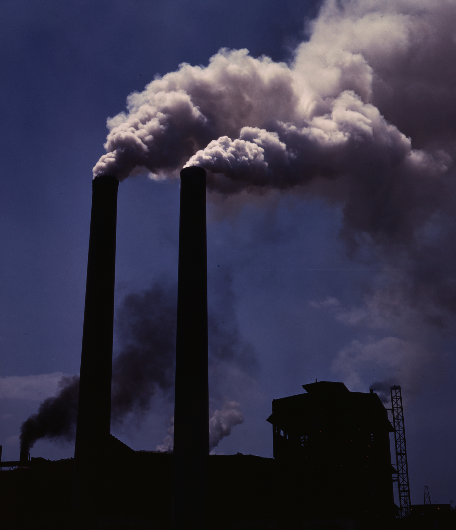
CO₂ is released from the burning of fossil fuels. The atmospheric concentration of CO₂ has increased rapidly since first recorded.
MAUNA LOA 1958 - 2020
420
400
380
CO₂ CONCENTRATION (PPM)
360
340
320
1960
1970
1980
1990
2000
2010
2020
For more help, please visit www.exampaperspractice.co.uk
© 2025 Exams Papers Practice. All Rights Reserved

Slide 11
Rice paddy fields are a major source of atmospheric methane.
For more help, please visit www.exampaperspractice.co.uk
© 2025 Exams Papers Practice. All Rights Reserved

Slide 12
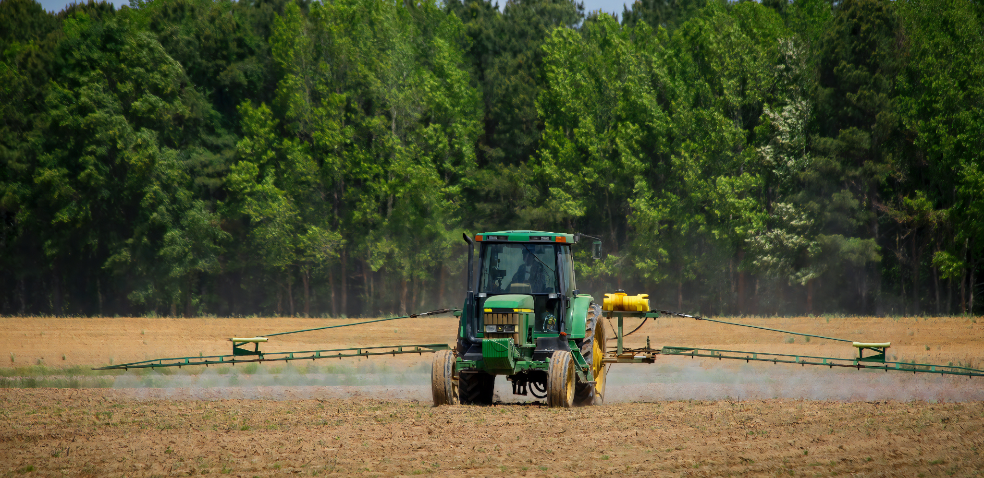
Nitrous oxides are released from agricultural fertilizers.
For more help, please visit www.exampaperspractice.co.uk
© 2025 Exams Papers Practice. All Rights Reserved

Slide 13
The Greenhouse Effect
Specification Point 4.15
Understand how an increase in greenhouse gases results in an enhanced greenhouse effect and that this may lead to global warming and its consequences.
Greenhouse gases contribute to the greenhouse effect.
Greenhouse gases trap infrared radiation before it escapes to space.
This keeps heat energy in the atmosphere.
The greenhouse effect is necessary for life.
Without the greenhouse effect, Earth would be too cold for organisms to survive.
Humans are responsible for the enhanced greenhouse effect.
A rapid increase in the concentrations of greenhouse gases are strongly linked to an increase in global surface temperatures.
Greenhouse effect video.
Increased surface temperatures are referred to as global warming.
For more help, please visit www.exampaperspractice.co.uk
© 2025 Exams Papers Practice. All Rights Reserved

Slide 14
1. SOLAR ENERGY HITS EARTH
The greenhouse effect traps heat energy in the atmosphere, ensuring it is warm enough to support life.
GREENHOUSE
GASES
4. SOME HEAT ESCAPES TO SPACE
2. INFRARED HEAT
3. MOST HEAT IS CONTAINED IN THE ATMOSPHERE
For more help, please visit www.exampaperspractice.co.uk
© 2025 Exams Papers Practice. All Rights Reserved

Slide 15
Consequences of Global Warming
There are a number of consequences of global warming:
Increased global temperatures will lead to rising sea levels.
As glaciers melt, huge quantities of water will be added to the oceans.
Increased temperature may lead to more frequent extreme weather events.
Tsunamis, hurricanes and droughts have all increased in frequency in recent years.
Habitats will be lost.
Increases in temperature will disrupt ecosystems.
This is likely to lead to the extinctions of many species.
Species will migrate to new areas.
In order to find more comfortable habitats, species will migrate into new areas.
This may have negative effects on native species.
For more help, please visit www.exampaperspractice.co.uk
© 2025 Exams Papers Practice. All Rights Reserved

Slide 16
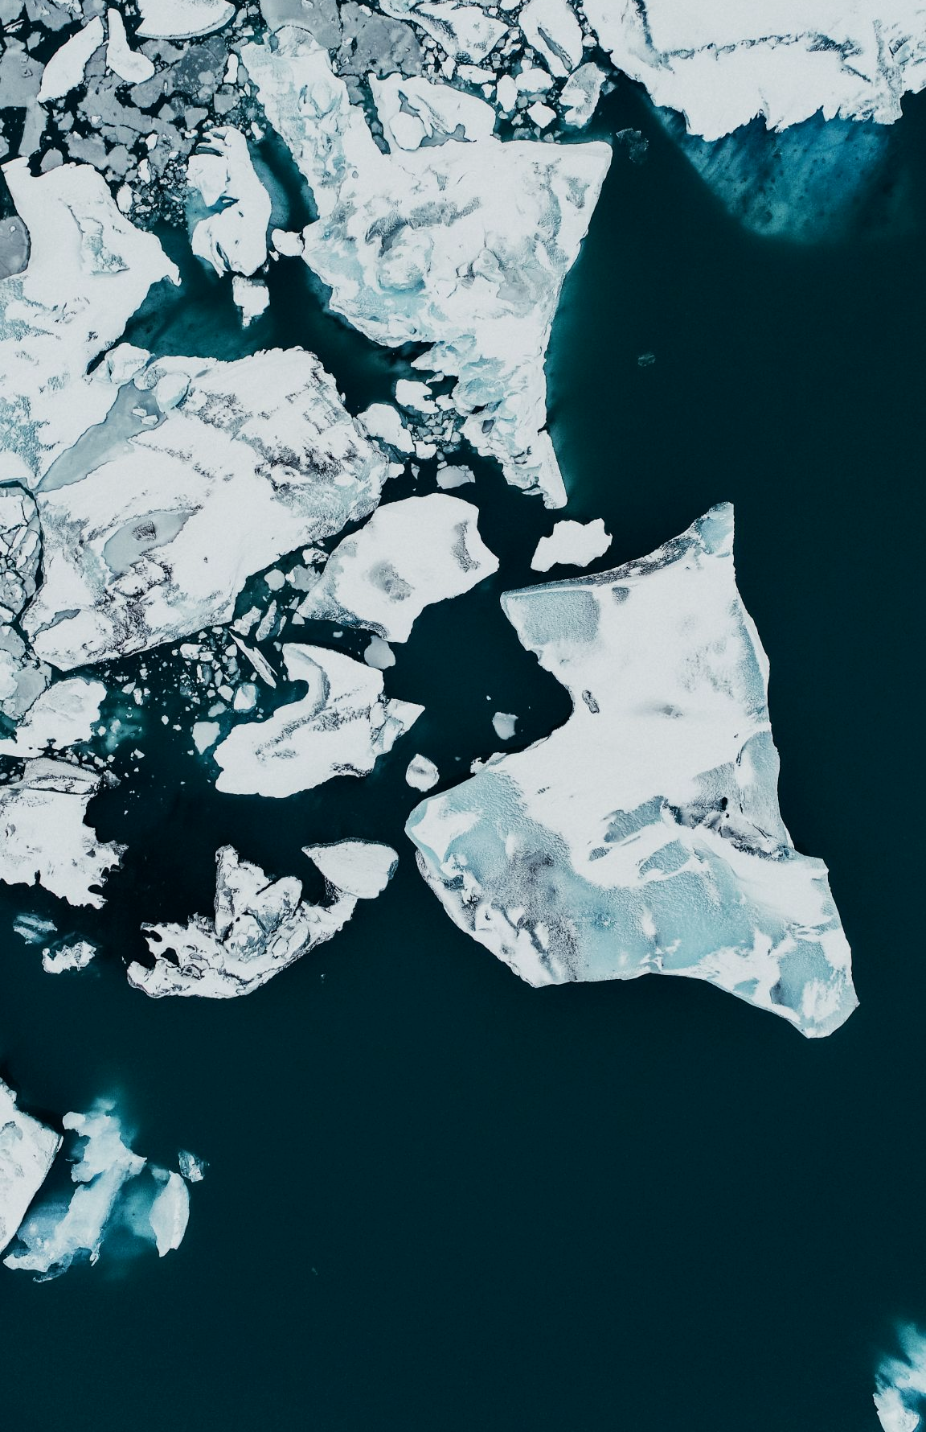
The polar ice caps are melting at a rate of around 9% every year. This has been strongly linked to global warming.
GLOBAL MASS CHANGE OF GLACIERS
+ 0.4
+ 0.2
0.0
- 0.2
CHANGE (T/m²)
- 0.4
- 0.6
- 0.8
- 1.0
- 1.2
1950
1960
1970
1980
1990
2000
2010
2020
For more help, please visit www.exampaperspractice.co.uk
© 2025 Exams Papers Practice. All Rights Reserved

Slide 17
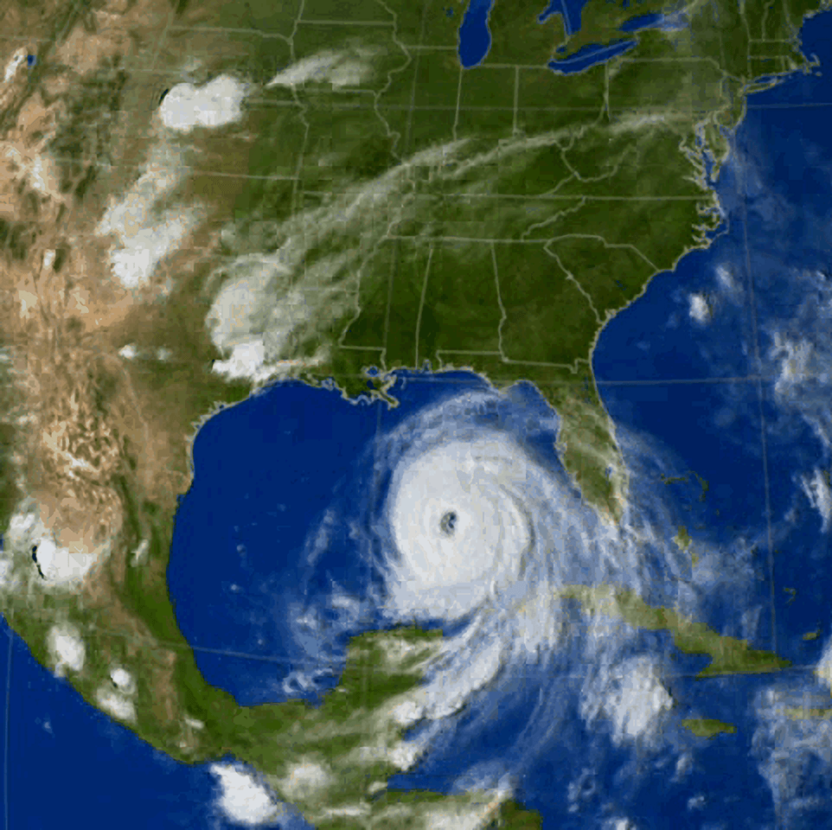
Global warming has also been linked to more frequent extreme weather events, such as hurricanes and tsunamis.
For more help, please visit www.exampaperspractice.co.uk
© 2025 Exams Papers Practice. All Rights Reserved

Slide 18
Water Pollution and Sewage
Specification Point 4.16
Understand the biological consequences of pollution of water by sewage.
Waste from homes and industry flows into water sources as sewage.
Sewage is a form of water pollution.
Sewage is rich in bacteria.
Bacteria use sewage as a food source.
Bacteria use up oxygen in aerobic respiration.
This decreases the concentration of oxygen dissolved in the water.
Aquatic organisms die due to a lack of oxygen.
Fish and invertebrate populations may have insufficient oxygen for respiration.
Waste that flows into a nearby water source is called sewage.
For more help, please visit www.exampaperspractice.co.uk
© 2025 Exams Papers Practice. All Rights Reserved

Slide 19
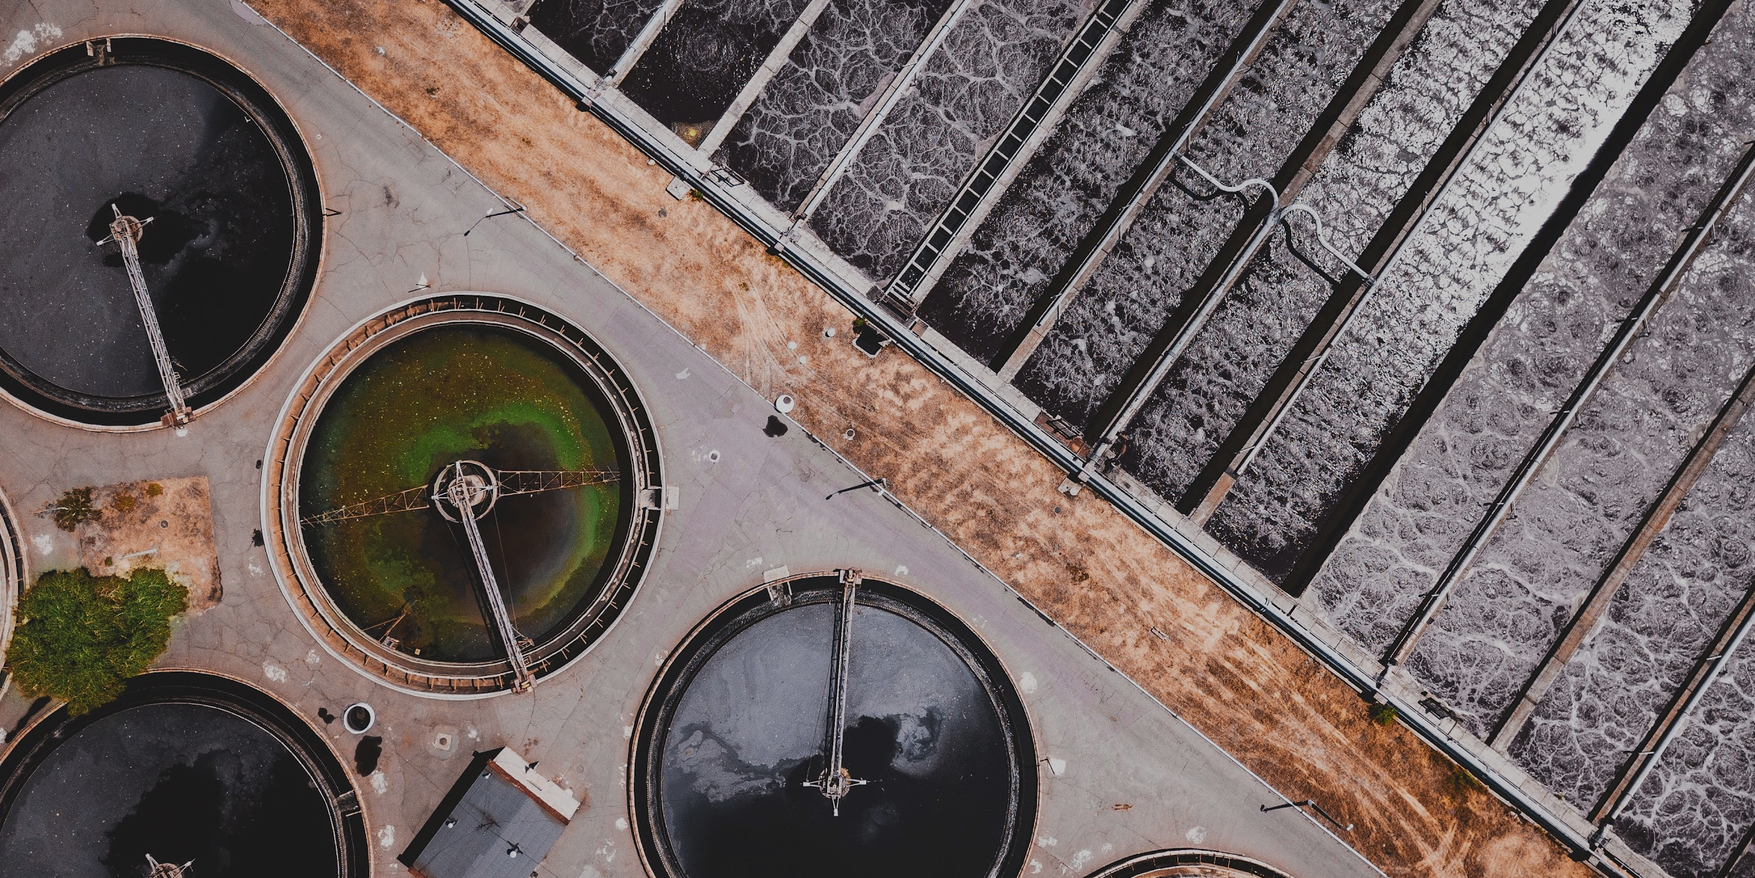
Sewage is often treated before it is released into water sources to remove bacteria.
For more help, please visit www.exampaperspractice.co.uk
© 2025 Exams Papers Practice. All Rights Reserved

Slide 20
Inorganic Fertilizers
Specification Point 4.17
Understand the biological consequences of eutrophication caused by leached minerals from fertilizer.
Inorganic fertilizers do not contain carbon.
Inorganic fertilizers contains lots of nutrients for crop growth:
Inorganic fertilizers contain nitrates for proteins.
Inorganic fertilizers contain magnesium for chlorophyll.
Inorganic fertilizers contain phosphates for DNA.
Inorganic fertilizers are very soluble.
When it rains, fertilizer in the soil dissolves in water.
Dissolved fertilizer can enter nearby water sources like lakes and rivers.
This is called fertilizer runoff.
For more help, please visit www.exampaperspractice.co.uk
© 2025 Exams Papers Practice. All Rights Reserved

Slide 21
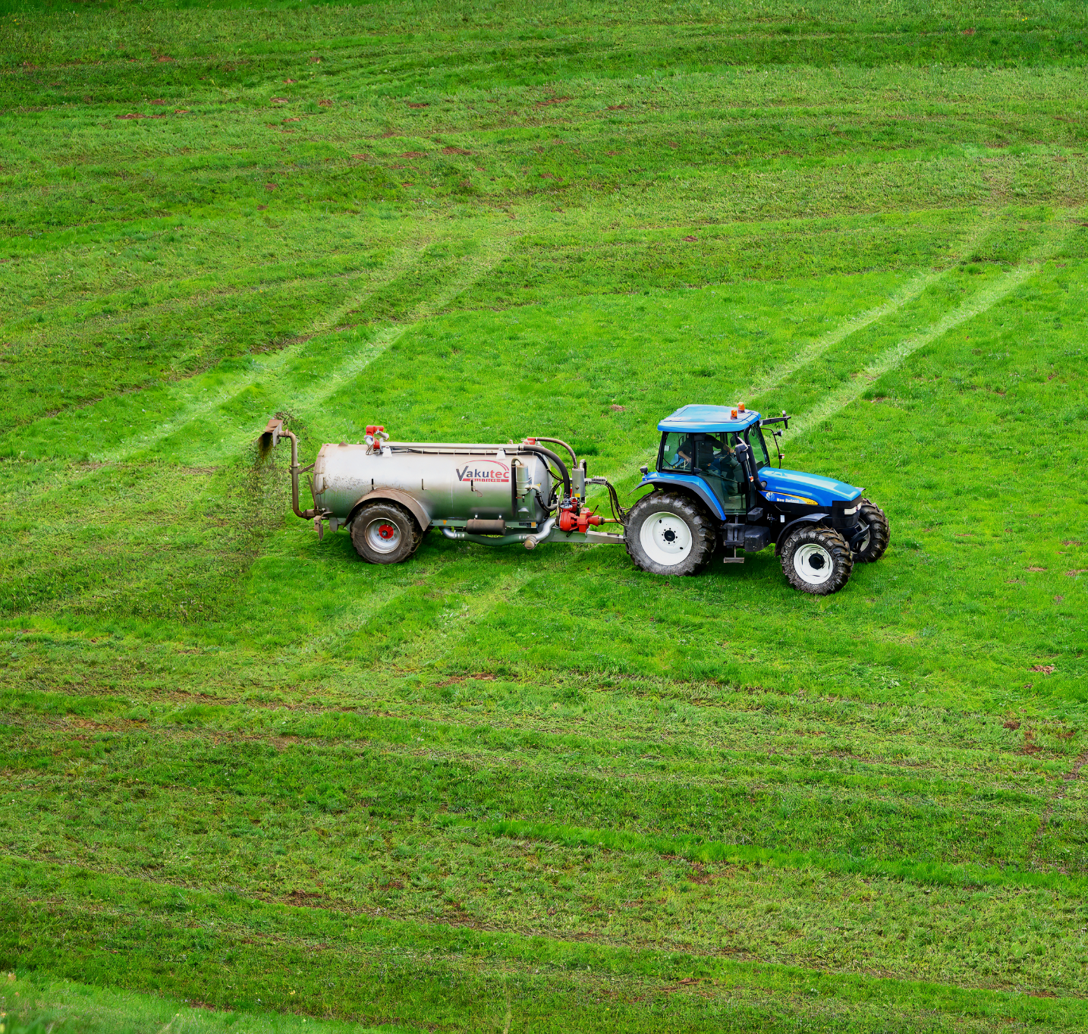
Farmers will routinely spray inorganic fertilizers to increase crop yields.
These fertilizers are, however, very soluble and can easily enter nearby rivers and lakes.
For more help, please visit www.exampaperspractice.co.uk
© 2025 Exams Papers Practice. All Rights Reserved

Slide 22
Eutrophication
When fertilizer enters a river or lake, a process called eutrophication can occur:
Fertilizer runoff causes algae to grow rapidly.
This is because there is an increase in the amount of available nutrients.
The rapid growth of algae is referred to as an algal bloom.
The algal bloom blocks incoming sunlight from reaching aquatic plants under the surface of the water.
These plants can no longer photosynthesize so begin to die.
Decomposing bacteria break down the dead aquatic plants.
The bacteria respire whilst doing this, using up oxygen in the water source.
The oxygen concentration of the water source drops.
Other aquatic life such as fish and invertebrates now die due to a lack of oxygen.
Eventually, the ecosystem can collapse.
For more help, please visit www.exampaperspractice.co.uk
© 2025 Exams Papers Practice. All Rights Reserved

Slide 23
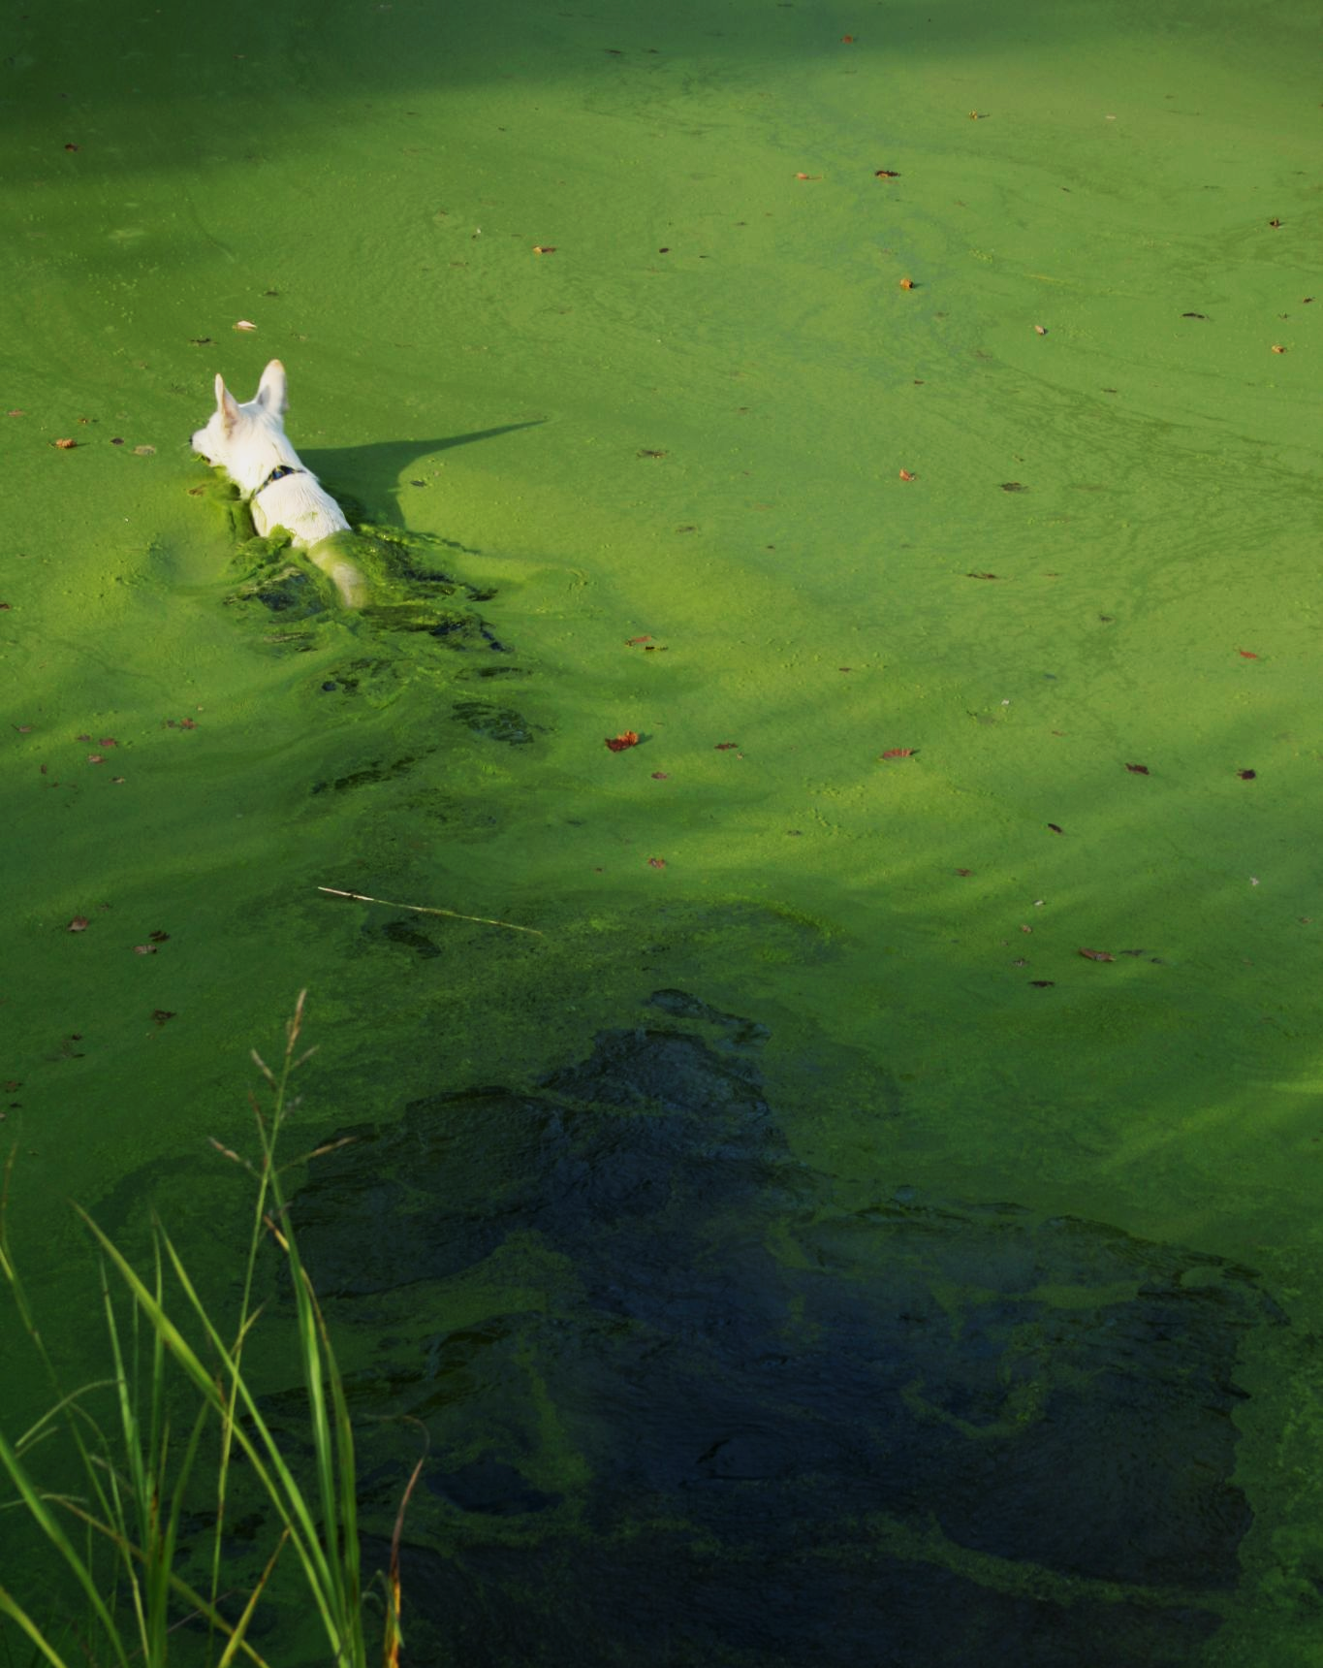
Algal blooms block sunlight from reaching aquatic plants under the surface.
For more help, please visit www.exampaperspractice.co.uk
© 2025 Exams Papers Practice. All Rights Reserved

Slide 24
3. SUNLIGHT IS BLOCKED BY THE ALGAL BLOOM
The process of eutrophication. Eutrophication can lead to the collapse of aquatic ecosystems.
2. ALGAL BLOOM GROWS DUE TO INFLUX OF NUTRIENTS
4. AQUATIC PLANTS DIE BECAUSE THEY CANNOT PHOTOSYNTHESISE
1. DISSOLVED FERTILIZER ENTERS NEARBY WATER SOURCE
5. FISH AND OTHER ORGANISMS DIE BECAUSE OF THE LACK OF OXYGEN
For more help, please visit www.exampaperspractice.co.uk
© 2025 Exams Papers Practice. All Rights Reserved

