Slide 1
Edexcel IGCSE Biology
53 - The Carbon Cycle
Storing and Releasing Carbon
For more help, please visit www.exampaperspractice.co.uk
© 2025 Exams Papers Practice. All Rights Reserved

Slide 2
The Carbon Cycle
Specification Point 4.10
Describe the stages in the carbon cycle, including respiration, photosynthesis, decomposition and combustion.
Carbon is found in all organic molecules.
Carbohydrates, proteins and lipids all contain carbon.
Carbon is found in the atmosphere as carbon dioxide (CO₂).
The removal and return of CO₂ to and from the atmosphere is called the carbon cycle.
Carbon dioxide (CO₂) is where most of the carbon in the atmosphere is stored.
For more help, please visit www.exampaperspractice.co.uk
© 2025 Exams Papers Practice. All Rights Reserved

Slide 3
Carbon is the basis of all organic molecules, including sugars like glucose.
For more help, please visit www.exampaperspractice.co.uk
© 2025 Exams Papers Practice. All Rights Reserved

Slide 4
Releasing Carbon Dioxide
CO₂ is released into the atmosphere during respiration.
Animals and plants both respire.
CO₂ is released by decomposers.
Decomposers also respire when they break down dead organic matter from plants and animals.
CO₂ is released by combustion.
Fossil fuels contain large quantities of carbon.
When fossil fuels are burnt for energy or fuel, CO₂ is released into the atmosphere.
The combustion of fossil fuels is one of the main ways CO₂ is released into the atmosphere.
For more help, please visit www.exampaperspractice.co.uk
© 2025 Exams Papers Practice. All Rights Reserved

Slide 5
All respiring creatures, including humans, release CO₂ when they respire.
For more help, please visit www.exampaperspractice.co.uk
© 2025 Exams Papers Practice. All Rights Reserved

Slide 6
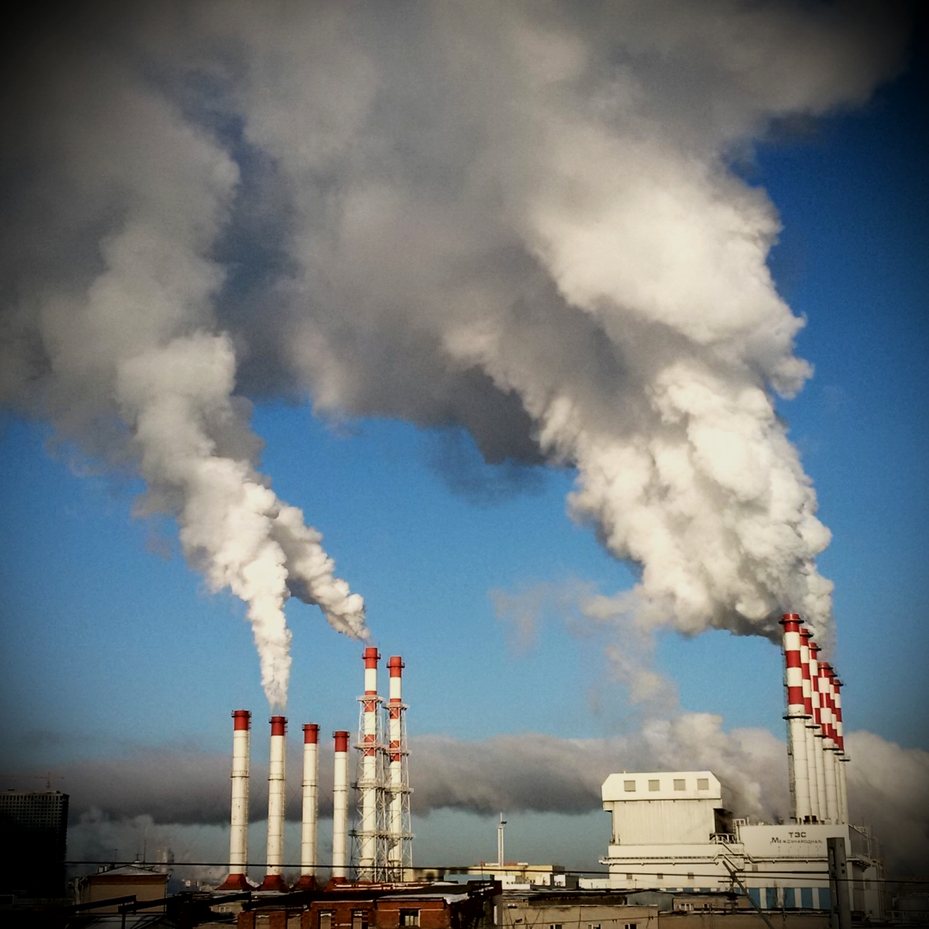
Power plants and factories burn fossil fuels and release CO₂.
For more help, please visit www.exampaperspractice.co.uk
© 2025 Exams Papers Practice. All Rights Reserved

Slide 7
Capturing Carbon
CO₂ is absorbed by plants in photosynthesis.
Carbon used to produce carbohydrates and other organic molecules.
CO₂ can also dissolve in water sources such as oceans and lakes.
Areas which store a lot of carbon are called carbon sinks.
Forests and oceans are examples of carbon sinks.
Trees incorporate carbon into their leaves and roots during photosynthesis.
For more help, please visit www.exampaperspractice.co.uk
© 2025 Exams Papers Practice. All Rights Reserved

Slide 8
Forests are referred to as carbon sinks. They store lots of carbon by capturing it from the atmosphere during photosynthesis.
44%
LIVING BIOMASS
4%
DEAD WOOD
6%
LEAF LITTER
45%
SOIL MATTER
For more help, please visit www.exampaperspractice.co.uk
© 2025 Exams Papers Practice. All Rights Reserved

Slide 9
Forests are referred to as carbon sinks. They store lots of carbon by capturing it from the atmosphere during photosynthesis.
For more help, please visit www.exampaperspractice.co.uk
© 2025 Exams Papers Practice. All Rights Reserved

Slide 10
Oceans store the majority of global CO₂. The gas is dissolved in water to form carbonic acid.
For more help, please visit www.exampaperspractice.co.uk
© 2025 Exams Papers Practice. All Rights Reserved

Slide 11
LAND USE
PHOTOSYNTHESIS
RESPIRATION
BURNING OF FOSSIL FUELS
DECAY
SEA-SURFACE
GAS EXCHANGE
The carbon cycle illustrates how CO₂ is removed from and returned to the atmosphere.
For more help, please visit www.exampaperspractice.co.uk
© 2025 Exams Papers Practice. All Rights Reserved

