Slide 1
Edexcel IGCSE Biology
52 - Feeding Relationships
Trophic Levels, Food Chains and Energy Transfer
For more help, please visit www.exampaperspractice.co.uk
© 2025 Exams Papers Practice. All Rights Reserved

Slide 2
Trophic Levels
Specification Point 4.6
Understand the names given to different trophic levels, including producers, primary, secondary and tertiary consumers and decomposers.
Organisms in ecosystems will exhibit feeding relationships.
Organisms that eat other organisms are called predators.
Organisms that are eaten by other organisms are called prey.
The position of an organism within a feeding relationship is called its trophic level.
A trophic level is often used to demonstrate the role an organism plays within a food chain.
The position an organism occupies in a food chain is called its trophic level.
For more help, please visit www.exampaperspractice.co.uk
© 2025 Exams Papers Practice. All Rights Reserved

Slide 3
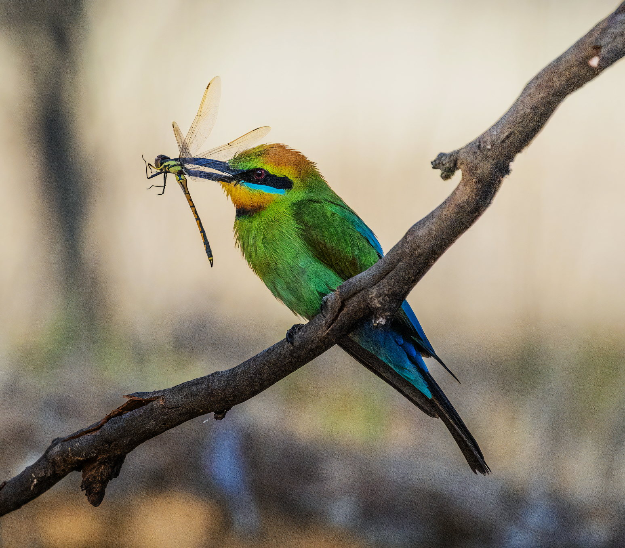
Organisms that eat other organisms are called predators. Organisms that are eaten by predators are called prey.
For more help, please visit www.exampaperspractice.co.uk
© 2025 Exams Papers Practice. All Rights Reserved

Slide 4
Trophic Levels
There are usually four trophic levels.
Very few food chains have enough energy to support more than four trophic levels.
Trophic Level | Definition
Producers | Producers create their own nutrients, almost always from sunlight. Plants are the main group of producers.
Primary Consumers | These organisms feed on the producers (plants). They are termed herbivores.
Secondary Consumers | These organisms feed on the primary consumers. They are carnivores.
Tertiary Consumers | These organisms feed on secondary consumers. They are also carnivores.
Decomposers | Some organisms gain energy by feeding on dead organic matter. These are mostly types of bacteria and fungi.
For more help, please visit www.exampaperspractice.co.uk
© 2025 Exams Papers Practice. All Rights Reserved

Slide 5
Food Chains and Food Webs
Specification Point 4.7
Understand the concepts of food chains, food webs, pyramids of number, pyramids of biomass and pyramids of energy transfer.
A food chain shows what eats what in a particular habitat.
Food chains show the flow of energy from one trophic level to the next, starting with a producer.
Sunlight continually adds energy to the start of the food chain.
A food web is a network of connected food chains.
Food webs are more realistic depictions of feeding relationships.
An organism rarely relies on one food source.
Food webs show interdependence - this is how a change in the population of one species can have effects on the populations of other species.
For more help, please visit www.exampaperspractice.co.uk
© 2025 Exams Papers Practice. All Rights Reserved

Slide 6
An Example Food Chain
There are a number of exemplar food chains:
Grass is the producer.
Using sunlight, grass photosynthesises to create its own food source.
The field mouse is the primary consumer.
The field mouse eats the grass to gain energy.
The owl is the secondary consumer.
The owl predates on the field mouse to gain energy.
GRASS → FIELD MOUSE → OWL
For more help, please visit www.exampaperspractice.co.uk
© 2025 Exams Papers Practice. All Rights Reserved

Slide 7
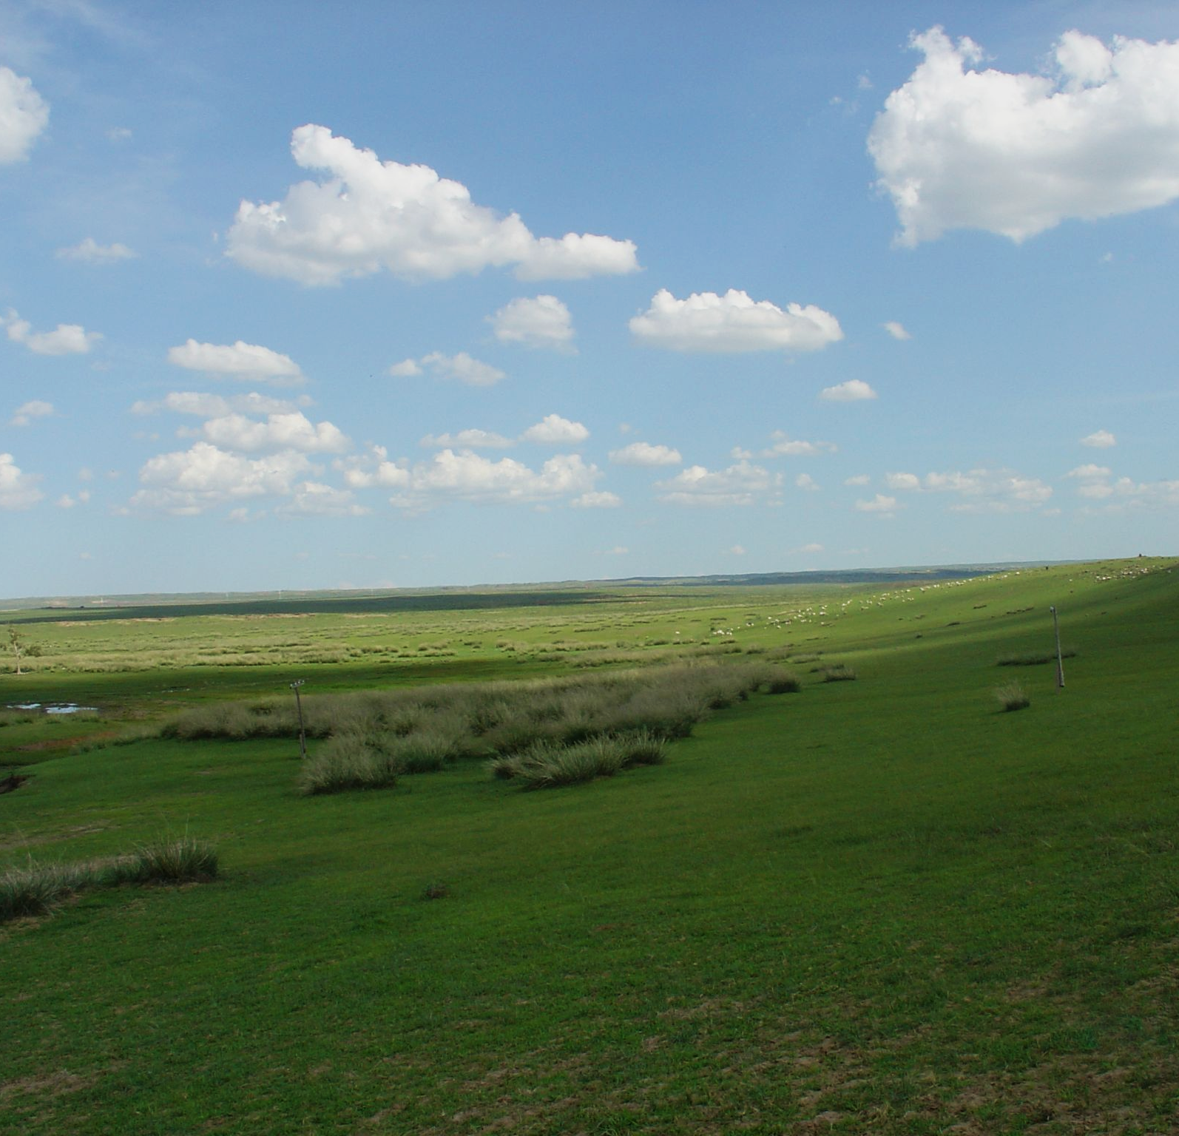
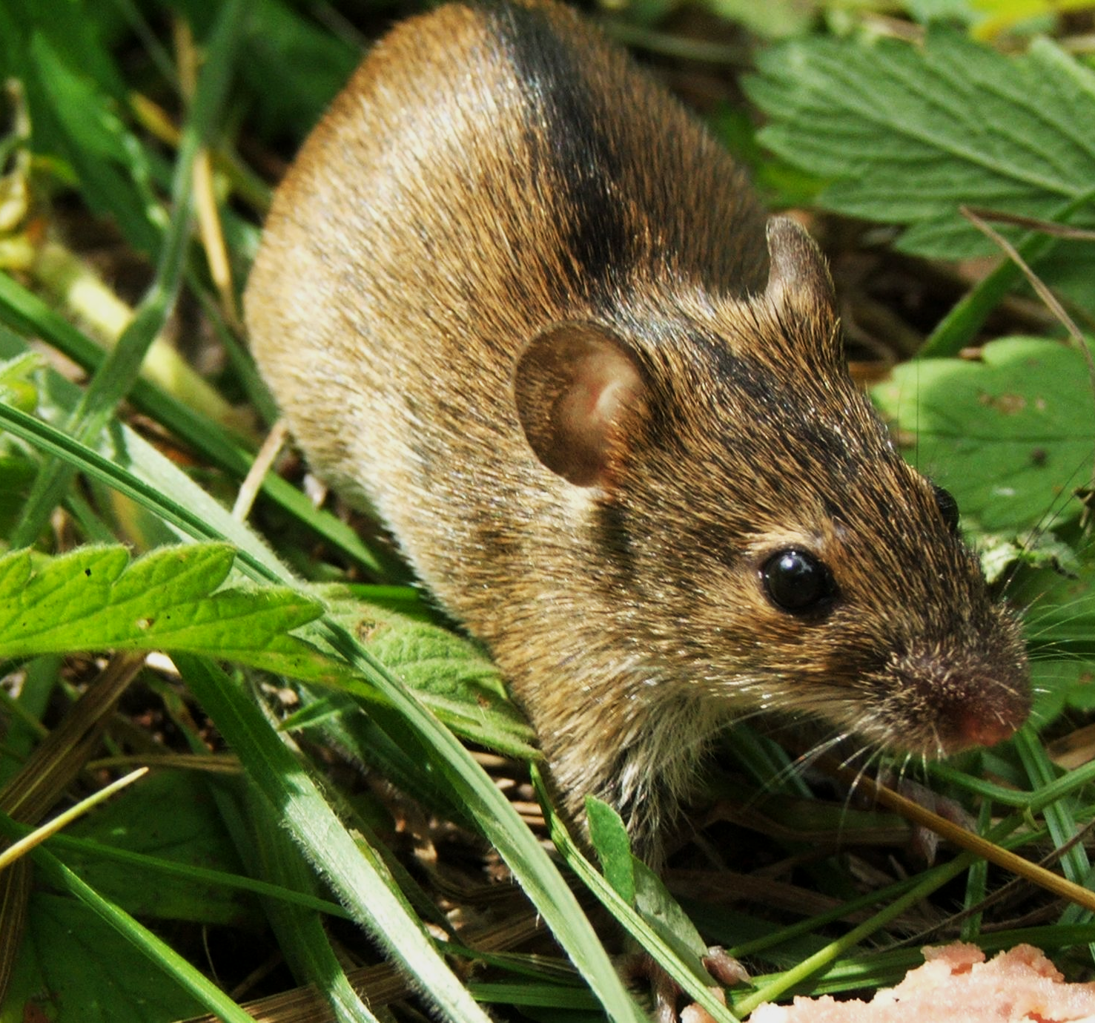
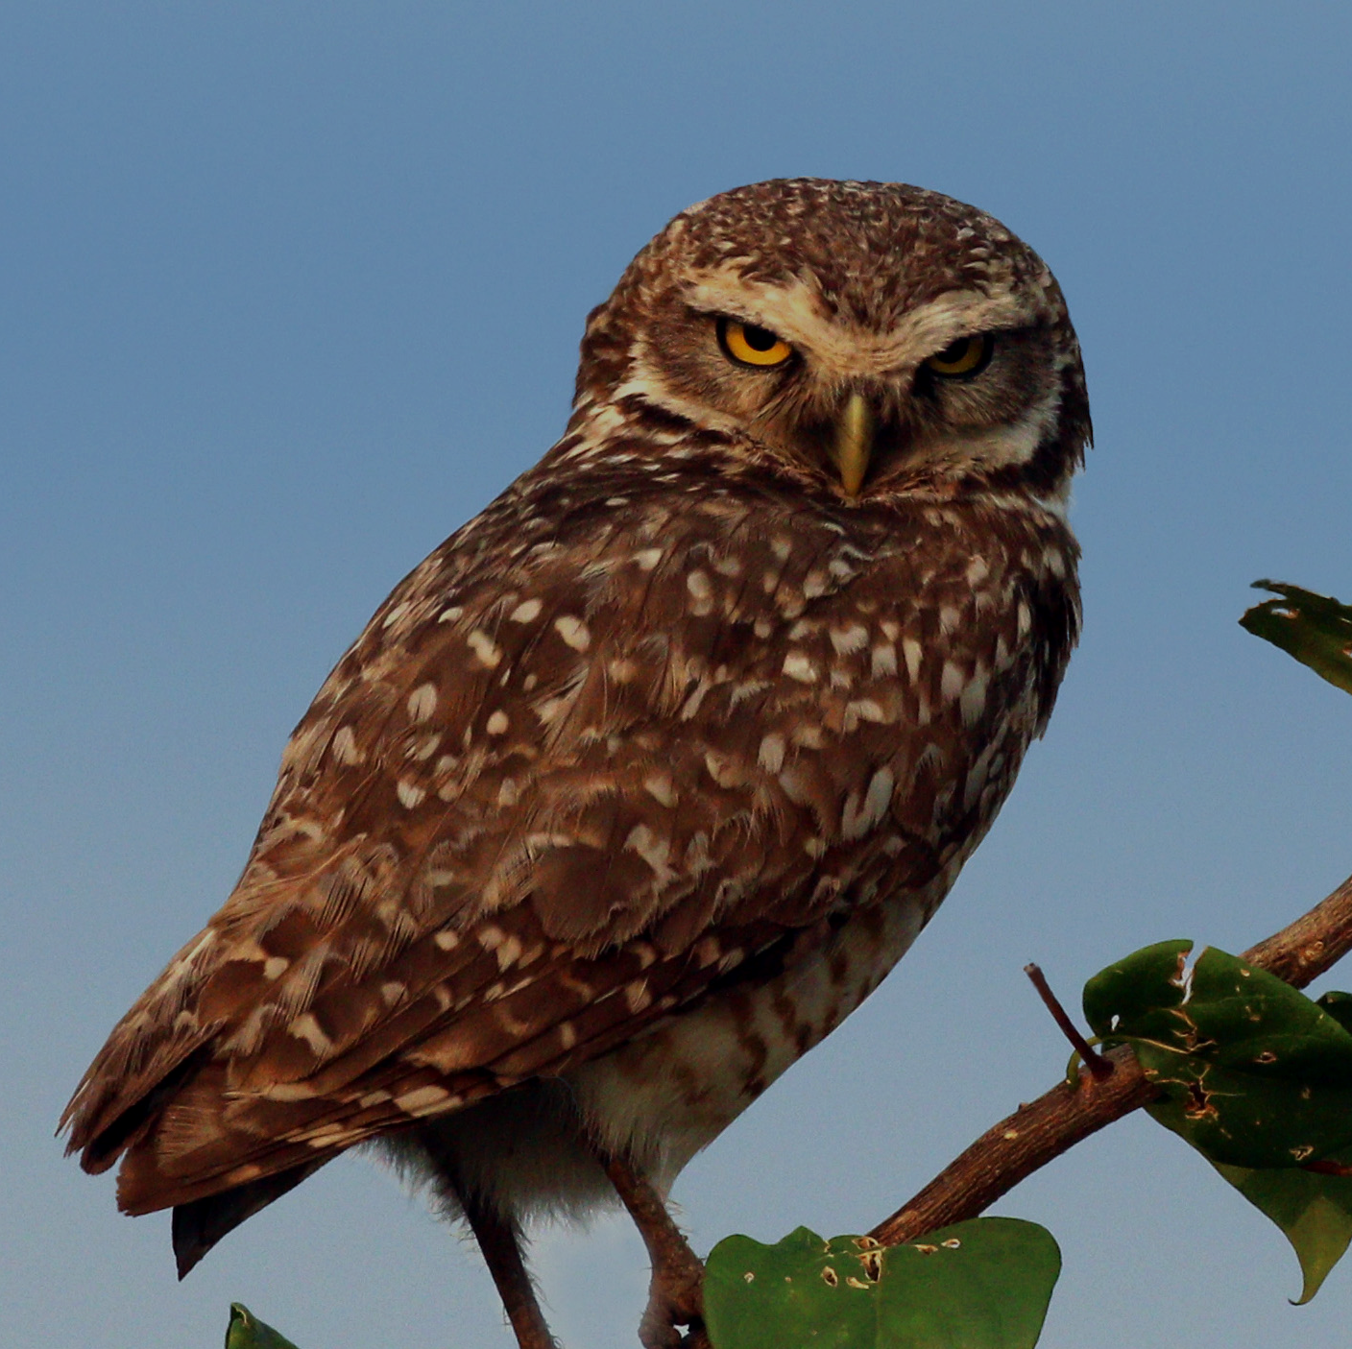
PRODUCER
PRIMARY CONSUMER
SECONDARY CONSUMER
The grassland photosynthesises to grow.
The herbivorous field mouse feeds on the grass for its energy.
The carnivorous owl fields on the field mice for its energy.
For more help, please visit www.exampaperspractice.co.uk
© 2025 Exams Papers Practice. All Rights Reserved

Slide 8
Food webs are more realistic depictions of feeding relationships. Food webs depict the interdependent relationships between different species.
For more help, please visit www.exampaperspractice.co.uk
© 2025 Exams Papers Practice. All Rights Reserved

Slide 9
Pyramids of Number
Food chains can be visualised in pyramids.
Pyramids of number show the number of organisms at each trophic level.
The width of each box indicate how many individuals are present in a population.
Not all pyramids of number are pyramid shaped.
In some cases the number of primary consumers may be higher than the number of producers.
One example where this is true is when many insects (primary consumers) will predate on a single tree (the producer).
OWLS (10)
MICE (100)
GRASSLAND (1,000)
A pyramid of number.
For more help, please visit www.exampaperspractice.co.uk
© 2025 Exams Papers Practice. All Rights Reserved

Slide 10
Pyramids of Biomass
Biomass is dry organic matter.
Biomass is the mass of the organism without water.
Biomass is measured in kilograms (kg).
Pyramids of biomass show the biomass of organisms at each trophic level.
All pyramids of biomass are pyramid shaped.
Mass must decrease as we go up the food chain.
This is because some organic matter is wasted when an organism is eaten.
OWLS (10 kg)
MICE (100 kg)
GRASSLAND (1,000 kg)
A pyramid of biomass.
For more help, please visit www.exampaperspractice.co.uk
© 2025 Exams Papers Practice. All Rights Reserved

Slide 11
Pyramids of Energy
Pyramids of energy show the amount of energy stored in organisms at each trophic level.
Some energy is transferred from one trophic level to the next during feeding.
Energy is measured in kilojoules (kJ).
All pyramids of energy are pyramid shaped.
Energy must decrease as we go up the food chain.
This is because some energy is wasted when an organism is eaten.
OWLS (10 kJ)
MICE (100 kJ)
GRASSLAND (1,000 kJ)
A pyramid of energy.
For more help, please visit www.exampaperspractice.co.uk
© 2025 Exams Papers Practice. All Rights Reserved

Slide 12
Energy through a Food Chain
Specification Point 4.8
Understand the transfer of substances and energy along a food chain.
Sunlight is the original source of energy for a food chain.
Producers convert sunlight into chemical energy during photosynthesis.
Other organisms then consume this chemical energy by eating.
Energy from the sun provides the stimulus for photosynthesis, which creates carbohydrates. These carbohydrates are then distributed through the food chain.
For more help, please visit www.exampaperspractice.co.uk
© 2025 Exams Papers Practice. All Rights Reserved

Slide 13
Energy Losses
Specification Point 4.9
Understand why only about 10% of energy is transferred from one trophic level to the next.
Energy is lost between trophic levels.
Only around 10% of the total available energy is passed onto the next trophic level.
Energy Losses | Reasoning
From sun to producer | Not all sunlight will hit chloroplasts, some light is of the incorrect wavelength, some light is converted to heat during photosynthesis.
From consumer to consumer | Not all organism is consumed (bones), not all organism is digestible (cellulose), lots of energy is lost as heat from respiration.
For more help, please visit www.exampaperspractice.co.uk
© 2025 Exams Papers Practice. All Rights Reserved

Slide 14
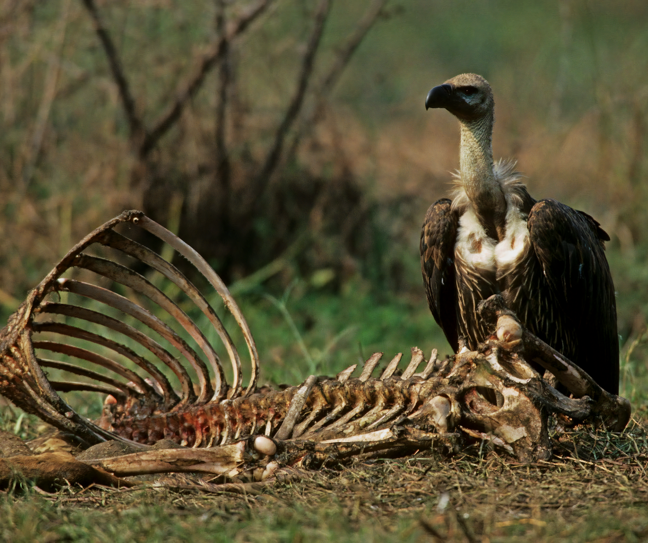
Only around 10% of the energy available is transferred from one trophic level to another.
One reason for this is that not all of the prey is consumed. Some parts of the prey, such as the bones, are not edible.
For more help, please visit www.exampaperspractice.co.uk
© 2025 Exams Papers Practice. All Rights Reserved

