Slide 1
Edexcel IGCSE Biology
51 - Biotic and Abiotic Factors
Impacts on Populations
For more help, please visit www.exampaperspractice.co.uk
© 2025 Exams Papers Practice. All Rights Reserved

Slide 2
Biotic and Abiotic Factors
Specification Point 4.5
Understand how abiotic and biotic factors affect the population size and distribution of organisms.
Biotic factors are living factors that affect an ecosystem.
Abiotic factors are non-living factors that affect an ecosystem.
Biotic and abiotic factors can impact the size and distribution of populations.
Biotic and abiotic factors often interact with one another.
For more help, please visit www.exampaperspractice.co.uk
© 2025 Exams Papers Practice. All Rights Reserved

Slide 3
Examples of Biotic Factors
Biotic factors are living components that affect other organisms.
Factor | Explanation
Predators | Predators eat other organisms. They control the population of other organisms.
Pathogens | Pathogens spread disease between organisms. Some of the organisms may die due to the pathogen.
Parasites | Parasites live inside or on other organisms. They steal some of the nutrients from the host organism. This may lead to its death or an inability to breed.
Competition | When different species eat the same food, they begin to compete for resources. If one species is a better competitor, it can lead to extinction for the other species.
For more help, please visit www.exampaperspractice.co.uk
© 2025 Exams Papers Practice. All Rights Reserved

Slide 4
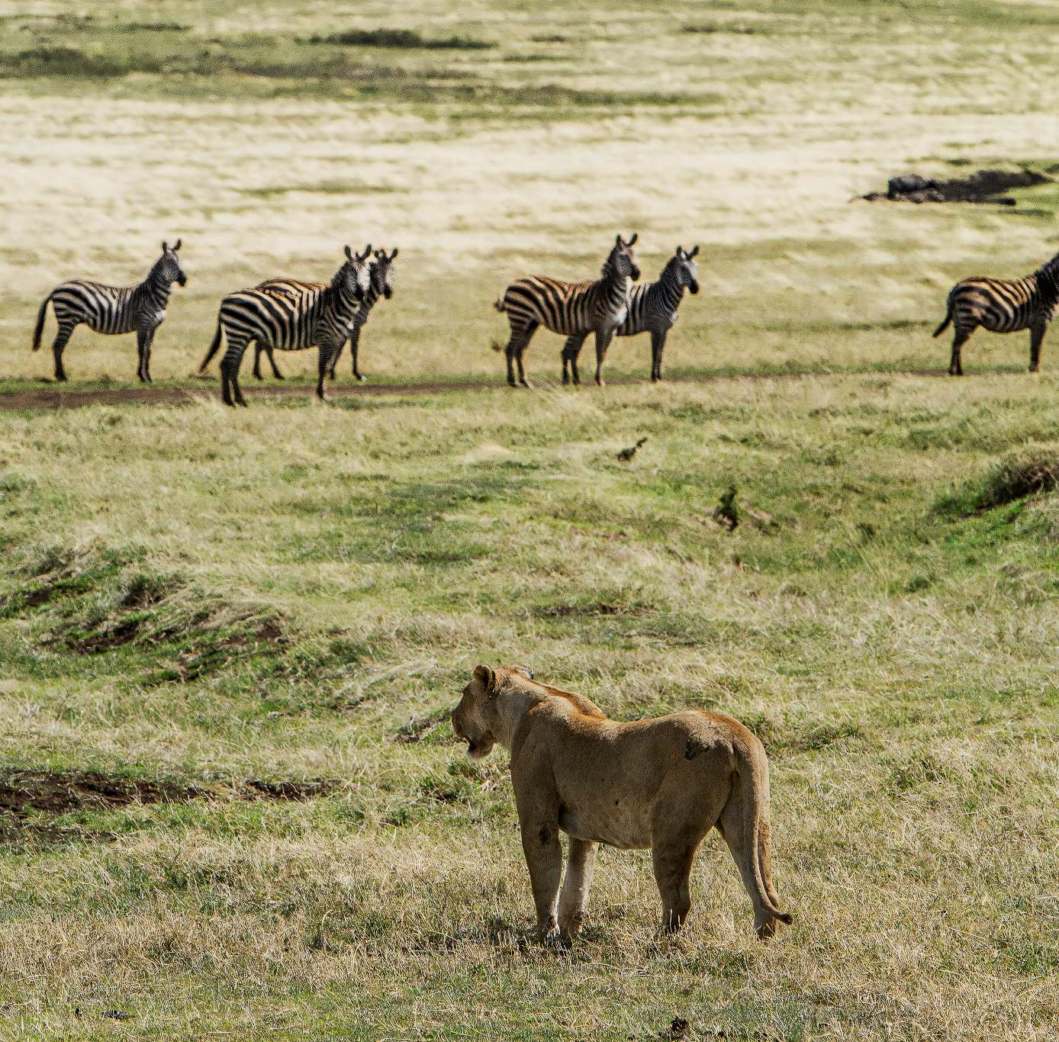
Lions are natural predators of zebras. This predation is a biotic factor and helps to suppress the population size of prey.
For more help, please visit www.exampaperspractice.co.uk
© 2025 Exams Papers Practice. All Rights Reserved

Slide 5
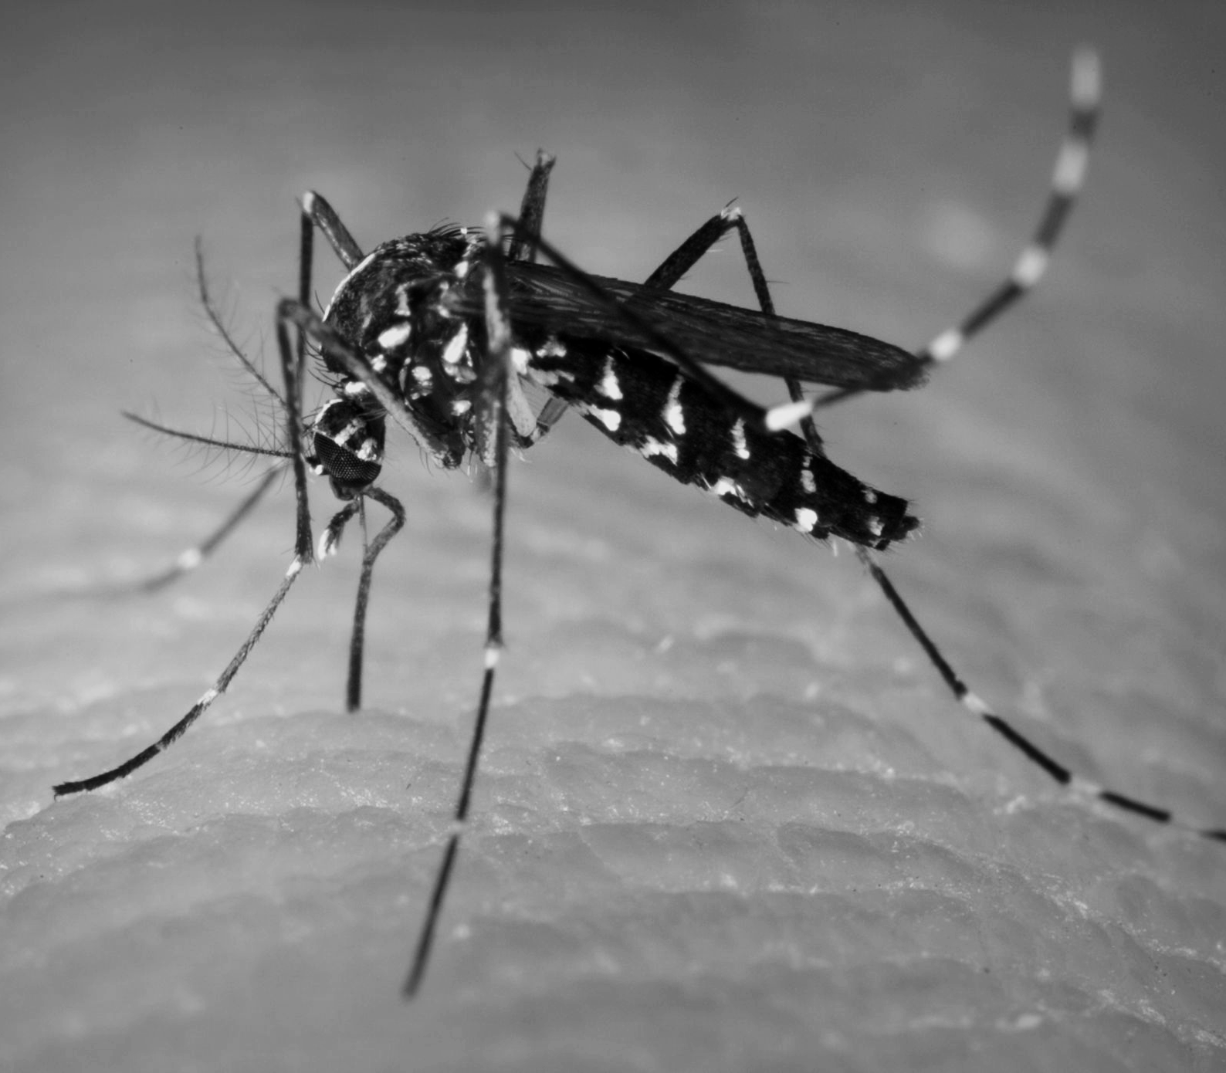
Parasites like mosquitos feed on the nutrients of their host. This biotic factor can reduce the health of a population.
For more help, please visit www.exampaperspractice.co.uk
© 2025 Exams Papers Practice. All Rights Reserved

Slide 6
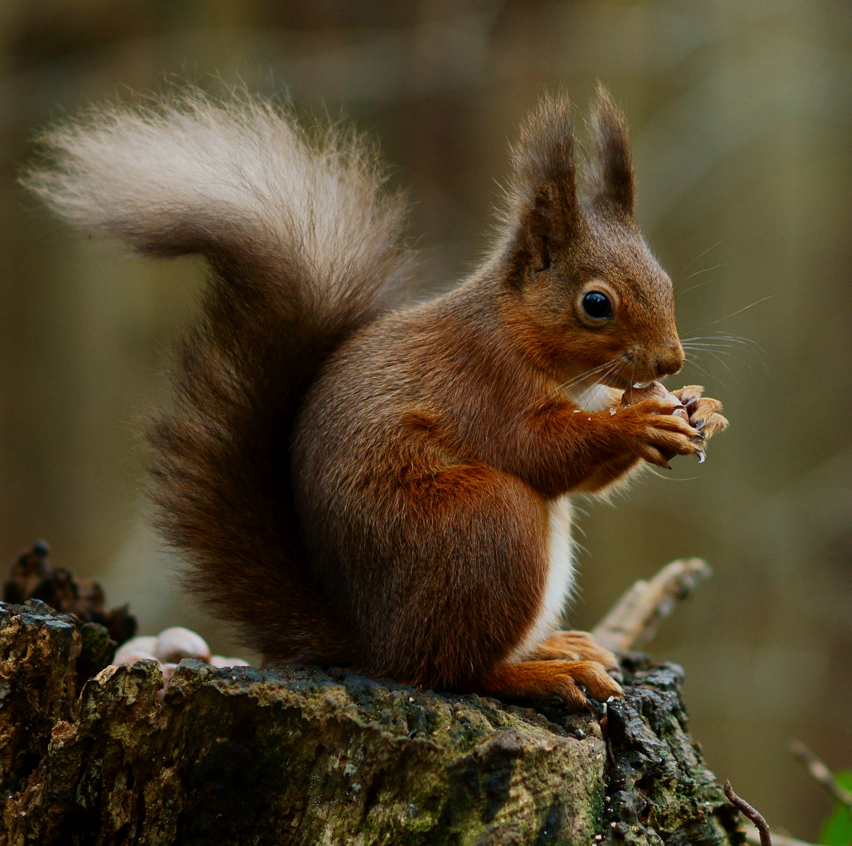
In the United Kingdom, the red squirrel has been almost entirely outcompeted by the larger and stronger grey squirrel.
For more help, please visit www.exampaperspractice.co.uk
© 2025 Exams Papers Practice. All Rights Reserved

Slide 7
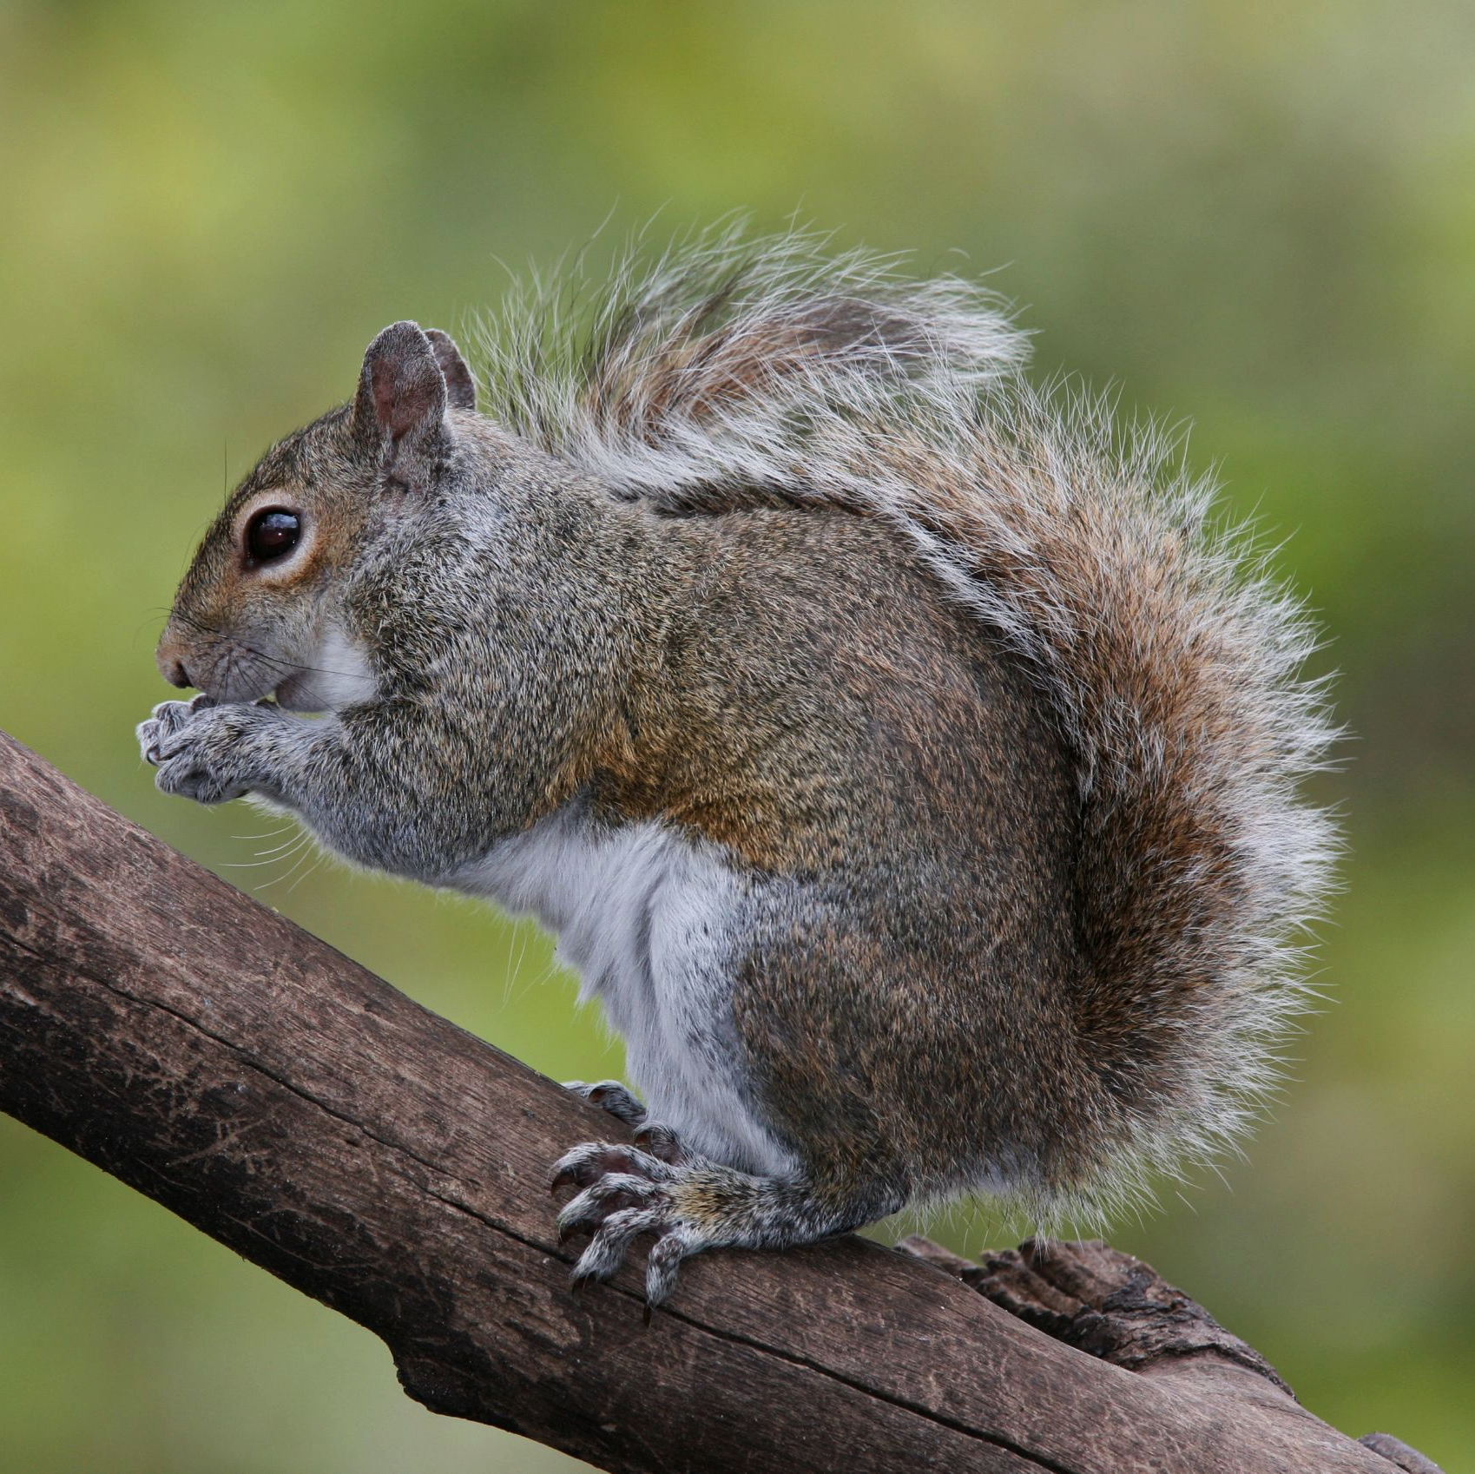
In the United Kingdom, the red squirrel has been almost entirely outcompeted by the larger and stronger grey squirrel.
For more help, please visit www.exampaperspractice.co.uk
© 2025 Exams Papers Practice. All Rights Reserved

Slide 8
POPULATION OF SQUIRRELS OVER TIME ON ANGLESEY
RED SQUIRREL
GREY SQUIRREL
In parts of the United Kingdom, the grey squirrel has forced the red squirrel into extinction.
POPULATION SIZE →
TIME →
For more help, please visit www.exampaperspractice.co.uk
© 2025 Exams Papers Practice. All Rights Reserved

Slide 9
Examples of Abiotic Factors
Abiotic factors are non-living components that affect other organisms.
Factor | Explanation
Temperature | Animals and plants have an optimum temperature for survival. If the temperature is far from optimal, organisms may not survive.
Light Availability | Light is required for photosynthesis. As light intensity increases, the rate of photosynthesis increases.
Water Availability | Water is vital for both plants and animals. Many chemical reactions in the body require water.
Soil Composition | Plants only grow in fertile soil. There must be sufficient minerals to sustain growth.
For more help, please visit www.exampaperspractice.co.uk
© 2025 Exams Papers Practice. All Rights Reserved

Slide 10
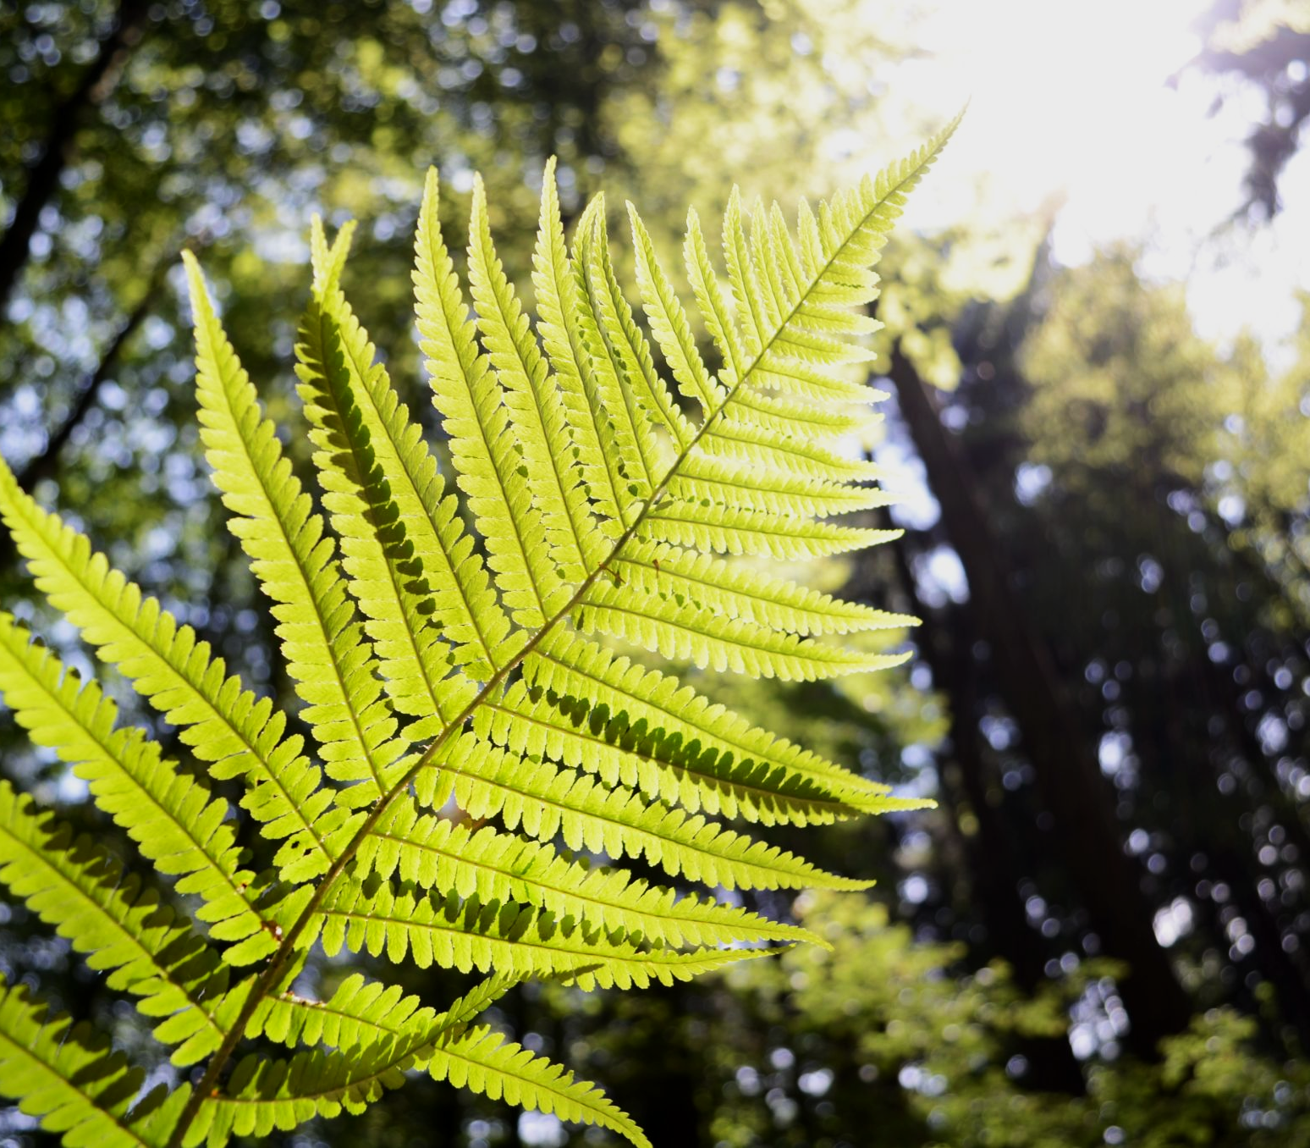
Sunlight is vital for photosynthesis. Areas with low light intensity only support a few species of plants.
For more help, please visit www.exampaperspractice.co.uk
© 2025 Exams Papers Practice. All Rights Reserved

Slide 11
As light intensity increases, the rate of photosynthesis increases until something else becomes a limiting factor.
RATE OF PHOTOSYNTHESIS →
LIGHT INTENSITY (LUX) →
For more help, please visit www.exampaperspractice.co.uk
© 2025 Exams Papers Practice. All Rights Reserved

Slide 12
TROPICAL
RAINFOREST
Water provides the medium for many chemical reactions. There is a strong correlation between annual rainfall and biodiversity.
TEMPERATE RAINFOREST
ANNUAL RAINFALL (mm) →
BIODIVERSITY →
TEMPERATE FOREST
SAVANNA
BOREAL
FOREST
WOODLAND
TUNDRA
GRASSLAND
DESERT
For more help, please visit www.exampaperspractice.co.uk
© 2025 Exams Papers Practice. All Rights Reserved

Slide 13
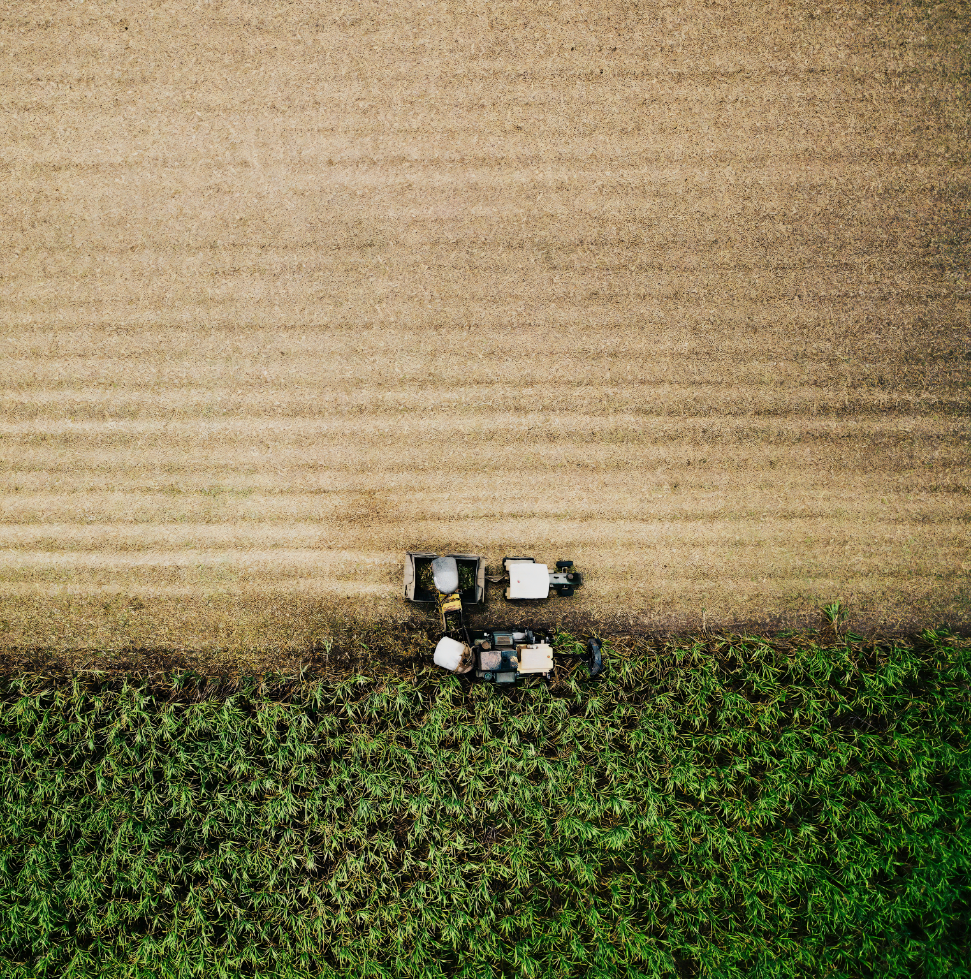
Plants require soil that are rich in nutrients such as magnesium or nitrates.
For more help, please visit www.exampaperspractice.co.uk
© 2025 Exams Papers Practice. All Rights Reserved

