Slide 1
Edexcel IGCSE Biology
49 - Ecosystems
Populations, Communities and Habitats
For more help, please visit www.exampaperspractice.co.uk
© 2025 Exams Papers Practice. All Rights Reserved

Slide 2
Ecology
Specification Point 4.1
Understand the terms population, community, habitat and ecosystem.
Ecology is the science of living things.
Ecology studies the relationship between organisms and the environment.
There are several key ecological terms:
A habitat is the place where an organism lives.
A population is a group of organisms of the same species living in a habitat.
A community is all the populations of different species living in a habitat.
An ecosystem is a unit containing all of the organisms and their environment, interacting with one another.
For more help, please visit www.exampaperspractice.co.uk
© 2025 Exams Papers Practice. All Rights Reserved

Slide 3
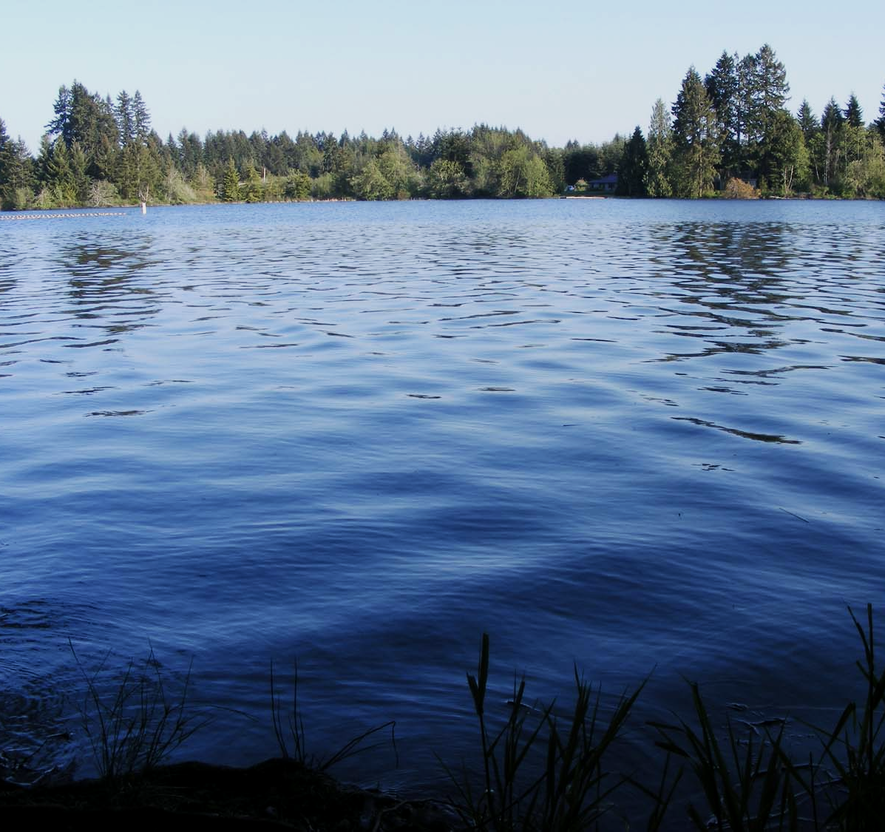
A lake provides a habitat for aquatic organisms such as fish.
For more help, please visit www.exampaperspractice.co.uk
© 2025 Exams Papers Practice. All Rights Reserved

Slide 4
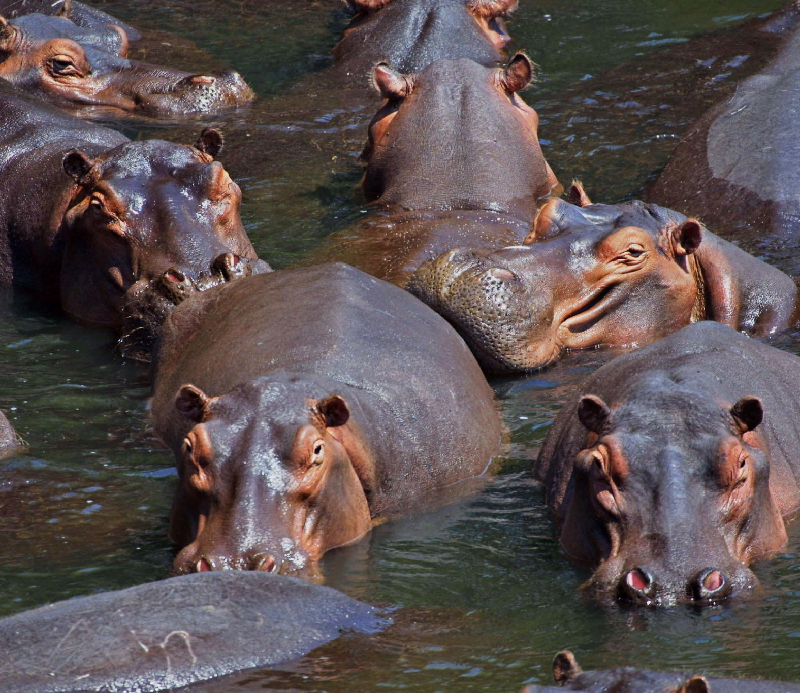
This population of hippopotamuses are all members of the same species.
For more help, please visit www.exampaperspractice.co.uk
© 2025 Exams Papers Practice. All Rights Reserved

Slide 5
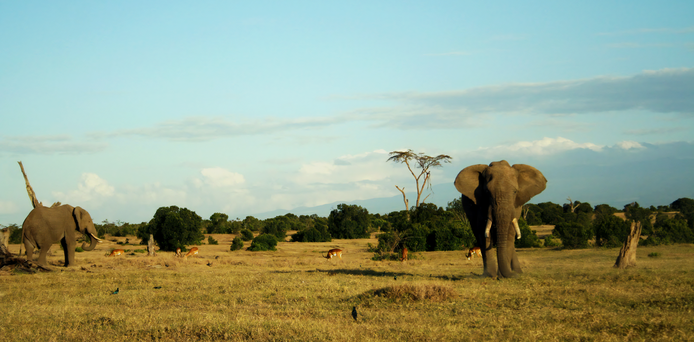
The African savanna hosts a community of several different species.
For more help, please visit www.exampaperspractice.co.uk
© 2025 Exams Papers Practice. All Rights Reserved

Slide 6
Ecosystems often contain several different habitats in the same location. These ecosystems tend to support a wide variety of life.
For more help, please visit www.exampaperspractice.co.uk
© 2025 Exams Papers Practice. All Rights Reserved

Slide 7
Investigating Populations
Specification Point 4.2
Practical: investigate the population size of an organism in two different areas using quadrats.
The size of populations can be estimated using a device called a quadrat.
A quadrat is a square frame with a known size.
Most quadrats are 1 m².
Some quadrats have a number of smaller squares within them.
Quadrats are usually used to sample the populations of plants.
Quadrats are placed randomly in an area.
Random sampling helps to remove bias.
Quadrat video.
1 m
1 m
A quadrat is a square frame with a known size that is used to estimate the size of populations.
For more help, please visit www.exampaperspractice.co.uk
© 2025 Exams Papers Practice. All Rights Reserved

Slide 8
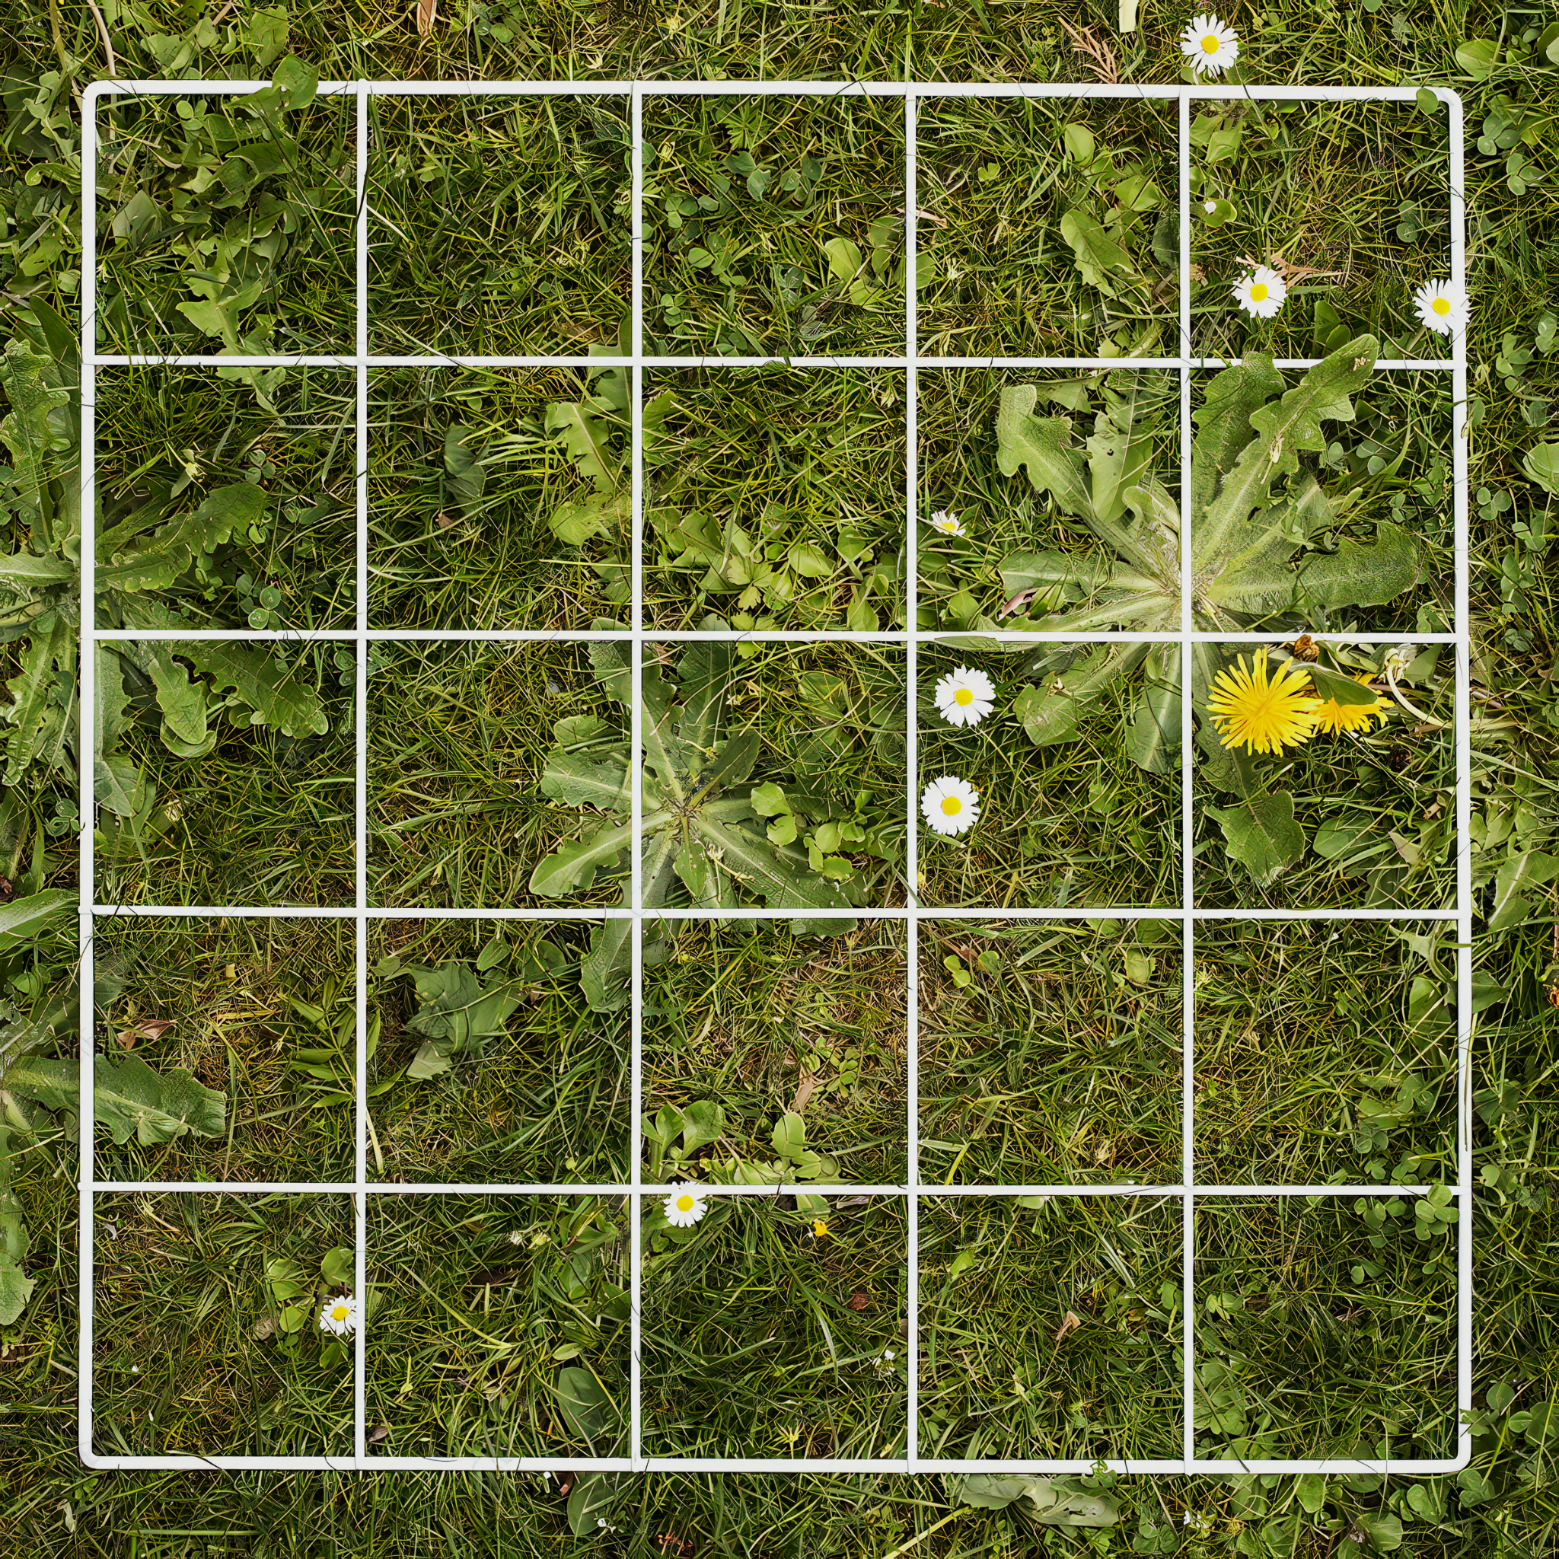
Quadrats are used to estimate the population size of different species, usually of plants.
For more help, please visit www.exampaperspractice.co.uk
© 2025 Exams Papers Practice. All Rights Reserved

Slide 9
Using a Quadrat
Divide the sample area into grid squares.
These squares should be the same size.
Distribute quadrats randomly within the grid.
A random number generator can be used to generate grid coordinates.
Count the number of organisms within each quadrat.
The amount of the quadrat covered by a particular species can also be estimated as a percentage.
This is called percentage cover.
Use a large number of quadrats to increase reliability.
An equation can be used to estimate the population size of a species.
For more help, please visit www.exampaperspractice.co.uk
© 2025 Exams Papers Practice. All Rights Reserved

Slide 10
Using a random number generator to select areas to sample helps to reduce bias and ensure a more reliable estimate of population size.
NON-RANDOM SAMPLING
RANDOM SAMPLING
For more help, please visit www.exampaperspractice.co.uk
© 2025 Exams Papers Practice. All Rights Reserved

Slide 11
Calculating Population Size
The following equation is used to estimate population size:
P = population size
A = total area
N = number of sampled individuals
S = sampled area
8 km
Assume an area has a total size (A) of 64 km².
8 km² is sampled (S) and a population of 200 individuals is discovered (N).
64 × 200 = 12,800
12,800 ÷ 8 = 1,600 individuals
8 km
For more help, please visit www.exampaperspractice.co.uk
© 2025 Exams Papers Practice. All Rights Reserved

