Slide 1
Edexcel IGCSE Biology
48 - Evolution
Darwin and Natural Selection
For more help, please visit www.exampaperspractice.co.uk
© 2025 Exams Papers Practice. All Rights Reserved

Slide 2
Evolution
Specification Point 3.38
Explain Darwin’s theory of evolution by natural selection.
Evolution describes how living things change over a long period of time.
Evolution can be observed through changes in the fossil record.
Evolution relies on genetic variation in a population.
Genetic variation affects the physical characteristics of the population.
The physical characteristics of a population is called the phenotype of the population.
Evolution was most famously observed by Charles Darwin.
Darwin travelled around the world on HMS Beagle between 1831 and 1836.
Darwin published his seminal work On the Origin of Species in 1859.
Evolution video.
For more help, please visit www.exampaperspractice.co.uk
© 2025 Exams Papers Practice. All Rights Reserved

Slide 3
MODERN HORSE - 1 MILLION YEARS AGO TO PRESENT DAY
The evolution of horses can be traced using the fossil record.
Gradual changes in the size and shape of horses’ hooves reveal an evolutionary history stretching back millions of years.
PLIOHIPPUS - 8 MILLION YEARS AGO
MERYCHIPPUS - 15 MILLION YEARS AGO
MESOHIPPUS - 35 MILLION YEARS AGO
For more help, please visit www.exampaperspractice.co.uk
© 2025 Exams Papers Practice. All Rights Reserved

Slide 4
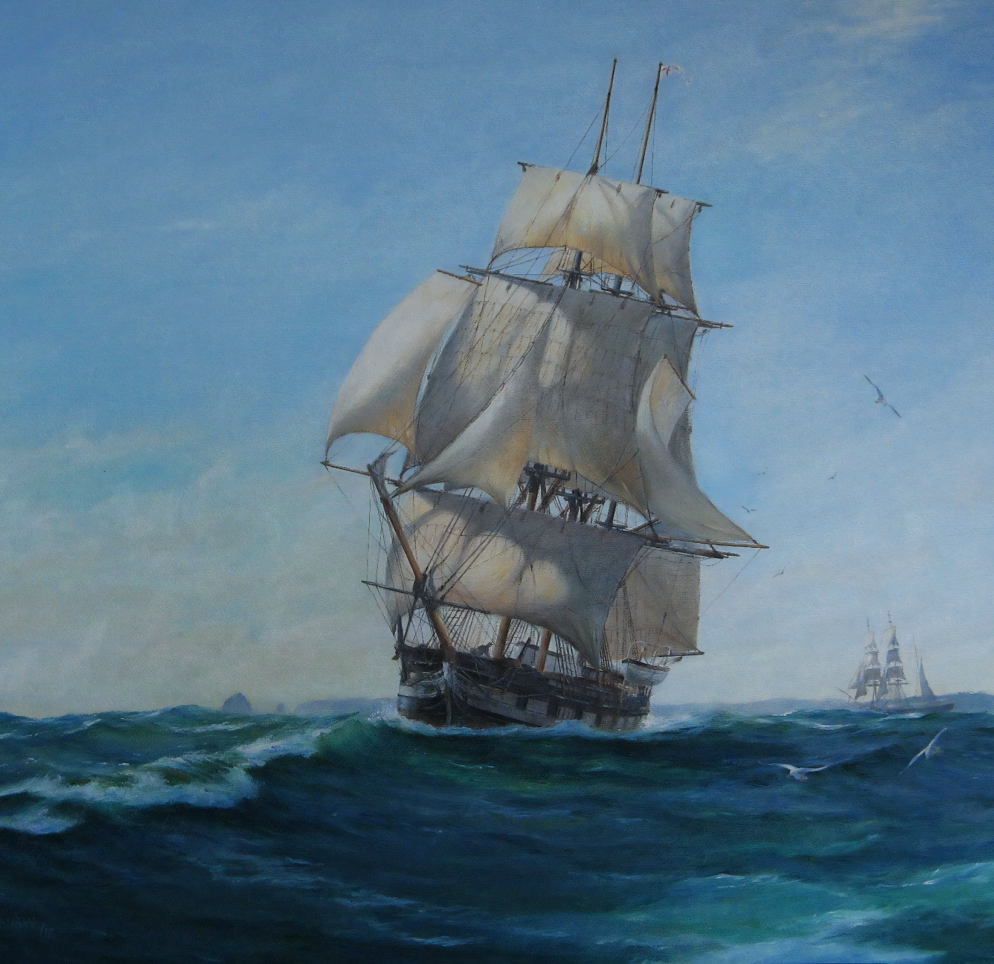
Between 1831 and 1836, Darwin travelled the world aboard the research ship HMS Beagle. It was during this time that he developed his theories on evolution.
For more help, please visit www.exampaperspractice.co.uk
© 2025 Exams Papers Practice. All Rights Reserved

Slide 5
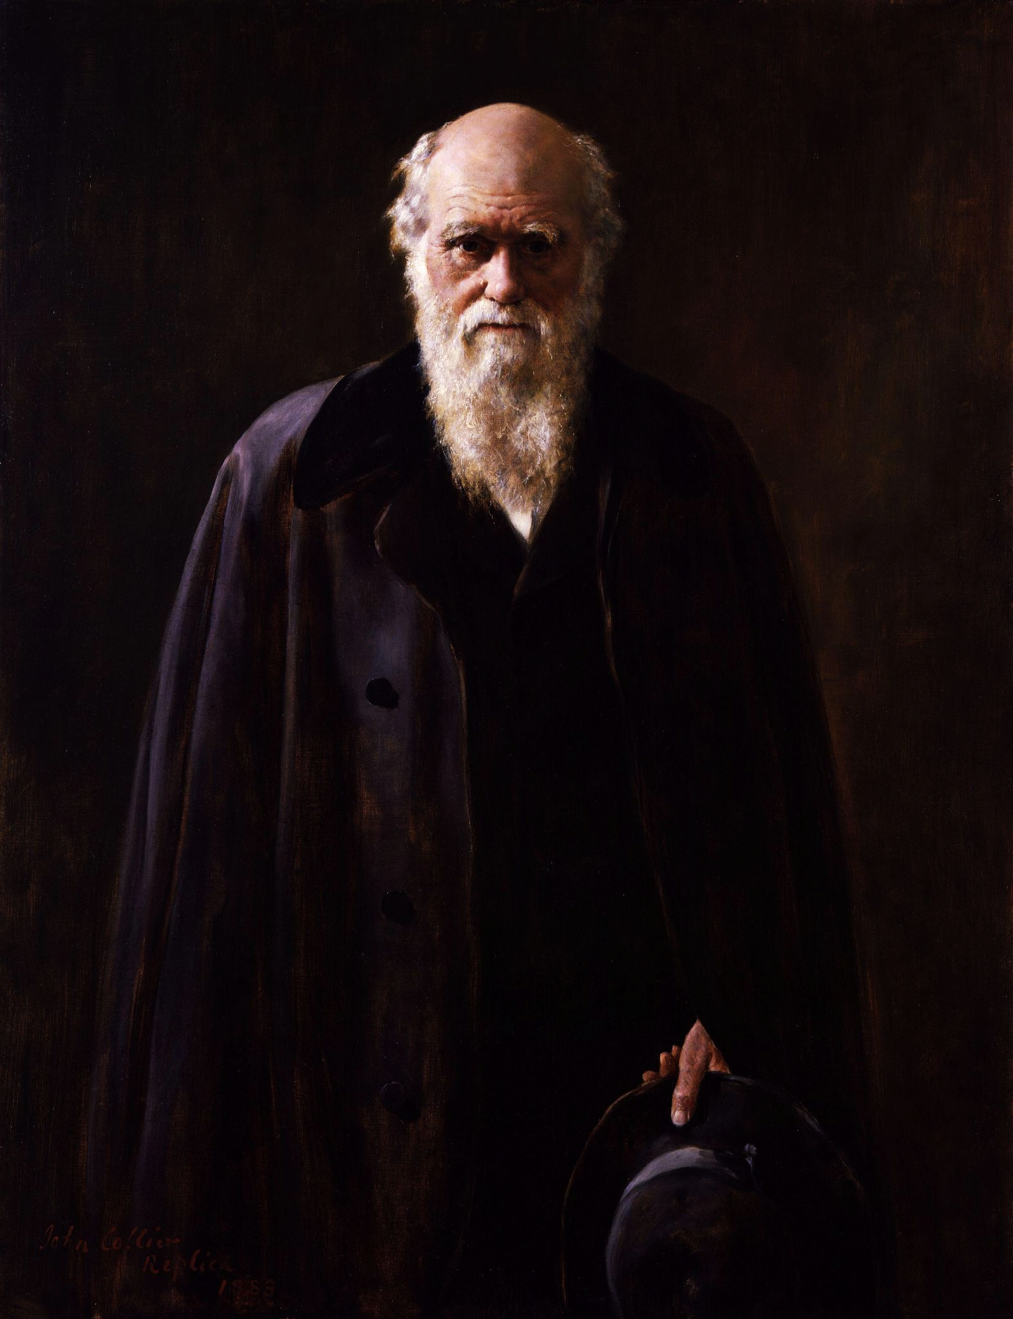
Upon his return to London, Darwin began writing his seminal work, On the Origin of Species. It was published in 1859 and is now considered to be the foundation of evolutionary biology.
For more help, please visit www.exampaperspractice.co.uk
© 2025 Exams Papers Practice. All Rights Reserved

Slide 6
Darwin’s theory of evolution provides an explanation for the tremendous diversity of life on Earth.
For more help, please visit www.exampaperspractice.co.uk
© 2025 Exams Papers Practice. All Rights Reserved

Slide 7
By Means of Natural Selection
Darwin proposed that only the organisms which are well-adapted to their environment will survive.
This was dubbed ‘survival of the fittest’.
Organisms that are well-adapted to their environment will pass on their alleles to the next generation.
The organisms that don’t survive will not pass on their alleles.
Over a number of generations, the characteristics of the population will change to suit the environment.
Over many generations, populations will become better-adapted to their environment.
For more help, please visit www.exampaperspractice.co.uk
© 2025 Exams Papers Practice. All Rights Reserved

Slide 8
The Mechanism of Natural Selection
Genetic variation is present in a population.
This variation means there are lots of different versions of the same gene - alleles.
Variation comes about by mutation.
There is competition for resources.
Competition might be for food or for mates.
The individuals with the characteristics that are better suited to the environment will survive.
These individuals will have the alleles associated with better survivability.
These individuals will pass their alleles on to the next generation.
Over a number of generations, the frequency of this allele will increase.
For more help, please visit www.exampaperspractice.co.uk
© 2025 Exams Papers Practice. All Rights Reserved

Slide 9
1. The first generation of mice has naturally more light mice than dark mice.
2. Mice with light fur are more visible to predators. They are hunted in greater numbers than dark mice.
3. Only a few light mice now remain, the survivors repopulate.
4. Mice with dark fur have a much better chance of survival against predators. Over several generations, dark fur becomes normal for the population.
For more help, please visit www.exampaperspractice.co.uk
© 2025 Exams Papers Practice. All Rights Reserved

Slide 10
Antibiotic Resistance
Specification Point 3.39
Understand how resistance to antibiotics can increase in bacterial populations, and appreciate how such an increase can lead to infections being difficult to control.
One example of natural selection can be demonstrated in the rise of antibiotic resistance in bacteria.
Antibiotics are chemicals that kill bacteria.
Most antibiotics kill bacteria by punching holes in the bacterial cell wall.
A mutation might produce a new allele that is resistant to a particular antibiotic.
This allele will give the bacteria increased survivability.
Due to natural selection, this allele will spread through the population.
Antibiotic resistance is a major problem in hospital settings.
For more help, please visit www.exampaperspractice.co.uk
© 2025 Exams Papers Practice. All Rights Reserved

Slide 11
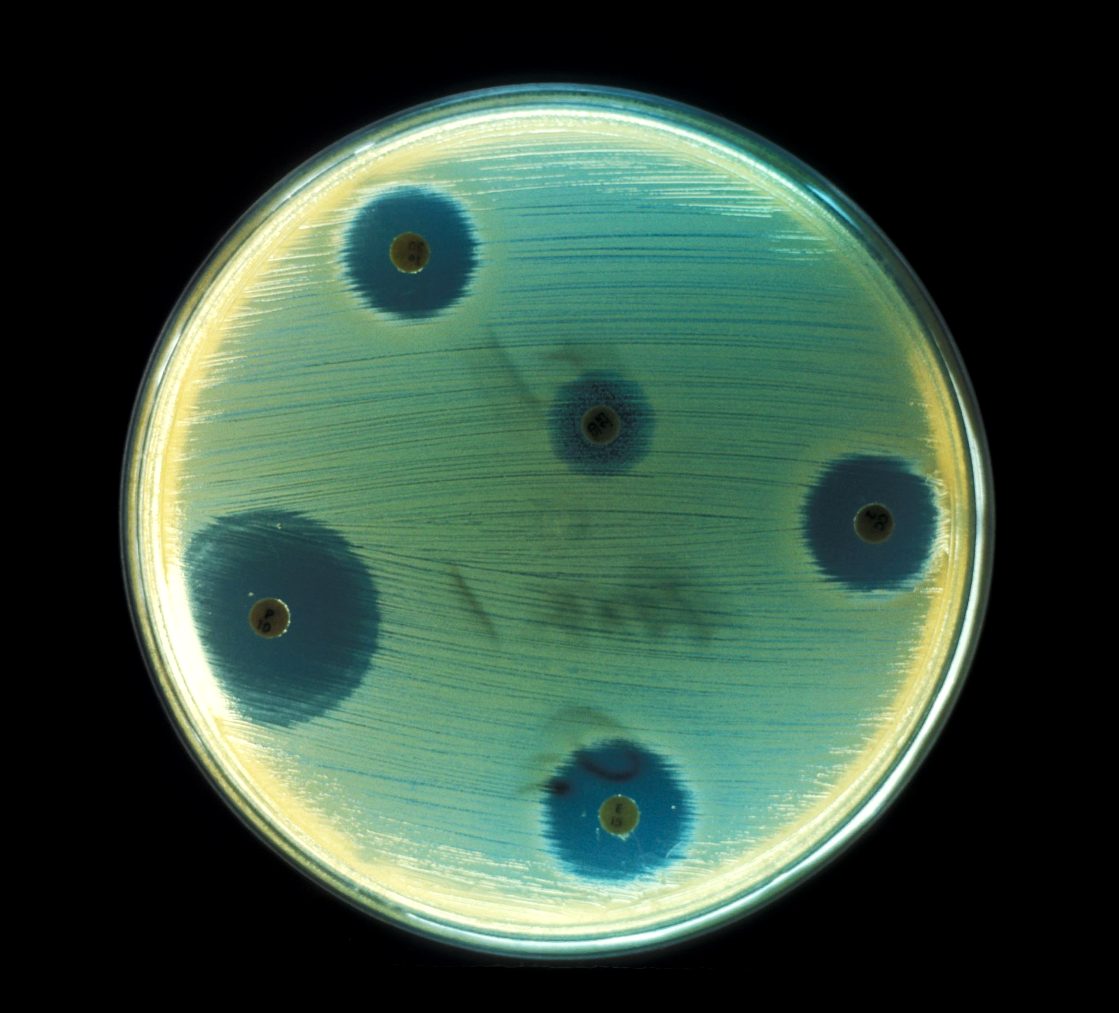
Methicillin-resistant Staphylococcus aureus (MRSA) is a bacterial infection that has become resistant to most known antibiotics.
For more help, please visit www.exampaperspractice.co.uk
© 2025 Exams Papers Practice. All Rights Reserved

Slide 12
Antibiotic Resistance
Antibiotic-resistant bacteria have become difficult to control.
There are a limited number of different antibiotics.
Bacteria divide very rapidly - a population can quickly become resistant.
Humans have also overused antibiotics.
Antibiotics have traditionally been used to treat minor infections.
Antibiotics have also been routinely used in animal feed to prevent infections in livestock.
There are ways to slow the development of antibiotic resistance:
We should avoid the unnecessary use of antibiotics.
Patients should always complete the full course of prescribed antibiotics.
For more help, please visit www.exampaperspractice.co.uk
© 2025 Exams Papers Practice. All Rights Reserved

Slide 13
% OF HOSPITALS THAT SUFFERED AN MRSA OUTBREAK IN 2017
1%-5%
5%-10%
10%-25%
25%-50%
There was a major outbreak of MRSA throughout European hospitals in 2017. Antibiotic resistance is now a major problem for public health.
There are a number of strategies than can be used to reduce the spread of antibiotic resistance.
For more help, please visit www.exampaperspractice.co.uk
© 2025 Exams Papers Practice. All Rights Reserved

