Slide 1
Edexcel IGCSE Biology
46 - Variation in a Species
Genes, Environment and Mutation
For more help, please visit www.exampaperspractice.co.uk
© 2025 Exams Papers Practice. All Rights Reserved

Slide 2
Random Fertilization
As fusion between sperm and egg is random, there are almost limitless genetic combinations.
Specification Point 3.31
Understand how random fertilization produces genetic variation of offspring.
In mammals, a female egg is fertilized when it fuses with a male sperm.
These cells are gametes.
The fusion of the egg and the sperm is a random process.
There are billions of sperm released during sexual intercourse.
Any one of these sperm could fertilize the egg.
Because of meiosis, every gamete is genetically distinct.
As a result, all individuals in a population are genetically different to each other.
EGG CELL
?
?
?
For more help, please visit www.exampaperspractice.co.uk
© 2025 Exams Papers Practice. All Rights Reserved

Slide 3
Dogs from the same litter can display lots of genetic variation.
For more help, please visit www.exampaperspractice.co.uk
© 2025 Exams Papers Practice. All Rights Reserved

Slide 4
Diploid and Haploid Cells
Specification Point 3.32
Know that in human cells the diploid number of chromosomes is 46 and the haploid number is 23.
Body cells have two copies of each chromosome.
Body cells are said to be diploid.
Humans have 46 chromosomes in diploid cells.
A human diploid cell has two sets of 23 chromosomes.
Gametes have one copy of each chromosome.
Gametes are said to be haploid.
Gametes are sperm cells and egg cells.
Humans have 23 chromosomes in haploid cells.
A human haploid cell has one set of 23 chromosomes.
For more help, please visit www.exampaperspractice.co.uk
© 2025 Exams Papers Practice. All Rights Reserved

Slide 5
Chromosomes in diploid cells can be displayed in a karyotype. This is a karyotype of a human female, as there are 2 copies of the X chromosome.
For more help, please visit www.exampaperspractice.co.uk
© 2025 Exams Papers Practice. All Rights Reserved
For more help, please visit www.exampaperspractice.co.uk
© 2025 Exams Papers Practice. All Rights Reserved

Slide 6
Genes and the Environment
Specification Point 3.33
Understand that variation within a species can be genetic, environmental, or a combination of both.
Living organisms differ, even when they have the same parents.
The differences in populations is referred to as variation.
Variation can be caused by genetics.
Genetic variation is determined by genes.
Variation can also be caused by the environment.
Environmental variation is determined by the environment the organism lives in.
Variation is often due to an interaction between genetics and the environment.
This is often called the nature versus nurture debate.
HEIGHT
The difference in height between siblings demonstrates the interaction between genes and the environment.
For more help, please visit www.exampaperspractice.co.uk
© 2025 Exams Papers Practice. All Rights Reserved

Slide 7
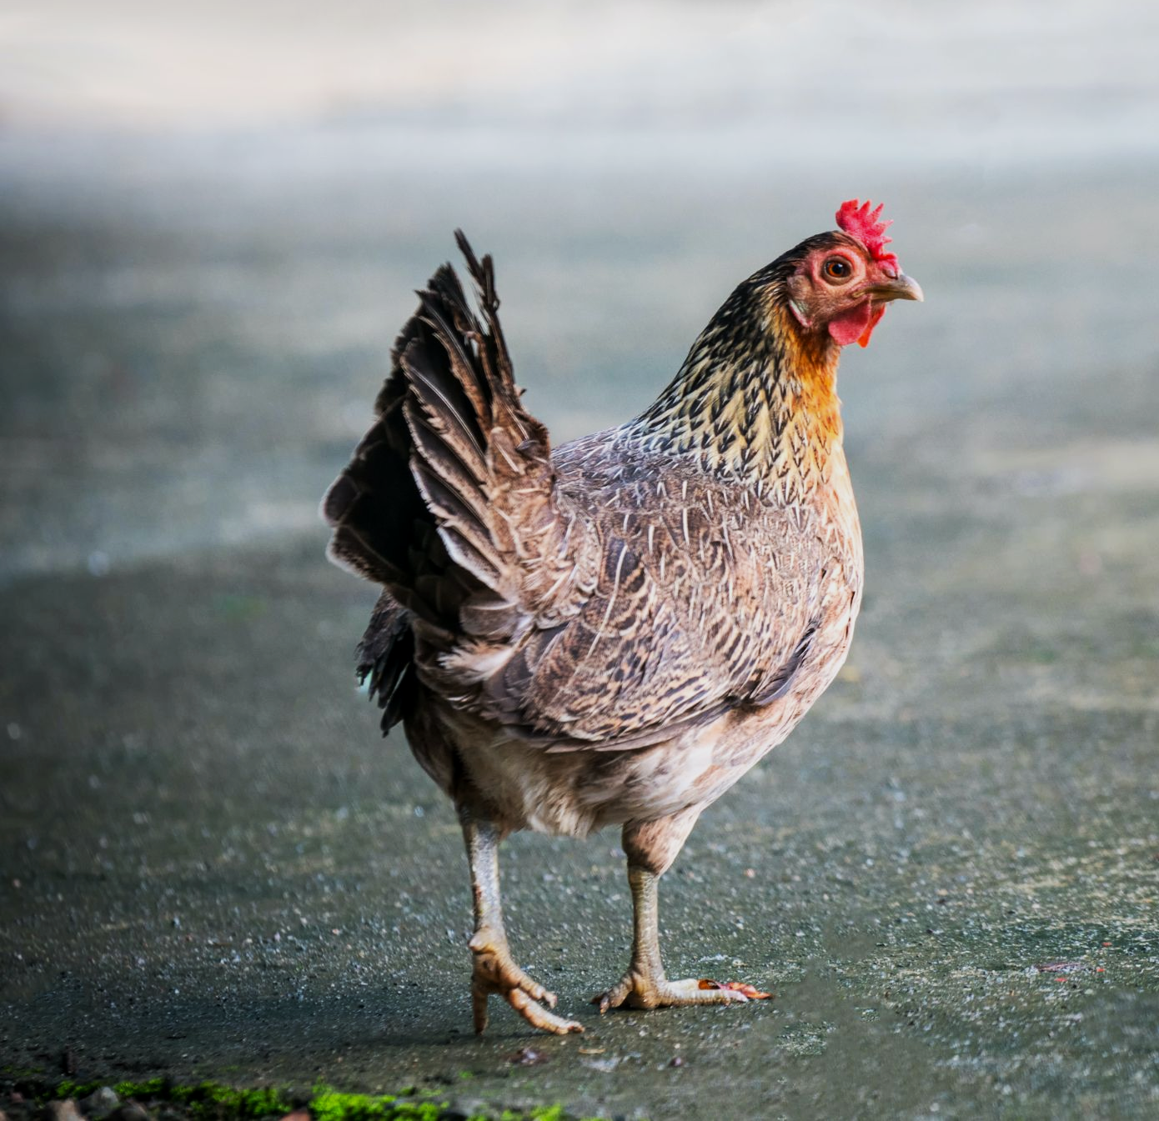
Coat colour in hens is entirely determined by genetics.

Slide 8
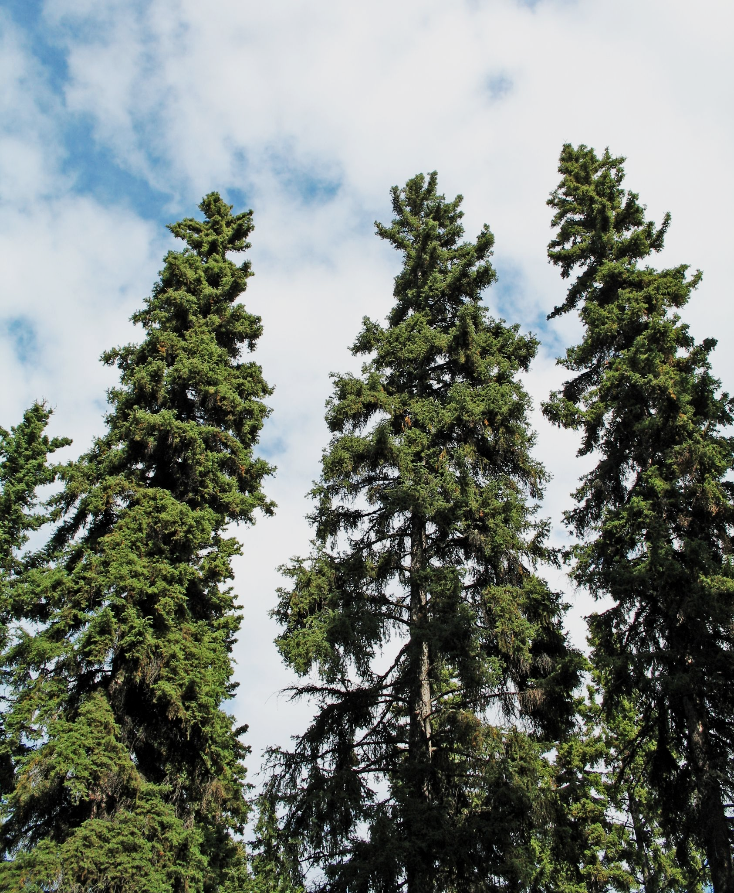
The height of trees can be affected by environmental factors such as the availability of light or nutrients.
VARIATION IN THE HEIGHT OF SPRUCE TREES
FREQUENCY →
HEIGHT →
For more help, please visit www.exampaperspractice.co.uk
© 2025 Exams Papers Practice. All Rights Reserved

Slide 9
Some diseases like diabetes have both genetic and environmental components.
For more help, please visit www.exampaperspractice.co.uk
© 2025 Exams Papers Practice. All Rights Reserved

Slide 10
Mutations
Specification Point 3.34
Understand that mutation is a rare, random change in genetic material that can be inherited.
A mutation is a change in the DNA sequence of an organism.
This can lead to a new form of a gene (allele).
This change can be passed down through generations.
The mutation is said to be inherited.
Mutations are random.
Mutations can occur in any gene.
Mutations are rare.
The general rate of mutation in humans is very low.
Mutations can occur in any gene. BRCA1 is a gene found on chromosome 17. Mutations in BRCA1 have been found to be strong risk factor for developing breast cancer.
For more help, please visit www.exampaperspractice.co.uk
© 2025 Exams Papers Practice. All Rights Reserved

