Slide 1
Edexcel IGCSE Biology
45 - Cell Division
Mitosis and Meiosis
For more help, please visit www.exampaperspractice.co.uk
© 2025 Exams Papers Practice. All Rights Reserved

Slide 2
Diploid and Haploid Cells
Specification Point 3.28/3.29
Understand how division of a diploid cell by mitosis produces two cells that contain identical sets of chromosomes.
Understand that mitosis occurs during growth, repair, cloning and asexual reproduction.
A diploid cell is one that contains a nucleus with two sets of chromosomes.
One set of chromosomes is provided by each parent.
All body cells are diploid (2n).
A haploid cell is one that contains a nucleus with only a single set of chromosomes.
Gametes are haploid (n).
In mammals, sperm and egg cells are gametes.
HAPLOID CELLS HAVE A SINGLE SET OF CHROMOSOMES
DIPLOID CELLS HAVE TWO SETS OF CHROMOSOMES
For more help, please visit www.exampaperspractice.co.uk
© 2025 Exams Papers Practice. All Rights Reserved

Slide 3
All body cells are diploid and contain two copies of the same chromosome.
For more help, please visit www.exampaperspractice.co.uk
© 2025 Exams Papers Practice. All Rights Reserved

Slide 4
Mitosis
Mitosis is a form of cell division.
Mitosis is important for the growth and repair of an organism.
Mitosis is also the mechanism used in asexual reproduction.
Mitosis begins with a single parent cell.
This cell is diploid, with two sets of chromosomes.
The cell makes a copy of each chromosome and then divides.
This produces two identical daughter cells.
Each daughter cell is diploid, with two sets of chromosomes.
Mitosis video.
For more help, please visit www.exampaperspractice.co.uk
© 2025 Exams Papers Practice. All Rights Reserved

Slide 5
Mitosis begins with a single parent cell and leads to the production of 2 genetically identical offspring.
2X DIPLOID CELLS
DNA REPLICATION
MITOSIS
For more help, please visit www.exampaperspractice.co.uk
© 2025 Exams Papers Practice. All Rights Reserved

Slide 6
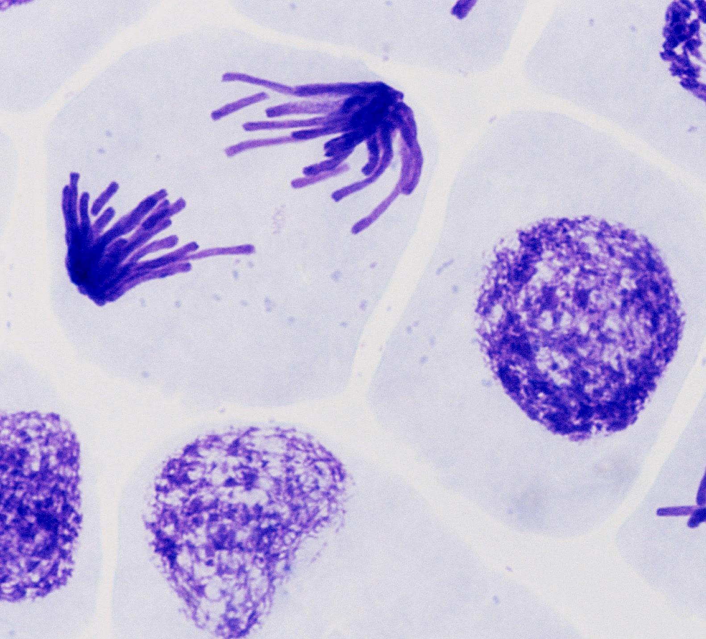
During mitosis, chromosomes will be pulled apart to the poles of the cell.
For more help, please visit www.exampaperspractice.co.uk
© 2025 Exams Papers Practice. All Rights Reserved

Slide 7
Meiosis
Specification Point 3.30
Understand how division of a cell by meiosis produces four cells, each with half the number of chromosomes, and that this results in the formation of genetically different haploid gametes.
Meiosis is another form of cell division.
The purpose of meiosis is to produce gametes.
Gametes have half the number of chromosomes of a body cell.
Gametes are haploid.
When fertilization occurs, the nuclei of the male gamete (sperm) and the female gamete (egg) will fuse.
The new offspring (zygote) will have a diploid nucleus.
For more help, please visit www.exampaperspractice.co.uk
© 2025 Exams Papers Practice. All Rights Reserved

Slide 8
Meiosis
Meiosis begins with a single parent cell.
This cell is diploid, with 46 chromosomes.
The cell makes a copy of each chromosome and then divides twice.
Meiosis produces four non-identical daughter cells.
Each daughter cell is haploid, with one set of chromosomes.
Meiosis creates genetic variation.
During meiosis, the genes on chromosomes are shuffled into new combinations.
Meiosis video.
For more help, please visit www.exampaperspractice.co.uk
© 2025 Exams Papers Practice. All Rights Reserved

Slide 9
Meiosis involves the shuffling of genes inside chromosomes to make new genetic combinations. Meiosis is responsible for creating genetic variation in populations.
For more help, please visit www.exampaperspractice.co.uk
© 2025 Exams Papers Practice. All Rights Reserved

Slide 10
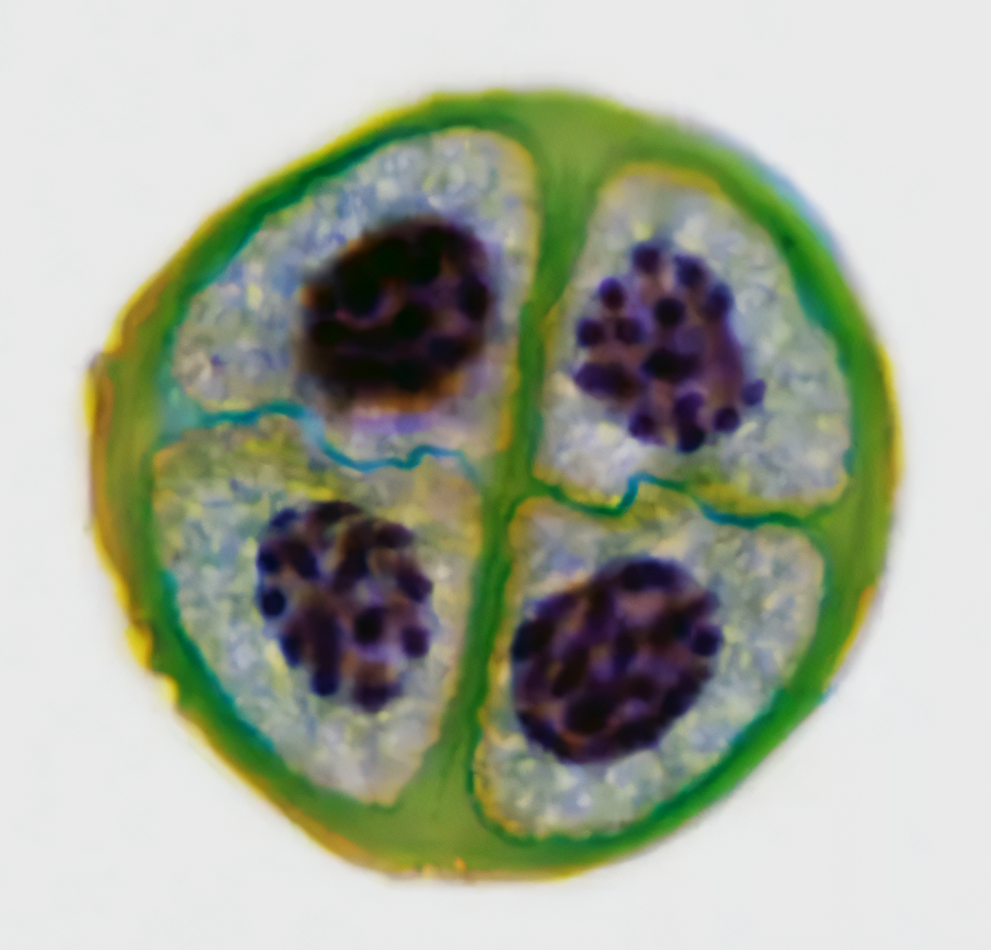
Meiosis creates 4 genetically distinct haploid daughter cells. In mammals these are sperm cells and egg cells.
For more help, please visit www.exampaperspractice.co.uk
© 2025 Exams Papers Practice. All Rights Reserved

Slide 11
Comparing Mitosis and Meiosis
There are key differences between mitosis and meiosis:
Mitosis | Meiosis
Two daughter cells produced. | Four daughter cells produced.
Daughter cells have two sets of chromosomes (diploid). | Daughter cells have one set of chromosomes (haploid).
Daughter cells are genetically identical to each other and the parent cell. | Daughter cells are genetically different to each other and the parent cell.
One cell division takes place. | Two cell divisions takes place.
For more help, please visit www.exampaperspractice.co.uk
© 2025 Exams Papers Practice. All Rights Reserved

