Slide 1
Edexcel IGCSE Biology
44 - Genetic Diagrams
Punnett Squares and Sex Determination
For more help, please visit www.exampaperspractice.co.uk
© 2025 Exams Papers Practice. All Rights Reserved

Slide 2
Polygenics
Specification Point 3.22
Understand that most phenotypic features are the result of polygenic inheritance rather than single genes.
Some characteristics are controlled by more than one gene.
This is called polygenic inheritance.
Polygenic inheritance results in lots of phenotypic combinations.
Human height for example is controlled by more than 400 different genes.
Polygenic interactions are thought to be one reason for the different average heights in different countries.
For more help, please visit www.exampaperspractice.co.uk
© 2025 Exams Papers Practice. All Rights Reserved

Slide 3
Height differs between countries. This is thought to be at least partly due to polygenic interactions.
INCREASING HEIGHT IN MALES →
For more help, please visit www.exampaperspractice.co.uk
© 2025 Exams Papers Practice. All Rights Reserved

Slide 4
Monohybrid Crosses
Specification Points 3.23, 3.24 and 3.25
Describe patterns of monohybrid inheritance using a genetic diagram.
Understand how to interpret family pedigrees.
Predict probabilities of outcomes from monohybrid crosses.
Monohybrid inheritance can be defined as the inheritance of characteristics from a single gene.
This is sometimes referred to as Mendelian genetics.
Monohybrid inheritance is displayed in a genetic diagram called a Punnett square.
Punnett squares can also be used to predict the outcomes of monohybrid crosses.
For more help, please visit www.exampaperspractice.co.uk
© 2025 Exams Papers Practice. All Rights Reserved

Slide 5
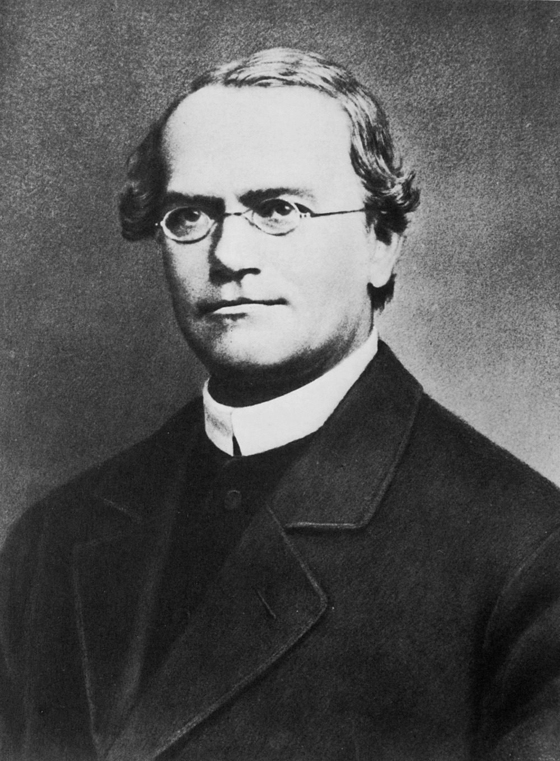
Gregor Mendel is considered the father of modern genetics. His experiments on pea plants established many of the rules on heredity which are still used today.
For more help, please visit www.exampaperspractice.co.uk
© 2025 Exams Papers Practice. All Rights Reserved

Slide 6
Punnett Squares
The height of pea plants is controlled by a single gene.
The gene for pea plant height has two alleles.
The tall allele (T) is dominant to the short allele (t).
If we cross a homozygous dominant (TT) pea plant with a homozygous recessive (tt) pea plant, we get four heterozygous (Tt) offspring.
All four offspring from this cross are tall.
MATERNAL PEA | PATERNAL PEA
 | T | T
t | Tt | Tt
t | Tt | Tt
Crossing two homozygous parents together will always yield heterozygous offspring.
For more help, please visit www.exampaperspractice.co.uk
© 2025 Exams Papers Practice. All Rights Reserved

Slide 7
Punnett Squares
When gametes are produced, only one allele is available from each parent.
This is because gametes have half the genetic information of other cells.
If we cross the offspring of the pea plants, we will get different genetic ratios.
This is referred to as crossing the F₁ generation.
In this scenario, we are crossing two heterozygotes (Tt) together.
This will yield one homozygous dominant (TT), two heterozygotes (Tt) and one homozygous recessive (tt).
There will be three tall plants to one short plant or a 3:1 ratio. This is sometimes written as 75% to 25%.
MATERNAL PEA | PATERNAL PEA
 | T | t
T | TT | Tt
t | Tt | tt
Crossing two heterozygous individuals will yield a variety of genotypes and phenotypes.
For more help, please visit www.exampaperspractice.co.uk
© 2025 Exams Papers Practice. All Rights Reserved

Slide 8
TALL PLANT
CROSSED WITH
SHORT PLANT
In the parental generation, 2 homozygotes (TT and tt) are crossed together.
All offspring (F₁) from this cross are heterozygous (Tt). These individuals are crossed with each other.
The next generation (F₂) have a variety of genotypes (TT, Tt and tt) and phenotypes (tall plants and short plants).
ALL TALL OFFSPRING
CROSSED TOGETHER
3 TALL PLANTS
1 SHORT PLANT
For more help, please visit www.exampaperspractice.co.uk
© 2025 Exams Papers Practice. All Rights Reserved

Slide 9
Family pedigrees
Another way to display how alleles are passed through generations is through family pedigrees.
Pedigrees are often used to trace genetic diseases through a family.
Pedigrees can be used to calculate the probability that someone in a family will inherit a particular condition.
AFFECTED MALE
AFFECTED FEMALE
UNAFFECTED MALE
UNAFFECTED FEMALE
For more help, please visit www.exampaperspractice.co.uk
© 2025 Exams Papers Practice. All Rights Reserved

Slide 10
Cystic fibrosis (CF) is an example of a genetic disease carried by a recessive allele. Homozygous recessive individuals for the CF gene will suffer a wide range of health issues, including chronic inflammation of the lung tissue.
The likelihood of inheriting cystic fibrosis can be calculated using a family pedigree.
INFLAMMATION
For more help, please visit www.exampaperspractice.co.uk
© 2025 Exams Papers Practice. All Rights Reserved

Slide 11
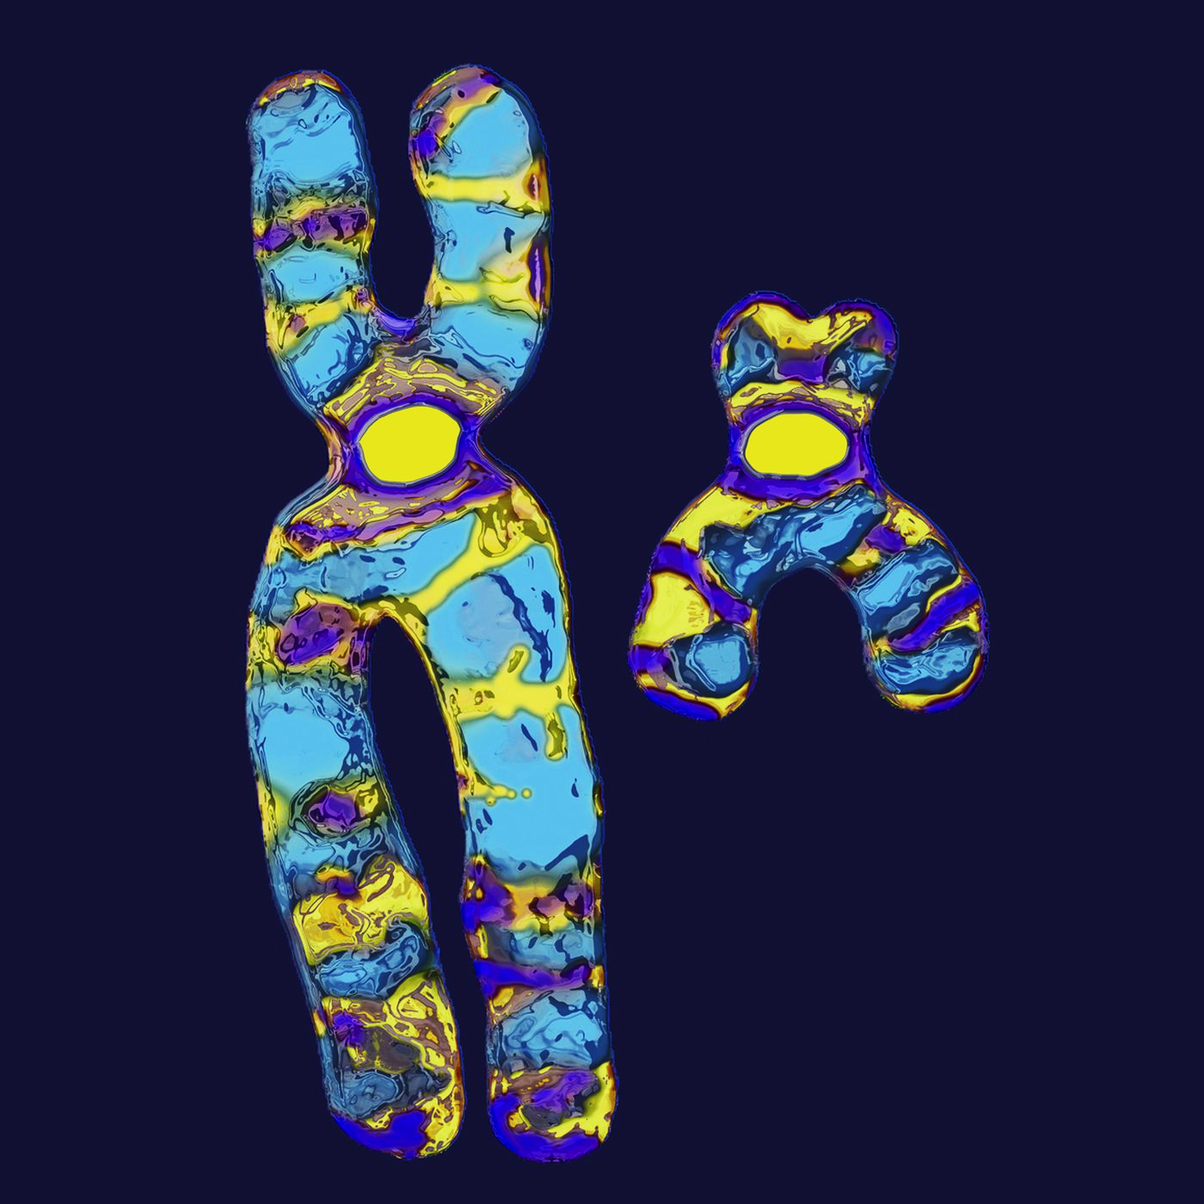
The X and Y Chromosomes
Specification Point 3.26
Understand how the sex of a person is controlled by one pair of chromosomes, XX in a female and XY in a male.
The sex or gender of a person is determined by a pair of chromosomes.
These chromosomes are called the sex chromosomes.
Females have two copies of the X chromosome (XX).
Males have one copy of the X chromosome and one copy of the Y chromosome (XY).
The X chromosome is much larger than the Y chromosome.
For more help, please visit www.exampaperspractice.co.uk
© 2025 Exams Papers Practice. All Rights Reserved

Slide 12
Sex Determination
Specification Point 3.27
Describe the determination of the sex of offspring at fertilisation, using a genetic diagram.
The father is responsible for determining the sex of the child.
A sperm cell can either carry an X chromosome or a Y chromosome.
The egg from the mother will always carry the X chromosome.
There will be a 1:1 ratio of male offspring (XY) to female offspring (XX).
There is a 50% chance of creating either gender.
MOTHER | FATHER
 | X | Y
X | XX | XY
X | XX | XY
There is an equal chance of creating male of female offspring.
For more help, please visit www.exampaperspractice.co.uk
© 2025 Exams Papers Practice. All Rights Reserved

Slide 13
EGG CELL
A sperm cell can either be carrying an X chromosome or a Y chromosome.
The sperm cell determines the gender of the offspring. An X sperm will create a female (XX). A Y sperm will create a male (XY).
For more help, please visit www.exampaperspractice.co.uk
© 2025 Exams Papers Practice. All Rights Reserved

