Slide 1


Edexcel IGCSE Biology
43 - Inheritance and Codominance
Alleles and Genotypes
For more help, please visit www.exampaperspractice.co.uk
© 2025 Exams Papers Practice. All Rights Reserved

Slide 2
Alleles
Specification Point 3.19
Understand how genes exist in alternative forms called alleles which give rise to differences in inherited characteristics.
Most organisms contain two copies of the same chromosome.
This is called a homologous pair of chromosomes.
Humans have two sets of 23 chromosomes.
The same gene will be present on both chromosomes.
One example the is the gene for eye colour.
These genes may have slightly different base sequences.
Different versions of a gene are called alleles.
Alleles will code for for different versions of a characteristic.
For example blue eyes or brown eyes.
For more help, please visit www.exampaperspractice.co.uk
© 2025 Exams Papers Practice. All Rights Reserved

Slide 3
1 specific region on chromosome 15 plays an important role in the development of eye colour in humans. 2 of the most common alleles are the brown (B) allele and the blue (b) allele. The combination of these alleles is referred to as an individual's genotype.
ALLELE
For more help, please visit www.exampaperspractice.co.uk
© 2025 Exams Papers Practice. All Rights Reserved

Slide 4
Homozygous and Heterozygous Alleles
Specification Point 3.20
Understand the meaning of the terms: dominant, recessive, homozygous, heterozygous, phenotype, and genotype.
There are usually two alleles of each gene.
This is because there are two of each chromosome.
If both alleles are the same, they are called homozygous alleles.
If alleles are different, they are called heterozygous alleles.
Some alleles are dominant.
This means their characteristic is always displayed in the organism.
Dominant alleles are said to always be expressed.
Other alleles are recessive.
This means their characteristic is not always displayed in the organism.
Recessive alleles are said to only be sometimes expressed.
For more help, please visit www.exampaperspractice.co.uk
© 2025 Exams Papers Practice. All Rights Reserved

Slide 5
Homozygous and Heterozygous Alleles
Specification Point 3.20
Understand the meaning of the terms: dominant, recessive, homozygous, heterozygous, phenotype, and genotype.
There are usually two alleles of each gene.
This is because there are two of each chromosome.
If both alleles are the same, they are called homozygous alleles.
If alleles are different, they are called heterozygous alleles.
In this example, both alleles are the same. The alleles are said to be homozygous.
For more help, please visit www.exampaperspractice.co.uk
© 2025 Exams Papers Practice. All Rights Reserved

Slide 6
Dominant and Recessive Alleles
Alleles are represented by letters.
Dominant alleles are given capital letters (B for brown eyes).
Recessive alleles are given lowercase letters (b for blue eyes).
An individual could be homozygous dominant.
This means both their alleles would be dominant - BB.
An individual could be homozygous recessive.
This means both their alleles would be recessive - bb.
An individual could be heterozygous.
This means they would have one of each allele - Bb.
For more help, please visit www.exampaperspractice.co.uk
© 2025 Exams Papers Practice. All Rights Reserved

Slide 7
Genotypes and Phenotypes
The letter notation (BB, bb or Bb) is called the genotype.
The characteristic displayed by the individual (brown eyes or blue eyes) is called the phenotype.
As the B allele is dominant to the b allele, the following combinations are possible:
BB - brown eyes.
Bb - brown eyes.
bb - blue eyes.
As the brown allele is dominant to the blue allele, this individual could be either BB or Bb.
As the blue allele is recessive to the brown allele, this individual could only be bb.
For more help, please visit www.exampaperspractice.co.uk
© 2025 Exams Papers Practice. All Rights Reserved

Slide 8
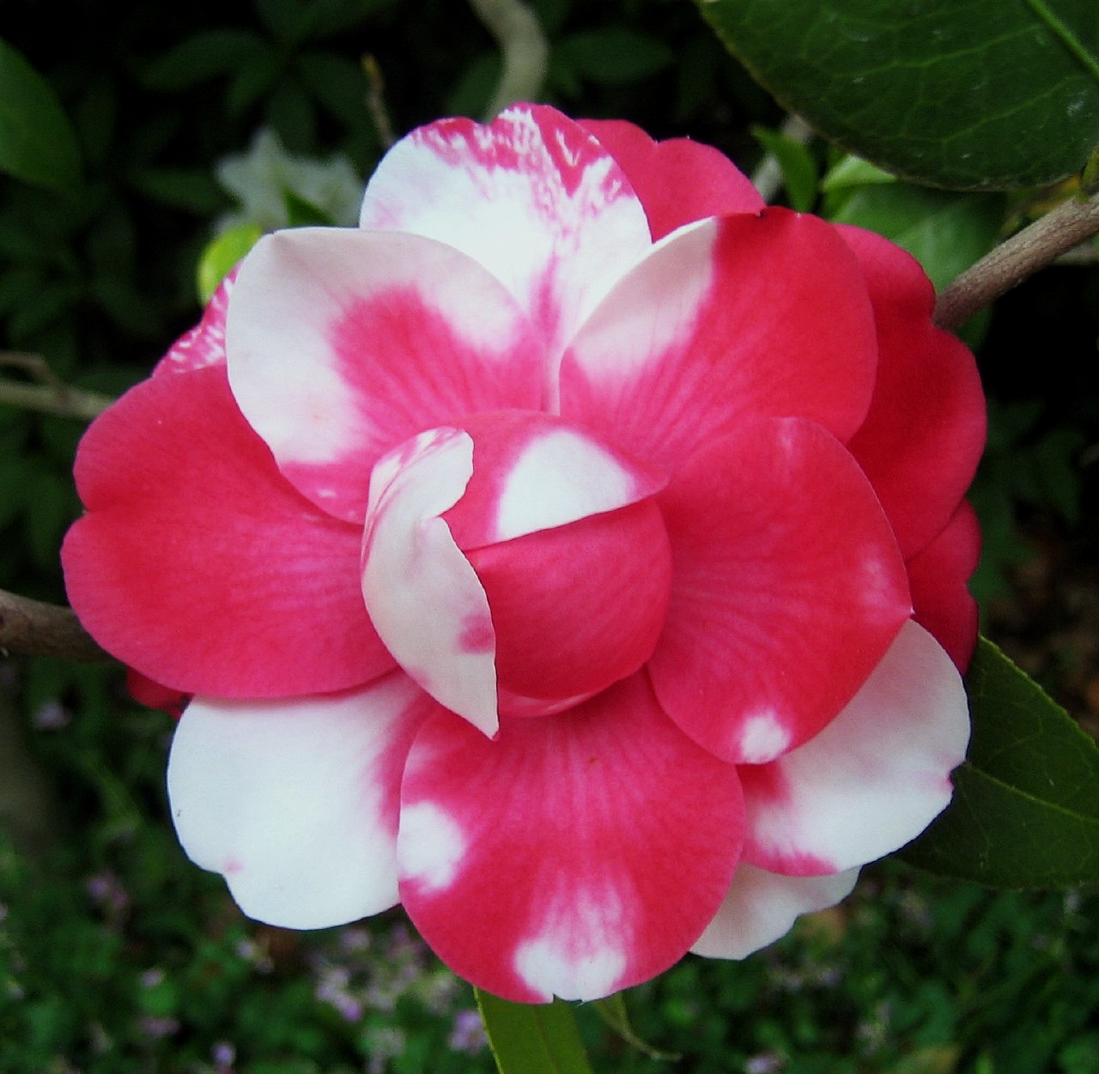
Codominance
Specification Point 3.21B
Understand the meaning of the term codominance.
Sometimes two alleles are equally as dominant as one another.
This is referred to as codominance.
Codominant alleles are both expressed in the phenotype.
The heterozygous genotype is different to both the homozygous dominant and the homozygous recessive genotypes.
In the case of this Rhododendron, the alleles for white and pink colour are codominant.
For more help, please visit www.exampaperspractice.co.uk
© 2025 Exams Papers Practice. All Rights Reserved

Slide 9
Roan Cattle
Some types of cattle experience codominance in their coat colour.
Cattle may be white, black or roan.
There are two alleles.
White (W) or black (B).
There are three potential genotypes.
WW, BB or WB.
There are also three potential phenotypes.
WW gives white cattle.
BB gives black cattle.
WB gives roan cattle.
For more help, please visit www.exampaperspractice.co.uk
© 2025 Exams Papers Practice. All Rights Reserved

Slide 10
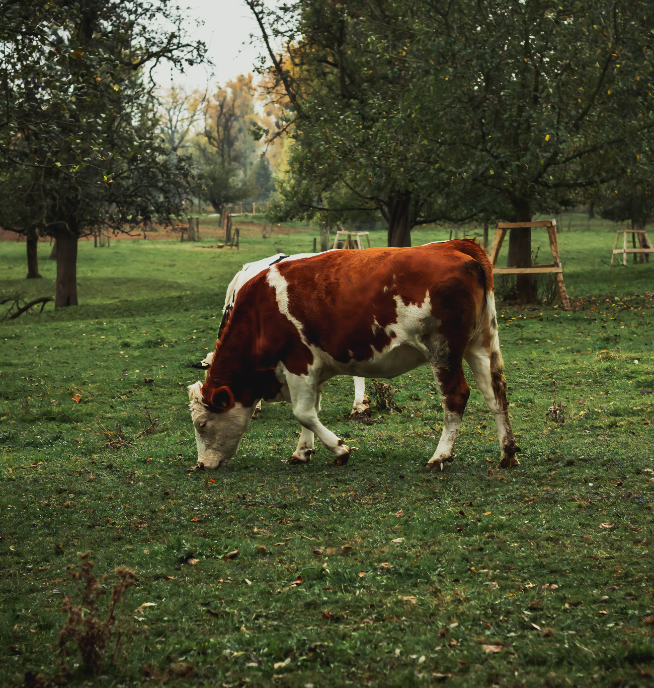
Roan cattle display codominance in their coat colour.
For more help, please visit www.exampaperspractice.co.uk
© 2025 Exams Papers Practice. All Rights Reserved

