Slide 1
Edexcel IGCSE Biology
40 - Pregnancy and Puberty
Growing a Baby, Secondary Sexual Characteristis
For more help, please visit www.exampaperspractice.co.uk
© 2025 Exams Papers Practice. All Rights Reserved

Slide 2
Growing a Baby
Specification Point 3.11
Describe the role of the placenta in the nutrition of the developing embryo.
A human embryo develops into a fully grown foetus in around 9 months.
At this point the foetus is born during childbirth.
As soon as the foetus is born it is referred to as a baby.
The foetus is attached to the placenta.
The placenta is a temporary organ that grows next to the foetus.
The placenta connects the foetus to the umbilical cord.
A human embryo will mature to term in around 9 months.
For more help, please visit www.exampaperspractice.co.uk
© 2025 Exams Papers Practice. All Rights Reserved

Slide 3
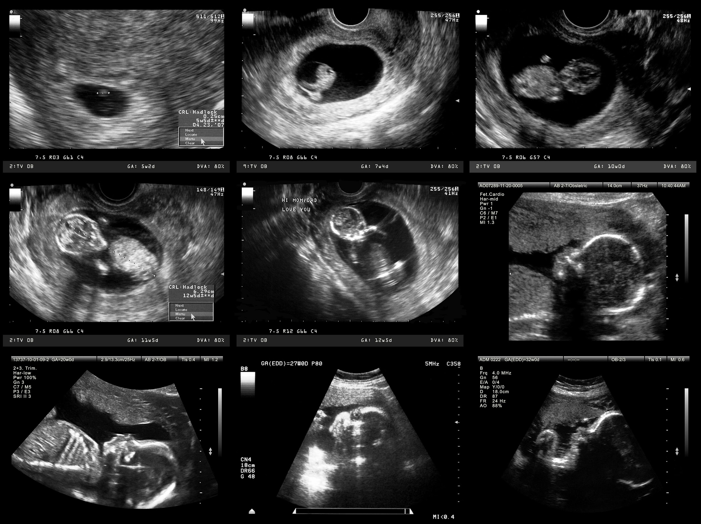
One way of investigating how the foetus is developing is through the use of ultrasound technology.
For more help, please visit www.exampaperspractice.co.uk
© 2025 Exams Papers Practice. All Rights Reserved

Slide 4
The Placenta
The placenta provides oxygen and nutrients for the foetus.
The mother’s blood does not mix with the blood of the foetus.
Instead oxygen and nutrients diffuse across the placenta.
The placenta removes waste substances from the foetus.
CO₂ and urea are some of the major compounds removed.
Some toxins are not filtered by the placenta.
Carbon monoxide from smoking and ethanol from alcohol consumption.
Women are advised to abstain from these substances during pregnancy.
The placenta detaches from the uterus when pregnancy ends.
The placenta is then pushed out of the body.
This is referred to as the afterbirth.
PLACENTA
For more help, please visit www.exampaperspractice.co.uk
© 2025 Exams Papers Practice. All Rights Reserved

Slide 5
The Amniotic Sac
Specification Point 3.12
Understand how the developing embryo is protected by amniotic fluid.
The foetus is surrounded by the amniotic sac.
The amniotic sac is filled with amniotic fluid.
The fluid is generated from the mother’s blood plasma.
The amniotic fluid protects the foetus.
The fluid acts as cushion from impacts to the mother’s abdomen.
As the foetus develops, it is protects by a fluid-filled capsule called the amniotic sac.
For more help, please visit www.exampaperspractice.co.uk
© 2025 Exams Papers Practice. All Rights Reserved

Slide 6
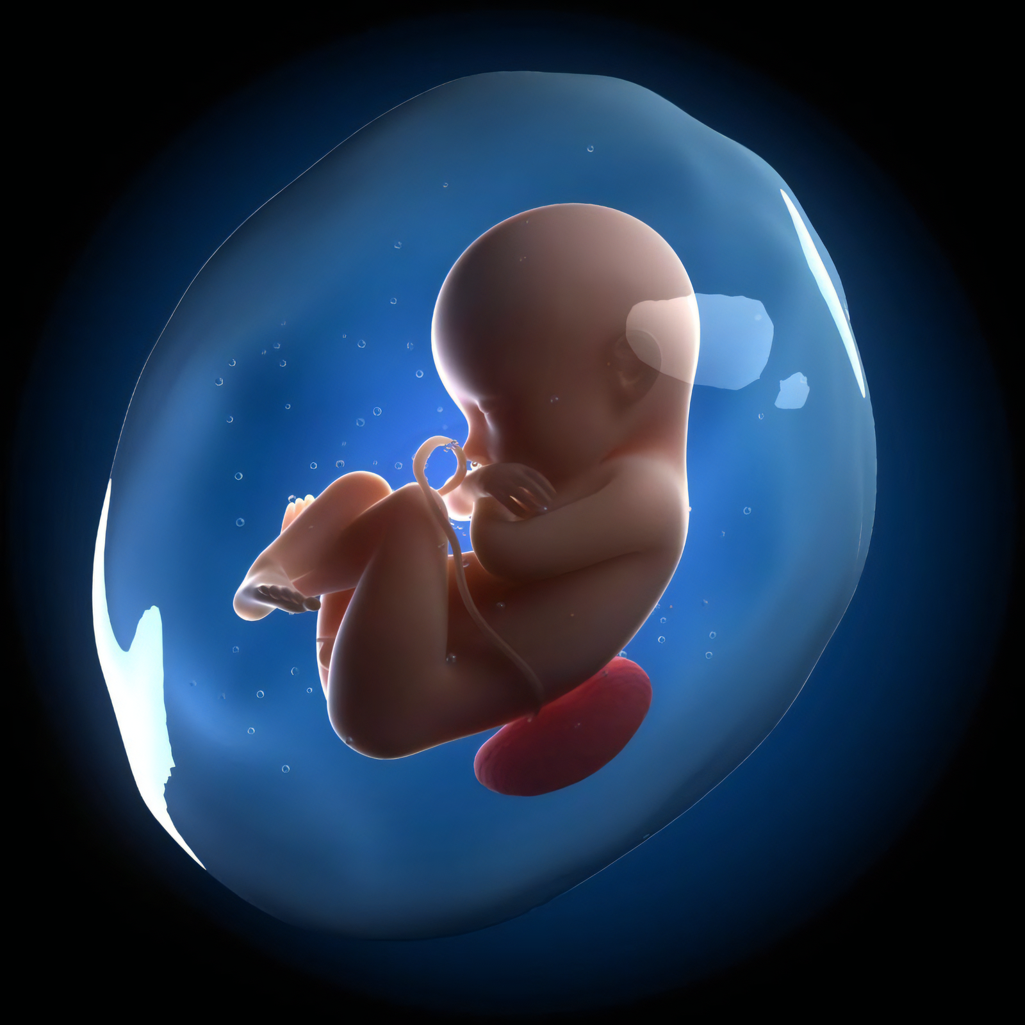
A foetus attached to the placenta. The foetus is protected in a bubble called the amniotic sac.
For more help, please visit www.exampaperspractice.co.uk
© 2025 Exams Papers Practice. All Rights Reserved

Slide 7
Primary Sexual Characteristics
Specification Point 3.13
Understand the roles of oestrogen and testosterone in the development of secondary sexual characteristics.
At birth, males and females have different reproductive organs.
Males have a penis and testes.
Females have a vagina and uterus.
These differences are called primary sexual characteristics.
Males and females have different primary sexual characteristics.
For more help, please visit www.exampaperspractice.co.uk
© 2025 Exams Papers Practice. All Rights Reserved

Slide 8
Secondary Sexual Characteristics
Children go through puberty when they turn into adolescents.
The average age for girls to begin puberty it 11.
The average age for boys to begin puberty is 12.
Puberty can take up to four years.
During puberty, the body goes through changes.
These body begins to display secondary sexual characteristics.
Secondary sexual characteristics are controlled by hormones.
Secondary sexual characteristics are controlled by the hormone oestrogen in girls.
Secondary sexual characteristics are controlled by the hormone testosterone in boys.
For more help, please visit www.exampaperspractice.co.uk
© 2025 Exams Papers Practice. All Rights Reserved

Slide 9
Puberty in Girls
In girls, the surge in oestrogen has a number of effects.
Girls develop breast tissue.
Breasts are grown for their role in child rearing (providing milk).
Girls grow body hair.
Body hair grows under the armpits.
Body hair grows in the pubic region.
The menstrual cycle begins.
At this point pregnancy is achievable.
The hips of girls get wider.
This is to allow for an easier birth of a foetus.
For more help, please visit www.exampaperspractice.co.uk
© 2025 Exams Papers Practice. All Rights Reserved

Slide 10
STAGE 1
STAGE 2
The Tanner scale is widely used to measure physical development in adolescents.
STAGE 3
STAGE 4
STAGE 5
For more help, please visit www.exampaperspractice.co.uk
© 2025 Exams Papers Practice. All Rights Reserved

Slide 11
Puberty in Boys
In boys, the surge in testosterone has a number of effects.
The penis and testes grow.
This allows for the production of sperm for fertilization.
It also allows for intercourse.
Boys grow body and facial hair.
The muscles become more developed.
This is an evolutionary mechanism where strength was vital for survival.
The voice breaks.
The voice becomes deeper as the larynx enlarges and the vocal cords stretch.
For more help, please visit www.exampaperspractice.co.uk
© 2025 Exams Papers Practice. All Rights Reserved

Slide 12
STAGE 1
STAGE 2
The Tanner scale is widely used to measure physical development in adolescents.
STAGE 3
STAGE 4
STAGE 5
For more help, please visit www.exampaperspractice.co.uk
© 2025 Exams Papers Practice. All Rights Reserved

Slide 13
Mood Swings and Sex
Puberty also has more generalised effects on both genders.
Emotional changes occur.
This is because of the surge in hormones released into the body.
Puberty often leads to increased sexual desire.
Testosterone and oestrogen have been shown to have impacts on sexual appetite.
Puberty can also lead to mood swings.
Puberty usually leads to an increased desire for sex.
For more help, please visit www.exampaperspractice.co.uk
© 2025 Exams Papers Practice. All Rights Reserved

