Slide 1
Edexcel IGCSE Biology
3 - Organisation and Cell Structure
Organelles to Organisms
For more help, please visit www.exampaperspractice.co.uk
© 2025 Exams Papers Practice. All Rights Reserved

Slide 2
Levels of Organisation
Specification Point 2.1
Describe the level of organisation in organisms: organelles, cells, tissues, organs and organ systems.
Organisms are organised into a variety of levels.
From smallest to largest they are:
Organelles.
Cells.
Tissues.
Organs.
Organ systems.
ORGANELLES
CELLS
TISSUES
INCREASING SIZE →
ORGANS
ORGAN SYSTEMS
For more help, please visit www.exampaperspractice.co.uk
© 2025 Exams Papers Practice. All Rights Reserved

Slide 3
Organelles
Organelles are the smallest of the organisational units.
Organelles can be defined as cell structures that are specialised to perform a particular function.
Most eukaryotic cells will have a number of different organelles:
The nucleus.
Mitochondria.
Chloroplasts.
Ribosomes.
A mitochondrion is a type of organelle and the site for aerobic respiration.
For more help, please visit www.exampaperspractice.co.uk
© 2025 Exams Papers Practice. All Rights Reserved

Slide 4
RIBOSOMES
CYTOPLASM
NUCLEUS
CELL MEMBRANE
Organelles are found within cells.
MITOCHONDRIA
For more help, please visit www.exampaperspractice.co.uk
© 2025 Exams Papers Practice. All Rights Reserved

Slide 5
Cells
Cells are the basic building blocks of an organism.
Cells are the fundamental units of life.
All living creatures are made up of one or more cells:
Animal cells.
Plant cells.
Fungal cells.
Protozoan cells.
Bacterial cells.
A typical plant cell.
For more help, please visit www.exampaperspractice.co.uk
© 2025 Exams Papers Practice. All Rights Reserved

Slide 6
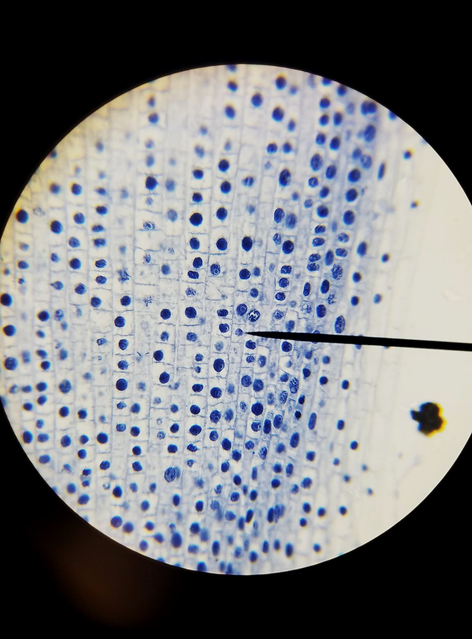
Cells are the fundamental building blocks of life. Pictured are some stained onion cells with their nuclei visible in blue.
For more help, please visit www.exampaperspractice.co.uk
© 2025 Exams Papers Practice. All Rights Reserved

Slide 7
Tissues
Tissues are groups of the same type of cell which are acting together for a specific function.
The cells in a tissue will be similar to each other.
There are lots of types of tissues in a human body:
Heart tissue.
Brain tissue.
Muscle tissue.
Muscles in the human body are made up of tissues. These tissues are made up of similar types of cell.
For more help, please visit www.exampaperspractice.co.uk
© 2025 Exams Papers Practice. All Rights Reserved

Slide 8
Organs
When several different tissue types assemble together, they create an organ.
Each organ has a particular task:
The heart to pump blood around the body.
The lungs to oxygenate the body.
The kidneys to filter out toxins.
Some organs are relatively simple.
The heart is a simple biological pump.
Other organs are very complex.
The brain is a hugely complicated organ that is still not fully understood.
The lungs are a pair of organs that help to oxygenate the body.
For more help, please visit www.exampaperspractice.co.uk
© 2025 Exams Papers Practice. All Rights Reserved

Slide 9
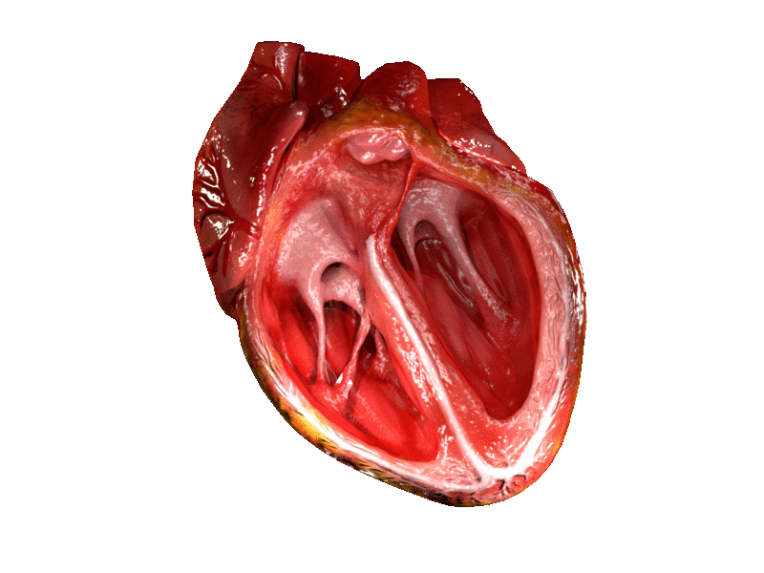
Several different tissues in the heart act together to pump blood.
For more help, please visit www.exampaperspractice.co.uk
© 2025 Exams Papers Practice. All Rights Reserved

Slide 10
Organ Systems
Groups of organs working together to achieve a task are called organ systems.
The human body has a number of different organ systems.
The circulatory system delivers oxygen and nutrients to the body.
The circulatory system includes the heart, lungs and blood vessels.
The digestive system breaks down and absorbs nutrients.
The digestive system includes the stomach, liver, pancreas and intestines.
The nervous system sends electrical impulses around the body.
The nervous system includes the brain, spinal cord and nerves.
The circulatory system is responsible for delivering oxygen and nutrients to the body.
For more help, please visit www.exampaperspractice.co.uk
© 2025 Exams Papers Practice. All Rights Reserved

Slide 11
Common Cell Structures
Specification Point 2.2/2.3
Describe the structures and functions of the cell’s organelles, including the nucleus, cytoplasm, cell membrane, cell wall, mitochondria, chloroplast, ribosome and vacuole.
Animal and plant cells contain some of the same organelles:
The nucleus controls the activity of the cell.
The nucleus is the largest organelle.
It also contains the genetic material for making new cells.
The cell membrane determines what enters and leaves the cell.
The cell membrane is selectively permeable.
This means only certain substances can get in and out of the cell.
The cytoplasm is the site where most metabolic reactions take place.
The cytoplasm is a liquid gel that takes up most of the inner volume of the cell.
Ribosomes are involved in making proteins.
Ribosomes are small organelles that make important proteins like enzymes.
The mitochondria are sites of aerobic respiration.
Mitochondria are referred to as microscopic powerhouses.
Mitochondria create energy for metabolic processes.
For more help, please visit www.exampaperspractice.co.uk
© 2025 Exams Papers Practice. All Rights Reserved

Slide 12
The nucleus controls the activity of the cell.
For more help, please visit www.exampaperspractice.co.uk
© 2025 Exams Papers Practice. All Rights Reserved

Slide 13
The cell membrane determines what enters and leaves the cell.

Slide 14
Proteins are made at ribosomes.
For more help, please visit www.exampaperspractice.co.uk
© 2025 Exams Papers Practice. All Rights Reserved

Slide 15
Aerobic respiration takes place inside mitochondria.
For more help, please visit www.exampaperspractice.co.uk
© 2025 Exams Papers Practice. All Rights Reserved

Slide 16
Plant Cell Structures
Plant cells are more complicated than animal cells.
Plant cells have a number of extra organelles:
The cell wall provides support and rigidity for the cell.
Plant cell walls are made up of a polysaccharide called cellulose.
Chloroplasts are the site of photosynthesis.
Chloroplasts are filled with a green pigment called chlorophyll.
Chlorophyll absorbs light energy which allows photosynthesis to take place.
The permanent vacuole regulates the water content of the cell.
The permanent vacuole is filled with a fluid called cell sap.
Cell sap is a solution of dissolved sugars and mineral ions.
For more help, please visit www.exampaperspractice.co.uk
© 2025 Exams Papers Practice. All Rights Reserved

Slide 17
Plant cell walls are made up of a tough polysaccharide called cellulose.
For more help, please visit www.exampaperspractice.co.uk
© 2025 Exams Papers Practice. All Rights Reserved

Slide 18
Photosynthesis takes place inside chloroplasts.
For more help, please visit www.exampaperspractice.co.uk
© 2025 Exams Papers Practice. All Rights Reserved

Slide 19
The permanent vacuole regulates the water content of plant cells.
For more help, please visit www.exampaperspractice.co.uk
© 2025 Exams Papers Practice. All Rights Reserved

Slide 20
Comparing Plant and Animal Cells
Specification Point 2.4
Know the similarities and differences in the structure of plant and animal cells.
Animal cells and plant cells have slightly different structures.
These differences can be compared with each other:
Plant Cells | Animal Cells
Cell wall | No cell wall
Large, permanent vacuole | No permanent vacuole
Fixed shape | No fixed shape
Chloroplasts | No chloroplasts
For more help, please visit www.exampaperspractice.co.uk
© 2025 Exams Papers Practice. All Rights Reserved

