Slide 1
Edexcel IGCSE Biology
38 - Human Reproductive Systems and the Menstrual Cycle
Male and Female Reproductive Systems and Hormones
For more help, please visit www.exampaperspractice.co.uk
© 2025 Exams Papers Practice. All Rights Reserved

Slide 2
Male and Female Reproductive Systems
Specification Point 3.8
Understand how the structure of the male and female reproductive systems are adapted for their functions.
Males and females have different reproductive systems.
The male reproductive system consists of the penis and testes.
The male reproductive system creates sperm.
The female reproductive system consists of the vagina, uterus and ovaries.
The female reproductive system creates eggs.
For more help, please visit www.exampaperspractice.co.uk
© 2025 Exams Papers Practice. All Rights Reserved

Slide 3
The Male Reproductive System
Sperm is made in the testes.
The testes are enclosed in a bag of skin called the scrotum.
Sperm passes from the testes through the sperm duct.
Sperm is them mixed with fluids produced by glands prior to ejaculation.
The fluid produced is called semen.
Semen is ejaculated from the penis during intercourse.
Semen is ejaculated through a tube in the centre of the penis called the urethra.
For more help, please visit www.exampaperspractice.co.uk
© 2025 Exams Papers Practice. All Rights Reserved

Slide 4
The purpose of the male reproductive system is to produce sperm.
VAS DEFERENS
PENIS
URETHRA
SCROTUM
TESTES
For more help, please visit www.exampaperspractice.co.uk
© 2025 Exams Papers Practice. All Rights Reserved

Slide 5
The Female Reproductive System
Eggs are made in the ovaries.
Eggs are released into the oviducts.
The oviducts are tubes which connect the ovaries to the uterus.
The oviducts are sometimes referred to as the fallopian tubes.
Eggs are implanted into the walls of the uterus.
The uterus is a muscular bag with a soft lining.
Sperm is deposited into the vagina during sexual intercourse.
The developing foetus is held in place by the cervix.
The cervix is a ring of muscle at the bottom of the uterus.
For more help, please visit www.exampaperspractice.co.uk
© 2025 Exams Papers Practice. All Rights Reserved

Slide 6
UTERUS
OVIDUCT
OVARY
OVARY
The purpose of the female reproductive system is to produce eggs.
CERVIX
VAGINA
For more help, please visit www.exampaperspractice.co.uk
© 2025 Exams Papers Practice. All Rights Reserved

Slide 7
The Menstrual Cycle
Specification Point 3.9
Understand the roles of oestrogen and progesterone in the menstrual cycle.
The menstrual cycle is a recurring process where the lining of the uterus is prepared for pregnancy.
The menstrual cycle occurs in women.
The duration of the menstrual cycles is around 28 days.
If pregnancy does not occur, the lining of the uterus is shed during menstruation.
This is more commonly referred to as a period.
For more help, please visit www.exampaperspractice.co.uk
© 2025 Exams Papers Practice. All Rights Reserved

Slide 8
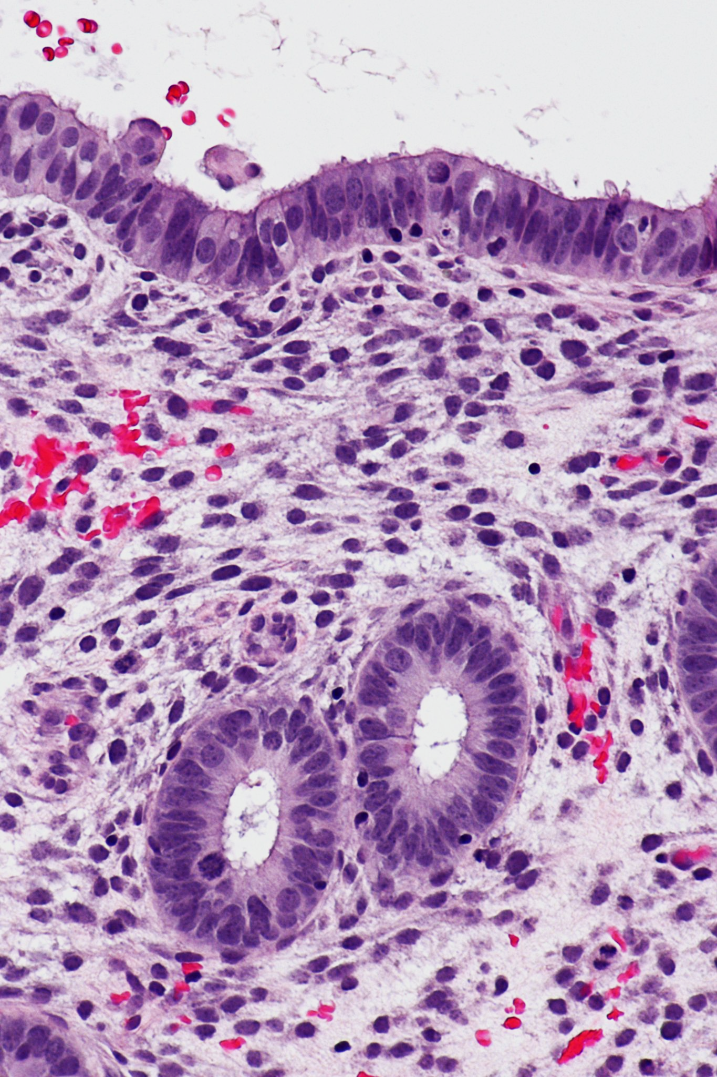
If an egg is not fertilised, the lining of the uterus will begin to break down. Several days of bleeding from the vagina will occur, commonly referred to as a period.
For more help, please visit www.exampaperspractice.co.uk
© 2025 Exams Papers Practice. All Rights Reserved

Slide 9
Oestrogen and Progesterone
The menstrual cycle is controlled by a number of hormones.
Some of these hormones are released from the ovaries.
Other hormones are released from the pituitary gland in the brain.
Oestrogen and progesterone are two hormones released from the ovaries.
Oestrogen causes the lining of the uterus to thicken and the egg to mature.
Progesterone maintains the lining of the uterus.
Progesterone levels rise after the egg is released.
If pregnancy does not occur progesterone levels fall.
This causes the lining of the uterus to break down during menstruation.
For more help, please visit www.exampaperspractice.co.uk
© 2025 Exams Papers Practice. All Rights Reserved

Slide 10
TIME IN DAYS →
The menstrual cycle is controlled by a number of hormones. Oestrogen and progesterone are hormones that are released from the ovaries.
HORMONE LEVEL →
1
14
28
For more help, please visit www.exampaperspractice.co.uk
© 2025 Exams Papers Practice. All Rights Reserved

