Slide 1
Edexcel IGCSE Biology
37 - Reproduction in Plants
Pollination and Germination, Sexual and Asexual Reproduction
For more help, please visit www.exampaperspractice.co.uk
© 2025 Exams Papers Practice. All Rights Reserved

Slide 2
Flowers
Specification Point 3.3
Describe the structures of an insect-pollinated and a wind-pollinated flower and explain how each is adapted for pollination.
The reproductive organ of a plant is a flower.
Flowers contain both male and female reproductive parts.
Flowers produce the male gamete - pollen.
Pollen is transferred by the process of pollination.
Pollen can be moved from flower to flower by insects.
Pollen can also be moved from flower to flower by the wind.
Flowers create pollen which is transported between plants.
For more help, please visit www.exampaperspractice.co.uk
© 2025 Exams Papers Practice. All Rights Reserved

Slide 3
Parts of a Flower
There are a number of components in a flower:
Component | Explanation
Anther | Where the pollen grains are made and stored.
Filament | Holds up the anther.
Petals | Provides protection to the internals of the flower and attracts insects.
Stigma | Collects the pollen grains during pollination.
Style | Links the stigma to the ovary.
Ovary | Produces the ovule.
Ovule | Contains the female gamete (the ovum).
For more help, please visit www.exampaperspractice.co.uk
© 2025 Exams Papers Practice. All Rights Reserved

Slide 4
A flower. The male components of the flower are found in the stamen, the female components are found in the carpel.
For more help, please visit www.exampaperspractice.co.uk
© 2025 Exams Papers Practice. All Rights Reserved

Slide 5
Insect Pollination
Insect-pollinated plants have large and sticky pollen.
This allows the pollen to be easily picked up by insects.
The anthers of insect-pollinated plants are inside the flower.
The anthers brush up against the insect.
This helps the pollen to stick to the insect.
The stigma of insect-pollinated plants is inside the flower.
The stigma brushes up against the insect.
The flowers of insect-pollinated plants may be brightly coloured.
They may also be scented to attract insects.
There may be a nectary present in insect-pollinate plants.
Nectaries produce sweet, edible nectar to attract the insect.
Many plants use insects like bees to fertilise and reproduce.
For more help, please visit www.exampaperspractice.co.uk
© 2025 Exams Papers Practice. All Rights Reserved

Slide 6
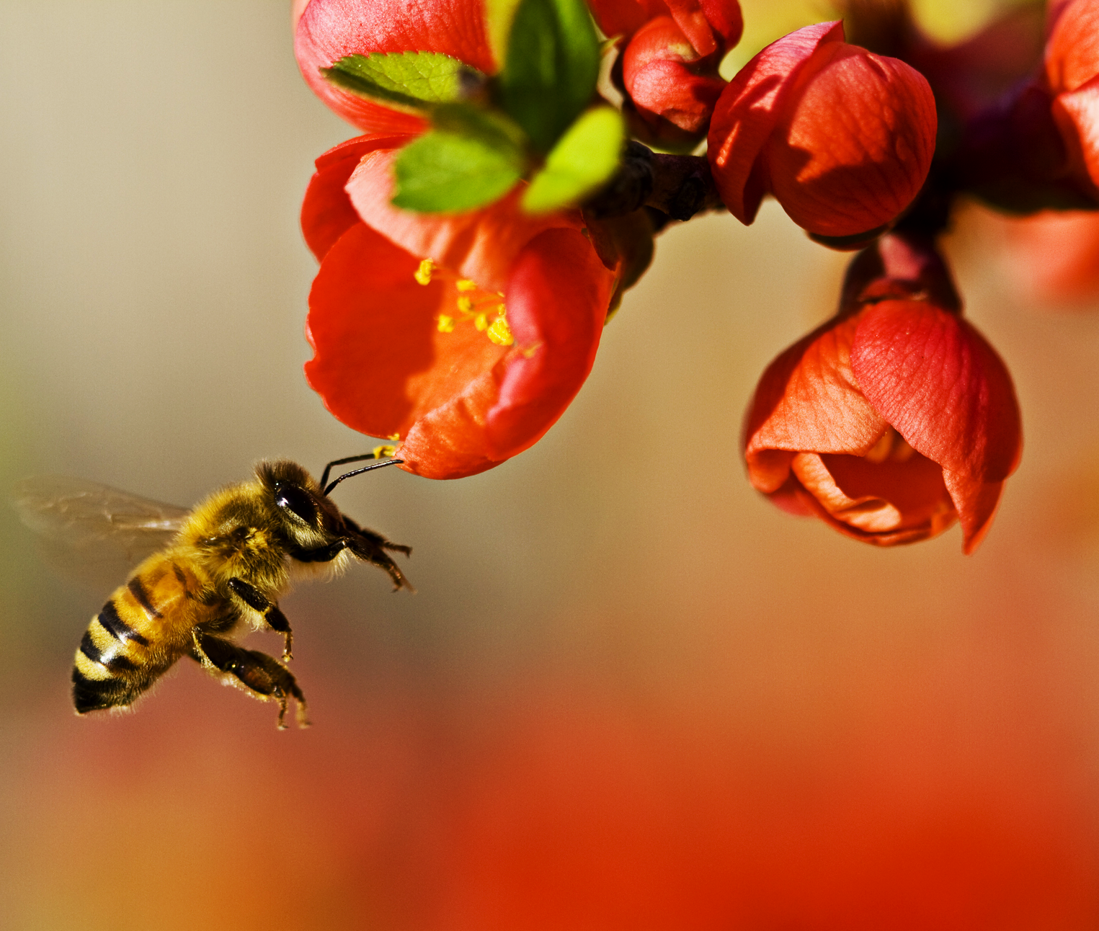
Plants that are pollinated by insects, such as bees, tend to have brightly coloured flowers as well as sweet, edible nectar.
For more help, please visit www.exampaperspractice.co.uk
© 2025 Exams Papers Practice. All Rights Reserved

Slide 7
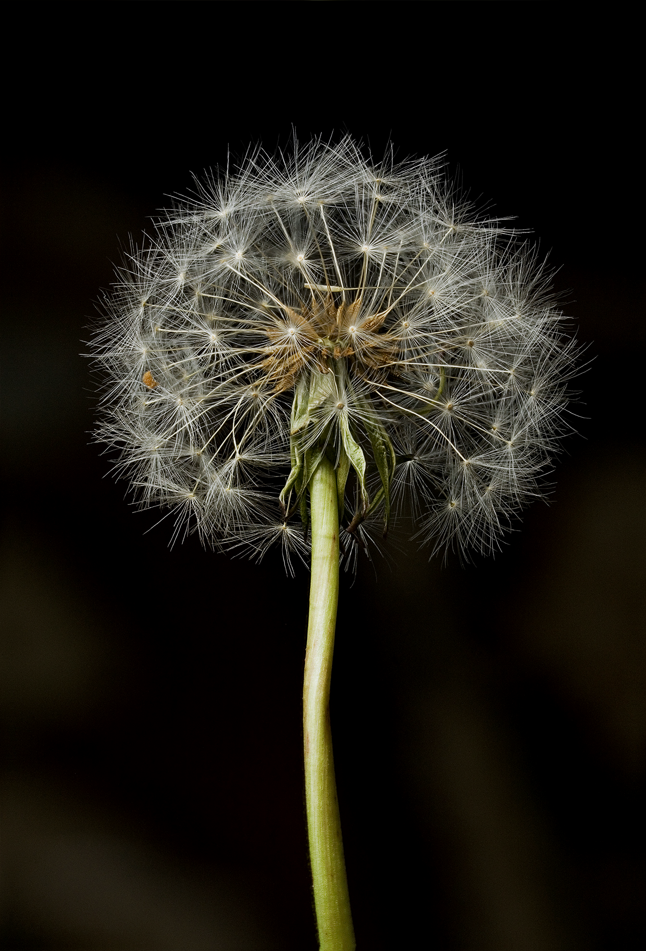
Wind Pollination
Wind-pollinated plants have small and light pollen.
This allows for the pollen to be easily carried by the wind.
Wind-pollinated plants have exposed anthers.
This makes it easy to for the anther to release pollen grains.
The stigma of wind-pollinated plants hangs outside of the flower.
This allows the stigma to catch the pollen from other plants.
Dandelions are examples of plants that pollinate using the wind.
For more help, please visit www.exampaperspractice.co.uk
© 2025 Exams Papers Practice. All Rights Reserved

Slide 8
Fertilization
Specification Point 3.4
Understand that the growth of the pollen tube followed by fertilization leads to seed and fruit formation.
Fertilization occurs when the male gametes and female gametes fuse together.
In plants, the male gamete is a pollen grain.
In plants, the female gamete is the ovum.
The ovum is located inside the ovule.
The male gamete in plants is a pollen grain.
For more help, please visit www.exampaperspractice.co.uk
© 2025 Exams Papers Practice. All Rights Reserved

Slide 9
Fertilization
Pollen lands on a stigma and grows into a pollen tube.
The tube grows down the style using digestive enzymes.
The nucleus of the pollen grain travels down the pollen tube to fertilize the egg (ovum).
The fertilized egg develops into an embryo.
The ovule becomes the seed.
The ovary becomes the fruit.
The seeds are dispersed from the plant.
The seeds can then germinate away from the plant.
This means they are not competing for resources.
Fertilization video.
For more help, please visit www.exampaperspractice.co.uk
© 2025 Exams Papers Practice. All Rights Reserved

Slide 10
During fertilization a pollen grain will land on the stigma and grow into a pollen tube. The nucleus of the pollen grain will fertilize the ovum, creating an embryo.
For more help, please visit www.exampaperspractice.co.uk
© 2025 Exams Papers Practice. All Rights Reserved

Slide 11
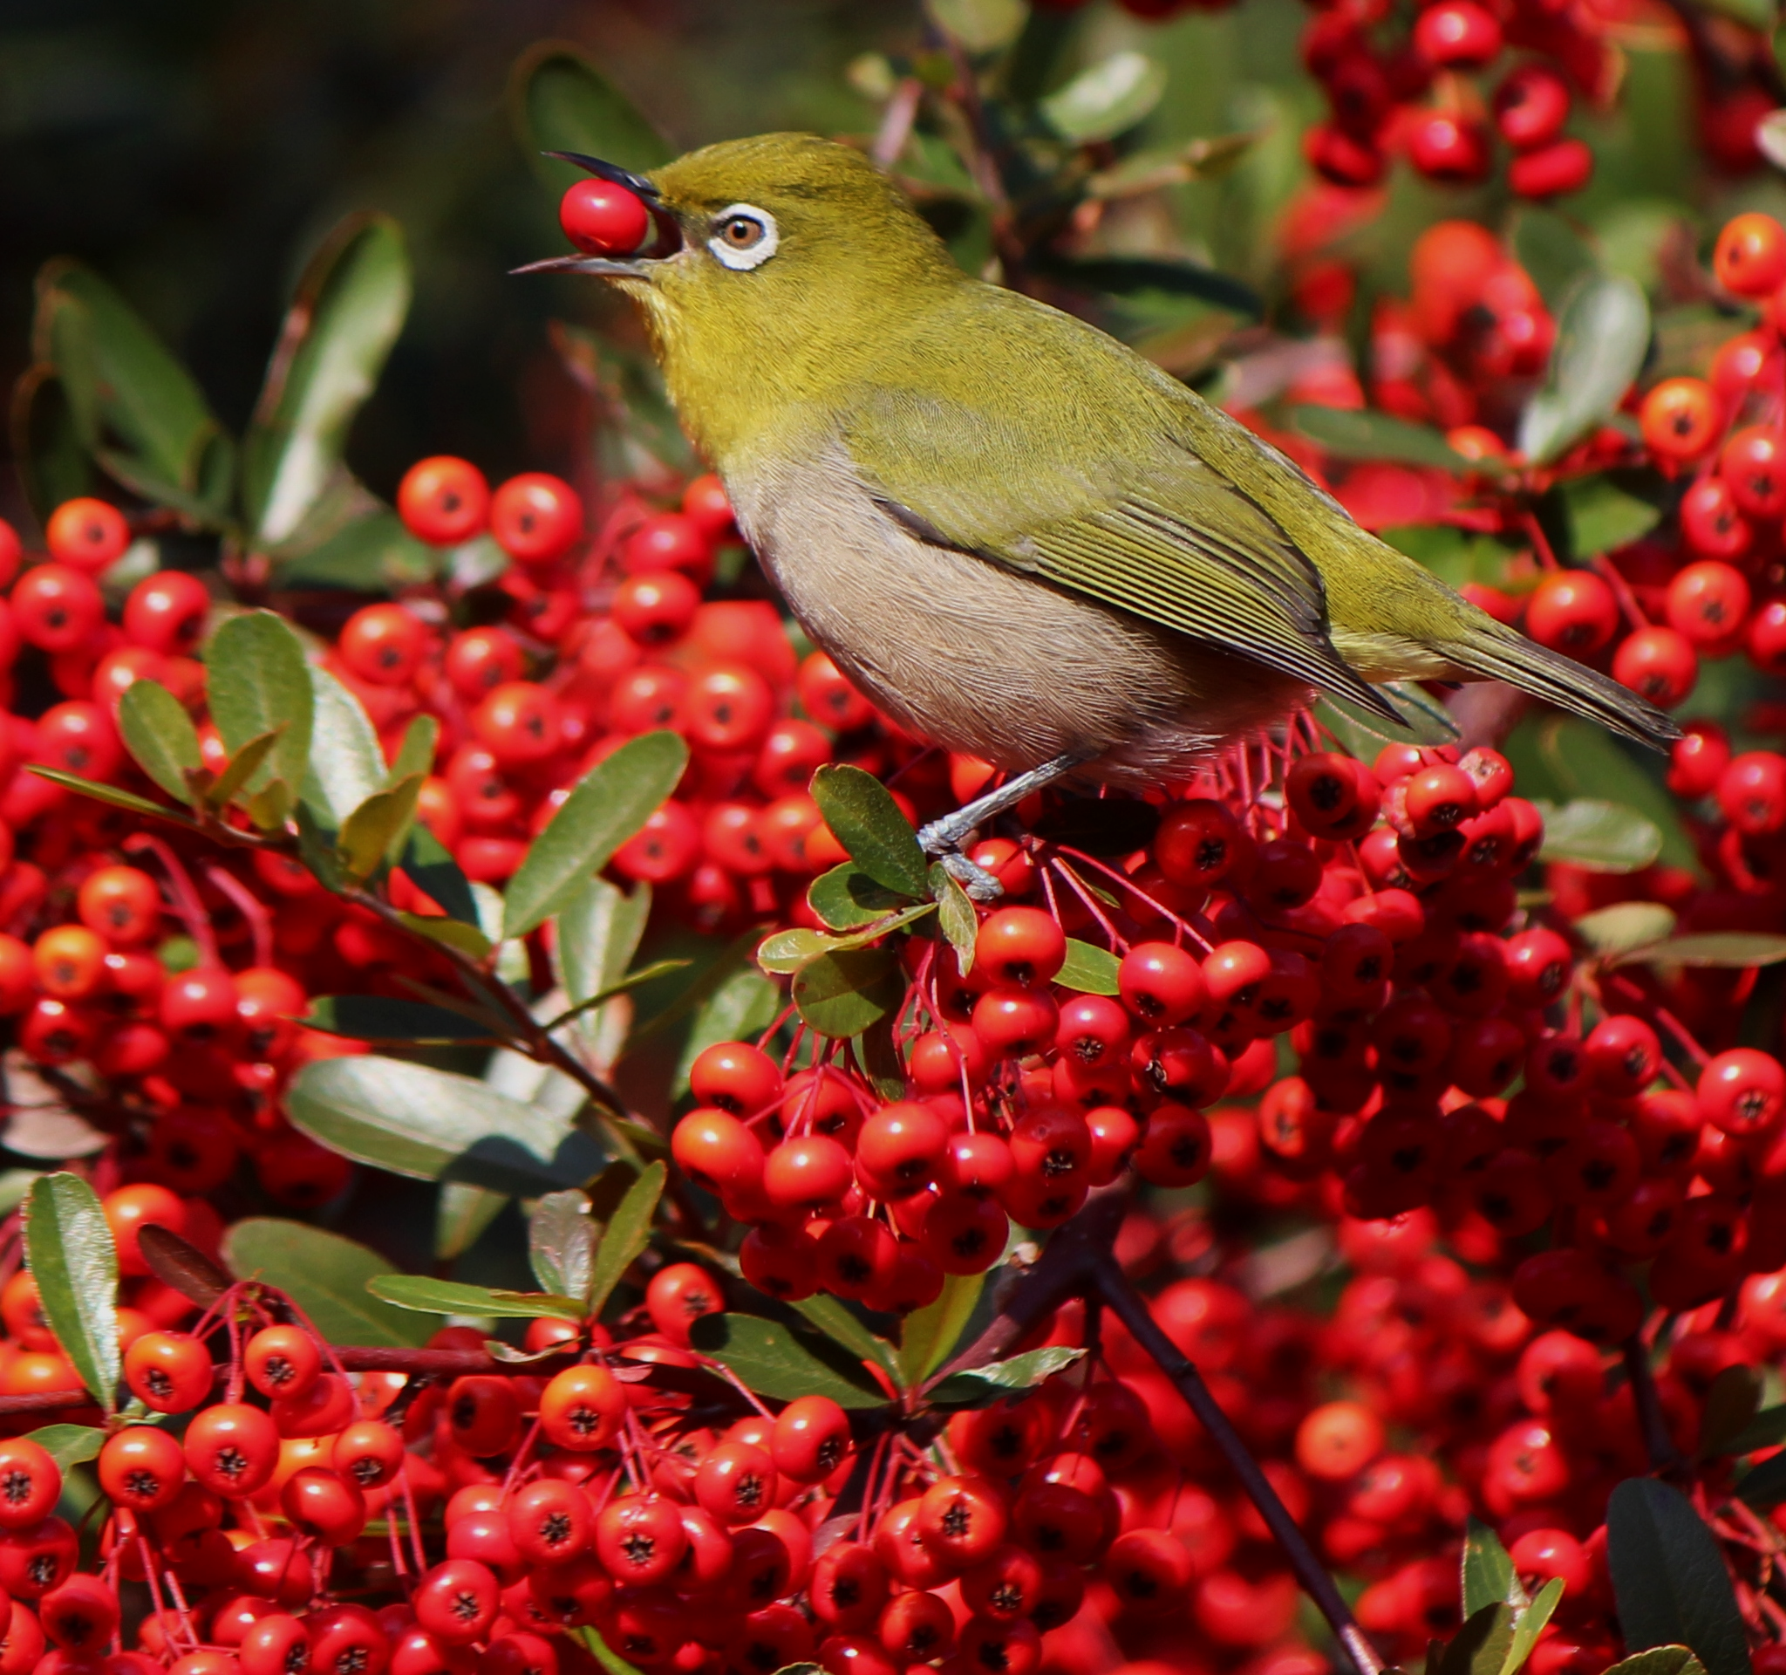
Seeds can be dispersed by birds and other animals. This ensures that new plants will grow away from the parent plant, limiting competition for resources.
For more help, please visit www.exampaperspractice.co.uk
© 2025 Exams Papers Practice. All Rights Reserved

Slide 12
Germination
Specification Point 3.5
Practical: investigate the conditions needed for seed germination.
The process in which a seedling grows into a new plant is called germination.
In order for seed to germinate, certain conditions are required.
Seeds require water to germinate.
Water allows enzymes in the seed to work correctly.
Seeds require oxygen to germinate.
Oxygen is required for respiration which releases energy.
Seeds require warmth to germinate.
Enzymes only work efficiently if there is enough kinetic energy.
For more help, please visit www.exampaperspractice.co.uk
© 2025 Exams Papers Practice. All Rights Reserved

Slide 13
Germination
Specification Point 3.6
Understand how germinating seeds utilise food reserves until the seedling can carry out photosynthesis.
When conditions are favourable, enzymes will break down the starch into maltose and glucose.
The enzyme amylase is responsible for this.
The seed will the respire the glucose to release energy.
It will use this energy to grow into a plant.
Eventually the plant will begin to photosynthesize.
At this point the plant is creating its own store of glucose.
For more help, please visit www.exampaperspractice.co.uk
© 2025 Exams Papers Practice. All Rights Reserved

Slide 14
The process of germination.
For more help, please visit www.exampaperspractice.co.uk
© 2025 Exams Papers Practice. All Rights Reserved

Slide 15
Investigating Germination
An experiment can be carried out to investigate germination.
Set up four pots each containing watercress seeds:
Pot A - all factors present (acting as a control).
Pot B - no water present.
Pot C - no oxygen present.
Pot D - no light present.
Pots A and D will germinate.
This is because seeds do not need light to germinate.
Pots B and C will not germinate.
Seeds need both water and oxygen to germinate.
For more help, please visit www.exampaperspractice.co.uk
© 2025 Exams Papers Practice. All Rights Reserved

Slide 16
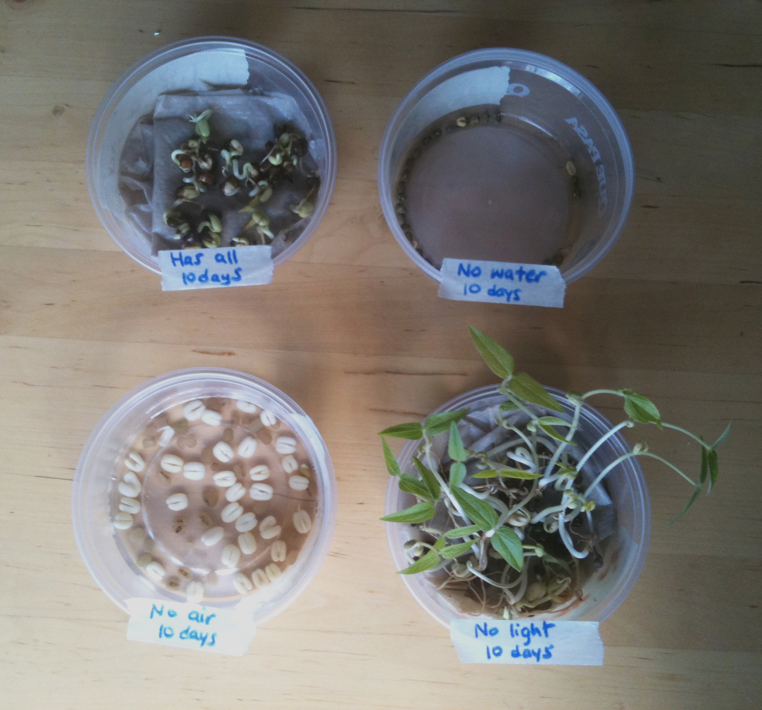
POT A
POT B
Seeds require oxygen, water and warmth in order to germinate.
POT C
POT D
For more help, please visit www.exampaperspractice.co.uk
© 2025 Exams Papers Practice. All Rights Reserved

Slide 17
The Seed
The seed is the first stage of the plant life-cycle.
All seeds contain the following:
The embryo.
Found in the centre of the seed, the embryo will develop into the plant.
The embryo also contains cotyledons - these contain starch which is used for energy until photosynthesis begins.
The seed coat.
The seed coat is sometimes called the testa.
The seed coat will protect the seed before germination.
SEED COAT
EMBRYO
For more help, please visit www.exampaperspractice.co.uk
© 2025 Exams Papers Practice. All Rights Reserved

Slide 18
Asexual Reproduction in Plants
Specification Point 3.7
Understand that plants can reproduce asexually by natural methods (illustrated by runners) and by artificial methods (illustrated by cuttings).
Some plants have the ability to reproduce asexually.
Asexual reproduction only requires one parent.
All offspring are clones of their parents. This means they are genetically identical.
Plants can reproduce asexually naturally.
One group of plants that reproduce asexually are called runners.
Strawberries are an example of a runner.
Humans can manipulate plants to reproduce asexaully artifically.
On a small scale this is called taking cuttings.
On a large scale this is called tissue culture or micropropagation.
For more help, please visit www.exampaperspractice.co.uk
© 2025 Exams Papers Practice. All Rights Reserved

Slide 19
Some types of plants, colloquially referred to as runners, reproduce asexually. All offspring are genetically identical to their parent.
For more help, please visit www.exampaperspractice.co.uk
© 2025 Exams Papers Practice. All Rights Reserved

Slide 20
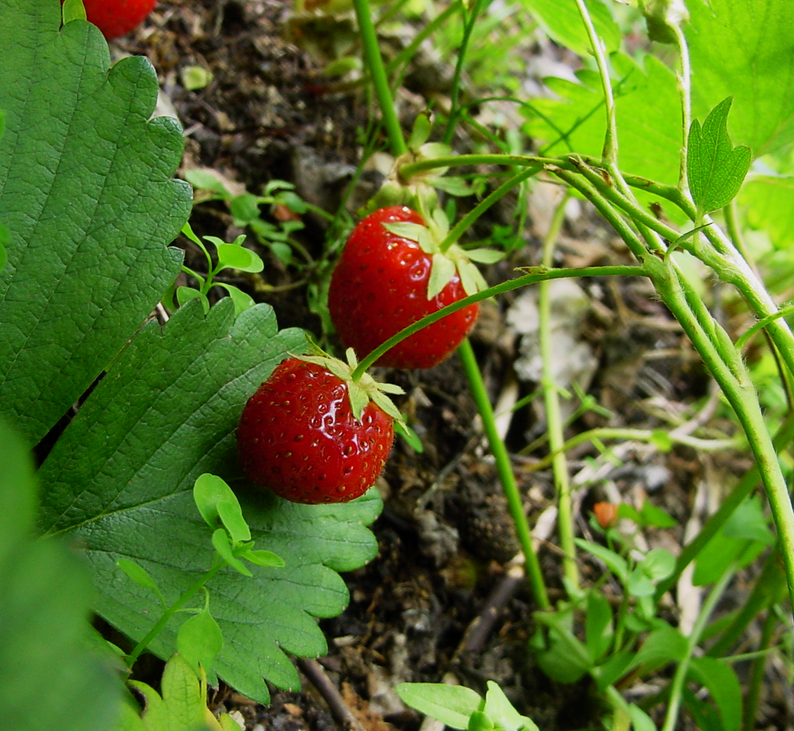
Strawberries are an example of a plant that creates runners, a method of asexual reproduction.
For more help, please visit www.exampaperspractice.co.uk
© 2025 Exams Papers Practice. All Rights Reserved

Slide 21
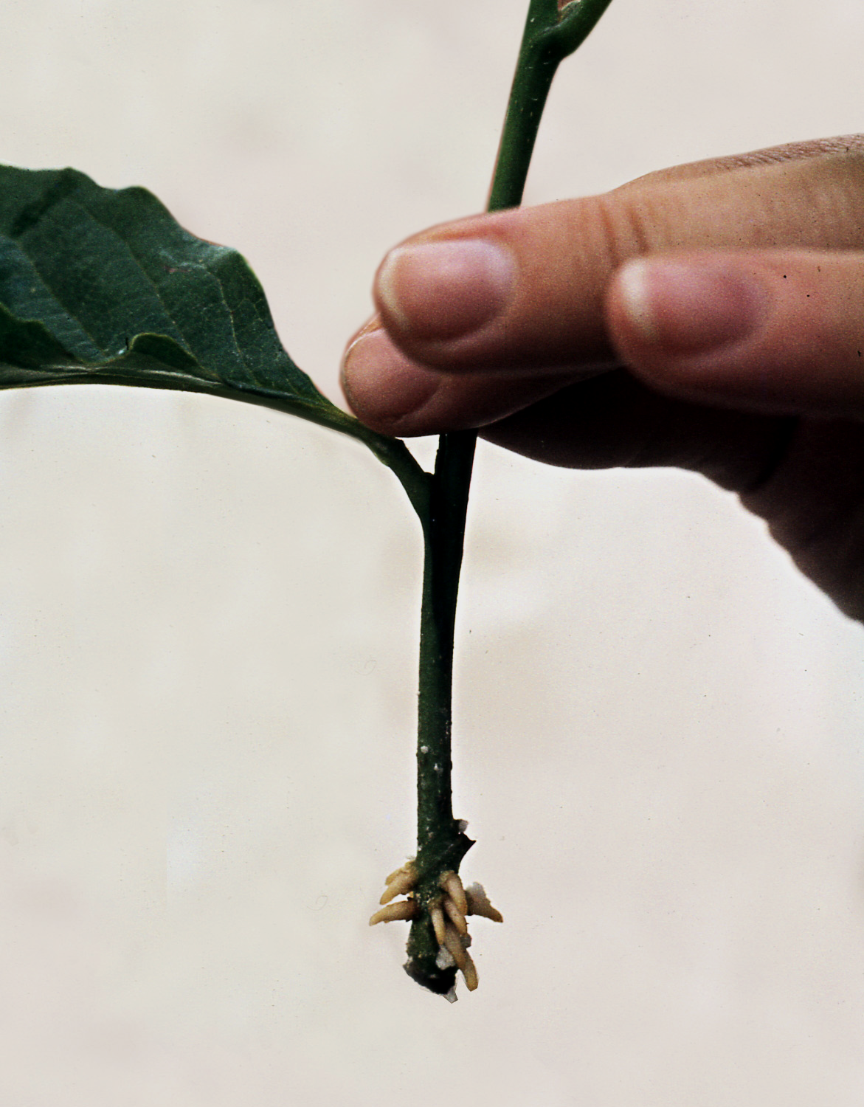
Taking Cuttings
Taking cuttings is the easiest way to clone a plant:
A side branch is cut from the parent plant.
The lower leaves are stripped and the plant is replanted in compost or water.
The end of the stem can be coated in rooting powder - a substance that contains a number of plant growth hormones.
A new root system will grow and the cutting will develop into a new plant.
A cutting taken from a magnolia plant. The roots have been dipped in rooting powder to encourage new growth.
For more help, please visit www.exampaperspractice.co.uk
© 2025 Exams Papers Practice. All Rights Reserved

Slide 22
Tissue Culture
Tissue culture makes lots of new clones.
These clones are referred to as explants.
Cells are taken from the parent plant.
These cells are then transferred to a petri dish which contains all the nutrients for optimum growth.
Plant growth hormones are added to the petri dish.
The hormones encourage the cells to grow into a mass of tissue.
This tissue is called a callus.
The calluses grow into small plants, called plantlets.
Plantlets then develop into full-sized plants.
For more help, please visit www.exampaperspractice.co.uk
© 2025 Exams Papers Practice. All Rights Reserved

Slide 23
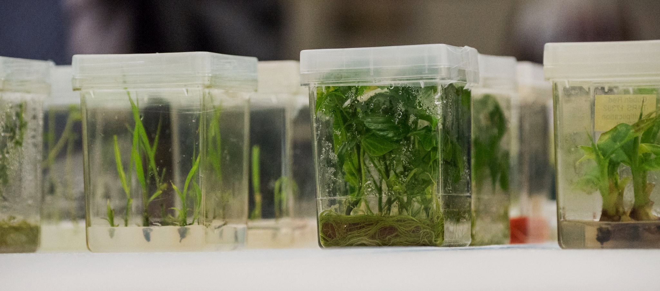
Tissue culture is sometimes referred to as micropropagation and can occur on the industrial scale.
For more help, please visit www.exampaperspractice.co.uk
© 2025 Exams Papers Practice. All Rights Reserved

