Slide 1
Edexcel IGCSE Biology
36 - Reproduction
Sexual and Asexual Reproduction
For more help, please visit www.exampaperspractice.co.uk
© 2025 Exams Papers Practice. All Rights Reserved

Slide 2
Sexual and Asexual Reproduction
Specification Point 3.1
Understand the differences between sexual and asexual reproduction.
Reproduction can be defined as the production of offspring.
Reproduction may occur sexually.
Reproduction may also occur asexually.
Sexual reproduction creates genetically unique offspring.
During sexual reproduction, two sex cells fuse together to create a new cell.
Each sex cell is from a different parent.
Asexual reproduction creates genetically identical offspring.
Asexual reproduction creates clones.
There is only one parent during asexual reproduction.
In mammals, a sperm and egg cell will fuse together during sexual reproduction.
For more help, please visit www.exampaperspractice.co.uk
© 2025 Exams Papers Practice. All Rights Reserved

Slide 3
Some types of plants, colloquially referred to as runners, reproduce asexually. All offspring are genetically identical to their parent.
For more help, please visit www.exampaperspractice.co.uk
© 2025 Exams Papers Practice. All Rights Reserved

Slide 4
Sexual Reproduction
Sexual reproduction creates genetic variation.
When sex cells are made, genes are shuffled into new combinations.
This creates a genetically diverse population that is more resistant to changes to the environment.
It takes a lot of time and energy to find mates for sexual reproduction.
Many species undergo asexual reproduction to conserve energy.
Sexual reproduction creates genetic variation, famously observed by Charles Darwin in finches on the Galapagos Islands.
For more help, please visit www.exampaperspractice.co.uk
© 2025 Exams Papers Practice. All Rights Reserved

Slide 5
Asexual Reproduction
Asexual reproduction is rapid.
During asexual reproduction, cells divide into identical clones.
Asexual reproduction does not require a mate or much energy.
Compared to sexual reproduction, asexual reproduction is quick and easy.
Populations that reproduce asexually have no genetic variation.
These population are less resistant to changes in the environment.
SINGLE BACTERIAL PARENT CELL DIVIDES INTO TWO DAUGHTER CELLS
For more help, please visit www.exampaperspractice.co.uk
© 2025 Exams Papers Practice. All Rights Reserved

Slide 6
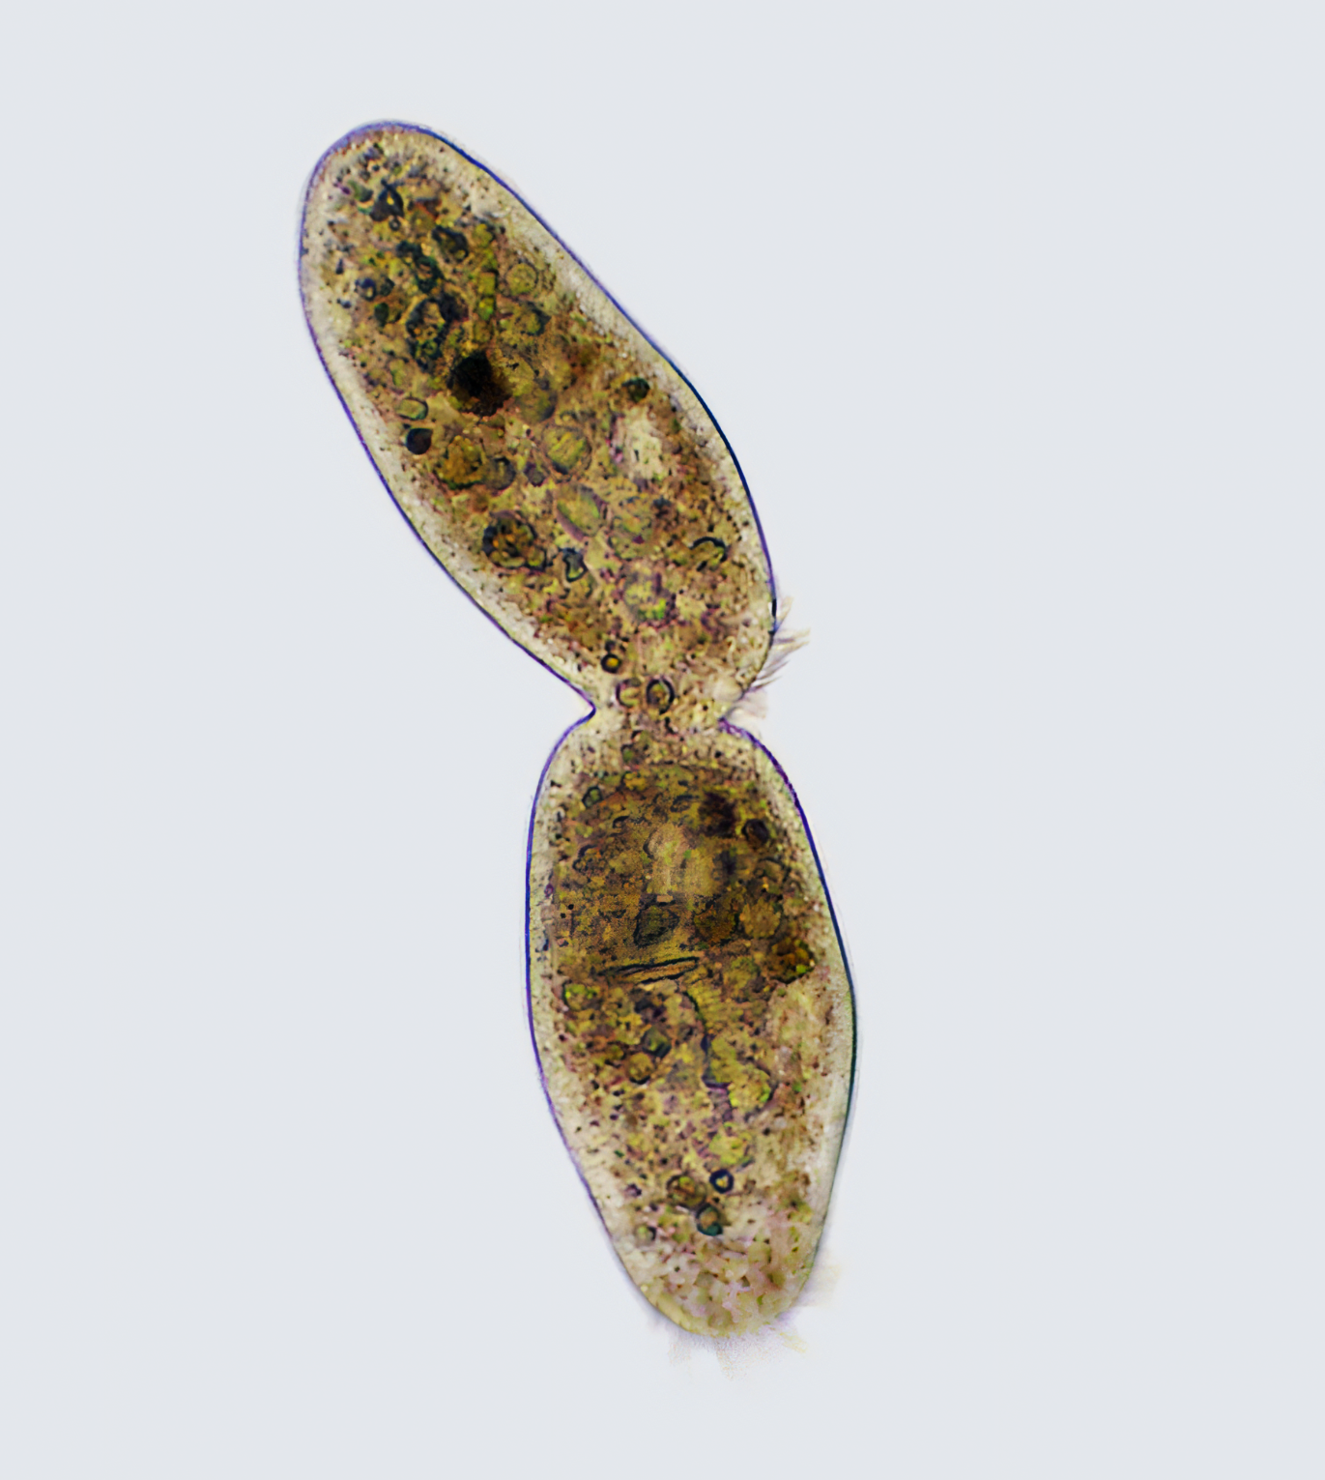
Bacteria and other single-celled organisms undergo a type of asexual reproduction refered to as binary fission.
For more help, please visit www.exampaperspractice.co.uk
© 2025 Exams Papers Practice. All Rights Reserved

Slide 7
Fertilization
Specification Point 3.2
Understand that fertilization involves the fusion of a male and female gamete to produce a zygote that undergoes cell division and develops into an embryo.
Sex cells are called gametes.
In mammals, the male gamete is a sperm cell and the female gamete is an egg cell.
Gametes have half the number of chromosomes as other cells.
Chromosomes store genetic information in the nucleus.
A human body cell has 46 chromosomes.
A human gamete has 23 chromosomes.
Gametes fuse together to form a zygote during fertilization.
The zygote has 46 chromosomes.
A zygote has 23 chromosomes from the mother and 23 chromosomes from the father.
The zygote eventually develops into an embryo and then to a baby.
For more help, please visit www.exampaperspractice.co.uk
© 2025 Exams Papers Practice. All Rights Reserved

Slide 8
During fertilization, the male gamete (a sperm cell) will penetrate the female gamete (the egg cell). These gametes will fuse to create a zygote.
For more help, please visit www.exampaperspractice.co.uk
© 2025 Exams Papers Practice. All Rights Reserved

