Slide 1
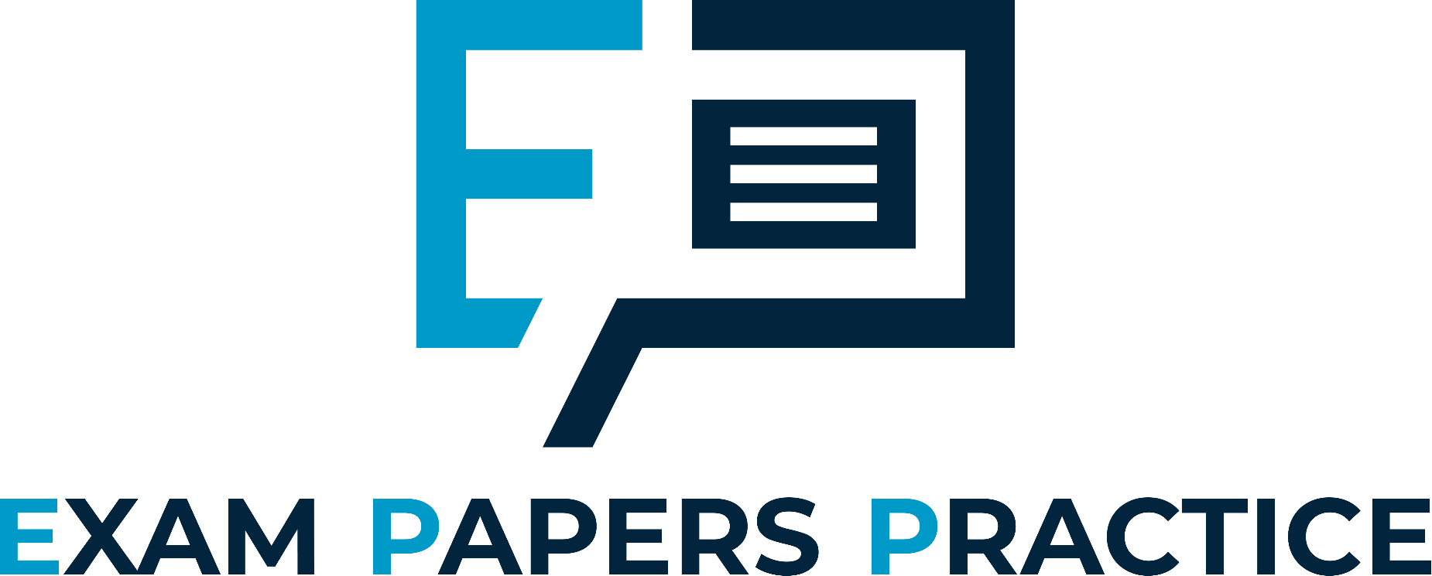
Edexcel IGCSE Biology
34 - Hormones
Sources, Roles and Effects
For more help, please visit www.exampaperspractice.co.uk
© 2025 Exams Papers Practice. All Rights Reserved

Slide 2
Hormones
Specification Point 2.94
Understand the sources, roles and effects of the following hormones: adrenaline, insulin, testosterone, progesterone and oestrogen.
Hormones are chemical messengers.
Hormones are produced in structures called glands.
Hormones are then released into the bloodstream.
Hormones act on target cells.
Hormones stimulate a change in the behaviour of these cells.
Hormones and their glands are collectively referred to as the endocrine system.
Once they have been used, hormones are recycled in the liver.
For more help, please visit www.exampaperspractice.co.uk
© 2025 Exams Papers Practice. All Rights Reserved

Slide 3
Adrenaline
Adrenaline stimulates the ‘fight or flight’ response.
Adrenaline has a number of effects:
Adrenaline causes the heart rate to increase.
Adrenaline binds to receptors on cardiac muscle cells.
Adrenaline causes the heart muscle to contract more frequently.
Adrenaline causes the ventilation rate to increase.
The ventilation rate is the number of breaths a person takes per minute.
Increasing the ventilation rate allows more oxygen (O₂) to reach cells for respiration.
Adrenaline increases the blood flow to muscles.
Increasing the blood flow delivers the O₂ to muscles for respiration.
This increases amount of energy that can be supplied to the muscles.
Adrenaline is secreted by the adrenal glands.
The adrenal glands are found just above the kidneys.
Adrenaline is a hormone responsible for the ‘fight or flight’ response in mammals.
For more help, please visit www.exampaperspractice.co.uk
© 2025 Exams Papers Practice. All Rights Reserved

Slide 4
ADRENAL GLAND
KIDNEY
The adrenal glands, located just above the kidneys, are responsible for producing and secreting adrenaline.
For more help, please visit www.exampaperspractice.co.uk
© 2025 Exams Papers Practice. All Rights Reserved

Slide 5
‘Adrenaline junkies’ often seek out thrilling or dangerous activities to achieve the euphoric sensations that can be associated with a surge of adrenaline.
For more help, please visit www.exampaperspractice.co.uk
© 2025 Exams Papers Practice. All Rights Reserved

Slide 6
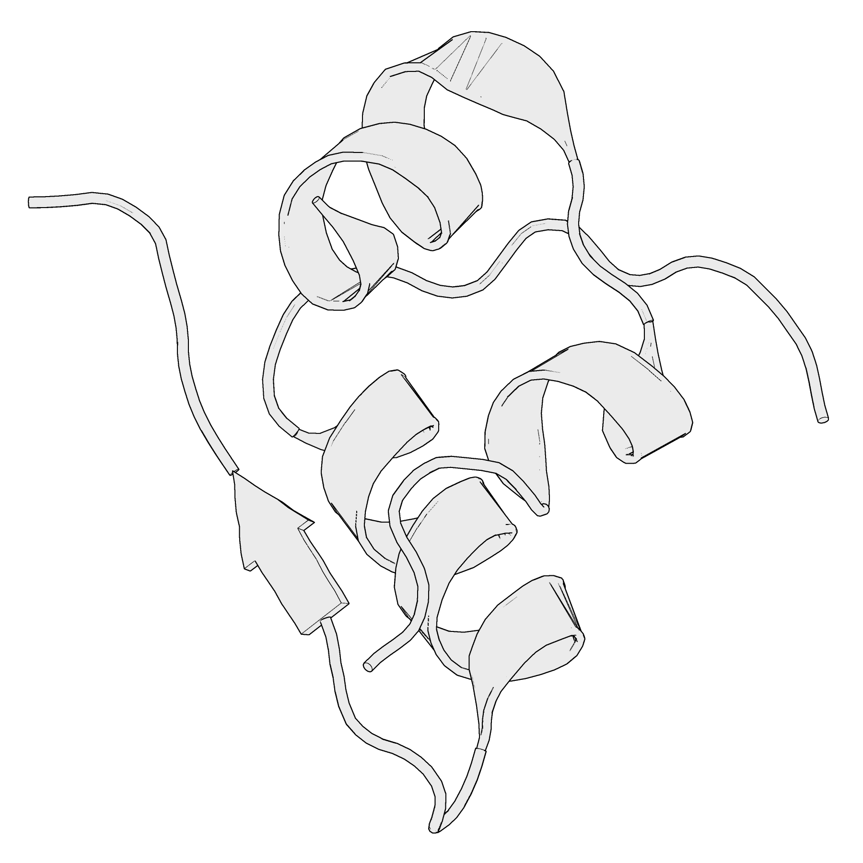
Insulin
Insulin lowers the concentration of glucose in the bloodstream.
Insulin signals the liver to convert glucose into the storage molecule glycogen.
This causes the concentration of glucose in the blood to drop.
Insulin is secreted by the pancreas.
Insulin is secreted by a type of cell called β cells.
An inability to secrete insulin leads to Type I diabetes.
Type I diabetics are most commonly treated with regular injections of insulin.
An insulin monomer. Insulin is a complex protein-based hormone secreted by the pancreas.
For more help, please visit www.exampaperspractice.co.uk
© 2025 Exams Papers Practice. All Rights Reserved

Slide 7
INSULIN AND BLOOD GLUCOSE CONCENTRATIONS THROUGHOUT THE DAY
In a healthy individual, the concentration of insulin mimics the changes in blood glucose.
In diabetics, this must be managed through regular insulin injections or an insulin pump.
INSULIN CONCENTRATION (pmol/L) →
BLOOD GLUCOSE CONCENTRATION (mmol/L) →
TIME →
For more help, please visit www.exampaperspractice.co.uk
© 2025 Exams Papers Practice. All Rights Reserved

Slide 8
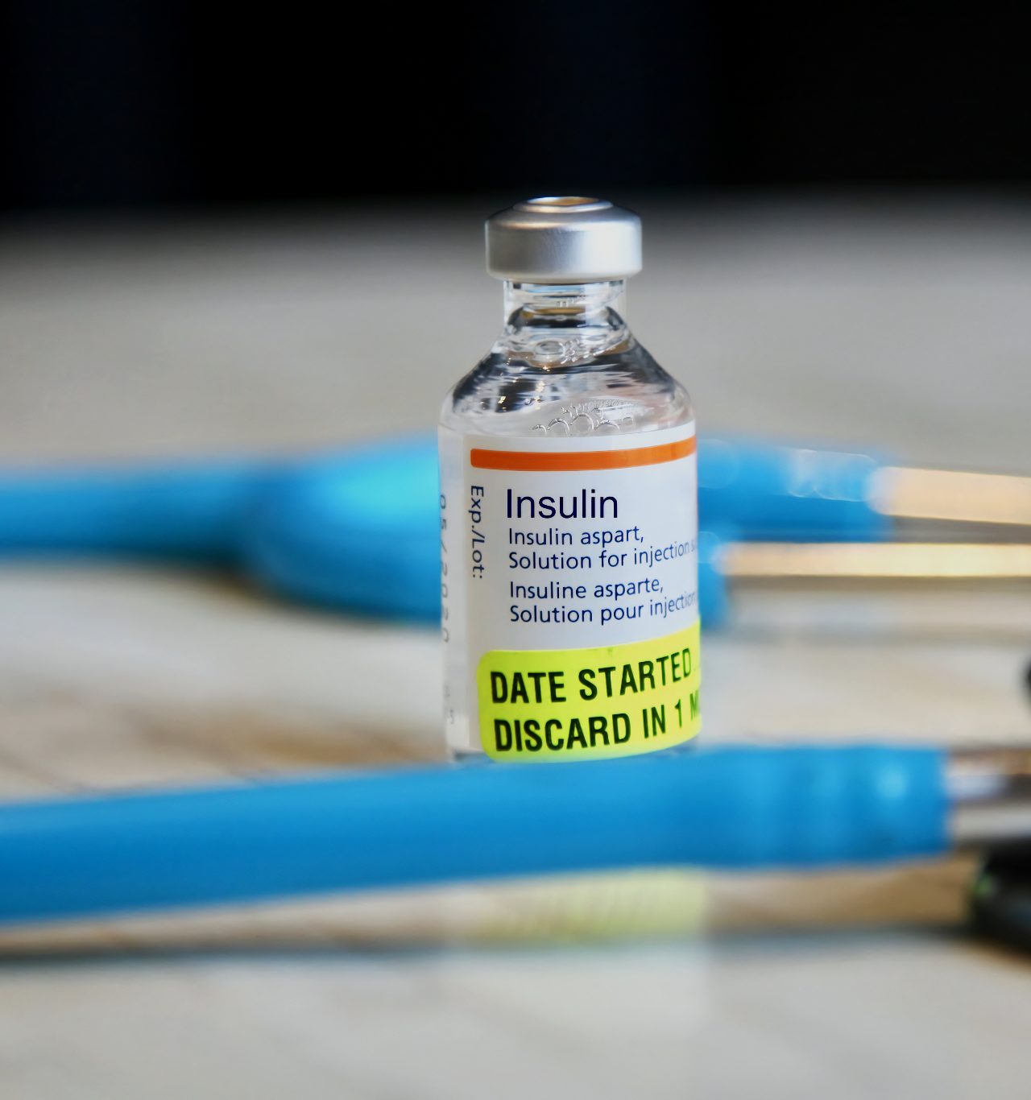
Insulin is usually administered as an injection at least twice a day.
For more help, please visit www.exampaperspractice.co.uk
© 2025 Exams Papers Practice. All Rights Reserved

Slide 9
Testosterone
Testosterone stimulates secondary sexual characteristics in males:
Testosterone causes the voice to deepen.
Testosterone is linked with the enlargement of the larynx and the stretching of the vocal cords.
Testosterone stimulates muscle development.
Testosterone stimulates the production of body hair.
Body hair will grow on the face, under the armpits and in the pubic region.
There is a spike in testosterone production at puberty.
In boys, puberty begins at around age 12.
Testosterone is secreted from the testes.
Testosterone is primarily responsible for triggering puberty in males.
For more help, please visit www.exampaperspractice.co.uk
© 2025 Exams Papers Practice. All Rights Reserved

Slide 10
Testosterone allows for the muscles to development more fully.
Many bodybuilders and athletes also inject synthetic versions of testosterone to increase muscle mass.
For more help, please visit www.exampaperspractice.co.uk
© 2025 Exams Papers Practice. All Rights Reserved

Slide 11
Oestrogen
Oestrogen stimulates secondary sexual characteristics in females:
Oestrogen causes breasts to develop.
Oestrogen stimulates the production of body hair.
Body hair will grow under the armpits and in the pubic region.
A surge in oestrogen stimulates the start of menstruation.
There is a spike in oestrogen production at puberty.
In girls, puberty begins at around age 11.
Oestrogen is secreted from the ovaries.
Oestrogen is primarily responsible for triggering puberty in females.
For more help, please visit www.exampaperspractice.co.uk
© 2025 Exams Papers Practice. All Rights Reserved

Slide 12
TIME IN DAYS →
LEVEL OF OESTROGEN →
Oestrogen is a major hormone in the menstrual cycle.
Oestrogen causes the lining of the uterus to thicken.
THICKNESS OF UTERUS →
1
14
28
For more help, please visit www.exampaperspractice.co.uk
© 2025 Exams Papers Practice. All Rights Reserved

Slide 13
Progesterone
Progesterone maintains the lining of the uterus during pregnancy.
Progesterone also creates a cushioned environment for the egg to implant in.
Progesterone is also used as a contraceptive.
The progesterone-only pill is a very common form of birth control.
Progesterone is secreted from the ovaries.
Progesterone helps to maintain the lining of the uterus during pregnancy.
For more help, please visit www.exampaperspractice.co.uk
© 2025 Exams Papers Practice. All Rights Reserved

Slide 14
Oestrogen and progesterone are both hormones that are produced in the ovaries.
OVARY
OVARY
For more help, please visit www.exampaperspractice.co.uk
© 2025 Exams Papers Practice. All Rights Reserved

Slide 15
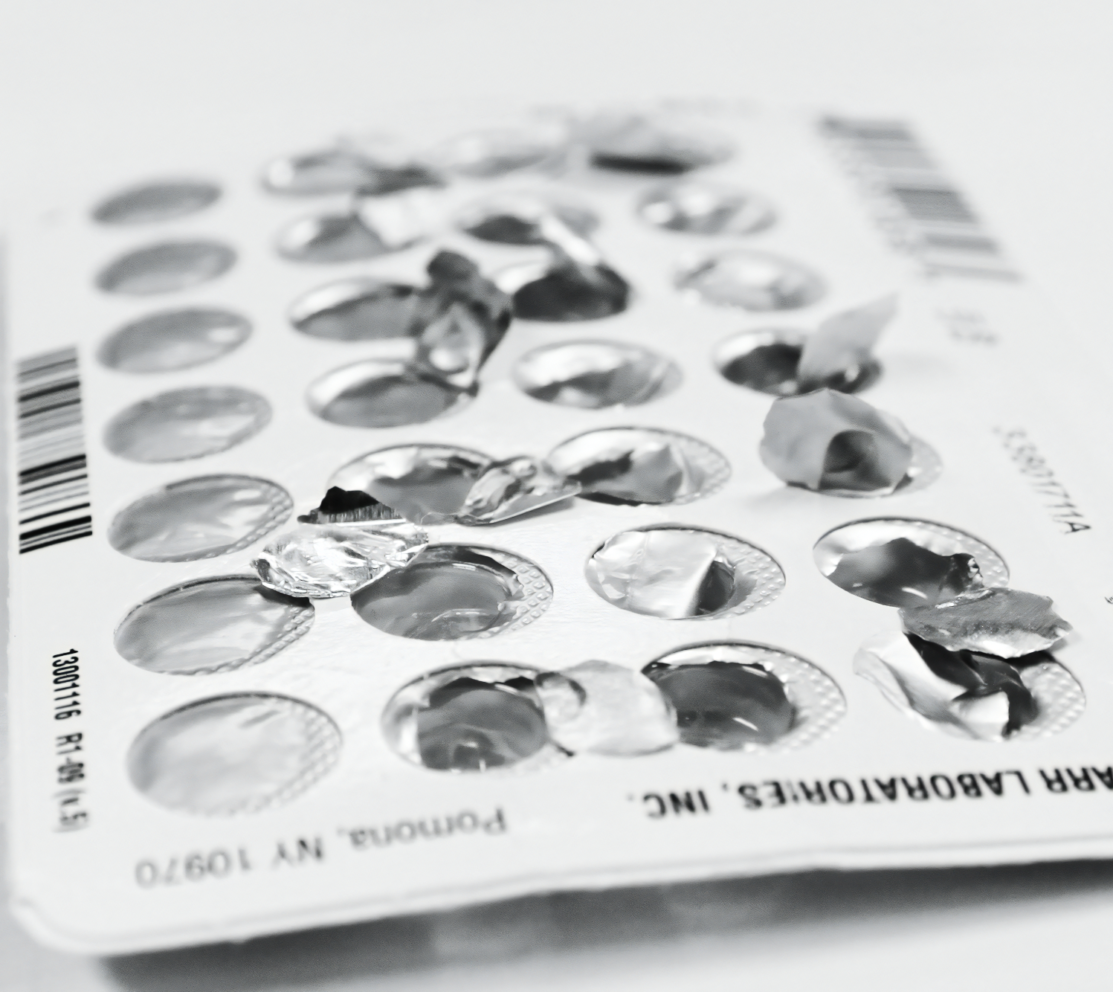
The progesterone-only or ‘mini-pill’ is a very common form of birth control.
The progesterone-only pill mimics the effects of pregnancy, preventing the release of an egg into the uterus.
For more help, please visit www.exampaperspractice.co.uk
© 2025 Exams Papers Practice. All Rights Reserved

