Slide 1
Edexcel IGCSE Biology
33 - Controlling Body Temperature
Thermoregulation
For more help, please visit www.exampaperspractice.co.uk
© 2025 Exams Papers Practice. All Rights Reserved

Slide 2
Thermoregulation
Specification Point 2.93
Describe the role of the skin in temperature regulation, with reference to sweating, vasoconstriction and vasodilation.
Thermoregulation is the ability to control internal body temperature.
The human body works best at around 37°C.
If the body temperature falls too low, metabolic reactions become too slow.
If the body temperature rises too high, enzymes are at risk of denaturing.
Thermoregulation is an example of homeostasis.
Homeostasis can be defined as the ability to maintain a constant internal environment.
For more help, please visit www.exampaperspractice.co.uk
© 2025 Exams Papers Practice. All Rights Reserved

Slide 3
TOO COLD
TOO HOT
The human body will aim to keep the internal temperature at around 37°C.
This is considered the optimum temperature for metabolic reactions.
RATE OF REACTION →
OPTIMUM TEMPERATURE - 37°C
TEMPERATURE (°C) →
For more help, please visit www.exampaperspractice.co.uk
© 2025 Exams Papers Practice. All Rights Reserved

Slide 4
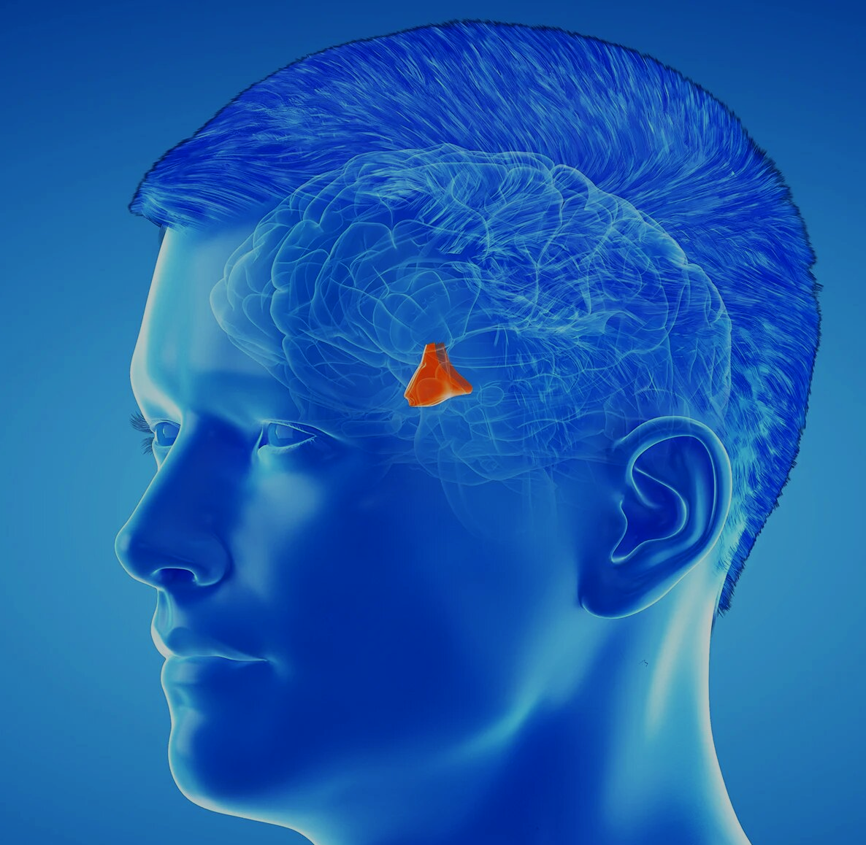
Detecting Temperature Change
Changes in body temperature are detected by cells called thermoreceptors.
Thermoreceptors send impulses to an area of the brain called the hypothalamus.
The hypothalamus is responsible for controlling body temperature.
The hypothalamus responds by sending impulses to effectors to maintain the body temperature.
Thermoregulation is an example of negative feedback.
Whenever a change occurs in a system, this automatically causes a correction back to the original system.
The hypothalamus is a region of the brain that is responsible for controlling body temperature.
For more help, please visit www.exampaperspractice.co.uk
© 2025 Exams Papers Practice. All Rights Reserved

Slide 5
Cooling Down
A rise in temperature is detected by thermoreceptors.
The hypothalamus initiates several cooling mechanisms:
The body begins to sweat.
Sweat glands will open to ensure that water evaporates from the surface of the skin.
Evaporation has a cooling effect on the body.
This is because water carries a lot of thermal energy.
Arterioles begin to dilate.
More blood is carried near the surface of the skin.
More heat is radiated from the body.
This is referred to as vasodilation.
Hairs on the skin lie flat.
This prevents pockets of warm air being trapped in them.
For more help, please visit www.exampaperspractice.co.uk
© 2025 Exams Papers Practice. All Rights Reserved

Slide 6
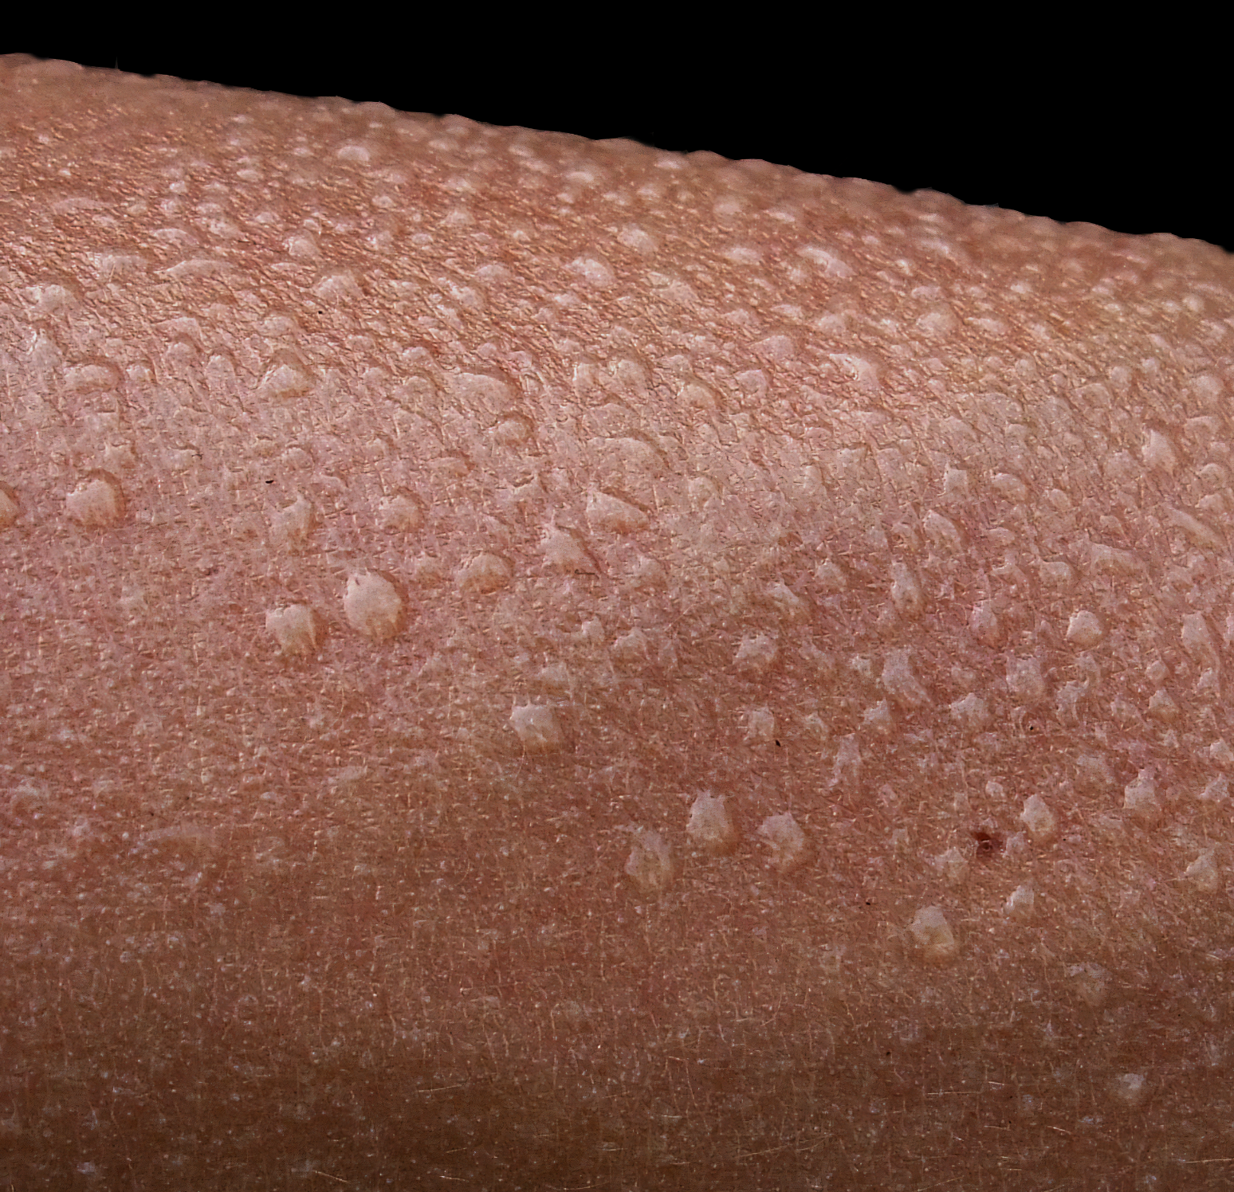
When the body gets too hot, sweat glands on the surface of the skin open.
This allows sweat to evaporate from the skin, cooling the body.
For more help, please visit www.exampaperspractice.co.uk
© 2025 Exams Papers Practice. All Rights Reserved

Slide 7
VASODILATION
NORMAL VESSEL
During vasodilation, arterioles widen. This allows for more blood to be carried near the surface of the skin.
Heat is radiated from the body due to the proximity of the arteriole to the skin’s surface.
For more help, please visit www.exampaperspractice.co.uk
© 2025 Exams Papers Practice. All Rights Reserved

Slide 8
HAIR
HAIRS LIE FLAT
SKIN
When the body gets too hot, hair follicles in the skin retract, causing hairs on the surface of the skin to lie flat.
HAIR FOLLICLE
For more help, please visit www.exampaperspractice.co.uk
© 2025 Exams Papers Practice. All Rights Reserved

Slide 9
Warming Up
A drop in temperature is detected by thermoreceptors.
The hypothalamus initiates several warming mechanisms:
The body stops sweating.
The body begins to shiver.
Rapid muscle contractions require respiration.
Respiration releases heat as a byproduct.
Arterioles begin to constrict.
Blood is moved inwards, towards the core of the body.
Less heat is radiated from the body in vasoconstriction.
Hair on the skin stand up.
This traps a pocket of warm air, insulating the body.
For more help, please visit www.exampaperspractice.co.uk
© 2025 Exams Papers Practice. All Rights Reserved

Slide 10
VASOCONSTRICTION
NORMAL VESSEL
During vasoconstriction, arterioles narrow. Blood is carried closer to the core of the body.
Less heat is lost to the environment through radiation.
For more help, please visit www.exampaperspractice.co.uk
© 2025 Exams Papers Practice. All Rights Reserved

Slide 11
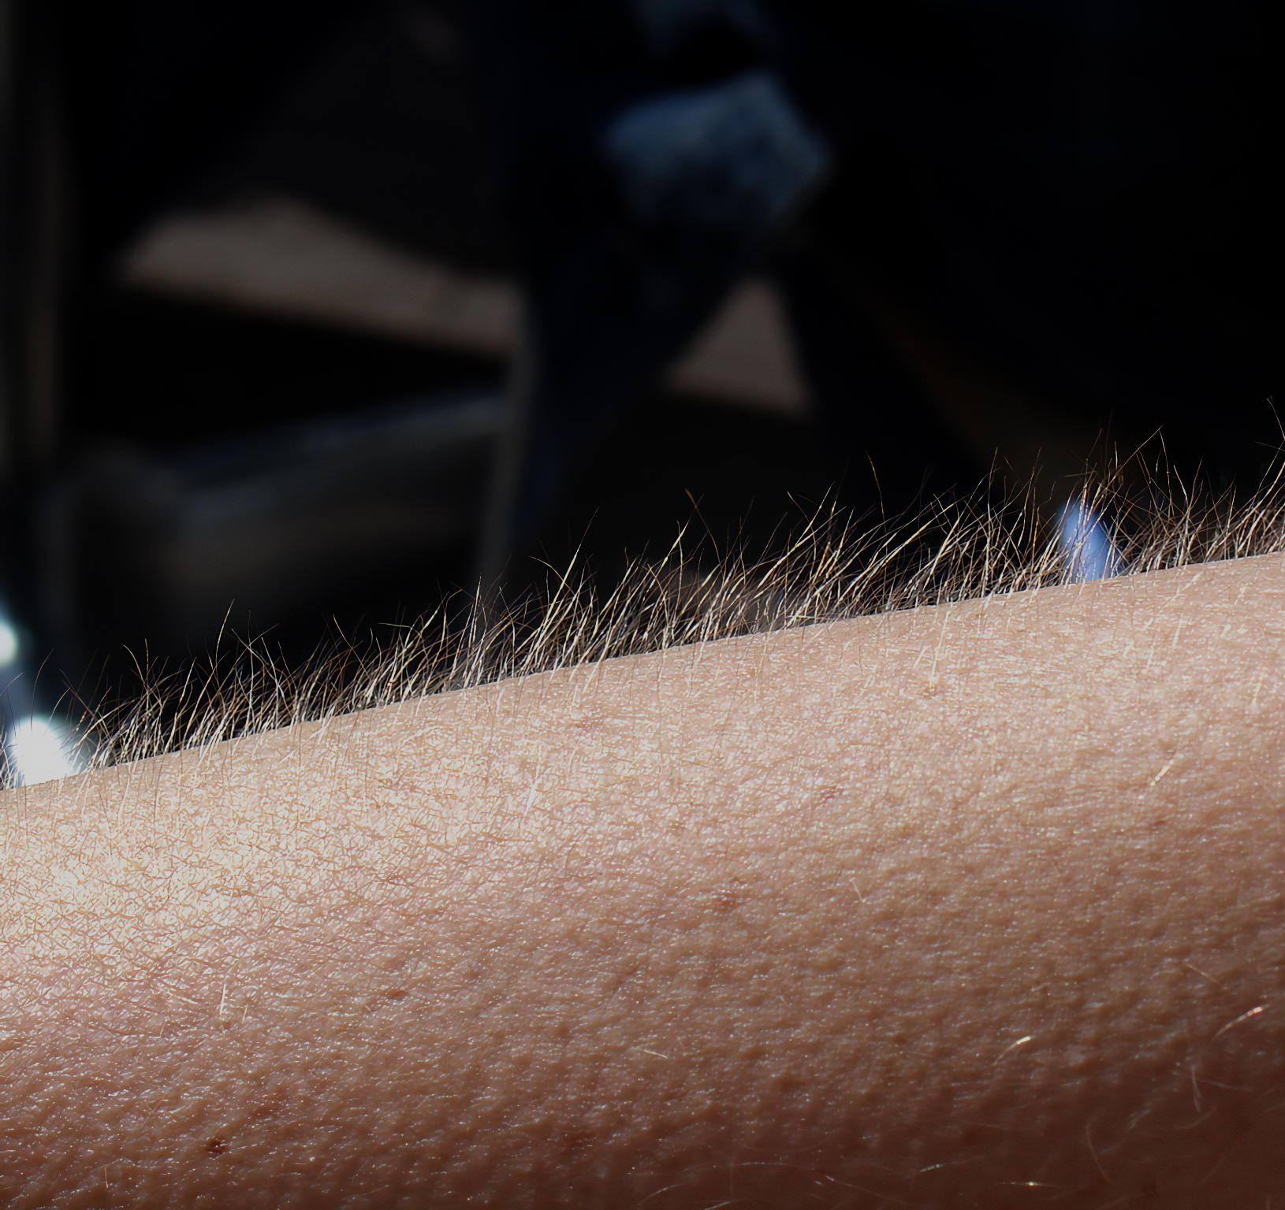
When the body gets too cold, sweat glands on the surface of the skin close.
Hair follicles also extend, causing hair to stand upright on the surface of the skin.
This is more commonly referred to as goosebumps.
For more help, please visit www.exampaperspractice.co.uk
© 2025 Exams Papers Practice. All Rights Reserved

Slide 12
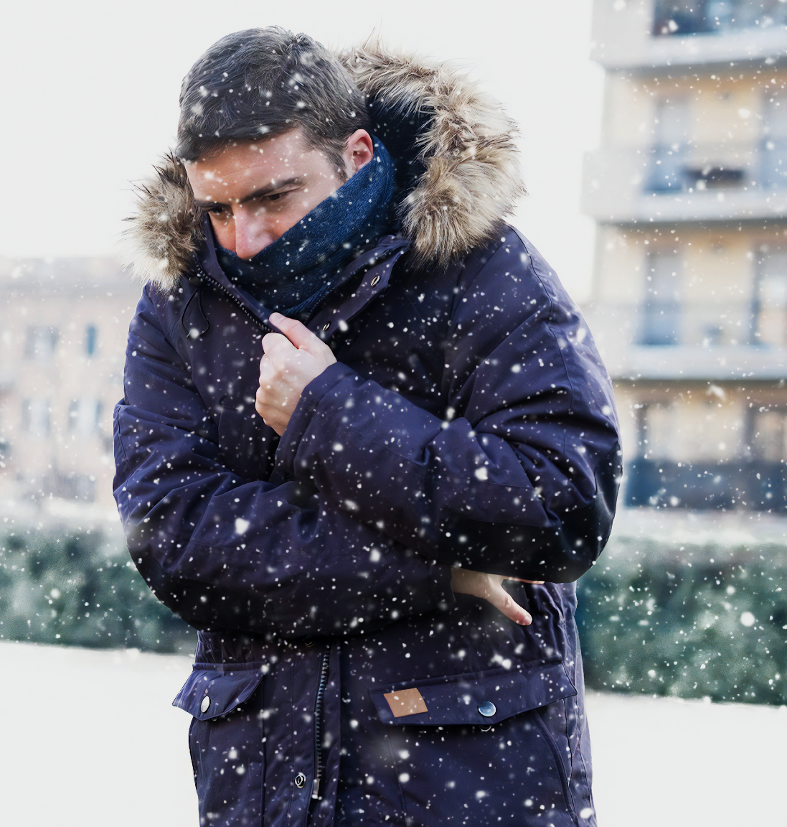
When the body gets too cold, signals are sent to muscles, which cause them to contract rapidly. This is referred to as shivering.
Shivering creates both friction in the muscles, as well as requiring respiration, an exothermic process.
For more help, please visit www.exampaperspractice.co.uk
© 2025 Exams Papers Practice. All Rights Reserved

