Slide 1
Edexcel IGCSE Biology
32 - Reflexes and the Eye
Minimising Damage and Focusing Light
For more help, please visit www.exampaperspractice.co.uk
© 2025 Exams Papers Practice. All Rights Reserved

Slide 2
Reflex Actions
Specification Point 2.90
Describe the structure and functioning of a simple reflex arc illustrated by the withdrawal of a finger from a hot object.
Reflex actions do not require conscious thought.
Reflex actions are rapid and automatic.
During a reflex action, the brain and CNS are bypassed.
Impulses pass from a sensory neurone, via a relay neurone, to a motor neurone.
A reflex action is almost instantaneous.
Reflex actions exist to avoid harm.
Reflex actions are quicker than ones that require conscious thought.
Reflex actions are evolved to limit the amount of damage an individual might receive.
The route that impulses take are referred to as a reflex arc.
For more help, please visit www.exampaperspractice.co.uk
© 2025 Exams Papers Practice. All Rights Reserved

Slide 3
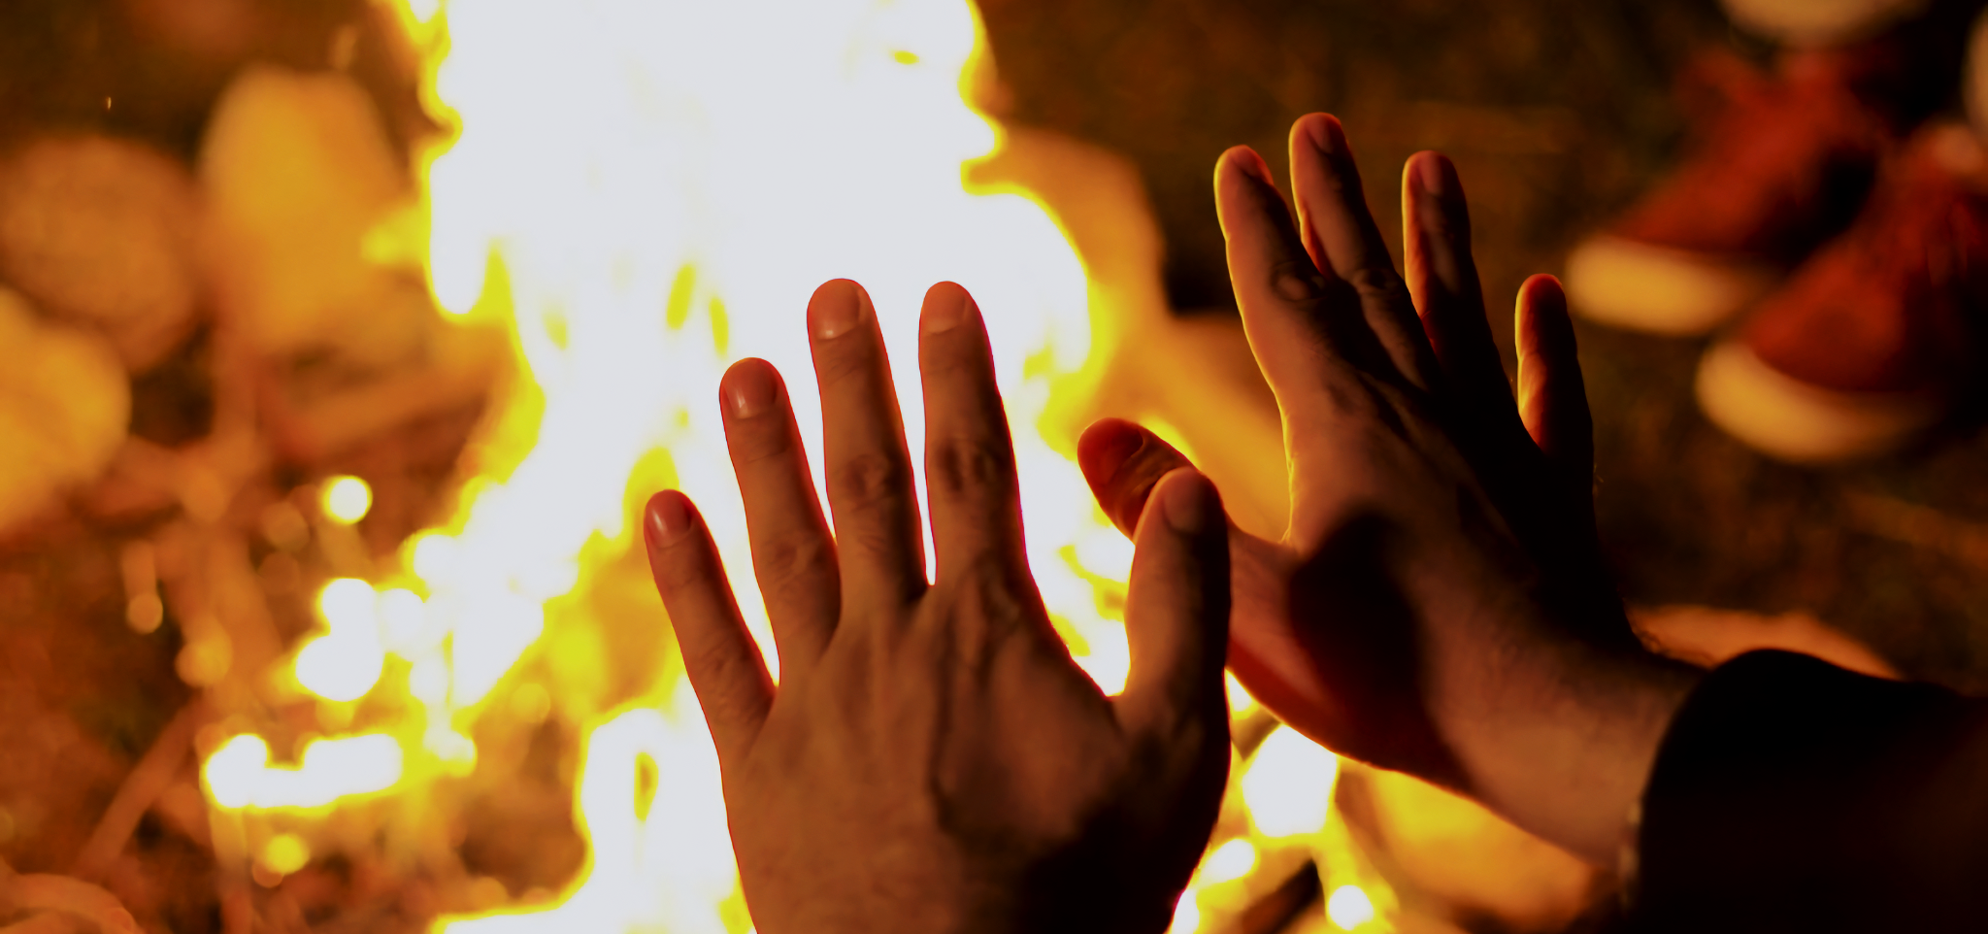
The reflex arc is rapid and automatic, bypassing the CNS and minimizing the risk of damage to the body.
For more help, please visit www.exampaperspractice.co.uk
© 2025 Exams Papers Practice. All Rights Reserved

Slide 4
The Reflex Arc
A stimulus is detected by a receptor.
This stimulus is often threatening - for example heat.
The receptor converts this information into an electrical impulse.
Many pain receptors are found on the surface of the skin.
The impulse is carried along a sensory neurone.
The impulse is transmitted to a relay neurone.
The impulse will have to cross a synapse to do this.
The message of pain is sent to the brain.
The impulse is then transmitted to a motor neurone.
The motor neurone stimulates an effector to cause a response.
A response may be the muscle in the biceps contracting, pulling the hand away from a hot object.
For more help, please visit www.exampaperspractice.co.uk
© 2025 Exams Papers Practice. All Rights Reserved

Slide 5
2. IMPULSE CARRIED DOWN SENSORY NEURONE
SPINAL CORD
3. IMPULSE CARRIED TO MOTOR NEURONE
The reflex arc bypasses the CNS and spinal cord, allowing for a near-instantaneous response.
4. EFFECTOR MOVES HAND AWAY FROM DANGER
1. RECEPTORS IN FINGERTIP DETECT HEAT
For more help, please visit www.exampaperspractice.co.uk
© 2025 Exams Papers Practice. All Rights Reserved

Slide 6
The Eye
Specification Point 2.91
Describe the structure and function of the eye as a receptor.
The eye is a sensory organ.
The eye contains cells that detect structure.
These cells are called rod cells.
The eye also contains cells that detect colour.
These cells are called cone cells.
Rods and cones function as receptor cells.
The eye contains rod cells and cone cells. These are receptors that detect detail and colour, allowing for vision.
For more help, please visit www.exampaperspractice.co.uk
© 2025 Exams Papers Practice. All Rights Reserved

Slide 7
Structures of the Eye
The eye has a number of key structures:
The cornea is a clear film on the outer layer of the eye.
The cornea is transparent and refracts light into the eye.
The pupil is a hole that allows light to enter the eye.
The pupil can get bigger (during dilation) or smaller (during constriction).
The iris controls how much light enters the eye.
The iris is the coloured portion of the eye that controls the diameter of the pupil.
The lens focuses light onto the retina.
The retina contains rod cells and cone cells.
Rods and cones are receptor cells found at the back of the eye.
A particularly dense region of rods and cones is called the fovea.
The optic nerve carries impulses to from the rods and cones to the brain.
The optic nerve allows the brain to process and create an image.
For more help, please visit www.exampaperspractice.co.uk
© 2025 Exams Papers Practice. All Rights Reserved

Slide 8
CORNEA
PUPIL
IRIS
SUSPENSORY
LIGAMENTS
CILIARY MUSCLES
The eye is a sensory organ that detects light.
Light enters through the pupil and is focused onto the retina which contains rods and cones.
Information is carried down the optic nerve to the brain where the image is processed.
RETINA
FOVEA
OPTIC NERVE
For more help, please visit www.exampaperspractice.co.uk
© 2025 Exams Papers Practice. All Rights Reserved

Slide 9
Accommodation
Specification Point 2.92
Understand the function of the eye in focusing on near and distant objects, and in responding to changes in light intensity.
The lens is an elastic object.
This means that the shape of the lens can change.
The shape of the lens is controlled by ciliary muscles.
The lens is held in place by suspensory ligaments.
To focus on near objects, the ciliary muscles contract and the suspensory ligaments slacken.
This causes the lens to fatten.
A thicker lens means light is refracted to a greater degree.
To focus on far objects, the ciliary muscles relax and the suspensory ligaments tighten.
This causes the lens to become thinner.
A thinner lens means light is redacted to a lesser degree.
This process is called accommodation.
For more help, please visit www.exampaperspractice.co.uk
© 2025 Exams Papers Practice. All Rights Reserved

Slide 10
NEAR OBJECT
To focus on near objects, the ciliary muscles contract and the suspensory ligaments slacken, causing the lens to get thicker.
Accommodation allows the eyes to focus on both near and far objects.
In both cases light is focused onto the retina.
FAR OBJECT
To focus on far objects, the ciliary muscles relax and the suspensory ligaments tighten, causing the lens to get thinner.
For more help, please visit www.exampaperspractice.co.uk
© 2025 Exams Papers Practice. All Rights Reserved

Slide 11
The Iris
The iris controls how much light enters the eye.
The iris constricts or dilates the pupil.
The pupil is dilated in dim light.
Dilating or widening the pupil maximises the amount of detail that can be seen in dim conditions.
The pupil is constricted in bright light.
Constricting the pupil helps to protect the eye from damage.
The iris contains two sets of muscles to control pupil diameter:
The iris contains the circular muscles.
The iris also contains the radial muscles.
The curricular and radial muscles work antagonistically.
When one set of muscles is contracted the other is relaxed.
For more help, please visit www.exampaperspractice.co.uk
© 2025 Exams Papers Practice. All Rights Reserved

Slide 12
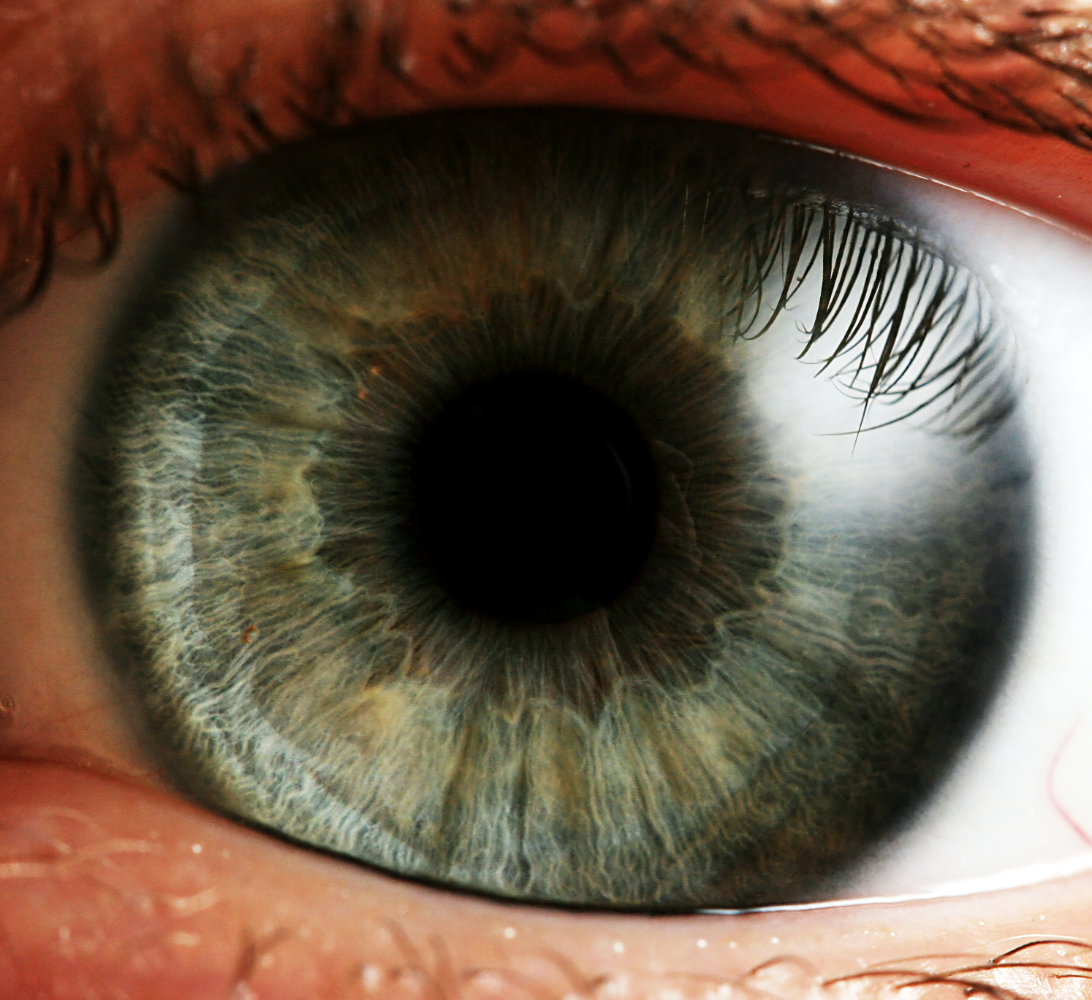
The iris is the coloured portion of the eye.
By dilating or constricting the pupil, the iris controls how much light enters the eye.
For more help, please visit www.exampaperspractice.co.uk
© 2025 Exams Papers Practice. All Rights Reserved

Slide 13
DIM LIGHT
BRIGHT LIGHT
The iris reflex.
In order to control how much light enters the eye, the iris uses the radial and circular muscles to control the diameter of the pupil.
RADIAL MUSCLES
CONTRACT
CIRCULAR MUSCLES
CONTRACT
For more help, please visit www.exampaperspractice.co.uk
© 2025 Exams Papers Practice. All Rights Reserved

