Slide 1
Edexcel IGCSE Biology
31 - Coordination in Humans
Receptors, Neurones and Synapses
For more help, please visit www.exampaperspractice.co.uk
© 2025 Exams Papers Practice. All Rights Reserved

Slide 2
Nerves and Hormones
Specification Point 2.86
Describe how nervous and hormonal communication control responses and understand the differences between the two systems.
The two main systems that control the body are the nervous system and the endocrine system:
The nervous system includes the brain, the spinal cord and the nerves.
Electrical impulses travel to and from the brain from various nerve cells.
The endocrine system includes the hormones and the glands that release them.
Hormones are chemical messengers that act on cells.
For more help, please visit www.exampaperspractice.co.uk
© 2025 Exams Papers Practice. All Rights Reserved

Slide 3
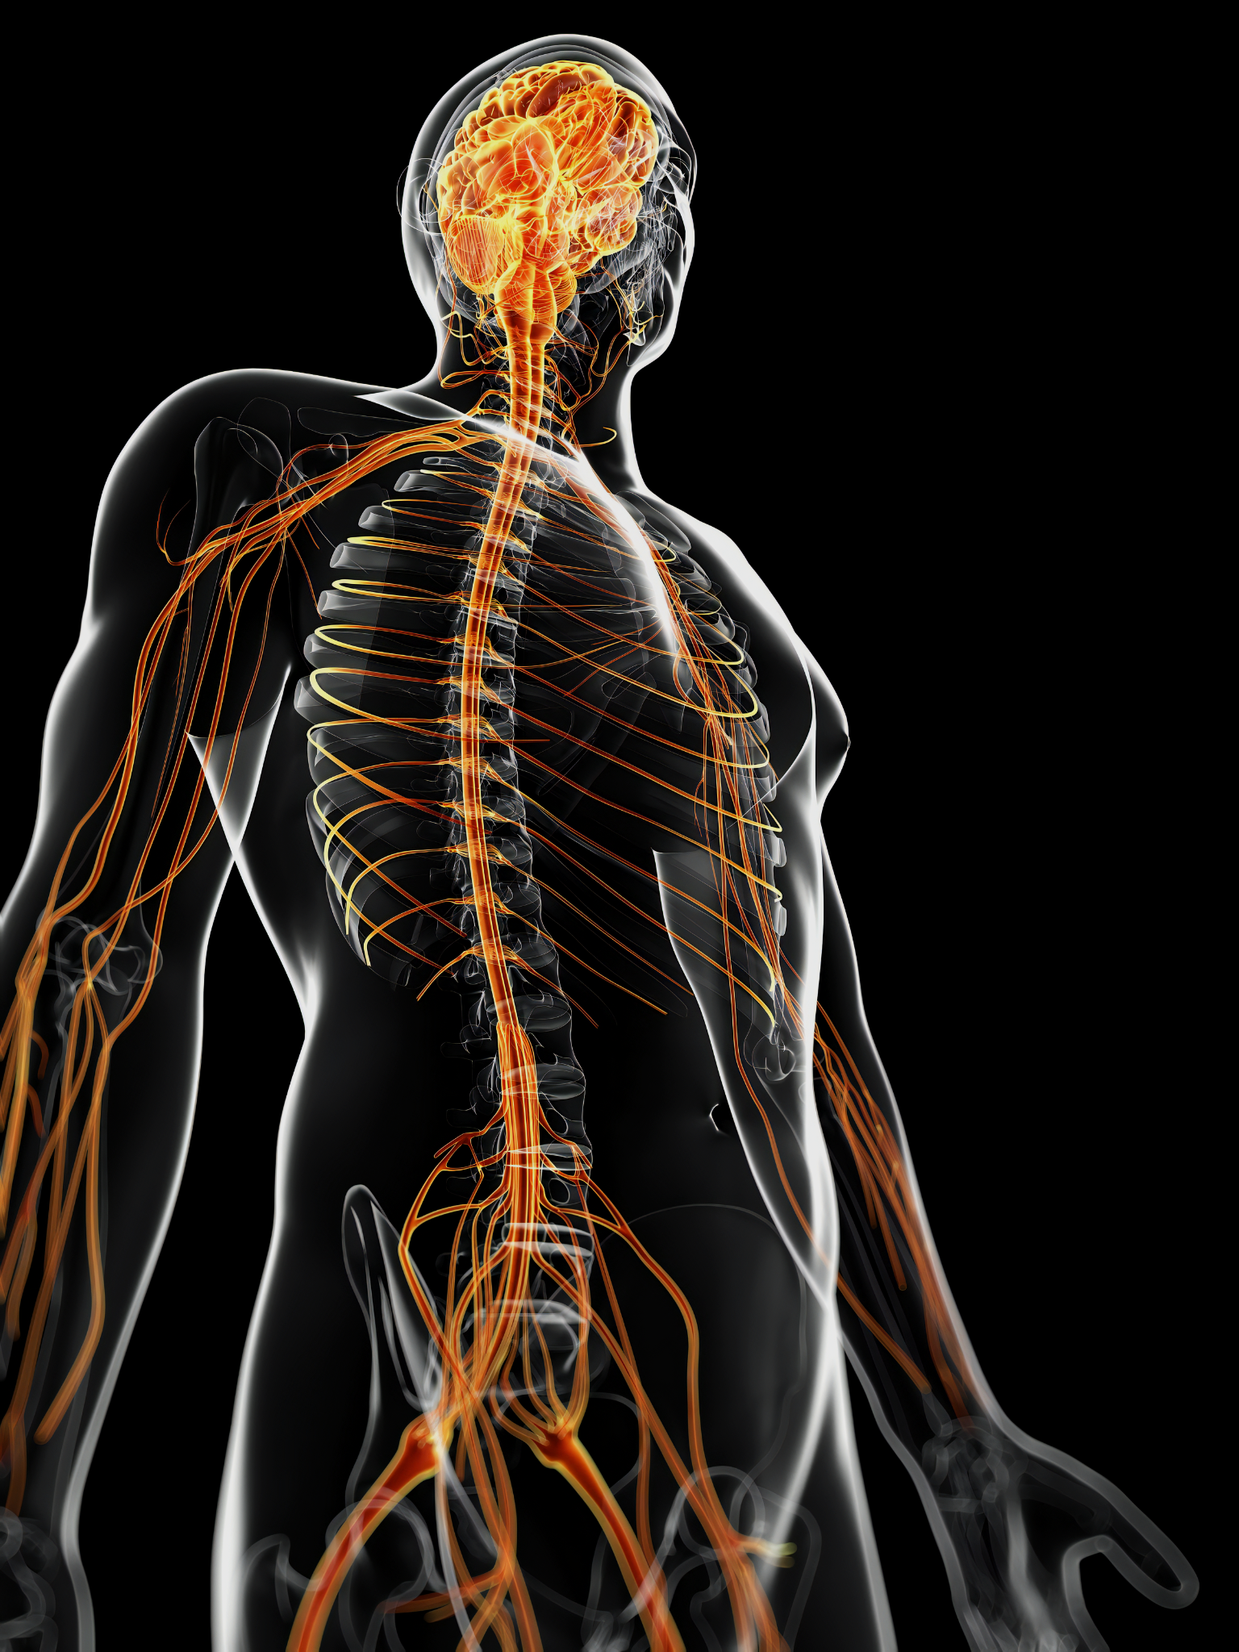
The nervous system consists of the brain, the spinal cord and the many peripheral nerves in the body.
For more help, please visit www.exampaperspractice.co.uk
© 2025 Exams Papers Practice. All Rights Reserved

Slide 4
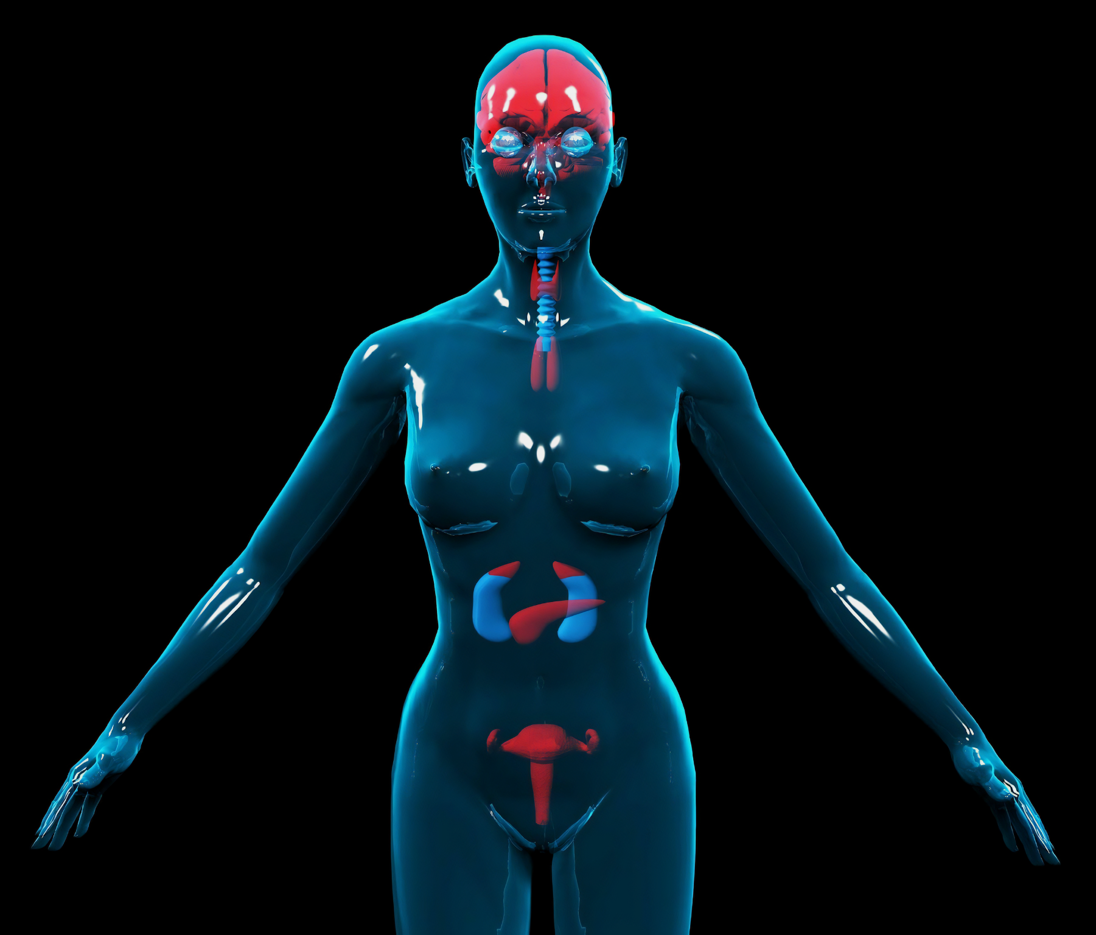
The endocrine system contains glands found in the brain, torso and reproductive organs.
These glands release chemical messengers, called hormones, into the bloodstream.
For more help, please visit www.exampaperspractice.co.uk
© 2025 Exams Papers Practice. All Rights Reserved

Slide 5
The Nervous System
The nervous system communicates through electrical impulses.
Small changes in ion concentrations determine whether or not electrical impulses are transmitted.
The nervous system acts on muscles or glands.
The nervous system can trigger the action of a muscle.
The nervous system can also trigger the release of hormones from glands.
The duration of a nerve impulse is short-lived.
Nerve impulses last only a fraction of a second.
The area of target for a the nervous system is specific.
Nerves may target individual cells or small groups of cells.
For more help, please visit www.exampaperspractice.co.uk
© 2025 Exams Papers Practice. All Rights Reserved

Slide 6
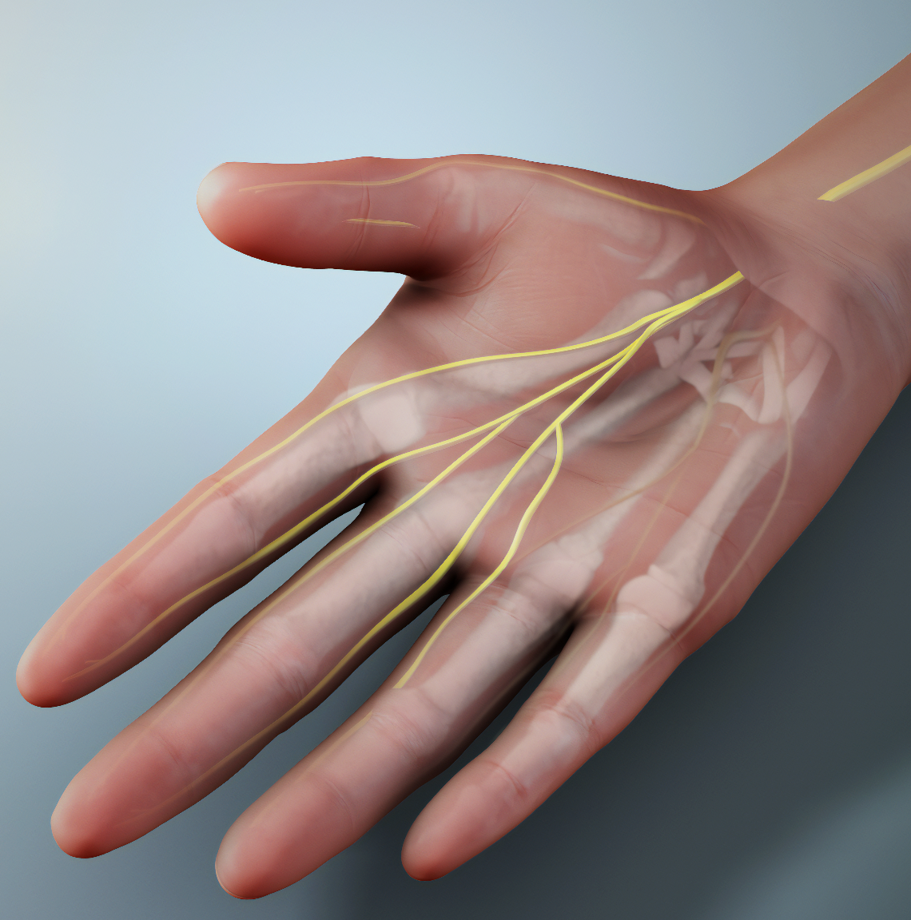
The median nerve is responsible for the fine motor control seen in the fingers.
Electrical impulses travel down the median nerve, causing muscles in the hand to contract and relax.
For more help, please visit www.exampaperspractice.co.uk
© 2025 Exams Papers Practice. All Rights Reserved

Slide 7
The Endocrine System
The endocrine system communicates through chemical messengers called hormones.
Hormones are released from glands into the bloodstream.
The endocrine system acts on cells, tissues or organs.
The endocrine system has a much wider area of target than the nervous system.
The effect of a hormone is long-lived.
The effect of some hormones (such as progesterone) may last several days.
The effect of other hormones (such as testosterone or oestrogen) may cause permanent changes to the body.
For more help, please visit www.exampaperspractice.co.uk
© 2025 Exams Papers Practice. All Rights Reserved

Slide 8
The pituitary gland is found at the base of the brain.
The pituitary gland is sometimes referred to as the master gland because it secretes lots of different hormones into the bloodstream.
Hormones are long-lived chemical signals that affect lots of different types of cells, tissues or organs.
For more help, please visit www.exampaperspractice.co.uk
© 2025 Exams Papers Practice. All Rights Reserved

Slide 9
Neurones
Specification Point 2.87
Understand that the central nervous system consists of the brain and spinal cord and is linked to sense organs by nerves.
Nerve cells are specialised cells and are often referred to as neurones.
There are three major groups of neurones:
Sensory neurones carry impulses from receptors.
Relay neurones carry impulses between neurones.
Motor neurones carry impulses to effectors.
Neurones carry electrical impulses to and from the brain.
The brain and the spinal cord are collectively referred to as the central nervous system (CNS).
For more help, please visit www.exampaperspractice.co.uk
© 2025 Exams Papers Practice. All Rights Reserved

Slide 10
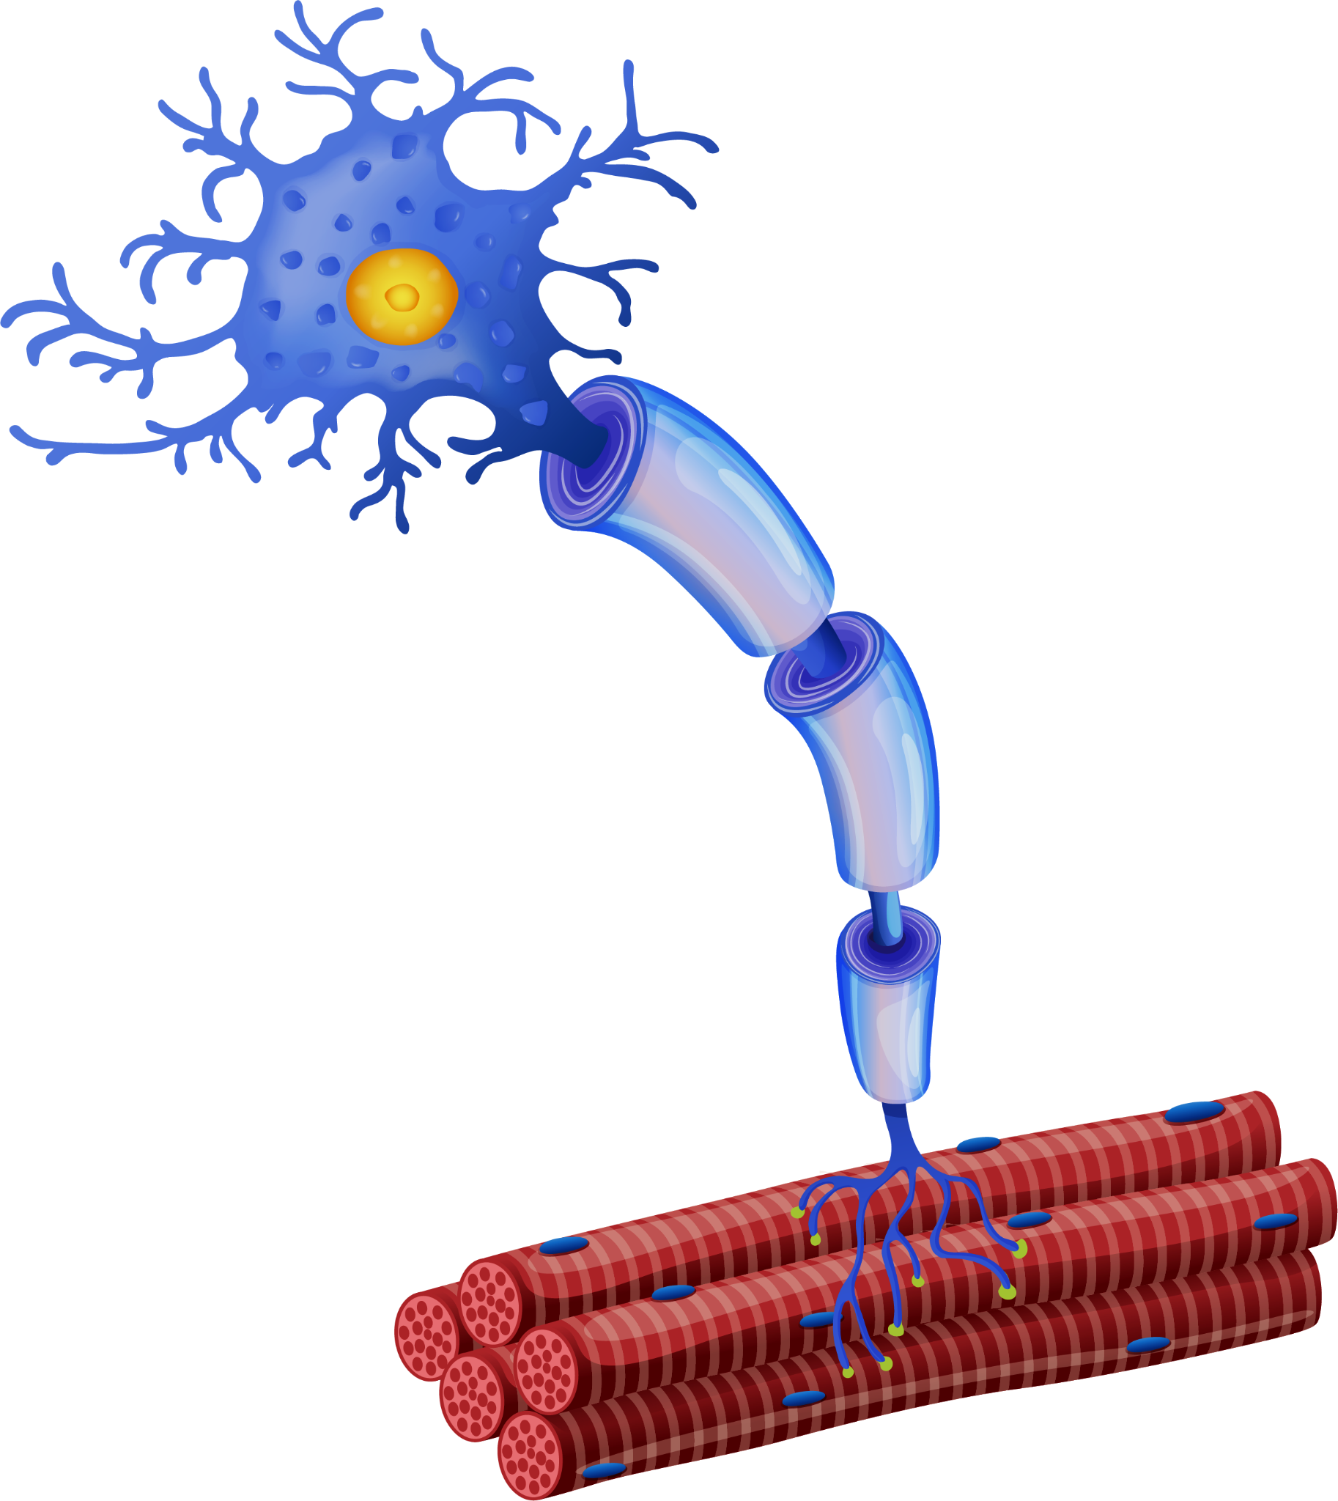
Neurones
Neurones are adapted for their function.
Neurones have a long central fibre, called an axon.
The axon is conductive and carries electrical information along the neurone.
The axon of a neurone is insulated.
A fatty substance called myelin speeds up the rate of transmission.
Neurones are linked to other neurones.
Neurones are linked to bridging structures are called dendrites.
Motor neurones stimulate muscle contraction.
For more help, please visit www.exampaperspractice.co.uk
© 2025 Exams Papers Practice. All Rights Reserved

Slide 11
A myelinated motor neurone. Impulses travel from the start of the axon to the axon terminal.
DENDRITES
AXON TERMINAL
CELL BODY
DIRECTION OF IMPULSE
AXON
MYELIN SHEATH
NUCLEUS
For more help, please visit www.exampaperspractice.co.uk
© 2025 Exams Papers Practice. All Rights Reserved

Slide 12
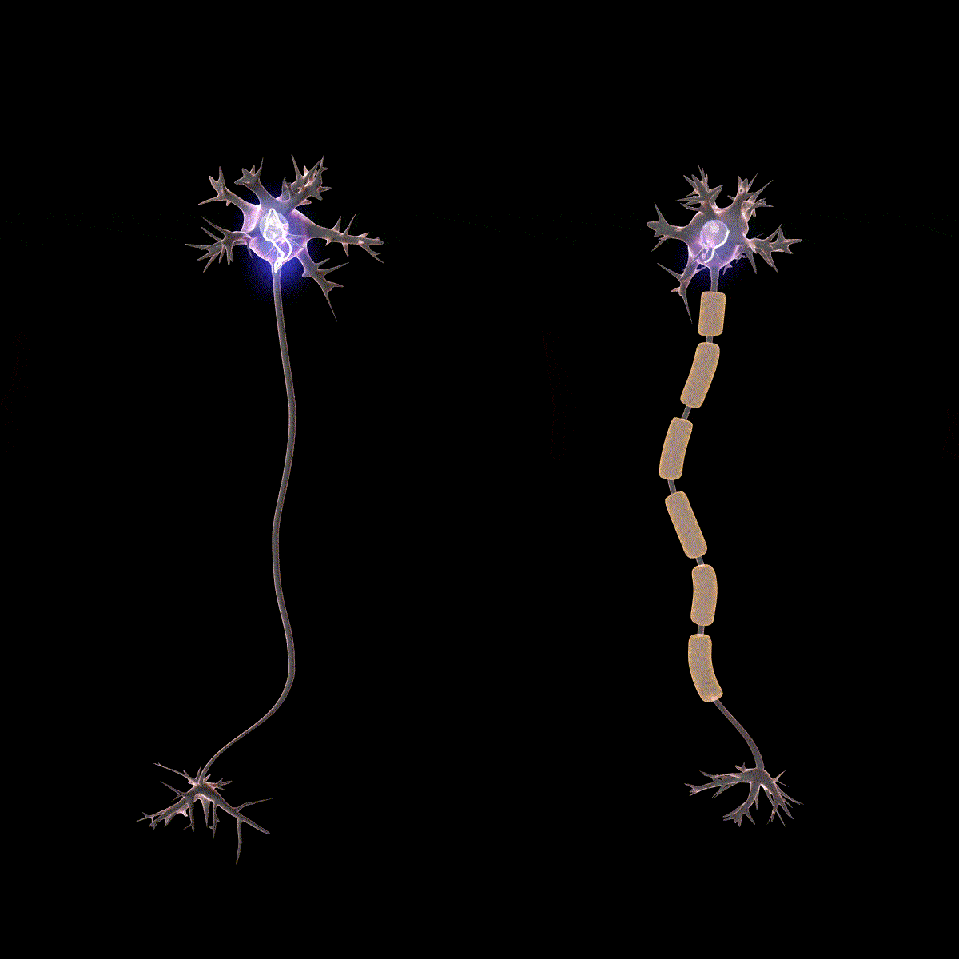
A fatty substance called myelin speeds up the rate of electrical transmission in neurones.
Myelin helps to insulate the neurone and is found in all mammals.
For more help, please visit www.exampaperspractice.co.uk
© 2025 Exams Papers Practice. All Rights Reserved

Slide 13
2. IMPULSE CARRIED DOWN SENSORY NEURONE
3. IMPULSE CARRIED BETWEEN RELAY NEURONES
4. IMPULSE CARRIED TO MOTOR NEURONE
Different types of neurones carry electrical impulses to and from the brain.
5. EFFECTOR MOVES HAND AWAY FROM DANGER
1. RECEPTORS IN FINGERTIP DETECT HEAT
For more help, please visit www.exampaperspractice.co.uk
© 2025 Exams Papers Practice. All Rights Reserved

Slide 14
Receptors
Specification Point 2.88
Understand that stimulation of receptors in the sense organs sends electrical impulses along nerves into and out of the central nervous system, resulting in rapid responses.
Receptors are another group of specialised cells.
Receptors detect changes to the environment:
Photoreceptors detect changes in light.
Thermoreceptors detect changes in temperature.
Baroreceptors detect changes in pressure.
Receptors are found in sense organs.
Photoreceptors for example are found in the eyes.
For more help, please visit www.exampaperspractice.co.uk
© 2025 Exams Papers Practice. All Rights Reserved

Slide 15
Receptors
Receptors generate impulses in sensory neurones.
The sensory neurone will carry the information, in the form of electrical charge, to the central nervous system (CNS).
The brain processes this information and stimulates a response.
In the case of cells in the tongue, the sensation of taste.
As this response is electrical, it is very fast.
TASTE RECEPTOR CELL
SENSORY NEURONE
Taste buds in the tongue contain receptors. These receptors generate impulses which are passed to sensory neurones. These are processed in the CNS and sensed as taste.
For more help, please visit www.exampaperspractice.co.uk
© 2025 Exams Papers Practice. All Rights Reserved

Slide 16
Synapses
Specification Point 2.89
Understand the role of neurotransmitters at synapses.
Synapses are the gaps between neurones.
Neurones never come into direct contact with one another.
At a synapse, electrical impulses are converted into chemical messengers.
These chemical messengers are called neurotransmitters.
Acetylcholine is an example of a neurotransmitter.
Synapses ensure that the impulse is unidirectional.
This means the impulse only travels in one direction.
This ensures the signal is not misinterpreted.
A synapse is the gap between two neurones.
For more help, please visit www.exampaperspractice.co.uk
© 2025 Exams Papers Practice. All Rights Reserved

Slide 17
Synaptic Transmission
An electrical impulse arrives at the end of one neurone.
The impulse reaches the dendrites at the end of the axon.
Neurotransmitters are released into the gap between neurones.
This gap is referred to as the synaptic cleft.
Neurotransmitters diffuse across the gap and bind to receptors on the second neurone.
The binding of these neurotransmitters stimulates the second neurone to generate an impulse.
In this way information is carried between neurones.
Synapse video.
For more help, please visit www.exampaperspractice.co.uk
© 2025 Exams Papers Practice. All Rights Reserved

Slide 18
NEURONE 1
NEUROTRANSMITTER
An electrical impulse arrives at the end of one neurone.
Neurotransmitters are released into the synaptic cleft.
Neurotransmitters diffuse across the gap and bind to receptors on the second neurone.
This triggers an impulse in the second neurone.
SYNAPTIC CLEFT
RECEPTOR FOR NEUROTRANSMITTER
NEURONE 2
For more help, please visit www.exampaperspractice.co.uk
© 2025 Exams Papers Practice. All Rights Reserved

