Slide 1


Edexcel IGCSE Biology
30 - Coordination in Plants
Phototropism, Geotropism and Auxins
For more help, please visit www.exampaperspractice.co.uk
© 2025 Exams Papers Practice. All Rights Reserved

Slide 2
Tropisms
Specification Point 2.83
  Understand that plants respond to stimuli.
Plants must respond to their environment in order to survive.
  These responses are much slower than in animals.
In a plant, a movement towards or away from a stimulus is called a tropism:
Phototropism is a movement towards or away from light.
Geotropism is a movement towards or away from gravity.
Hydrotropism is a movement towards or away from water.
Tropisms can be either positive or negative.
  Positive phototropism for example is growth towards a source of light.
For more help, please visit www.exampaperspractice.co.uk
© 2025 Exams Papers Practice. All Rights Reserved

Slide 3
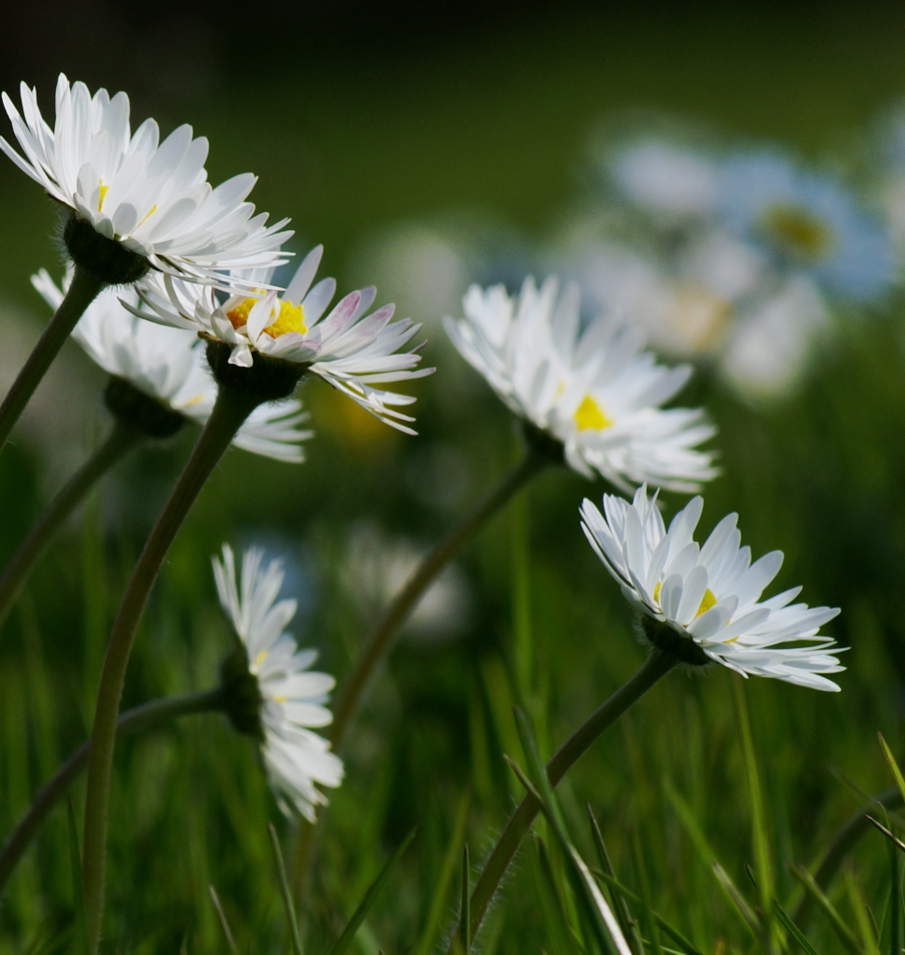
Daisies exhibiting positive phototropism in response to light.
Positive phototropism allows plants to orientate themselves to where there is most sunlight, maximising their rate of photosynthesis.
For more help, please visit www.exampaperspractice.co.uk
© 2025 Exams Papers Practice. All Rights Reserved

Slide 4
Roots and Shoots
Specification Point 2.84
  Describe the geotropic and phototropic responses of roots and stems.
Shoots will grow upwards to maximise their ability to photosynthesise.
The movement of shoots is an example of a positive phototropism.
  Shoots grow upwards towards sunlight.
The movement of shoots is also an example of a negative geotropism.
  Shoots grow upwards, against gravity.
Roots will grow downwards into the soil for nutrients.
The movement of roots is an example of a negative phototropism.
  Roots grow downwards away from sunlight.
The movement of roots is also an example of a positive geotropism.
  Roots grow downwards towards gravity.
For more help, please visit www.exampaperspractice.co.uk
© 2025 Exams Papers Practice. All Rights Reserved

Slide 5
SHOOTS GROW UPWARDS AGAINST GRAVITY
The roots of plants are both positively geotropic (growing towards gravity) and negatively phototropic (growing away from light).
The shoots of plants are both positively phototropic (growing towards light) and negatively geotropic (growing against gravity).
ROOTS GROW DOWNWARDS TOWARDS GRAVITY
For more help, please visit www.exampaperspractice.co.uk
© 2025 Exams Papers Practice. All Rights Reserved

Slide 6
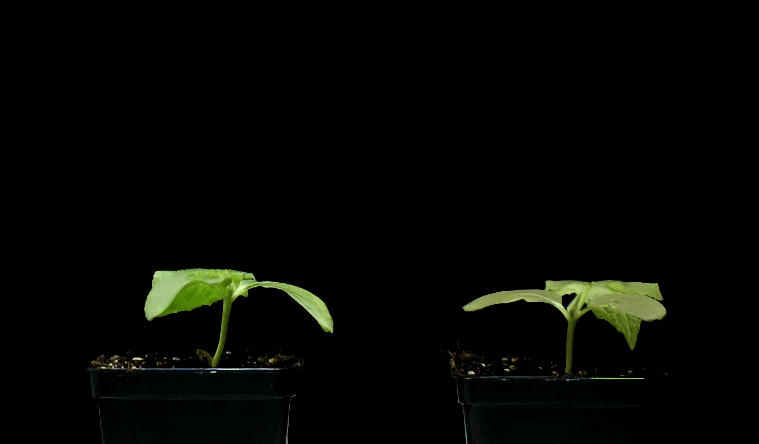
Plant shoots are negatively geotropic - they grow upwards, away from the ground.
For more help, please visit www.exampaperspractice.co.uk
© 2025 Exams Papers Practice. All Rights Reserved

Slide 7
Auxins
Specification Point 2.85
  Understand the role of auxin in the phototropic response of stems.
Auxins are a type of plant hormone.
Auxins control the growth rate of plant cells.
  Most auxins speed up the rate of growth in plants.
Auxins are made in the tip of growing stems.
One type of auxin is called indoleacetic acid (IAA).
IAA causes cells to elongate.
  IAA changes the behaviour of the plant cell wall, causing cells to stretch out.
IAA is a type of auxin that causes the cells in the stem of a plant to stretch.
For more help, please visit www.exampaperspractice.co.uk
© 2025 Exams Papers Practice. All Rights Reserved

Slide 8
IAA and Phototropism
When the plant is illuminated on all sides, IAA causes the cells in the shoot to grow at the same rate.
  The shoot will grow directly upwards.
When light shines on one side of the shoot, IAA will accumulate on the shady side of the shoot:
Cells on the shady side of the shoot will stretch.
This will cause the shoot to bend towards the light.
The mechanism is an example of positive phototropism.
  IAA growth video.
For more help, please visit www.exampaperspractice.co.uk
© 2025 Exams Papers Practice. All Rights Reserved

Slide 9
3. IAA causes cells on the shady side to elongate, bending the stem towards the light in an example of positive phototropism.
2. Light from one direction causes IAA to accumulate on the shady side of the stem.
LIGHT
1. The auxin IAA is made in the tip of growing shoots.
For more help, please visit www.exampaperspractice.co.uk
© 2025 Exams Papers Practice. All Rights Reserved

