Slide 1
Edexcel IGCSE Biology
2 - Variety of Living Organisms
Animals, Plants, Fungi, Protoctista, Bacteria and Viruses
For more help, please visit www.exampaperspractice.co.uk
© 2025 Exams Papers Practice. All Rights Reserved

Slide 2
Eukaryotes
Specification Point 1.2
Describe the common features shown by eukaryotic organisms: plants, animals, fungi and protoctista.
Eukaryotic organisms have a nucleus.
The nucleus controls the functions of cells.
Eukaryotes may be unicellular or multicellular.
Unicellular organisms are composed of a single cell.
Multicellular organisms are composed of many cells.
An organelle is a structure that makes up a cell.
Each cell will contain a number of different organelles.
A typical eukaryotic cell will contain the following organelles:
A nucleus.
Cytoplasm.
A cell membrane.
Mitochondria.
Ribosomes.
For more help, please visit www.exampaperspractice.co.uk
© 2025 Exams Papers Practice. All Rights Reserved

Slide 3
RIBOSOMES
CYTOPLASM
NUCLEUS
CELL MEMBRANE
A typical animal cell.
MITOCHONDRIA
For more help, please visit www.exampaperspractice.co.uk
© 2025 Exams Papers Practice. All Rights Reserved

Slide 4
Animals
Animals are multicellular.
This means that they consist of many different types of cell.
Animals feed on organic substances made by other living things.
This is referred to as heterotrophy.
Animals can be carnivorous or herbivorous.
Animals store their carbohydrates as glycogen.
Glycogen is a sugar with a complicated structure.
Glycogen is stored in the liver of most animals.
Animals are heterotrophic. This means that they feed on substances made by other organisms.
For more help, please visit www.exampaperspractice.co.uk
© 2025 Exams Papers Practice. All Rights Reserved

Slide 5
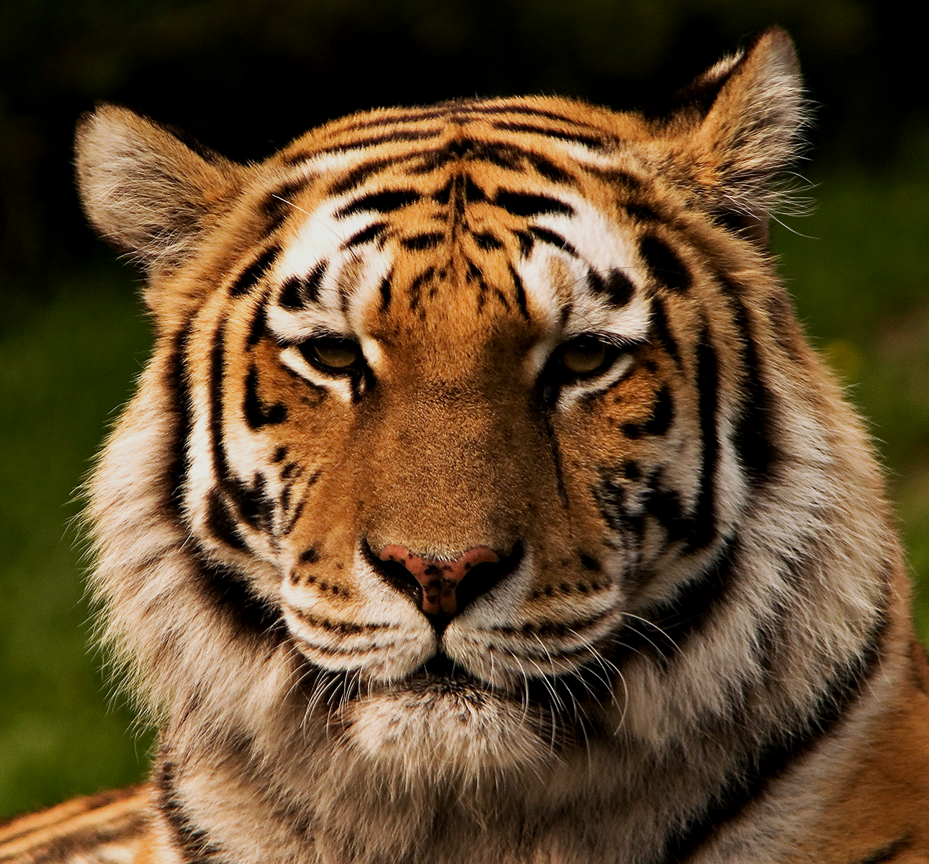
Many animals are carnivorous. They eat other animals for energy.
For more help, please visit www.exampaperspractice.co.uk
© 2025 Exams Papers Practice. All Rights Reserved

Slide 6
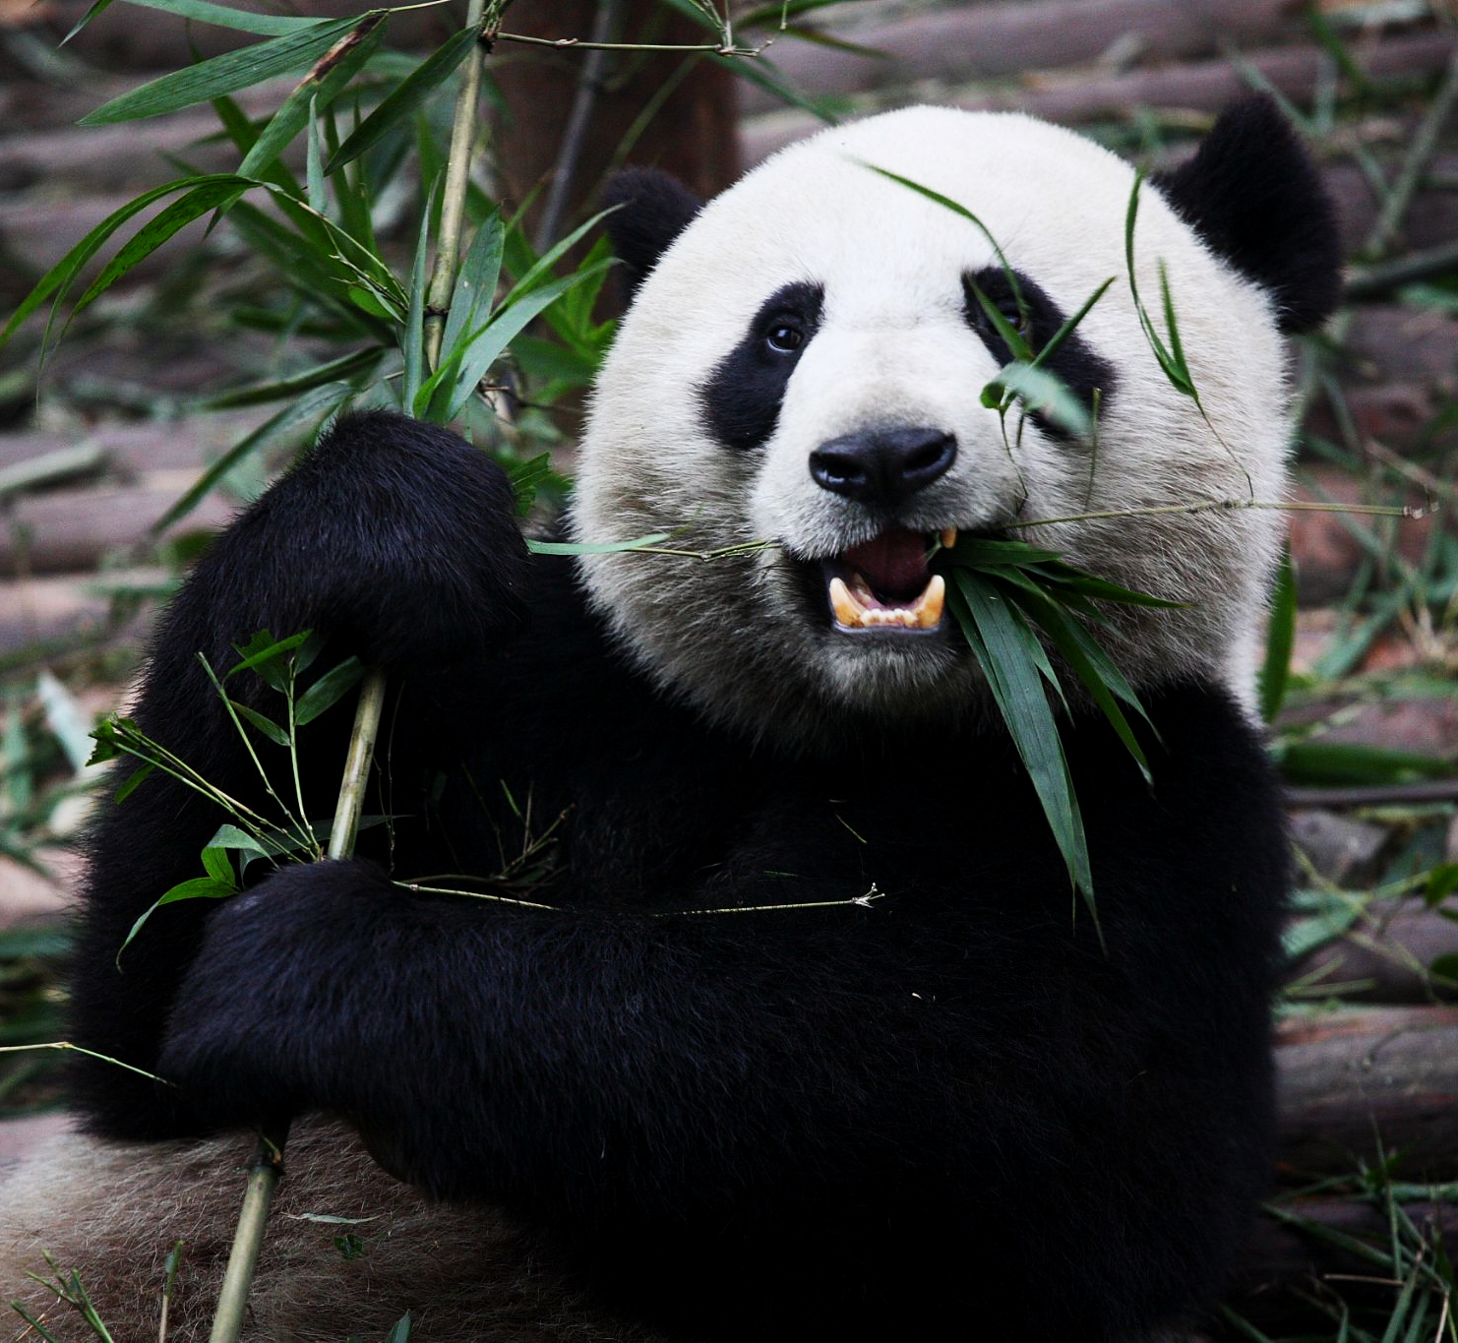
Other animals are herbivorous. They feed on plants for their energy.
For more help, please visit www.exampaperspractice.co.uk
© 2025 Exams Papers Practice. All Rights Reserved

Slide 7
Plants
Plants are multicellular.
This means that they consist of many different types of cell.
Plants create their own food during photosynthesis.
This is a form of autotrophy.
Plant cells are still eukaryotic but they contain extra organelles:
A cell wall.
A permanent vacuole.
Chloroplasts.
Plants store their energy as starch.
Starch is another complex sugar that is confirmed by the iodine test.
Plants store starch as starch grains in various cells.
Plants are autotrophic. This means that they make their own food.
For more help, please visit www.exampaperspractice.co.uk
© 2025 Exams Papers Practice. All Rights Reserved

Slide 8
RIBOSOMES
CYTOPLASM
NUCLEUS
CELL MEMBRANE
A typical plant cell.
CELL WALL
MITOCHONDRIA
PERMANENT VACUOLE
CHLOROPLAST
For more help, please visit www.exampaperspractice.co.uk
© 2025 Exams Papers Practice. All Rights Reserved

Slide 9
Fungi
Fungi are eukaryotic and include organisms like mushrooms and yeast.
Most fungi are multicellular with a mass of thread-like structures called hyphae.
These hyphae are organised into a mycelium.
Yeast is a fungus which is unicellular.
Fungi have cell walls made out of chitin.
Chitin is a complex sugar.
Fungi often feed by saprotrophic nutrition.
This means they feed on dead or decaying matter.
Some fungi are parasites.
This means they feed on live material.
Most fungi store their carbohydrates as glycogen.
Mushrooms are often seen as the typical fungus. Many fungi are saprotrophic and feed on dead or decaying matter.
For more help, please visit www.exampaperspractice.co.uk
© 2025 Exams Papers Practice. All Rights Reserved

Slide 10
Protoctista
Protoctista are almost always unicellular.
This means they are almost always single-celled.
Some protoctista look like animal cells.
Amoeba are examples of animal-like protoctista.
Other protoctista look more like plant cells.
Chlorella are examples of plant-like protoctista.
All protoctista have a nucleus.
Some protoctista have cell walls and/or chloroplasts.
Some protists can photosynthesise.
Protoctista like amoeba are simple, mostly water-borne organisms. Some resemble animal cells, whilst others look more like plant cells.
For more help, please visit www.exampaperspractice.co.uk
© 2025 Exams Papers Practice. All Rights Reserved

Slide 11
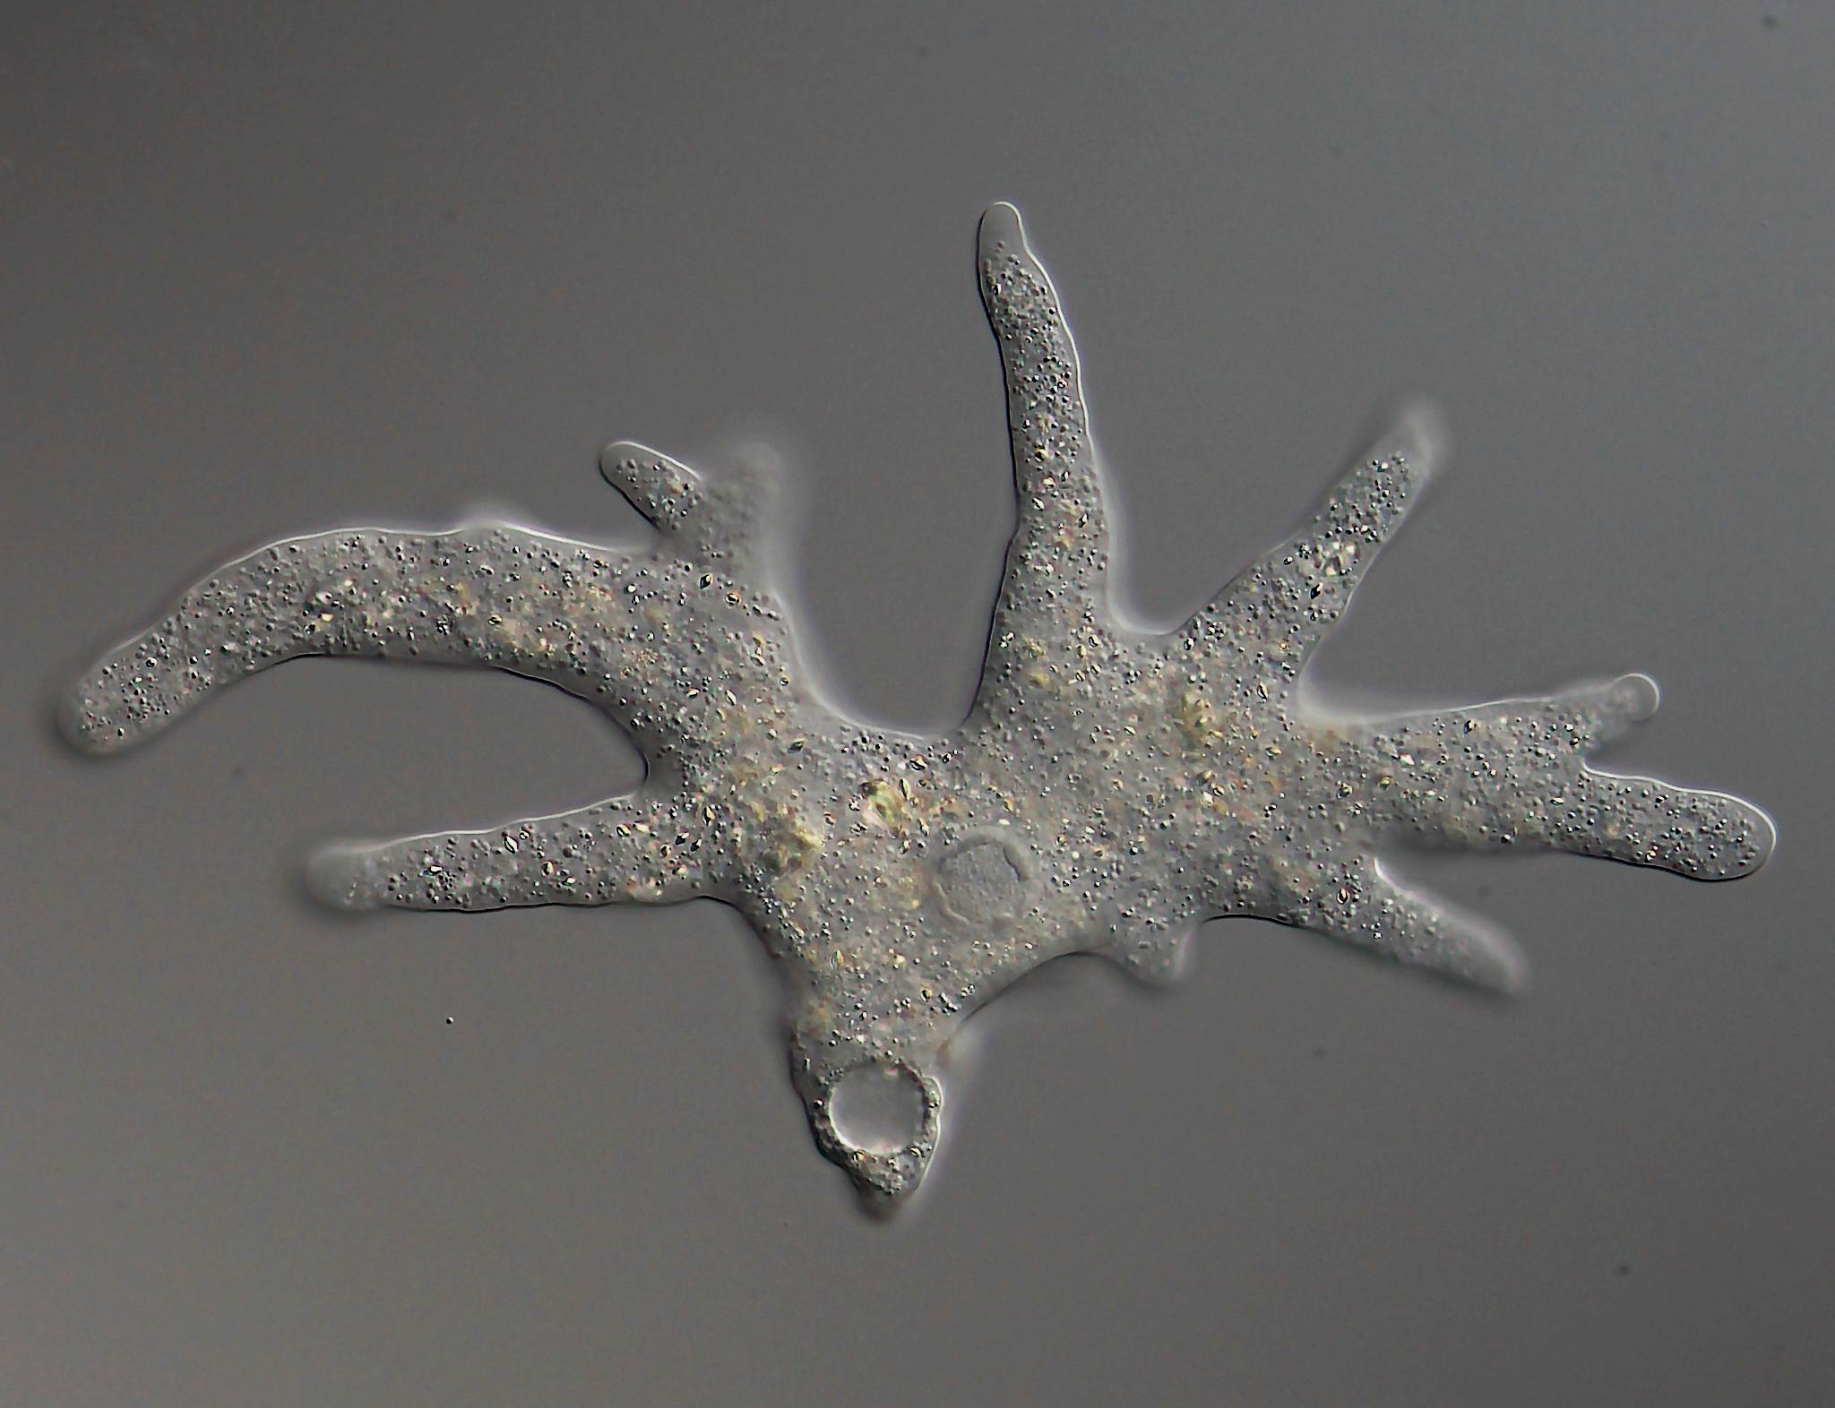
Protoctista like amoeba are simple, mostly water-borne organisms. Some resemble animal cells, whilst others look more like plant cells.
For more help, please visit www.exampaperspractice.co.uk
© 2025 Exams Papers Practice. All Rights Reserved

Slide 12
Prokaryotes
Specification Point 1.3
Describe the common features shown by prokaryotic organisms such as bacteria.
Prokaryotic cells do not contain a nucleus.
Bacteria are the largest group of prokaryotes.
Bacterial cells contain a single strand of DNA arranged in a coil.
This is called a nucleoid.
Bacterial cells contain several loops of DNA.
These are called plasmids.
Bacterial cells do not contain any membrane-bound organelles:
No mitochondria.
No chloroplasts.
Smaller ribosomes.
Some bacterial cells have a flagellum.
This is a tail-like projection that is used for movement.
For more help, please visit www.exampaperspractice.co.uk
© 2025 Exams Papers Practice. All Rights Reserved

Slide 13
RIBOSOMES
CYTOPLASM
CELL MEMBRANE
CELL WALL
A typical bacterial cell.
NUCLEOID
PLASMID
FLAGELLUM
For more help, please visit www.exampaperspractice.co.uk
© 2025 Exams Papers Practice. All Rights Reserved

Slide 14
Pathogens
Specification Point 1.4
Understand the term pathogen and know that pathogens may include the following: fungi, bacteria, protoctista and viruses.
A pathogen is an organism or particle that causes disease.
Fungi, protoctista, bacteria and viruses all have the capability to cause disease:
Fungi - athlete’s foot.
Protoctista - malaria.
Bacteria - pneumonia.
Viruses - HIV, influenza, COVID-19.
Pathogens like the virus COVID-19 have the potential to cause disease.
For more help, please visit www.exampaperspractice.co.uk
© 2025 Exams Papers Practice. All Rights Reserved

Slide 15
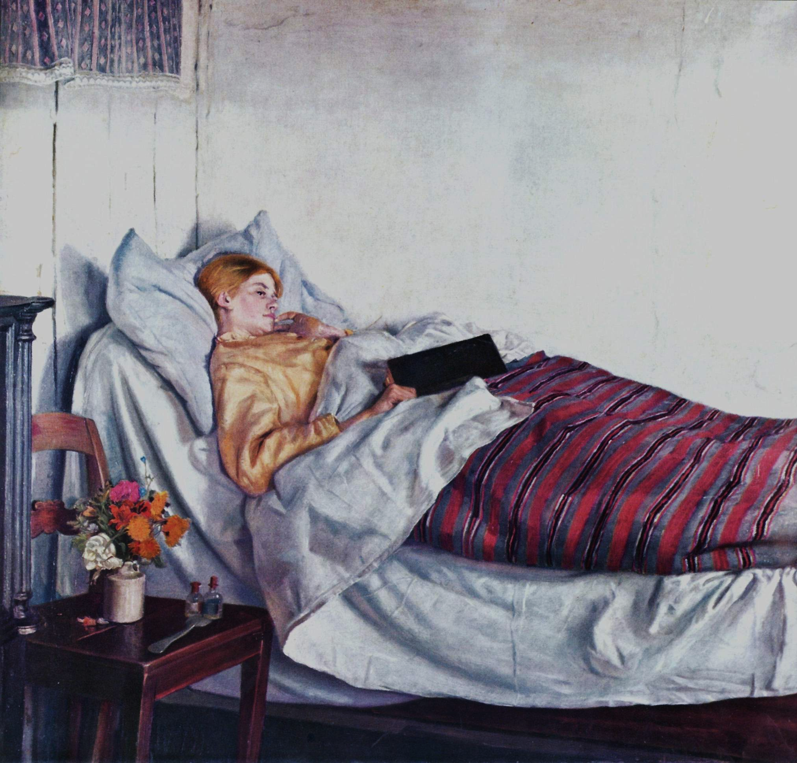
Pathogens are organisms or particles that have the potential to cause disease and illness in individuals.
For more help, please visit www.exampaperspractice.co.uk
© 2025 Exams Papers Practice. All Rights Reserved

Slide 16
Viruses
Viruses do not carry out some of the key processes to be considered ‘alive’.
Viruses are instead referred to as particles.
Viruses are much smaller than bacteria and are always parasitic.
They reproduce inside host cells by hijacking their internal mechanisms to make lots of identical copies of themselves.
Viruses have the ability to infect every type of living cell.
The viral envelope (like a cell membrane) is used to enter the host cell.
A protein coat or capsid holds the genetic information of the virus.
DNA or RNA contains the code to make new viruses.
VIRAL ENVELOPE
CAPSID
DNA OR RNA
The typical structure of a virus.
For more help, please visit www.exampaperspractice.co.uk
© 2025 Exams Papers Practice. All Rights Reserved

