Slide 1
Edexcel IGCSE Biology
29 - Coordination
Responding to Stimuli
For more help, please visit www.exampaperspractice.co.uk
© 2025 Exams Papers Practice. All Rights Reserved

Slide 2
Nerves and Hormones
Specification Point 2.80
Understand how organisms are able to respond to changes in their environment.
The two main systems that control the body are the nervous system and the endocrine system:
The nervous system includes the brain, the spinal cord and the nerves.
Electrical impulses travel to and from the brain from various nerve cells.
The endocrine system includes the hormones and the glands that release them.
Hormones are chemical messengers that act on cells.
In order to survive, organisms must be able to respond to their environment.
The ability of an individual to respond to changes in their environment is referred to as sensitivity.
For more help, please visit www.exampaperspractice.co.uk
© 2025 Exams Papers Practice. All Rights Reserved

Slide 3
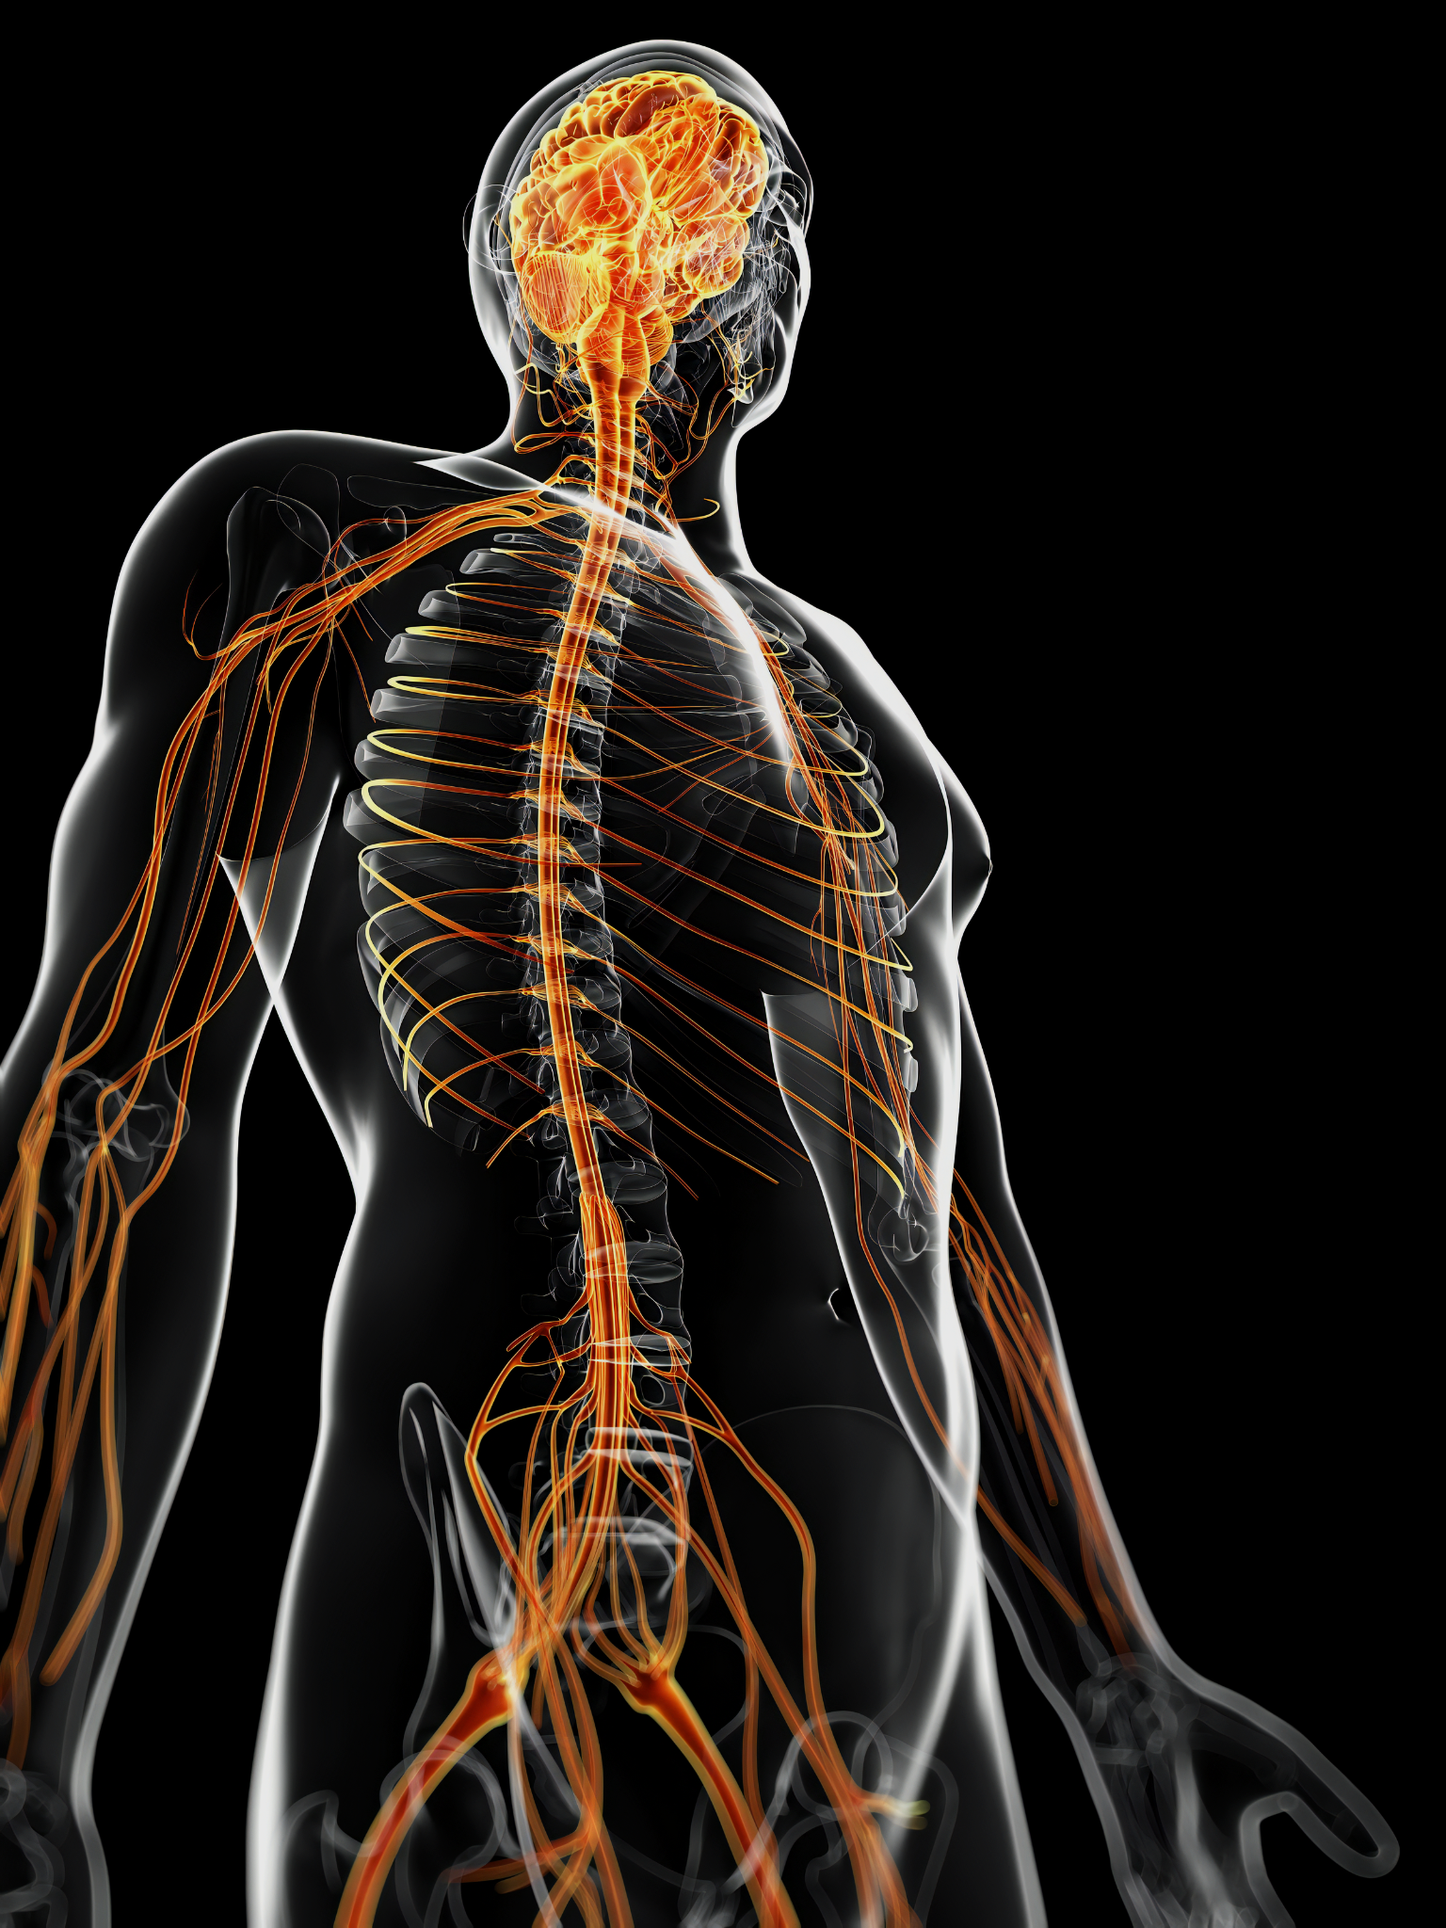
The nervous system consists of the brain, the spinal cord and the many peripheral nerves in the body.
For more help, please visit www.exampaperspractice.co.uk
© 2025 Exams Papers Practice. All Rights Reserved

Slide 4
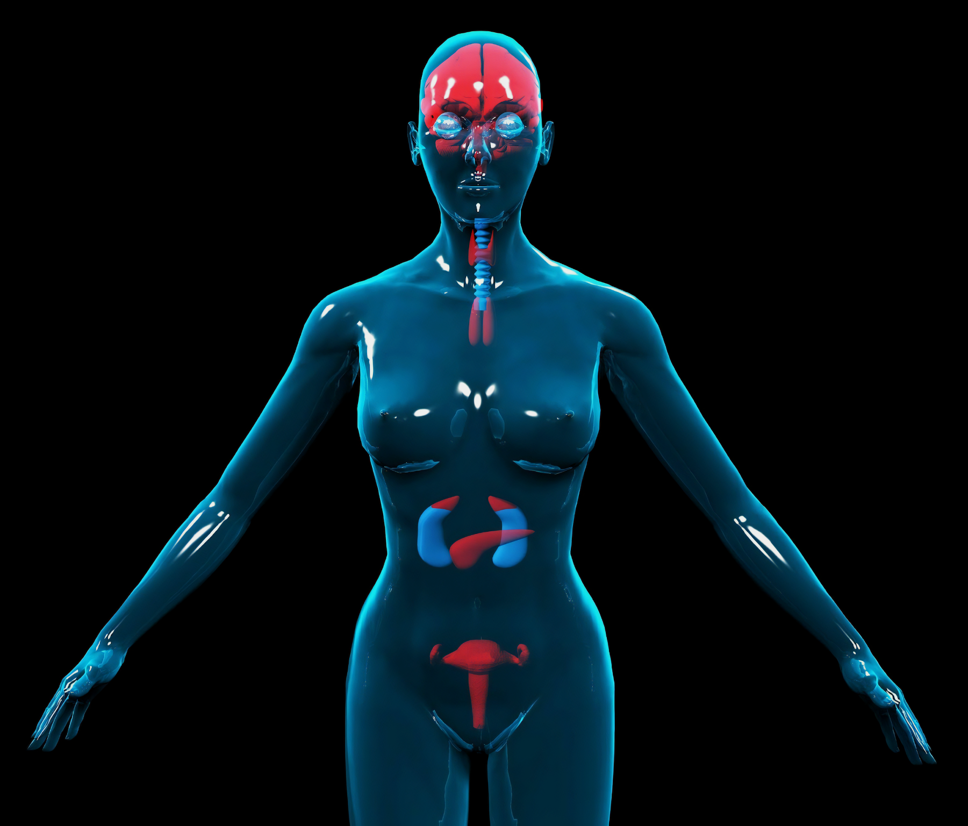
The endocrine system contains glands found in the brain, torso and reproductive organs.
These glands release chemical messengers, called hormones, into the bloodstream.
For more help, please visit www.exampaperspractice.co.uk
© 2025 Exams Papers Practice. All Rights Reserved

Slide 5
Homeostasis
Specification Point 2.81
Understand that homeostasis is the maintenance of a constant internal environment, and that body water content and body temperature are both examples of homeostasis.
Homeostasis is the control of a constant internal environment.
The body attempts to keep several conditions as constant as possible:
The body keeps its internal temperature at around 37°C.
The water content of the body is kept fairly constant.
The glucose concentration in the blood is kept fairly constant.
Homeostasis may be maintained by the nervous system, the endocrine system, or both systems.
These control mechanisms are automatic.
These mechanisms do not require conscious thought to take place.
For more help, please visit www.exampaperspractice.co.uk
© 2025 Exams Papers Practice. All Rights Reserved

Slide 6
Stimuli and Response
Specification Point 2.82
Understand that a coordinated response requires a stimulus, a receptor and an effector.
A stimulus is a change in the environment.
Examples of stimuli include light, sound and pressure.
Stimuli are detected by a type of cells called receptors.
Photoreceptors detect light changes in the eye.
Baroreceptors detect pressure changes in the circulatory system.
The central nervous system (CNS) coordinates a response.
The response is brought about by effectors.
Effectors maybe muscles or glands.
For more help, please visit www.exampaperspractice.co.uk
© 2025 Exams Papers Practice. All Rights Reserved

Slide 7
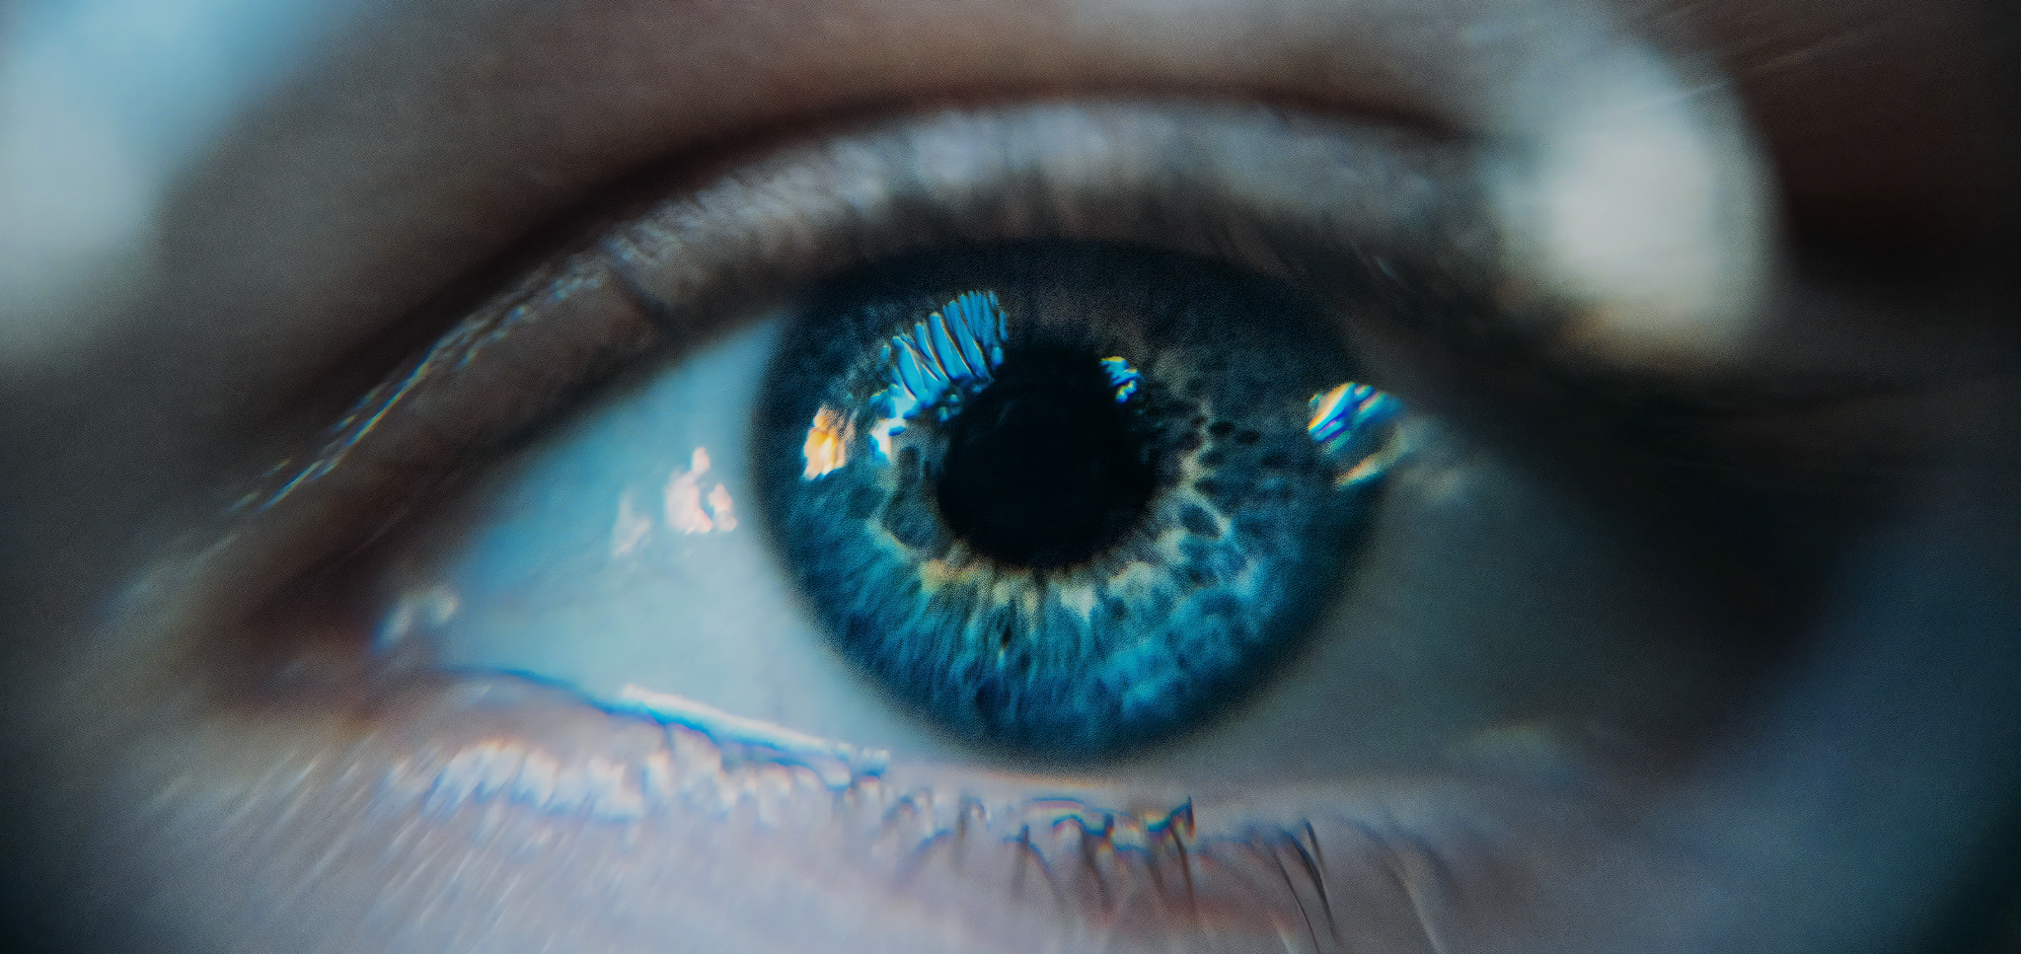
Photoreceptors in the eye detect the amount of light that enters. Muscles in the iris act as effectors to control how much light enters the eye.
For more help, please visit www.exampaperspractice.co.uk
© 2025 Exams Papers Practice. All Rights Reserved

