Slide 1
Edexcel IGCSE Biology
27 - Excretion
Removing Waste in Plants and Animals
For more help, please visit www.exampaperspractice.co.uk
© 2025 Exams Papers Practice. All Rights Reserved

Slide 2
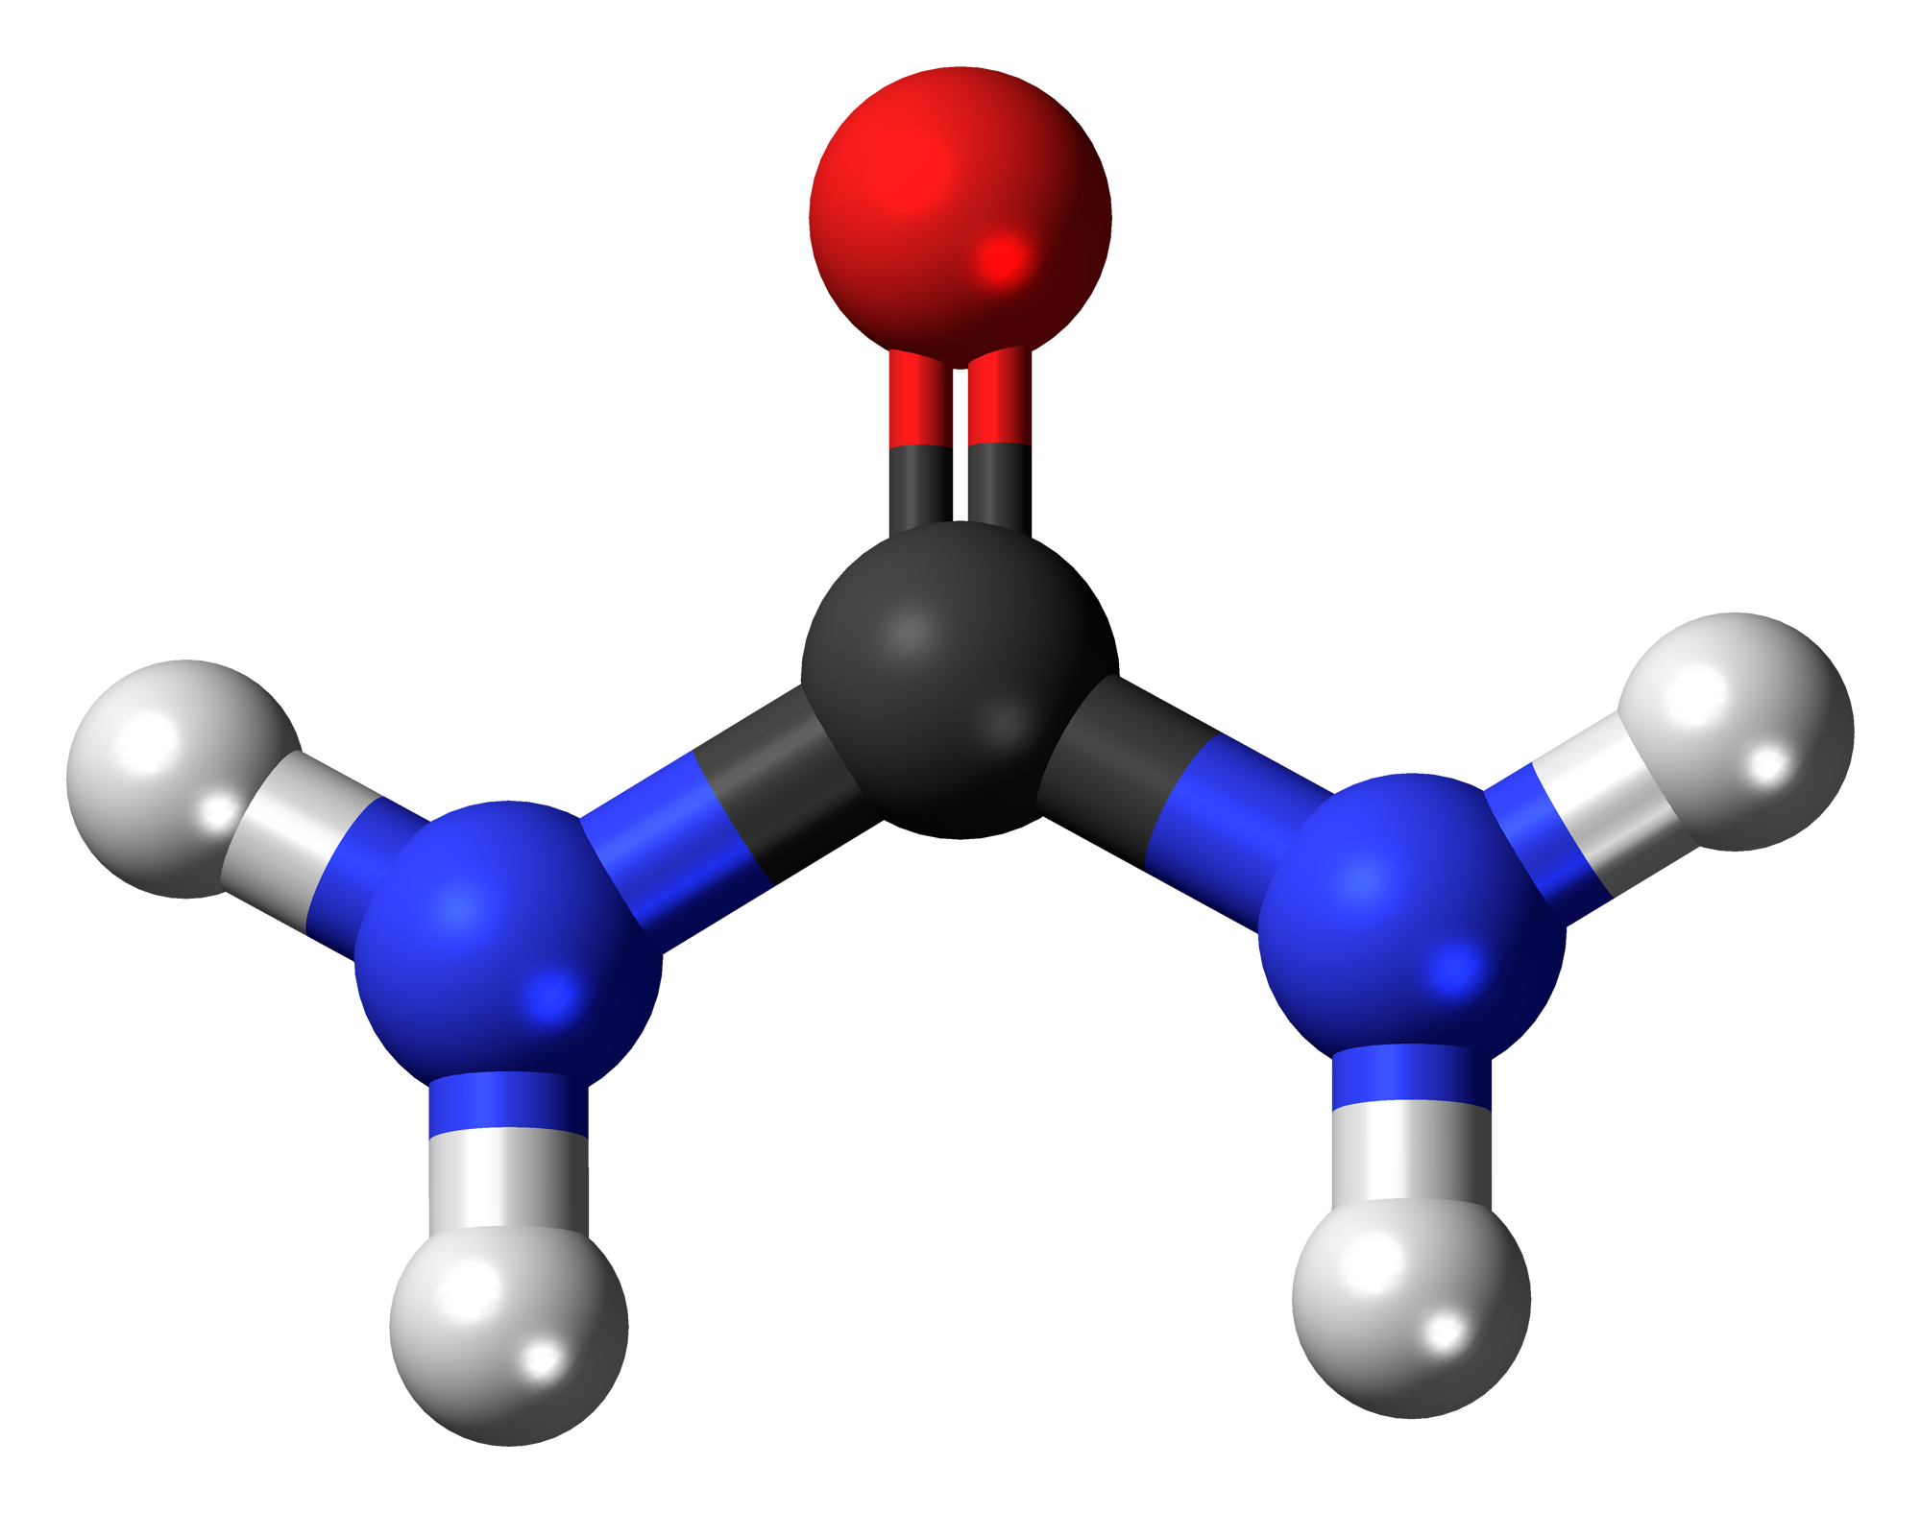
Excretion
Specification Point 2.70
Understand the origin of carbon dioxide and oxygen as waste products of metabolism and their loss from the stomata of a leaf.
Excretion can be defined as the removal of metabolic waste.
Metabolic waste is the byproduct of chemical reactions.
Metabolic reactions such as respiration and protein synthesis both produce waste products.
Waste products must be removed from the body as they are toxic.
Plants and animals both excrete waste products.
Urea is a toxic molecule that is made when proteins are broken down in the body. Urea must be excreted from the body.
For more help, please visit www.exampaperspractice.co.uk
© 2025 Exams Papers Practice. All Rights Reserved

Slide 3
Excretion in Plants
Plants excrete two major gases:
Plants excrete oxygen (O₂)
O₂ is a byproduct of photosynthesis.
Plants excrete carbon dioxide (CO₂)
CO₂ is a byproduct of aerobic respiration.
Both O₂ and CO₂ are excreted through the stomata on the underside of the leaf.
Stomata are tiny pores that allow for gas exchange to take place in plants.
EXCRETION OF O₂ AND CO₂
Plants excrete waste gases (O₂ and CO₂) through openings called stomata. The stomata are the main route for plants to excrete gases.
For more help, please visit www.exampaperspractice.co.uk
© 2025 Exams Papers Practice. All Rights Reserved

Slide 4
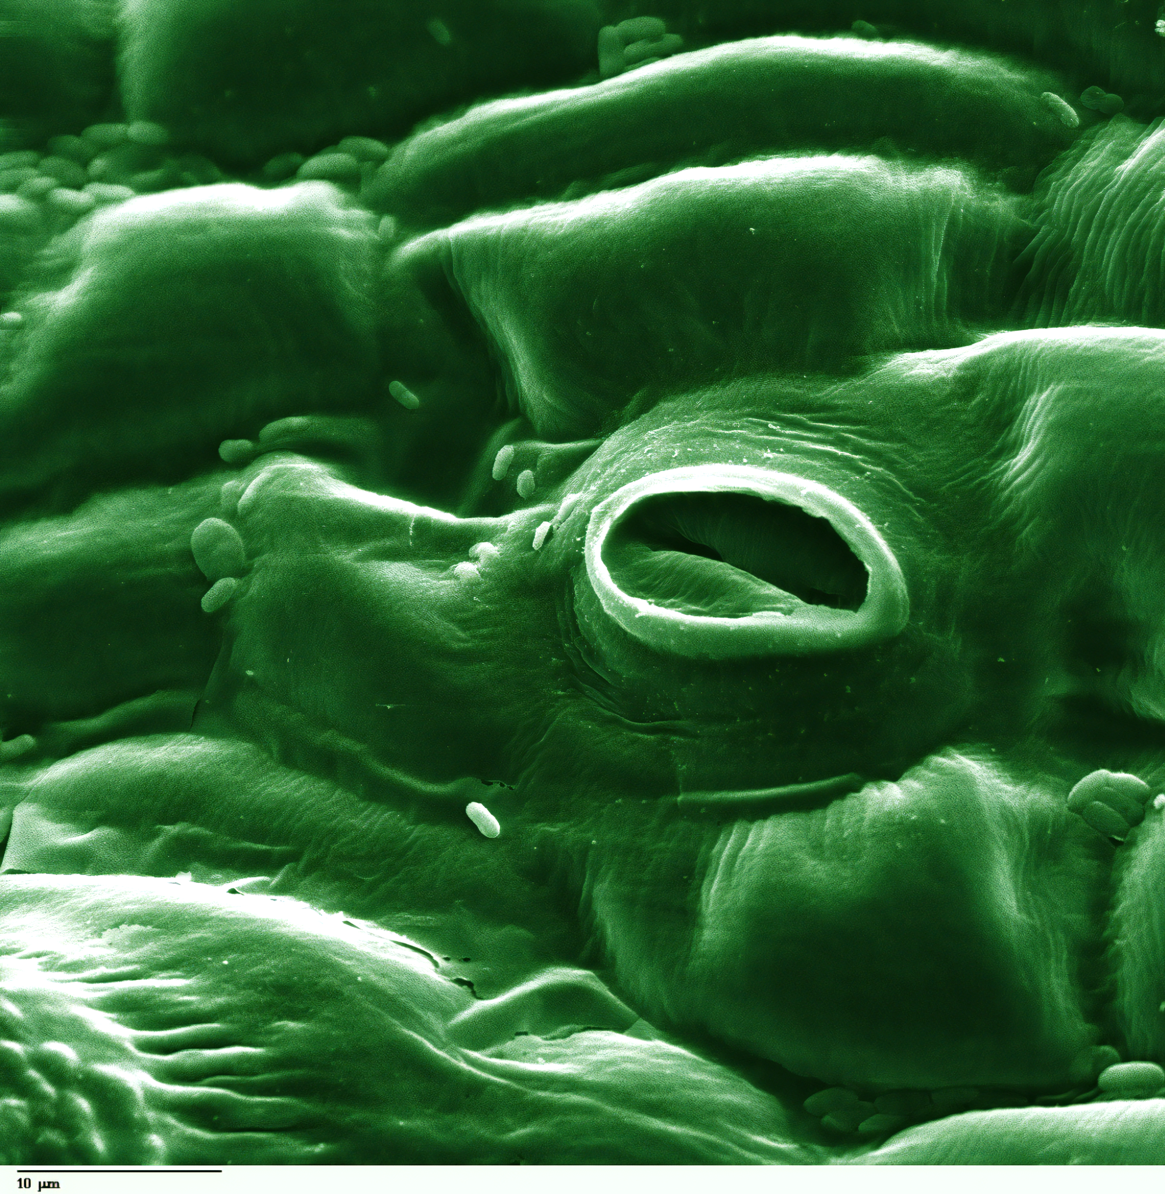
Stomata are small pores that are usually found on the underside of the leaf.
Both O₂ and CO₂ exit through stomatal pores.
For more help, please visit www.exampaperspractice.co.uk
© 2025 Exams Papers Practice. All Rights Reserved

Slide 5
Excretion in Humans
Specification Point 2.71
Know the excretory products of the lungs, kidneys and skin.
Humans have a number of specialised organs for excretion.
The lungs remove CO₂ from the body.
During ventilation, O₂ is drawn into the lungs and CO₂ is forced out.
CO₂ is a metabolic waste product of aerobic respiration.
The kidneys remove water, salts and urea from the body.
When combined this is referred to as urine.
Urea is a waste product of protein breakdown.
The skin removes water and salts from the body.
These are excreted through sweat glands.
For more help, please visit www.exampaperspractice.co.uk
© 2025 Exams Papers Practice. All Rights Reserved

Slide 6
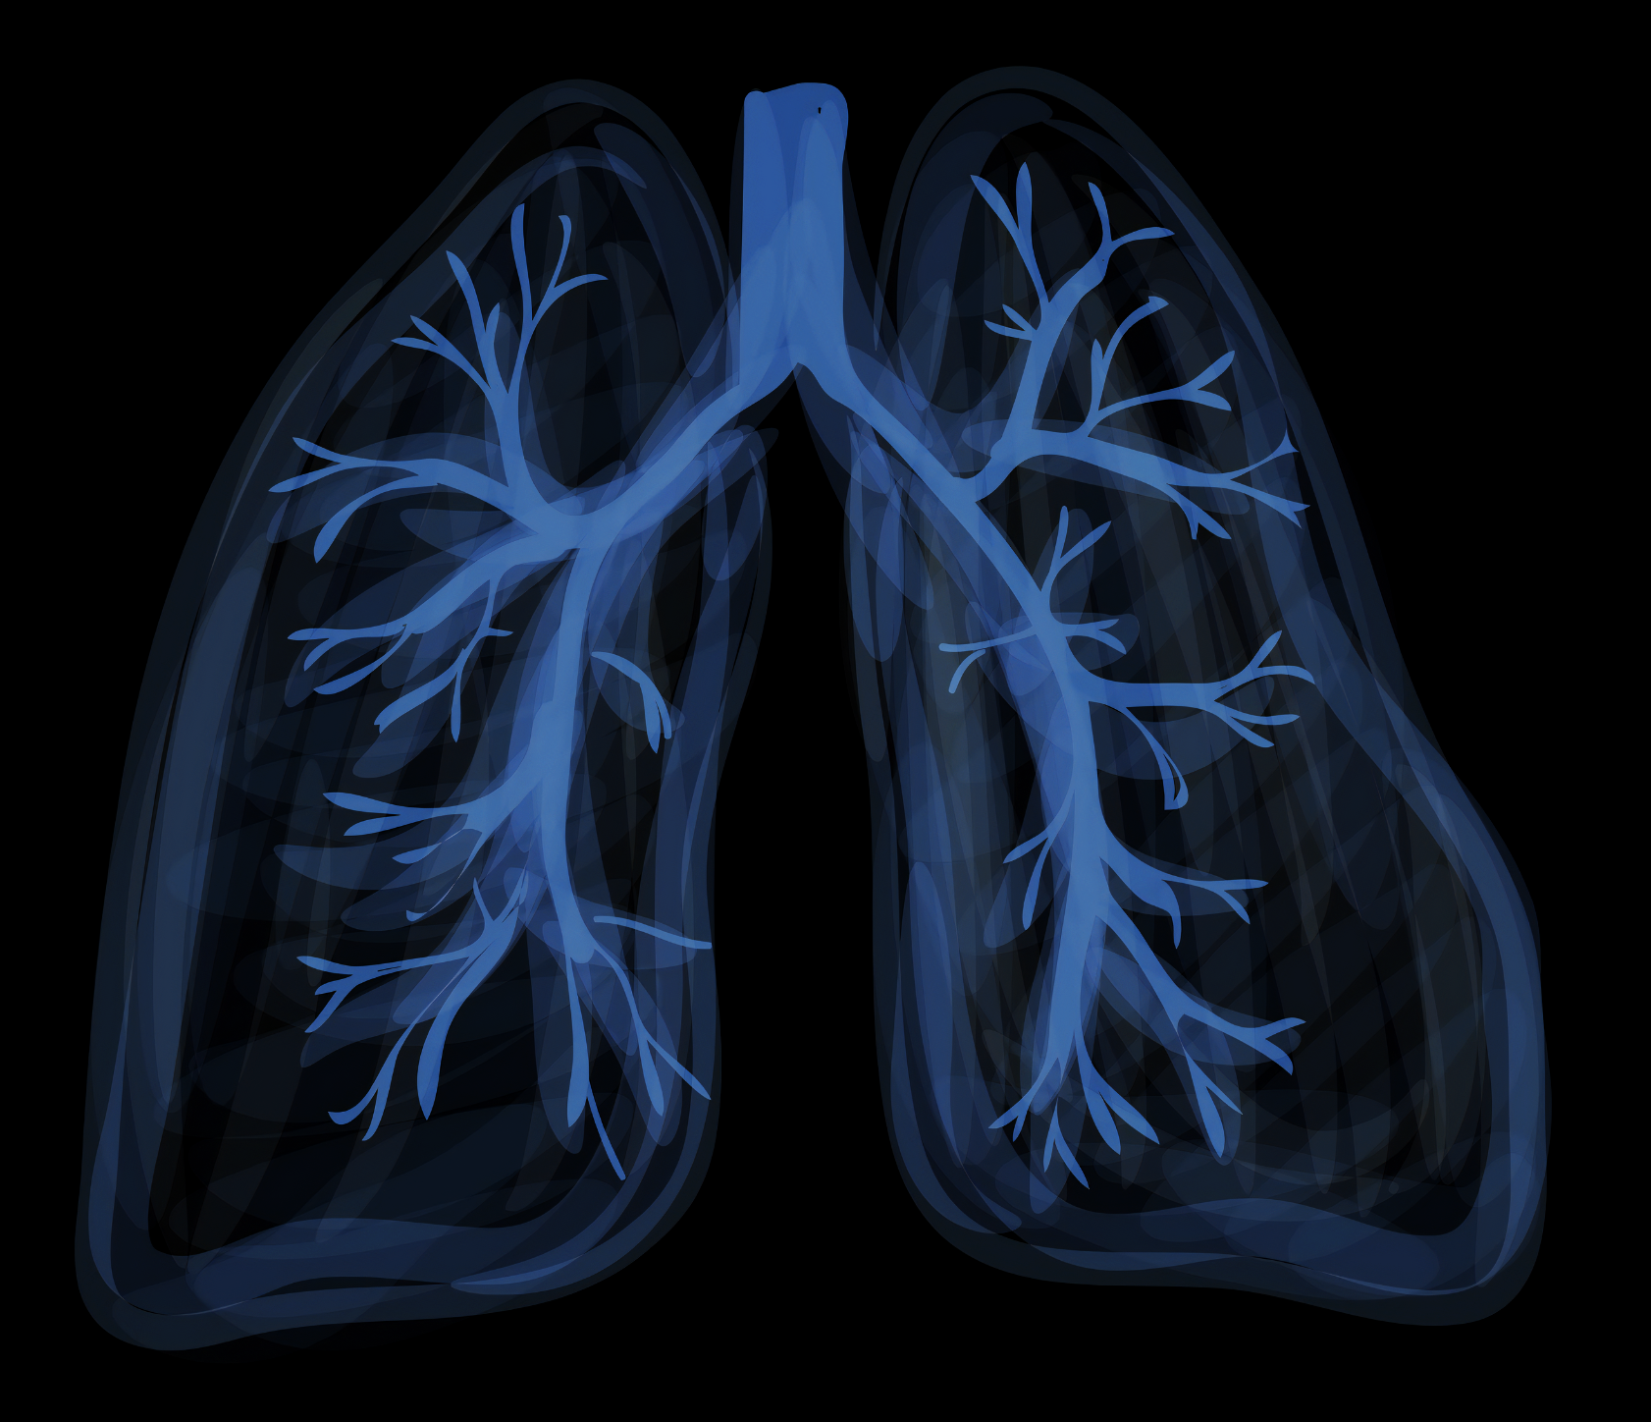
The lungs are a pair of excretory organs.
This is because they remove CO₂ from the body during exhalation.
For more help, please visit www.exampaperspractice.co.uk
© 2025 Exams Papers Practice. All Rights Reserved

Slide 7
The kidneys are a pair of excretory organs.
This is because they remove urea from the body during ultrafiltration.
For more help, please visit www.exampaperspractice.co.uk
© 2025 Exams Papers Practice. All Rights Reserved

Slide 8
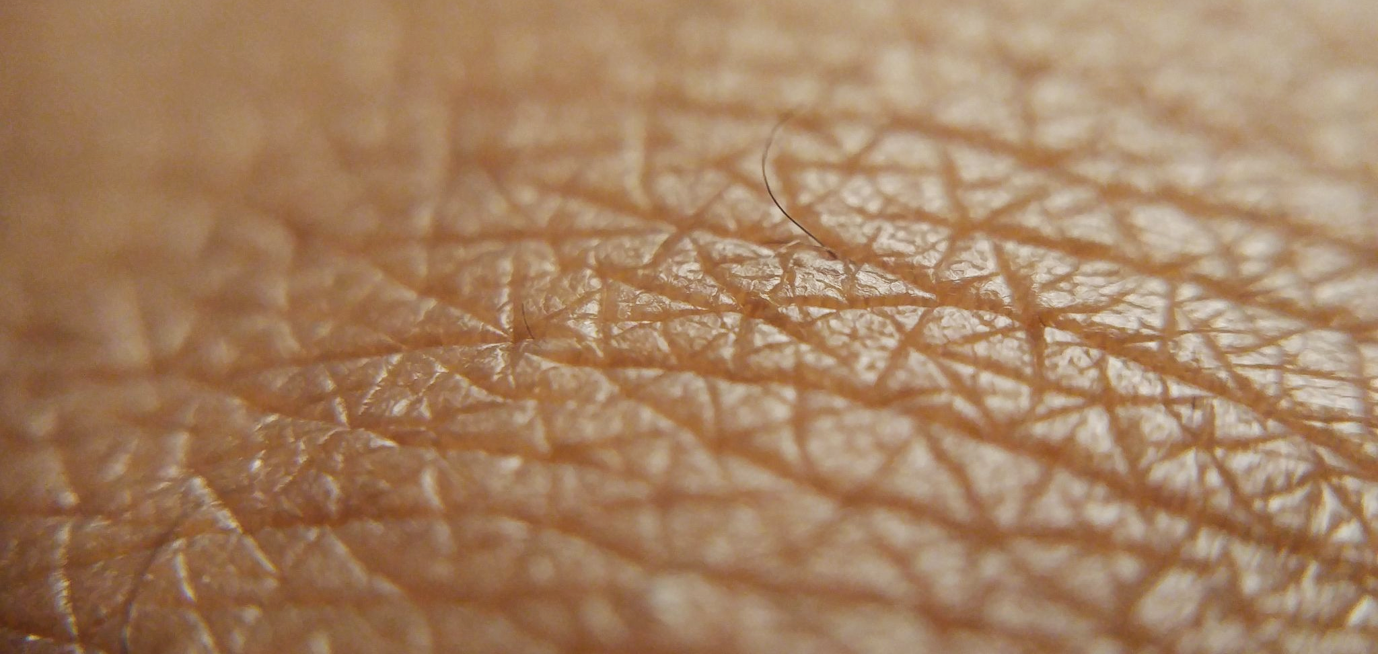
The skin is the largest organ in the human body. The skin is responsible for excreting water and salts from the body.
For more help, please visit www.exampaperspractice.co.uk
© 2025 Exams Papers Practice. All Rights Reserved

