Slide 1
Edexcel IGCSE Biology
26 - The Circulatory System
Blood Vessels and Routes
For more help, please visit www.exampaperspractice.co.uk
© 2025 Exams Papers Practice. All Rights Reserved

Slide 2
Arteries
Specification Point 2.68
Understand how the structure of arteries, veins and capillaries relate to their function.
Blood is carried inside blood vessels.
Arteries, veins and capillaries are all examples of blood vessels.
Arteries carry blood away from the heart.
Arteries mostly carry oxygenated blood around the body.
One exception is the pulmonary artery, which carries deoxygenated blood to the lungs.
Arteries have thick muscular walls.
This is to resist the high pressure created by the heart.
Arteries have a narrow lumen.
The lumen is the interior space inside a blood vessel.
For more help, please visit www.exampaperspractice.co.uk
© 2025 Exams Papers Practice. All Rights Reserved

Slide 3
NARROW
LUMEN
THICK LAYER OF MUSCLE
The structure of an artery.
Arteries carry blood away from the heart.
Arteries have thick, muscular walls to tolerate high pressures, as well as a narrow lumen.
ARTERIOLES
For more help, please visit www.exampaperspractice.co.uk
© 2025 Exams Papers Practice. All Rights Reserved

Slide 4
Veins
Veins carry blood towards the heart.
Veins mostly carry deoxygenated blood around the body.
One exception is the pulmonary vein, which carries oxygenated blood to the heart from the lungs.
Veins have a thin wall with little muscle.
The blood that is carried in veins is at a much lower pressure than the blood in arteries.
Veins have a wide lumen.
Veins also contain valves.
Due to the lower blood pressure, valves are present to prevent the backflow of blood.
For more help, please visit www.exampaperspractice.co.uk
© 2025 Exams Papers Practice. All Rights Reserved

Slide 5
VALVE
WIDE
LUMEN
THIN LAYER OF MUSCLE
The structure of a vein.
Veins carry blood towards the heart.
Veins do not contain much muscle but have much wider lumens than arteries, as well as valves to prevent the backflow of blood.
VENULES
For more help, please visit www.exampaperspractice.co.uk
© 2025 Exams Papers Practice. All Rights Reserved

Slide 6
Capillaries
Capillaries are found at the end of arteries and veins:
Arteries branch into arterioles.
Arterioles terminate at capillaries.
Veins branch into venules.
Venules also terminate at capillaries.
The exchange of substances happens at capillary beds.
O₂ and CO₂ are exchanged.
Nutrients and waste substances are also exchanged.
Capillaries are one cell thick.
This ensures that the rate of diffusion is high.
This is because there is a short diffusion pathway.
For more help, please visit www.exampaperspractice.co.uk
© 2025 Exams Papers Practice. All Rights Reserved

Slide 7
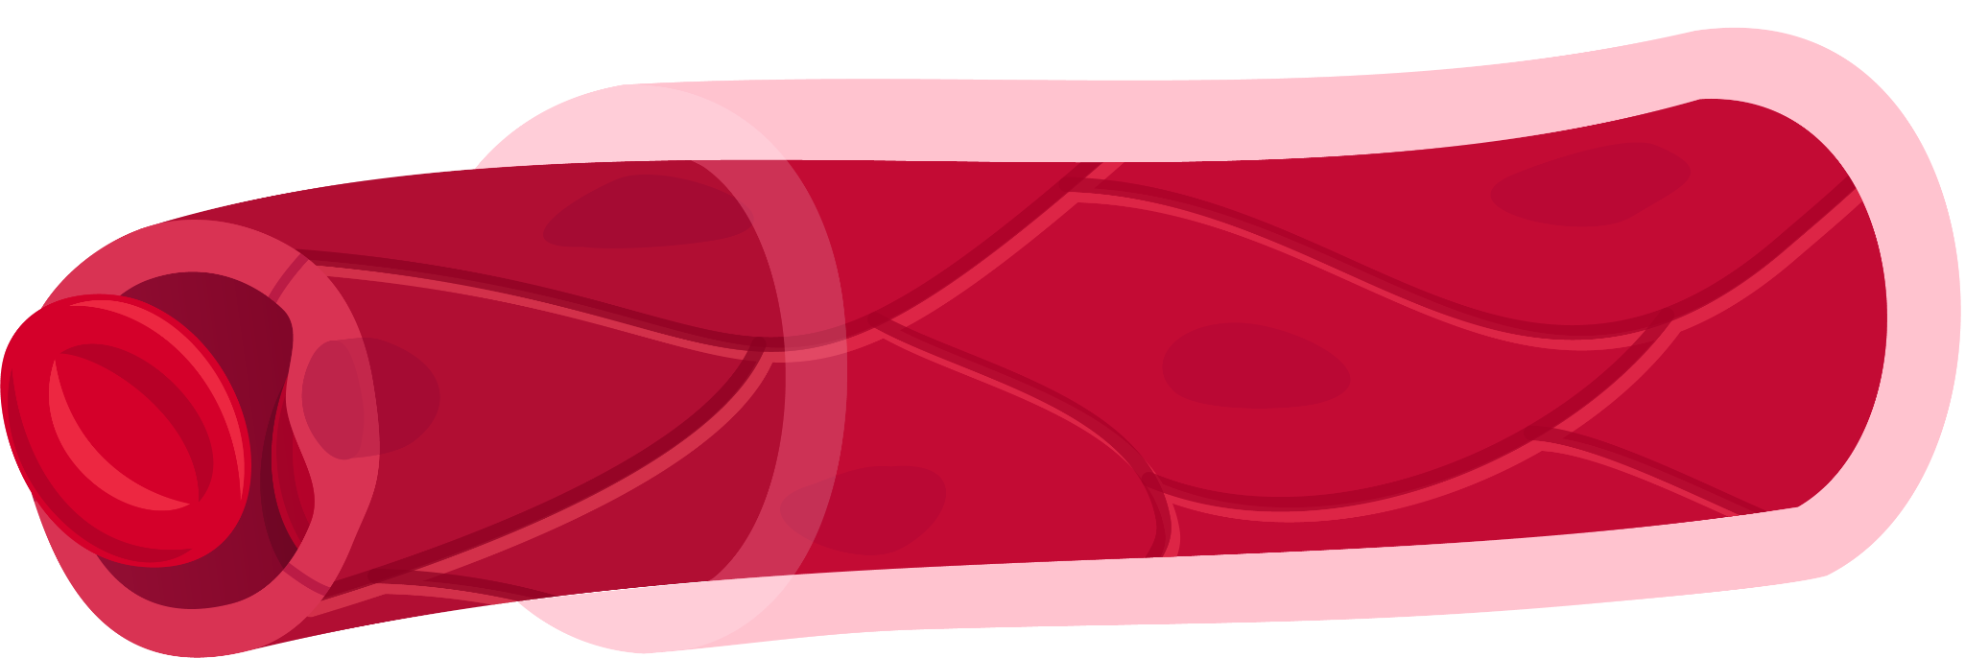
ONE CELL THICK
The structure of a capillary.
The inner lining of the capillary, sometimes referred to as the endothelium, is a single-cell in thickness.
This means the rate of diffusion of gases is extremely efficient, primarily due to the short diffusion pathway.
RED BLOOD CELL
For more help, please visit www.exampaperspractice.co.uk
© 2025 Exams Papers Practice. All Rights Reserved

Slide 8
Blood Circulation
Specification Point 2.69
Understand the general structure of the circulation system, including the blood vessels to and from the heart and lungs, liver and kidneys.
There are a number of names for the vessels supplying the major organs of the body:
The vessels that supply the heart with blood are called the coronary vessels.
The coronary vessels include the coronary artery and the coronary vein.
The vessels that supply the lungs with blood are called the pulmonary vessels.
The pulmonary vessels include the pulmonary artery and the pulmonary vein.
The vessels that supply the liver with blood are called the hepatic vessels.
The hepatic vessels include the hepatic artery, the hepatic vein and the hepatic portal vein.
The vessels that supply the kidneys with blood are called the renal vessels.
The renal vessels include the renal artery and the renal vein.
For more help, please visit www.exampaperspractice.co.uk
© 2025 Exams Papers Practice. All Rights Reserved

Slide 9
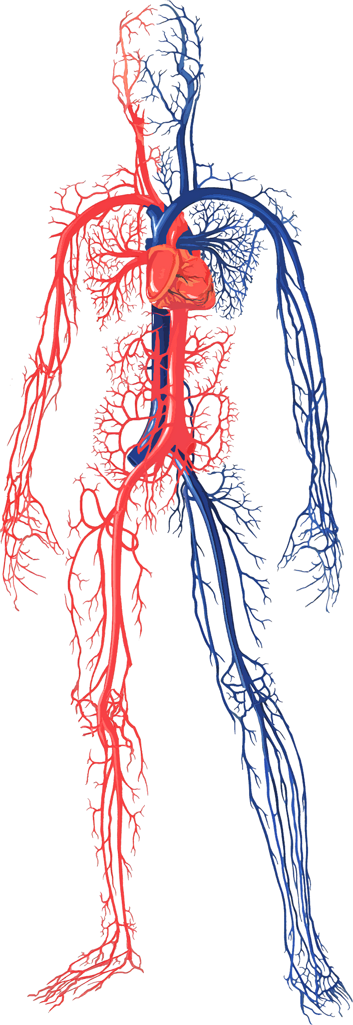
The circulatory system is a hugely complicated network of vessels.
Coordinating the circulatory system is the heart, a biological pump which ensures oxygenated and deoxygenated blood are cycled around the body.
For more help, please visit www.exampaperspractice.co.uk
© 2025 Exams Papers Practice. All Rights Reserved

Slide 10
There are major blood vessels supplying the heart (coronary), the lungs (pulmonary), the liver (hepatic) and the kidneys (renal).
For more help, please visit www.exampaperspractice.co.uk
© 2025 Exams Papers Practice. All Rights Reserved

