Slide 1
Edexcel IGCSE Biology
25 - The Heart
Structure, Function and Health
For more help, please visit www.exampaperspractice.co.uk
© 2025 Exams Papers Practice. All Rights Reserved

Slide 2
The Heart
Specification Point 2.65
Describe the structure of the heart and how it functions.
The heart is a muscular organ evolved to pump blood around the body.
Mammals have hearts with two sides and four chambers.
Some simpler organisms like fish and insects. have one or two chambered hearts.
The heart is part of a double circulatory system:
One side of the heart pumps blood to the lungs.
This is called the pulmonary circuit.
The other side of the heart pumps blood to the rest of the body.
This is called the systemic circuit.
The heart functions as a pump, moving blood through the major systems in the body.
For more help, please visit www.exampaperspractice.co.uk
© 2025 Exams Papers Practice. All Rights Reserved

Slide 3
An MRI scan of a heart beating inside a person’s chest.
An average human heart is expected to beat 2.5 billion times in a lifetime.
For more help, please visit www.exampaperspractice.co.uk
© 2025 Exams Papers Practice. All Rights Reserved

Slide 4
Atria and Ventricles
The chambers at the top of the heart are called the atria.
The atria pump blood into the chambers at the bottom of the heart, called the ventricles.
The right atrium pumps blood into the right ventricle.
The left atrium pumps blood into the left ventricle.
The right ventricle pumps blood to the lungs.
The left ventricle pumps blood to the rest of the body.
The atria and ventricles are labelled back to front on diagrams.
The heart is drawn as if it were in the chest.
The left hand of the diagram equates to the right side of the heart and vice versa.
For more help, please visit www.exampaperspractice.co.uk
© 2025 Exams Papers Practice. All Rights Reserved

Slide 5
AORTA
SUPERIOR VENA CAVA
LEFT PULMONARY ARTERIES
RIGHT PULMONARY ARTERIES
LEFT PULMONARY VEINS
RIGHT PULMONARY VEINS
LEFT ATRIUM
RIGHT ATRIUM
SEMILUNAR VALVES
The structure of the heart.
ATRIOVENTRICULAR VALVE
ATRIOVENTRICULAR VALVE
LEFT VENTRICLE
RIGHT VENTRICLE
INFERIOR VENA CAVA
For more help, please visit www.exampaperspractice.co.uk
© 2025 Exams Papers Practice. All Rights Reserved

Slide 6
The Route of Blood through the Heart
The deoxygenated blood enters through the vena cava.
Blood is pumped from the right atrium to the right ventricle.
Blood has to pass through an atrioventricular valve.
Blood is pumped from the right ventricle through the pulmonary artery to the lungs.
Blood has to pass through a semilunar valve.
Blood is oxygenated in the lungs.
The oxygenated blood returns through the pulmonary vein into the left atrium.
Blood is pumped from the left atrium to the left ventricle.
Blood is pumped through another atrioventricular valve.
Blood is pumped from the left ventricle through the aorta to the whole body.
Blood passes through another semilunar valve.
The left side of the heart is more muscular than the right side.
This is because the left side of the heart has to pump blood greater distances.
For more help, please visit www.exampaperspractice.co.uk
© 2025 Exams Papers Practice. All Rights Reserved

Slide 7
1.
Deoxygenated blood enters the vena cava.
Blood is pumped from the right atrium to the right ventricle.
Blood is pumped from the right ventricle through the pulmonary artery to the lungs.
Blood is oxygenated in the lungs.
The oxygenated blood returns through the pulmonary vein into the left atrium.
Blood is pumped from the left atrium to the left ventricle.
Blood is pumped from the left ventricle through the aorta to the whole body.
4.
4.
7.
5.
5.
2.
6.
3.
1.
7.
For more help, please visit www.exampaperspractice.co.uk
© 2025 Exams Papers Practice. All Rights Reserved

Slide 8
The Role of Valves
Valves help to prevent the backflow of blood.
The atrioventricular valves (AV) separate the atria from the ventricles.
The semilunar valves are located at the opening of the arteries.
Valves are opened when pressure increases.
When the pressure in the atria is greater than the pressure in the ventricles, the atrioventricular valves open.
When the pressure in the ventricles is greater than the pressure in the blood vessels, the semilunar valves open.
VALVE CLOSED
VALVE OPEN
For more help, please visit www.exampaperspractice.co.uk
© 2025 Exams Papers Practice. All Rights Reserved

Slide 9
The Heart and Exercise
Specification Point 2.66
Explain how the heart rate changes during exercise and under the influence of adrenaline.
Exercise increases the heart rate.
Muscles require more oxygen for aerobic respiration.
That oxygen is supplied by the bloodstream.
The flow of blood is determined by the heart rate.
Exercise also increases stroke volume.
Stroke volume is the volume of blood pumped in one heartbeat.
A more powerful contraction in the heart causes more blood to be pumped every ‘stroke’.
Exercise has the effect of increasing the heart rate.
200
EXERCISE HALTED
150
100
HEART RATE (BPM) →
50
0
TIME →
For more help, please visit www.exampaperspractice.co.uk
© 2025 Exams Papers Practice. All Rights Reserved

Slide 10
Exercise also increases the stroke volume of the heart. This is essentially a measure of how strongly the heart is beating.
Athletes such as cyclists tend to have highly developed heart muscle and, therefore, large stroke volumes.
STROKE VOLUME (ml) →
TIME →
For more help, please visit www.exampaperspractice.co.uk
© 2025 Exams Papers Practice. All Rights Reserved

Slide 11
Measuring Heart Rate
Heart rate can be estimated by measuring pulse rate.
The heartbeat will cause the walls of arteries to ‘pulse’ at the same rate.
A pulse can taken by holding two fingers to the neck or the wrist.
The change in heart rate due to exercise can be measured in the following way:
Take a resting pulse for 1 minute.
Run for 2 minutes at maximum effort.
Take the pulse again.
The pulse will take several minutes to return to normal.
In order to breakdown lactic acid, oxygen is required.
This is referred to as the oxygen debt.
For more help, please visit www.exampaperspractice.co.uk
© 2025 Exams Papers Practice. All Rights Reserved

Slide 12
The heart rate of an individual can be estimated by taking their pulse, either from vessels in the wrist or the neck.
One way to quickly estimate the heart rate is to measure the pulse for 10 seconds and then multiply this value by 6.
For more help, please visit www.exampaperspractice.co.uk
© 2025 Exams Papers Practice. All Rights Reserved

Slide 13
Adrenaline
Adrenaline is a hormone that is released during exercise or stress.
Adrenaline is responsible for the ‘fight or flight’ system in the body.
Adrenaline increases both heart rate and stroke volume.
More oxygen is supplied to tissues for respiration.
More energy is released in the form of ATP.
Blood is also redirected from other organs.
Blood is diverted from the digestive system during periods of intense exercise.
Adrenaline is a protein-based hormone that increases the heart rate, as well as having a number of other wider effects on the body.
For more help, please visit www.exampaperspractice.co.uk
© 2025 Exams Papers Practice. All Rights Reserved

Slide 14
Heart Disease
Specification Point 2.67
Understand how factors may increase the risk of developing coronary heart disease.
As a muscle, the heart requires its own oxygen supply.
Oxygen is provided to the heart by the coronary arteries.
The coronary arteries are easily blocked.
Fatty substances including cholesterol can deposit on the walls of the coronary arteries.
Deposits of cholesterol can harden to form plaque.
Plaque can cut off the blood supply to the cardiac muscle.
The symptoms associated with plaque buildup are referred to as coronary heart disease (CHD).
In severe cases CHD can lead to a heart attack.
Fatty deposits of cholesterol on the walls of coronary arteries can lead to a number of health issues, including CHD.
For more help, please visit www.exampaperspractice.co.uk
© 2025 Exams Papers Practice. All Rights Reserved

Slide 15
Cholesterol and other fatty substances can also embed themselves into the heart muscle itself.
This will reduce the effectiveness of the heart and may eventually lead to a heart attack.
For more help, please visit www.exampaperspractice.co.uk
© 2025 Exams Papers Practice. All Rights Reserved

Slide 16
Risk Factors for CHD
Several risk factors can make the likelihood of developing CHD more likely:
Some people are genetically predisposed to heart disease.
Heart disease runs in families and can be carried through generations.
A poor diet can increase the risk of heart disease.
Diets that are high in cholesterol and saturated fats are linked to an increased risk of developing CHD.
A stressful lifestyle can increase the risk of heart disease.
Stress releases hormones like adrenaline and cortisol.
These increase blood pressure, which may damage the walls of arteries.
Those who smoke are at an increased risk of heart disease.
Cigarettes contain nicotine, a chemical which increases blood pressure.
Nicotine also makes the formation of blood clots more likely.
For more help, please visit www.exampaperspractice.co.uk
© 2025 Exams Papers Practice. All Rights Reserved

Slide 17
A diet high in cholesterol and saturated fats has been strongly linked to CHD.
For more help, please visit www.exampaperspractice.co.uk
© 2025 Exams Papers Practice. All Rights Reserved

Slide 18
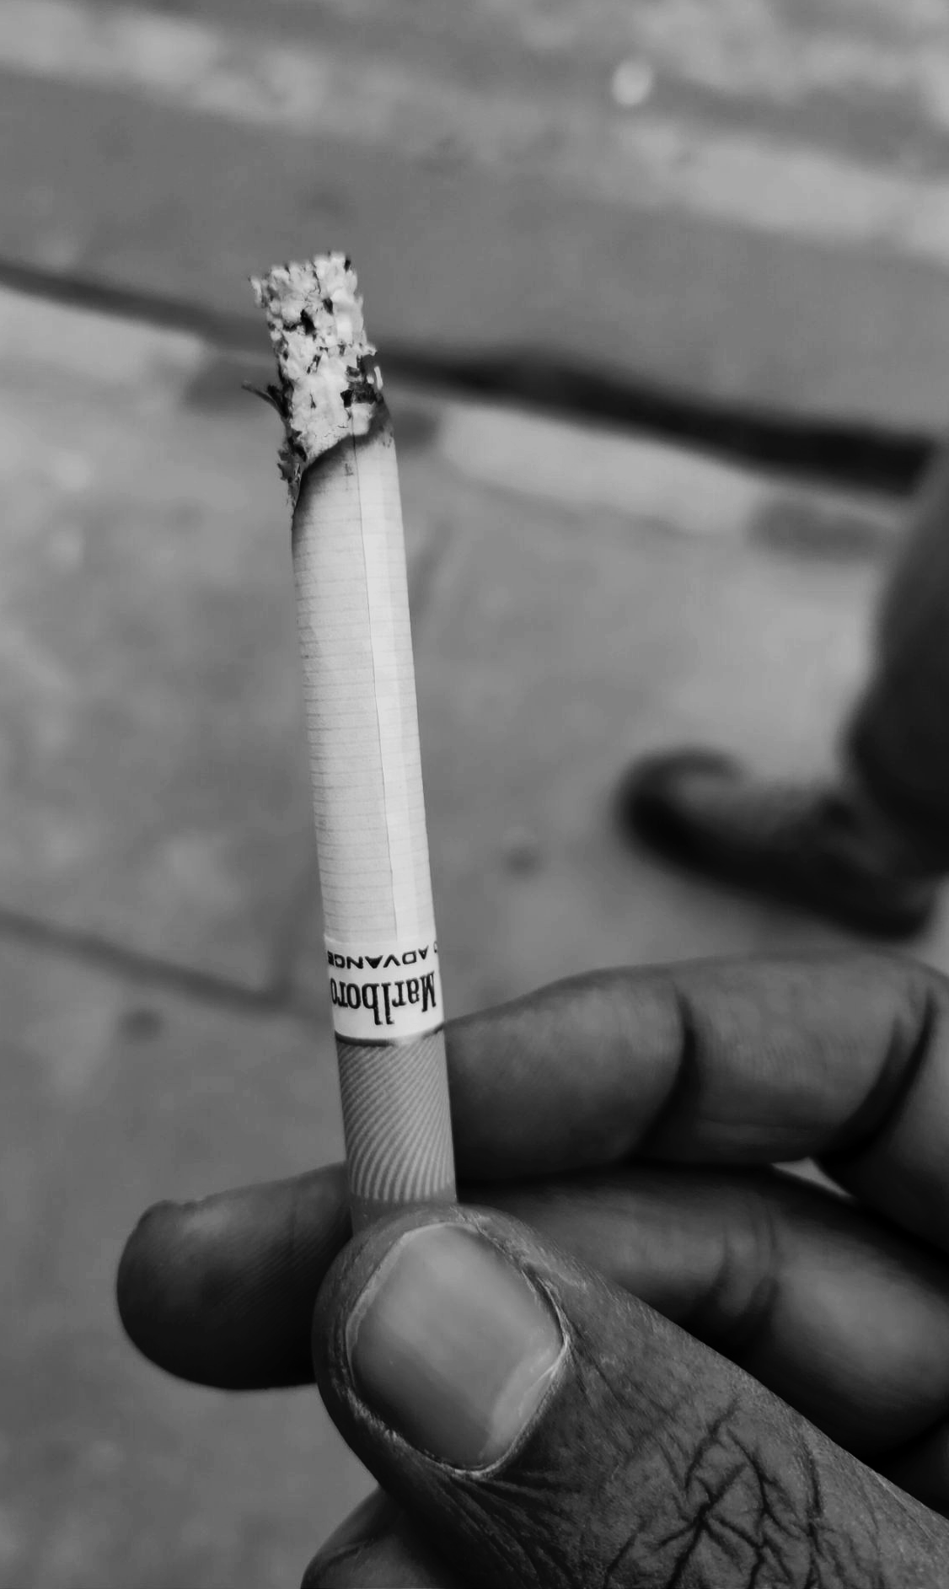
There is an overwhelmingly strong positive correlation between the number of cigarettes smoked by an individual each year and their mortality rate from CHD.
CIGARETTE CONSUMPTION PER YEAR →
300
200
DEATHS FROM CHD PER 100,000 →
100
0
1,500
2,000
2,500
3,000
3,500
4,000
For more help, please visit www.exampaperspractice.co.uk
© 2025 Exams Papers Practice. All Rights Reserved

