Slide 1
Edexcel IGCSE Biology
20 - The Alveoli and Lung Disease
Alveolar Adaptations and the Consequences of Smoking
For more help, please visit www.exampaperspractice.co.uk
© 2025 Exams Papers Practice. All Rights Reserved

Slide 2
The Alveoli
Specification Point 2.48
Explain how alveoli are adapted for gas exchange by diffusion between air in the lungs and blood in capillaries.
Gas exchange in the lungs takes place inside structures called alveoli.
Alveoli are small sacs found at the end of bronchioles.
O₂ diffuses from the alveoli into the blood.
CO₂ diffuses from the blood into the alveoli.
ALVEOLAR SACS
Gas exchange in the lungs takes place inside microscopic sacs called alveoli.
For more help, please visit www.exampaperspractice.co.uk
© 2025 Exams Papers Practice. All Rights Reserved

Slide 3
Alveolar Adaptations
The alveoli are adapted for efficient gas exchange:
Alveoli have a very high surface area to volume ratio (SA:V).
A high SA:V allows gases to diffuse very quickly.
The walls of an alveolus is one cell thick.
Having very thin walls creates a very short diffusion pathway.
This means that O₂ and CO₂ can move quickly through structures.
Alveoli have an excellent blood supply.
Having a good blood supply means CO₂ is quickly removed from the blood and O₂ is quickly moved into the blood.
This ensures that a concentration gradient is maintained.
The surface an alveolus is moist.
Gases like CO₂ and O₂ dissolve more easily in liquids.
For more help, please visit www.exampaperspractice.co.uk
© 2025 Exams Papers Practice. All Rights Reserved

Slide 4
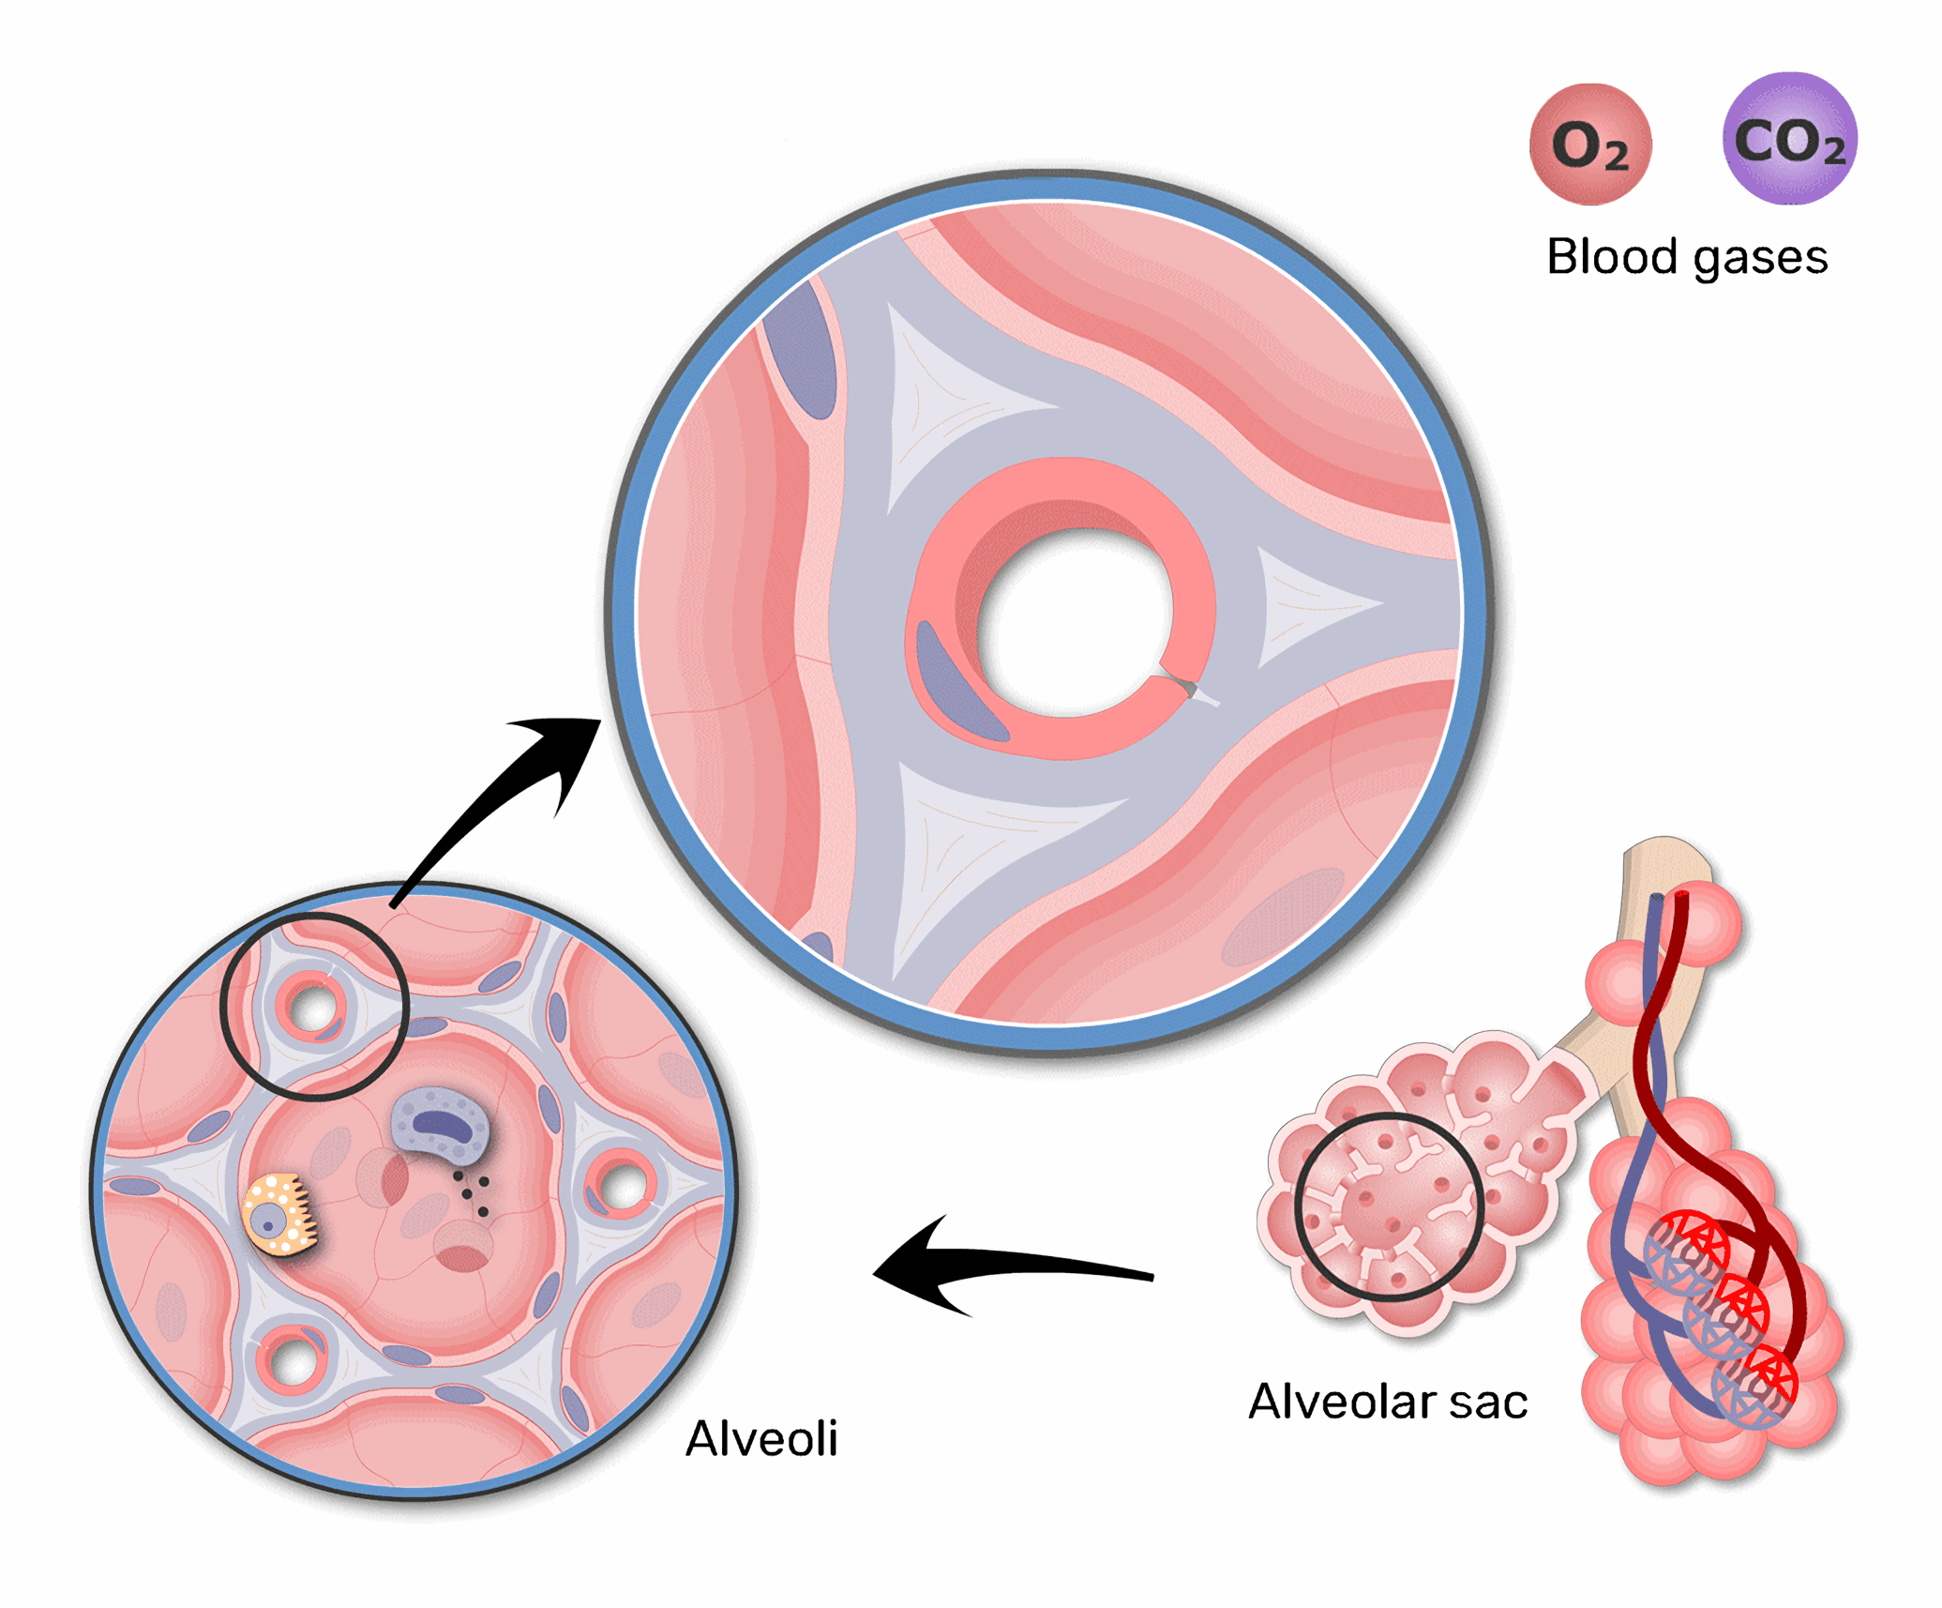
Alveoli are extremely well-adapted for gas exchange.
CO₂ diffuses out of the bloodstream into the alveoli.
O₂ diffuses into the bloodstream out of the alveoli.
For more help, please visit www.exampaperspractice.co.uk
© 2025 Exams Papers Practice. All Rights Reserved

Slide 5
Smoking
Specification Point 2.49
Understand the biological consequences of smoking in relation to the lungs and the circulatory system.
Smoking cigarettes has a number of long term health consequences.
There are several compounds found in cigarettes that are harmful:
A brown sticky substance called tar is deposited into the lungs.
Tar is considered to be a carcinogen.
This means tar increases the risk of cancer.
Smoking releases a gas called carbon monoxide (CO) into the lungs.
Carbon monoxide is a highly poisonous gas.
Carbon monoxide reduces the ability of the blood to carry oxygen.
Cigarettes also contain a drug called nicotine.
Nicotine is not toxic but it is highly addictive.
Nicotine can increase the resting heart rate and narrow the blood vessels.
This can increase blood pressure.
For more help, please visit www.exampaperspractice.co.uk
© 2025 Exams Papers Practice. All Rights Reserved

Slide 6
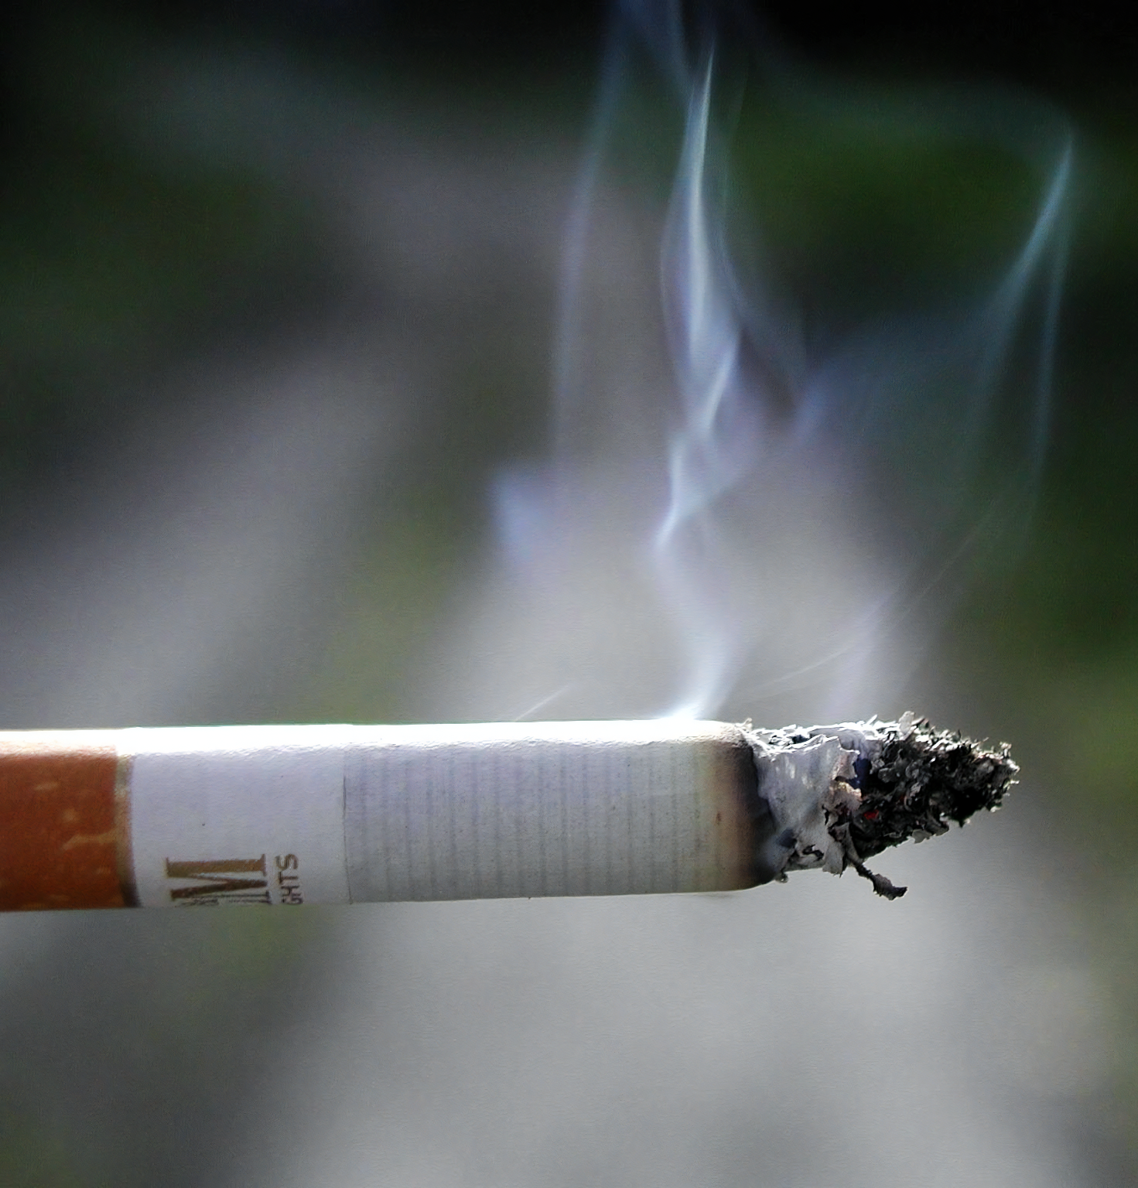
Smoking has a number of long term health consequences.
This is primarily due to the large number of toxic compounds that are present in cigarettes.
For more help, please visit www.exampaperspractice.co.uk
© 2025 Exams Papers Practice. All Rights Reserved

Slide 7
Bronchitis
Cells in the lungs produce mucus in the respiratory tract to trap dirt and pathogens.
These cells are called ciliated cells.
Tar binds to ciliated cells and makes them non-functional.
This leads to a build up of mucus containing both dirt and bacteria.
Tar makes infection of the airways more likely.
One common infection from smoking is called bronchitis.
The main symptom of bronchitis is a chronic cough that brings up mucus.
A lung with bronchitis is inflamed and infected, leading to a chronic, mucus-filled cough.
For more help, please visit www.exampaperspractice.co.uk
© 2025 Exams Papers Practice. All Rights Reserved

Slide 8
Lung Cancer
Cigarettes contain many carcinogenic compounds:
A cigarette contains approximately 100 µg of arsenic.
A cigarette contains approximately 60 µg of benzene.
A cigarette contains approximately 6 µg of formaldehyde.
A cigarette contains approximately 2 µg of lead.
Carcinogens are chemicals that cause cells to mutate.
Mutations can lead to the formation of a cancerous tumour.
Cigarette smoking is linked to around 85% of deaths from lung cancer.
There is an extremely strong correlation between cigarette consumption and lung cancer.
For more help, please visit www.exampaperspractice.co.uk
© 2025 Exams Papers Practice. All Rights Reserved

Slide 9
Smoking cigarettes and other tobacco products is linked to over 80% of deaths by lung cancer.
TUMOUR
For more help, please visit www.exampaperspractice.co.uk
© 2025 Exams Papers Practice. All Rights Reserved

Slide 10
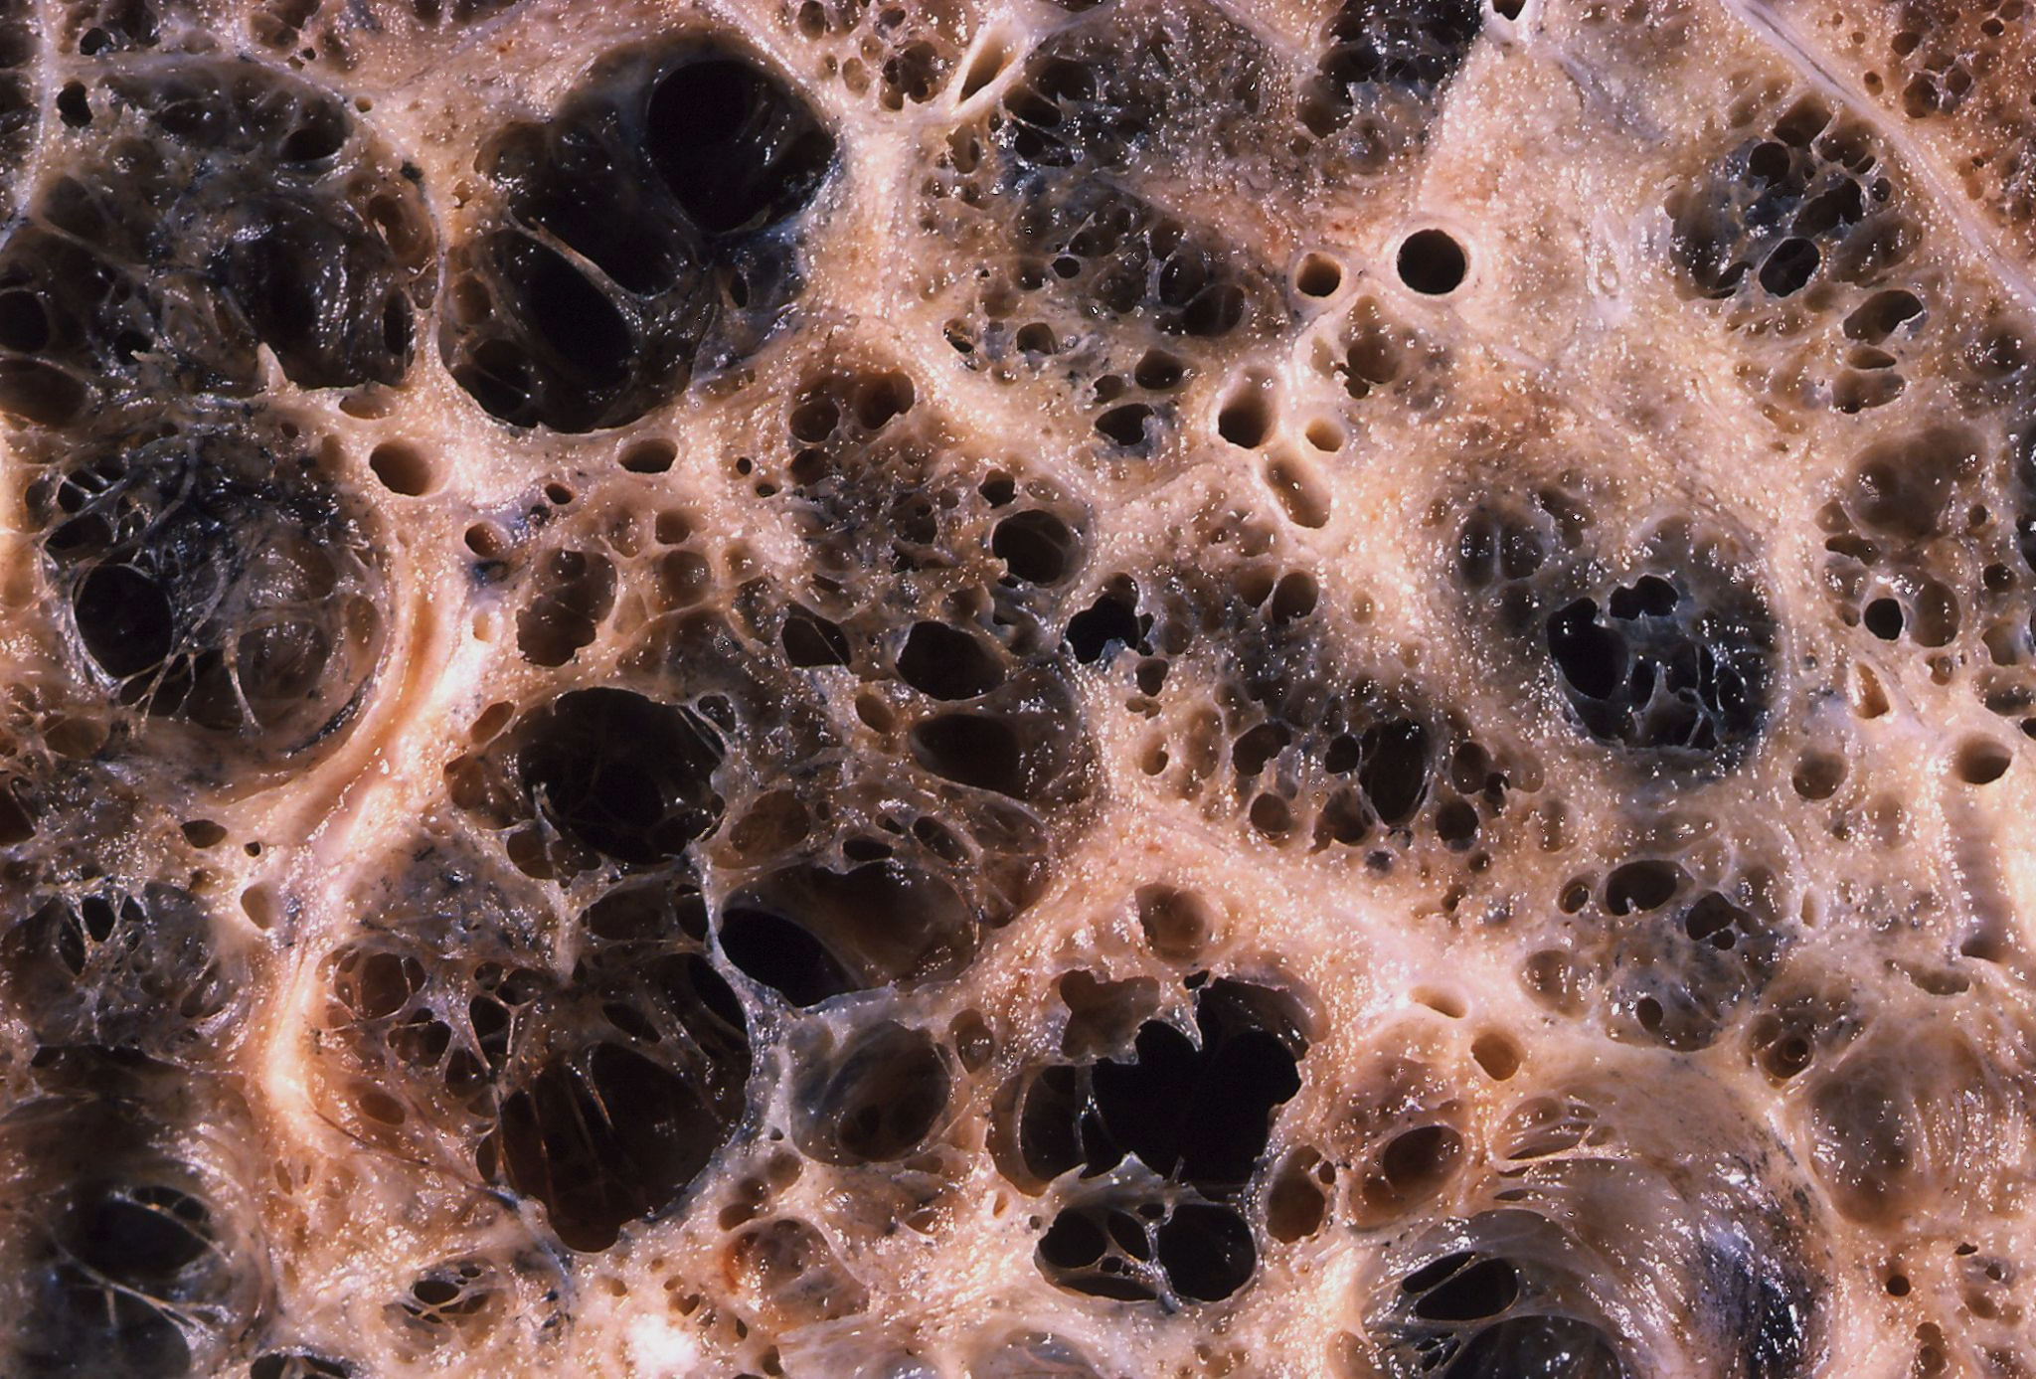
Emphysema
The alveoli that populate the lungs are delicate.
Smoking causes the alveoli to lose elasticity.
Smoking also causes scar tissue to form in the alveoli.
Smoking reduces the SA:V of the alveoli.
Gas exchange becomes less efficient.
This means that less energy is released into cells.
This may lead to tiredness and shortness of breath.
Emphysema leads to the formation of scar tissue in the lungs.
For more help, please visit www.exampaperspractice.co.uk
© 2025 Exams Papers Practice. All Rights Reserved

Slide 11
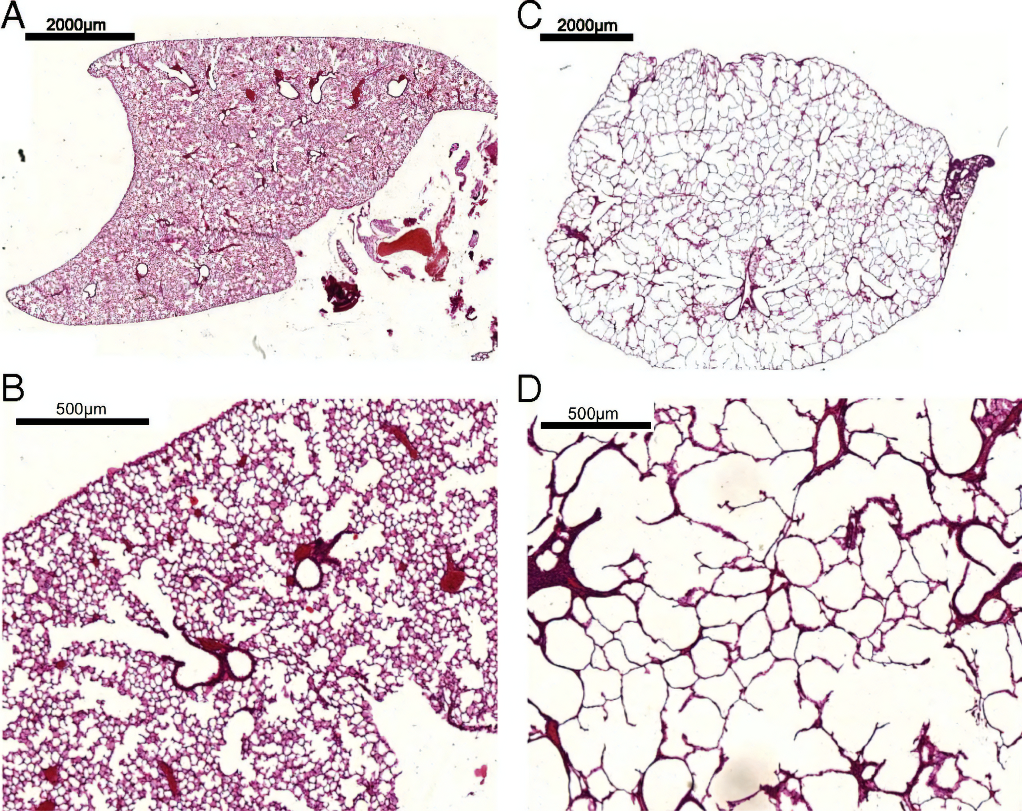
The patient on the left (A and B) of the image has a healthy lung. The patient on the right (C and D) is suffering from emphysema.
Note the reduction in the number of alveoli, and therefore the efficiency of gas exchange.
For more help, please visit www.exampaperspractice.co.uk
© 2025 Exams Papers Practice. All Rights Reserved

Slide 12
Widespread Health Implications of Smoking
As well as the lungs, smoking has consequences for the rest of the body:
Nicotine narrows the blood vessels.
This leads to increased blood pressure.
It also leads to increased blood cholesterol.
Cells in the heart receive less oxygen.
This increases the likelihood of anaerobic respiration in the heart muscle.
Lactic acid forms, leading to an acidic environment.
Enzymes denature, causing the death of heart muscle.
Carbon monoxide (CO) binds to haemoglobin.
This reaction forms carboxyhaemoglobin, reducing the carrying capacity of the blood.
A lack of free haemoglobin further increases blood pressure.
For more help, please visit www.exampaperspractice.co.uk
© 2025 Exams Papers Practice. All Rights Reserved

Slide 13
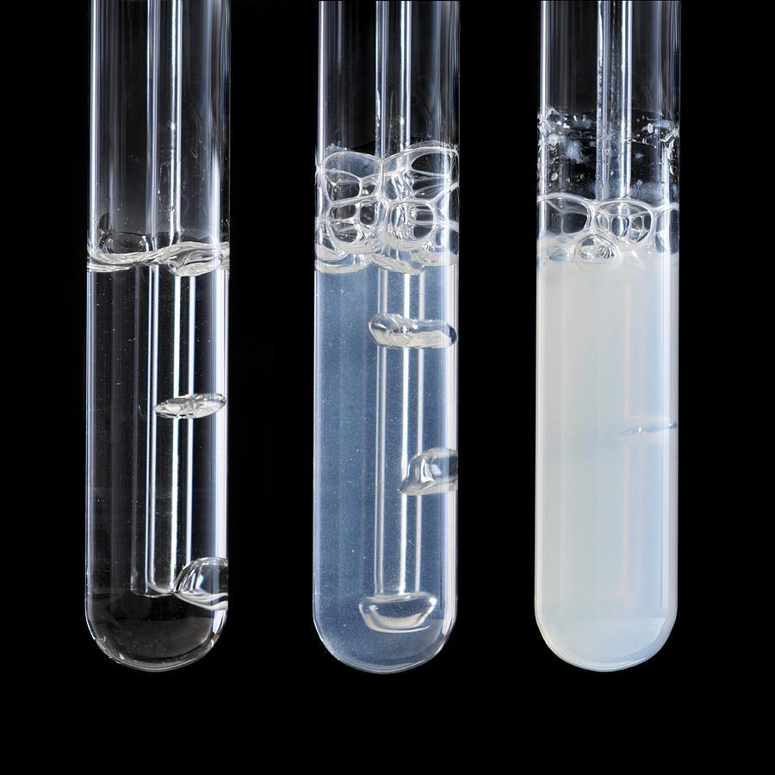
Investigating the Release of CO₂
Specification Point 2.50
Practical: Investigate breathing in humans, including the release of carbon dioxide and the effect of exercise.
The test for CO₂ is called the limewater test.
The presence of CO₂ will cause the limewater to turn cloudy.
Limewater test video.
Individuals should breathe through a straw into a solution containing limewater.
Individuals should aim to exhale for as long as possible to ensure the limewater turns cloudy.
TIME →
Exhaling into a test tube containing limewater will confirm the presence of CO₂.
For more help, please visit www.exampaperspractice.co.uk
© 2025 Exams Papers Practice. All Rights Reserved

Slide 14
Investigating The Rate of Ventilation
The ventilation rate of an individual increases during exercise.
The ventilation rate of an individual can be calculated as number of breaths per minute.
During exercise, muscles require more energy.
Energy is required in the form of ATP.
In order for the rate of respiration to increase, more O₂ is required.
O₂ is supplied by a higher ventilation rate.
This change in ventilation rate can be investigated using a simple experiment:
Measure the ventilation rate at rest.
Most healthy individuals have a ventilation rate of around 12 breaths per minute.
Run at maximum effort for as long as possible.
Measure the breathing rate immediately after exercise.
Continue to measure the breathing rate every minute until it returns to the level at rest.
For more help, please visit www.exampaperspractice.co.uk
© 2025 Exams Papers Practice. All Rights Reserved

Slide 15
TIME (MINS) →
60
A simple experiment can be devised to measure how exercise can affect ventilation rate.
Healthier individuals will tend to have a lower peak ventilation rate, as well as a faster rate of recovery.
40
VENTILATION RATE (BREATHS/MIN) →
20
10
0
-5
0
5
10
15
For more help, please visit www.exampaperspractice.co.uk
© 2025 Exams Papers Practice. All Rights Reserved

