Slide 1


Edexcel IGCSE Biology
1 - Characteristics of Living Organisms
For more help, please visit www.exampaperspractice.co.uk
© 2025 Exams Papers Practice. All Rights Reserved

Slide 2
Characteristics of Living Organisms
Specification Point 1.1
  Understand how living organisms share certain characteristics.
All living organisms share certain characteristics.
All eight of these characteristics have to be present to consider an organism as living:
  Movement.
  Respiration.
  Sensitivity.
  Homeostasis.
  Growth.
  Reproduction.
  Excretion.
  Nutrition.
This is often memorised using the mnemonic Mrs. H Gren.
For more help, please visit www.exampaperspractice.co.uk
© 2025 Exams Papers Practice. All Rights Reserved

Slide 3
Movement
Animals move their entire bodies to get from one place to another.
  Many animals will move rapidly to get to their prey.
Plants can also move their leaves in response to sunlight or their roots in response to gravity.
  This will allow plants to move efficiently photosynthesise.
  It will also allow plants to reach mineral ions in the soil more easily.
The cheetah is the world's fastest land mammal and can reach speeds of up to 70 mph.
For more help, please visit www.exampaperspractice.co.uk
© 2025 Exams Papers Practice. All Rights Reserved

Slide 4
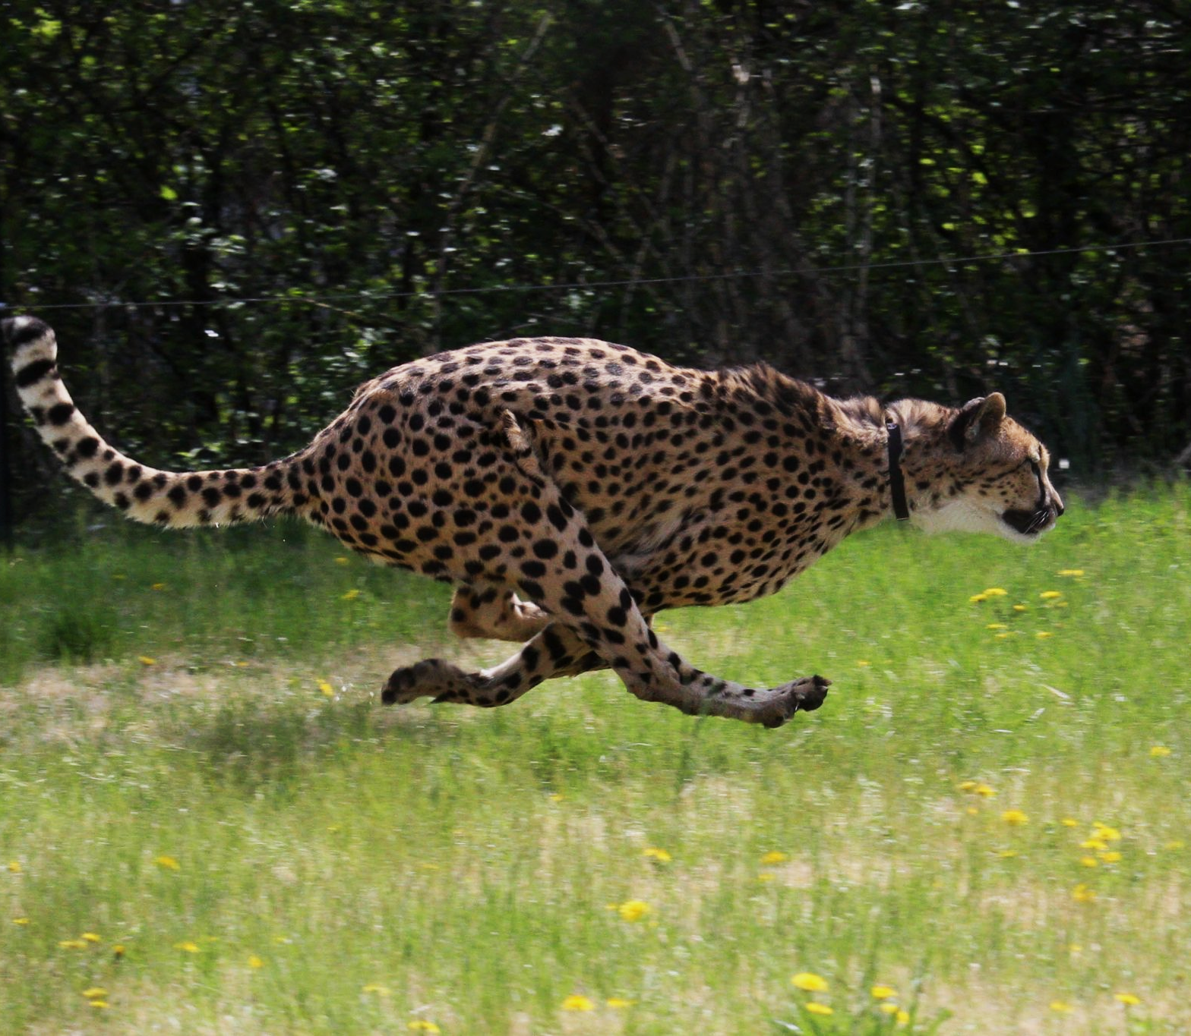
Movement is key to life. The cheetah will move at speeds upwards of 70 mph to catch its prey.
For more help, please visit www.exampaperspractice.co.uk
© 2025 Exams Papers Practice. All Rights Reserved

Slide 5
Plants move towards light for photosynthesis.
For more help, please visit www.exampaperspractice.co.uk
© 2025 Exams Papers Practice. All Rights Reserved

Slide 6
Respiration
Plants and animals use oxygen from the air to convert glucose into energy.
  This is referred to as the process of aerobic respiration.
This energy is then used for a variety of life processes, including:
  Movement.
  Growth.
  Excretion.
  Reproduction.
There is an equation for aerobic respiration:
OXYGEN + GLUCOSE → CARBON DIOXIDE + WATER + ENERGY
For more help, please visit www.exampaperspractice.co.uk
© 2025 Exams Papers Practice. All Rights Reserved

Slide 7
Respiration releases energy which is used for a variety of other metabolic processes.
For more help, please visit www.exampaperspractice.co.uk
© 2025 Exams Papers Practice. All Rights Reserved

Slide 8

Sensitivity
All living things respond to changes.
  These changes are referred to as stimuli.
Living things have the capability to detect these changes through receptors.
  Plants notice changes in season.
  Animals notice changes in temperature and pressure.
These organisms then react accordingly.
  Plants may lose their leaves when the weather gets colder.
  Animals may change their internal biochemistry or seek shelter to get warm.
The human hand contains millions of receptors in the fingertips which can detect different stimuli.
For more help, please visit www.exampaperspractice.co.uk
© 2025 Exams Papers Practice. All Rights Reserved

Slide 9
Homeostasis
Sometimes referred to in textbooks as control, this is the ability to regulate the internal conditions of the body.
  Animals have a nervous system and a hormonal system which allows for coordinated responses.
  Some plants have hormone-like chemicals which work in the same way.
Homeostasis ensures that conditions in the body remain constant.
  This ensures that molecules like enzymes can work as efficiently as possible.
Many hormones that are important for homeostasis are produced in glands found in the brain.
For more help, please visit www.exampaperspractice.co.uk
© 2025 Exams Papers Practice. All Rights Reserved

Slide 10
Growth
Growth is an increase of cell size, cell number or cell complexity.
  Babies grow into infants, infants into adolescents and adolescents into adults.
  In botany, seedlings grow into plants.
Growth is important as it increases the likelihood of survival.
  An adult animal for example is more able to defend itself against attack than an infant.
It takes approximately 20 years for a human to fully develop into an adult.
For more help, please visit www.exampaperspractice.co.uk
© 2025 Exams Papers Practice. All Rights Reserved

Slide 11
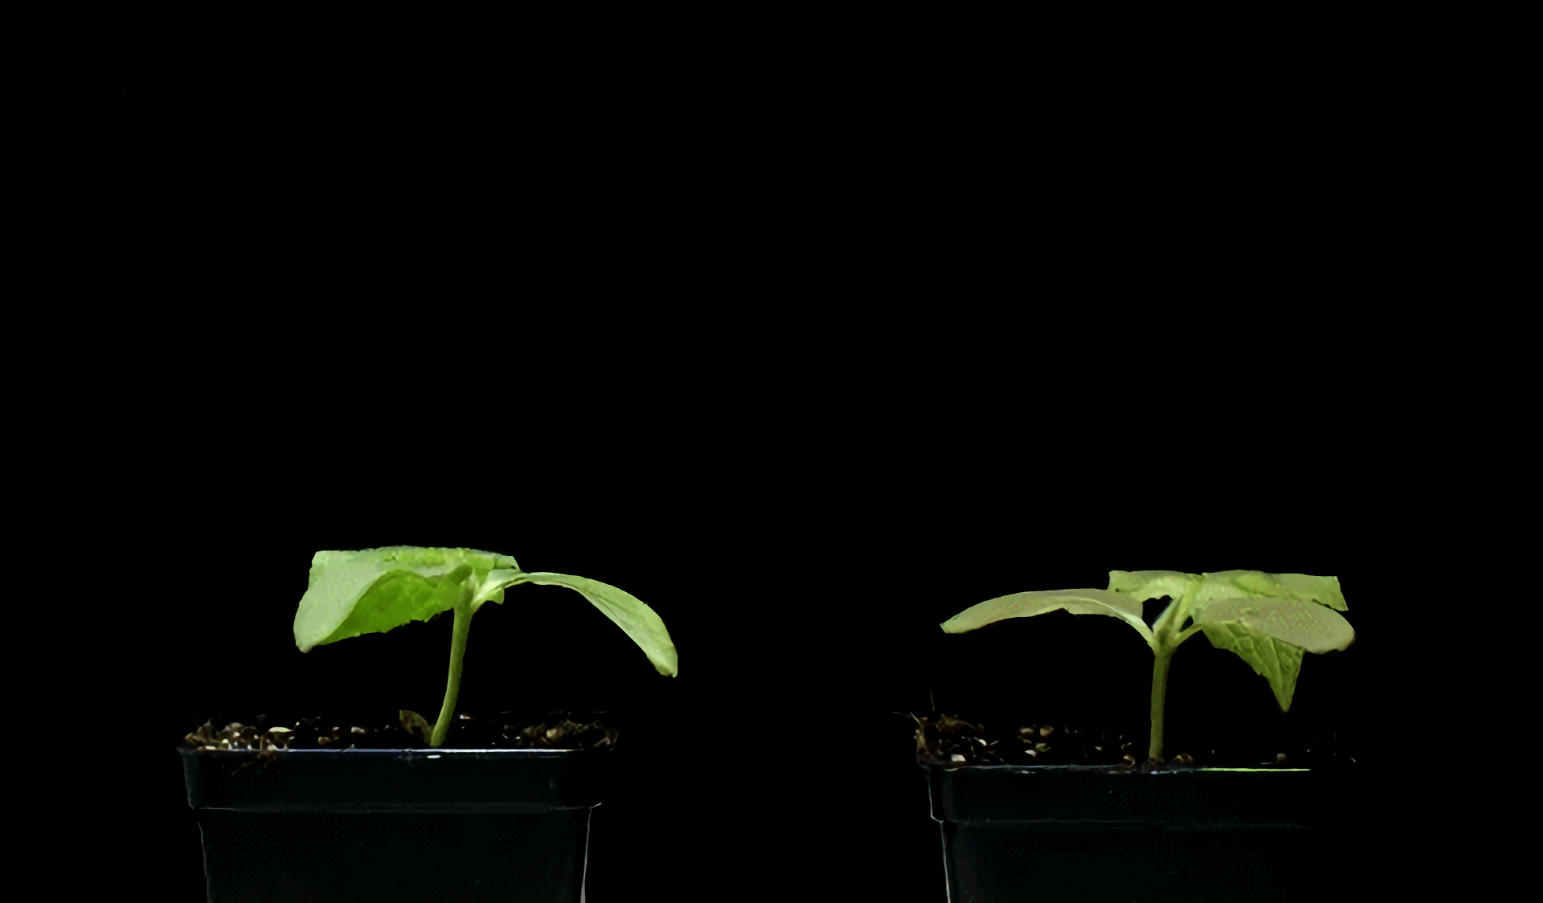
As plants grow their stems will get longer.
For more help, please visit www.exampaperspractice.co.uk
© 2025 Exams Papers Practice. All Rights Reserved

Slide 12
Reproduction
All living organisms reproduce.
Animals either use sexual or asexual reproduction to produce offspring
  Mammals reproduce sexually.
  Some animals (mostly amphibians) and all bacteria reproduce asexually.
Plants use pollination or self-fertilization to produce offspring.
Reproduction ensures that a species does not become extinct.
  The survivability of a species is ensured through reproduction.
Many plants use pollinators like bees to fertilise and reproduce.
For more help, please visit www.exampaperspractice.co.uk
© 2025 Exams Papers Practice. All Rights Reserved

Slide 13
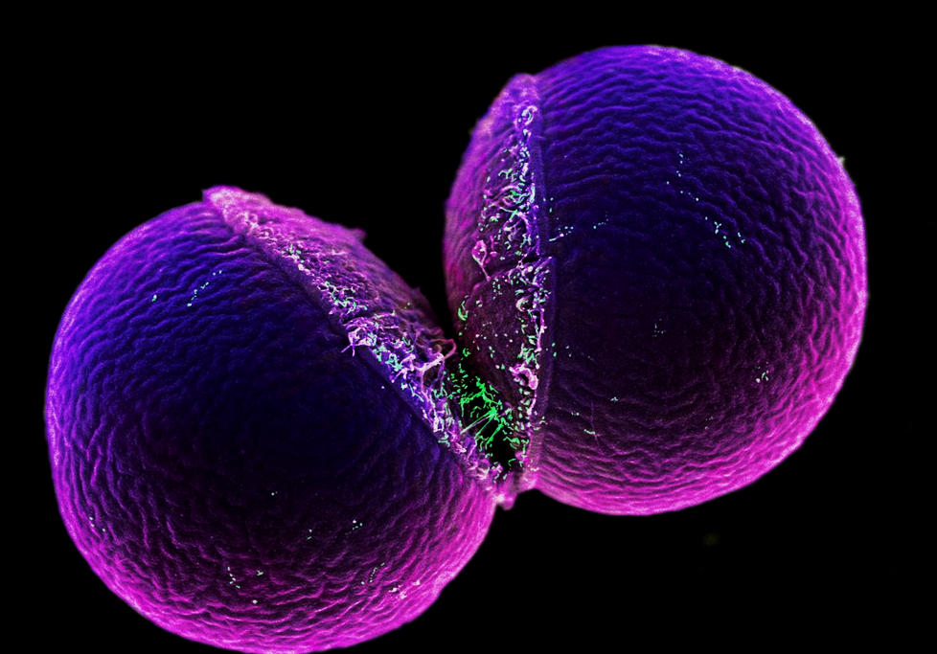
Bacteria reproduce by a kind of asexual reproduction referred to as binary fission.
For more help, please visit www.exampaperspractice.co.uk
© 2025 Exams Papers Practice. All Rights Reserved

Slide 14
Excretion
As a consequence of metabolic processes, the body will build up waste chemicals.
These have to be removed from the body to prevent toxic build-up:
  Both plants and animals have mechanisms to accomplish this.
The kidneys in mammals and the stomata in plants are good examples of excretory organs.
  The kidneys remove excess urea in the form of urine.
  The stomata remove excess oxygen from photosynthesis.
The kidneys are an important excretory organ that filter toxins out of the bloodstream.
For more help, please visit www.exampaperspractice.co.uk
© 2025 Exams Papers Practice. All Rights Reserved

Slide 15
Nutrition
Energy is needed for growth and repair of the body.
  A growing organism will require energy to develop new cells.
  Cells can also become damaged or can wear out over time.
  Energy is used to repair or replace these cells.
Nutrients (food) are used to provide this energy:
  Animals derive energy from eating.
    This is referred to as heterotrophy.
    Some eat other animals (carnivores), some eat plants (herbivores).
  Plants create their own food source using photosynthesis.
    This is referred to as autotrophy.
Many animals are part of nutrient food chains.
For more help, please visit www.exampaperspractice.co.uk
© 2025 Exams Papers Practice. All Rights Reserved

Slide 16
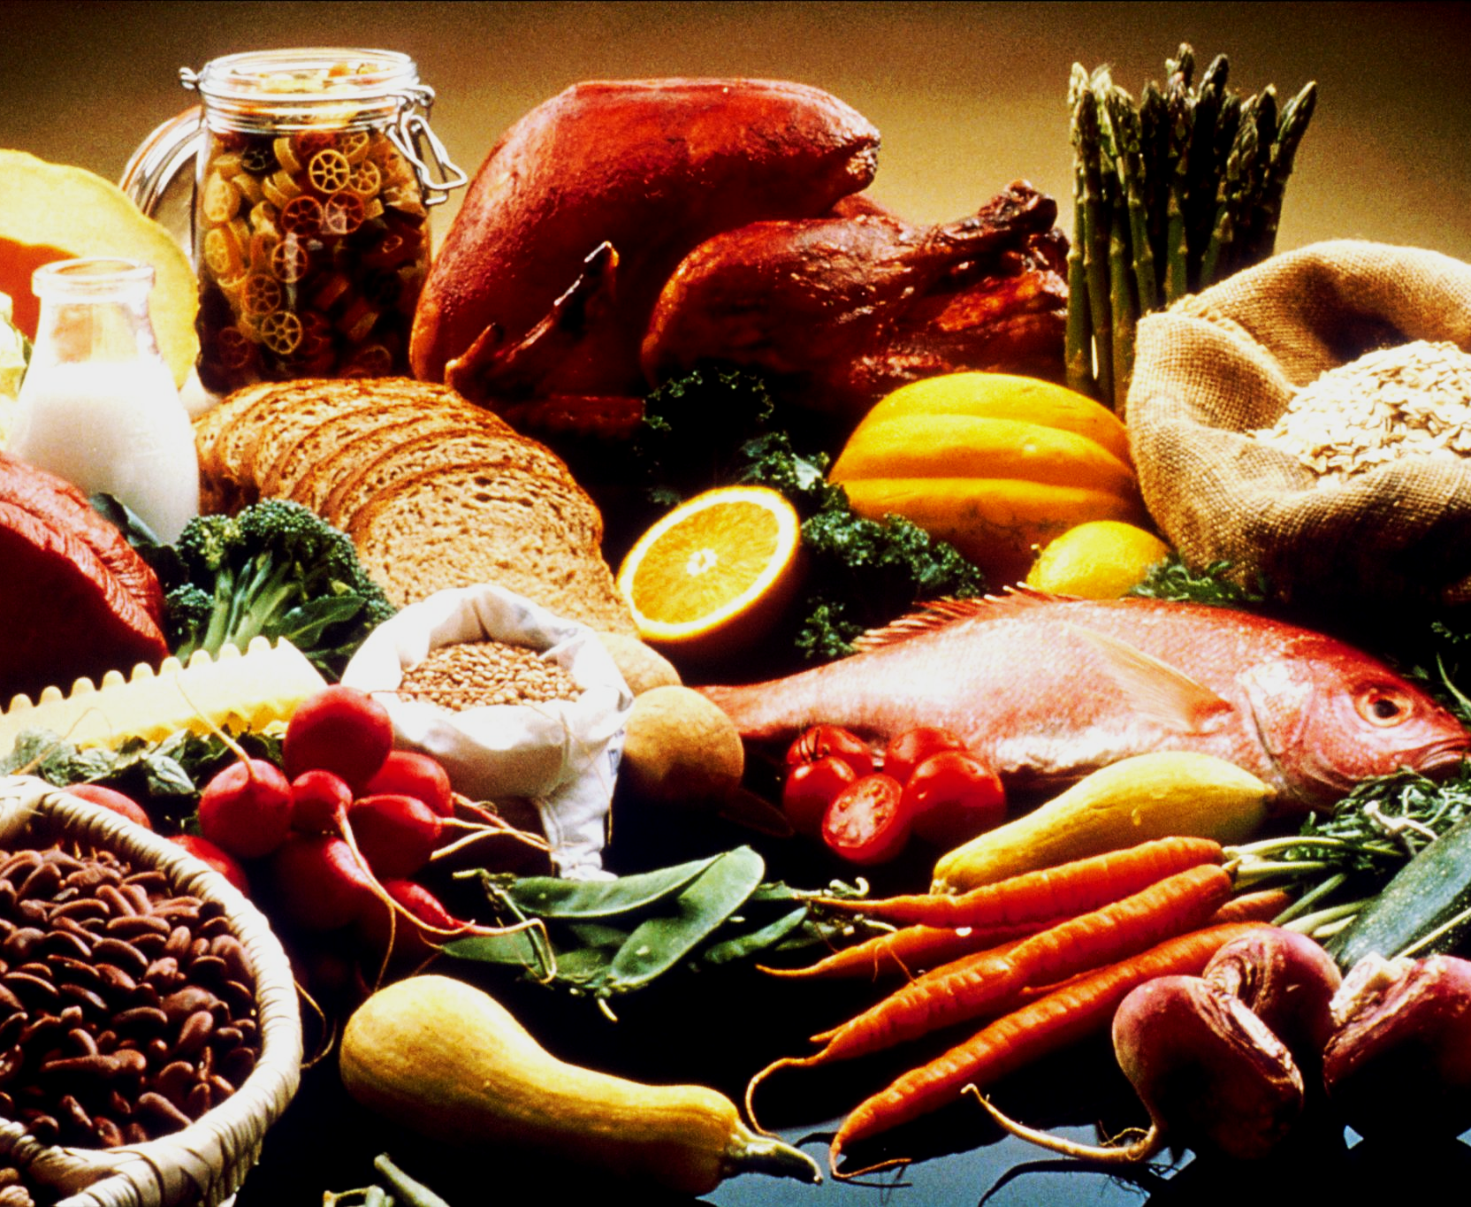
Humans should eat a balanced diet of fruit and vegetables for optimum nutrition.
For more help, please visit www.exampaperspractice.co.uk
© 2025 Exams Papers Practice. All Rights Reserved

