Slide 1
Edexcel IGCSE Biology
17 - Respiration
Aerobic and Anaerobic Energy Release, Experiments
For more help, please visit www.exampaperspractice.co.uk
© 2025 Exams Papers Practice. All Rights Reserved

Slide 2
Respiration
Specification Points 2.34 and 2.35
Understand how the process of respiration produces ATP in living organisms.
Know that ATP provides energy for cells.
Respiration releases energy from glucose (C₆H₁₂O₆).
Energy is required for a number of vital processes in the body:
Energy is required for cell division.
Energy is required for active transport.
Energy is required to synthesise proteins.
Energy is required for homeostasis.
Aerobic respiration takes place in the mitochondria.
Anaerobic respiration takes place in the cytoplasm.
For more help, please visit www.exampaperspractice.co.uk
© 2025 Exams Papers Practice. All Rights Reserved

Slide 3
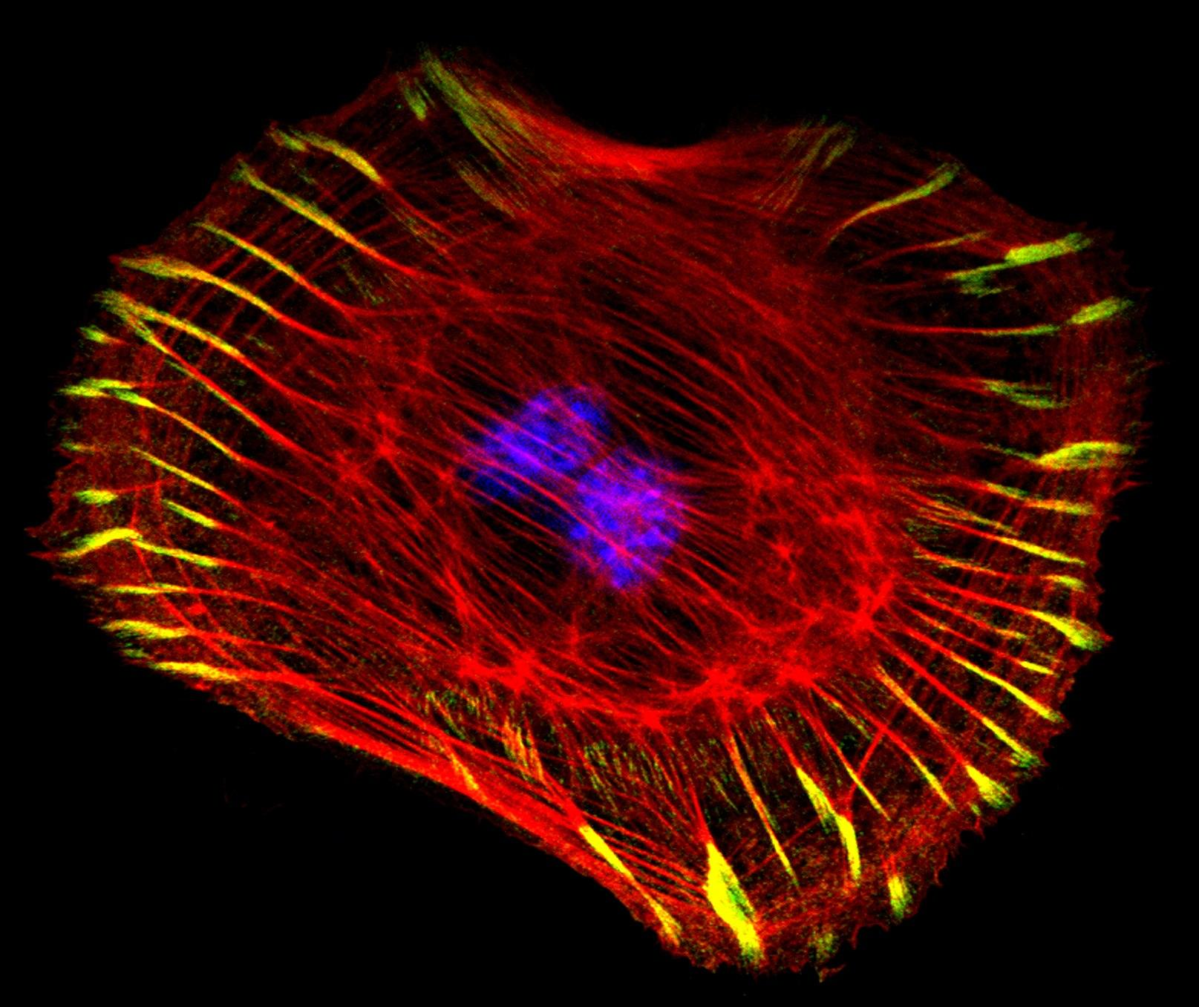
Processes like cell division require lots of energy.
This energy is derived from respiration.
For more help, please visit www.exampaperspractice.co.uk
© 2025 Exams Papers Practice. All Rights Reserved

Slide 4
Aerobic respiration takes place inside mitochondria.
For more help, please visit www.exampaperspractice.co.uk
© 2025 Exams Papers Practice. All Rights Reserved

Slide 5
CYTOPLASM
Anaerobic respiration takes place inside the fluid cytoplasm of a cell.
For more help, please visit www.exampaperspractice.co.uk
© 2025 Exams Papers Practice. All Rights Reserved

Slide 6
Respiration and ATP
The energy released from respiration is stored in a molecule called adenosine triphosphate (ATP).
ATP provides energy for cellular processes quickly and efficiently.
ATP is broken down into a molecule called ADP.
This reaction releases a small amount of energy.
ATP
ADP
The energy in ATP is stored in three phosphate bonds. One of these bonds is broken, releasing a small amount of energy.
When the phosphate bond is broken, a molecule of ADP is formed.
For more help, please visit www.exampaperspractice.co.uk
© 2025 Exams Papers Practice. All Rights Reserved

Slide 7
Aerobic Respiration
Specification Points 2.36 and 2.37
Describe the differences between aerobic and anaerobic respiration.
Know the word equation and the balanced chemical symbol equation for aerobic respiration in living organisms.
Aerobic respiration requires oxygen (O₂) to occur.
Aerobic respiration releases lots of energy for every glucose molecule that is broken down:
Aerobic respiration produces lots of ATP.
GLUCOSE + OXYGEN → CARBON DIOXIDE + WATER
C₆H₁₂O₆ + 6O₂ → 6CO₂ + 6H₂O
For more help, please visit www.exampaperspractice.co.uk
© 2025 Exams Papers Practice. All Rights Reserved

Slide 8
Aerobic respiration produces a slow, steady release of energy.
Aerobic respiration is ideal for long periods of low-intensity exercise, such as jogging.
For more help, please visit www.exampaperspractice.co.uk
© 2025 Exams Papers Practice. All Rights Reserved

Slide 9
Anaerobic Respiration in Mammals
Specification Point 2.38
Know the word equation for anaerobic respiration in plants and in animals.
Anaerobic respiration does not require oxygen to occur.
It releases a small amount of ATP for every molecule of glucose.
In mammals, glucose is converted into lactic acid and a little energy:
Anaerobic respiration releases a small amount of ATP for every glucose molecule.
GLUCOSE → LACTIC ACID
Lactic acid build up leads to muscle fatigue and cramp.
After exercise, lactic acid needs to be broken down.
This requires oxygen and is referred to as the oxygen debt.
For more help, please visit www.exampaperspractice.co.uk
© 2025 Exams Papers Practice. All Rights Reserved

Slide 10
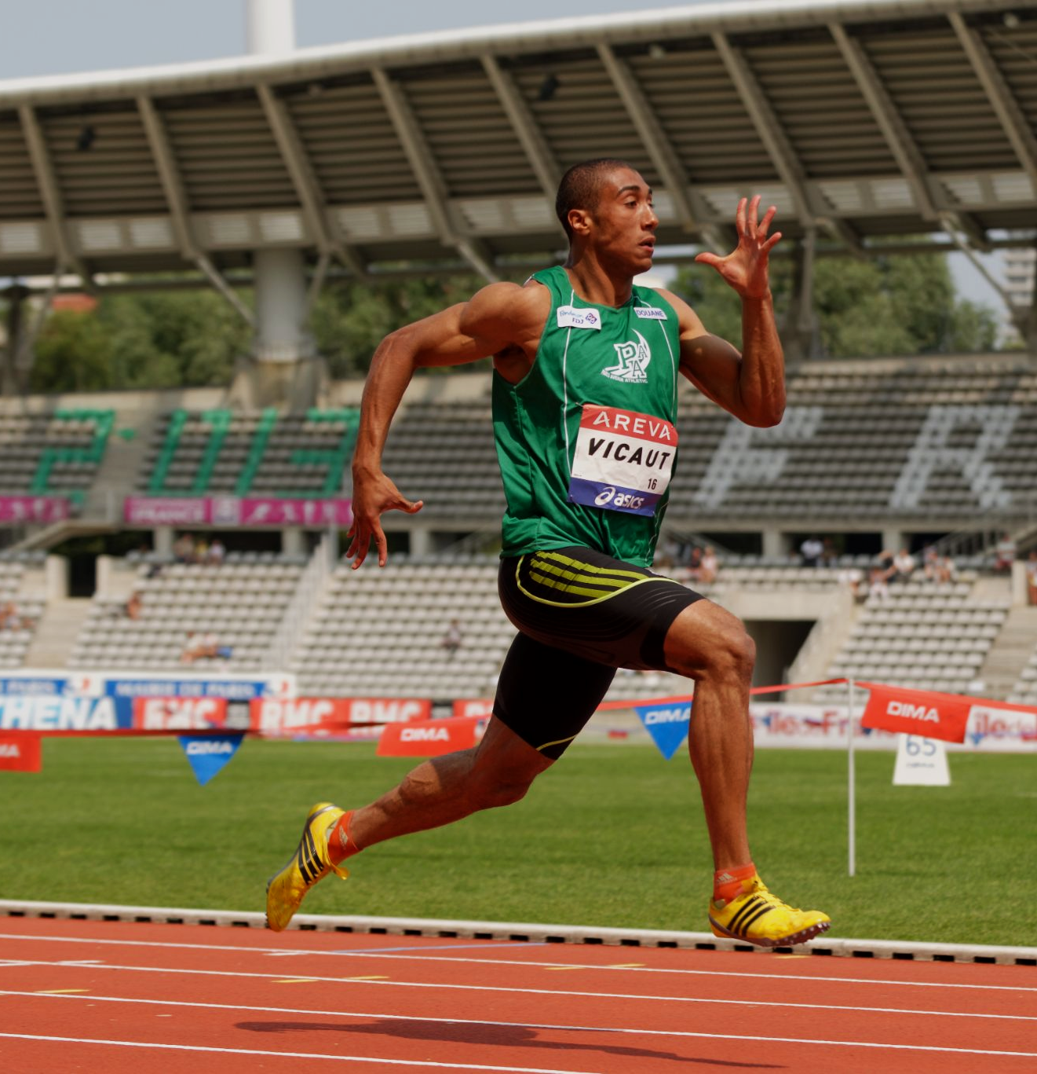
Anaerobic respiration is a simple reaction and produces energy very quickly.
Anaerobic respiration is ideal for short periods of high-intensity exercise, such as sprinting.
High-intensity activity is unsustainable, partly due to the buildup of lactic acid during anaerobic respiration, which leads to muscle cramping.
For more help, please visit www.exampaperspractice.co.uk
© 2025 Exams Papers Practice. All Rights Reserved

Slide 11
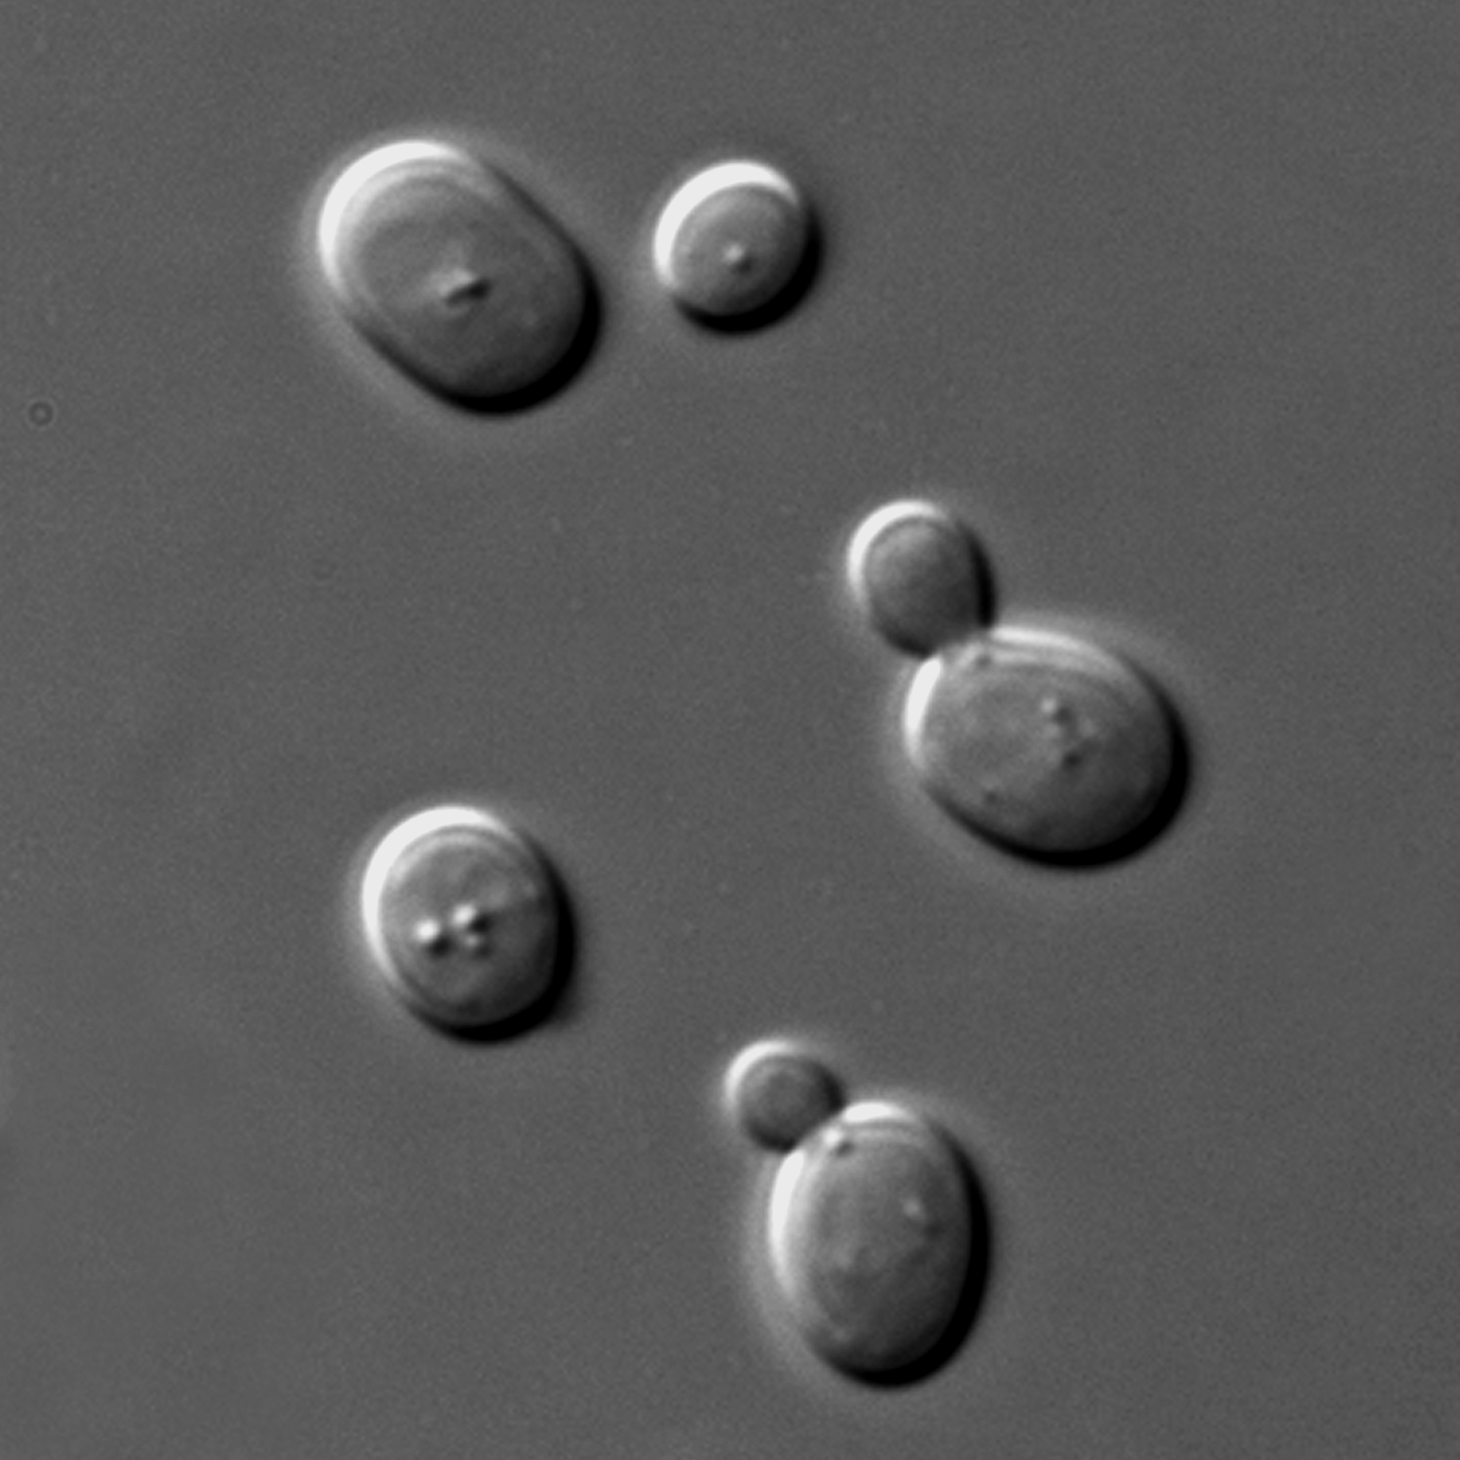
Anaerobic Respiration in Plants and Yeast
Anaerobic respiration also occurs in other organisms.
In plants and yeast, glucose is broken down into ethanol and carbon dioxide (CO₂).
Anaerobic respiration in mammals does not produce CO₂.
Anaerobic respiration in plants and yeast is often referred to as alcoholic fermentation:
GLUCOSE → ETHANOL + CARBON DIOXIDE
Anaerobic respiration in yeast creates both ethanol and CO₂.
For more help, please visit www.exampaperspractice.co.uk
© 2025 Exams Papers Practice. All Rights Reserved

Slide 12
Respiration and CO₂ Production
Specification Point 2.39
Practical: investigate the evolution of carbon dioxide and heat from respiring seeds or other suitable living organisms.
Aerobic respiration releases CO₂.
The test for CO₂ is called the limewater test.
When CO₂ is bubbled through limewater it will turn cloudy.
Limewater test video.
Living organisms can be used to demonstrate CO₂ production.
For ethical reasons this organism must be relatively simple.
Germinating seeds or maggots are often used to demonstrate the production of CO₂.
For more help, please visit www.exampaperspractice.co.uk
© 2025 Exams Papers Practice. All Rights Reserved

Slide 13
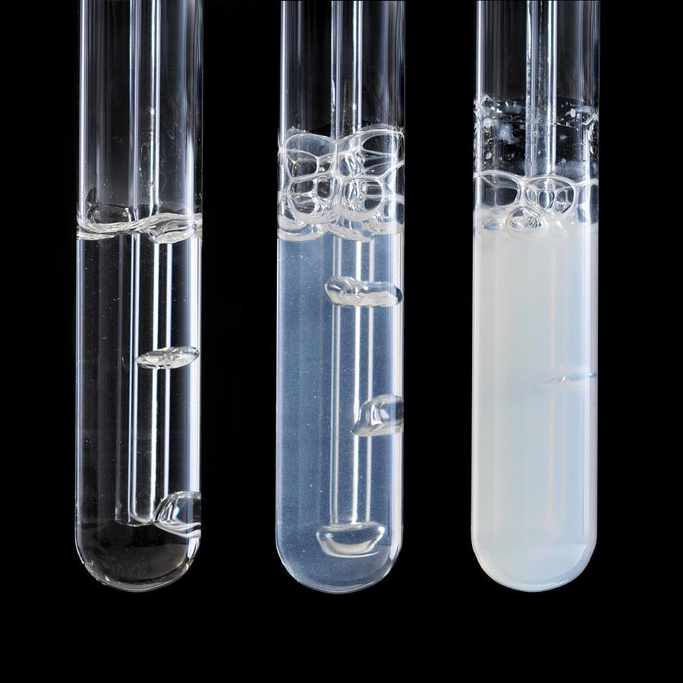
The test for CO₂ is called the limewater test.
Limewater will turn cloudy when CO₂ is bubbled through it.
For more help, please visit www.exampaperspractice.co.uk
© 2025 Exams Papers Practice. All Rights Reserved

Slide 14
Respiration and CO₂ Production
The organism is sealed inside a container.
The organism will begin to respire and produce CO₂.
A control consisting of a dead organism is also sealed inside its own container.
The control is there to ensure that only the living organism is affecting the concentration of CO₂.
Limewater is added to the container.
With the respiring organism, limewater will turn cloudy.
With the dead organism, limewater will remain colourless.
RESPIRING SEEDS
CO₂ BUBBLED THROUGH LIMEWATER
For more help, please visit www.exampaperspractice.co.uk
© 2025 Exams Papers Practice. All Rights Reserved

Slide 15
Hydrogen Carbonate Indicator
Another test for CO₂ involves the use of hydrogen carbonate indicator.
Hydrogen carbonate indicator is sensitive to changes in pH.
Hydrogen carbonate indicator changes colour depending on the concentration of CO₂:
Hydrogen carbonate indicator is yellow at high concentrations of CO₂.
Hydrogen carbonate indicator is red at normal concentrations of CO₂.
Hydrogen carbonate indicator is purple at low concentrations of CO₂.
For more help, please visit www.exampaperspractice.co.uk
© 2025 Exams Papers Practice. All Rights Reserved

Slide 16
HIGH CO₂
NORMAL CO₂
LOW CO₂
pH 7
pH 8
pH 9
Hydrogen carbonate indicator can be used to estimate the concentration of CO₂ in a solution.
For more help, please visit www.exampaperspractice.co.uk
© 2025 Exams Papers Practice. All Rights Reserved

Slide 17
As the seeds respire, CO₂ is released. This increases the concentration of CO₂ in the vessel containing the hydrogen carbonate indicator.
This turns the indicator a yellow colour.
RESPIRING SEEDS
CO₂ BUBBLED THROUGH HYDROGEN CARBONATE INDICATOR

Slide 18
Respiration and Heat Production
A respiring organism will also release heat.
Metabolic processes like respiration are exothermic.
Place some germinating seeds in a vacuum flask.
The flask insulates the seeds to ensure that any change in the temperature is due to respiration, rather than changes to the environment.
Insert a thermometer into the top of the flask and surround with cotton wool.
The cotton wool also insulates against heat loss from the top of the flask.
Measure the change in temperature at regular intervals.
As the seeds respire, the temperature recorded by the thermometer will increase.
A negative control of boiled seeds can increase the validity of this experiment.
A vacuum flask can be used to insulate against heat loss.
For more help, please visit www.exampaperspractice.co.uk
© 2025 Exams Papers Practice. All Rights Reserved

Slide 19
As the germinating seeds respire, they release heat energy.
This can be recorded using a thermometer inserted into a vacuum flask.
TEMPERATURE IN FLASK (°C) →
TIME →
For more help, please visit www.exampaperspractice.co.uk
© 2025 Exams Papers Practice. All Rights Reserved

