Slide 1
Edexcel IGCSE Biology
15 - Digestion and Absorption
Enzymes, Bile and Villi
For more help, please visit www.exampaperspractice.co.uk
© 2025 Exams Papers Practice. All Rights Reserved

Slide 2
Digestive Enzymes
Specification Point 2.29
Understand the role of digestive enzymes, including the digestion of starch to glucose by amylase and maltase, the digestion of proteins to amino acids by proteases and the digestion of lipids to fatty acids and glycerol by lipases.
Digestion involves the breakdown of large, insoluble molecules into smaller, soluble ones.
Digestion involves both mechanical and chemical breakdown.
The teeth break down food mechanically.
Enzymes break down food chemically.
Digested molecules are then absorbed into the bloodstream.
For more help, please visit www.exampaperspractice.co.uk
© 2025 Exams Papers Practice. All Rights Reserved

Slide 3
PRODUCTS
SUBSTRATE
ACTIVE SITE
SUBSTRATE ENTERS THE ACTIVE SITE OF THE ENZYME
ENZYME-SUBSTRATE COMPLEX IS FORMED
ENZYME-PRODUCT COMPLEX IS FORMED
PRODUCTS LEAVE THE ACTIVE SITE OF ENZYME
For more help, please visit www.exampaperspractice.co.uk
© 2025 Exams Papers Practice. All Rights Reserved

Slide 4
Types of Enzymes
Digestive enzymes fall into one of three groups:
Carbohydrases.
Proteases.
Lipases.
Carbohydrases break down carbohydrates into simple sugars.
Proteases break down proteins into amino acids.
Lipases break down lipids into fatty acids and glycerol.
In the digestive system, enzymes are either carbohydrases, proteases or amylases.
For more help, please visit www.exampaperspractice.co.uk
© 2025 Exams Papers Practice. All Rights Reserved

Slide 5
Carbohydrases
Carbohydrases are synthesized in the mouth and the pancreas:
The salivary glands make salivary amylase.
The pancreas makes pancreatic amylase.
The amylase breaks down a polysaccharide called starch into a disaccharide called maltose.
Maltose is then broken down into glucose by an enzyme called maltase.
Glucose is respired for energy.
STARCH → MALTOSE → GLUCOSE
For more help, please visit www.exampaperspractice.co.uk
© 2025 Exams Papers Practice. All Rights Reserved

Slide 6
Proteases
Proteases are synthesized in the stomach and the pancreas:
The stomach makes the enzyme pepsin.
The pancreas makes the enzyme trypsin.
All proteases break down proteins into amino acids.
Some proteases remove amino acids from the ends of proteins.
Other proteases break proteins into two smaller pieces.
Proteins are broken down into amino acids by proteases like pepsin and trypsin.
For more help, please visit www.exampaperspractice.co.uk
© 2025 Exams Papers Practice. All Rights Reserved

Slide 7
Lipases
Lipases are synthesized in the pancreas.
Lipases are then released into the small intestine.
Most lipases break down lipids into fatty acid and glycerol.
These products are then built into new molecules or respired for energy.
Lipases are synthesized by the pancreas and then released into the small intestine.
For more help, please visit www.exampaperspractice.co.uk
© 2025 Exams Papers Practice. All Rights Reserved

Slide 8
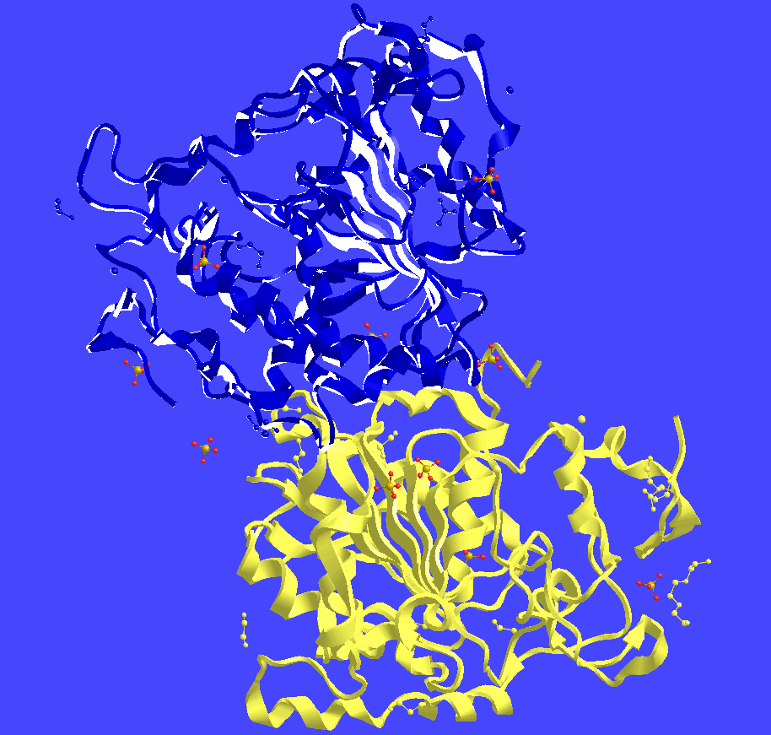
Enzymes like this lipase are tremendously complicated 3D structures made out of proteins.
For more help, please visit www.exampaperspractice.co.uk
© 2025 Exams Papers Practice. All Rights Reserved

Slide 9
Bile
Specification Points 2.30 and 2.31
Understand that bile is produced by the liver and stored in the gallbladder.
Understand the role of bile in neutralising stomach acid and emulsifying lipids.
Bile is a yellow-green liquid that is produced in the liver and stored in the gallbladder.
When required, bile is secreted into the large intestine.
Bile helps to neutralise stomach acid.
When digested food leaves the stomach, some hydrochloric acid is also released into the small intestine.
Bile helps creates an alkaline environment.
Enzymes in the small intestine work best in alkaline conditions.
Bile also emulsifies fats.
Large lipid droplets are broken down into smaller ones.
This increases the SA:V for enzymes to work on.
For more help, please visit www.exampaperspractice.co.uk
© 2025 Exams Papers Practice. All Rights Reserved

Slide 10
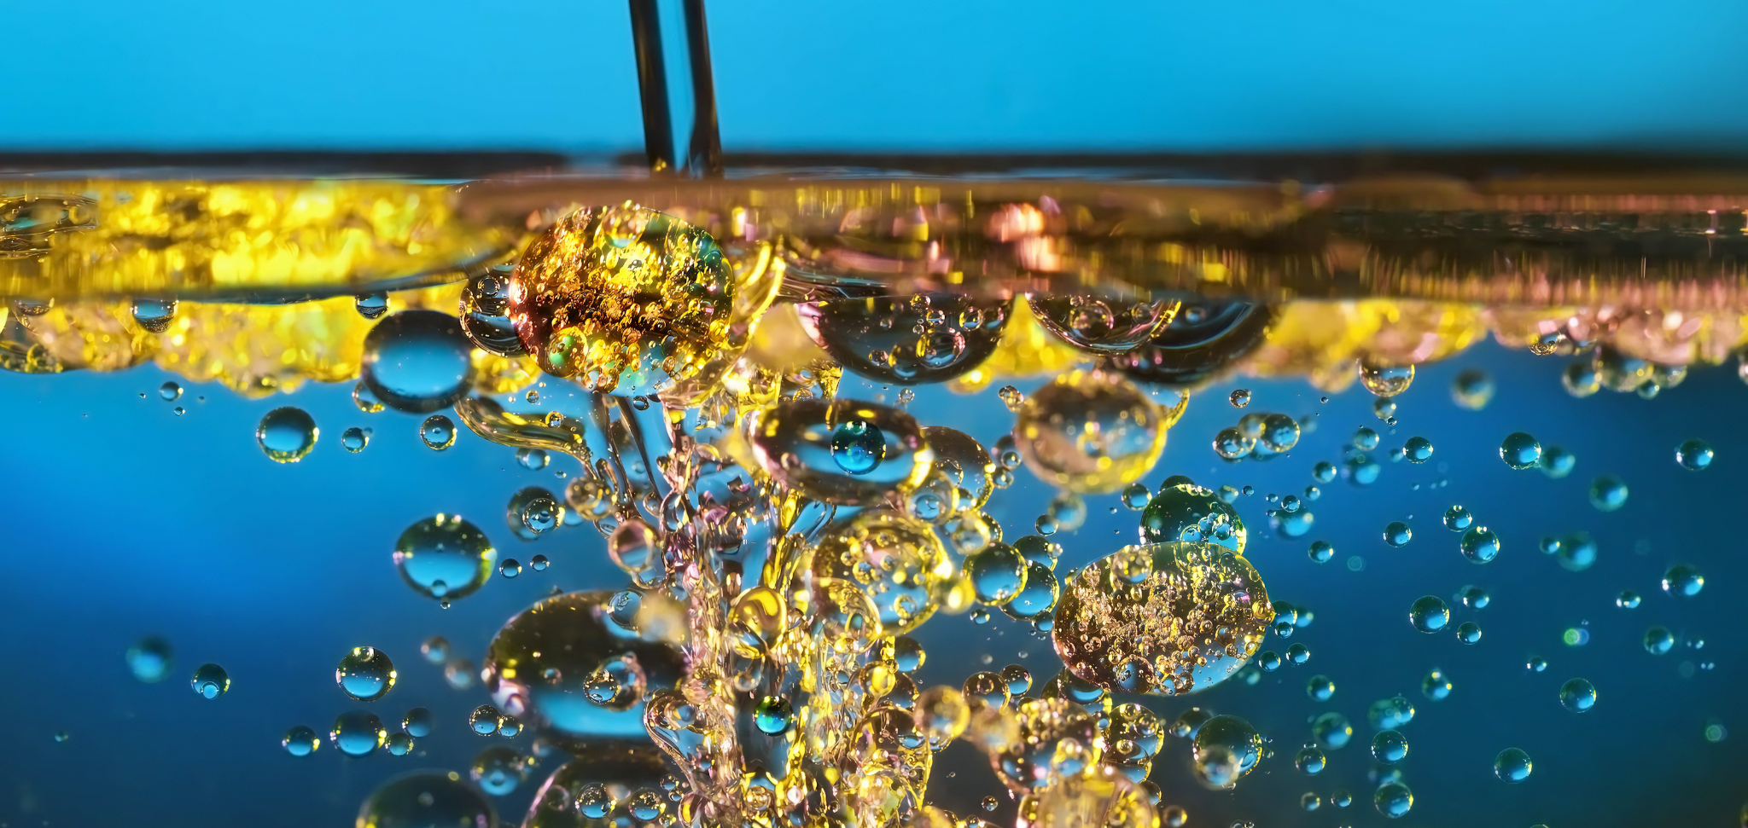
Bile is a molecule that helps to emulsify lipids, making it easier for lipases to break them down.
For more help, please visit www.exampaperspractice.co.uk
© 2025 Exams Papers Practice. All Rights Reserved

Slide 11
Absorption
Specification Point 2.32
Understand how the small intestine is adapted for absorption, including the structure of a villus.
Once food has been digested it is absorbed into the bloodstream.
Food is absorbed in the ileum.
The ileum is the second part of the small intestine.
The ileum has a folded inner membrane.
This creates finger-like projections called villi.
These folds increase the SA:V of the ileum.
Absorption is both active and passive.
Nutrients are passively absorbed by diffusion.
Nutrients are actively absorbed by active transport.
For more help, please visit www.exampaperspractice.co.uk
© 2025 Exams Papers Practice. All Rights Reserved

Slide 12
Villi
THIN SURFACE LAYER
Villi are covered in smaller projections called microvilli.
This further increases their SA:V.
Villi are only one cell thick.
A short diffusion pathway increases the rate of diffusion.
They have a good blood supply.
This creates a steep concentration gradient.
Glucose and other nutrients are constantly taken away from the ileum.
Villi also contain lacteals.
Lacteals are small vessels that absorb fats from the small intestine.
BLOOD CAPILLARY
LACTEAL
A villus is well-adapted to absorb digested nutrients.
For more help, please visit www.exampaperspractice.co.uk
© 2025 Exams Papers Practice. All Rights Reserved

Slide 13
Villi massively increase the surface area of the small intestine.
This allows for the diffusion and active transport of nutrients into the bloodstream as quickly as possible.
For more help, please visit www.exampaperspractice.co.uk
© 2025 Exams Papers Practice. All Rights Reserved

