Slide 1
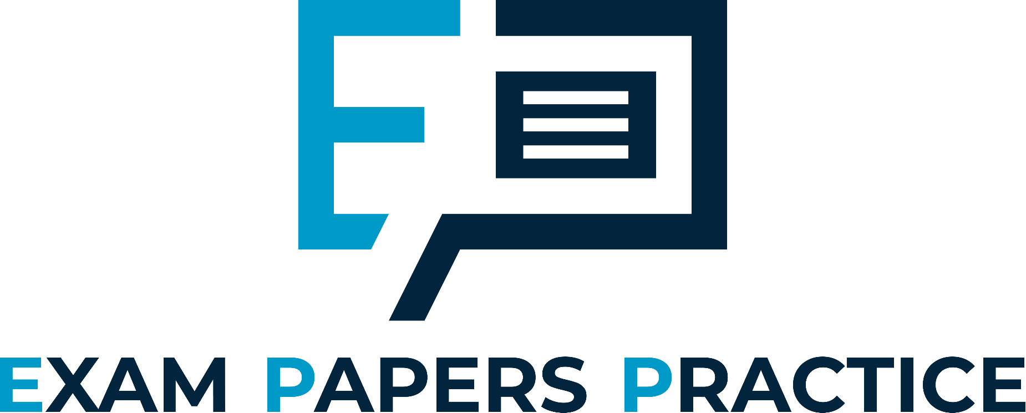
Edexcel IGCSE Biology
14 - The Digestive System
The Alimentary Canal and Peristalsis
For more help, please visit www.exampaperspractice.co.uk
© 2025 Exams Papers Practice. All Rights Reserved

Slide 2
The Alimentary Canal
Specification Point 2.27
Describe the structure and function of the human alimentary canal, including: the mouth esophagus, stomach, small intestine, large intestine and pancreas.
Digestion involves the breakdown of large, insoluble molecules into smaller, soluble ones:
Food is taken in through the mouth.
Food then passes through a number of organs where it is digested.
Undigested food and waste is passed out through the anus in the process of egestion.
This route is referred to as the alimentary canal.
For more help, please visit www.exampaperspractice.co.uk
© 2025 Exams Papers Practice. All Rights Reserved

Slide 3
SALIVARY GLANDS
TONGUE
ESOPHAGUS
LIVER
The alimentary canal is a complicated series of organs which allows for the breakdown and absorption of food.
STOMACH
GALLBLADDER
PANCREAS
DUODENUM
ILEUM
COLON
RECTUM
ANUS
For more help, please visit www.exampaperspractice.co.uk
© 2025 Exams Papers Practice. All Rights Reserved

Slide 4
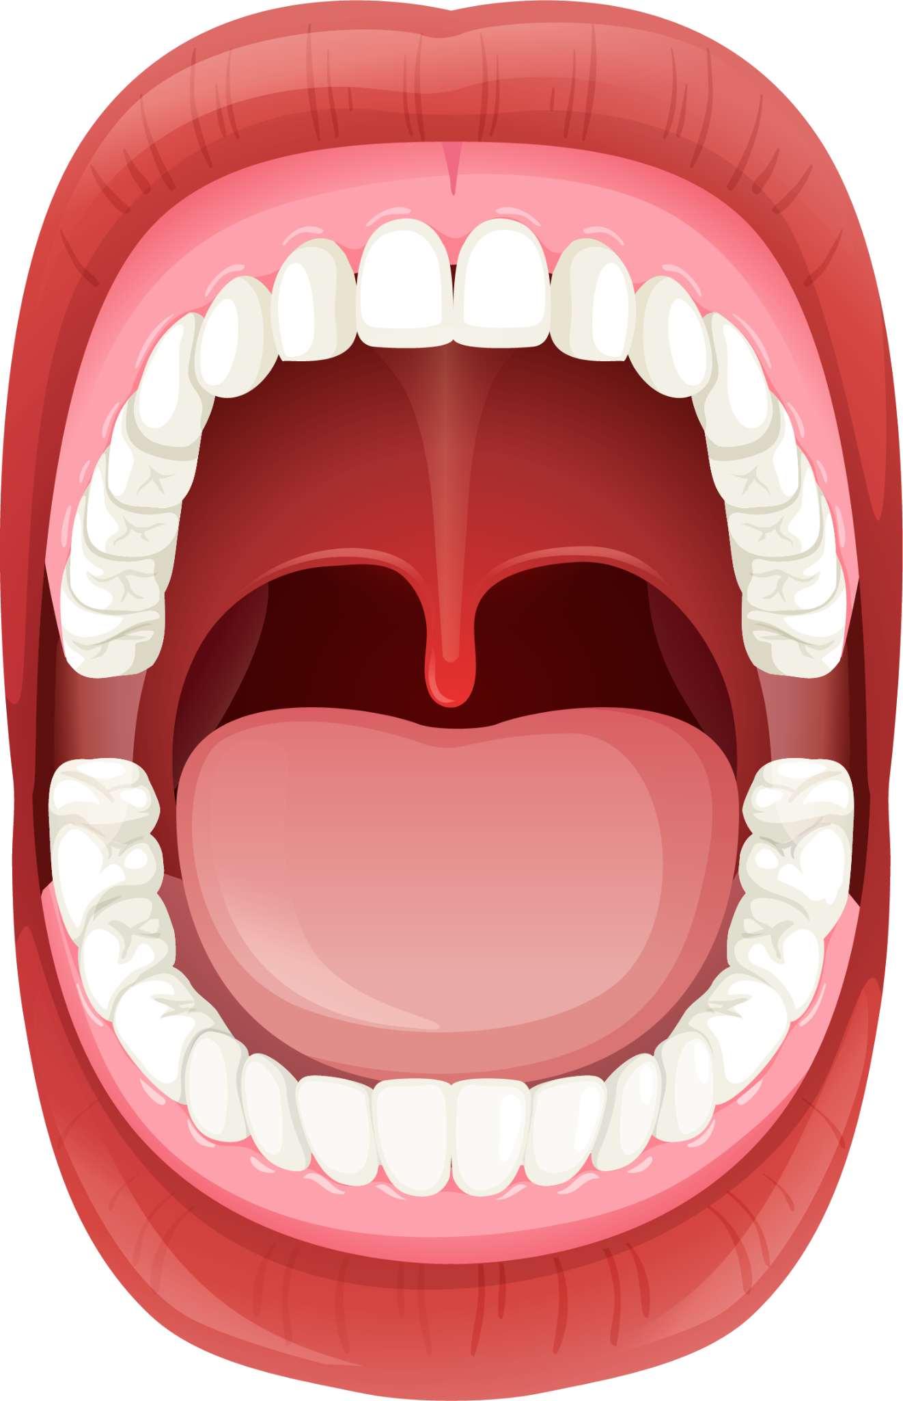
The Mouth
Food is taken in through the mouth.
The act of eating is referred to as ingestion.
The teeth chew food through mechanical digestion.
Chewing increases the surface area to volume ratio (SA:V) of the food.
This allows to allow enzymes break down the food more efficiently.
Digestive enzymes then begin to break down the food molecules.
Amylase is present in the saliva.
Amylase begins to break down starch into maltose.
Food is swallowed with the help of the tongue.
The teeth in the mouth help to break down food through mechanical digestion.
For more help, please visit www.exampaperspractice.co.uk
© 2025 Exams Papers Practice. All Rights Reserved

Slide 5
The Esophagus
The esophagus is a muscular tube that connects the mouth to the stomach.
Food travels down the esophagus after it is swallowed.
There are waves of muscular contraction that help to aid the food down the esophagus
These waves of contraction are referred to as peristalsis.
Food is also moved by gravity.
The esophagus connects the mouth to the rest of the digestive system.
For more help, please visit www.exampaperspractice.co.uk
© 2025 Exams Papers Practice. All Rights Reserved

Slide 6
The Stomach
The stomach is a hollow, muscular organ that holds food.
Food can be held in the stomach for up to four hours.
Food is mechanically digested by churning.
This is a form of peristalsis.
Food is also chemically digested through enzyme action.
Protease enzymes such as pepsin begin to digest the proteins in food.
The stomach is full of hydrochloric acid (HCl).
HCl helps to kill bacteria.
HCl also provides an optimum pH for enzymes.
The stomach is a muscular bag that holds food for both mechanical and chemical digestion.
For more help, please visit www.exampaperspractice.co.uk
© 2025 Exams Papers Practice. All Rights Reserved

Slide 7
The Small Intestine
The small intestine is divided into two sections:
The first section is called the duodenum.
The second section is called the ileum.
Digestion is completed in the duodenum.
Enzymes are secreted from the pancreas into the duodenum.
The pH of the duodenum is slightly alkaline to provide an optimum for these enzymes.
Food is absorbed in the ileum.
The ileum is covered in finger-like projections called villi.
Villi increase the SA:V for quicker absorption.
DUODENUM
ILEUM
For more help, please visit www.exampaperspractice.co.uk
© 2025 Exams Papers Practice. All Rights Reserved

Slide 8
The Large Intestine
The large intestine is divided into two sections:
The first section is called the colon.
The second section is called the rectum.
By this point most of the useful substances in food have been removed.
Most of the remaining matter is waste.
Water is absorbed from this material in the colon.
Some salts like sodium and potassium are also absorbed.
The rectum stores faeces.
Faeces are removed from the body by egestion.
Egestion happens in the anus.
COLON
RECTUM

Slide 9
The Pancreas
The pancreas manufactures and secretes enzymes:
Amylases breaks down starch into maltose.
Proteases break down proteins into amino acids.
Pepsin and trypsin are examples of proteases.
Lipases break down fats into glycerol and fatty acids.
The pancreas releases enzymes into the small intestine.
Enzymes are secreted into the duodenum.
The pancreas is an organ that is primarily responsible for creating and secreting enzymes.
For more help, please visit www.exampaperspractice.co.uk
© 2025 Exams Papers Practice. All Rights Reserved

Slide 10
Peristalsis
Specification Point 2.28
Understand how food is moved through the gut by peristalsis.
Peristalsis is a wave of muscular contraction.
Two sets of muscles act in the gut.
One set moves along the gut, the other circles the gut.
When acting together, this creates a wave.
Peristalsis pushes food through the gut.
A ball of food is referred to as a bolus.
During peristalsis, a ball of food, called a bolus, is moved through the gut by waves of muscular contraction.
BOLUS IS SQUEEZED THROUGH GUT
For more help, please visit www.exampaperspractice.co.uk
© 2025 Exams Papers Practice. All Rights Reserved

