Slide 1


Edexcel IGCSE Biology
13 - Human Nutrition
A Balanced Diet and Energy Demands
For more help, please visit www.exampaperspractice.co.uk
© 2025 Exams Papers Practice. All Rights Reserved

Slide 2
A Balanced Diet
Specification Point 2.24
Understand that a balanced diet should include appropriate proportions of carbohydrate, protein, lipid, vitamins, minerals, water and dietary fibre.
There are a number of major components to a balanced diet:
Carbohydrates should make up 45%-65% of the diet.
Carbohydrates include breads, grains and pasta.
Proteins should make up 10%-35% of the diet.
Proteins include meats, fish and eggs.
Lipids should make up 20%-35% of the diet.
Lipids include fats and oils.
There should be a number of vitamins and minerals in the diet.
Vitamins and minerals are present in the other major food groups.
At least 2 litres of water should be consumed per day.
For more help, please visit www.exampaperspractice.co.uk
© 2025 Exams Papers Practice. All Rights Reserved

Slide 3
PROCESSED FOODS
HEALTHY FATS
The components of a healthy, balanced diet.
PROTEINS + GRAINS
FRUITS
VEGETABLES
For more help, please visit www.exampaperspractice.co.uk
© 2025 Exams Papers Practice. All Rights Reserved

Slide 4
Carbohydrates, Proteins and Lipids
Specification Point 2.25
Identify the sources and describe the functions of carbohydrate, protein, lipid (fats and oils), vitamins A, C and D, the mineral ions calcium and iron, water and dietary fibre as components of the diet.
Carbohydrates are required for energy.
Carbohydrates are easily broken down into glucose.
Glucose is then respired to release energy.
Proteins are required for the growth and repair of cells.
Proteins contain amino acids.
Amino acids are required to build new structural and functional proteins.
Lipids are required for long term storage, insulation and protection.
Lipids contain fatty acids and glycerol.
These are broken down when no carbohydrates remain in the body.
Lipids also protect organs and insulate the body from the cold.
For more help, please visit www.exampaperspractice.co.uk
© 2025 Exams Papers Practice. All Rights Reserved

Slide 5
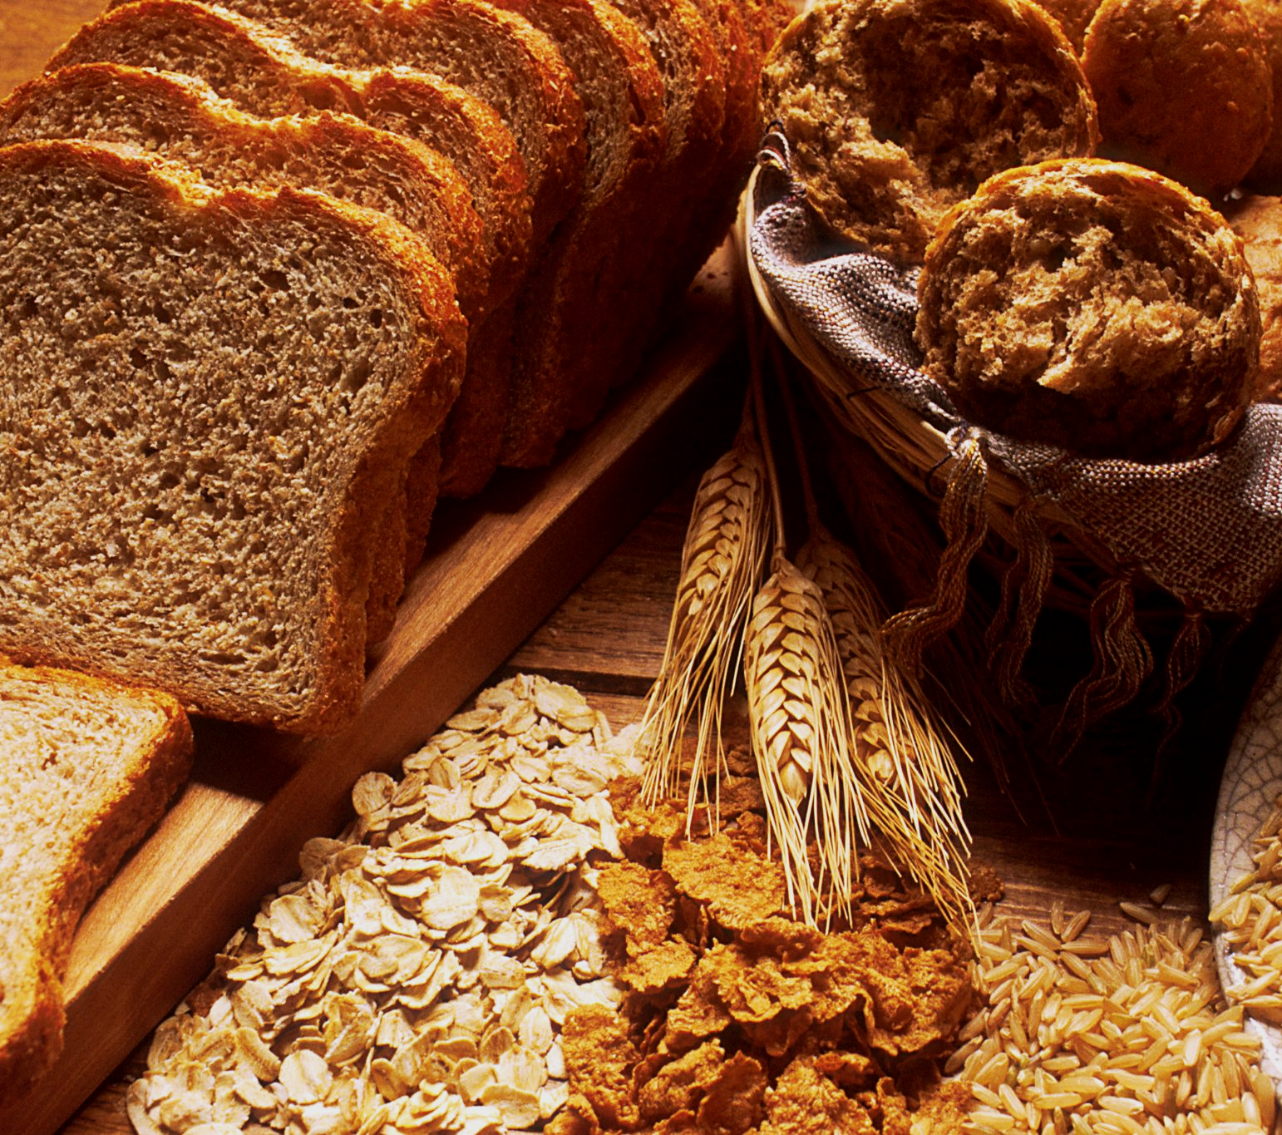
Breads, grains and pasta are good sources of carbohydrates.
For more help, please visit www.exampaperspractice.co.uk
© 2025 Exams Papers Practice. All Rights Reserved

Slide 6

Cooked meats are an excellent source of protein.
For more help, please visit www.exampaperspractice.co.uk
© 2025 Exams Papers Practice. All Rights Reserved

Slide 7
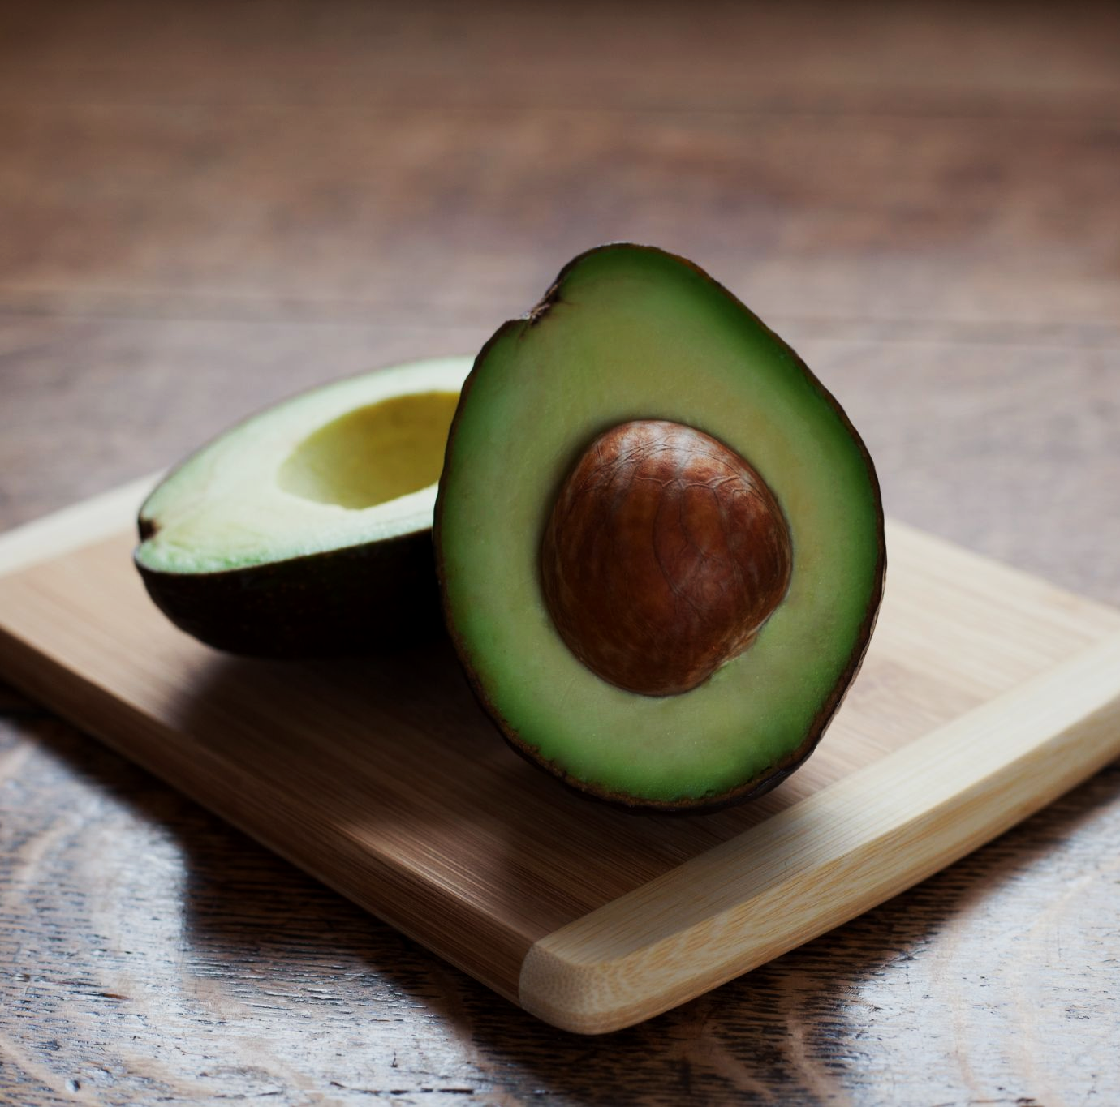
Some fruits like avocados are a good source of healthy lipids.
For more help, please visit www.exampaperspractice.co.uk
© 2025 Exams Papers Practice. All Rights Reserved

Slide 8
Vitamins
Vitamins are micronutrients the body needs to function correctly.
Vitamins cannot be synthesised by the body.
Vitamin A is important for good vision.
Vitamin A makes a light-sensitive chemical in the eye called retinol.
Vitamin A deficiency can lead to night blindness.
One good source of vitamin A are carrots.
Vitamin C is important for healthy skin.
Vitamin C is involved in the manufacture of a connective tissue called collagen.
Vitamin C deficiency can lead to scurvy.
One good source of vitamin C are citrus fruits.
Vitamin D is important for healthy bones.
Vitamin D helps the body absorb calcium.
Vitamin D deficiency can lead to rickets.
One good source of vitamin D is sunlight.
For more help, please visit www.exampaperspractice.co.uk
© 2025 Exams Papers Practice. All Rights Reserved

Slide 9
Vitamin A deficiency is extremely common in regions of Africa and Asia. Severe deficiencies can lead to problems with vision.
NO DATA
0%
10%
20%
30%
40%
50%
60%
70%
80%
90%
100%
For more help, please visit www.exampaperspractice.co.uk
© 2025 Exams Papers Practice. All Rights Reserved

Slide 10
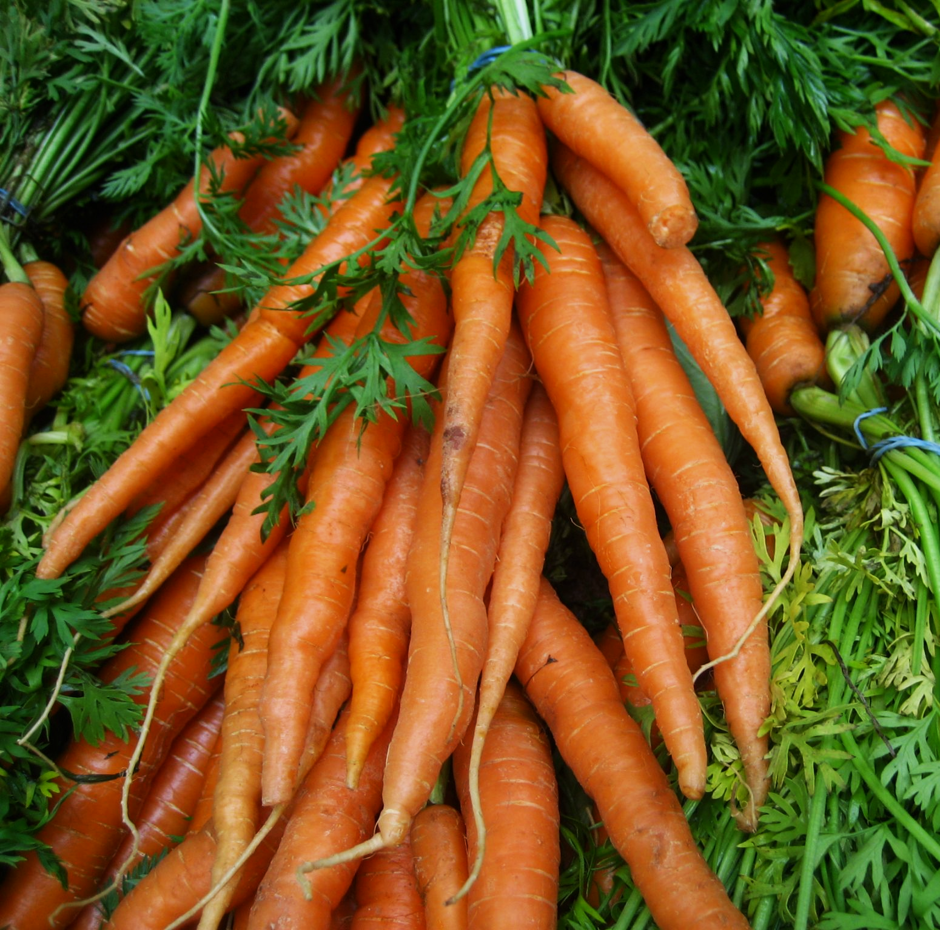
Carrots are a good source of vitamin A.
For more help, please visit www.exampaperspractice.co.uk
© 2025 Exams Papers Practice. All Rights Reserved

Slide 11
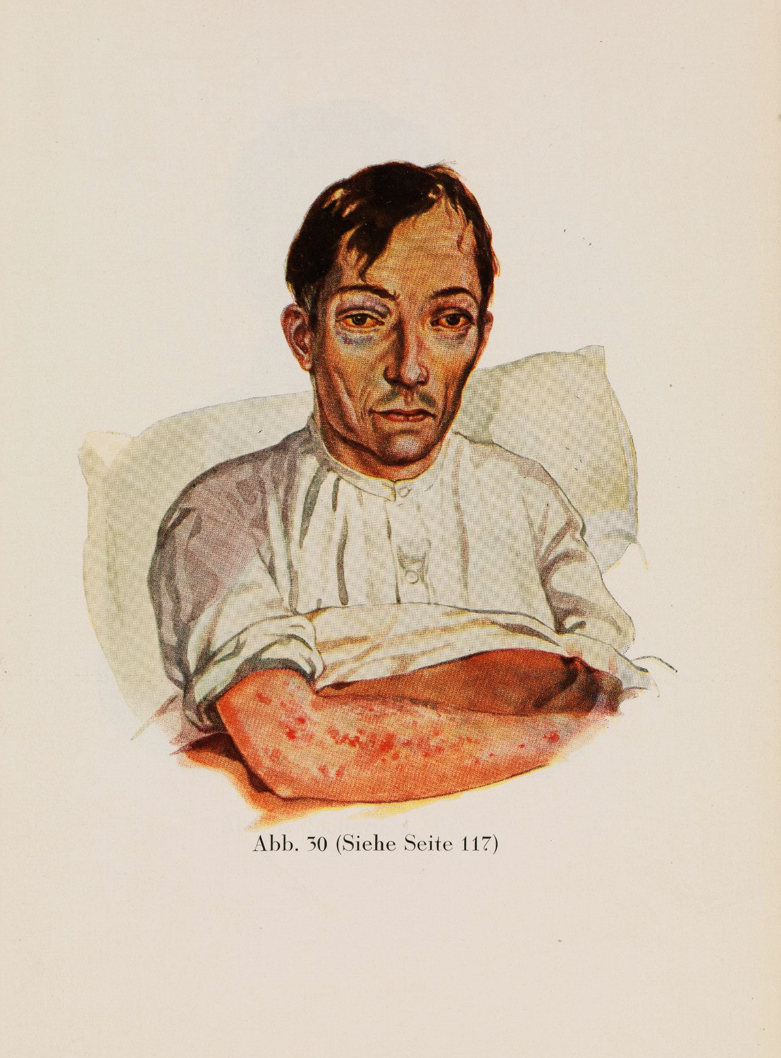
A vitamin C deficiency can lead to scurvy, a disease which is associated with a general worsening of the skin, hair and gums.
For more help, please visit www.exampaperspractice.co.uk
© 2025 Exams Papers Practice. All Rights Reserved

Slide 12
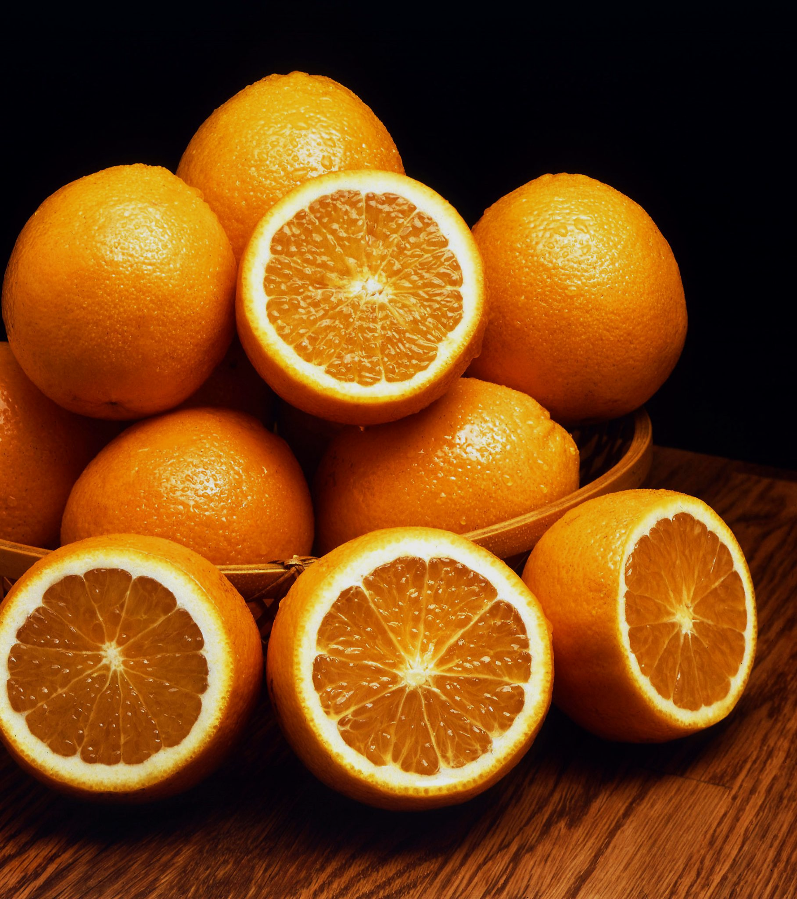
Citrus fruits like oranges are a good source of vitamin C.
For more help, please visit www.exampaperspractice.co.uk
© 2025 Exams Papers Practice. All Rights Reserved

Slide 13
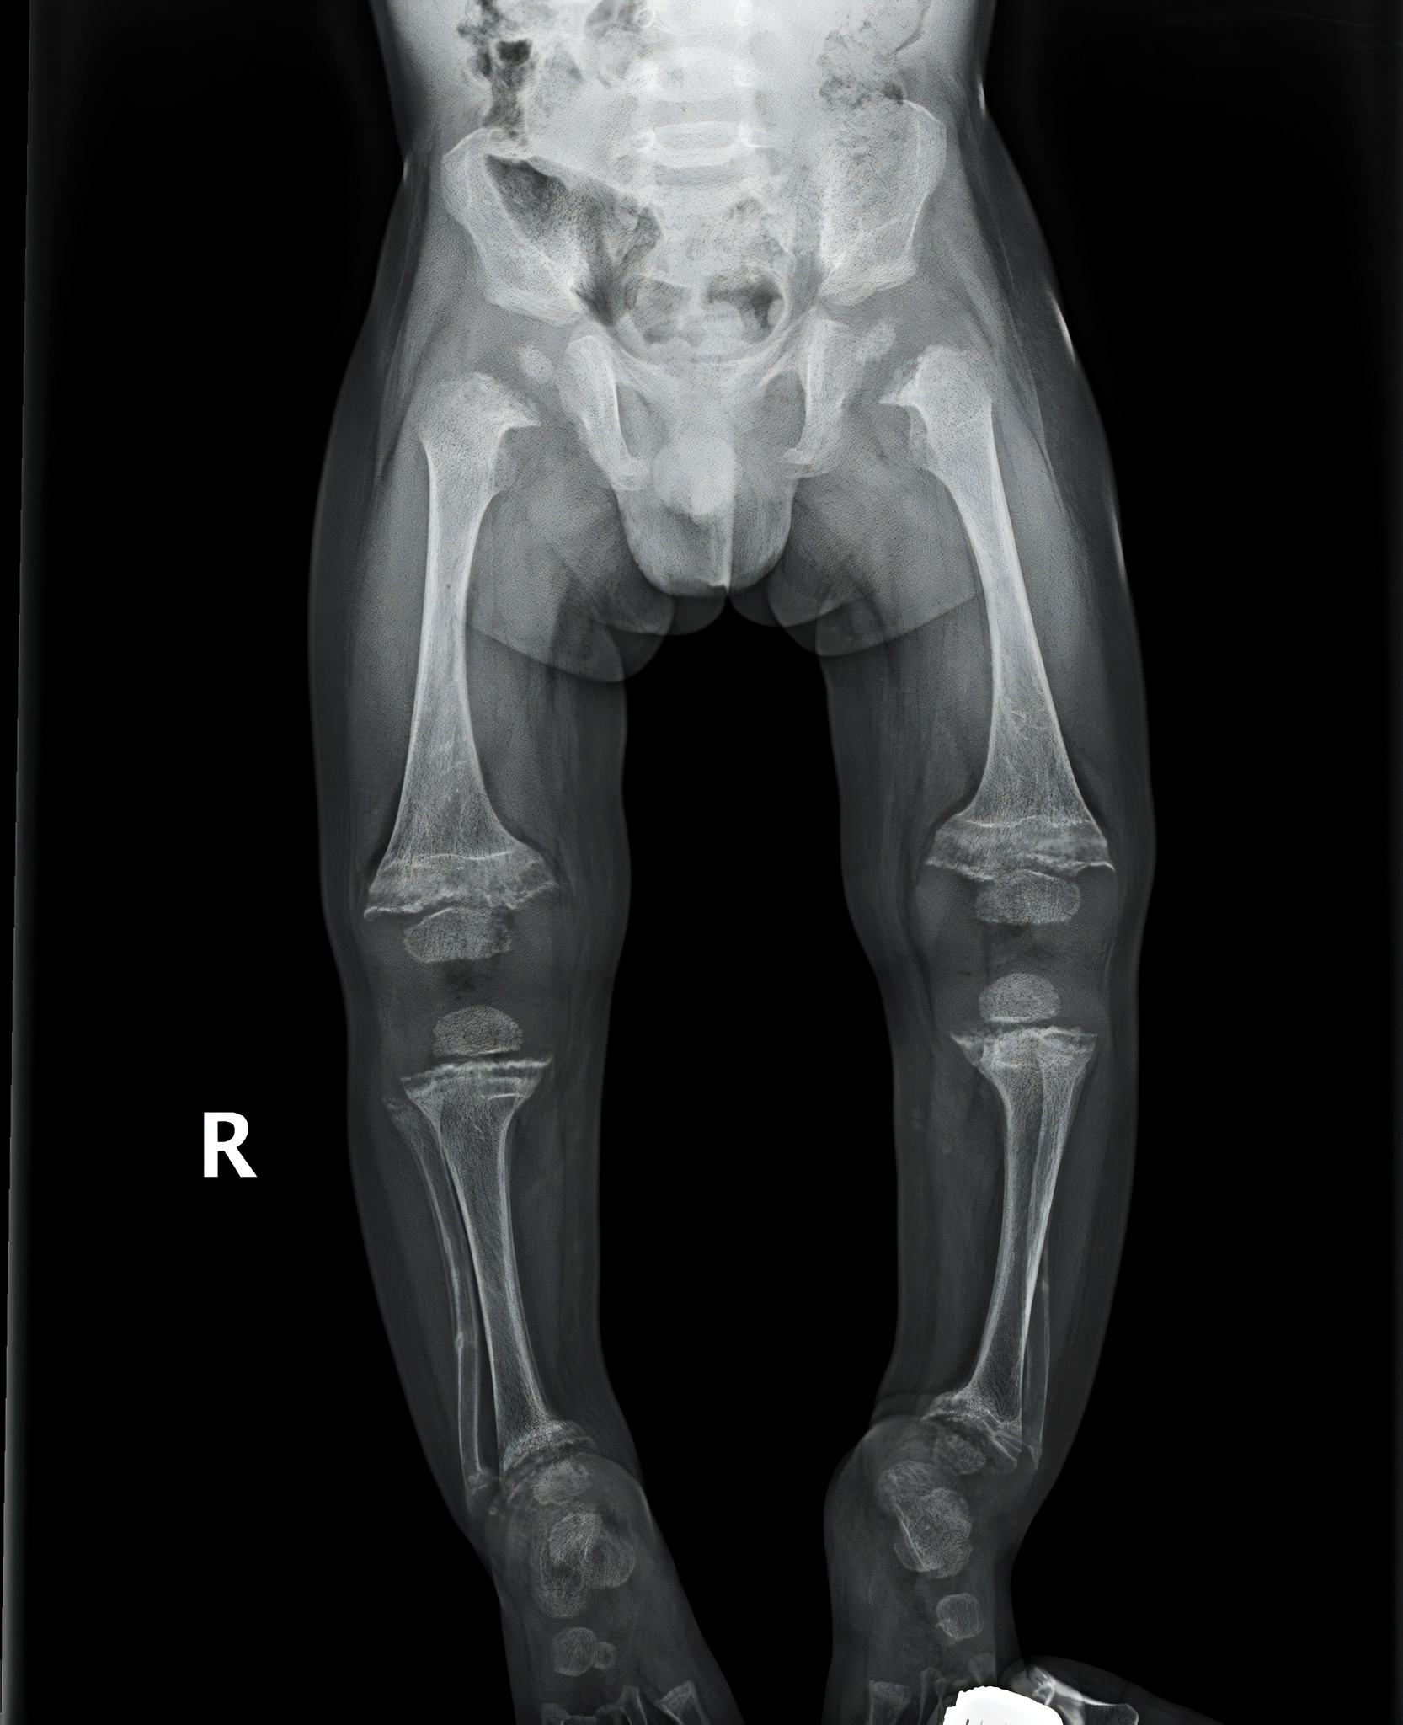
In children, a vitamin D deficiency can prevent the body from effectively absorbing calcium, causing rickets.
Rickets softens the bones, meaning they may grow in a misshapen way.
For more help, please visit www.exampaperspractice.co.uk
© 2025 Exams Papers Practice. All Rights Reserved

Slide 14

UV light from the sun causes a chemical reaction on the surface of the skin, creating vitamin D.
For more help, please visit www.exampaperspractice.co.uk
© 2025 Exams Papers Practice. All Rights Reserved

Slide 15
Minerals
Minerals are micronutrients the body needs to function correctly.
Calcium is important for the maintenance of healthy teeth and bones.
Calcium is commonly found in dairy products such as milk and cheese.
Iron is needed to form haemoglobin.
Haemoglobin is a protein found in red blood cells which carry oxygen (O₂) around the body.
Iron is found in red meat, eggs and spinach.
A deficiency in iron is called anemia.
Hemoglobin is a protein with an iron (Fe²⁺) ion at its core. Anaemic individuals will not carry O₂ around the body efficiently.
For more help, please visit www.exampaperspractice.co.uk
© 2025 Exams Papers Practice. All Rights Reserved

Slide 16
Water
Around 60% of the body is made up of water.
Water is a medium for chemical reactions.
Water is also a transport mechanism.
Blood is primarily composed of water.
Water is often found in large quantities in food.
Cucumbers consist of 96% water.
Water is vital for a number of cellular processes. Around 2 litres of water are required every day.
For more help, please visit www.exampaperspractice.co.uk
© 2025 Exams Papers Practice. All Rights Reserved

Slide 17
Dietary Fibre
Dietary fibre consists of cellulose.
Dietary fibre is sometimes referred to as roughage.
Cellulose is found in plant cell walls.
Fruits and vegetables are a good source of dietary fibre.
Dietary fibre is not digested by the body.
Dietary fibre provides bulk for the muscles of the digestive system to push against.
Dietary fibre helps to keep the gut healthy.
Dietary fibre also helps to avoid constipation.
Dietary fibre helps to aid digestion and keep the gut healthy.
For more help, please visit www.exampaperspractice.co.uk
© 2025 Exams Papers Practice. All Rights Reserved

Slide 18
Energy Requirements
Specification Point 2.26
Understand how energy requirements vary with activity levels, age and pregnancy.
Different people require different amounts of energy:
Athletes have a high requirement for energy.
The more exercise an individual does, the more calories are burned.
Children have a high requirement for energy.
Lots of energy is required to build mass.
Pregnant women have a high requirement for energy.
Lots of energy is required to support the growth of a foetus.
For more help, please visit www.exampaperspractice.co.uk
© 2025 Exams Papers Practice. All Rights Reserved

Slide 19
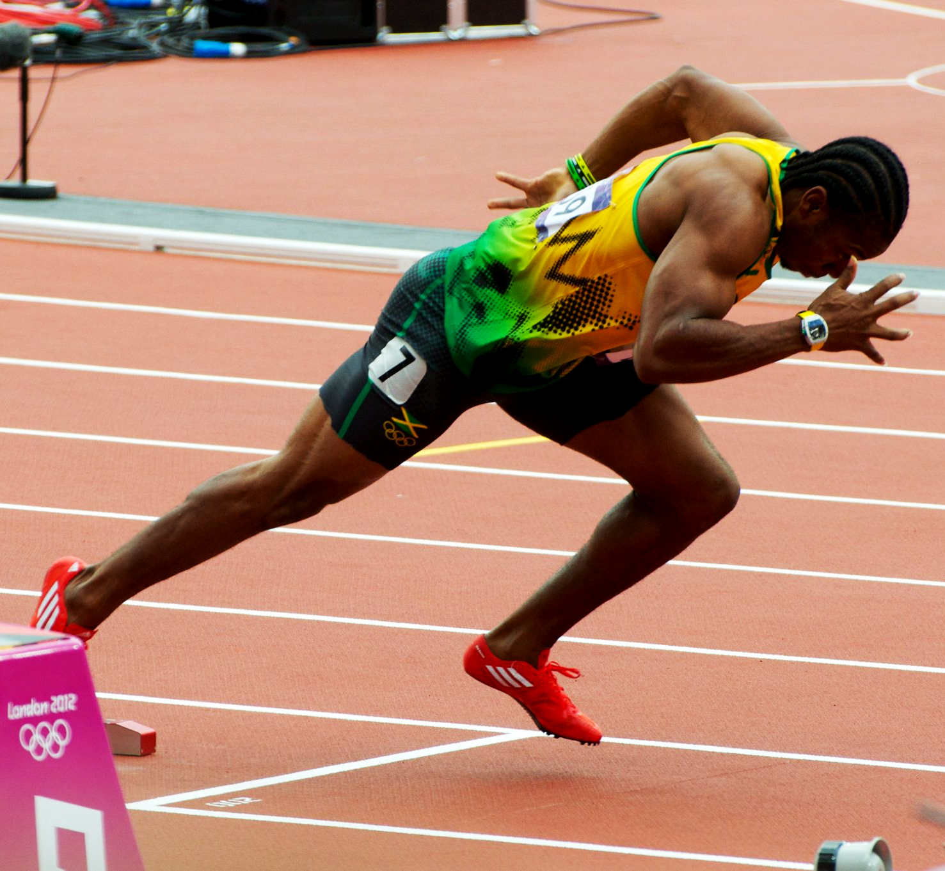
Athletes use lots of calories during training and competition and therefore have high energy demands.
For more help, please visit www.exampaperspractice.co.uk
© 2025 Exams Papers Practice. All Rights Reserved

Slide 20
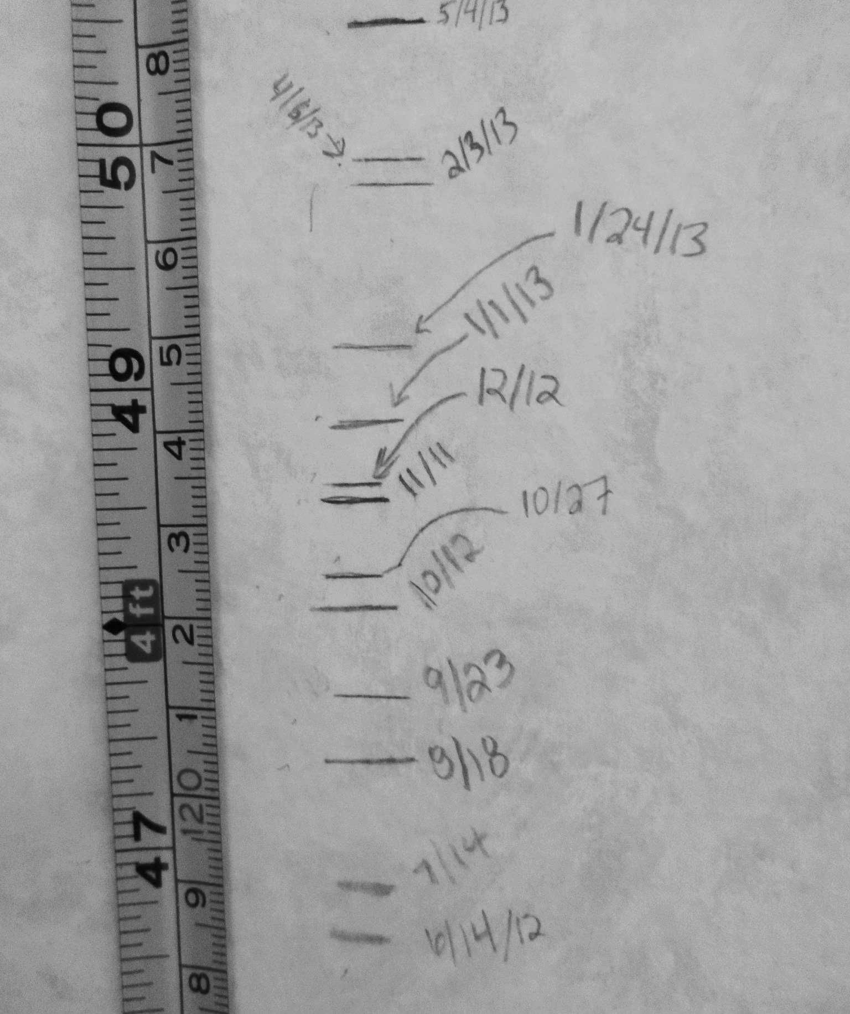
Children have high energy demands as they quickly put on size and mass.
For more help, please visit www.exampaperspractice.co.uk
© 2025 Exams Papers Practice. All Rights Reserved

Slide 21
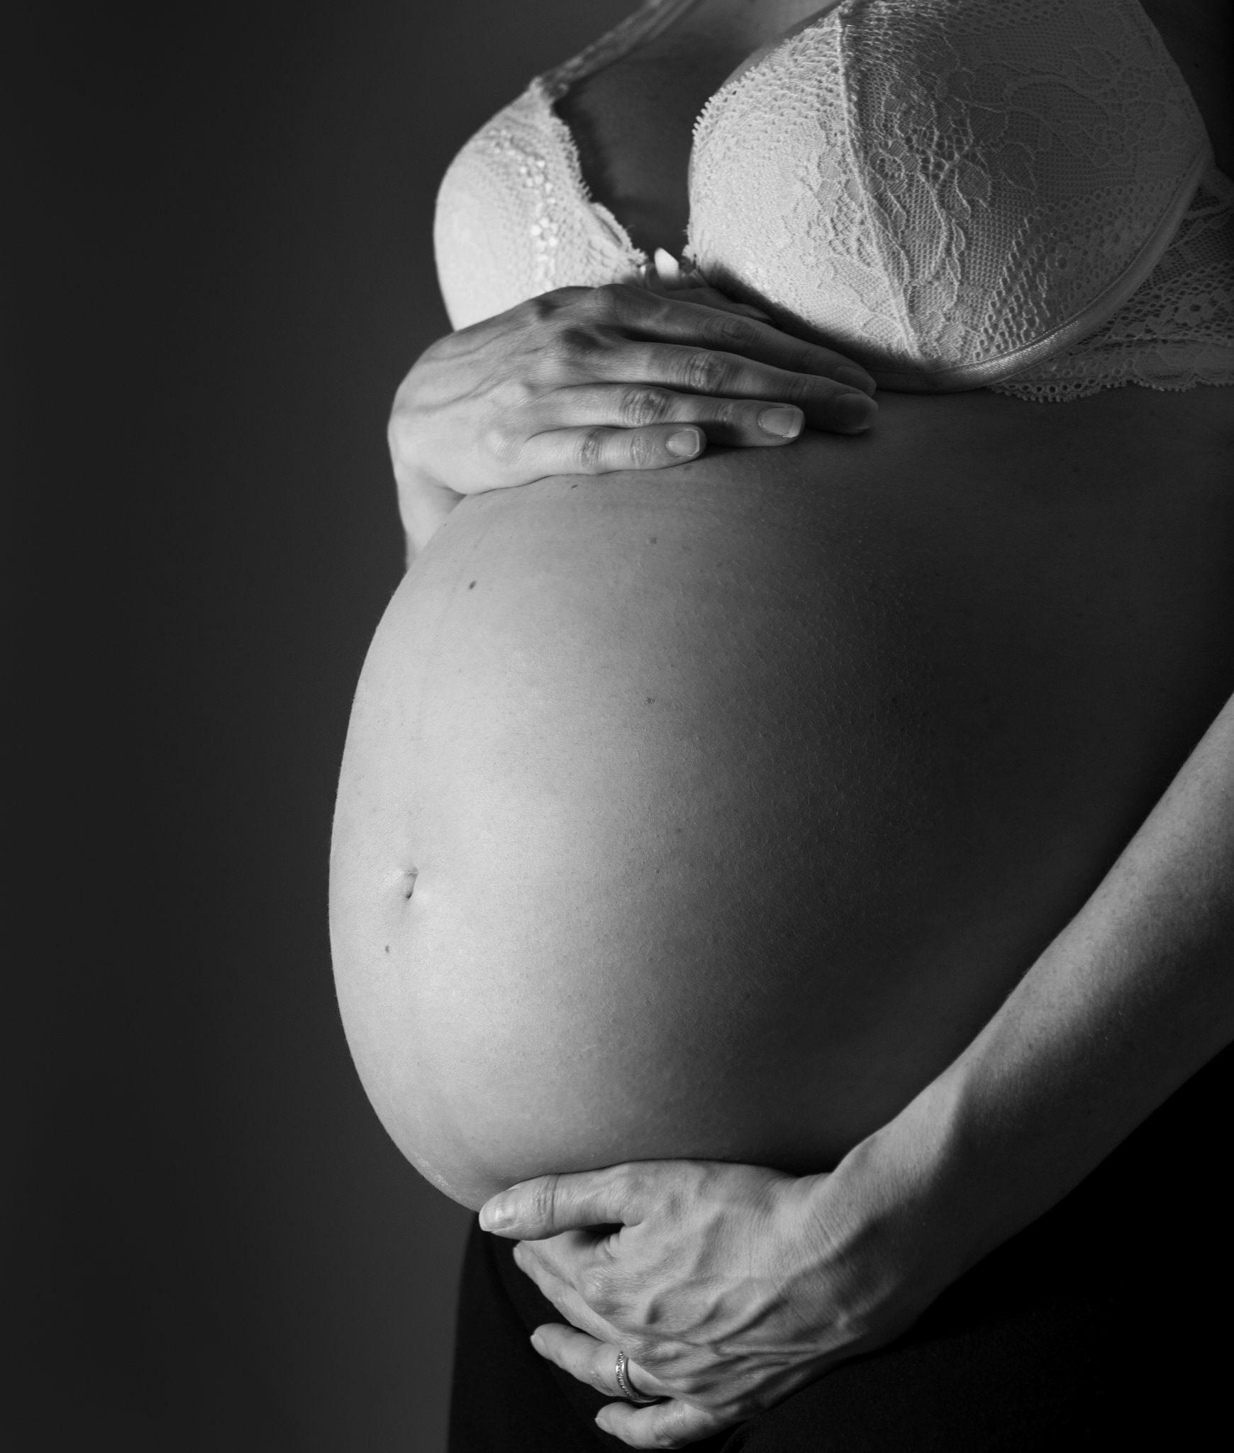
Pregnant women have high energy demands as they need to support the growth of a foetus.
For more help, please visit www.exampaperspractice.co.uk
© 2025 Exams Papers Practice. All Rights Reserved

