Slide 1
Edexcel IGCSE Biology
12 - Investigating Photosynthesis
Pondweed, the Variegated Leaf and the Bell Jar
For more help, please visit www.exampaperspractice.co.uk
© 2025 Exams Papers Practice. All Rights Reserved

Slide 2
Pondweed and Photosynthesis
Specification Point 2.23
Practical: Investigate photosynthesis, showing the evolution of oxygen from a water plant, the production of starch and the requirements of light, carbon dioxide and chlorophyll.
Photosynthesis releases oxygen (O₂) as a gas.
O₂ is a waste product from photosynthesis.
When an aquatic plant is submerged, O₂ is seen as bubbles.
An example of an aquatic plant is pondweed.
The faster the rate of photosynthesis, the more bubbles are released.
One measure of photosynthesis is bubbles of O₂ per minute.
Photosynthesis practical video.
S. pectinata is a species of pondweed that photosynthesises underwater.
For more help, please visit www.exampaperspractice.co.uk
© 2025 Exams Papers Practice. All Rights Reserved

Slide 3
The distance of the pondweed from a desk lamp can be varied using a ruler. This will change the light intensity of the experiment.
As the distance from the lamp increases, the rate of photosynthesis decreases. This is because the light intensity also decreases.
BUBBLES OF O₂ PER MIN →
DISTANCE FROM LAMP (CM) →
For more help, please visit www.exampaperspractice.co.uk
© 2025 Exams Papers Practice. All Rights Reserved

Slide 4
Testing for Starch
Glucose created during photosynthesis is converted to starch for storage.
Starch is stored in the leaves of a plant.
Chlorophyll is a green pigment that is is required for photosynthesis.
Without chlorophyll photosynthesis cannot occur.
Leaves without chlorophyll will not create starch.
Submerge the top half of a leaf in boiling ethanol.
This removes the chlorophyll from the leaf cells.
Cover the leaves in iodine.
The regions of the leaf that still contain chlorophyll will turn blue-black.
The regions of the leaf without chlorophyll will remain orange.
Testing for starch practical video.
For more help, please visit www.exampaperspractice.co.uk
© 2025 Exams Papers Practice. All Rights Reserved

Slide 5
LEAF WITH CHLOROPHYLL
LEAF WITHOUT CHLOROPHYLL
Leaves that have had their chlorophyll removed will contain no starch and return a negative iodine test.
Leaves with their chlorophyll intact will still photosynthesise, converting glucose to starch and will return a positive iodine test.
For more help, please visit www.exampaperspractice.co.uk
© 2025 Exams Papers Practice. All Rights Reserved

Slide 6
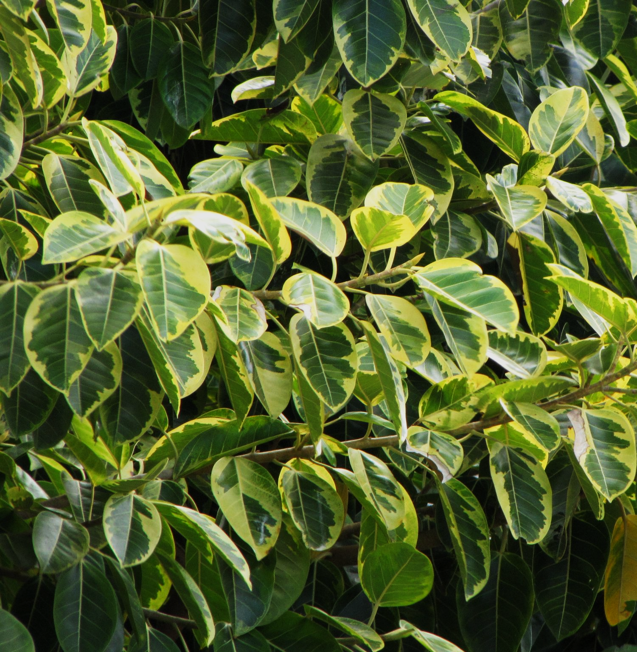
Variegated leaves naturally have regions with and without chlorophyll.
For more help, please visit www.exampaperspractice.co.uk
© 2025 Exams Papers Practice. All Rights Reserved

Slide 7
The Requirement for CO₂
Plants require CO₂ for photosynthesis.
CO₂ is required to created glucose.
When CO₂ is removed from the environment, photosynthesis stops.
The requirement for CO₂ can be investigated:
Enclose a plant within a sealed bell jar.
The bell jar will not allow CO₂ from the surrounding air to enter.
Add some soda lime to the bell jar.
The soda lime will absorb any CO₂ that remains in the jar.
Test the plant for starch after 24 hours.
Remove the chlorophyll from the leaves of the plant using boiling ethanol.
Use the iodine test to confirm that no starch is present.
Starch will not be present due to the lack of CO₂.
For more help, please visit www.exampaperspractice.co.uk
© 2025 Exams Papers Practice. All Rights Reserved

Slide 8
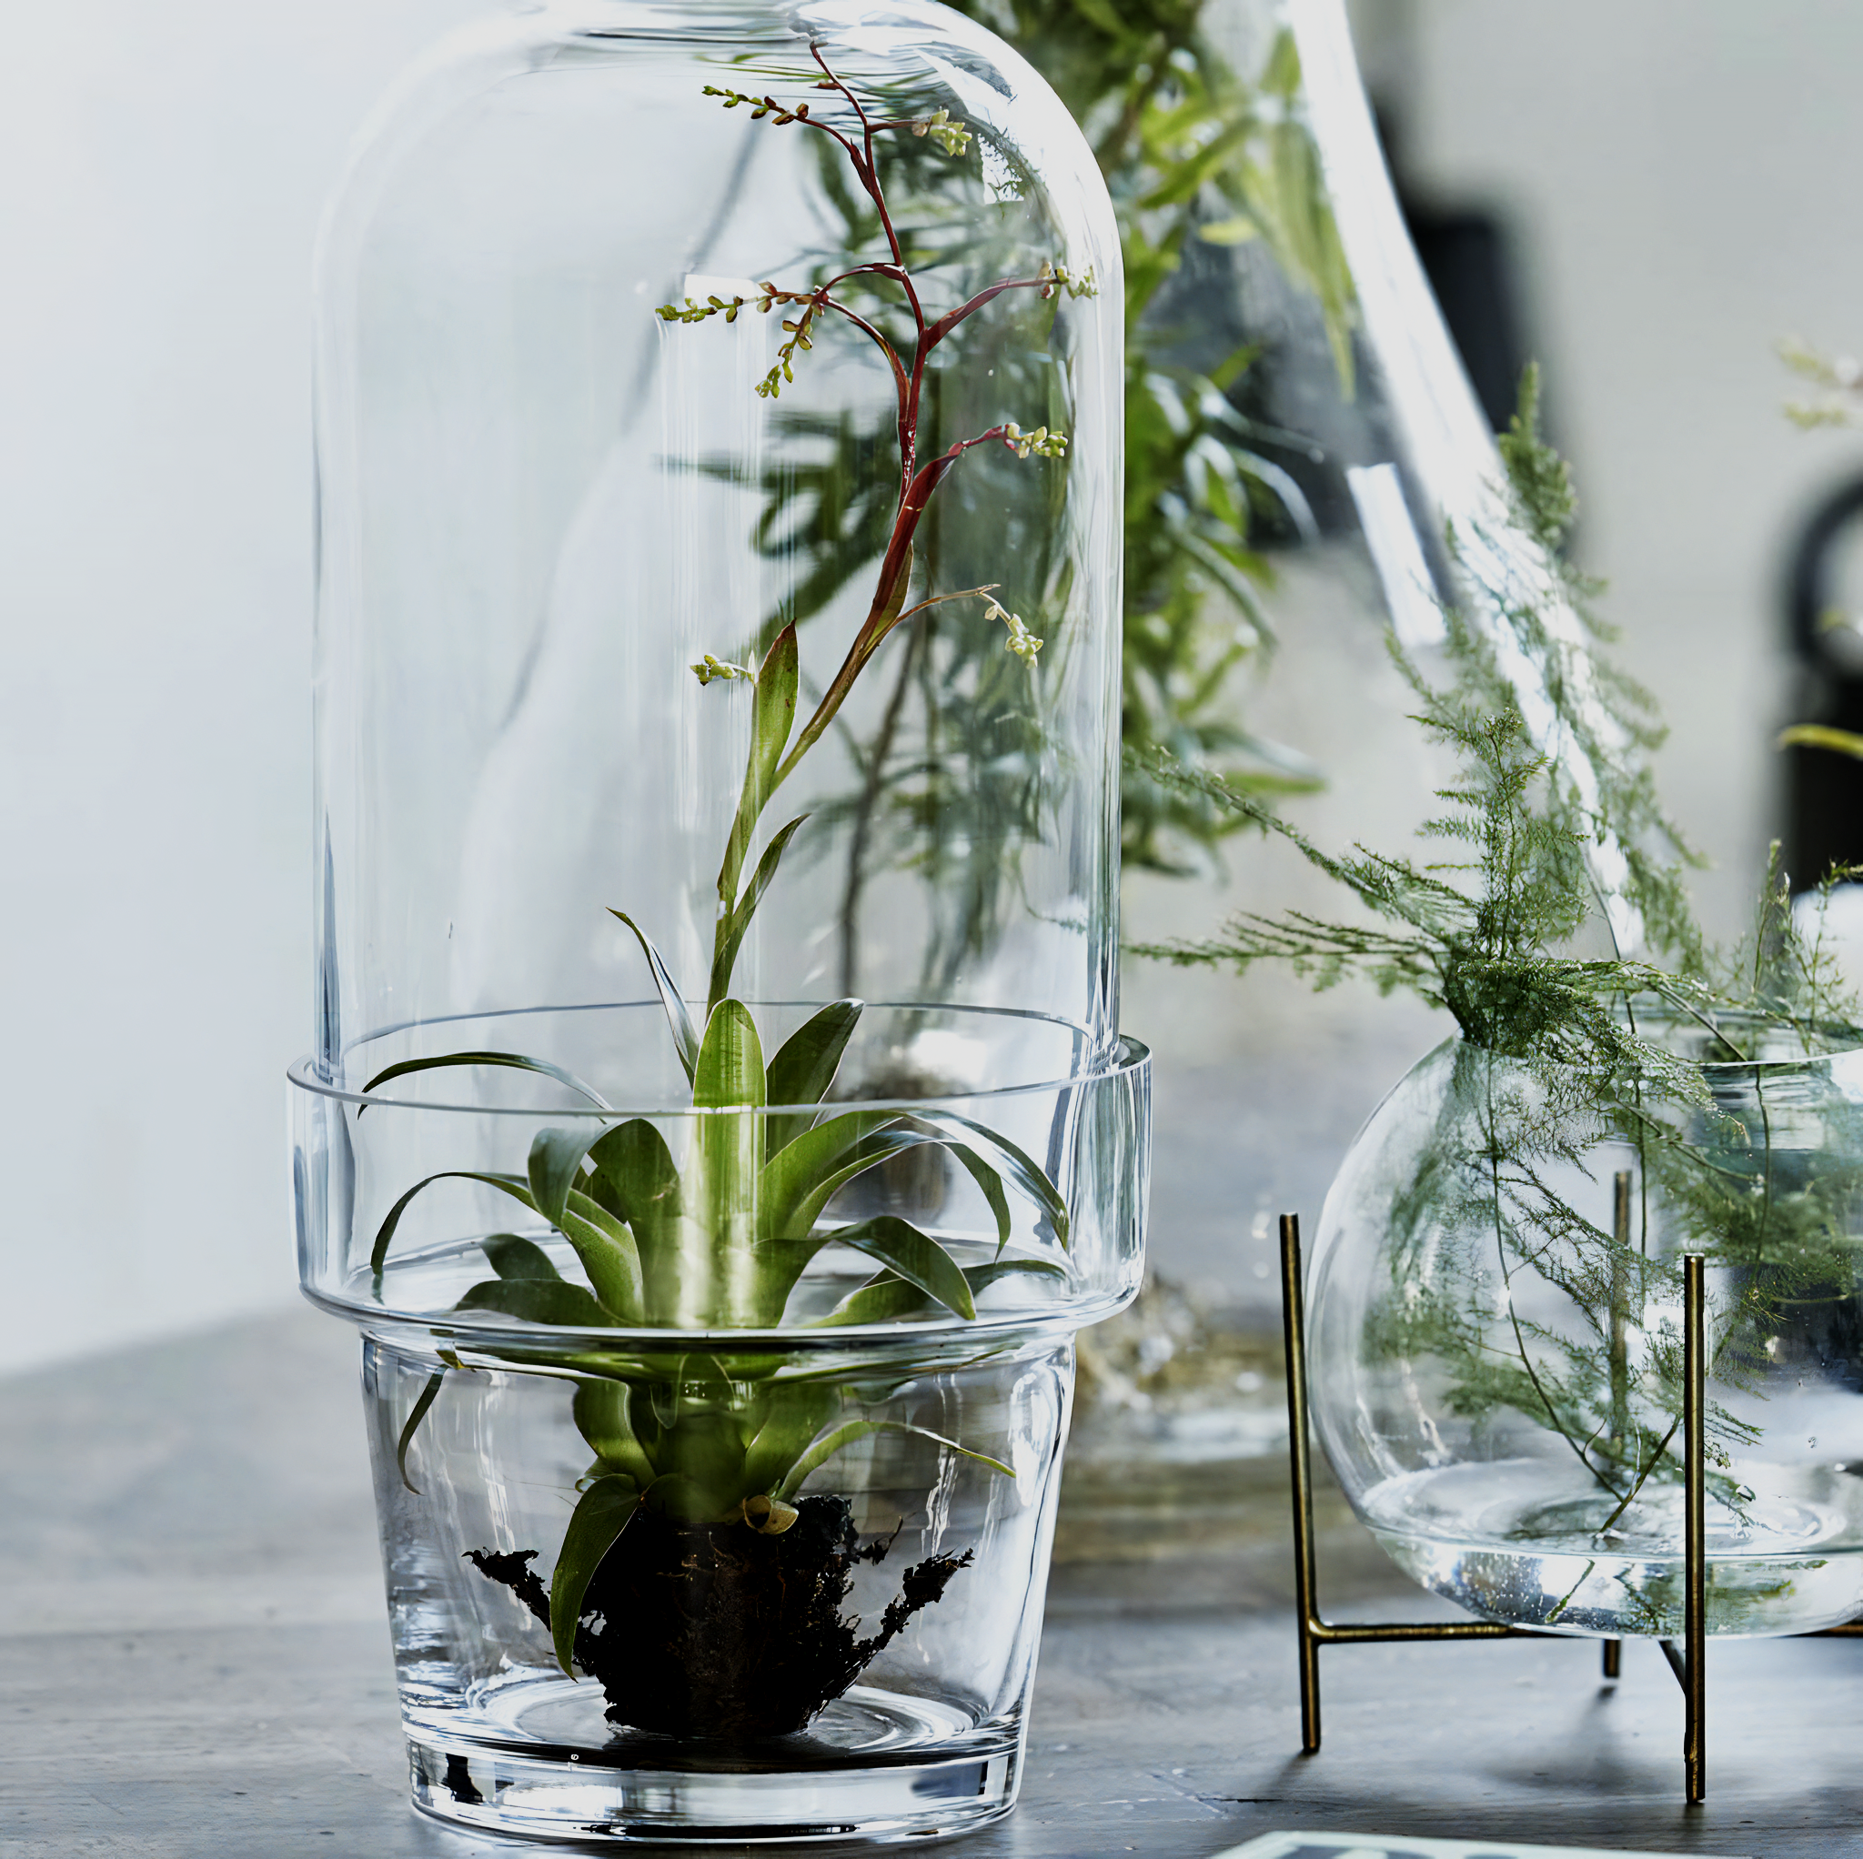
A bell jar can be set up to investigate a plant’s requirement for CO₂.
For more help, please visit www.exampaperspractice.co.uk
© 2025 Exams Papers Practice. All Rights Reserved

Slide 9
The sealed bell jar prevents any CO₂ reaching the plant, whilst the soda lime absorbs any CO₂ present in the jar itself.
The causes photosynthesis to stop. The lack of starch production can then be confirmed using the iodine test.
BELL JAR
SODA LIME
For more help, please visit www.exampaperspractice.co.uk
© 2025 Exams Papers Practice. All Rights Reserved

