Slide 1
Edexcel IGCSE Biology
11 - The Leaf
Structure, Adaptations and Mineral Requirements
For more help, please visit www.exampaperspractice.co.uk
© 2025 Exams Papers Practice. All Rights Reserved

Slide 2
The Leaf
Specification Point 2.21
Describe the structure of the leaf and explain how it is adapted for photosynthesis.
A plant leaf is highly adapted for photosynthesis and it has several layers:
The upper epidermis.
The upper epidermis contains the waxy cuticle - a waterproof layer to prevent water loss.
The palisade mesophyll.
Palisade cells are found at the top of the leaf.
Palisade cells are full of chloroplasts for photosynthesis.
The spongy mesophyll.
Cells in the spongy mesophyll are loosely packed with air spaces for gas exchange.
The lower epidermis.
The lower epidermis contains guard cells which open and close.
These openings are called stomata.
Stomata allow CO₂ to move into the leaf and O₂ to move out of the leaf.
For more help, please visit www.exampaperspractice.co.uk
© 2025 Exams Papers Practice. All Rights Reserved

Slide 3
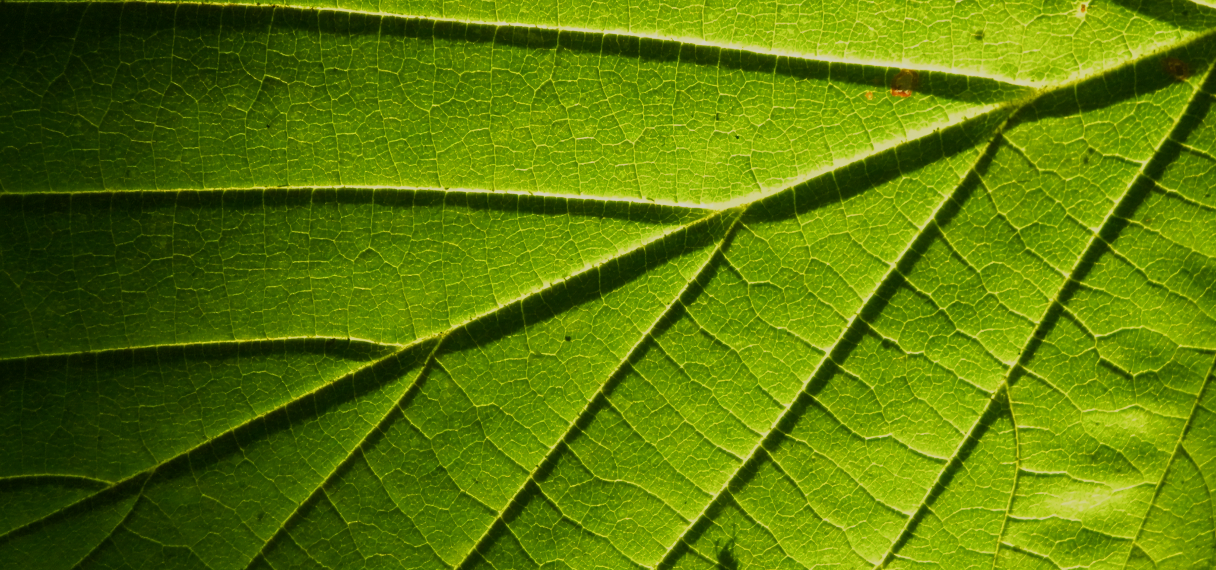
The leaf is the primary photosynthetic organ of plants.
For more help, please visit www.exampaperspractice.co.uk
© 2025 Exams Papers Practice. All Rights Reserved

Slide 4
WAXY CUTICLE
UPPER EPIDERMIS
PALISADE
A leaf has several distinct layers including the palisade mesophyll and the spongy mesophyll.
MESOPHYLL
SPONGY
LOWER EPIDERMIS
WAXY CUTICLE
GUARD CELL
STOMATA
For more help, please visit www.exampaperspractice.co.uk
© 2025 Exams Papers Practice. All Rights Reserved

Slide 5
Minerals for Plant Growth
Specification Point 2.22
Understand that plants require mineral ions for growth, and that magnesium ions are needed for chlorophyll and nitrate ions are needed for amino acids.
Plants are autotrophic organisms.
This means that they can produce their own carbohydrates through photosynthesis.
Plants do require a number of other nutrients to survive:
Nitrates.
Magnesium.
Potassium
Phosphorous.
Whilst plants can create their own glucose from photosynthesis, other nutrients must be taken from the soil.
For more help, please visit www.exampaperspractice.co.uk
© 2025 Exams Papers Practice. All Rights Reserved

Slide 6
Obtaining Minerals
Minerals are found in the soil.
Most soils contain lots of different minerals.
Minerals are pumped into the plant through active transport.
Minerals enter the plant through root hair cells.
Root hair cells are specialised cells.
Root hair cells have a very high surface area to volume ratio (SA:V).
The process of active transport is very energy intensive.
A root hair cell is a specialised plant cell with lots of mitochondria, no chloroplasts, a very high SA:V and a thin cell wall. This allows for the cell to actively uptake mineral ions very efficiently.
For more help, please visit www.exampaperspractice.co.uk
© 2025 Exams Papers Practice. All Rights Reserved

Slide 7
Nitrates
Nitrates (NO₃⁻) are a good source of nitrogen.
Nitrates are used to make amino acids.
Amino acids are the building blocks of protein.
Nitrates are needed to make enzymes, hormones and DNA.
Plants with a nitrogen deficiency have leaves which will begin to yellow and die.
The growth of plants with a nitrate deficiency will be stunted.
Plants with a nitrogen deficiency will have yellow leaves and stunted growth.
For more help, please visit www.exampaperspractice.co.uk
© 2025 Exams Papers Practice. All Rights Reserved

Slide 8
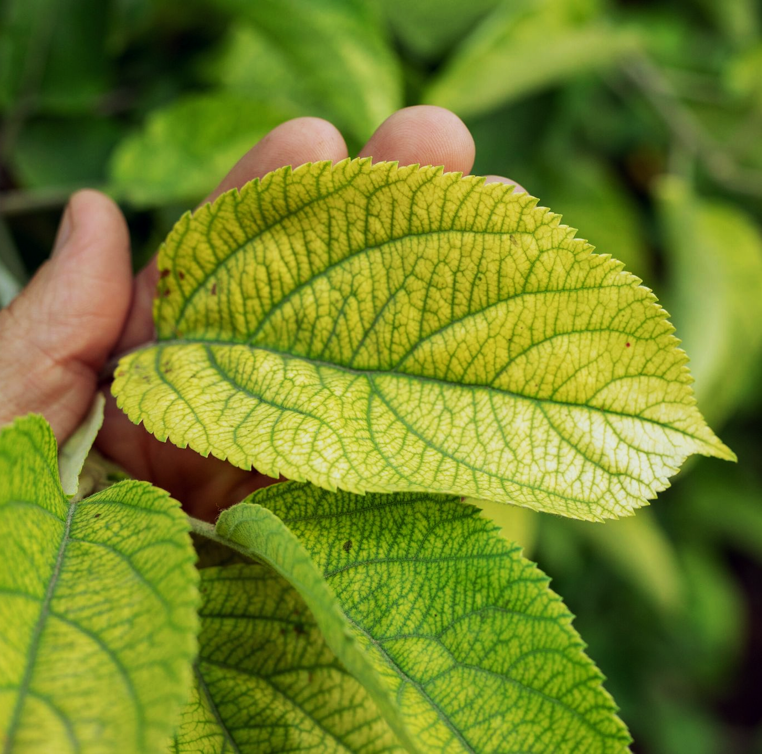
Nitrogen-deficient plants will have yellow leaves and stunted growth.
This is because they lack cannot make sufficient levels of enzymes, hormones or DNA.
For more help, please visit www.exampaperspractice.co.uk
© 2025 Exams Papers Practice. All Rights Reserved

Slide 9
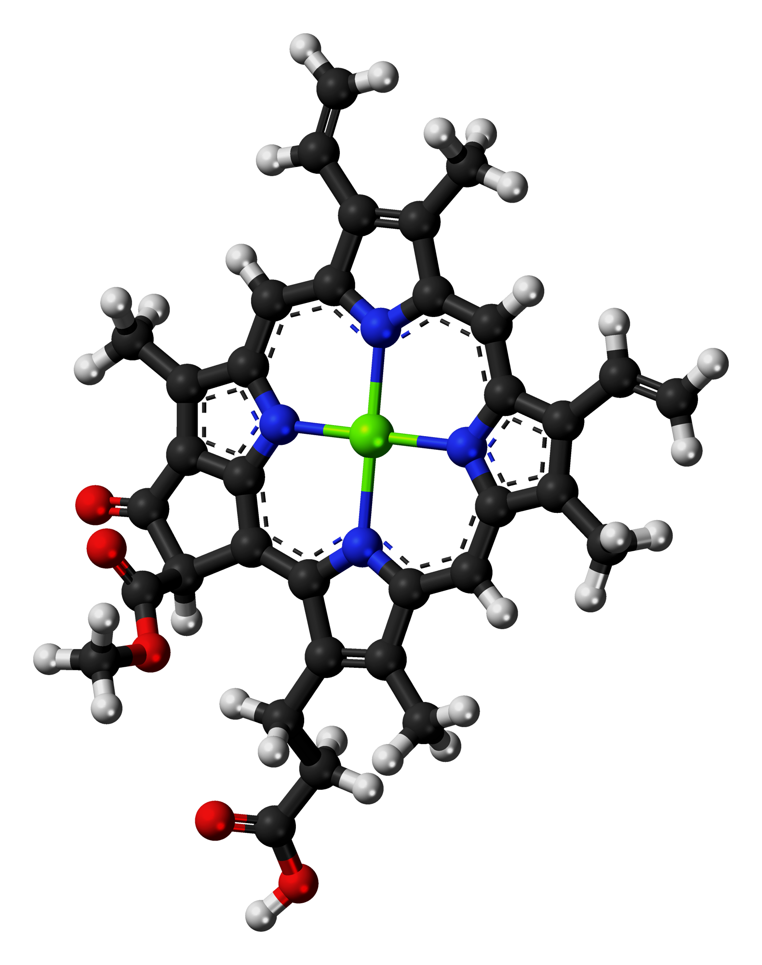
Magnesium
Magnesium (Mg²⁺) ions are required to produce chlorophyll.
Chlorophyll is a green pigment that absorbs light energy.
Without enough chlorophyll, the rate of photosynthesis will decrease.
Certain complex enzymes and nucleic acids will not function correctly without magnesium.
Plants with a magnesium deficiency will have yellow leaves and slowed growth.
Chlorophyll is a complex molecule with a magnesium core. A deficiency in magnesium will lead to low rates of photosynthesis.
For more help, please visit www.exampaperspractice.co.uk
© 2025 Exams Papers Practice. All Rights Reserved

Slide 10
Potassium
Potassium (K⁺) ions are used to construct certain respiratory and photosynthetic enzymes.
Without potassium not enough ATP is produced.
This slows the rate of many metabolic processes.
Plants with a potassium deficiency contain yellow leaves and dead spots.
Plants with a potassium deficiency will have yellow leaves and dead spots.
For more help, please visit www.exampaperspractice.co.uk
© 2025 Exams Papers Practice. All Rights Reserved

Slide 11
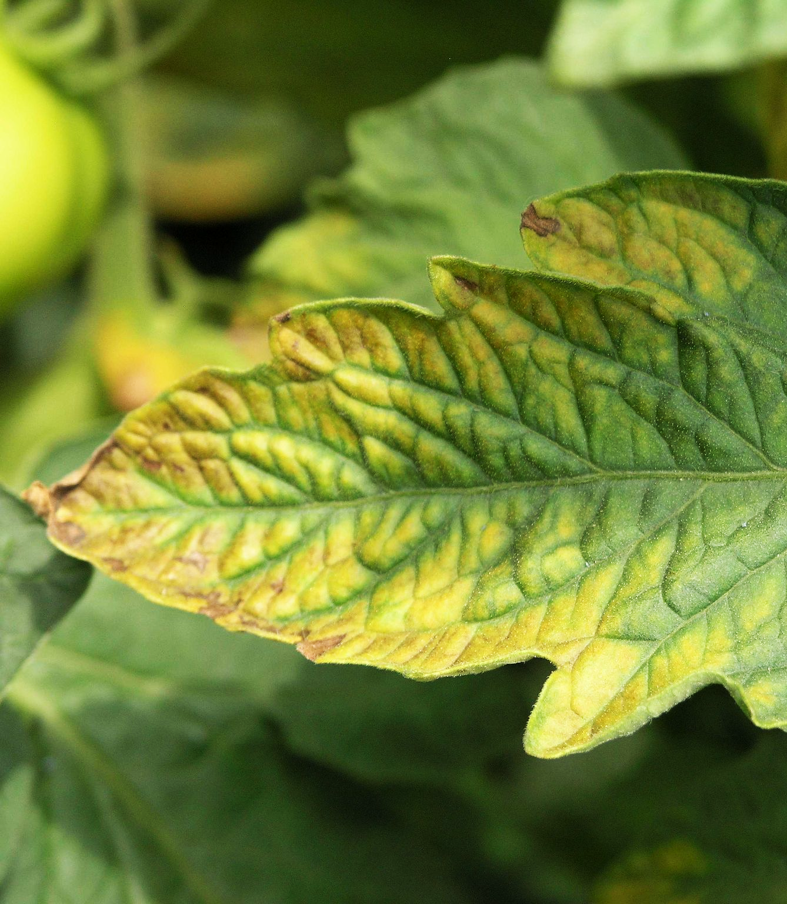
Potassium-deficient plants will have yellow leaves and dead spots.
Potassium is important for the production of ATP, which controls many metabolic processes.
For more help, please visit www.exampaperspractice.co.uk
© 2025 Exams Papers Practice. All Rights Reserved

Slide 12
Phosphates
Phosphate (PO₄³⁻) ions are a good source of phosphorous.
Phosphorus is required for the production of ADP and ATP.
ATP and ADP are important for metabolic processes.
Phosphorus is also required for the construction of nucleic acids.
Without phosphorus, new DNA cannot be synthesised.
Phosphorus is also needed for root growth.
Plants that are deficient in phosphorus have purple leaves and wilted roots.
Plants with a phosphorus deficiency will have purple leaves and wilted roots.
For more help, please visit www.exampaperspractice.co.uk
© 2025 Exams Papers Practice. All Rights Reserved

Slide 13
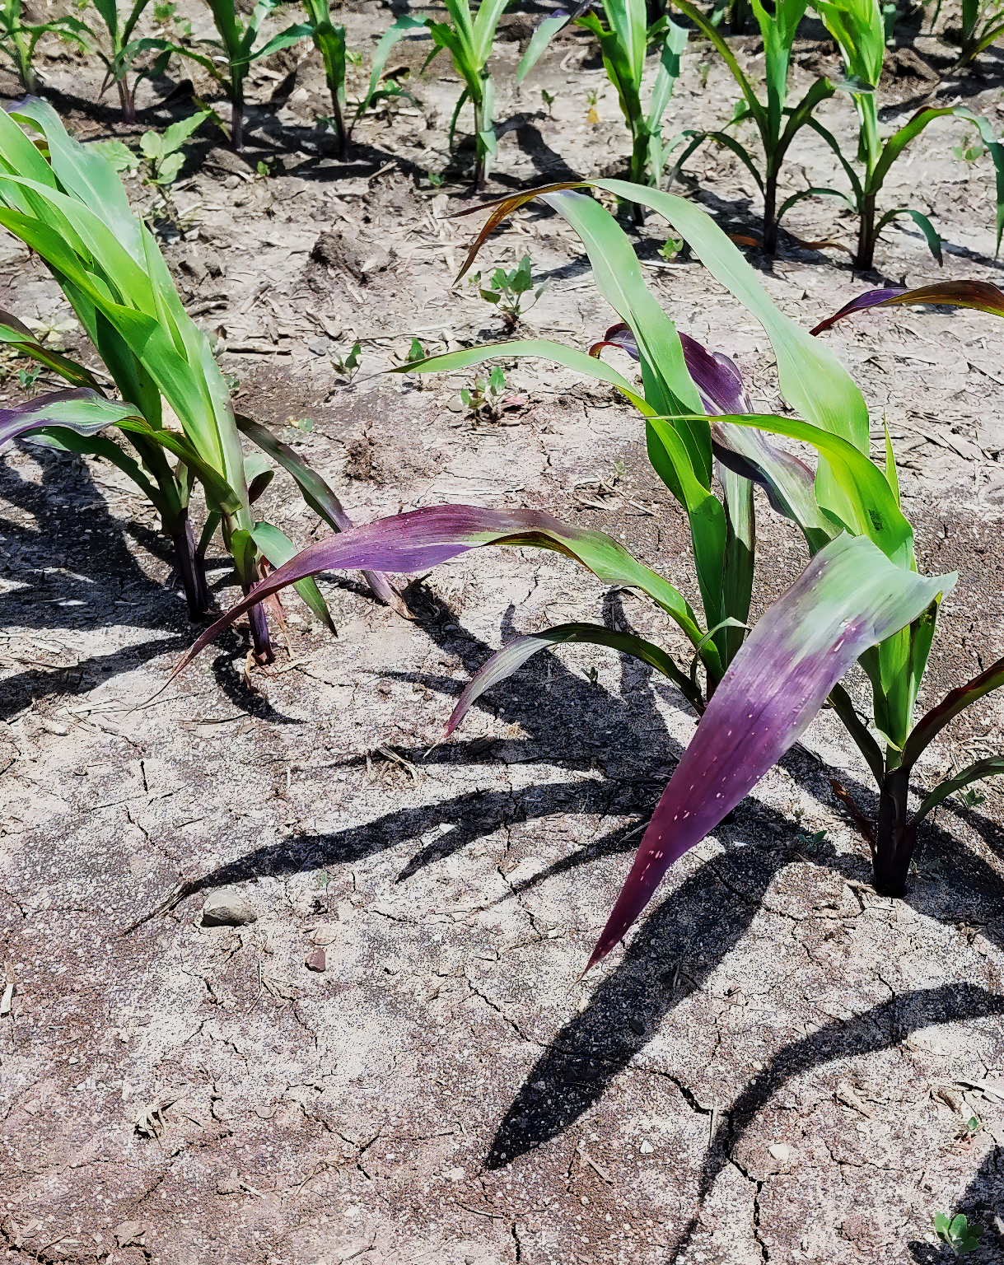
Phosphorus-deficient plants will have purple leaves and wilted roots.
Phosphorus is required for the construction of ADP, ATP and nucleic acids.
For more help, please visit www.exampaperspractice.co.uk
© 2025 Exams Papers Practice. All Rights Reserved

