Slide 1
Edexcel IGCSE Biology
10 - Nutrition in Plants
Photosynthesis
For more help, please visit www.exampaperspractice.co.uk
© 2025 Exams Papers Practice. All Rights Reserved

Slide 2
Photosynthesis
Specification Points 2.18 and 2.19
Understand the process of photosynthesis and its importance to the conversion of light energy into chemical energy.
Know the word equation and balanced chemical symbol equation for photosynthesis.
Photosynthesis is the process by which plants make food from light.
Photosynthesis takes in carbon dioxide (CO₂) from the atmosphere and converts it into glucose.
Photosynthesis also releases oxygen (O₂) as a waste product.
CARBON DIOXIDE + WATER → GLUCOSE + OXYGEN
6CO₂ + 6H₂O → C₆H₁₂O₆ + 6O₂
For more help, please visit www.exampaperspractice.co.uk
© 2025 Exams Papers Practice. All Rights Reserved

Slide 3
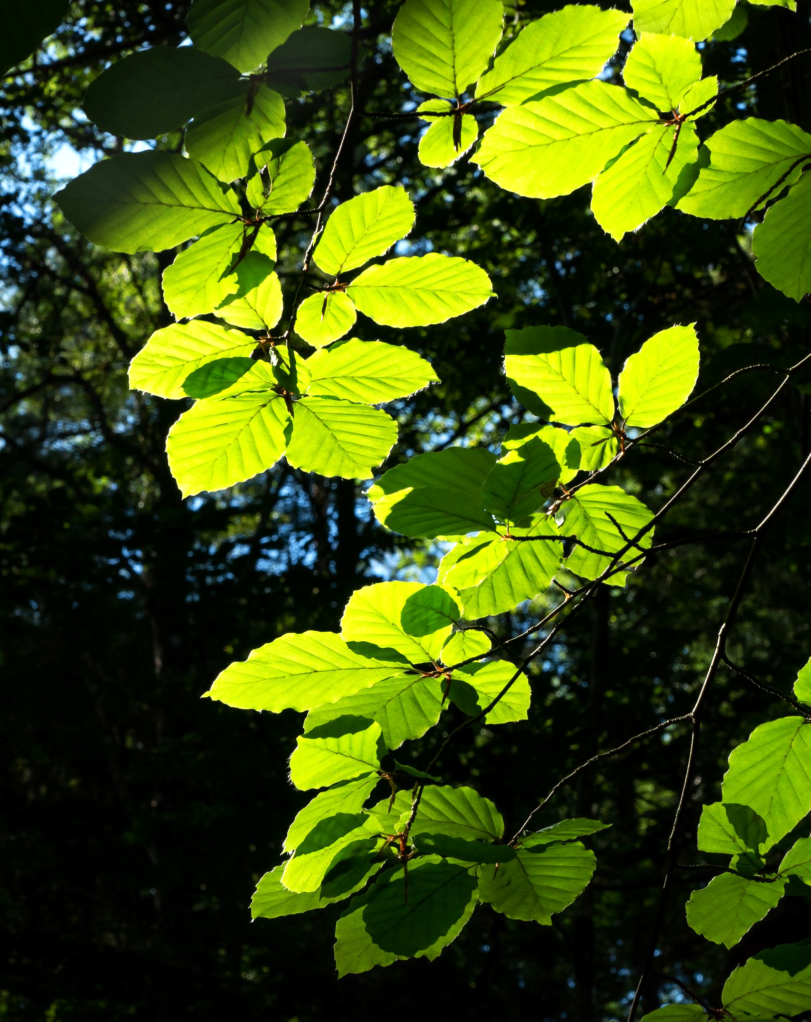
A green pigment called chlorophyll absorbs light energy which allows the leaves of plants to photosynthesise.
Photosynthesis allows plants to synthesise glucose (C₆H₁₂O₆).
For more help, please visit www.exampaperspractice.co.uk
© 2025 Exams Papers Practice. All Rights Reserved

Slide 4
Photosynthesis
Plants are referred to as autotrophic.
This means they have the ability to create their own food.
All food chains rely on plants as the primary producer of nutrients.
This means that photosynthesis is vital to the survival of ecosystems.
Some of the glucose created by photosynthesis is immediately respired.
Respiration creates energy for the plant.
Some of the glucose is stored as starch.
Glucose may also be converted into cellulose.
Photosynthesis is also largely responsible for creating new oxygen.
Without photosynthesis, the atmosphere would not be habitable to life.
For more help, please visit www.exampaperspractice.co.uk
© 2025 Exams Papers Practice. All Rights Reserved

Slide 5
Whilst most of the glucose created by photosynthesis is immediately respired for energy, some of it is packaged for storage as starch.
For more help, please visit www.exampaperspractice.co.uk
© 2025 Exams Papers Practice. All Rights Reserved

Slide 6
The great oxygenation of the atmosphere is partly down to the increased activity of photosynthetic plants.
GLOBAL CONCENTRATION OF O₂ AGAINST TIME
CONCENTRATION OF O₂ →
4 Bn YEARS
2 Bn YEARS
PRESENT
For more help, please visit www.exampaperspractice.co.uk
© 2025 Exams Papers Practice. All Rights Reserved

Slide 7
Factors Affecting Photosynthesis
Specification Point 2.20
Understand how varying carbon dioxide concentration, light intensity and temperature affect the rate of photosynthesis.
How quickly photosynthesis takes place is dependent on certain environmental factors:
Photosynthesis is dependent on temperature.
Photosynthesis is dependent on light intensity.
Photosynthesis is dependent on CO₂ concentration.
Because they control the rate of photosynthesis, these are often referred to as limiting factors.
For more help, please visit www.exampaperspractice.co.uk
© 2025 Exams Papers Practice. All Rights Reserved

Slide 8
Temperature
As the temperature increases, the rate of photosynthesis increases.
Photosynthesis is a biochemical reaction that is driven by enzymes.
If it is too cold, there is not enough kinetic energy for a reasonable rate of reaction.
At high temperatures, enzymes denature and become ineffective.
If it gets too hot, the rate of photosynthesis drops rapidly.
This change is irreversible and usually leads to the death of the plant.
As photosynthesis is controlled by enzymes, its rate is linked to the temperature of the environment.
RATE OF REACTION →
OPTIMUM TEMPERATURE
TEMPERATURE (°C) →
For more help, please visit www.exampaperspractice.co.uk
© 2025 Exams Papers Practice. All Rights Reserved

Slide 9
Light Intensity
As the light intensity increases, the rate of photosynthesis increases.
Certain aspects of the photosynthetic reaction require light to take place.
If chlorophyll does not absorb enough light energy, the reaction will slow down.
The rate of photosynthesis will continue to increase until another factor becomes limiting.
CO₂ concentration or temperature may now become limiting factors.
RATE OF PHOTOSYNTHESIS →
LIGHT INTENSITY (LUX) →
For more help, please visit www.exampaperspractice.co.uk
© 2025 Exams Papers Practice. All Rights Reserved

Slide 10
Carbon Dioxide Concentration
As CO₂ concentration increases, rate of photosynthesis increases.
This is because CO₂ is a substrate for the photosynthetic reaction.
CO₂ provides the carbon to make glucose.
The rate of photosynthesis will continue to increase until another factor becomes limiting.
Light intensity or temperature may now become limiting factors.
RATE OF PHOTOSYNTHESIS →
CO₂ CONCENTRATION (PPM) →
For more help, please visit www.exampaperspractice.co.uk
© 2025 Exams Papers Practice. All Rights Reserved

