Slide 1
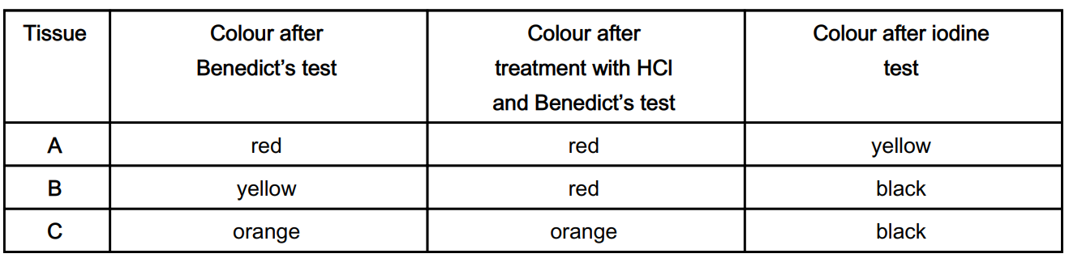
Knowledge retrieval questions
Q1. Glucose and other carbohydrates are present in respiring cells. The concentrations of carbohydrate molecules vary between tissues. A student conducted tests on three tissues, A, B and C. Table 2 shows the results of these tests.
Two of the tissues were known to be phloem tissue and liver tissue. Use the evidence in Table 2 to identify which tissue, A, B or C, is phloem and which tissue is liver. Explain your answer.
Tissue :
must be phloem because :
Tissue :
must be liver because :
B
Contains sucrose / non-reducing sugars – hydrolysed/broken down with HCl given red colour
A
Does not contain starch – negative iodine test
Notes:
HCl hydrolyses sucrose into glucose and fructose
Hydrolyse – to break down using a chemical reaction with water
A non-reducing sugars are carbohydrates – sucrose is the most common NRS.
Glucose is reducing because it is easily oxidised – so is an reducing agent.
When levels of glucose (and consequently insulin) are high in the blood, the liver responds to the insulin by absorbing glucose.

Slide 2
Knowledge retrieval questions
Q2. The majority of cells in phloem tissue are either companion cells or sieve tube elements. A scientist isolated companion cells and conducted some experiments to investigate the mechanism involved in loading sucrose into the sieve tubes.
She recorded the following observations:
observation 1 isolated companion cells became slightly negatively charged compared with their surroundings
observation 2 companion cells could decrease the pH of the surrounding solution from 7.0 to 5.6
observation 3 the pH inside the companion cells rose from 7.0 to 8.2
observation 4 treatment with cyanide (which stops aerobic respiration) prevents the change in pH occurring
From observation 1, the scientist concluded that the mechanism involved a transfer of charged particles (ions) between the companion cells and their surroundings.
What conclusions can be drawn from observations 2 and 3 about the mechanism? (2 marks)
(ii) What conclusions can be drawn from observation 4 about the mechanism? (1 mark)
The charged particles are hydrogen ions / these are moved out of the cell into the surround solution
Hydrogen ions are no longer being pumped out of the cell, meaning it I an active process requiring ATP

Slide 3
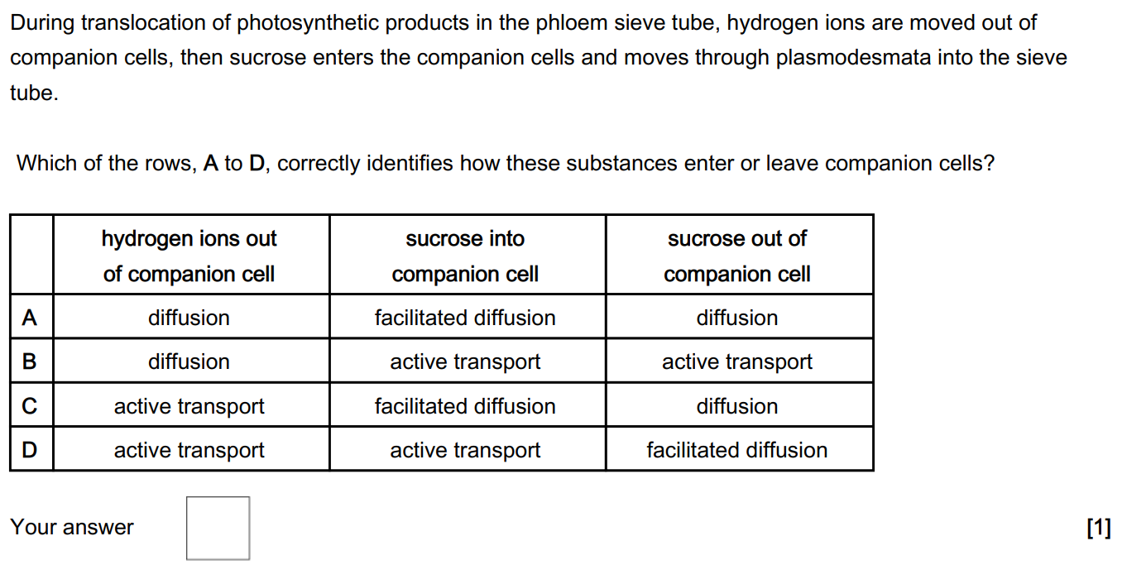
Knowledge retrieval question
Q3.
c

Slide 4
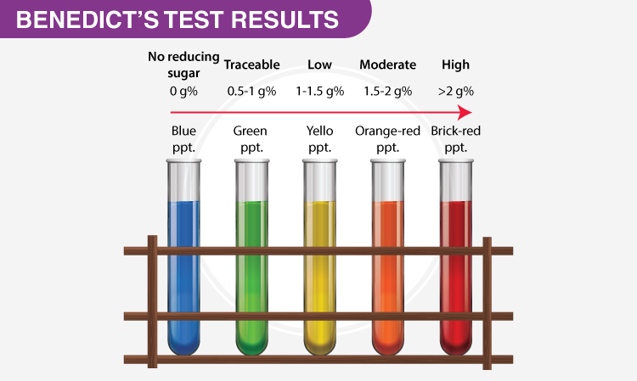

Slide 5
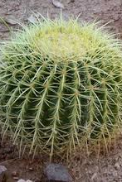
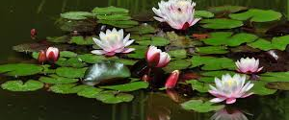
Plant adaptations to the availability of water

Slide 6
MINI ECOLOGY TRIP
Visit the following location to gather information and photos to complete your table for the following types of plant:
Mesophytes – Under the arch by the wizard
Xerophytes – On the tables (mint café)
Hydrophytes – By the pond (next to 6th form block) Don’t fall in!

Slide 7
Type of plant | Description | Adaptations | Photo
Mesophytes
Hydrophytes
Xerophytes

Slide 8
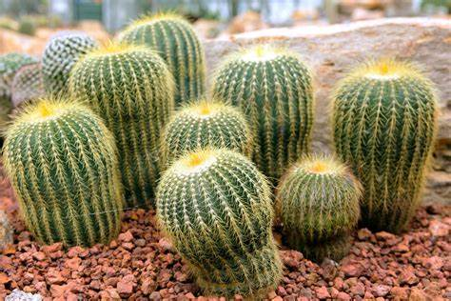
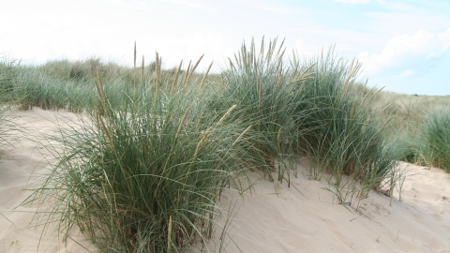
Description
Xerophytes
dry
plant
Xerophytes are plants with structural and physiological adaptations that enable them to survive in hot, dry conditions. They live in areas where water lost via transpiration is greater than taken up by roots.
In prolonged drought, they have several adaptations, which make them successful.
Examples of these are cacti and marram grass

Slide 9
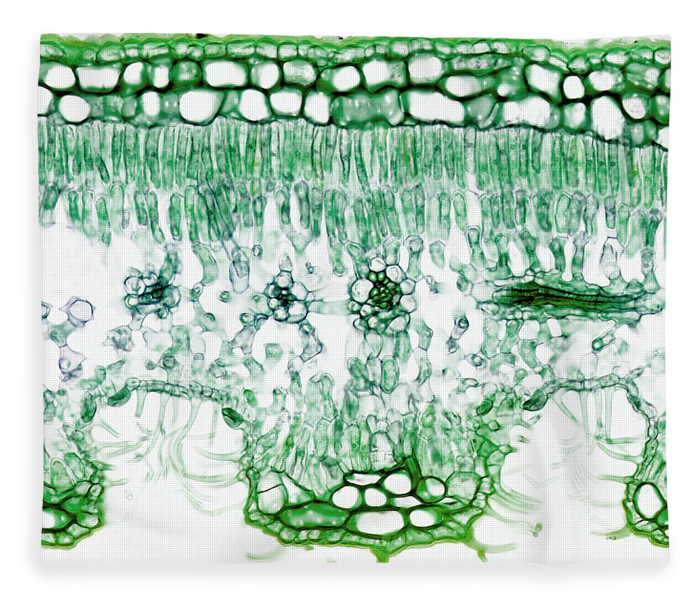
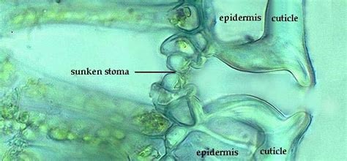
Adaptation – Sunken stomata
A sunken stomata in a small pit, which protects the escaping water vapor from air currents, decreasing water loss from the leaf.

Slide 10
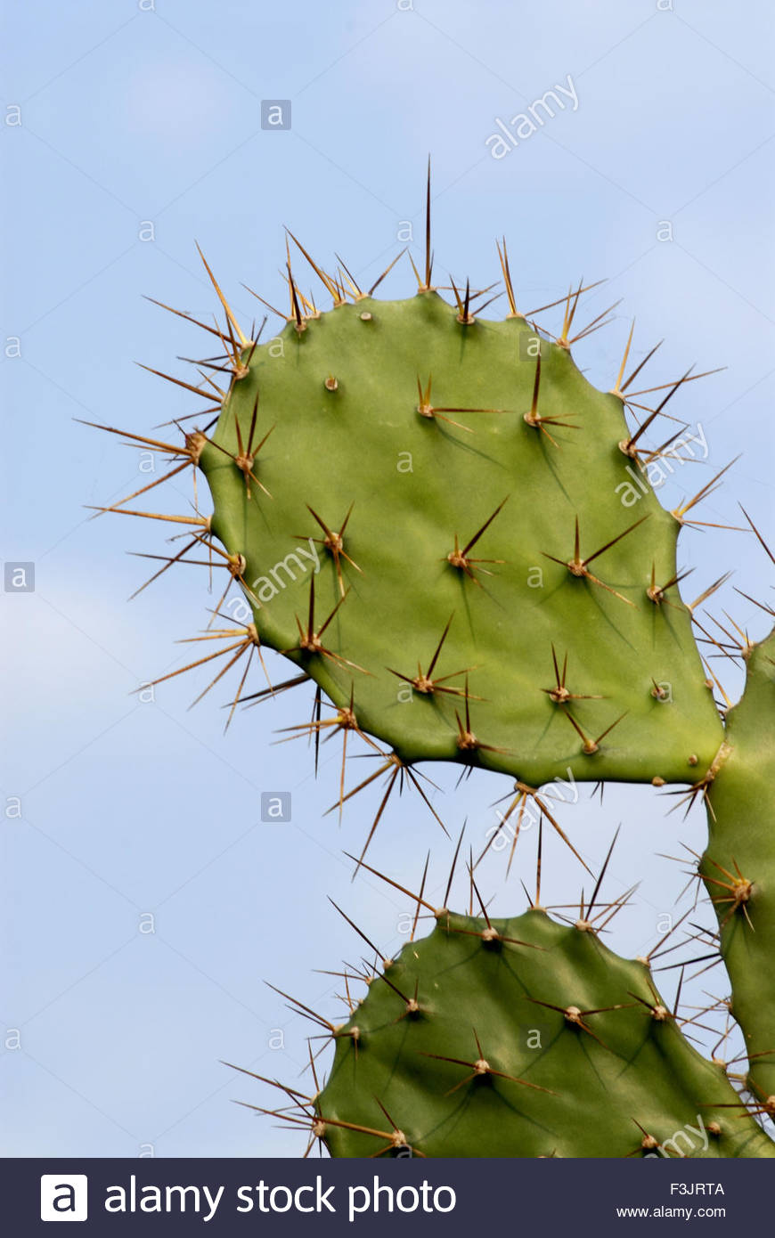
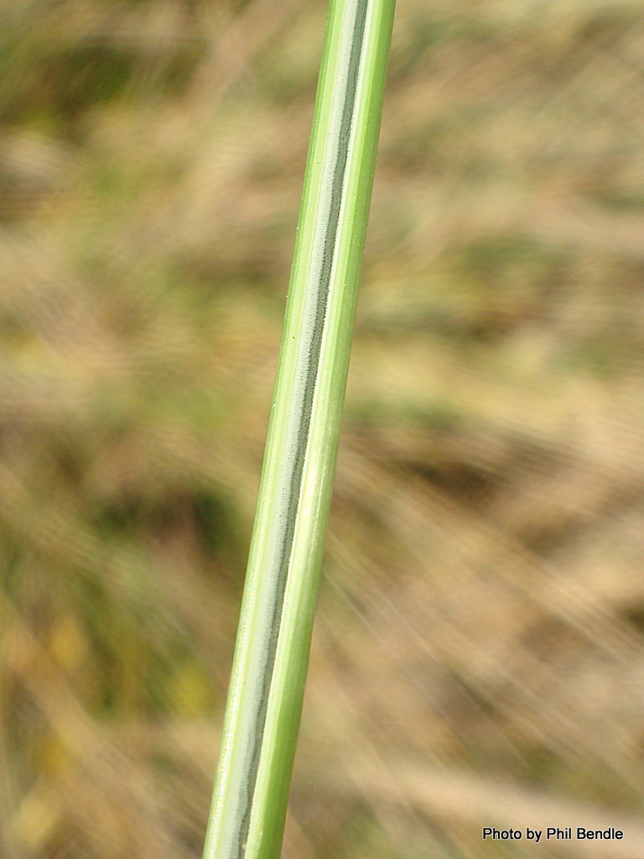
Adaptation – Rolled leaves or spines / thick waxy cuticle
Long thin leaves / spines reduced surface area and decrease the rate of transpiration
A thick waxy cuticle helps to reduce evaporation on the upper surface of the leaf

Slide 11
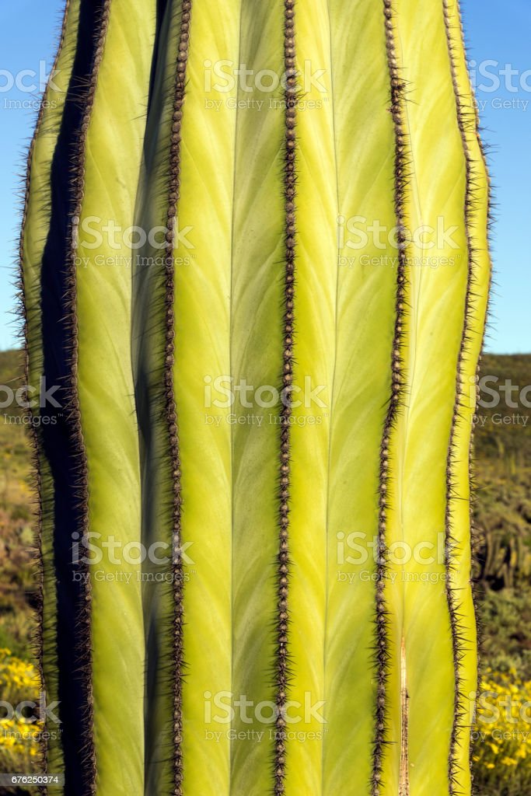
Adaptation – Fleshy stem / green stem / dense mesophyll
The stem are fleshy and able to expand to store water when it becomes available
The stem is also green (containing chlorophyll) and able to photosynthesise
They also have a dense spongey mesophyll, so less air space for evaporation

Slide 12
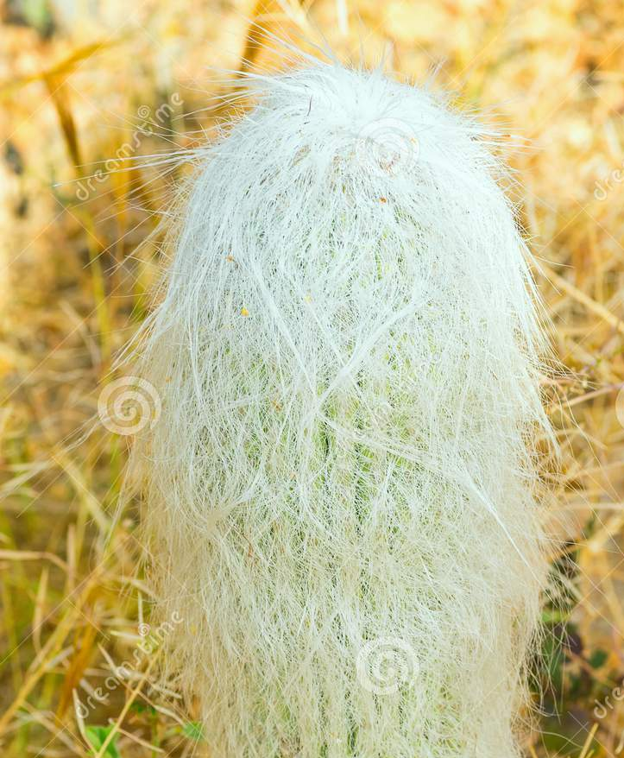
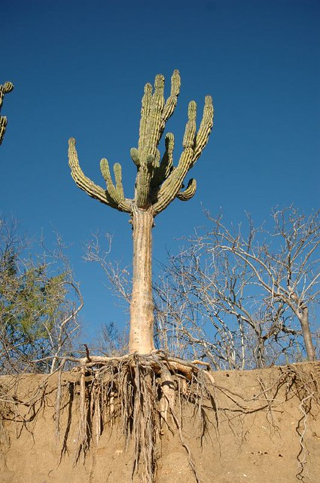
Adaptation – deep root system / hairs surrounding plant
A deep root system increases the uptake of water in the roots
Small hairs surrounding the plants creates localized humidity, reducing water loss.

Slide 14
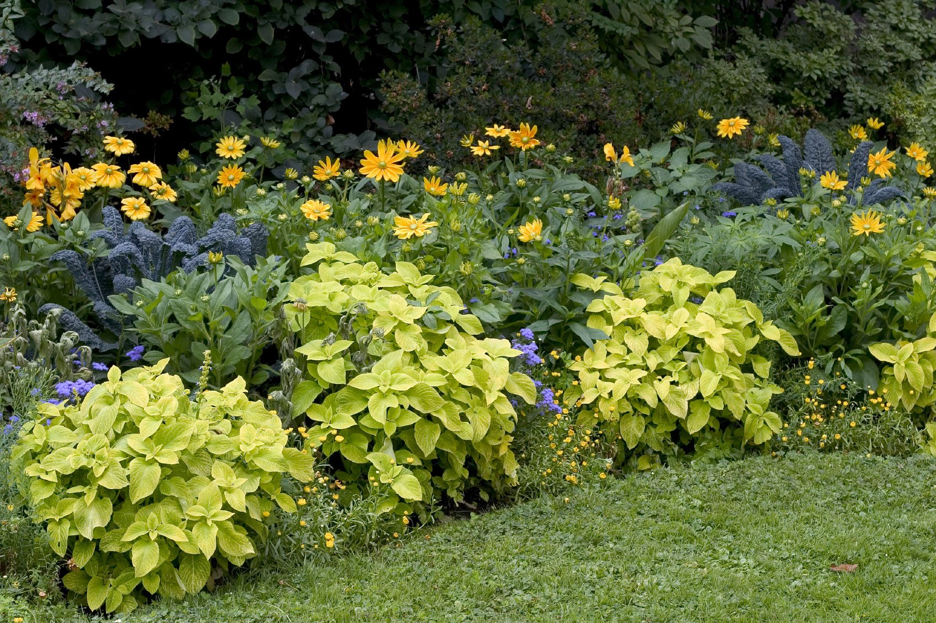
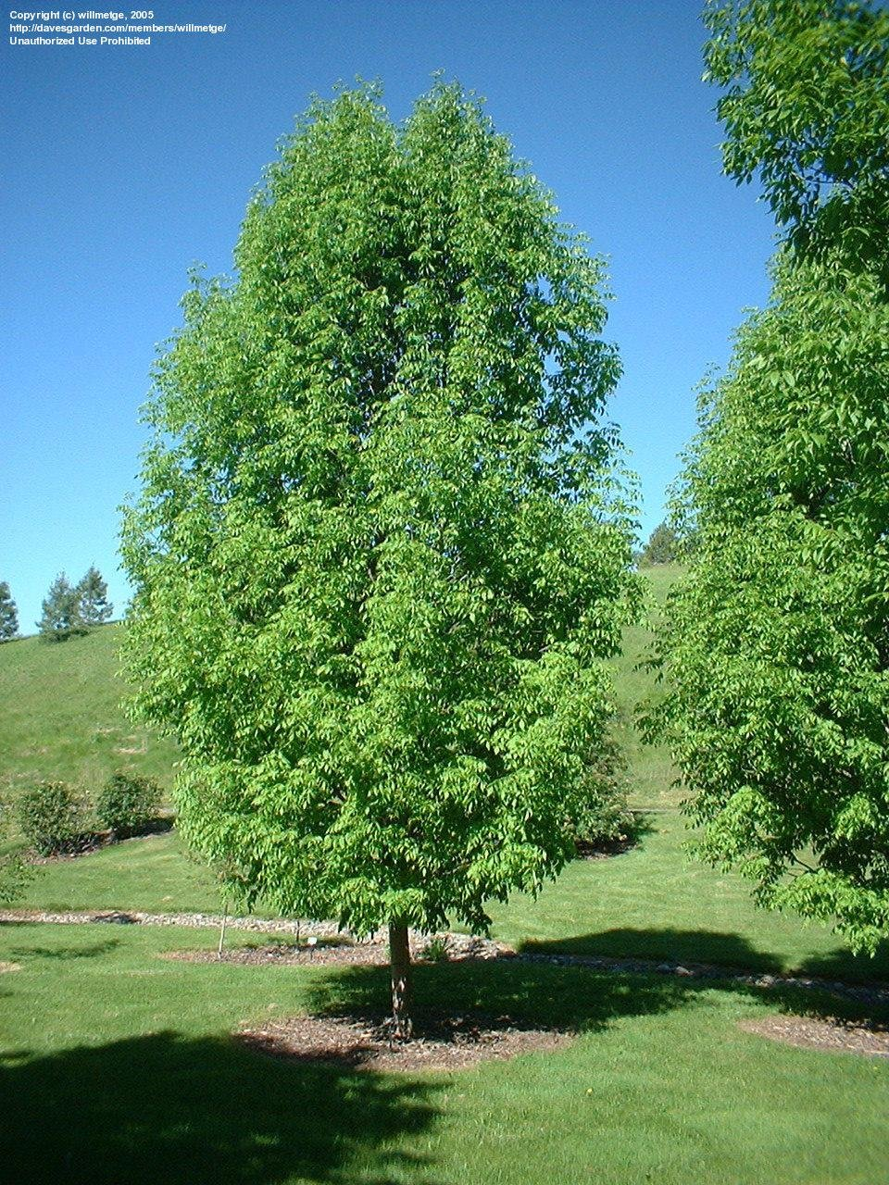
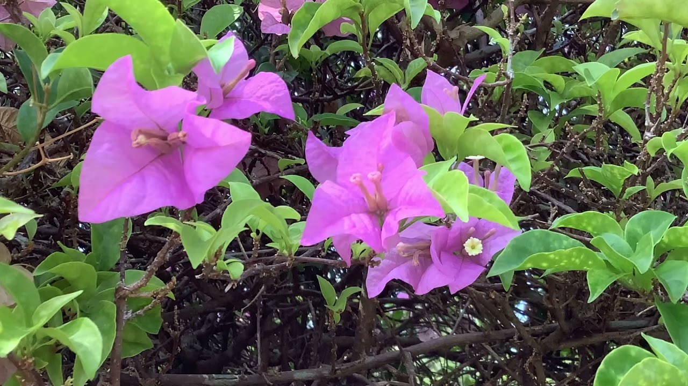
Description
Mesophytes
middle
plant
Are able to take up sufficient water to replace transpiration loss (most plants)

Slide 15
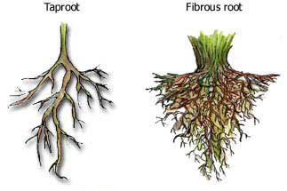
Adaptation – roots
Root systems can be fibrous, which are thin roots and are only penetrate the soil at a shallow level, meaning that they can absorb water quickly from the surface of the soil.
Roots can also be formed in a taproot system. In a taproot system here is one thick primary root, with several smaller roots branching off the primary root. Taproots penetrate deeply into the soil, meaning that they can absorb moisture from the deep soil.

Slide 16
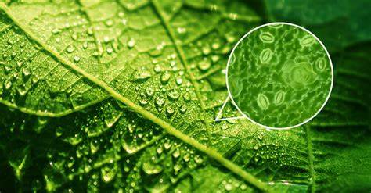
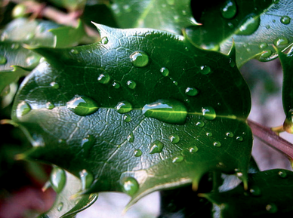
Adaptation – stomata / waxy cuticle
Most only have stomata present on their lower epidermis. Stomata are cells that control the exchange of water and gases from inside and outside of the leaf.
The waxy cuticle present on both epidermis’, but it is thicker on the upper epidermis. The waxy cuticle prevents water loss as it traps water inside the leaf, keeping moisture contained, and it prevents water from easily diffusing through the leaf to the outside. It is thicker on the upper epidermis because the upper side of a leaf is exposed to harsher conditions such as temperature, wind, humidity and light exposure

Slide 18
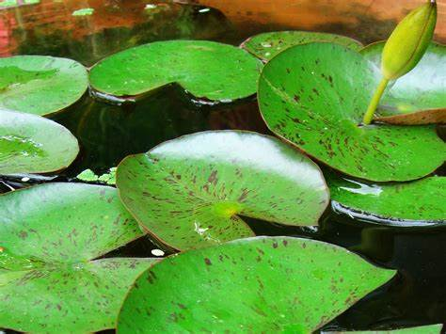
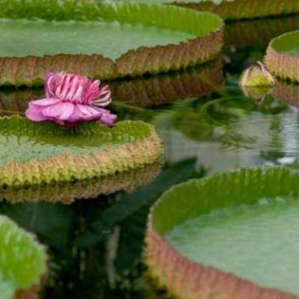
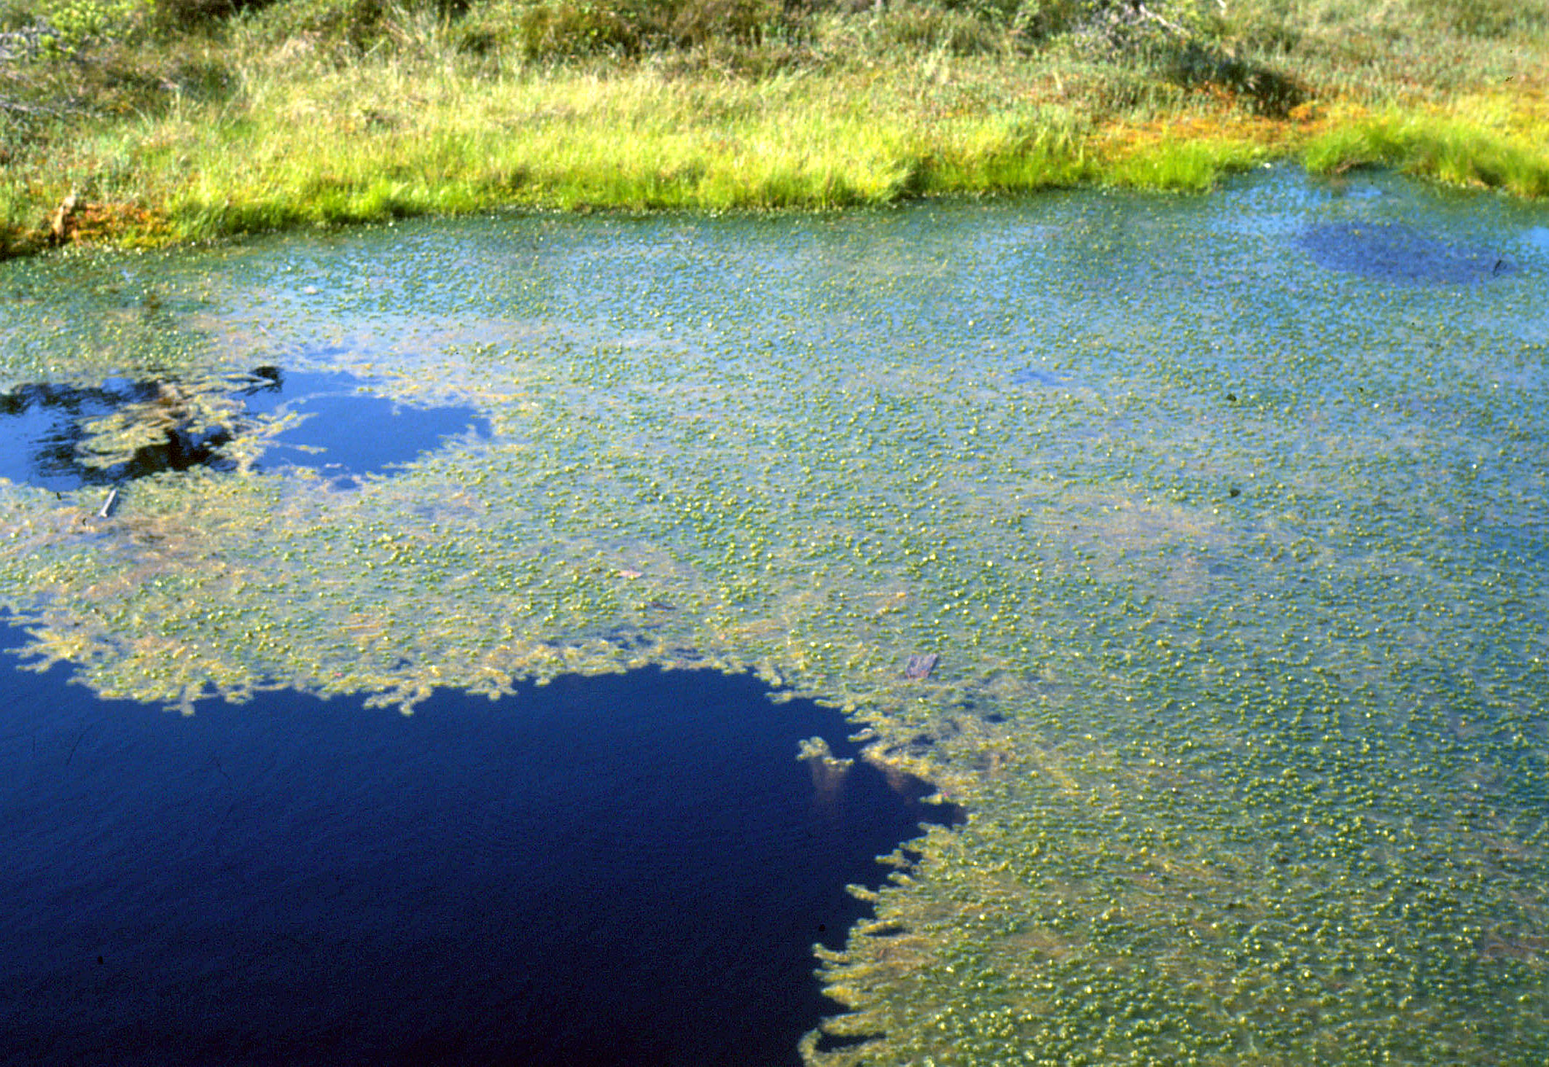
Description
Hydrophytes
water
plant
Live either partially or completely submerged in water – problems with O₂ uptake.

Slide 19
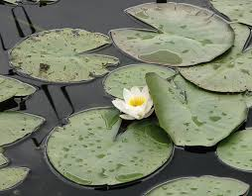
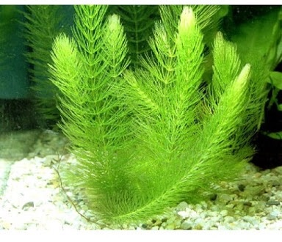
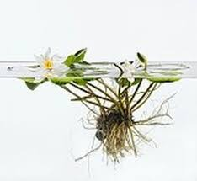
These plants have a permanent supply of water, so why could this cause them a problem?
Water uptake is caused by water loss from the stomata.
Watery environments are very humid.
Oxygen needs to diffuse from the surface leaves all the way to the roots.

Slide 20
Adaptation – stomata / waxy cuticle
The green pigment-containing chloroplasts important for photosynthesis are restricted to the upper surface of the leaves which are the only surface to be well lit.
Stomata are also found only on the upper surface of the leaf.
No waxy cuticle to maximise water loss and avoid oversaturation

Slide 21
Adaptation – roots and stem
Roots are often also reduced and their main function is anchorage.
This upper surface often has a thick waxy cuticle to repel water and help to keep the stomata open and clear.
The presence of little or no strengthening tissue in stems or leaf. Support would be disadvantage as it would limit flexibility in the event of changes in water level or water movements.

Slide 22
Adaptation – leaf / (no) waxy cuticle / stem
Large air spaces in the stem and leaves to allow the plant to float and absorb maximum sunlight.
Water diffuses directly into the stem
Contain hydathodes, which are openings within the epidermis of plants that release water during the process known as guttation.
Aerenchyma - specialised parenchyma tissue which aids buoyancy and forms an efficient pathway for oxygen into the tissues, important for the anoxic conditions.

Slide 23
Upload all work onto Teams

Slide 24
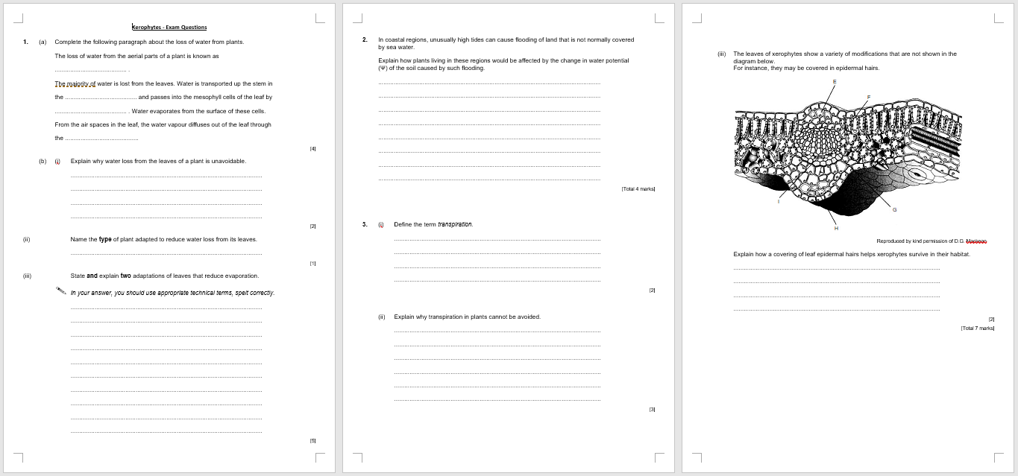
Try these exam questions in the folder

Slide 25
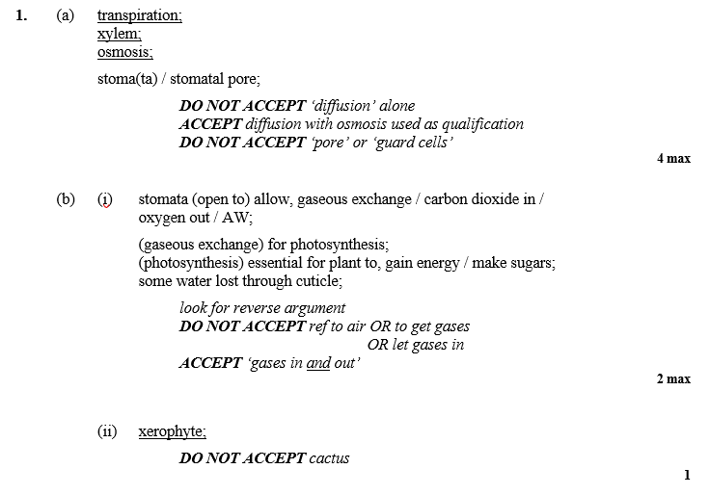

Slide 26
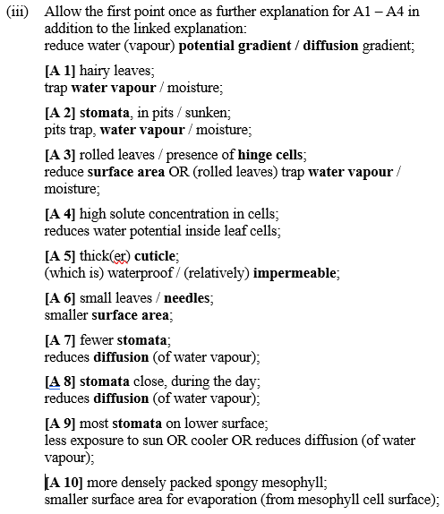
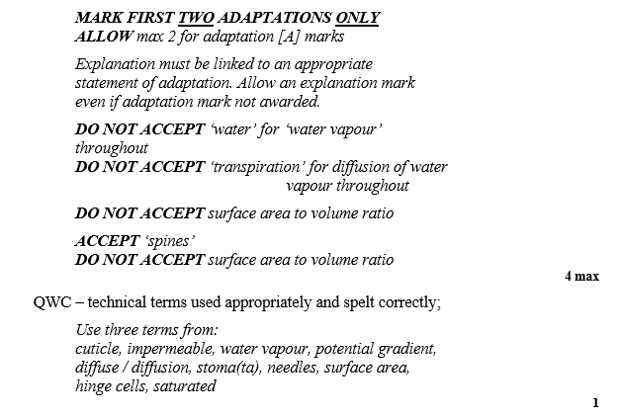

Slide 27
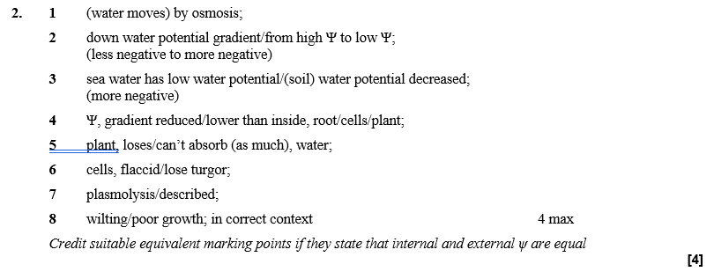

Slide 28
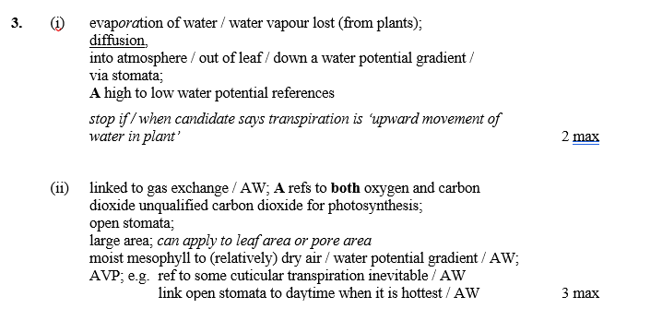
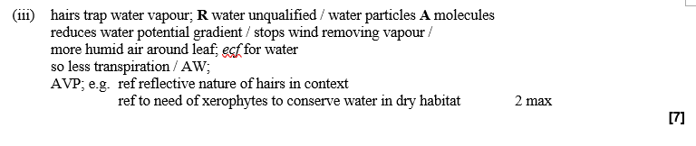

Slide 29
Key terms:
Now you add:
Plasmodesmata
Pits
Middle lamella
Pectin
Hydathodes
Amyloplast
Xerophyte
Sieve plate element
Companion cell
Casparian strip
Cortex
Steele
Endodermis
Potometer
Water vapour potential gradient
Apoplast pathway
Symplast pathway
Vacuolar pathway
Lignin
Sieve plates
Sclerenchyma
Parenchyma
Water potential
Transpiration
Diffusion
Evaporation

Slide 30
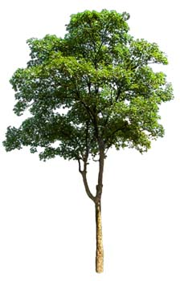
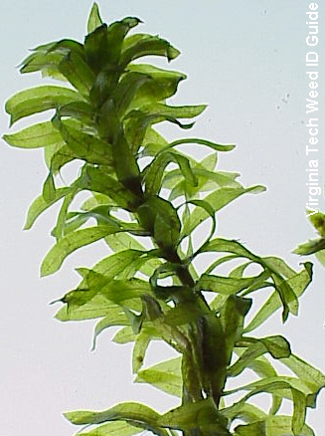
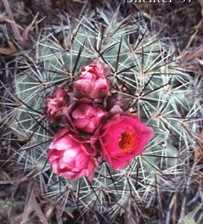
Plants and Water
Mesophytes: able to take up sufficient water to replace transpiration (most plants).
Hydrophytes: live either partially or completely submerged in water – problems with O₂ uptake.
Xerophytes: live in areas where water lost via transpiration is greater than taken up by roots.

