Slide 1
(f) the use of the Hardy–Weinberg principle to calculate allele frequencies in populations
Keywords: H-W, allele frequency, phenotype, genotype
Lesson objectives:
Describe the purpose of the H-W principle
Complete calculation questions
Notes:
Equations for H-W principle will be provided

Slide 2
Starter – define the keywords
Total number of alleles in a particular population at a specific time
Gene pool
Allele
Phenotype
Genotype
The form of a gene
The characteristics of an organism
The genetic composition of an organism – the alleles it possesses

Slide 3
Key terms
Gene pool:
Allelic frequency:
All alleles of all genes of all individuals in a population at any one time
The number of times an allele occurs within a gene pool

Slide 4
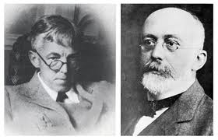
Hardy- Weinberg principle
It predicts the proportion of dominant and recessive alleles in a population. This stays the same provided that:
No mutations arise
The population is isolated (no alleles in or out)
There is no selection ( all alleles are equally likely to be passed on)
The population is large
Mating within the population is random

Slide 5
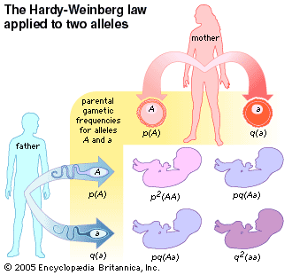
From this information can you deduce an equation to represent all the genotypes in a population?
This law uses p to represent the dominant allele and q to represent the recessive.

Slide 6
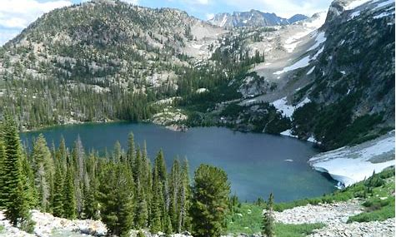
2 conclusions to make.....
Of one species of fish living in the lake:
All the fish can only have dominant or recessive alleles.
Therefore
p + q = 100%
The fish can only be homozygous dominant, homozygous recessive or heterozygous.
Therefore
p2 + 2pq + q2 = 100%

Slide 7
Using the formula
Hardy-Weinberg equations are used to calculate genetic frequencies.
Either:
Allele frequencies – how often an allele occurs in a population using
p + q = 1
Or:
Genotype frequencies – how often the different genotypes occur in a population using
p² + 2pq + q² = 1

Slide 8
Rules:
1. Don’t panic!!
2. In genetics it is usual for p to represent the dominant allele and q to represent the recessive allele.
3. Frequencies are usually written as a decimal or a percentage – look out for this in the question, you may have to convert the figure in the question or the answer.
4. For this equation you must use decimals, you convert a percentage into a decimal by dividing by 100, or vice versa.

Slide 9
Now:
Work through the first equation, (how often alleles occur in a population), substituting the given numbers for the letters, this bit's easy!
A species of mouse has two alleles for coat colour, B and b. If the frequency of B in a population is 0.67, what is the frequency of b in the population?
B = p and b = q.
From the equation we know B+b=1
Rearrange the equation b=1-B
b=1-0.67
b=0.33

Slide 10
Calculating genotype frequencies
Remember there are 3 possible genotypes using the Hardy-Weinberg symbols:
pp or p² – homozygous dominant
2pq – heterozygous (2xpxq)
qq or q² – homozygous recessive
If you are given values for any of these frequencies, you should be able to substitute them into the equation and calculate the required frequencies.
Next:
1. Try the worked example on the next slide

Slide 11
A different species of mouse has two alleles for coat colour, D and d. D is the dominant allele. If the frequency of the genotype DD in a population is 0.16 and the frequency of the genotype Dd is 0.48, what is the frequency of genotype dd in the population?
Select the correct equation, p² + 2pq + q² = 1
DD (homozygous dominant) = p²
Dd (heterozygous) = 2pq
dd (homozygous recessive) = q²
3. Rearrange the equation
q² = 1 – 0.16 – 0.48 = 0.36
Now combine the equations and work through the example

Slide 12
The shape of seeds in pea plants (wrinkled or smooth) is controlled by a gene with two alleles: S (smooth) and s (wrinkled). S is dominant.
If the frequency of plants with wrinkled seeds (ss) in a population is 0.16, what is the frequency of the heterozygous genotype in the population?
Calculate the frequency of the allele ‘s’ in the population.
Square root of 0.16 = 0.40
2. Work out the frequency of the ‘S’ allele in the population
p = 1 – 0.40 = 0.60
3. Find the frequency of the heterozygous genotype in the population
2pq = 2 x 0.60 x 0.40 = 0.48

Slide 13
Question 1
If 98 out of 200 individuals in a population express the recessive phenotype, what percent of the population would you predict would be heterozygotes?

Slide 14
Answer 1
98/200 = (q²)
0.49 = q²
0.7 = q
p + q = 1
p = 1 – 0.7
p = 0.3
2pq = 2(0.3)(0.7) = 0.42 = 42% heterozygotes

Slide 15
Question 2
Your original population of 200 in Q1 was hit by a tidal wave and 100 organisms were wiped out, leaving 36 homozygous recessive out of the 100 survivors. If we assume that all individuals were equally likely to be wiped out, how did the tidal wave affect the predicted frequencies of the alleles in the population?
Calculate the predicted heterozygous population and homozygous dominant

Slide 16
Answer 2
36/100 = q²
0.6 = q
p + q = 1
p = 0.4
Heterozygous = 2 (0.4)(0.6) = 0.48 = 48%
Homozygous dominant = (0.4)(0.4) = 0.16 = 16%

Slide 17
Question 3
Lets say that brown fur coloring is dominant to grey fur colour in mice. If you have 168 brown mice in a population of 200 mice........
What is the predicted frequency of
  Homozygous dominants
  Heterozygotes
  Homozygous recessives

Slide 18
Answer 3
200 mice in total
168 = brown = p2 + 2pq
32/200 = grey fur = q²
0.16 = q²
0.4 = q
p = 0.6 (p + q = 1)
p² = 0.36 = 36%
2pq = 0.48 = 48%
q² = 0.16 = 16%

Slide 19
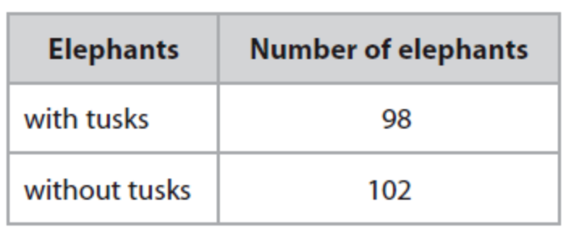
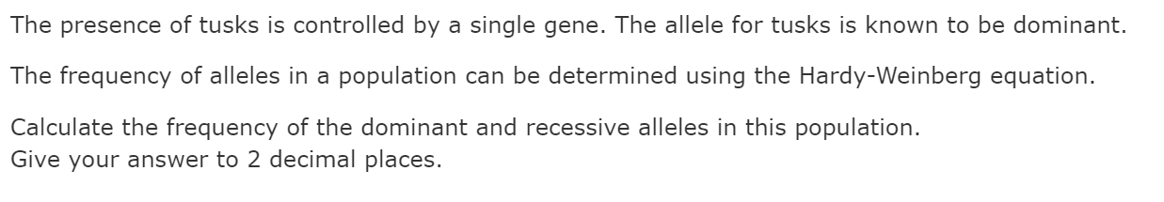
During the civil war in Mozambique, from 1977 to 1992, 90% of the African elephants were killed for the ivory in their tusks.
Since 1992, the elephant population in Mozambique has increased
A study of an elephant population in Mozambique was carried out in 2017.
The elephants studied were all born before 1992.
The table shows the number of elephants with and without tusks

Slide 20
