Slide 1
Knowledge retrieval
Start with a quiz!
Love Biology A Level Quiz | Transport in animals

Slide 2
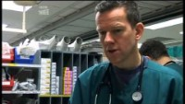

Slide 3
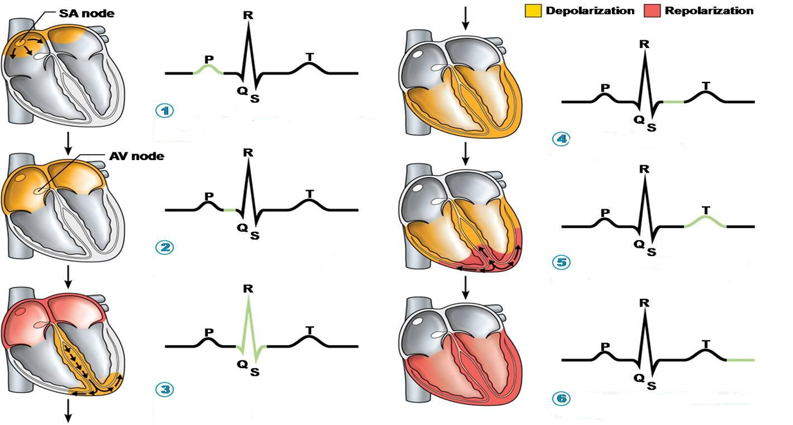
Knowledge retrieval question
Explain what is happening at each step using key scientific terminology (6 marks)

Slide 4
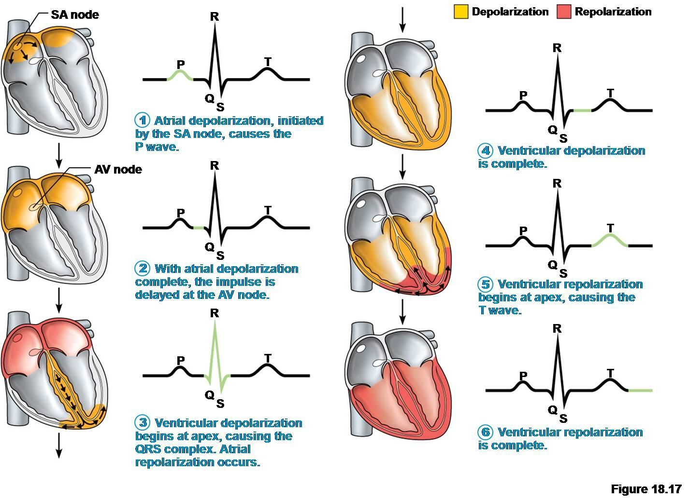
Excitation travels through the bundle of His
Notes:
Any change in Pd of a cell causes a wave

Slide 5
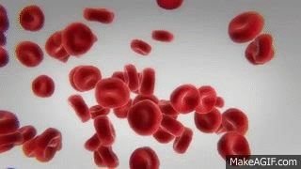
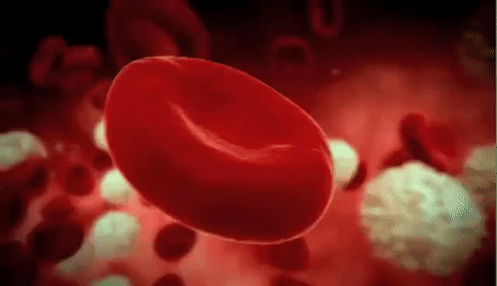
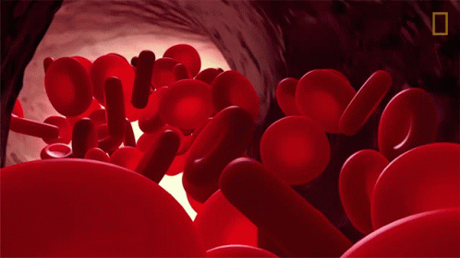
Why do red blood cells only last for around 120 days?
Notes:
Removal of the nuclei:
To maximise the amount of haemoglobin that can fit into the cell.
*it also limits the life of the cell
Why?
Limits the cells repair capabilities – only last 120 days in the bloodstream

Slide 6
Function / adaptations / where are they produced?
Make annotations around your erythrocyte diagram

Slide 7
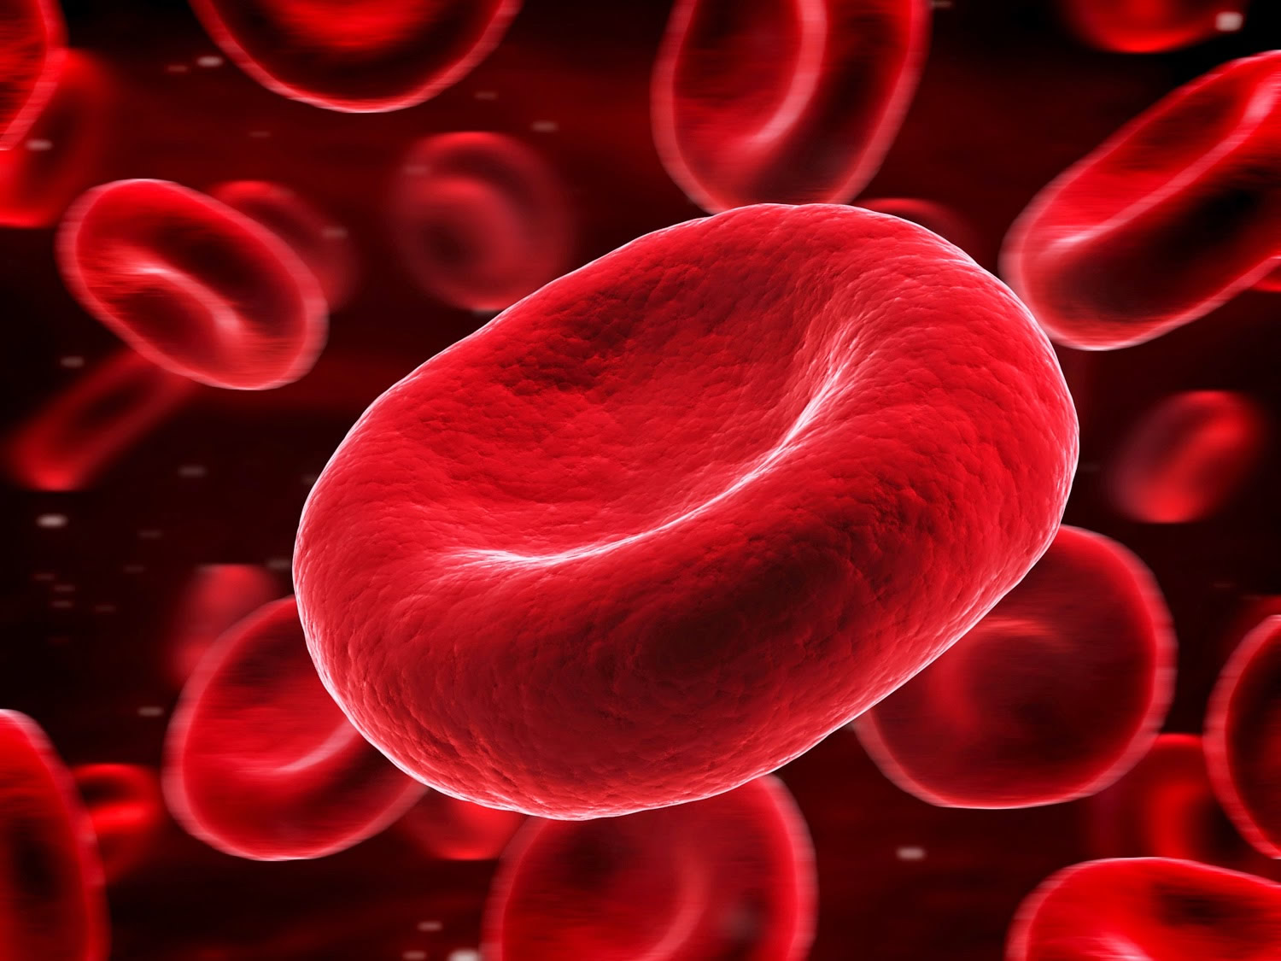

Adaptations:
Biconcave shape:
Increase the surface area for diffusion of gases
Allows the cell to pass through narrow capillaries
Contain haemoglobin:
Binds to oxygen for transport
Removal of the nuclei:
To maximise the amount of haemoglobin that can fit into the cell.
*it also limits the life of the cell
Why?
Limits the cells repair capabilities – only last 120 days in the bloodstream
Function:
Transport of oxygen to the cells
Removal of CO₂ from the cells
Production site:
Formed continuously in the red bone marrow
There are approx. 300 million molecules of Hb in each rbc
Notes:
Neutrophils are very short-lived, with a half-life of 5 days – contain toxins after killing microbes that need to be removed from the body
T cells have a half-life of 1-8 years.
The ABO system
There are 4 main blood groups defined by the ABO system:
blood group A – has A antigens on the red blood cells with anti-B antibodies in the plasma
blood group B – has B antigens with anti-A antibodies in the plasma
blood group O – has no antigens, but both anti-A and anti-B antibodies in the plasma
blood group AB – has both A and B antigens, but no antibodies
Blood group O is the most common blood group. Almost half of the UK population (48%) has blood group O.
Receiving blood from the wrong ABO group can be life-threatening. For example, if someone with group B blood is given group A blood, their anti-A antibodies will attack the group A cells.
This is why group A blood must never be given to someone who has group B blood and vice versa.
As group O red blood cells do not have any A or B antigens, it can safely be given to any other group.

Slide 8
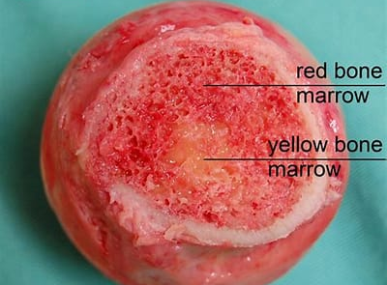
How bones make blood - Melody Smith - YouTube
Notes:
Yellow marrow is found in the center of the long bones. In the fetus and infants, red marrow is found in almost all the bones of the body As a child matures, the red marrow recedes and is replaced by yellow marrow, which consists of fat cells and connective tissue. It is also stimulated to produce more red blood cells in the result of sudden blood loss.

Slide 9
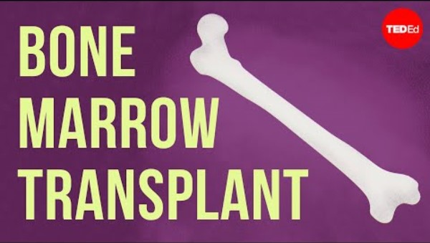
Making blood

Slide 10
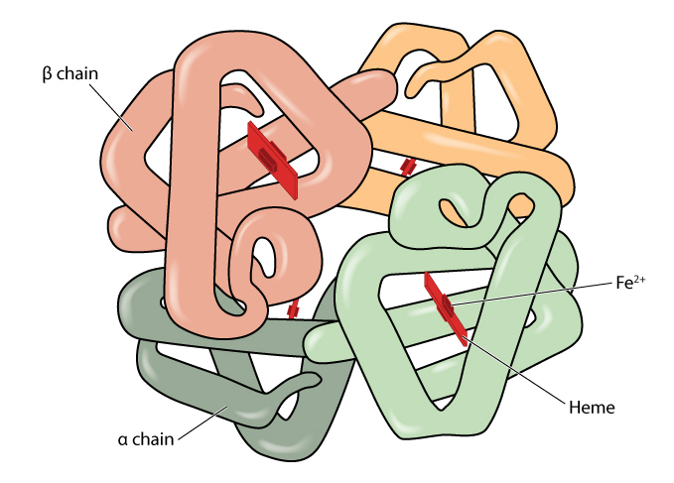
Annotate around the structure with as much detail as you can about haemoglobin
Notes:
Contains a red pigment that gives them their colour.
Made from four polypeptide chains, two alpha (α) and two beta (β)
Each polypeptide has an iron-containing haem group.
Each haemoglobin molecule can bind to four oxygen molecules for transport around the body.

Slide 11
Haemoglobin
A large globular conjugated protein.
O₂
O₂
Structure
Contains a red pigment that gives them their colour.
Made from four polypeptide chains, two alpha (α) and two beta (β)
Each polypeptide has an iron-containing haem group.
Each haemoglobin molecule can bind to four oxygen molecules for transport around the body.
Oxygen binds loosely to the haemoglobin forming oxyhaemoglobin. It is is a reversible reaction:
Haemoglobin + oxygen ⇌ oxyhaemoglobin
Hb = haemoglobin
Complete the chemical equation below:
Hb + …..O₂ ⇌ Hb(O₂)…..
O₂
O₂
Why does this need to be a reversible reaction?
4
4
Notes:
Test them on the word conjugated – “The union of two compounds”

Slide 12
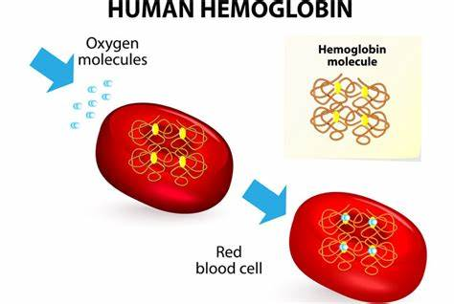
Why does Oxygen keep moving into a RBC?

Slide 13
Haemoglobin saturation
O₂ binds to the Hb
Free oxygen concentration in the RBC remains low
Maintaining a steep concentration gradient
Until all Hb become saturated with O₂
Explain what happens to the oxygen when it reaches the respiring tissue? (4 marks)
Hint: Why would oxygen move from the RBC into the cells?
Notes:
Because the oxygen is bound to the haemoglobin in the RBC
The free oxygen concentration in the erythrocyte stays low – maintaining a steep concentration gradient until all of the haemoglobin is saturated with oxygen

Slide 14
Explain what happens to the oxygen when it reaches the respiring tissue? (4 marks)
The concentration of the oxygen in the cytoplasm of the body cells is ……….. than in the ………………………
As a result ………….. moves out of the …………………….. into the cells
Down the …………………….. gradient
Once the …………. molecule of O₂ is released the Hb ………. ………… to make it easier to remove the remaining oxygen molecules

Slide 15
Explain what happens to the oxygen when it reaches the respiring tissue? (4 marks)
The concentration of the oxygen in the cytoplasm of the body cells is lower than in the erythrocytes
As a result oxygen moves out via diffusion of the erythrocytes into the cells
Down the concentration gradient
Once the first molecule of O₂ is released the Hb changes shape to make it easier to remove the remaining oxygen molecules

Slide 16
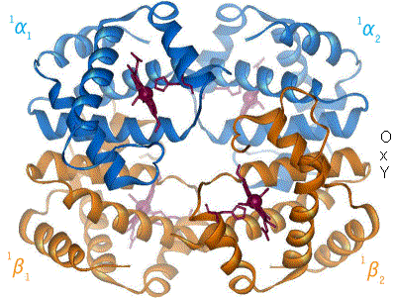
Cooperative nature of oxygen binding
This is also true when loading oxygen

Slide 17
Cooperative nature of oxygen binding
Joining = association (loading)
Leaving = dissociation (unloading)
1st O₂ binds = when the first O₂ molecule associates with the heam group the Hb changes shape and allows easier access for the 2nd and 3rd molecules of O₂
After 3rd O₂ binds = it is harder for final O₂ to bind as we are reaching 100% saturation

Slide 18
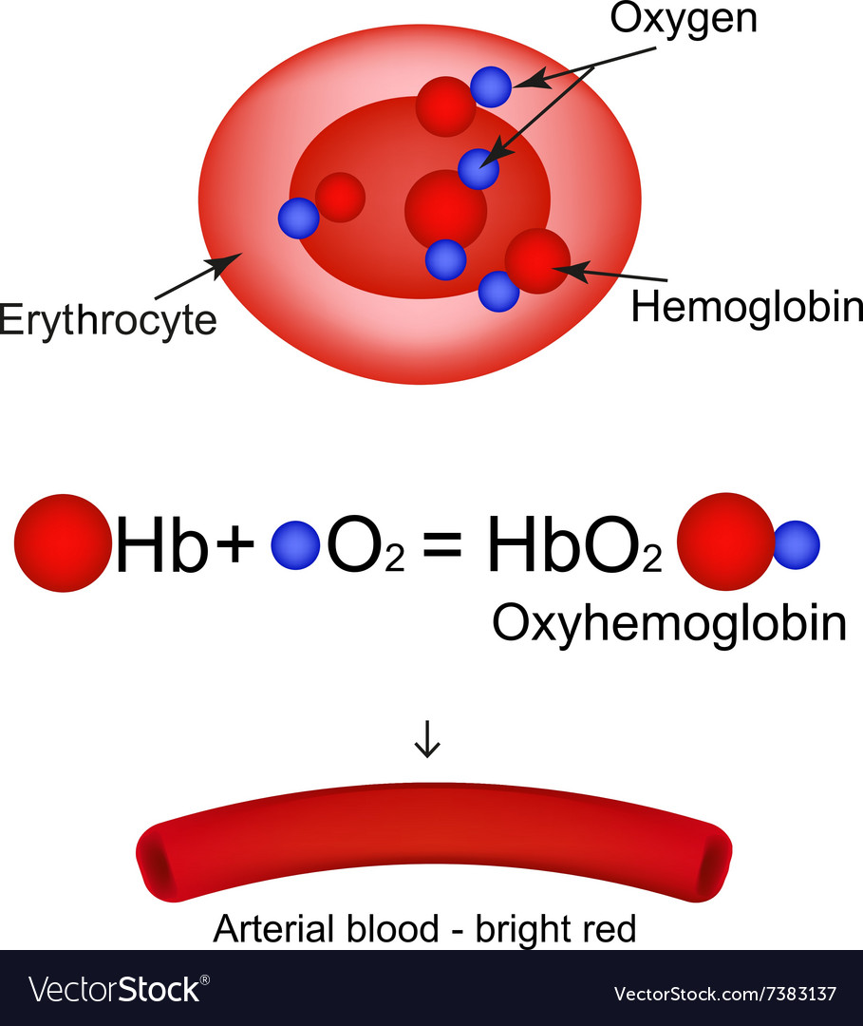
Carrying oxygen
RECAP
Reversible reaction
Joining = association (loading)
Leaving = dissociation (unloading)
Affinity for O₂ = ability to bind O₂
A high affinity means lots of oxygen bound and a low affinity means little oxygen bound.
Exam tip:
You must refer to Hb having a HIGH affinity for O₂ not just an affinity.
Hb has the affinity NOT the oxygen
Haemoglobin’s affinity for oxygen depends on many things, one being the partial pressure of oxygen ( pO₂ ), measured in kPa.

Slide 19
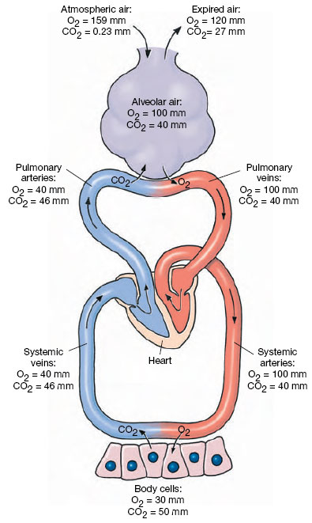
Partial pressure of oxygen (pO₂)
A measure of oxygen concentration
The greater the concentration of O₂ the higher the pO₂.
As pO₂ increases, haemoglobin’s affinity for O₂ also increases.
This means that there is more oxyhaemoglobin at high pO₂.
There is less oxyhaemoglobin at low pO₂.
In summary:
Haemoglobin has a high affinity for O₂ at high pO₂
Haemoglobin has a low affinity for O₂ at low pO₂
High [O₂]
High pO₂
High affinity
Oxygen association
(lungs)
Try to explain the shape of the following graph
Low [O₂]
Low pO₂
Low affinity
Oxygen dissociation
(respiring cells)

Slide 20
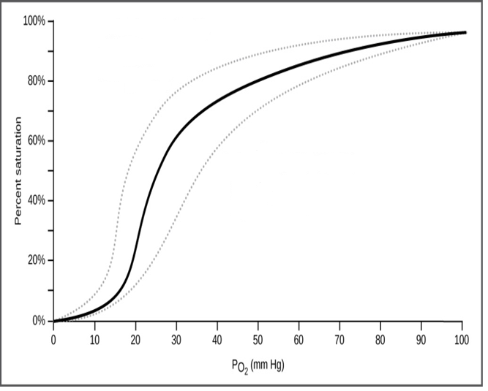
Annotate your graph with as much detail as you can to explain the sigmoid curve – discuss and annotate
Why does the graph level off?
Where in the body are we?
Why the sudden steep rise? (sigmoid = S shape curve)
Why such low levels of saturation?
Where in the body are we?

Slide 21
Oxygen dissociation curves
Show how saturated Hb is with O₂ at any one time / the affinity of Hb for O₂
The graph levels out when at the higher pO2 when all of the haem groups are bound to oxygen. (completely saturated Hb – unable to load anymore)
Capillaries surrounding alveoli
High pO₂ = high saturation
The first O₂ molecule attaches changing the shape of Hb, making it easier for subsequent O₂ to attach – steep rise in O₂ saturation on curve. This is called the cooperative nature of oxygen binding
Capillaries surrounding respiring tissue. Low pO₂ = low saturation
Low pO₂ means low saturation levels of Hb.
A small change in the partial pressure of oxygen makes a significant difference to the saturation of Hb

Slide 22
The number of oxygen molecules that are bound to haemoglobin depends on the surrounding concentration of oxygen:
On the graph below, plot 3 points to show the number of O₂ molecules bound to haemoglobin:
X - as it passes through capillaries surrounding the alveoli in the lungs
Y – as it passes through capillaries in body tissues
Z - as it passes through capillaries in muscles during vigorous exercise
number of O₂ molecules bound to haemoglobin
4
X
Hb fully loaded with 4O₂
at high O₂ concentration in the lungs
3
Y
Hb has released 1 of its O₂ molecules
at the O₂ concentration in resting tissues
2
Hb has released 3 of its O₂ molecules
at the very low O₂ concentration in heavily respiring tissues
1
Z
O₂ concentration
Notes:
This is not finite – the amount of O2 bound to Hb can vary

Slide 24


Slide 25
STARTER – CLICK THE LINK IN POSTS
Match: The cardiac cycle | Love Biology
The timer starts as soon as you open the link!!

Slide 26
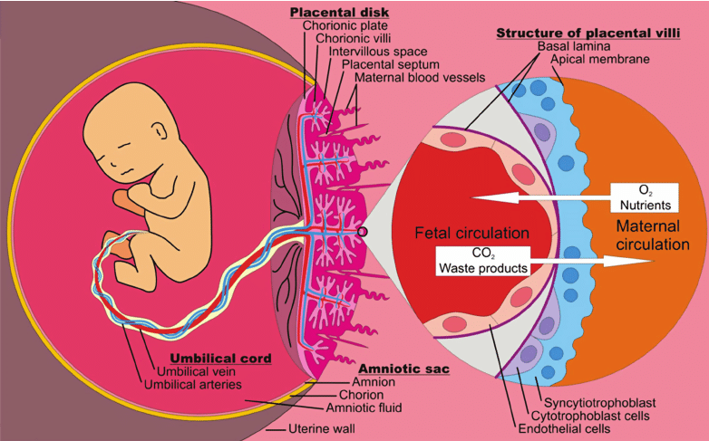
How does a foetus get its oxygen?
Notes:
How does the foetus extract oxygen from the maternal circulation?

Slide 27
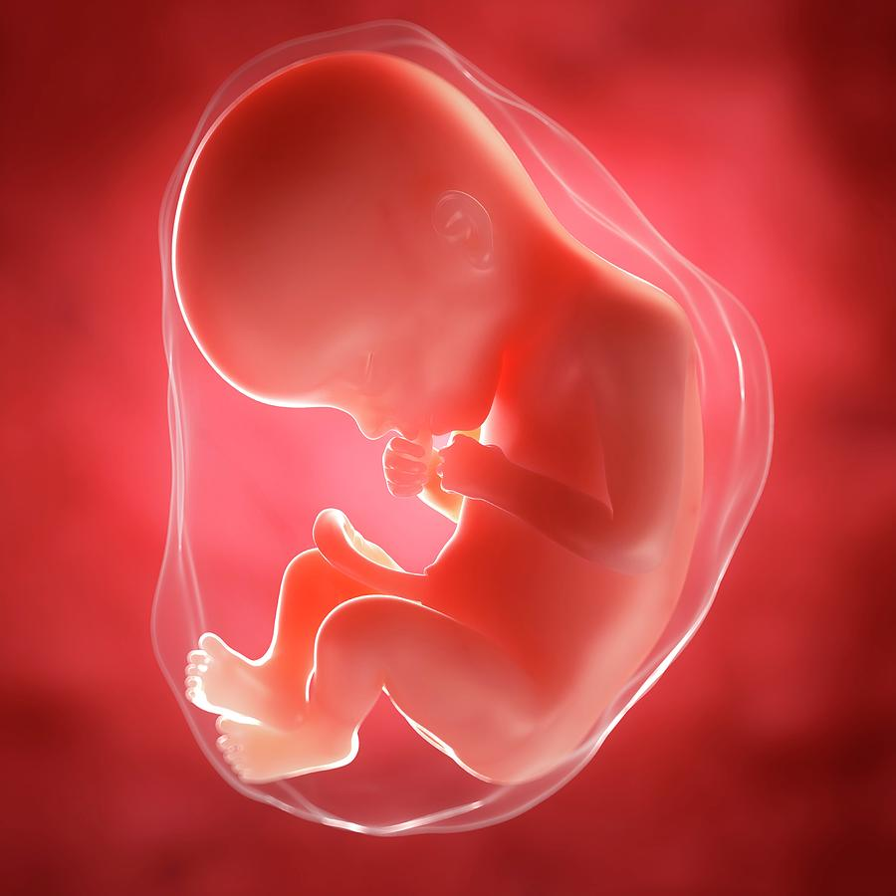
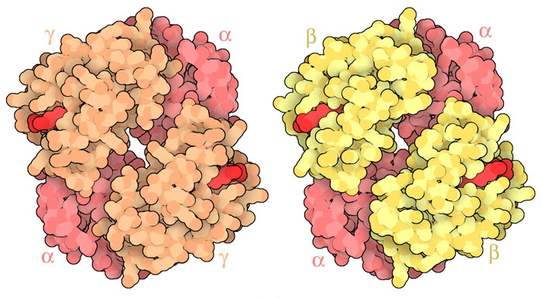
Foetal haemoglobin Vs adult haemoglobin affinity for oxygen
Which has a higher affinity for oxygen and why?

Slide 28
Why does foetal blood have a higher affinity for oxygen?
Adult haemoglobin is composed of two ……….. and two ………… subunits.
Foetal haemoglobin is composed of two alpha and two …………….. subunits.
This change in the chains results in a greater …………….. for ……………….
At low pO₂ in the placenta this allow the foetus to …………… oxygen from the ………………. circulation.
alpha
beta
gamma
affinity
oxygen
extract
maternal
Notes:
The gamma subunit differs from its adult counterpart in that it contains either an alanine or a glycine at position 136, both of which are neutral, nonpolar amino acids. This difference introduces conformational changes (change in shape) to the protein that gives rise to several physiological differences in oxygen delivery that are important in fetal circulation.

Slide 29
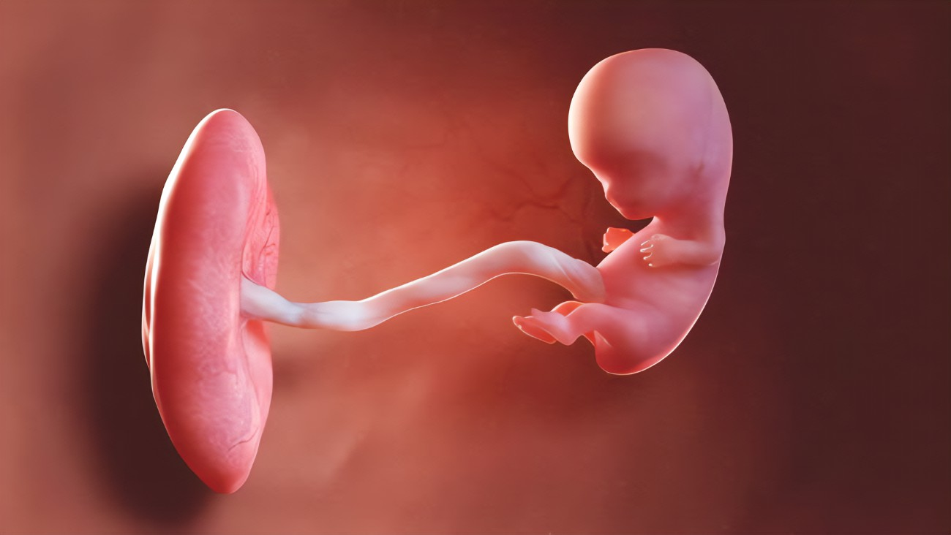
Interesting!
= Phosphate molecule
Notes:
Placental cells make small organic phosphate molecules which binds to adult haemoglobin and reduces its oxygen affinity, but it doesn’t bind strongly to foetal haemoglobin gamma sub-unit.
This causes adult haemoglobin to release its oxygen, allowing foetal haemoglobin to capture it. These differences in oxygen affinity work together to pass oxygen from the mother to the foetus.

Slide 30
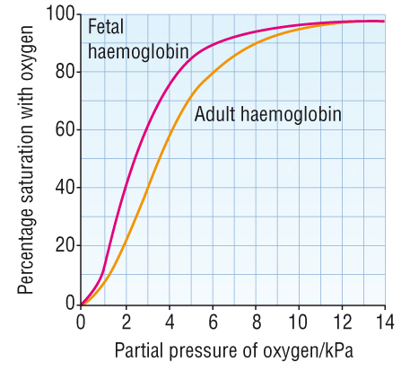
Use the graph to explain how a foetus gets oxygen from it’s mother – make annotations
Foetal Hb affinity is higher. The sigmoid curve is shifted to the left
Foetal blood better at absorbing O₂ compared to adult blood.
Low pO₂ in placenta, foetal Hb has higher affinity for O₂, so O₂ loads.
At low pO₂ in placenta, adult Hb has a lower affinity for O₂, so O₂ unloads.
Important because foetus gets its O₂ from the mother’s blood via the placenta
Mother’s blood at placenta has already lost some O₂ to rest of the tissues/cells in the body.
Foetus Hb takes up O₂ from mother’s blood and can do so at lower pO₂ compared to adult Hb.
Mother’s blood at placenta has a low pO₂.

Slide 31
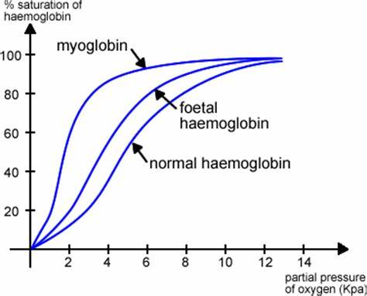

What about myoglobin?

Slide 32
Myoglobin
Found in muscle tissue, where it binds oxygen, helping to provide extra oxygen to release energy to power muscular contractions.
Myoglobin has a very high affinity for oxygen.
Once it binds to oxygen it changes shape to prevent it from unloading it easily = high affinity
Notes:
Unloading caused by changes in pH and temperature – alters the structure to allow if to unload

Slide 33

Let's summarise
Haemoglobin | Wellcome (youtube.com)

Slide 34
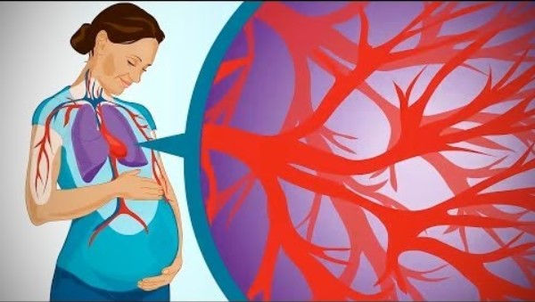

Slide 36
STARTER – CLICK THE LINK IN POSTS
Match: The cardiac cycle | Love Biology
The timer starts as soon as you open the link!!

Slide 37
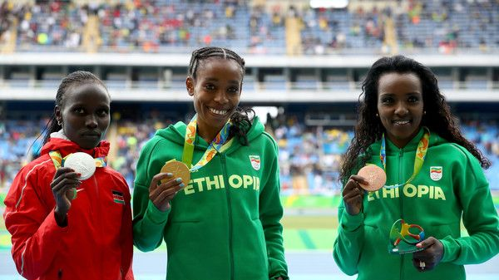
Think pO2

Slide 38
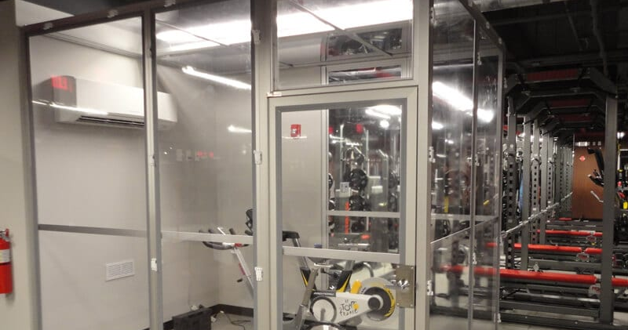

Slide 39

Altitude training. Why do we do it?
Notes:
Training periods of 3 weeks at moderate altitudes result in individual increase of haemoglobin concentration of about 1 to 4%.

Slide 40
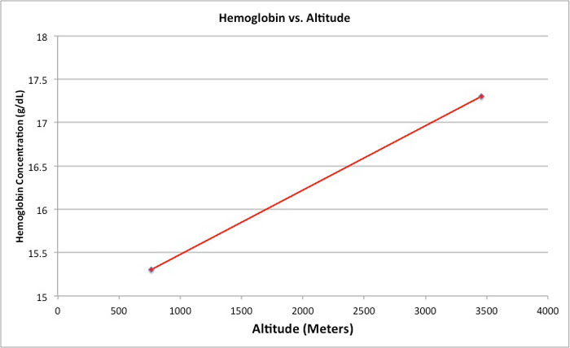

Slide 41
Is it just the number of hemoglobin?

Slide 42
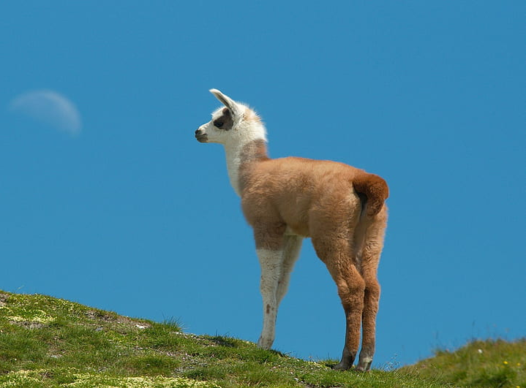
Effects of altitude
The pO₂ is lower at higher altitudes
Species living at high altitudes have haemoglobin that is adapted to these conditions
For example, llamas have haemoglobin that binds very readily to oxygen
This is beneficial as it allows them to obtain a sufficient level of oxygen saturation in their blood when the partial pressure of oxygen in the air is low

Slide 43
Different types of haemoglobin
The globin chains however can differ substantially between species
There are a wide range of haemoglobin types that exist
  They vary in their oxygen-binding properties
  They bind to and release oxygen in different conditions
Environmental factors can have a major impact on the evolution of haemoglobin within a species

Slide 44
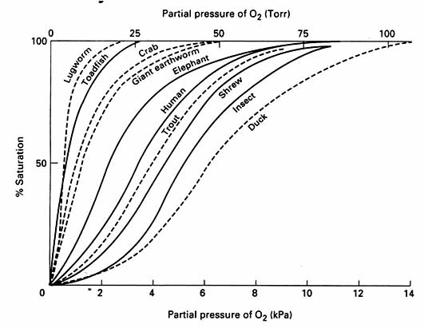
Different organisms have different types of haemoglobin.
Organisms living in low [O₂] conditions have haemoglobin with a higher affinity for O₂.
As long as the metabolic rate is not too high this won’t be a problem.
Organisms with a high metabolic rate need haemoglobin with a lower affinity for O₂, as they need the haemoglobin to release the O₂ when required.
Ability to bind O₂ depends on the specific shape of the haemoglobin, the tertiary structure, which depends on the primary structure (sequence of amino acids).

Slide 45
Animals living in environments with different oxygen levels will have haemoglobins with different affinities for oxygen.
A
B
Explain which animal lives in an
oxygen-poor environment.
Hb saturation %
pO2 concentration
A = oxygen-poor (i.e. mud/ high altitude)
- Hb has much higher affinity for oxygen
Hb fully saturated at lower pO₂
B = oxygen-rich (i.e. fast-moving water/ sea-level)
- Hb fully saturated at much higher pO2 levels
- Hb has much lower affinity for oxygen

Slide 46

Explain the meme

Slide 47

Oxygen
Myoglobin

Slide 48

Phospholipid bilayer
Polar molecule

Slide 49
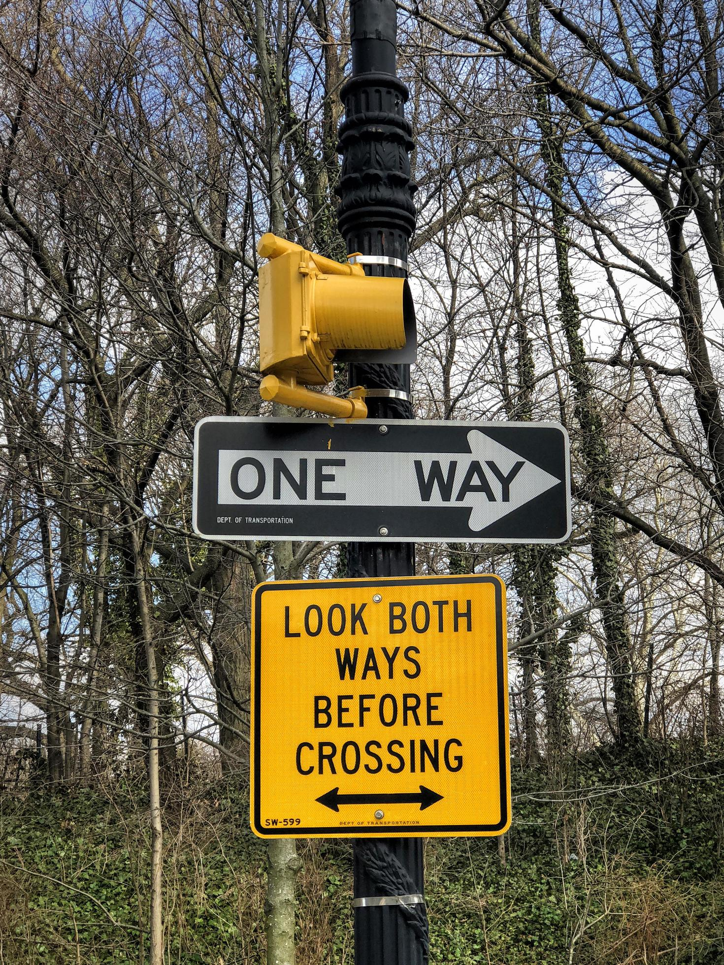
Cartilaginous fish (shark)
Bony fish

Slide 50
FINAL SLIDE

Slide 51

Foetal haemoglobin
Maternal haemoglobin
Oxygen

Slide 52
WHITEBOARD ROTATE
ANSWER EACH QUESTION AND WHEN YOU HEAR THE BUZZR CHECK THE ANSWER ON THE BACK
Please answer on the whiteboard NOT the paper

Slide 61
STARTER – CLICK THE LINK IN POSTS
Match: The cardiac cycle | Love Biology
The timer starts as soon as you open the link!!

Slide 62
Is the pO2 the only factor affecting the loading and unloading of oxygen from the haemoglobin?
Binding of oxygen to haemoglobin (youtube.com)

Slide 63
Giving blood
What happens after you give blood? Blood Manufacturing Tour - YouTube
Why is iron in our blood important? - Forces of Nature with Brian Cox: Episode 3 - BBC One - YouTube

Slide 64
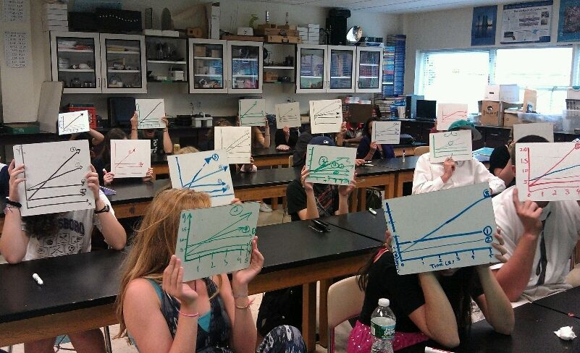
WHITE BOARDS AT THE READY!!

Slide 65
ROUND 1
Name the ECG trace!
First two to write the name and hold it up high win a point

Slide 66
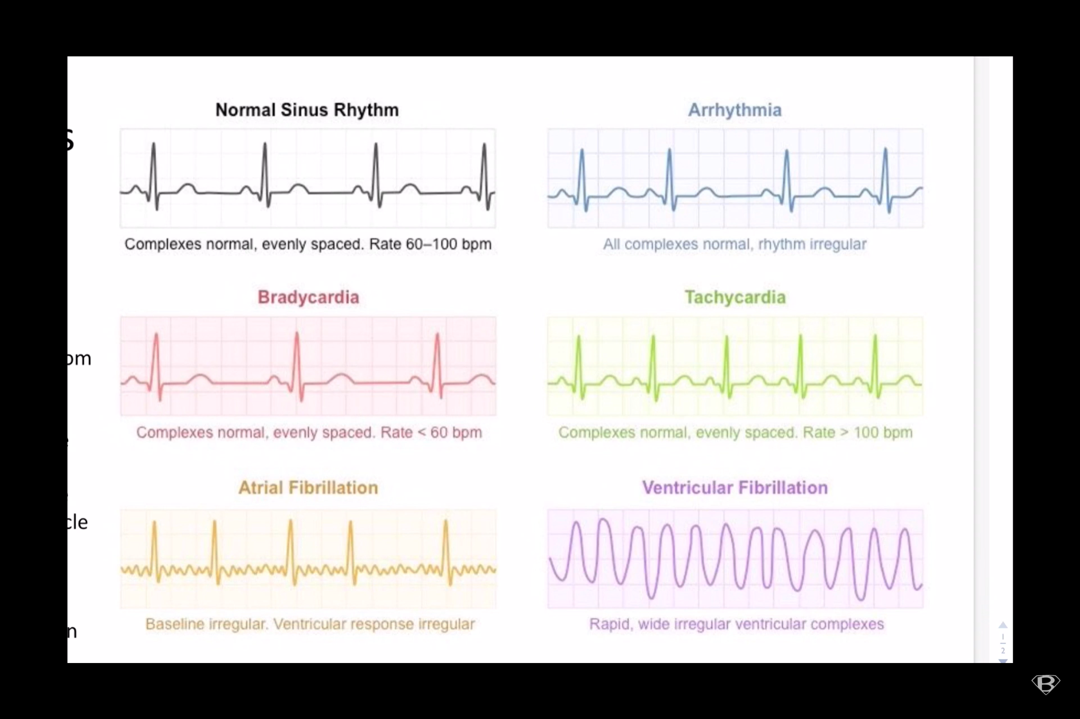

Slide 71
Ectopic heartbeat

Slide 72
ROUND 2
Draw the ECG trace!
First two to draw the ECG and hold it up high wins a point

Slide 74
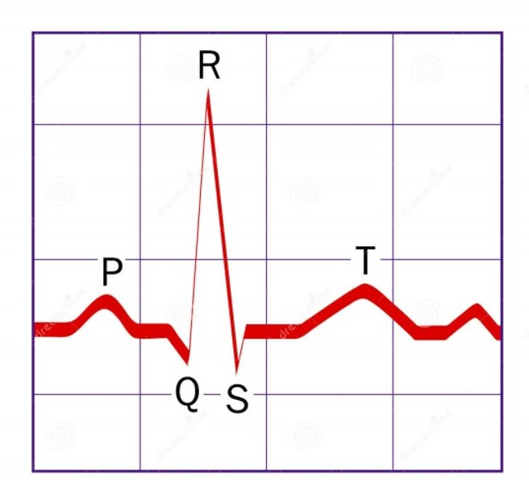
A normal ECG with an arrow pointing at the P wave

Slide 76
A normal ECG with an arrow pointing at the T wave

Slide 77
ROUND 3
What does the following show?

Slide 78
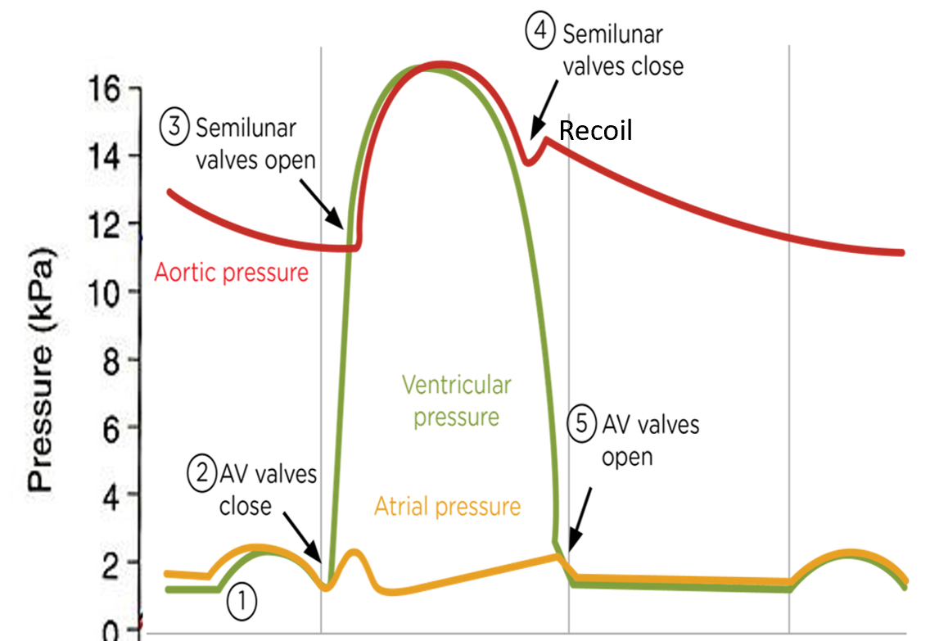
diastole

Slide 79
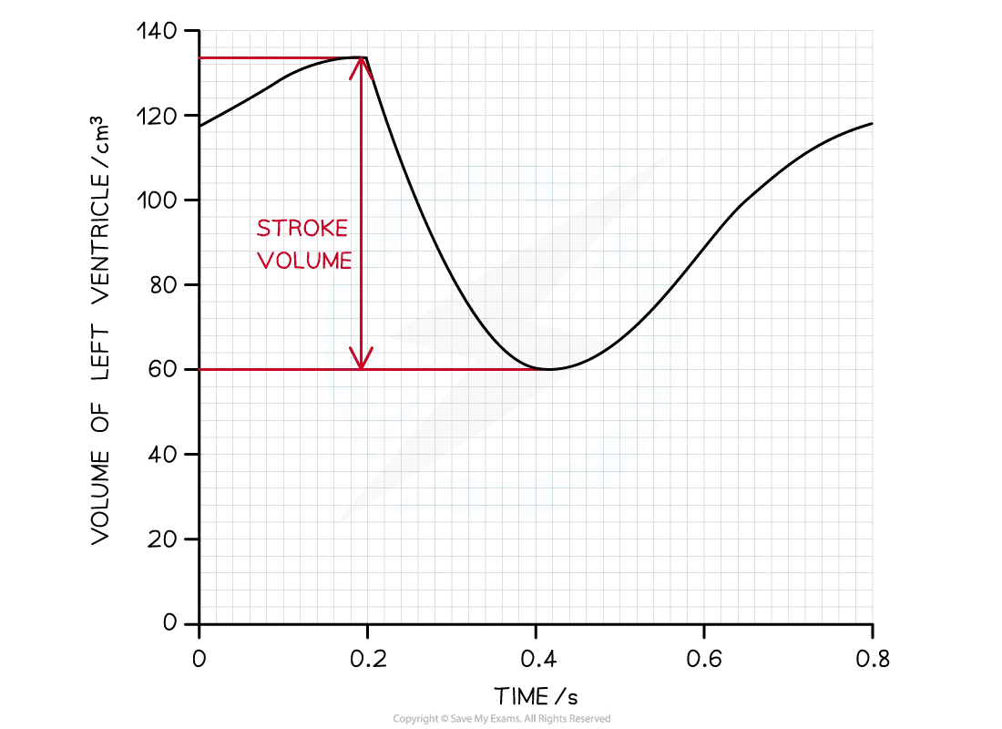
Stroke volume
?

Slide 80
Ventricular systole

Slide 81
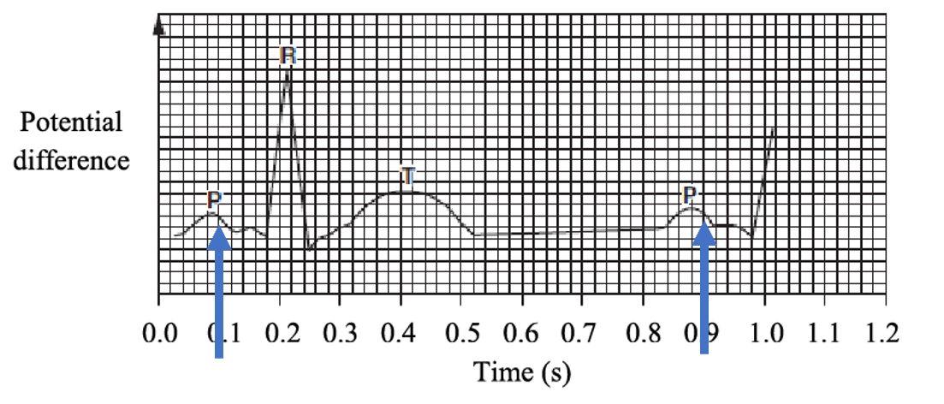
Length of one cardiac cycle

Slide 82
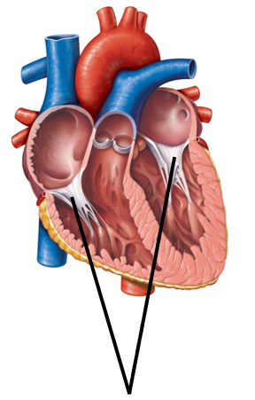
Tendinous cords
?

Slide 83
Atrial systole

Slide 84
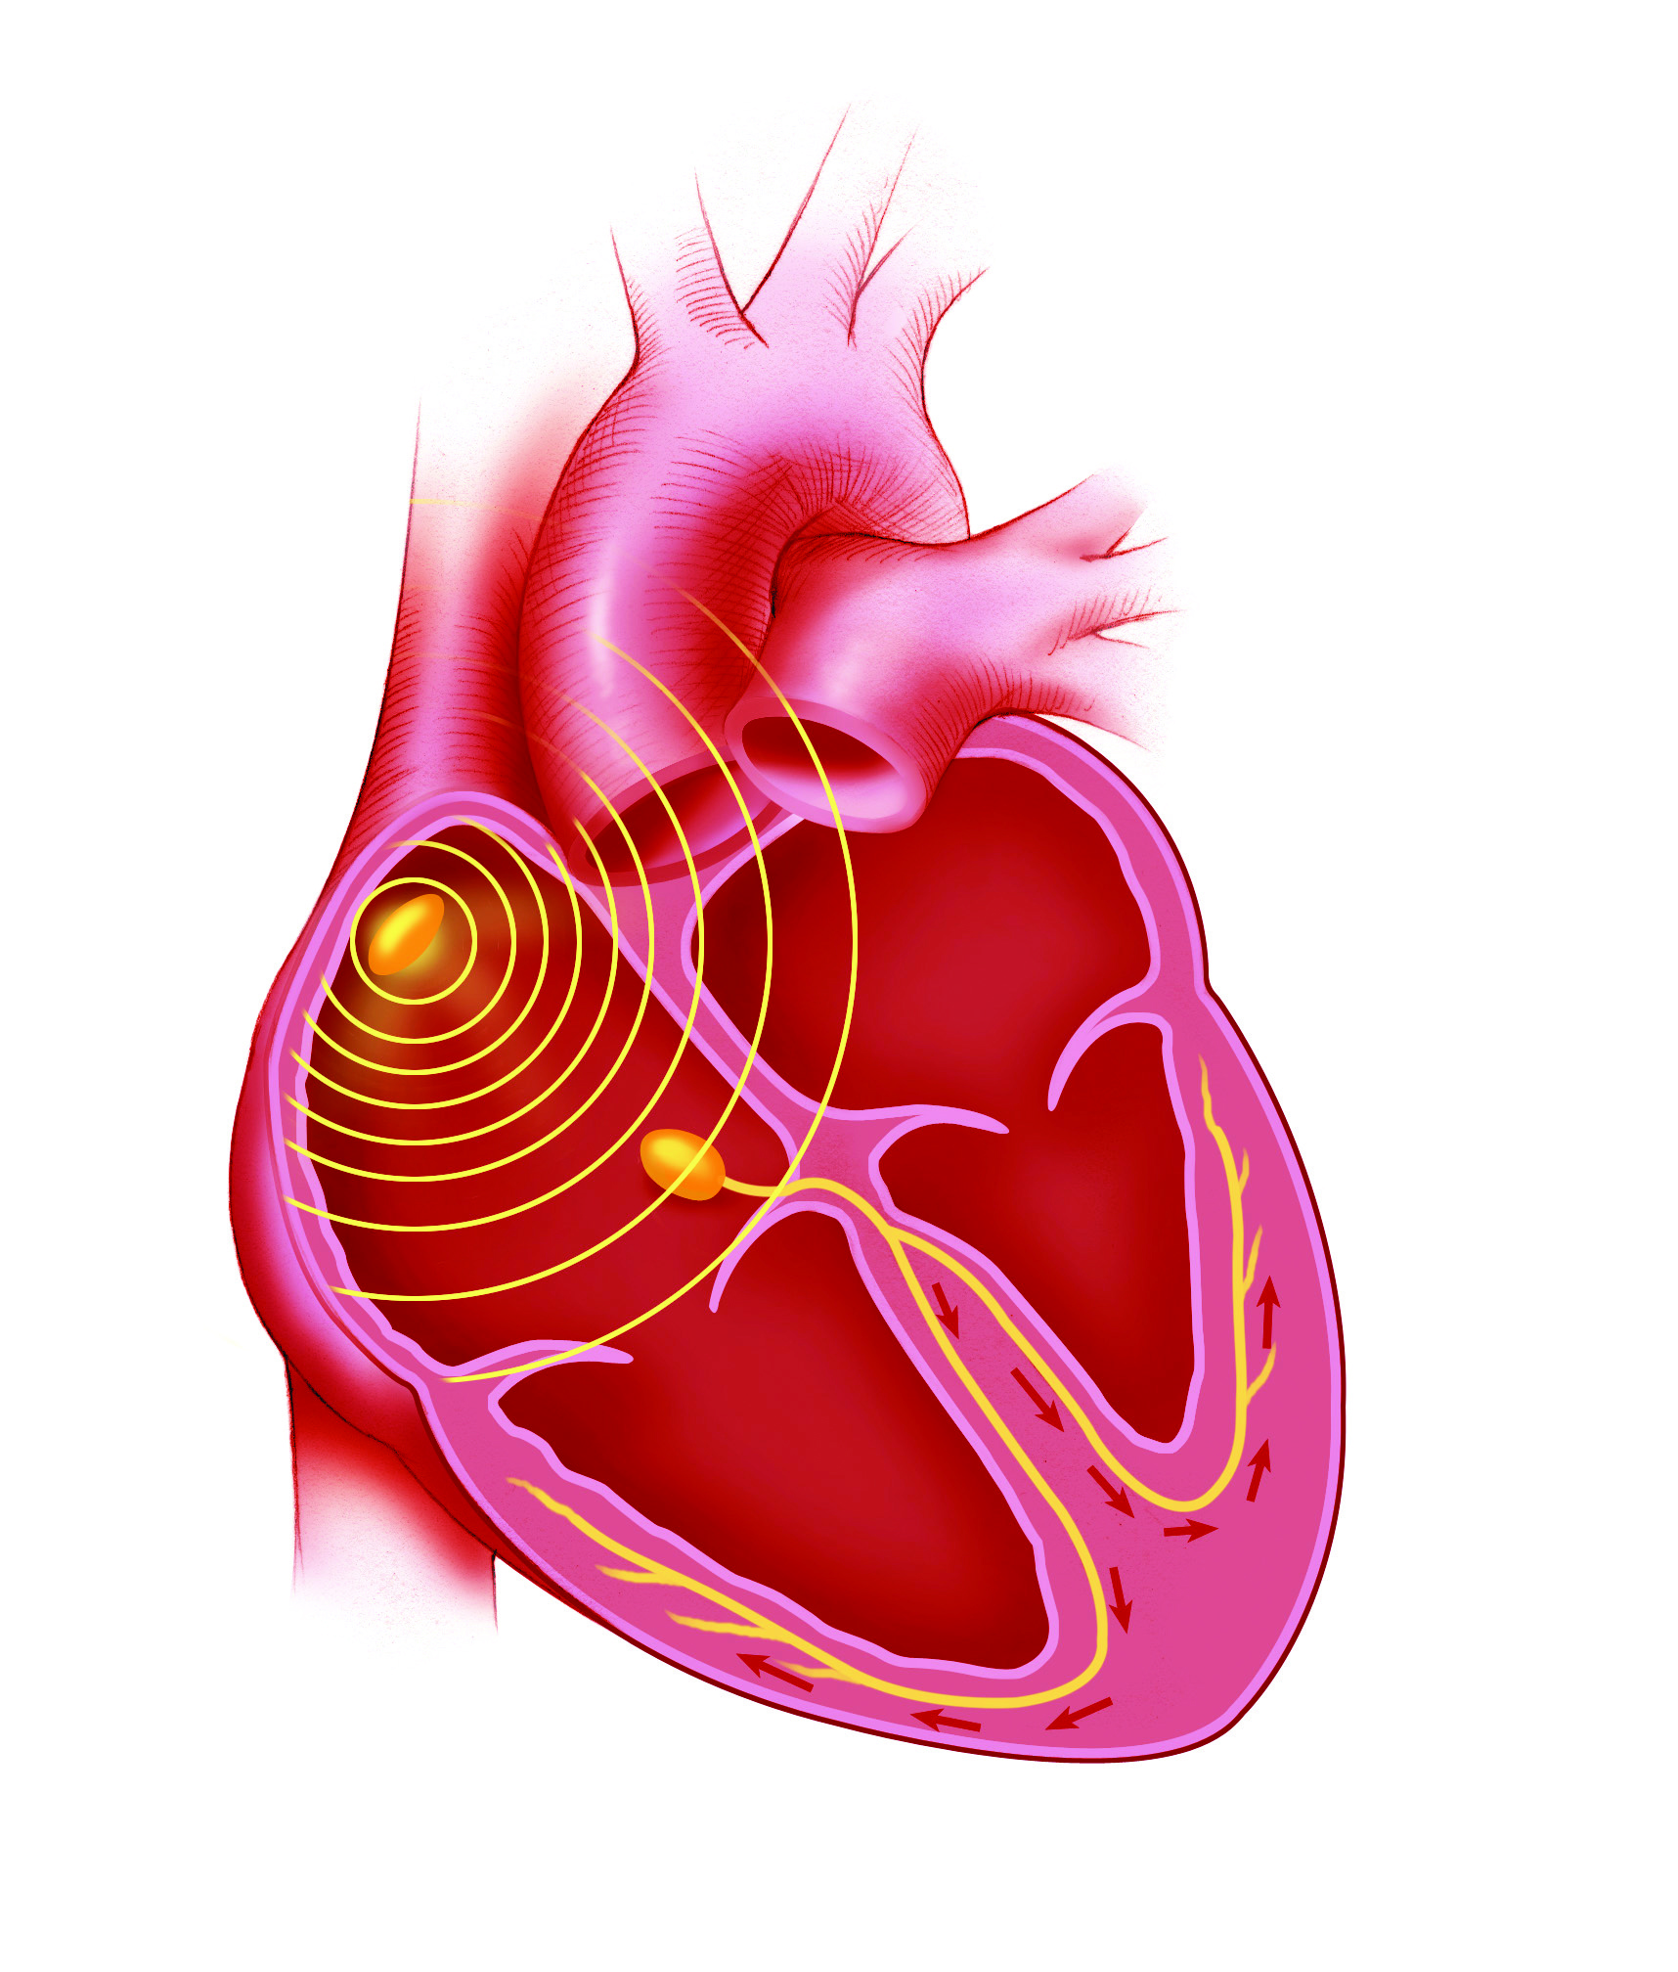
The location in the heart of the SA node

Slide 85
Final slide – triple points!
Draw the following…..

Slide 86
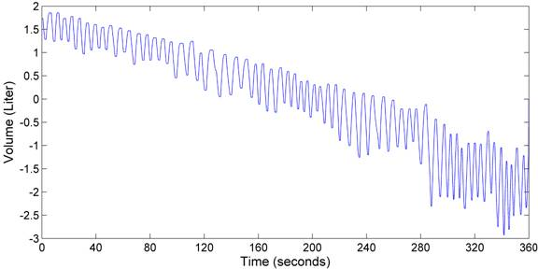
A spirometer trace showing a person who is starting to exercise

Slide 87
New game idea
Explain the meme

Slide 88
Explain the meme

Slide 89
Oxygen
Myoglobin

Slide 90
Phospholipid bilayer
Polar molecule

Slide 91
Cartilaginous fish (shark)
Bony fish

Slide 92
Foetal haemoglobin
Maternal haemoglobin
Oxygen

