Slide 1
Webpage Layout

Slide 2
Learning objectives
Understand and use the <div> tags
Use grid CSS for designing the layout

Slide 3
<div> Tags
The HTML <div> allows us to divide the page up into sections
The div element is a wrapper around sections of HTML that allow selectors applied to specific sections.
div is used for formatting and positioning parts of a webpage
There are lots of ways of laying out a page in CSS, but perhaps the easiest and at the same time most flexible is Grid
Open code grid.html

Slide 4
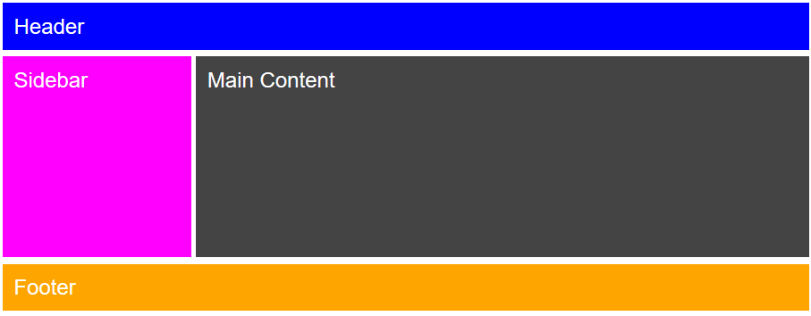
Example Layout
Grid layout uses the HTML <div> tags and divides the webpage into columns and rows
We are going to create the layout below, which is common for lots of websites
Open the code grid.html

Slide 5
Grid Layout CSS 1
.header {
grid-area: header;
}
.sidebar {
grid-area: sidebar;
}
.content {
grid-area: content;
}
.footer {
grid-area: footer;
}
Give a name to each area

Slide 6
Grid Layout CSS 2
.header {
grid-area: header;
background: #0000FF;
}
.sidebar {
grid-area: sidebar;
background: #FF00FF;
}
.content {
grid-area: content;
height: 400px;
}
.footer {
grid-area: footer;
background: #FFA500;
}
Add background colour, using a # followed by a 6-digit hexadecimal value

Slide 7
Colours in HTML
HTML is the language used to write web pages.
Colours in HTML are represented using 6 digit hexadecimal number, which is 24 binary bits.
Two digits are used to represent different light intensities of each of red, green and blue the primary colours from which other colours can be derived
For each colour values range from 00 to FF
This allows over 16 million colours to be represented. A typical number might be FFC1B3
Red | Green | Blue
FF | C1 | B3

Slide 8
Selected HTML colours
Red | Green | Blue | Colour
FF | 00 | 00 | Red
00 | FF | 00 | Green
00 | 00 | FF | Blue
00 | 00 | 00 | Black
FF | FF | FF | White
77 | 77 | 77 | Grey
FF | 00 | FF | Magenta
00 | FF | FF | Cyan
FF | FF | 00 | Yellow

Slide 9
Grid Layout CSS 3
.container {
display: grid;
grid-template-areas:
'header header header header header header'
'sidebar content content content content content'
'footer footer footer footer footer footer';
grid-column-gap: 10px;
grid-row-gap: 15px;
}
.grid {
background-color: #444444;
color: #FFFFFF;
padding: 25px;
font-size: 1rem;
font-family: Arial
}
Create the layout using the names of the selectors

Slide 10
Complete CSS code
<style>
.container {
display: grid;
grid-template-areas:
'header header header header header header'
'sidebar content content content content content'
'footer footer footer footer footer footer';
grid-column-gap: 10px;
grid-row-gap: 15px;}
.grid {
background-color: #444;
color: #fff;
padding: 25px;
font-size: 3rem;
font-family: Arial}
.header {
grid-area: header;
background: #0000FF; }
.sidebar {
grid-area: sidebar;
background: #FF00FF; }
.content {
grid-area: content;
height: 400px;}
.footer {
grid-area: footer;
background: #FFA500;}
</style>

Slide 11
Corresponding HTML Code
<!DOCTYPE html>
<html>
<head>
</head>
<body>
<div class="container">
<div class="grid header">
Header
</div>
<div class="grid sidebar">
Sidebar
</div>
<div class="grid content">
Main Content
</div>
<div class="grid footer">
Footer
</div>
</div>
</body>

Slide 12
Make
Create your own 2-3 page website, using this grid layout or a grid layout of your choice.
The website can be on anything you like, for instance on a hobby.

